Slide 1
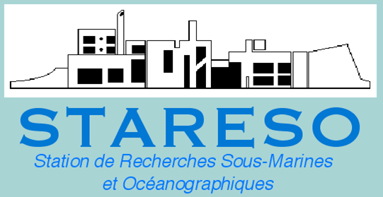
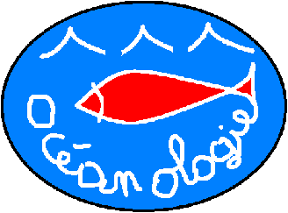

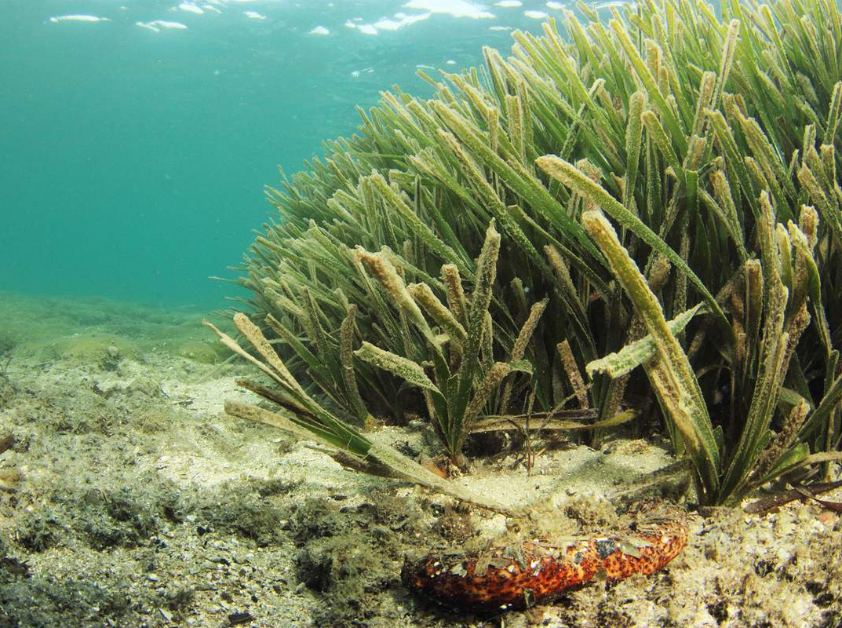
Trace element contamination severity of coastal waters: A first bioassessment
at the scale of the whole
Mediterranean
J. Richir, M. Salivas-Decaux,
C. Lafabrie, C. Lopez y Royo,
P. Lejeune, G. Pergent,
C. Pergent-Martini,
S. Gobert
Oristano, Italy
05-2015
Arnaud Abadie
Notes:
Ladies and gentlemen, I would like to present you, during this talk, a collaborative conceptualization model in order to fill knowledge gaps regarding trace element flows with P. oceanica meadows.

Slide 2


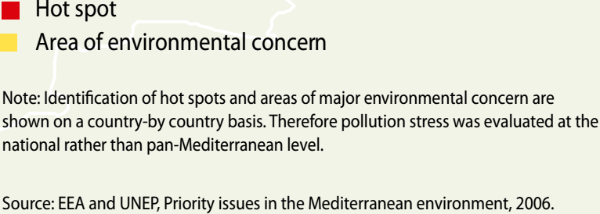
Coastal pollution of the Mediterranean
(UNEP/MAP, 2012; State of the Mediterranean Marine and Coastal Environment)
Notes:
The Mediterranean is submitted to numerous anthropogenic threats, among them the chemical contamination of its densely anthropized coasts. The red circles on this map hilights pollution hot spots along Mediterranean coasts.

Slide 3
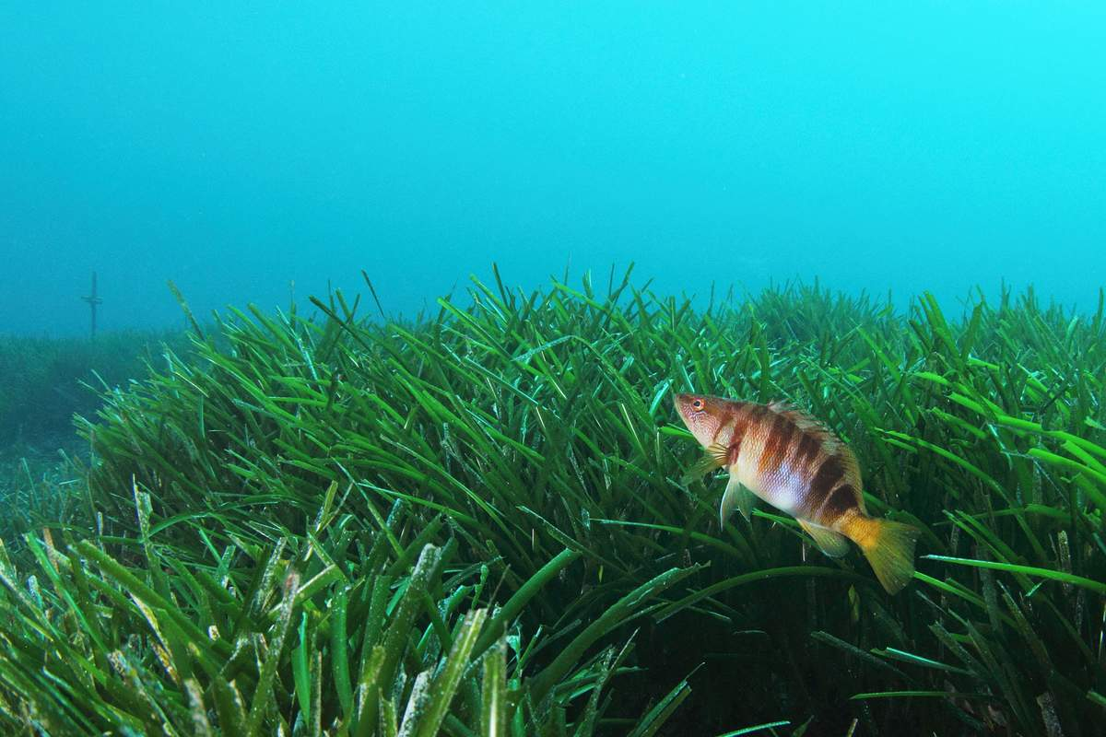
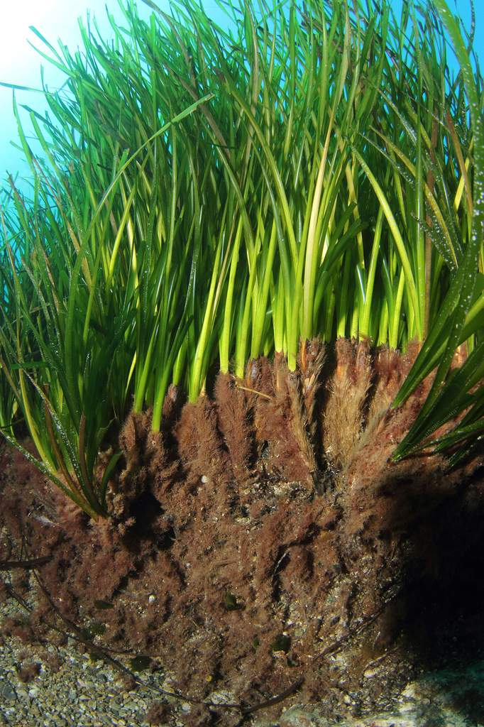
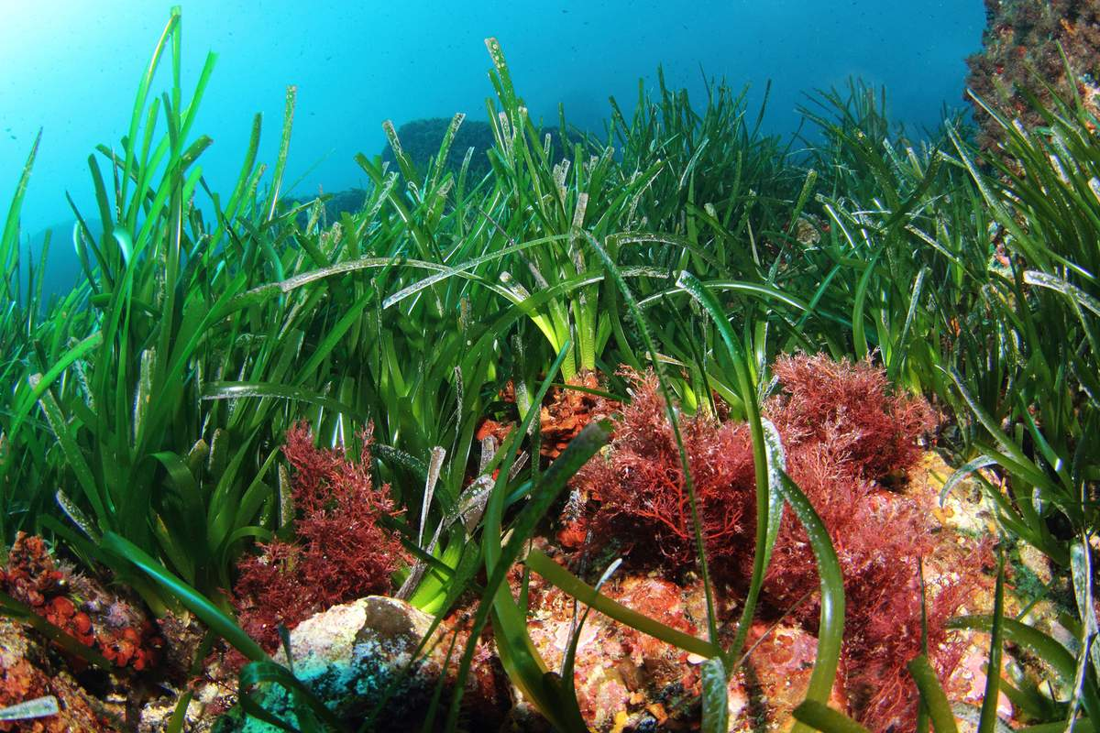
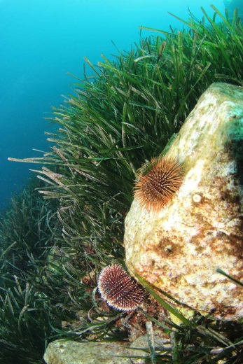
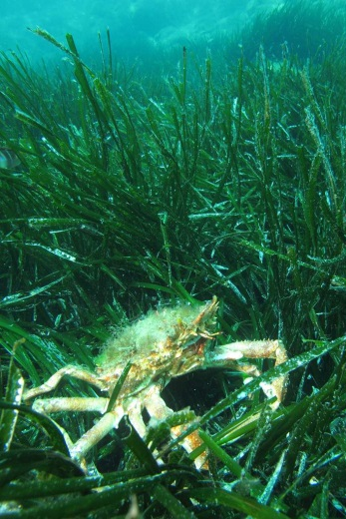
POSIDONIA OCEANICA
Arnaud Abadie

Slide 4
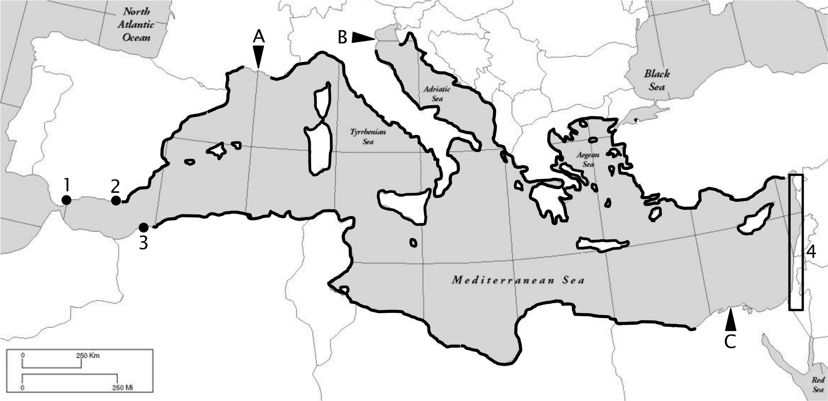
Posidonia oceanica distribution
Geographical distribution of Posidonia oceanica (Michel, 2012; redrawn using data from Lipkin et al., 2003 ; Procaccini et al., 2003; Boudouresque et al., 2006; Gobert et al., 2006; Meinesz et al., 2009). 1: Gibraltar; 2: Almeria; 3: Oran; 4: Coasts of Syria, Israel and Lebanon; A: Rhone estuary; B: Po estuary; C: Nile estuary.
Notes:
Posidonia oceanica is notably an interesting bioindicator because of its nearly circum-Mediterranean distribution. It therefore allows monitoring surveys at very different spatial scales …

Slide 5
Objectives
to assess, for the first time, the TE contamination in the entire Mediterranean biomonitored with P. oceanica;
to propose a new 5-level water quality scale;
to calculate coastal water pollution indices from bioaccumulated TE levels measured in that bioindicator;
to produce, on the basis of these data, accurate maps of the contamination of the Mediterranean by TEs.
OBJECT
I
VES
Overall aim of this work:
to develop a holistic approach in order to provide scientists, stakeholders and decision makers with a global tool to bioassess the TE contamination severity of Mediterranean coastal waters.

Slide 6
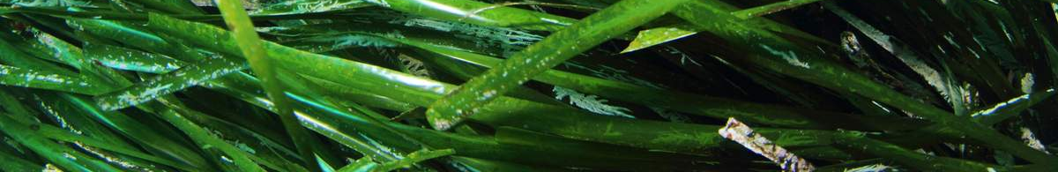
Monitoring survey along Mediterranean coasts
110 sites differing by their levels of exposure to contaminants sampled for P. oceanica.
Notes:
… to global scale, i.e. at the scale of the whole Mediterranean:
110 sites sampled for P. oceanica adult leaves.

Slide 7
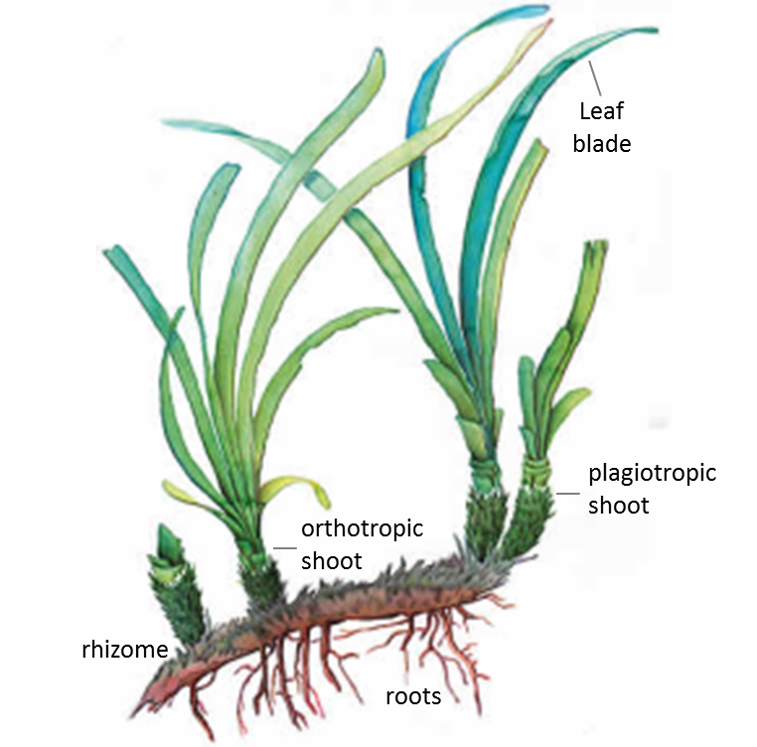
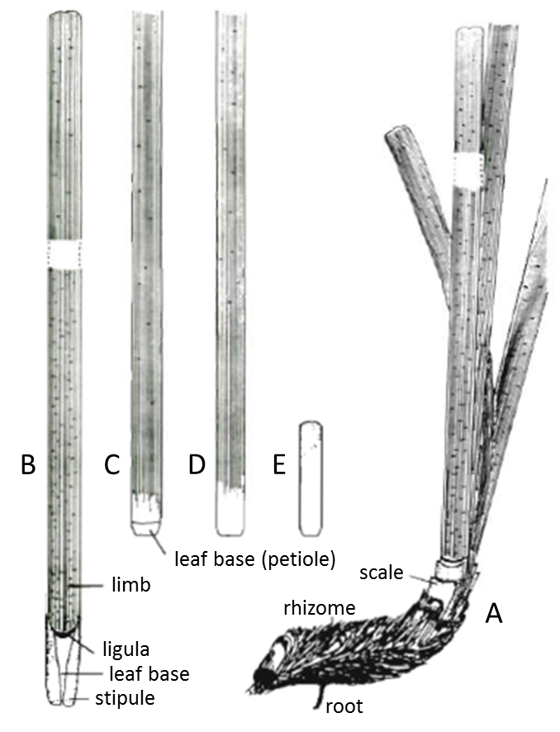
P. oceanica compartmentalization
M
ATER
I
AL
-
METHODS
Left: P. oceanica shoots fixed on a plagiotropic rhizome. Right: (A) shoot of leaves on a plagiotropic rhizome; (B, C) adult leaves; (D) intermediate leaf; (E) juvenile leaf (modified after Libes and Boudouresque, 1987).
Notes:
One of the most widely used bioindicator species in the Mediterranean is the seagrass Posidonia oceanica (and more precisely the shoots of leaves of that seagrass).

Slide 8
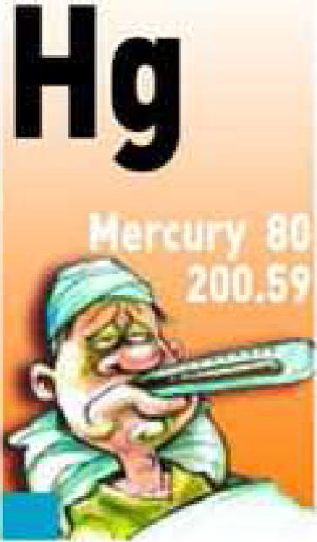
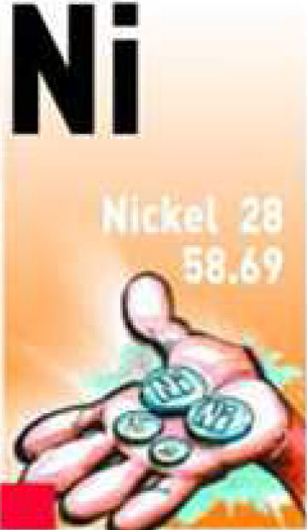
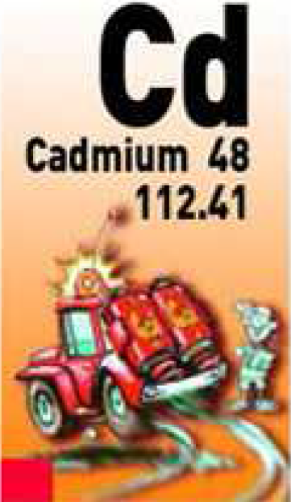

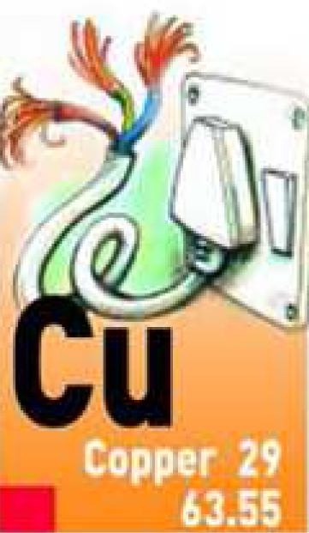

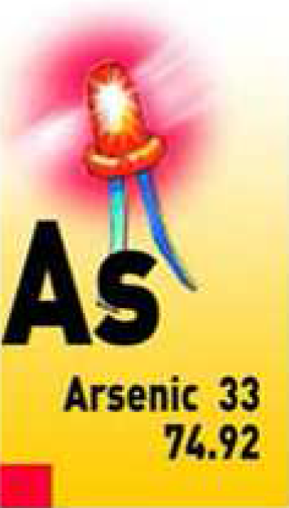
Trace elements monitored
M
ATER
I
AL
-
METHODS
Notes:
One of the most widely used bioindicator species in the Mediterranean is the seagrass Posidonia oceanica (and more precisely the shoots of leaves of that seagrass).

Slide 9

Maths and stats: 5-level water quality scale
qu. 1
qu. 2
qu. 3
qu. 4
Superior limit of quartiles
M
ATER
I
AL
-
METHODS
5 contamination levels
< 1st qu. mean : very low CL
1st-2nd qu. mean: low CL
2nd-3rd qu. mean: medium CL
3rd-4th qu. mean: high CL
> 4th qu. mean: very high CL
Quartile means
Notes:
One of the most widely used bioindicator species in the Mediterranean is the seagrass Posidonia oceanica (and more precisely the shoots of leaves of that seagrass).

Slide 10
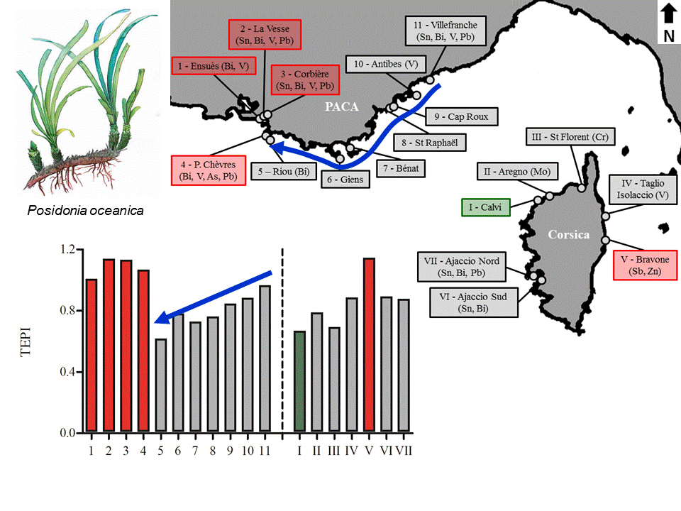
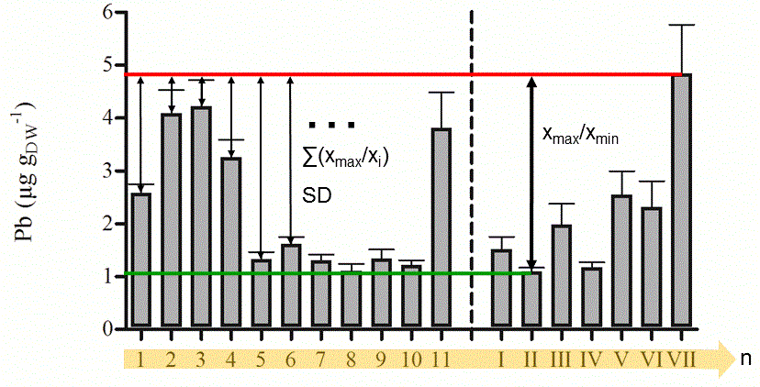
Conclusion
Maths and stats: pollution indices
Trace Element Spatial Variation Index
Trace Element Pollution Index
TEPI = (Cf₁ * Cf₂ … Cf_{n})^{1/n}
TESVI = [(x_{max}/x_{min}) / (∑(x_{max}/x_{i})/n)] * SD
TESVI and TEPI efficient complementary indices to monitor the pollution by TEs. They successfully led:
to the ordering of TEs according to the overall spatial variability of their environmental levels along the French Mediterranean littoral;
to the quantification of the global pollution in TEs between monitored sites.

Slide 11
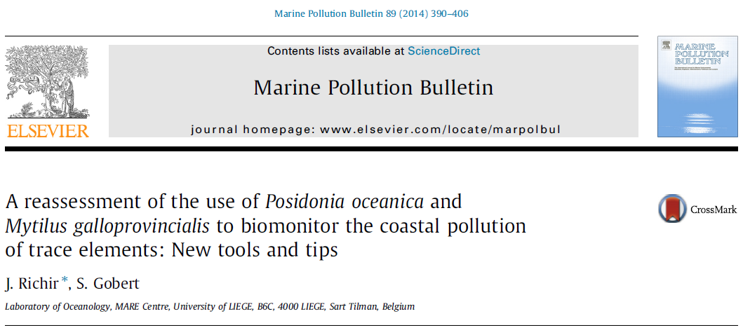
Maths and stats: pollution indices
M
ATER
I
AL
-
METHODS
More info …
Maths and stats: spatial analysis
Principal component analysis
Cluster analysis
Correlation analysis
GIS mapping
Notes:
One of the most widely used bioindicator species in the Mediterranean is the seagrass Posidonia oceanica (and more precisely the shoots of leaves of that seagrass).

Slide 12
Sub-areas differences
RESULTS
-
D
I
SCUSS
I
ON
Notes:
One of the most widely used bioindicator species in the Mediterranean is the seagrass Posidonia oceanica (and more precisely the shoots of leaves of that seagrass).

Slide 13
Spatial variability
Pb
Proportional ordinate scaling between TEs:
RESULTS
-
D
I
SCUSS
I
ON
Hg
As
Cd
Ag
Cu
Ni
Notes:
One of the most widely used bioindicator species in the Mediterranean is the seagrass Posidonia oceanica (and more precisely the shoots of leaves of that seagrass).

Slide 14
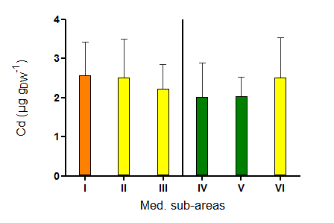
RESULTS
-
D
I
SCUSS
I
ON
Notes:
One of the most widely used bioindicator species in the Mediterranean is the seagrass Posidonia oceanica (and more precisely the shoots of leaves of that seagrass).

Slide 15
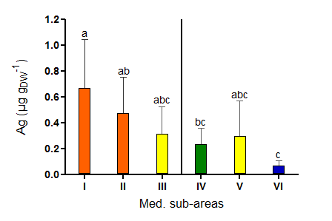
RESULTS
-
D
I
SCUSS
I
ON
Notes:
One of the most widely used bioindicator species in the Mediterranean is the seagrass Posidonia oceanica (and more precisely the shoots of leaves of that seagrass).

Slide 16
Global contamination
Notes:
One of the most widely used bioindicator species in the Mediterranean is the seagrass Posidonia oceanica (and more precisely the shoots of leaves of that seagrass).

Slide 17
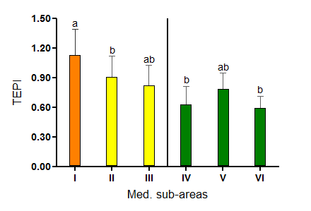
RESULTS
-
D
I
SCUSS
I
ON
Notes:
One of the most widely used bioindicator species in the Mediterranean is the seagrass Posidonia oceanica (and more precisely the shoots of leaves of that seagrass).

Slide 18
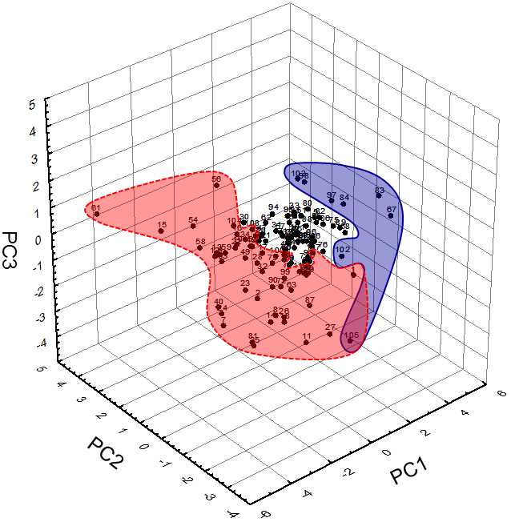
Principal component analysis
RESULTS
-
D
I
SCUSS
I
ON
Hg
Cd
Ag, TEPI
Notes:
One of the most widely used bioindicator species in the Mediterranean is the seagrass Posidonia oceanica (and more precisely the shoots of leaves of that seagrass).

Slide 19

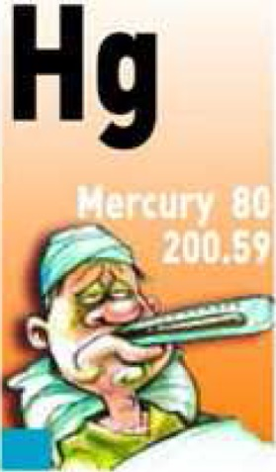



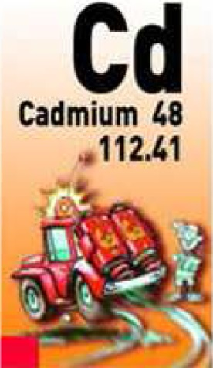
Correlation analysis
RESULTS
-
D
I
SCUSS
I
ON
Correlation matrix of parametric Pearson’s correlation coefficients and non-parametric Spearman’s rank correlation coefficients between TE concentrations and TEPI values in P. oceanica. Correlations significant at p < 0.05 are in bold; correlations significant at p < 0.01 are in bold underlined.
Notes:
One of the most widely used bioindicator species in the Mediterranean is the seagrass Posidonia oceanica (and more precisely the shoots of leaves of that seagrass).

Slide 20
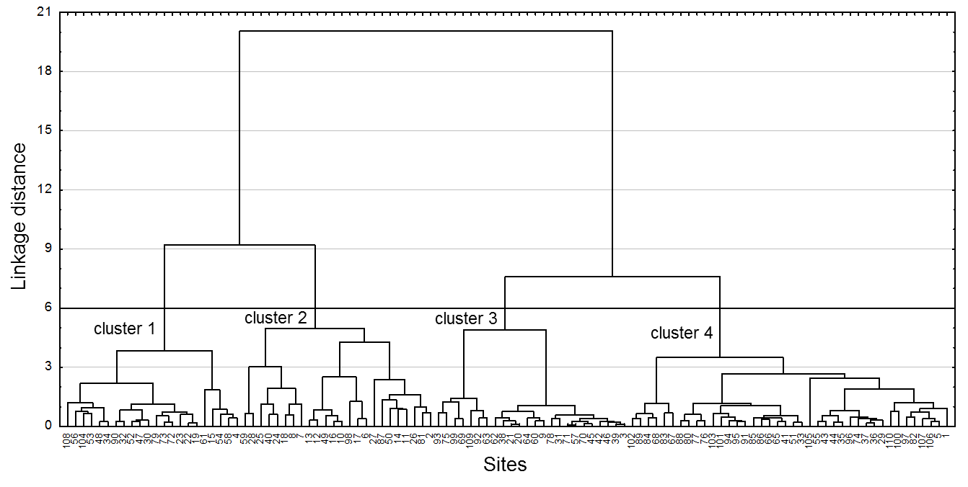
Cluster analysis
RESULTS
-
D
I
SCUSS
I
ON
sites highly contaminated
sites little contaminated
Dendrographic classification after cluster analysis of Ag, As, Cd, Cu, Hg, Ni and Pb concentrations measured in the blades of Posidonia oceanica, and TEPI values calculated from mean normalized TE concentrations.
Notes:
One of the most widely used bioindicator species in the Mediterranean is the seagrass Posidonia oceanica (and more precisely the shoots of leaves of that seagrass).

Slide 21
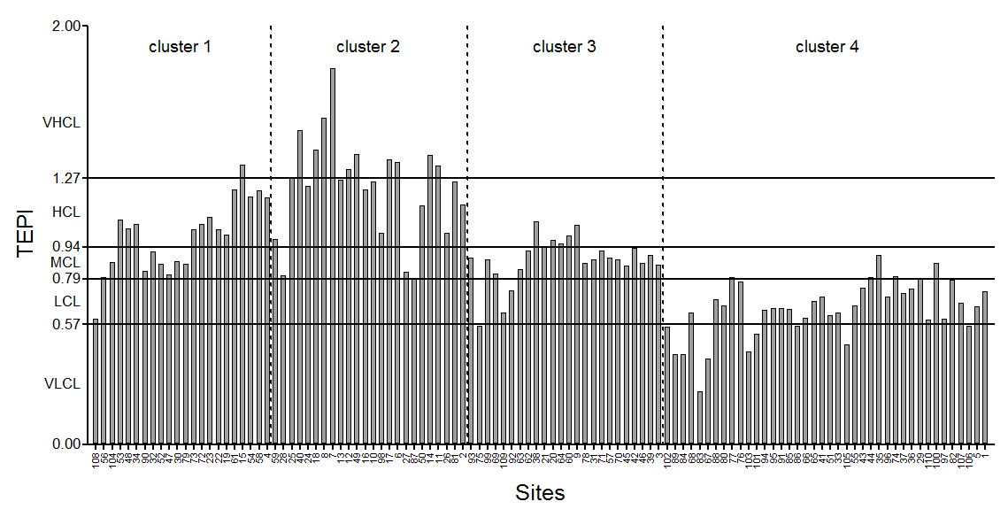
Cluster analysis
HC by Cd, Ni; LC by As
HC by Ag, As, Pb
LC by TEs overall
RESULTS
-
D
I
SCUSS
I
ON
TEPI values calculated from mean normalized Ag, As, Cd, Cu, Hg, Ni and Pb concentrations measured in the blades of P. oceanica adult leaves. Sampling sites are sorted on the graph according to the dendrographic classification after cluster analysis of trace element concentrations and TEPI values.
Notes:
One of the most widely used bioindicator species in the Mediterranean is the seagrass Posidonia oceanica (and more precisely the shoots of leaves of that seagrass).

Slide 22
RESULTS
-
D
I
SCUSS
I
ON
Notes:
One of the most widely used bioindicator species in the Mediterranean is the seagrass Posidonia oceanica (and more precisely the shoots of leaves of that seagrass).

Slide 23
RESULTS
-
D
I
SCUSS
I
ON
Notes:
One of the most widely used bioindicator species in the Mediterranean is the seagrass Posidonia oceanica (and more precisely the shoots of leaves of that seagrass).

Slide 24
Conclusion
Sustainable coastal management requires the development of appropriate contamination classification systems.
Combined utilization of several complementary monitoring tools:
water quality scale;
pollution index (TEPI and TESVI);
spatial analysis (PCA, CA, correlation analysis and GIS mapping).
In the Mediterranean:
To assess TE contamination threats;
To depict contamination gradients;
To monitor TE contamination at regional or local scales.
Conclusion: to privilege such holistic approaches to accurately monitor the TE contamination rate of coastal waters and to transfer relevant information on this composite problem to environmental managers and policy makers.
CONCLUS
I
ON
Notes:
One of the most widely used bioindicator species in the Mediterranean is the seagrass Posidonia oceanica (and more precisely the shoots of leaves of that seagrass).

Slide 25
Acknowledgements
This study was supported by the collaboration of several laboratories from all around the Mediterranean:
Dr Saïd Belbacha and Dr Rachid Semroud (Algeria);
University of Zagreb, Dr Tatjana Bakran-Petricioli (Croatia);
Melina Marcou and Myroula Hadjichristoforou (Cyprus);
Dr Stéphane Sartoretto, Ifremer Center of Toulon,
Berangère Casalta (France);
Dr Georges Skoufas and Dr Eugenia Apostolaki, Institute of Oceanography, Hellenic Centre for Marine Research (Greece);
Dr Cristina Buia and Dr Pier Panzalis (Italy);
Dr Joseph Borg (Malta);
Robert Turk, Borut Mavric and Lovrenc Lipej (Slovenia);
Boris Weitzmann, Dr Yolanda Fernandez Torquemade, F. Javier Zapata Salgado, Elvira Alvarez Pérez, Dr Javier Romero, Izaskun Llagostera (Spain);
Dr Habib Langar (Tunisia); Dr Baris Akçalı and Billür Celebi (Turkey).
We also thank Steven Barillec, Nicolas Luy and Renzo Biondo for their help.
ACKNOWLEDGEMENTS
Notes:
One of the most widely used bioindicator species in the Mediterranean is the seagrass Posidonia oceanica (and more precisely the shoots of leaves of that seagrass).

Slide 26
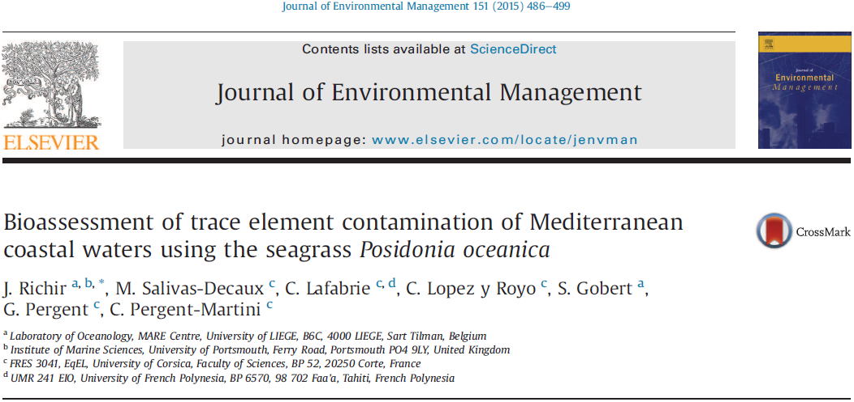
More info …
Notes:
One of the most widely used bioindicator species in the Mediterranean is the seagrass Posidonia oceanica (and more precisely the shoots of leaves of that seagrass).

Slide 27
G
I
S
MAPP
I
NG
Notes:
One of the most widely used bioindicator species in the Mediterranean is the seagrass Posidonia oceanica (and more precisely the shoots of leaves of that seagrass).

Slide 28
G
I
S
MAPP
I
NG
Notes:
One of the most widely used bioindicator species in the Mediterranean is the seagrass Posidonia oceanica (and more precisely the shoots of leaves of that seagrass).

Slide 29
G
I
S
MAPP
I
NG
Notes:
One of the most widely used bioindicator species in the Mediterranean is the seagrass Posidonia oceanica (and more precisely the shoots of leaves of that seagrass).

Slide 30
G
I
S
MAPP
I
NG
Notes:
One of the most widely used bioindicator species in the Mediterranean is the seagrass Posidonia oceanica (and more precisely the shoots of leaves of that seagrass).

Slide 31
G
I
S
MAPP
I
NG
Notes:
One of the most widely used bioindicator species in the Mediterranean is the seagrass Posidonia oceanica (and more precisely the shoots of leaves of that seagrass).

Slide 32
G
I
S
MAPP
I
NG
Notes:
One of the most widely used bioindicator species in the Mediterranean is the seagrass Posidonia oceanica (and more precisely the shoots of leaves of that seagrass).

Slide 33
G
I
S
MAPP
I
NG
Notes:
One of the most widely used bioindicator species in the Mediterranean is the seagrass Posidonia oceanica (and more precisely the shoots of leaves of that seagrass).

Slide 34
G
I
S
MAPP
I
NG
Notes:
One of the most widely used bioindicator species in the Mediterranean is the seagrass Posidonia oceanica (and more precisely the shoots of leaves of that seagrass).

Slide 35
G
I
S
MAPP
I
NG
Notes:
One of the most widely used bioindicator species in the Mediterranean is the seagrass Posidonia oceanica (and more precisely the shoots of leaves of that seagrass).

Slide 36
G
I
S
MAPP
I
NG
Notes:
One of the most widely used bioindicator species in the Mediterranean is the seagrass Posidonia oceanica (and more precisely the shoots of leaves of that seagrass).

