Slide 1
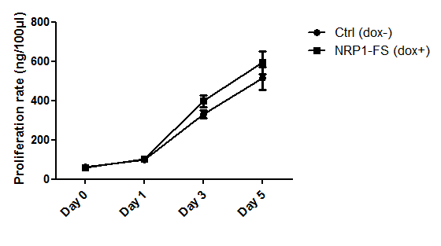
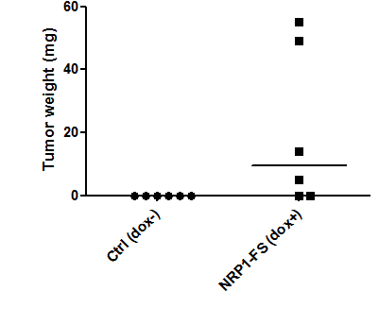
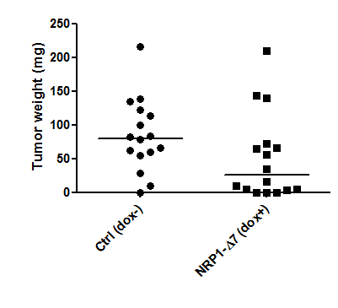
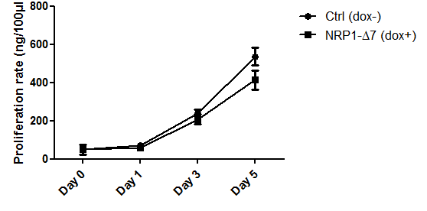
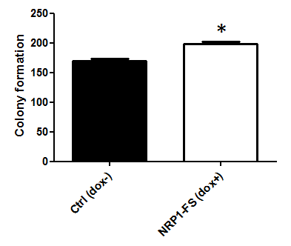
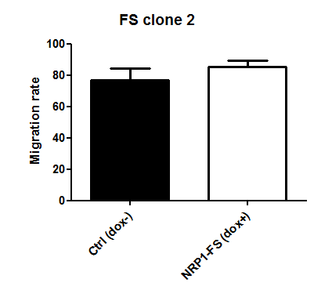
#5135
Study of a new splice variant of Neuropilin-1: antagonistic functions in the regulation of tumor progression?
C. HENDRICKS, L. JANSSEN, R. DELCOMBEL, J. DUBAIL, C. DEROANNE , A. COLIGE
Laboratory of Connective Tissues Biology, GIGA-Cancer, University of Liège, Tour de Pathologie, B23/3, B-4000 Sart-Tilman, Belgium
Introduction
Neuropilin-1 (NRP1) is a transmembrane glycoprotein and a co-receptor for several soluble factors, including some variants of the Vascular Endothelial Growth Factor A (VEGF-A). Therefore it contributes to regulate angiogenesis but is also linked to cancer formation. Neuropilin can be considered as a proteoglycan as it can be modified by the addition of a glycosaminoglycan side chain on serine 612. Six splice variants of NRP1 have been described in the literature. An additional form was recently identified. As compared to the full size NRP1 (NRP1-FS), it lacks the 7 amino acids encoded by the last 21 bases of exon 11. This new variant was named NRP1-Δ7.
Objectives and methodology
As the 7 amino acids deletion in the NRP1-Δ7 occurs 2 amino acids downstream of Ser612, the glycosylation process could be affected and the function of the entire molecule could be modified. The aim of this study was to characterize the functional properties of this new splice variant, especially in models relevant to tumorigenesis and angiogenesis. To this purpose, PC3 prostate cancer cells were engineered to express NRP1-FS or –Δ7 only in the presence of doxycycline.
Key findings
The NRP1-Δ7 transcript is expressed in many different cell lines and represents from 10 to 30% of the total amount of NRP1 mRNA. Recombinant NRP1-Δ7 is less glycosylated on serine 612, which can modify its biological functions.
While NRP1-FS overexpression stimulates PC3 migration, increased expression of NRP1-Δ7 inhibits it.
NRP1-FS enhances cell proliferation in vitro and tumor growth in an anchorage-independent model (soft agar). On the contrary, NRP1-Δ7 reduced these two processes, although the synthesis of endogenous NRP1-FS is not modified. This suggests a mechanism of competition between the two isoforms.
Doxycycline-responsive PC3 cells were also used to form tumors in nude mice. While NRP1-FS overexpression favors tumor growth, NRP1-Δ7 represses it, which is potentially related to a decrease in tumor angiogenesis.
A
Fig. 2: Migration of PC3 engineered to express NRP1-FS or -Δ7 in presence of doxycycline was assessed by wound healing assay. Due to the small difference in size (7a.a.), NRP1-FS and –Δ7 cannot be separated by SDS-PAGE. The relative production of recombinant NRP1 can be estimated by comparing NRP1 expression in absence and presence of Doxycycline (A). As compared to controls and to NRP1-FS expressing cells, a decreased migration rate was observed with cells producing NRP1- Δ7 (B).
NRP1-FS
Fig. 4: Growth of PC3 expressing either NRP1-FS or –Δ7 was evaluated in soft agar in presence of doxycycline (dox+). PC3 overexpressing NRP1-FS formed a higher number of colonies as compared to the control condition. On the contrary, the expression of NRP1-Δ7 was associated with a decreased tumor growth in vitro.
A
B
NRP1-FS
NRP1-Δ7
NRP1-Δ7
NRP1-FS
A
NRP1-FS
NRP1-Δ7
Ser612
B
Fig. 1: Expression of NRP1 in different human cell lines was measured by RT-PCR. NRP1-Δ7 represents 10-30% of the total amount of the NRP1 transcripts (A). Western blotting analysis of cells transfected with an empty vector (T0) or vectors coding for NRP1-FS or -Δ7 revealed very high molecular weight products in NRP1-FS that were much less abundant in NRP1-Δ7. These products are characteristic of glycosaminoglycans side chains (B).
B
Ratio = 2.64
Ratio = 3.82
NRP1-FS
NRP1-Δ7
Fig. 3: Proliferation of PC3 transfected with either NRP1-FS or –Δ7 was evaluated by DNA quantification. 18 hours after seeding, doxycycline was added in the culture medium (day 0) and cells were harvested 1, 3 or 5 days later. NRP1-FS was shown to elicit cell proliferation while NRP1-Δ7-expressing cells proliferated at a lower.
NRP1-Δ7
Fig. 5: PC3 conditionally expressing NRP1-FS or –Δ7 were injected in the flanks of nude mice that receive (dox+) or not (ctrl, dox-) doxycycline in drinking water. Tumor growth was evaluated by measuring tumor weight. (A) Expression of NRP1-FS elicited tumor growth, while NRP1-Δ7 seemed to reduce the proliferation in vivo. (B) Tumors were also analyzed for CD31 expression by immunohistochemistry. Tumors expressing NRP1-Δ7 were less vascularized.
Contact : C.Hendricks@doct.ulg.ac.be
Acknowledgment: F. Olivier, for technical assistance

