Slide 1



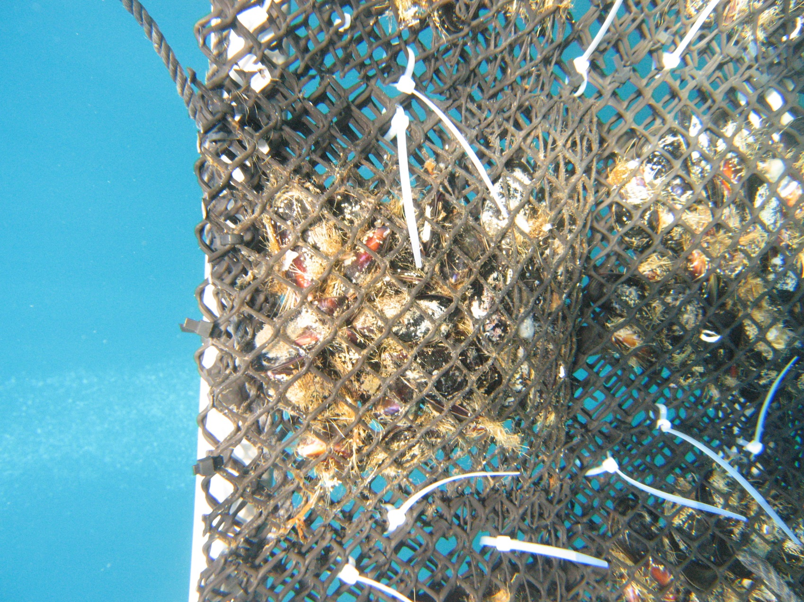
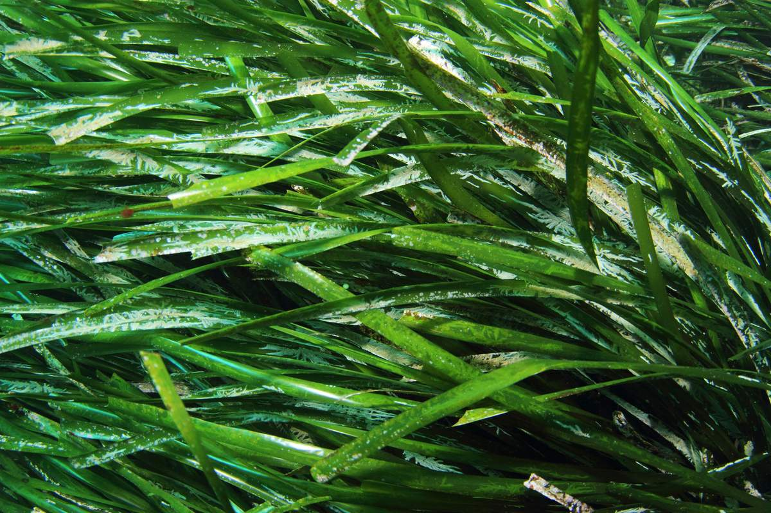


Seagrasses or caged mussels to bioassess the contamination rate of Mediterranean
coastal waters? That is the question
J. Richir, F. Galgani, J. Benedicto, B. Andral, P. Lejeune, M. Salivas-Decaux,
C. Lafabrie, C. Lopez y Royo,
G. Pergent, C. Pergent-Martini,
S. Gobert
Oristano, Italy
05-2015
Arnaud Abadie

Slide 2

Trace elements
I
N
T
R
O
D
U
C
T
I
O
N
(after Amiard ,2011)

Slide 3
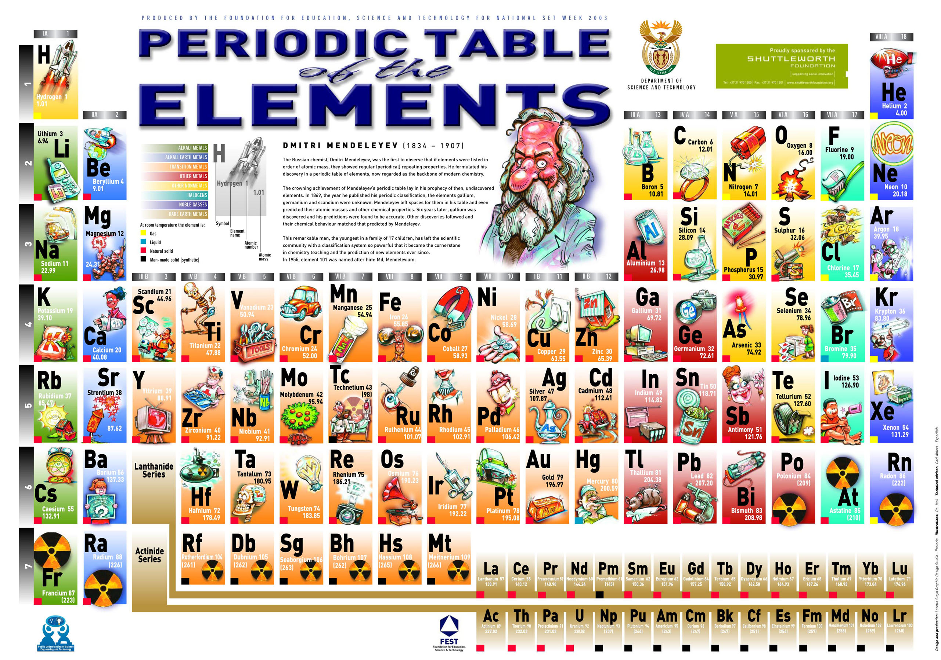

Slide 4
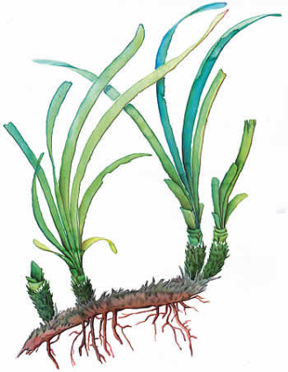
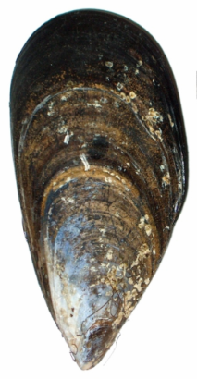
Monitoring
Mediterranean anthropogenic pressures
contamination
METHODS
trace elements
Mytilus
galloprovincialis
Posidonia oceanica
direct measurements in the environment:
water
sediment
suspended matter
bioindicators =
organisms accumulating contaminants to levels representative of their habitat pollution status

Slide 5
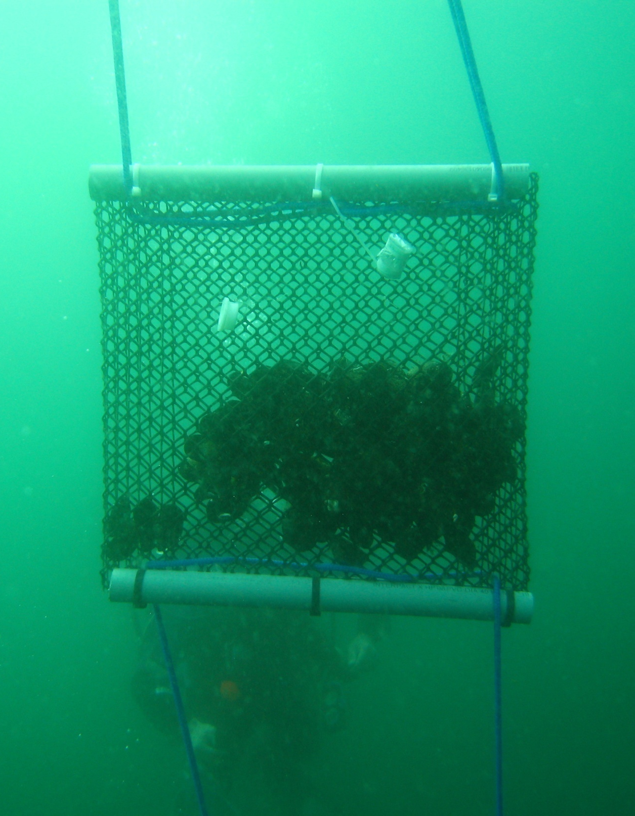
Caged mussels - monitoring station
Applications
APPLICATIONS

Slide 6

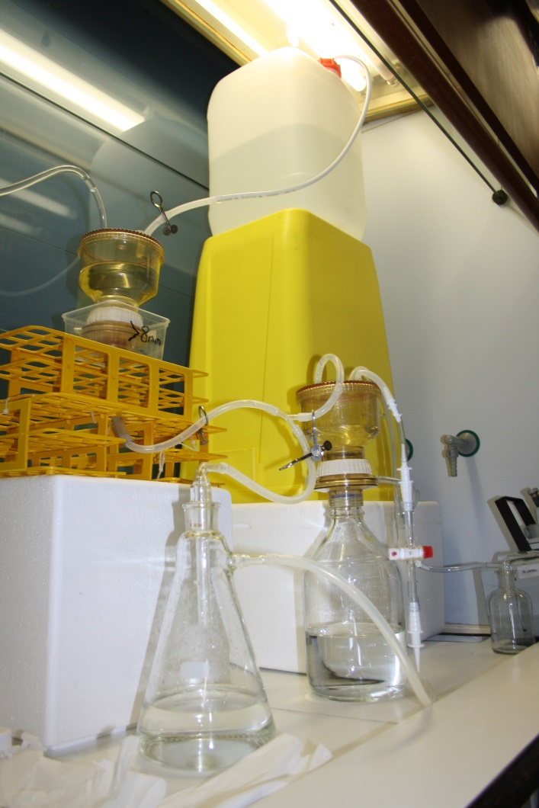
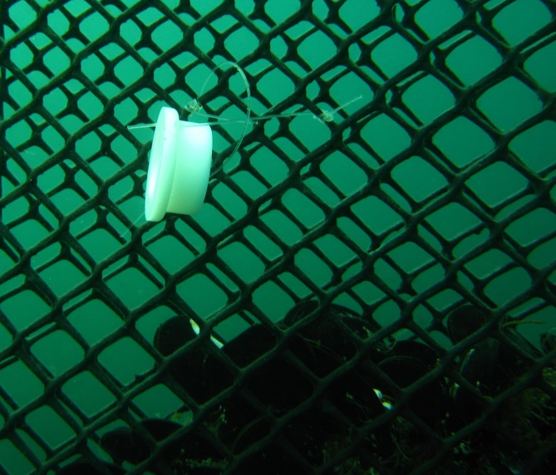
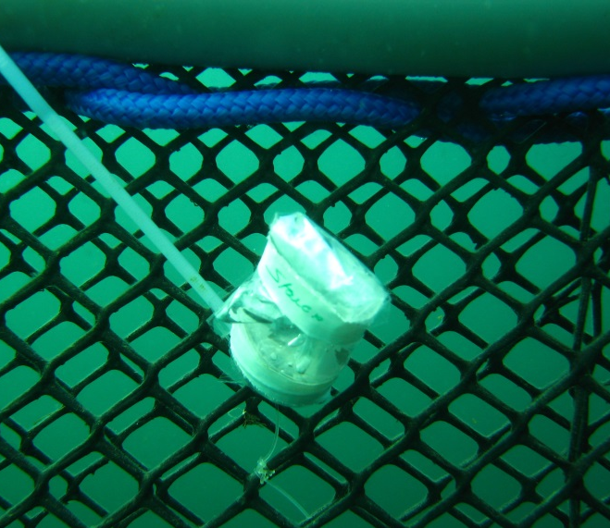
TE speciation
Water column:
dissolved
particulate
METHODS

Slide 7
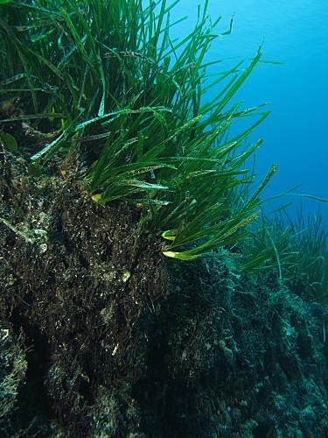
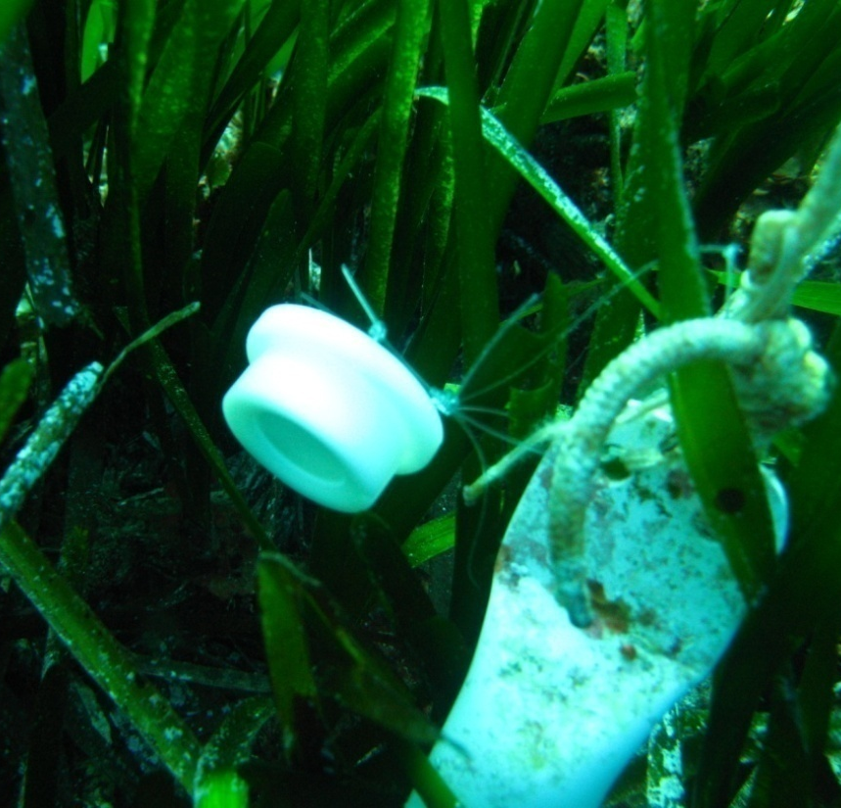
© A. Abadie
Posidonia oceanica
Posidonia oceanica shoots, rhizome and roots;
sediments;
canopy water.

Slide 8
Trace Element Pollution Index
How to compare global pollution levels in TEs between several monitored stations/sites ?
METHODS
Trace Element Pollution Index (TEPI)
TEPI = (Cf₁ * Cf₂ … Cf_{n})^{1/n},
a weighted version of the Metal Pollution Index (MPI) of Usero et al. (1996, MPB)
where:
Cf_{n} is the mean normalized concentration of the TE n in a given monitored station/site.
The highest the index value, the more the monitored site is globally contaminated in TEs compared to the others.

Slide 9
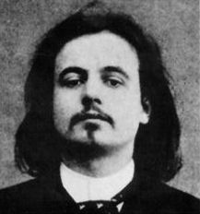
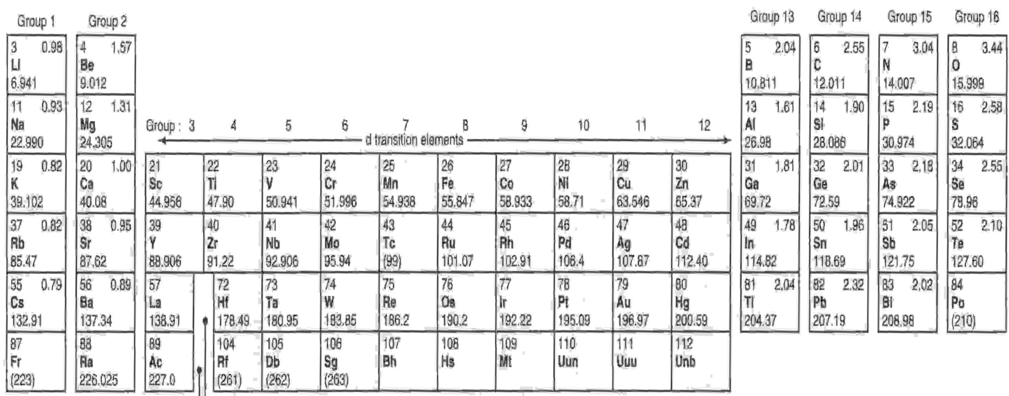
Monitoring of the pollution by trace elements
'Simplicity does not have to be simple', wrote Jarry, 'but complexity, compressed and synthesized.‘
Alfred Jarry, 1873 – 1907.
METHODS

Slide 10
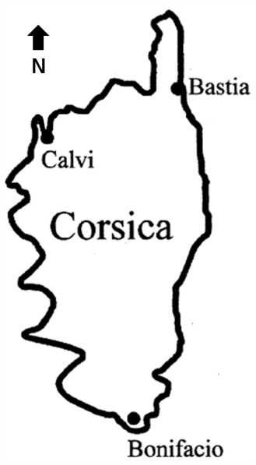
TE monitoring survey in the Calvi Bay
CASE
STUDY

Slide 11
M. galloprovincilias vs. P. oceanica
M. gallo.
P. oceanica
M. gallo.
P. oceanica
CASE
STUDY
M. gallo.
P. oceanica
M. gallo.
P. oceanica

Slide 12
Bioindicators … part of the story
CASE
STUDY
20%
38%

Slide 13
Looking for clues …
CASE
STUDY

Slide 14
The full story … not that simple
I
N
T
R
O
D
U
C
T
I
O
N

Slide 15
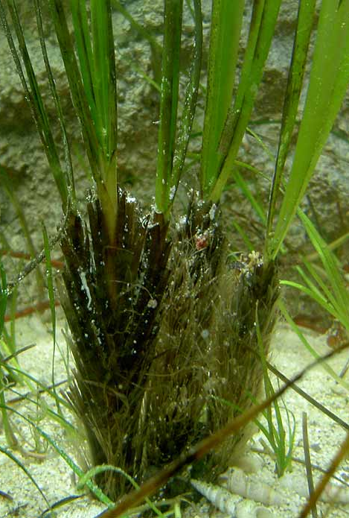
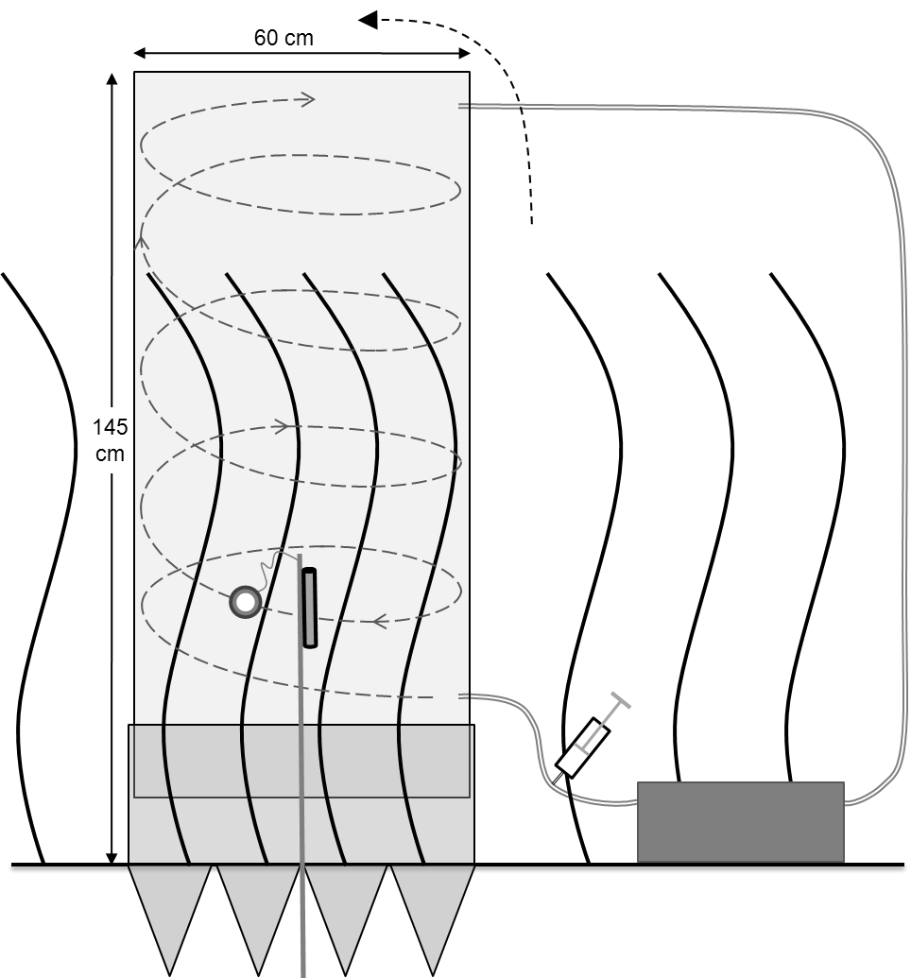
acropetal translocation
CASE
STUDY
Cu
growth demand
storage
© Mrkvicka A.

Slide 16
The full story … not that simple
A monitoring survey:
A static picture of a dynamic process …
Caged M. galloprovincialis physiological cycle;
dissolved and particulate TE;
Nutrients and PP;

Slide 17
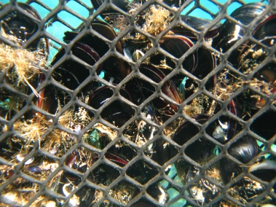
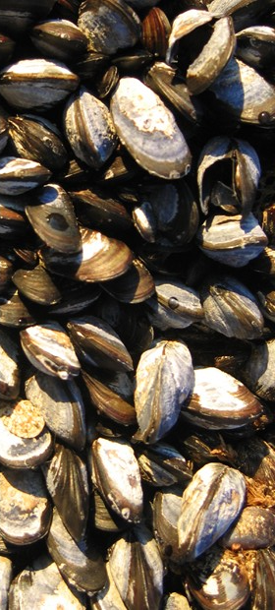
The full story … not that simple
ABIOTIC FACTORS
trace element
nature and speciation (dissolved, particulate)
trace element chemistry
trophic conditions
temperature, salinity, nutrients
www.wwfsassi.co.za/
storage
growth and emaciation
reproduction
LIFE CYCLE
BIOTIC FACTORS
(modified after Casas, 2005)

Slide 18

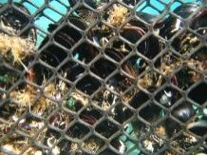

The full story … not that simple
7m
22m
top-down contamination

Slide 19
The full story … not that simple
7m
bottom-up contamination
13m
20m
40m

Slide 20

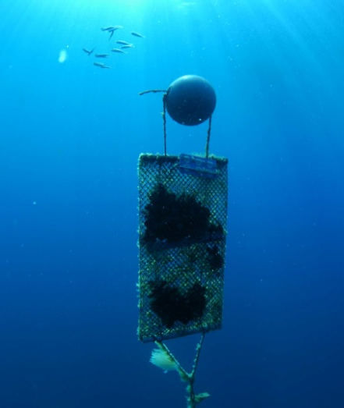
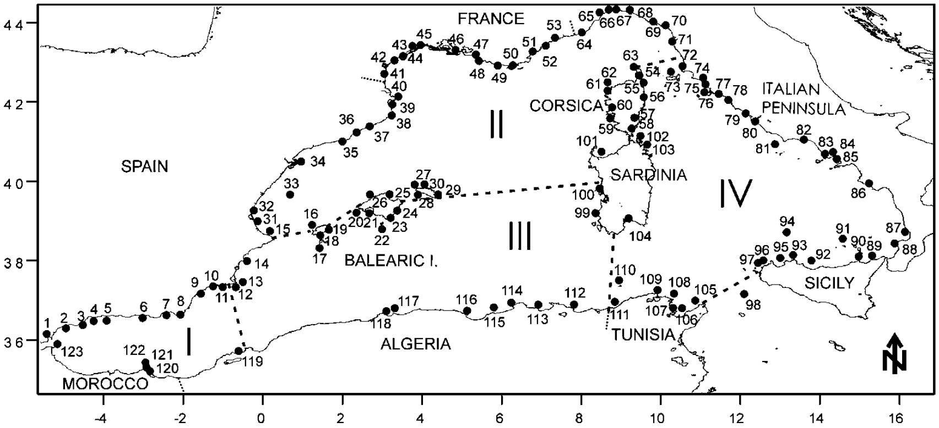
Monitoring of the western Mediterranean
©Ifremer/E. Emery
(Benedicto et al. 2011)
Cd
Pb
Ni
Hg
TEPI

Slide 21
Monitoring of the western Mediterranean
© A. Abadie
©Ifremer/E. Emery
(Richir et al. 2015)
France
Cd
Pb
Ni
Hg
TEPI
Italy
I(1-31)
Corsica
(33-62)
Spain
Sardinia
(63-74)
II(32-74)
Baleares (32)
Mediterranean Sea
III(75-82)
Algeria
Tunisia

Slide 22
CASE
STUDY

Slide 23
CASE
STUDY

Slide 24
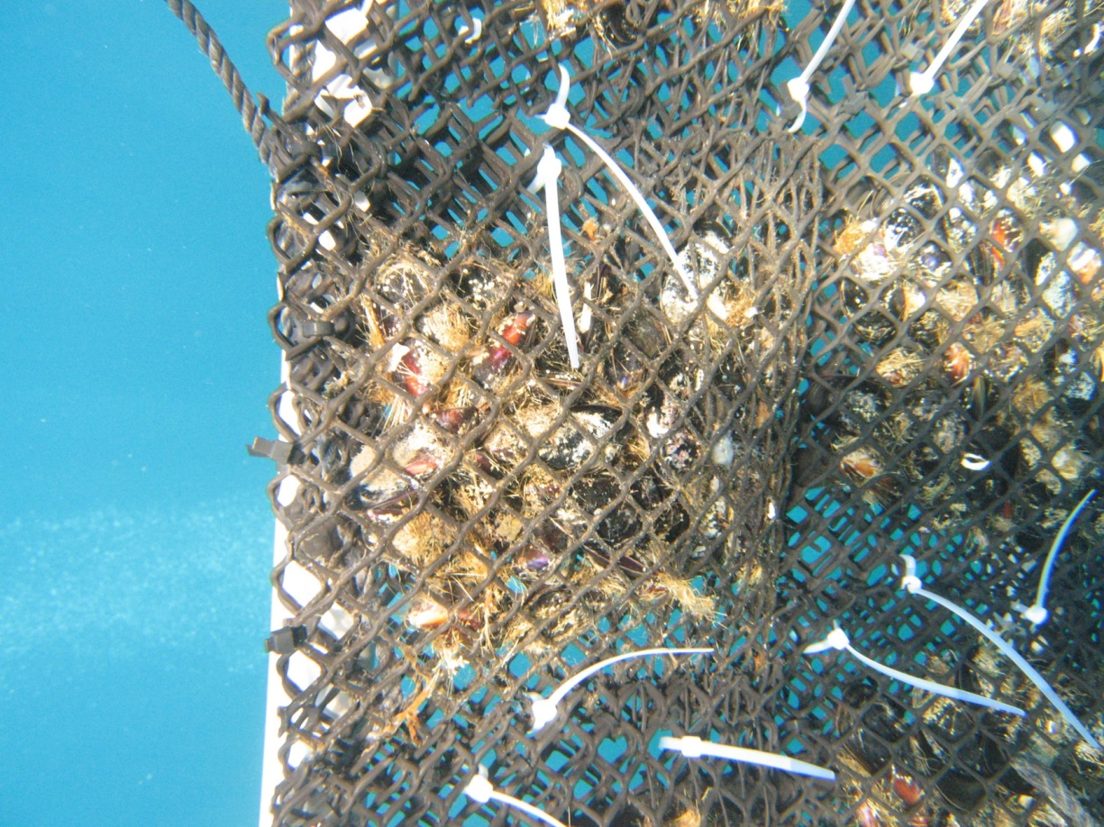
Two complementary contamination stories
P. oceanica and M. galloprovincialis accumulate TEs from the water column TE contamination severity integrated over several days to a few months;
P. oceanica, rooted in the sediments, reflects the long-term exposure to TEs A degree of time integration over several years to decades;
Caged mussels, as filter feeder, accumulate TEs from their particulate phase Continental-terrigenous inputs to coastal waters.
In conclusion : seagrasses and mussels should neither supplant, nor substitute, but rather complement each other in order to provide the full time- and space-integrated coastal contamination story of the Mediterranean.
CONCLUSION
Arnaud Abadie

Slide 25
Seagrasses or caged mussels to bioassess the contamination rate of Mediterranean
coastal waters?
That WAS the question …
Thank you for
attention
CONCLUSION
Arnaud Abadie

Slide 26
I
N
T
R
O
D
U
C
T
I
O
N

Slide 27
I
N
T
R
O
D
U
C
T
I
O
N

Slide 28
I
N
T
R
O
D
U
C
T
I
O
N

Slide 29
I
N
T
R
O
D
U
C
T
I
O
N

Slide 30
I
N
T
R
O
D
U
C
T
I
O
N

