Slide 1
Assimilation of HF radar in the Ligurian Sea
Spatial and Temporal scale considerations
L. Vandenbulcke, A. Barth, J.-M. Beckers
GHER/AGO, Université de Liège

Slide 2
Outline
Introduction
Ensemble generation
Data and observation operator
Data assimilation: OAK
Spatial considerations
Temporal considerations
SST considerations
Conclusion
DA of HF radar data in the Ligurian Sea
0/15

Slide 3
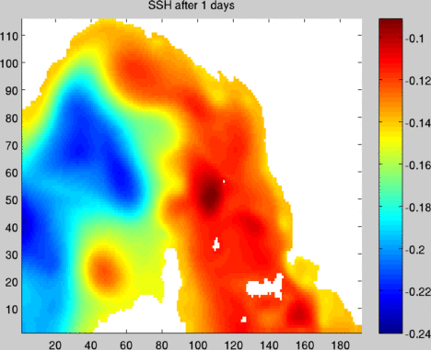
Introduction
Regional model of the Ligurian Sea: ROMS 1/60° 32 vertical levels
Open boundary from the MFS model
Atmospheric forcing fields from the COSMO model
Eastern & Western Corsican Current,
Liguro-Provencal Current
Mesoscale
Inertial oscillations, T~17 hours
DA of HF radar data in the Ligurian Sea
1/15

Slide 4
Introduction
Recognized Environmental Picture (REP’10) campaign during the summer 2010, drifter experiment LIDEX10
Available data: (a) 2 WERA high-frequency radars, (b) SST images, (c) drifters
Can the forecasts be improved by data from 2 WERA high-frequency radars ?
How long does an improvement last? Or, how frequent data do we need?
2 WERA radars:
Operated by NURC (now CMRE)
San Rossore, Palmaria
Azimuthal resolution 6°
Currents averages over 1 hour
DA of HF radar data in the Ligurian Sea
2/15

Slide 5
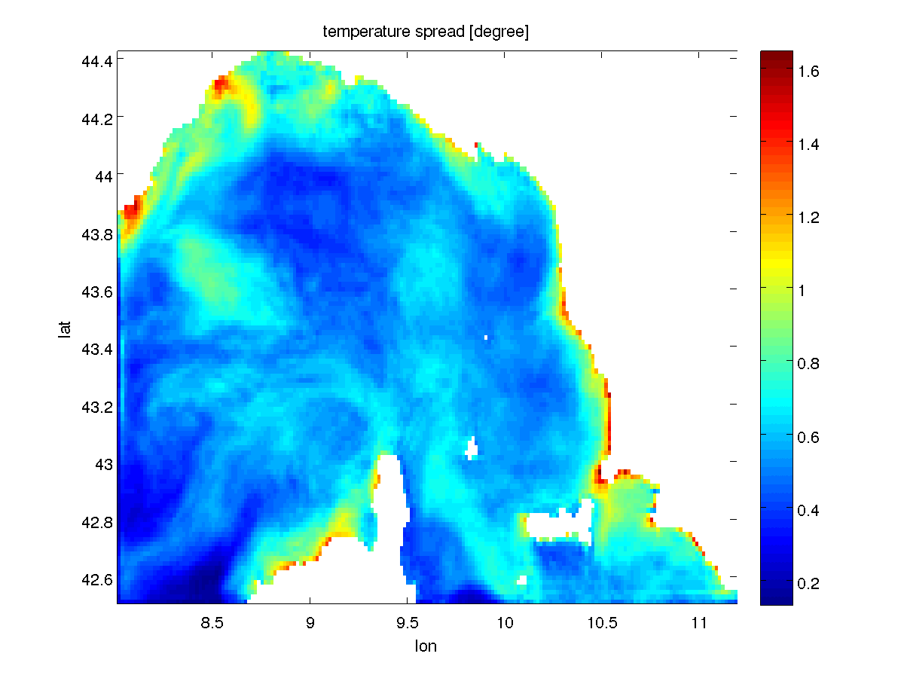
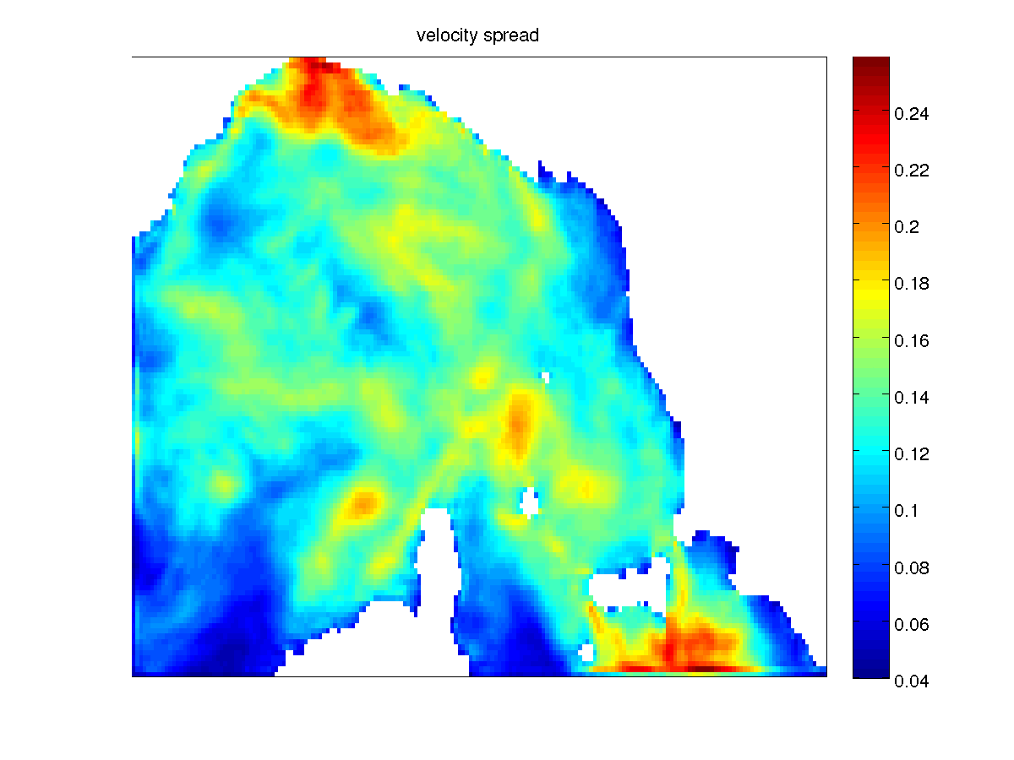
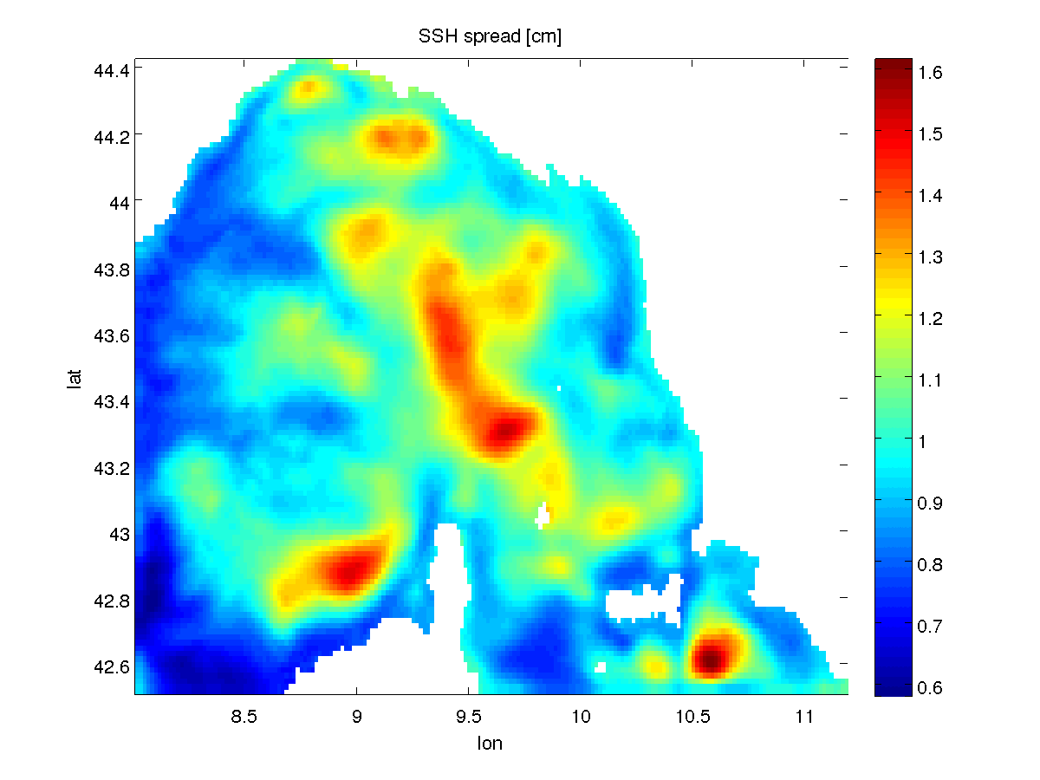
2. Ensemble generation
The ensemble members undergo perturbations of the most uncertain aspects of the model:
Perturbed wind field
Perturbed open boundary condition (velocity, surface elevation, temperature, salinity)
Supplementary stochastic term in the velocity equation
The ensemble is spun up from unique initial condition during 1 week, after which members have separated and created mesoscale circulation features
the respective perturbations are tuned so that their effect has the same order of magnitude
e.g. after 1 week, surface velocity spread ~ 10 cm/s
spatial autocorrelation ~ 50 km (temperature)
  ~10 km (velocity)
DA of HF radar data in the Ligurian Sea
3/15

Slide 6
3. Data and observation operator
DA of HF radar data in the Ligurian Sea
4/15

Slide 7

3. Data and observation operator
The observations to assimilate are the (radial) radar velocities (no interpolation)
The observation operator H transforms the model fields into radial currents towards the radars
Moreover, H also smooths the currents in the azimuthal direction (filters features smaller than 6°)
The points in the dense field of radar velocity observations are not uncorrelated. As we suppose the observation covariance matrix R is diagonal, we increase its diagonal
R = R_{instr} + R_{repr} R_{repr} = [ 5 , 50 , 250 ] cm/s
DA of HF radar data in the Ligurian Sea
5/15

Slide 8
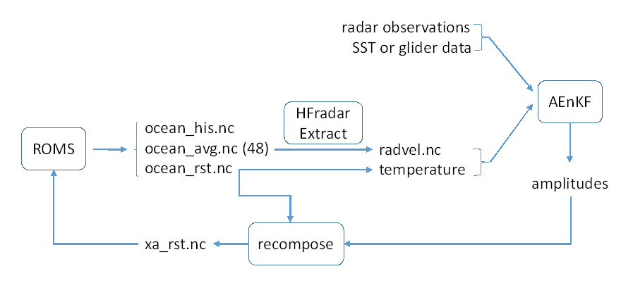
4. Data assimilation: EnKF implemented in OAK
The estimation vector x can contain the model fields at restart time
Or the model fields at different times during a time-window ( ~ AEnKF / smoother )
Or the model fields and forcing fields ( OBC, wind … ) ← see also poster by Mermain et al
DA of HF radar data in the Ligurian Sea
6/15

Slide 9
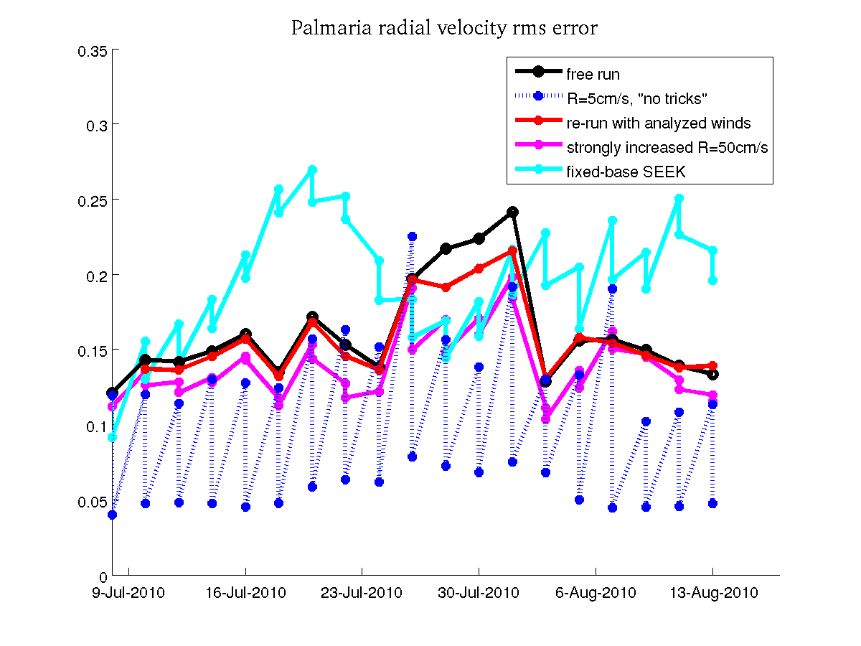
4. Data assimilation: results
difficulty to consistently improve the model
performs better with model error is larger
Optimize ?
different localisation radii
different R values
diffent window lengths (12h,24h…)
different cut-off lengths (50km?)
no T,S,SSH update
analyzed forcings + re-run
DA of HF radar data in the Ligurian Sea
7/15

Slide 10
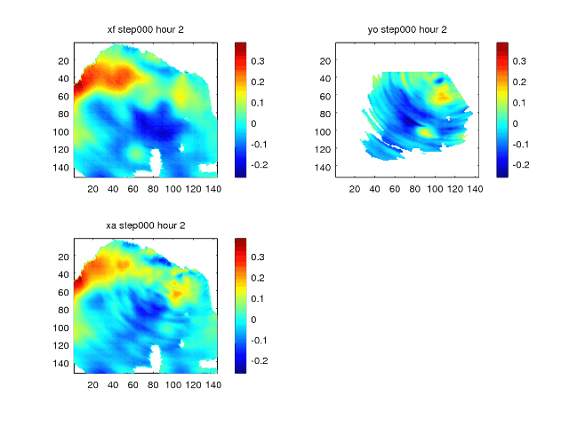
5. Spatial considerations
different localisation radii
different R values
different cut-off lengths (50km?)
observation
ensemble mean forecast projected on radial direction
ensemble mean analysis projected on radial direction
DA of HF radar data in the Ligurian Sea
8/15

Slide 11
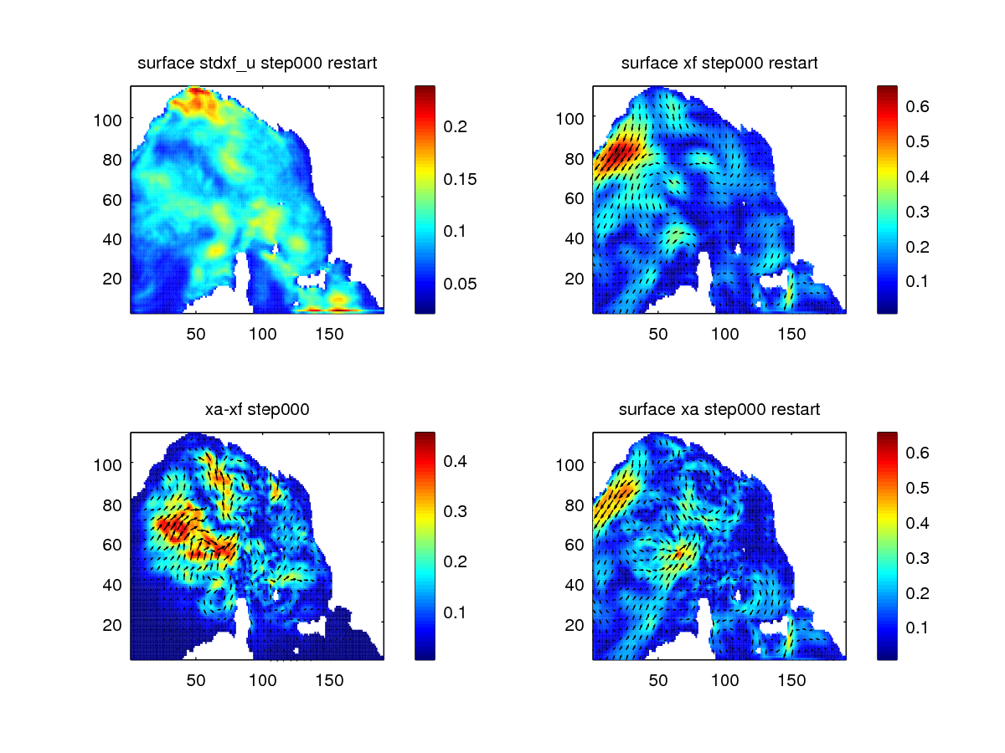
5. Spatial considerations
‘’ « restart » is not observed ‘’
case with R=5cm/s
DA of HF radar data in the Ligurian Sea
9/15

Slide 12
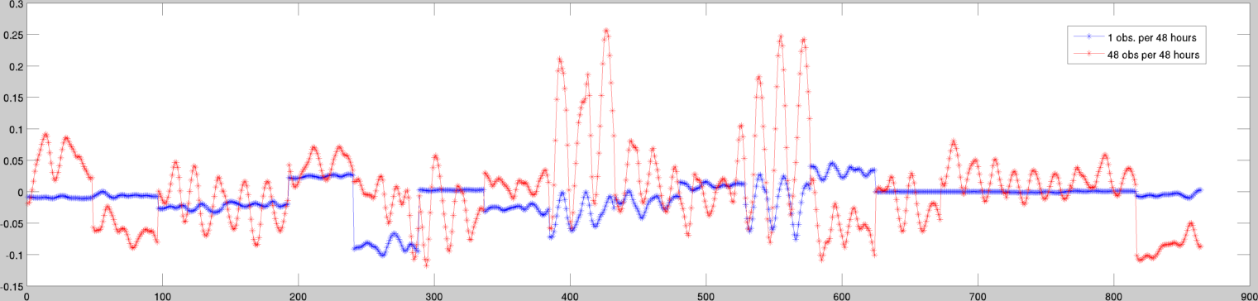
6. Temporal considerations
the ensemble should represent the variability at all considered spatial and temporal scales
instead of assimilating all (radar) data, let’s assimilate just velocities in 1 point
The obtained correction in that particular point in shown (the blue curve)
when assimilating in one single point every hour, the inertial oscillation is corrected much more strongly
meso- or large-scale
correction is dominant here
mixed correction
correction with inertial oscillation shows they are
present in the covariance
DA of HF radar data in the Ligurian Sea
10/15

Slide 13
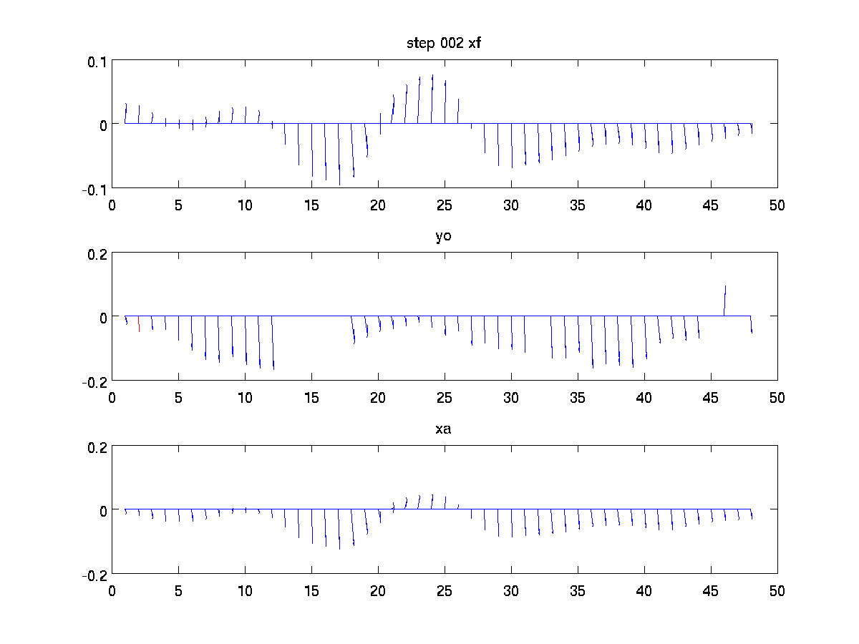
6. Temporal considerations
How long lasts the impact of 1 observation of hourly-averaged currents:
The correction has a large impact during ~10 hours → advantage (necessity) of very frequent observations
DA of HF radar data in the Ligurian Sea
11/15

Slide 14
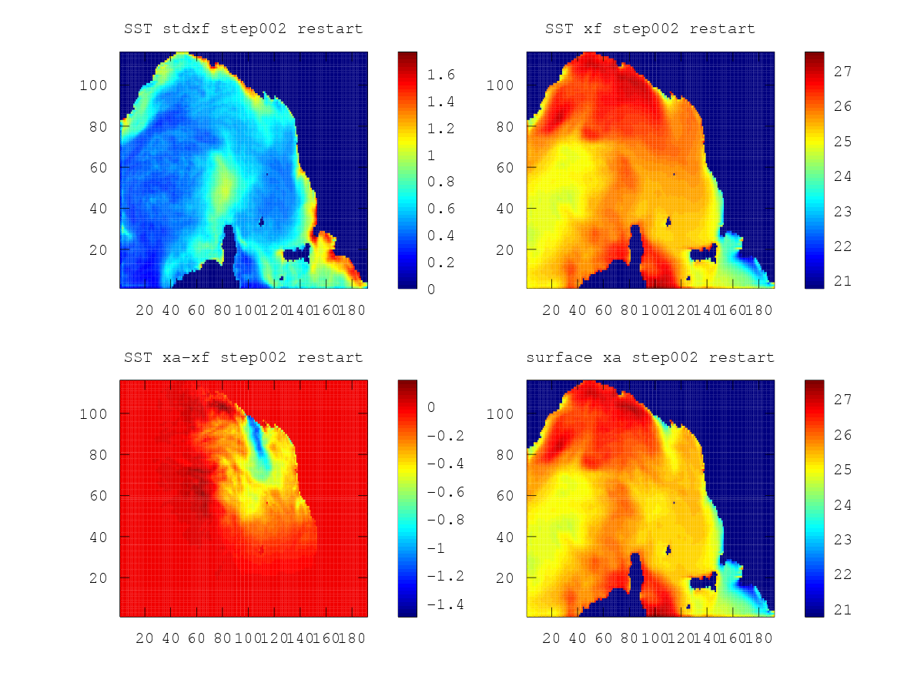
7. SST considerations
assimilate radar currents, and improve other variables such as SST ?
SST corrections have the right amplitude (std.dev ~ xa-xf), but:
model SST rms error is not improved ( similar conclusion obtained in other studies )
DA of HF radar data in the Ligurian Sea
12/15

Slide 15
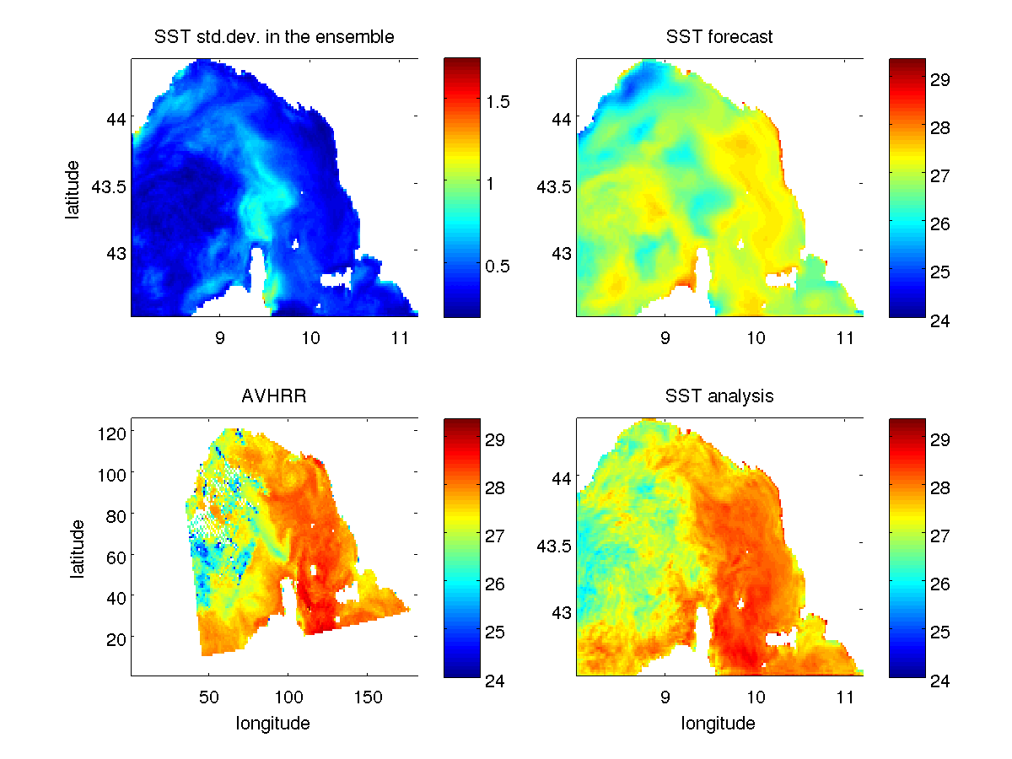
7. SST assimilation
Assimilate AVHRR SST with diagonal R = 1°C
mean improvement : 0.2°C
the heating appearing in the east is missing in the model
DA parameters need further tuning ,
e.g. E(xa-xf) ~ spread
ensemble mean forecast
observation
ensemble mean analysis
DA of HF radar data in the Ligurian Sea
13/15

Slide 16
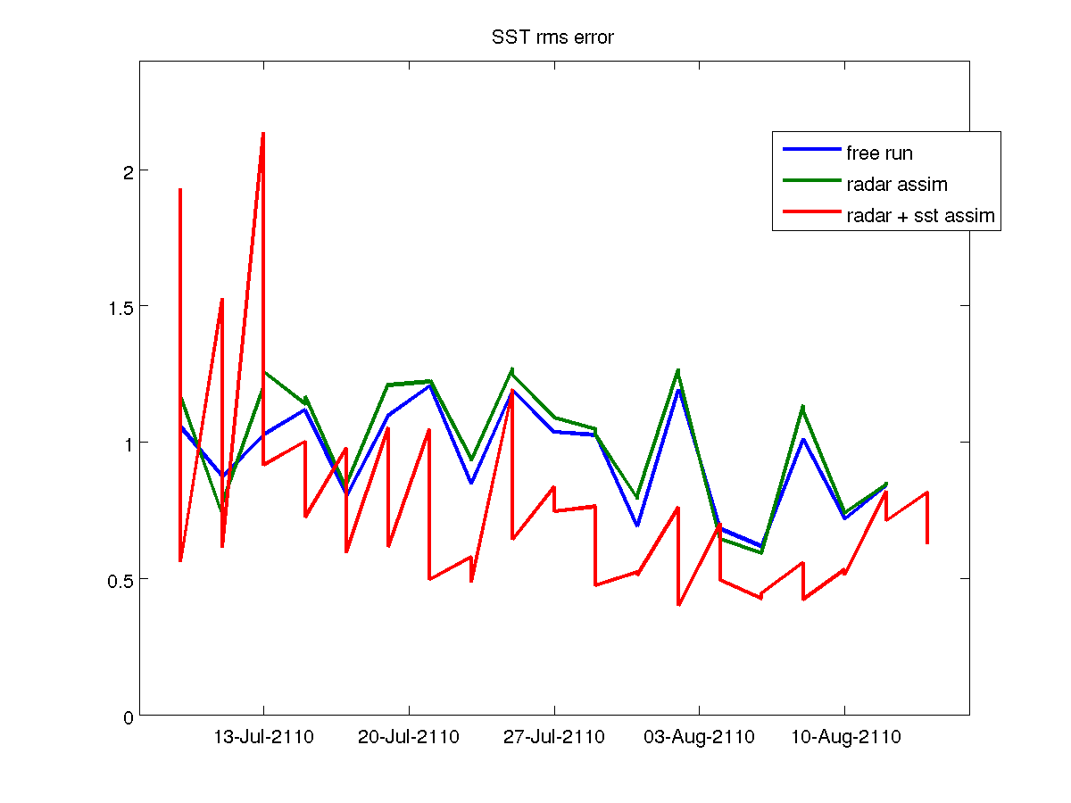
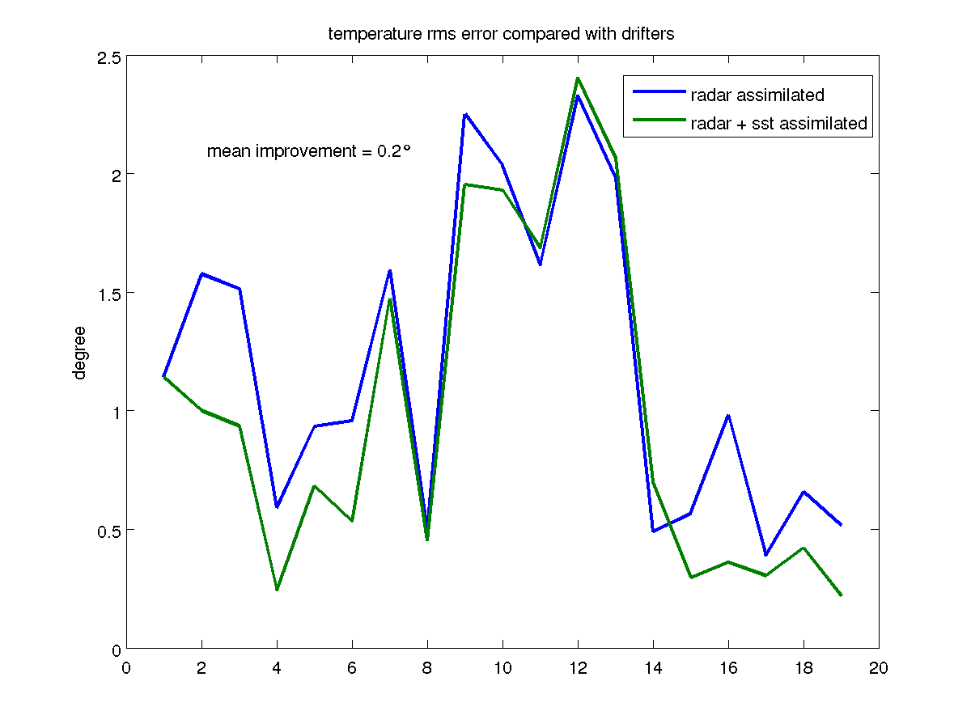
7. SST assimilation
Assimilate GHRSST with diagonal R = 1°C
                mean improvement compared with drifters : 0.2°C
DA of HF radar data in the Ligurian Sea
13/15

Slide 17
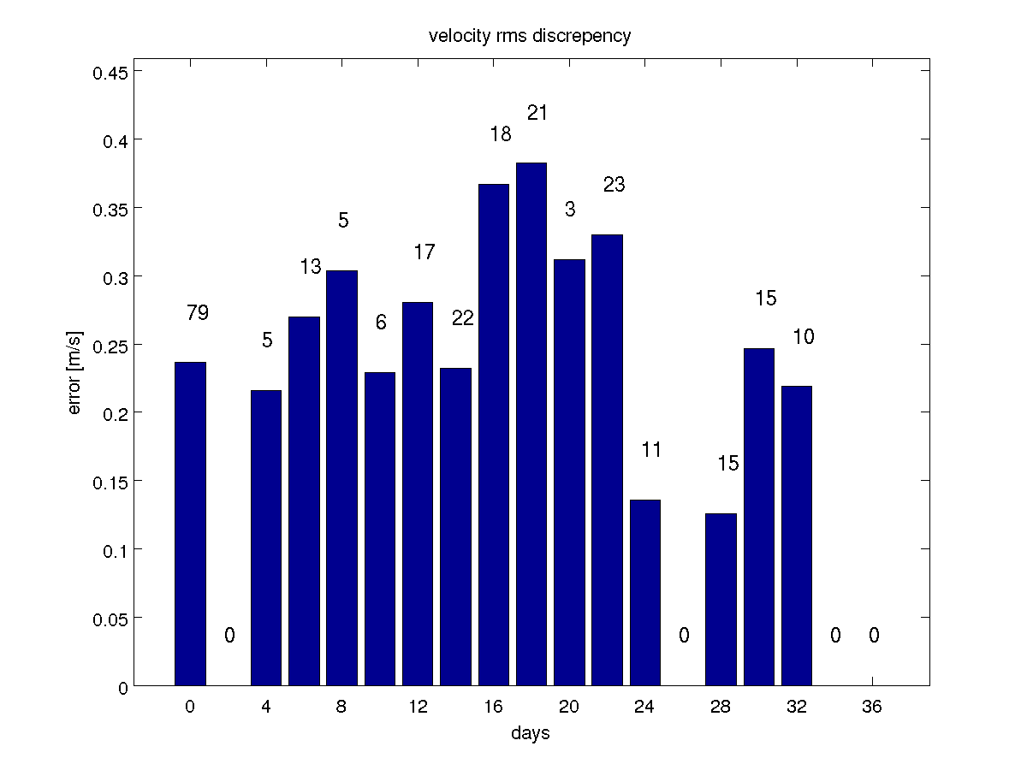
7. Velocity validation with drifter data ?
Compare model velocity with drifters velocity : huge discrepancy ( rms ~ 27 cm/s )
Compare radar radial velocity with (projected) drifter velocity :
  Choose all drifter data inside [18h00 - 06h00]
  For Palmaria, huge velocity discrepancy (rms ~ 25 cm/s)
  For San Rossore, no overlapping radar – drifter data
Possible cause ?
  the model and radar are hourly-averaged velocities;
  whereas the drifter data represent the velocity
  integrated over ~6 hours (1/3 period inert.oscil.)
  (many) outliers with discrepencies ~ 20 – 70 cm/s
    need to check them … ← see R. Gomez WERA QC talk
    margin of the radar coverage area ?
DA of HF radar data in the Ligurian Sea
14/15

Slide 18
Conclusions
AEnKF assimilating HF-radar surface velocity observations
limited success in general, better when model is drifting away
improving the forcing (wind) is not helping so much
ability to correct the inertial oscillation (phase) thanks to high temporal frequency
assimilating radar data does not improve SST
assimilating satellite SST as well improves model temperature
large discrepancies between radar and drifter data as well
Thank you !
DA of HF radar data in the Ligurian Sea
15/15

