Slide 1
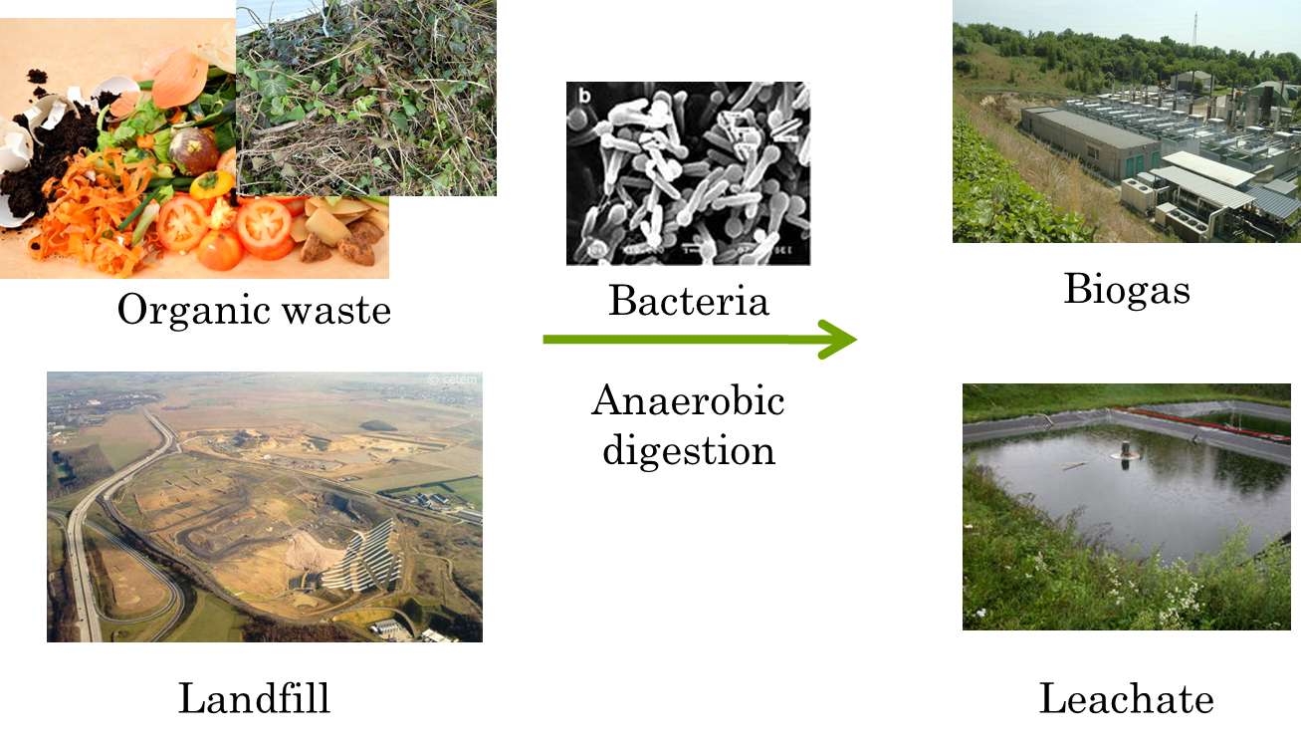
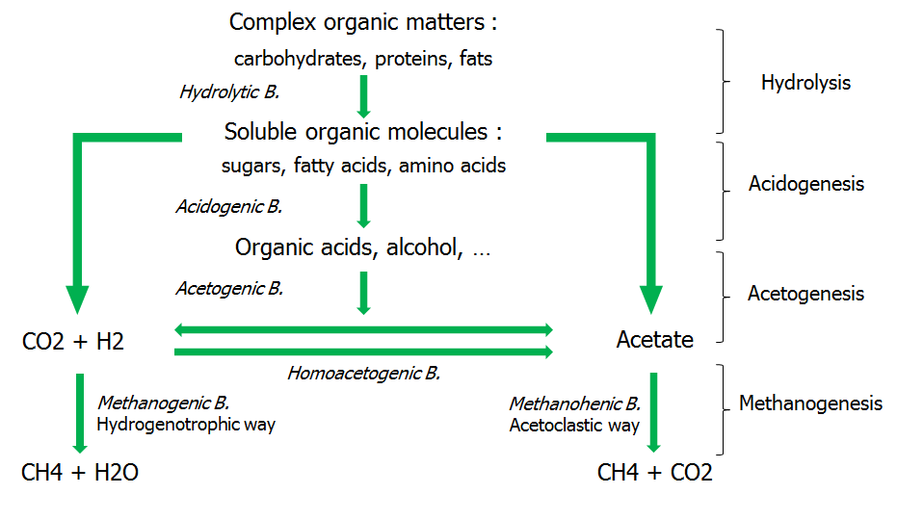
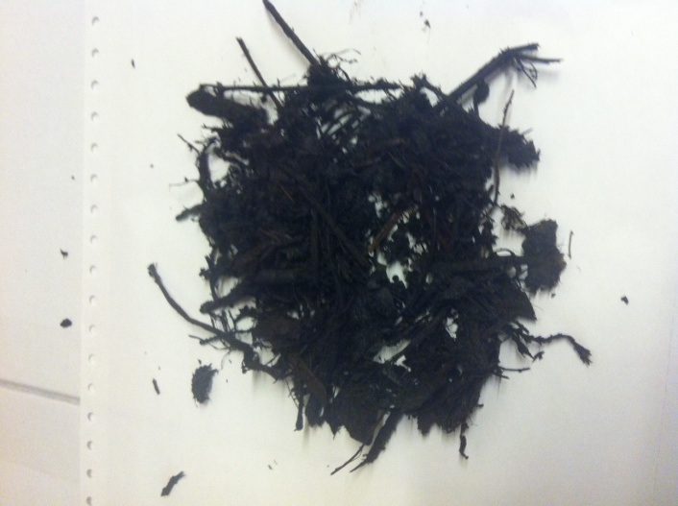
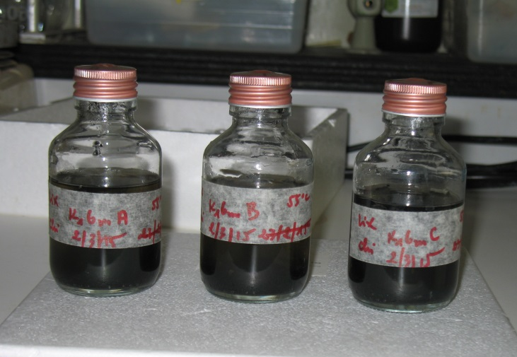
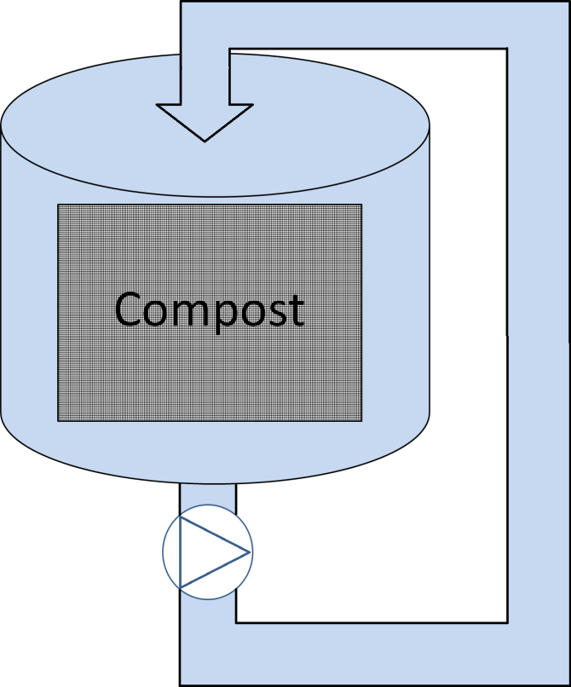
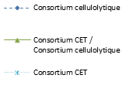
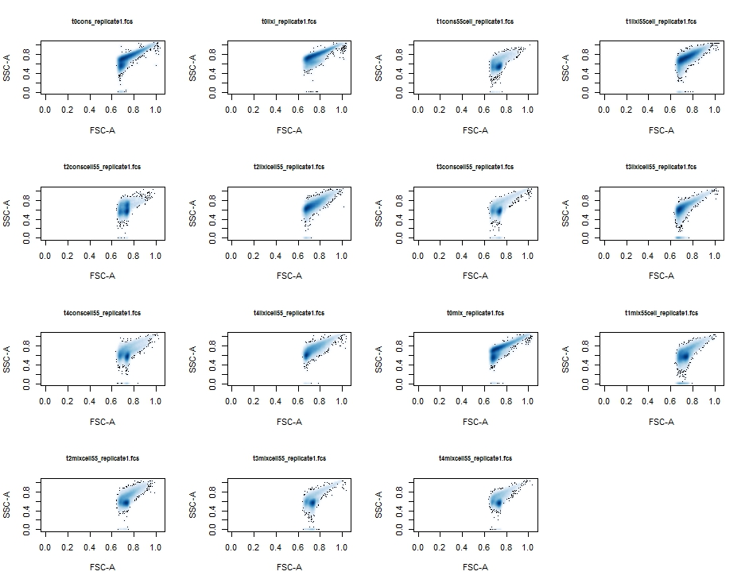
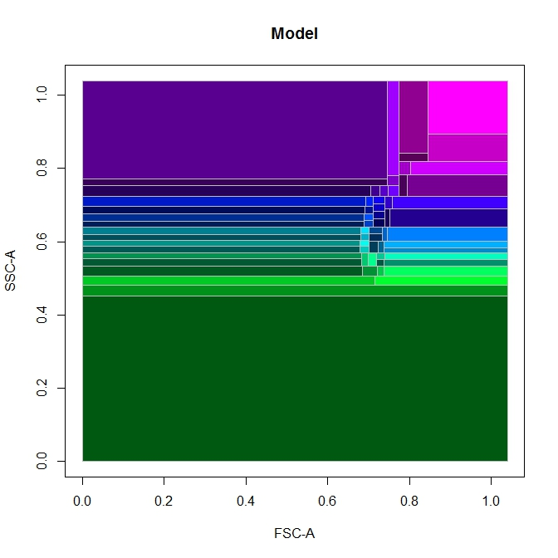
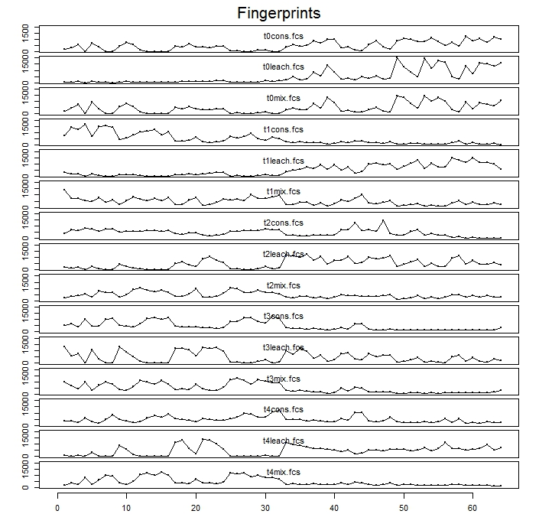
Improvement of anaerobic digestion of the organic part of landfilled wastes.
Ph. Dzaomuho ^{1*}, R. Kinet ^{1#}, S. Hiligsmann ², P. Thonart ^{1,2}, F. Delvigne¹
¹ ULg – Gembloux Agro-Bio Tech, Microbial Processes and Interactions. Passage des Déportés, 2, Gembloux, B-5030, Belgium. *corresponding author: p.dzaomuho@ulg.ac.be # founded by FNRS-FRIA
² Ulg – Service de Technologie microbienne, Boulevard du Rectorat 29, Liège, B-4000, Belgium
Context and objectives
Hydrolysis of lignocellulosic biomass = Limiting step
Addition of an anaerobic hydrolytic consortium to recirculated leachate to improve biodegradation processes
Method
Step 1 : Consortium isolation (Kinet et al., 2015)
Step 2 : BMP test
Step 3 : Scale-up production
Step 4 : Full scale application
Enrichment method:
Compost as microbial source (10%)
Anaerobia, 55°C, static
Filter paper 1% (w/v)
Experimental conditions:
Consortium, leachate or mix 1:1 as inoculum
Anaerobia, 55°C or 30°C, static
Excavated wastes as substrate 1% (w/v)
Experimental conditions:
Liquid phase = water
100 kg compsot
Recirculation flow = 1L.sec⁻¹
Extraction time = 1h
500L vessel
Compost
Selective medium
Degradation potential :
Filter paper → 10g/l
Microcrystalline cellulose → 10g/l
pump
Metallic cage
Recirculation loop
→ Punctual injection of leachate with added consortium
Results
Impact of cellulolytic microbial consortium on wastes digestion (lab scale)
Mesophilic conditions
Thermophilic conditions
Isolated consortium shows efficient cellulolytic activities in both mesophilic and thermophilic conditions.
Leachate presents an absence of cellulolytic activity in mesophilic conditions >< thermophilic conditions
Isolated consortium improves anaerobic digestion of wastes in thermophilic and mesophilic conditions.
Full scale experiment in progress
Figure 1 : Evolution of maximal total biogas production (ml/g cellulose) during anaerobic and mesophilic (30°C) digestion of a cellulosic substrate (10 g/l filter paper) by (1) leachate microflora (10% v/v), (2) isolated consortium (10% v/v) and (3) mix 1:1 of leachate and isolated consortium (10% v/v).
Figure 2 : Evolution of maximal total biogas production (ml/g cellulose) during anaerobic and thermophilic (55°C) digestion of a cellulosic substrate (10 g/l filter paper) by (1) leachate microflora (10% v/v), (2) isolated consortium (10% v/v) and (3) mix 1:1 of leachate and isolated consortium (10% v/v).
Figure 3 : Evolution of maximal total biogas production (ml/g cellulose) during anaerobic and mesophilic (30°C) digestion of organic part from landfilled wastes (10 g/l) by (1) leachate microflora (10% v/v), (2) isolated consortium (10% v/v) and (3) mix 1:1 of leachate and isolated consortium (10% v/v).
Figure 4 : Evolution of maximal total biogas production (ml/g cellulose) during anaerobic and thermophilic (55°C) digestion of organic part from landfilled wastes (10 g/l) by (1) leachate microflora (10% v/v), (2) isolated consortium (10% v/v) and (3) mix 1:1 of leachate and isolated consortium (10% v/v).
Microbial community structure
T0 cons.
T0 leach.
T1 cons.
T1 leach.
3000
0 days
Consortium
Leachate
T2 cons.
T2 leach.
T3 cons.
T3 leach.
2000
0 days
21 days
Mix
14 days
1000
22%
3 days
0 days
21 days
7days
14 days
3 days
T4 cons.
T4 leach.
T0 mix
T1 mix
Space modelization (FlowFP R package)
Samples Fingerprinting (FlowFP R package)
PC2
0
7days
PCA
21days
3 days
-1000
7days
T2 mix
T3 mix
T4 mix
-2000
14 days
-3000
-3000
-2000
-1000
0
1000
2000
3000
Figure 5 Evolution of microbial populations (cytometry analysis) during anaerobic and thermophilic (55°C) digestion of organic part from landfilled wastes (10 g/l) by (1) leachate microflora (10% v/v), (2) isolated consortium (10% v/v) and (3) mix 1:1 of leachate and isolated consortium (10% v/v)
PC1
58%
Cytometry fingerprinting allows (1) statistical sorting of complex microbial populations and (2) identification of population dynamics
→ Mix samples population evolves in same way than isolated consortium population ➔ consortium population overrides leachates microflora during cellulose digestion
Conclusions
Isolated consortium improves anaerobic digestion of landfilled wastes (organic part) when added to leachate.
Cytometry fingerprinting as an efficient and rapid tool for population dynamics identification.
These works fit in GreenWin project ‘‘Minerve’’ funded by Région Wallonne of Belgium.
Waste samples, leachate and in situ data come from landfill site of Mont-Saint-Guibert in Belgium managed by Shanks SA.
Kinet, R., et al., 2015. Thermophilic and cellulolytic consortium isolated from composting plants improves anaerobic digestion of cellulosic biomass: Toward a microbial resource management approach. Bioresour. Technol. 189, 138–144. doi:10.1016/j.biortech.2015.04.010

