Slide 1
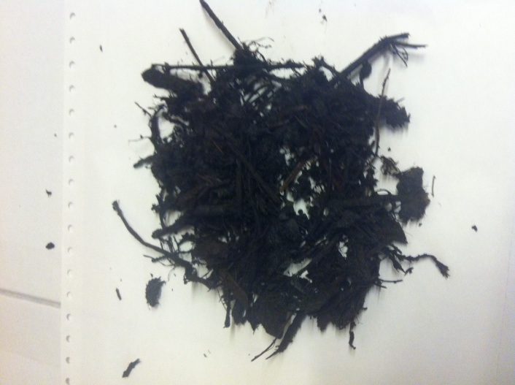
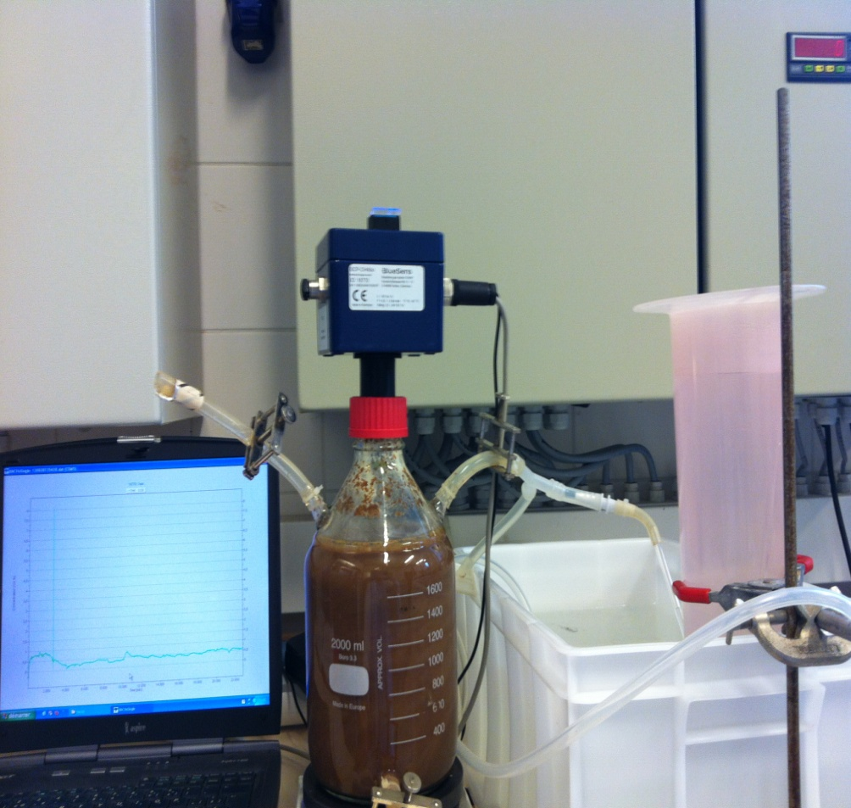
Development of an anaerobic, thermophilic and cellulolytic consortium to improve anaerobic digestion of lignocellulosic biomass.
Kinet R., Rouneaux N., Hissette M., Delvigne F., Destain J., Thonart Ph.
Bio-industry Units, Gembloux Agro-Bio Tech (GxABT)
University of Liège, Belgium
r.kinet@doct.ulg.ac.be
Introduction
Over the last years, the development of green industrial processes using products from plant biomass induces an important increase of lignocellulosic by-products. Anaerobic digestion of this organic matter can be an attractive option as a source of alternative energy. Moreover, this biological mechanism is also the only degradation pathway occurring in the landfill where organic fraction of municipal solid waste is buried. The low biodegradation rate of this biomass is an important obstacle in anaerobic microbial decomposition process. Rate-limiting step in anaerobic digestion is the lignocellulosic hydrolysis. The purpose of the project is to develop an anaerobic consortium able to degrade lignocellulosic products in thermophilic conditions to improve the methane production.
Isolation of the enriched microbial consortium and its cellulosis degradation ability :
Successive subcultivations :
Compost as microbial inoculum (10%)
Anaerobia, 55°C, static
Filter paper 1% (w/v)
Transfer after 5 days growth
Scale-up in the fourth transfer (50ml → 1L)
Figure 1 : Enrichment method to obtain a cellulolytic, anaerobic and thermophilic consortium from compost. Transfer after 5 days growth at 55°C and in anaerobic static conditions. Scale-up in the fourth transfer (50ml to 1L).
Conditions of cellulosis degradation test :
Inoculum 10% (v/v) = consortium obtained after 4 transfers
Anaerobia, 55°C, static
Cellulose 1% (w/v) → Filter paper or Microcrystalline cellulose
Microcrystalline cell
Filter paper
Maximal degradation ratio :
Filter paper → 99%
Microcrystalline cellulose → 98%
Figure 2 : Consortium ability to degrade different cellulosic substrates (filter paper and microcrystalline cellulose) in thermophilic (55°C) and anaerobic static conditions. Maximum degradation ratio (%) obtained after 7 days growth.
Cellulosis cristallinity impact:
Cristallinity slows-down degradation process BUT don’t stop it
Cellulosis degradation kinetics
Conditions :
Inoculum 10% (v/v)
Anaerobia, 55°C, static
Cellulose 1% (w/v) → Filter paper
3 distinct phases :
0 → 22h : adaptation period (0% → 6.4%)
22h → 70h : exponential degradation phase (6.4% → 69%)
70h → 142h : slow-down (69% → 82%)
Figure 3 : kinetic of filter paper (1% w/v) degradation by consortium (10% v/v). Experiments under thermophilic (55°C) and anaerobic static conditions.
Conclusions
The enrichment methodology, with high temperature compost as microbial source, permitted to obtain a consortium able to degrade efficiently different cellulosic products in anaerobic and thermophilic conditions.
Cellulosis cristalliny slows-down the anaerobic degradation but don’t stop it.
Cellulosis degradation kinetics is divided in three distinct phases comparable to classic microbial grown phases: latency, exponential growth and stationary
This work is supported by the national found for scientific research, Brussels, Belgium
The authors thank the national found for scientific research, Brussels, Belgium for travel grant

