Slide 1

The “Belgian Tetris”:
Assessing the political impact of metaphors on citizens’ perception of Belgian federalism
Julien Perrez & Min Reuchamps
University of Liege (ULg)
University of Louvain (UCLouvain)
CogLingDays 2014 (Ghent), 11/12/14

Slide 2
Introduction
Interdisciplinary project
  Linguistics & political science
  Metaphors in political discourse
    Context: Belgian federalism
  Use of metaphors
    Citizen data
  Impact of metaphors?
Notes:
Why are these metaphors used, and to what end?

Slide 3
The political impact of metaphors?
Key question to our understanding of political interactions
But the political impact of metaphors is often a no-question:
  Linguists assume a political impact of metaphors
    Conceptual Metaphor Theory
      Fundamental role of metaphors in our perception and comprehension of the world
      Models explaining how metaphors can frame political issues and shape the perception and comprehension of these issues by the public opinion (strict father >< nurturent parent).
    Critical discourse analysis
      Metaphors = important rhetorical tools
        Especially in political discourse
Notes:
A better understanding of the role and functions of metaphors in political discourse a key question to our udnerstanding of political interactions
Metaphors can thus be found in our daily life, including our political life. Yet in this domain, the political impact of metaphors is often taken for granted. Therefore a more global understanding of what this political impact could consist of is needed to further the current research agenda. As Koller (2009, 121) puts it: “metaphor helps construct particular aspects of reality and reproduce (or subvert) dominant schemas.” To be able to account for how metaphors, through discourses, actively shape the political reality, it is important to look at the relationships between metaphorical discourses and their environment.

Slide 4
« In political contexts metaphor can be, and often is, used for ideological purposes because it activates unconscious emotional associations and thereby contributes to myth creation: politicians use metaphors to tell the right story»
(…)
« Rhetorically, metaphors contribute to mental representations of political issues, making alternative ways of understanding these issues more difficult and in so doing ‘occupy’ the mind »
(Chatreris-Black, 2011 : 28)

Slide 5
The political impact of metaphors?
Key question to our understanding of political interactions
But the political impact of metaphors is often a no-question:
  Linguists assume a political impact of metaphors
  Political scientists do not really look at metaphors
Notes:
So what linguists do islooking at metaphors in discourse, and making hypotheses about how their are perceived by the audience
Political scientists do not even care about metaphors. And this is quite a problem considering that linguist are primarily interested in political discourse
Sometimes quite disturbing to see to see that linguists often seem to be more interested by political discourse than political scientists themesleves, but anyway

Slide 6
The political impact of metaphors?
Key question
But the political impact of metaphors is often a no-question:
  Linguists assume a political impact of metaphors
  Political scientists do not really look at metaphors
Why do we use metaphors in political discourse?
What effect(s) do they have?
  Cf. Thibodeau & Boroditsky (2011), Steen et al (2014)
Notes:
And what effects do they have on the people who come across them?
In answering these questions, this study will contribute to a better understanding of the role and functions metaphors play in political discourse, and more globally in our everyday political interactions.
Question which has started to be experimentally looked at

Slide 7
Belgian federalism?
Notes:
If I asked to spontaneously describe Begian federalism in your own terms, the chances are high that you would come up with things like
But you would probably not come up with this image

Slide 8
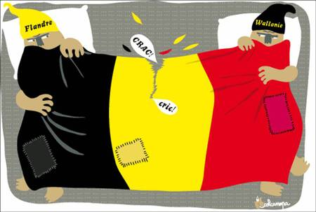
L2: “het is vergelijken met dat huwelijk he. De Belgische staat is een gearrangeerd en geforceerd huwelijk geweest.” (2263-2266)
(…)
L6: “het is inderdaad een gearrangeerd huwelijk en het is gearrangeerd door de internationale gemeenschap” (2268-2269)
(…)
L6 : “een gearrangeerd huwelijk kan ook ontbonden worden, zo moeilijk is dat allemaal niet. Het moet gewoon erkend worden door de internationale gemeenschap.” (2279-2280)
L2 : “ja maar dat is getrouwd voor goede en kwade dagen en wij zijn nu in kwade dagen.” (2281-2282)
L6 : “maar bij een gearrangeerd huwelijk is het niet in goede en kwade dagen vrijwillig, maar is het verplicht in kwade dagen. (…) ik hoop toch dat we zover zijn dat huwelijken niet meer verplicht zijn ofwel? ” (2283-2287)
Du. “Normale partijen die een staatshervorming willen enzovoort die willen eigenlijke hetzelfde als we zo zeggen een ernstige LAT relatie in dit land.” (PBN, M5, 3130-3131)’
c’est comme dans un ménage, on ne règle jamais les solutions une fois pour toutes. On se marie, ou en vit ensemble, peut importe, à 20 ans, puis on a des enfants, puis les enfants deviennent grands, puis le bonhomme fait sa crise de la quarantaine, puis on se dit que tout compte fait, on se dit que c’était quand même pas si mal et puis rien, et puis entre, temps, madame est ménopausée et puis... (…) puis..... Puis elle a perdu son job, puis les enfants se sont mariés, voilà que la maison est trop grande... les situations évoluent et je ne pense pas qu’on va rêver d’avoir une situation immuable. (PBF, B8, 1968-1977).
From Perrez & Reuchamps (to appear)
Notes:
Stories about some sort of complicated love relationship (people unhappy marraiges)

Slide 9

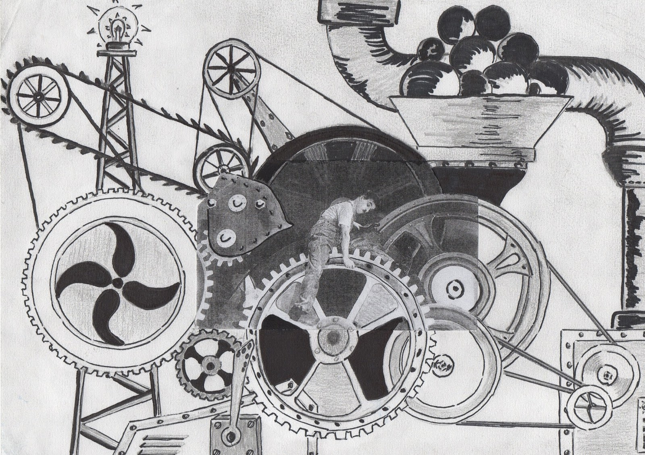
Fr. On a coupé le citoyen du fonctionnement d’une espèce de mécanisme, de
machine folle lancée sur elle-même. (PBF, B8, 839-840)
Du. “Maar ik denk dat je kunt concluderen dat het federalisme zoals het nu is
dat het niet werkt” (PBN, N4, 3318-3319)
From Perrez & Reuchamps (to appear)
Notes:
A very complex machinery with a lot of wheels, a mchine which is not working very properly

Slide 10
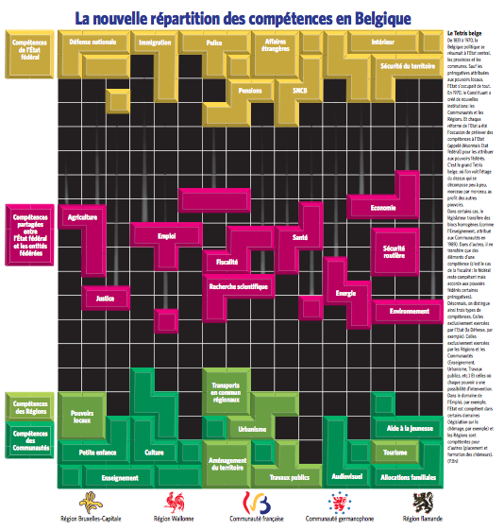
Notes:
But I don’t think you would spontaneously come up with a Tetris metaphor.
But this is the metaphor which has been produced by a journalist from Le Soir to present the last state reform.
Seeing this way of presenting Belgian federalism kind of naturally raised the question of (i) why the journalists chose to use such a metaphor and (2) how such a metaphor, produced in a natural context, would impact on the citizens who were confronted to it. we decided to develop an experimental set-up that was based on this article. To measure the possible impact of metaphors on the citizens’ political representations and attitudes,

Slide 11
Experimental material - Image

Slide 12
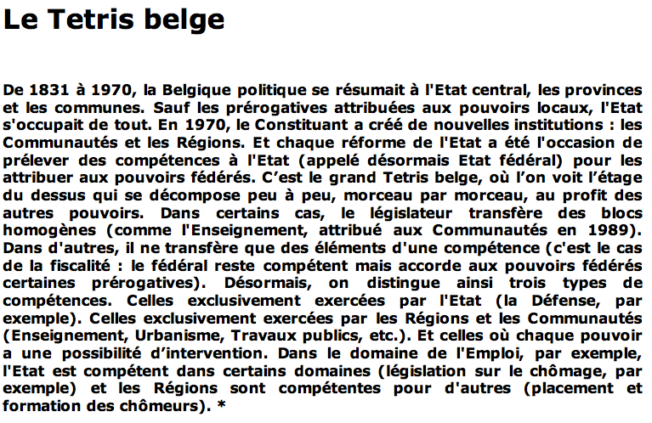
Experimental material - Text

Slide 13
The Belgian tetris
From 1831 to 1970, Belgium came down to the central state, the provinces and the municipalities. Except for the prerogatives attributed to the local authorities, the State was taking care of everything. In 1970, the constituent power created new institutions: communities and regions. And every state reform has been the occasion to take competences from the state (from there on called the federal state) to attribute them to federal authorities. This is the big Belgian Tetris, where we see the upper floor that is falling apart (decomposing) , block by block, at the benefit of other authorities. In certain cases, the legislator is transferring homogeneous blocks (like education, attributed to the communities in 1989). In other cases, it is only transferring some elements of a competence (it’s the case of tax system: the federal state remains competent but assigned certain prerogatives to the federal entities). From now on, we therefore make a distinction between three types of competences. The ones that are exclusively exercised by the federal state (like Defense, for example). The ones that are exclusively exercised by the Regions and Communities (Education, Town planning, Public works, and so on). An the ones for which each power has a possibility of intervention. In the domain of employment, for instance, the (federal) State is competent for certain domains (unemployment legislation, for instance) and the Regions are competent for other ones (training courses of unemployed people).

Slide 14
The Belgian tetris
From 1831 to 1970, Belgium came down to the central state, the provinces and the municipalities. Except for the prerogatives attributed to the local authorities, the State was taking care of everything. In 1970, the constituent power created new institutions: communities and regions. And every state reform has been the occasion to take competences from the state (from there on called the federal state) to attribute them to federal authorities. This is the big Belgian Tetris, where we see the upper floor that is falling apart (decomposing) , block by block, at the benefit of other authorities. In certain cases, the legislator is transferring homogeneous blocks (like education, attributed to the communities in 1989). In other cases, it is only transferring some elements of a competence (it’s the case of the tax system: the federal state remains competent but assigned certain prerogatives to the federal entities). From now on, we therefore make a distinction between three types of competences. The ones that are exclusively exercised by the federal state (like Defense, for example). The ones that are exclusively exercised by the Regions and Communities (Education, Town planning, Public works, and so on). An the ones for which each power has a possibility of intervention. In the domain of employment, for instance, the (federal) State is competent for certain domains (unemployment legislation, for instance) and the Regions are competent for other ones (training courses of unemployed people).

Slide 15
XP design
Central questions
  Does the Tetris metaphor have an impact on the representations of Belgian federalism by the citizens?
  If it does, what type of impact?

Slide 16


PRE-TEST
POST-TEST
4 Weeks
4 XP Conditions
FULL CONDITION
TEXT CONDITION
IMAGE CONDITION
CONTROL CONDITION

Slide 17
PRE-TEST
POST-TEST
4 Weeks
INPUT
FREE DESCRIPTION TASK
Describe Beglian federalism in your own terms
IMAGE ASSOCIATION TASK
Which political function can you fulfill without being directly elected?
POLITICAL KNOWLEDGE QUESTIONS
“To what extent should Flemish people and Walloon people live together in the same country?
ATTITUDE
“Belgium is like a couple, a better communication will pacify the relations between Flemish and Walloon people
PERSONAL INFO
Notes:
The whole experiment (including the pre-test and the post-test) has been conducted online using the LimeSurvey protocol. For the pre-test, the experimental protocol consisted of 6 to 8 different stages (depending on the experimental condition), each including different kinds of material or tackling different kinds of information. These different stages can be summarized as follows:
Stage 1 presented the experimental stimulus, either being the Tetris illustration (image condition and full condition) or the experimental text (text condition).
Stage 2 included the experimental text (only for the full condition).
In stage 3, the participants were asked to freely describe their own perception of Belgian federalism (description task. all conditions).
In stage 4, the participants had to choose an image from a list which they associated with Belgian federalism.
In stage 5, the participants were confronted with 5 multiple-choice questions tackling their general political knowledge about Belgian federalism (e.g. “Which political function can you fulfil without being directly elected?”).
In stage 6, the participants had to answer 13 questions aiming at measuring their attitudes towards Belgian federalism (e.g. “To what extent should Flemish people and Walloon people live together in the same country?”). These questions were either multiple-choice questions either choices on a Likert-scale. It should be specified that 4 of these questions were directed towards the participant’s perception of explicit metaphors regarding Belgian federalism (e.g. “Belgium is like a couple. a better communication will pacify the relations between Flemish and Walloon people”)
In stage 7, the participants were asked to fill in personal information.
In stage 8, the participants were asked to describe their perception of their own identity(ies) on a 10 point-Likert-scale.
The participants could go through each stage at his/her own pace. Once one stage had been validated, they could not get back to it.
In the post-test, the stages 1, 2, 5, 7 and 8 were left out, the stages 3 and 4 were fully replicated and stage 6 had been reduced to 6 questions (including the 4 metaphorical statements). Additionally, the participants were asked to freely describe their perception of the future of Belgian federalism.

Slide 18
PRE-TEST
POST-TEST
4 Weeks
INPUT
FREE DESCRIPTION TASK
FREE DESCRIPTION TASK
IMAGE ASSOCIATION TASK
IMAGE ASSOCIATION TASK
POLITICAL KNOWLEDGE QUESTIONS
ATTITUDE
ATTITUDE
PERSONAL INFO

Slide 19
XP design
Central questions
  Does the Tetris metaphor have an impact on the representations of Belgian federalism by the citizens?
  If it does, what type of impact?
Independent variables
  4 xp conditions (various degrees of exposure to input material)
  Pre-test – post-test
Dependent variables
  Representation of Belgian federalism
    Description task
    Image association
  Attitude towards Belgian federalism
    Statements on a Likert-scale

Slide 20
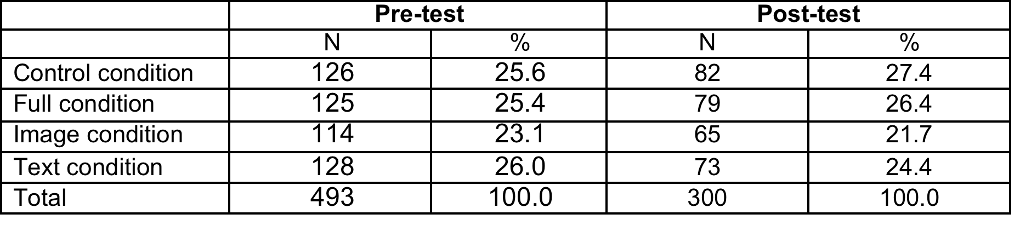
Participants
1st y. French-speaking bachelor students
Modern Languages + social and political sciences
Pre-test: N = 493
Post-test: N = 300

Slide 21
Results
Free description task
  Linguistic analysis
  Political science analysis

Slide 22
Results
Free description task
  Linguistic analysis
  Political science analysis

Slide 23
Results
General harvest
  Level of political knowledge
  Length of the description task
  Lexical influence of the input text
Image assocation analysis
Linguistic analysis
Political science analysis

Slide 24
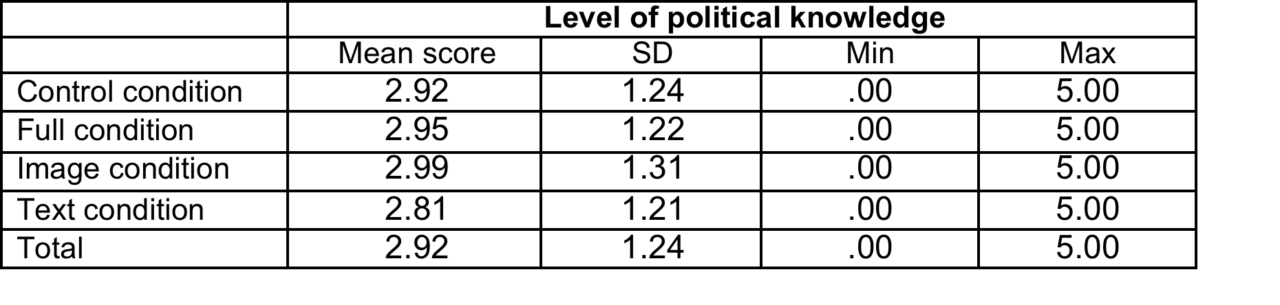
General harvest – Political knowledge
5 general questions about politics
One-way ANOVA:
  DV = score of political knowledge
  IV = experimental condition
  No statistically significant differences between the groups: (F_{(3.479)}= .411. p=.745)

Slide 25
(1) Level of political knowledge

Slide 26
Linguistic analysis
Linguistic analysis of the description task
  To what extent do the participants talk differently about Belgian federalism when having been exposed to the input material?
    1) Length of the productions
    2) Lexical influence of the experimental text
    3) Keyword analysis
    4) Corpus-based content analysis
Notes:
The descriptions of the participants’ perception of Belgian federalism have been analysed using different quantitative and qualitative techniques. Among the quantitative techniques we looked at the length of the productions (4.2.1), at the lexical influence of the experimental text (4.2.2) and performed a keyword analysis (4.2.3). Finally, we conducted a corpus-based content analysis of the participants’ productions (4.2.4).

Slide 27
Linguistic analysis
Free description task
Linguistic analysis
    1) Length of the productions
    2) Lexical influence of the experimental text
    3) Keyword analysis
    4) Corpus-based content analysis
Notes:
The descriptions of the participants’ perception of Belgian federalism have been analysed using different quantitative and qualitative techniques. Among the quantitative techniques we looked at the length of the productions (4.2.1), at the lexical influence of the experimental text (4.2.2) and performed a keyword analysis (4.2.3). Finally, we conducted a corpus-based content analysis of the participants’ productions (4.2.4).

Slide 28
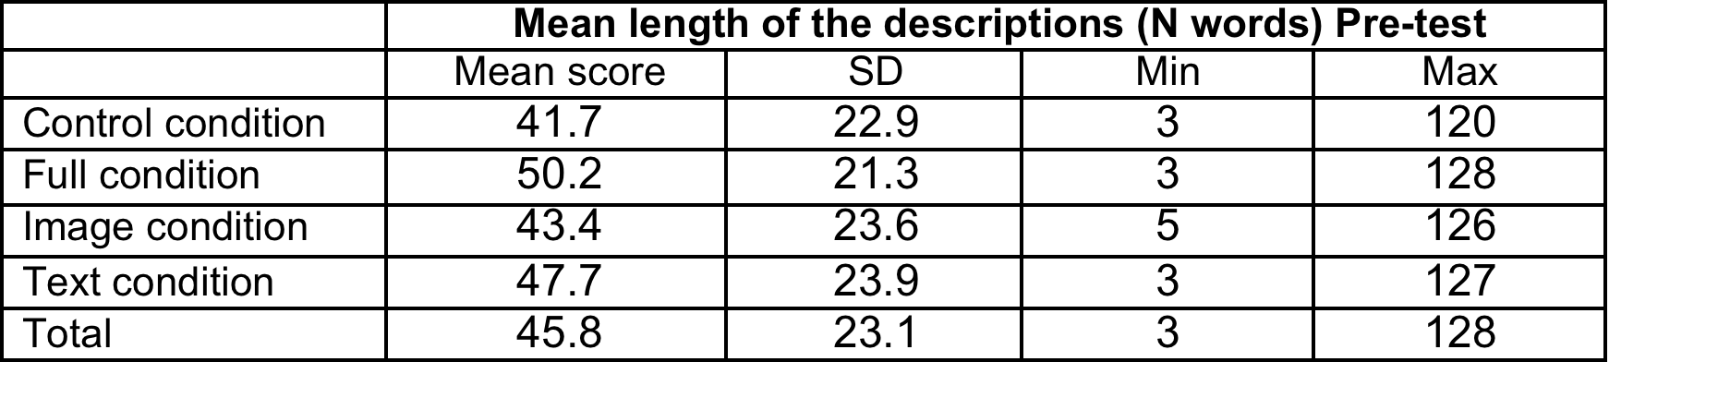
General harvest – Free description task
(pre-test)
Mean length (in terms of number of words) Linear trend: no input < visual input < textual input < visual and textual input
One-way ANOVA:
  Statistically significant differences between the groups: (F_{(3.489)}=3.652. p < .05)
Notes:
These results point to a linear trend suggesting that the participants who have been exposed to more visual and textual material tend to produce longer descriptions (no input < visual input < textual input < visual and textual input). Which is statistically significant.
A one-way ANOVA with the description length as dependent variable and the experimental condition as independent variable confirms that this tendency is significant (F_{(3.489)}=3.652. p < .05). Further post-hoc analyses however suggest that only the difference between the control condition and the full condition is significant (p < .05). Interestingly, this effect disappears in the post-test (Table 6). Though the participants from the full condition still produce longer descriptions, the differences in description length between the different experimental groups are not significant (F_{(3.295)}=.346. p=.792). Further post-hoc analyses do not reveal any significant differences either.

Slide 29
(2) Length of descriptions (pre-test)
Notes:
These results point to a linear trend suggesting that the participants who have been exposed to more visual and textual material tend to produce longer descriptions (no input < visual input < textual input < visual and textual input). Which is statistically significant.
A one-way ANOVA with the description length as dependent variable and the experimental condition as independent variable confirms that this tendency is significant (F_{(3.489)}=3.652. p < .05). Further post-hoc analyses however suggest that only the difference between the control condition and the full condition is significant (p < .05). Interestingly, this effect disappears in the post-test (Table 6). Though the participants from the full condition still produce longer descriptions, the differences in description length between the different experimental groups are not significant (F_{(3.295)}=.346. p=.792). Further post-hoc analyses do not reveal any significant differences either.

Slide 30
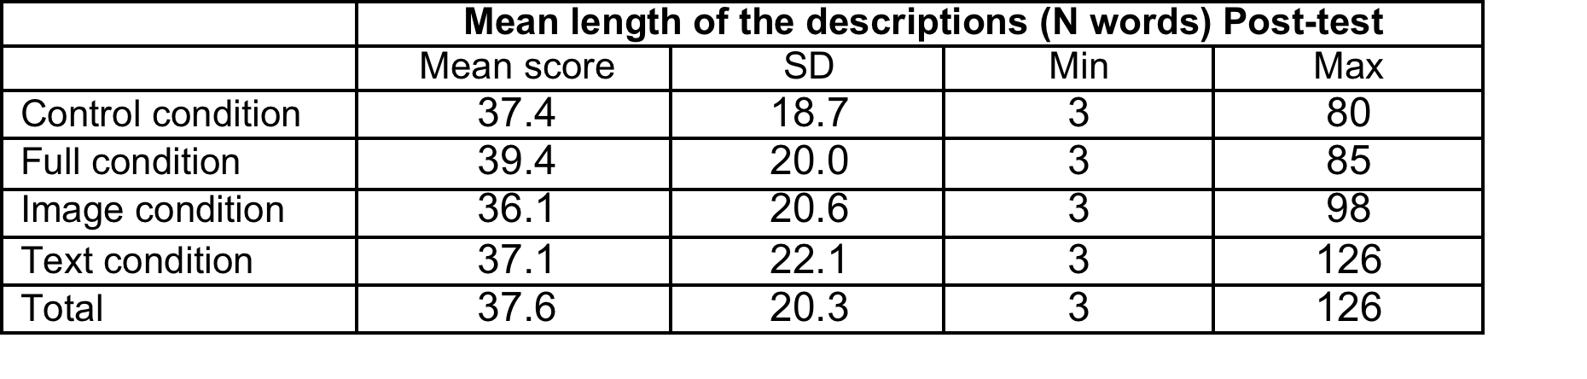
General harvest – Free description task
(post-test)
No effect anymore between groups
  One-way ANOVA: (F_{(3.295)}=.346. p=.792)
Mean length decreases
  Effect is globally significant: (t_{(1,299)}=7.833, p < .0001)
  Paired t-test: indicate this decreasing tendency is significant for all the conditions as well
Notes:
It can further be observed that the mean length of the descriptions decreases in the post-test, suggesting the influence of the input material does not last in time. This effect is globally significant (t_{(1,299)}=7.833, p < .0001). Further paired t-test analyses indicate this decreasing tendency is significant for all the conditions as well (control condition: t_{(1,81)}=3.316, p < .001, full condition: t_{(1,78)}=4.087, p < .0001, image condition: t_{(1,64)}= 3.125, p < .005, text condition: t_{(1,72)}=5.082, p < .0001).
These tendencies can be explained by the absence of input material but also probably by a more mundane reason: it was the second time that the respondents had to perform the free description task. Regardless of the experimental condition, respondents’ fatigue is thus likely to explain that the mean length of the post-test productions (for each experimental condition) remains lower than the mean length of the productions by the control group in the pre-test.

Slide 31
(2) Length of descriptions (pre+post)
Notes:
It can further be observed that the mean length of the descriptions decreases in the post-test, suggesting the influence of the input material does not last in time. This effect is globally significant (t_{(1,299)}=7.833, p < .0001). Further paired t-test analyses indicate this decreasing tendency is significant for all the conditions as well (control condition: t_{(1,81)}=3.316, p < .001, full condition: t_{(1,78)}=4.087, p < .0001, image condition: t_{(1,64)}= 3.125, p < .005, text condition: t_{(1,72)}=5.082, p < .0001). These tendencies can be explained by the absence of input material but also probably by a more mundane reason: it was the second time that the respondents had to perform the free description task. Regardless of the experimental condition, respondents’ fatigue is thus likely to explain that the mean length of the post-test productions (for each experimental condition) remains lower than the mean length of the productions by the control group in the pre-test.

Slide 32
Linguistic analysis
Free description task
Linguistic analysis
    1) Length of the productions
    2) Lexical influence of the experimental text
    3) Keyword analysis
    4) Corpus-based content analysis
Notes:
A second dimension that might have an impact on the productions of the participants is the lexical influence of the input text. To measure this influence, we derived the degree of lexical overlap between the experimental text and the free descriptions by calculating the number of similar lexical items divided by the total number of words of the text. Though each experimental group shows a minimal degree of lexical overlap with the input text (even the groups that did not view it at all), the results suggest that the answers of the participants who were exposed to the input text (full condition and text condition) show a higher degree of lexical overlap with the input text.

Slide 33
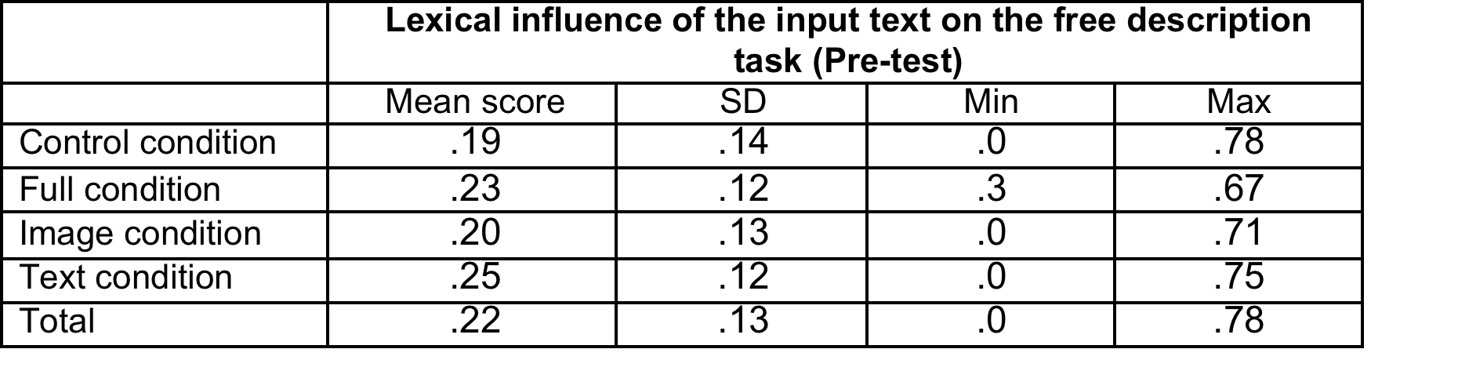
General harvest – Lexical influence
(pre-test)
Lexical overlap between the experimental text and the free descriptions
  N. of similar lexical items / Total N. of words
One-way ANOVA:
  Statistically significant differences between the groups: (F_{(3,489)}= 6.502, p < .001)
Notes:
A second dimension that might have an impact on the productions of the participants is the lexical influence of the input text. To measure this influence, we derived the degree of lexical overlap between the experimental text and the free descriptions by calculating the number of similar lexical items divided by the total number of words of the text. Though each experimental group shows a minimal degree of lexical overlap with the input text (even the groups that did not view it at all), the results suggest that the answers of the participants who were exposed to the input text (full condition and text condition) show a higher degree of lexical overlap with the input text.

Slide 34
(3) Lexical influence of the input (pre)
Notes:
A one-way ANOVA with the degree of lexical overlap as dependent variable and the experimental conditions as independent variable confirms that this lexical impact of the input text on the answers of the participants is significant (F_{(3,489)}= 6.502, p < .001), confirming that reading the text does have an influence on the participants’ descriptions. Further post-hoc comparisons show that only the differences between the control condition and the text condition, on the one hand, and between the image condition and the text condition, on the other hand, are significant (respectively p < .001 and p < .01). This lexical influence of the text disappears in the post-test however, as suggested by Table 8. This tendency is confirmed by a one-way ANOVA with the degree of lexical overlap as dependent variable and the experimental conditions as independent variable (F_{(3,295)}= .922, p=.430.).

Slide 35
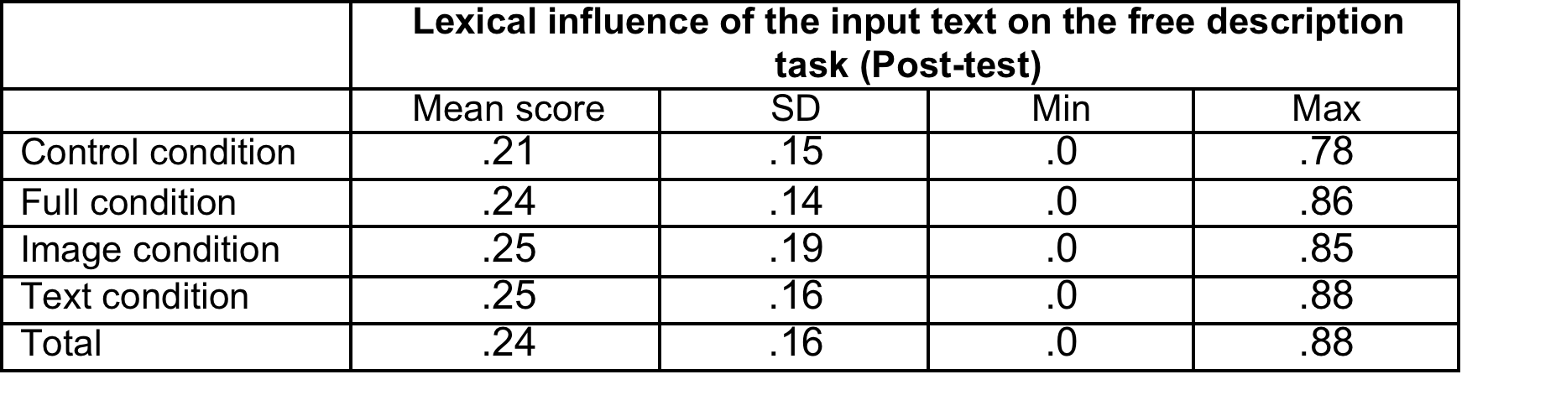
General harvest – Lexical influence
(post-test)
Lexical influence of the text disappears in the post-test
One-way ANOVA:
  No statistically significant differences between the group anymore: (F_{(3,295)}= .922, p=.430.)
Notes:
Although the input text appears to lexically influence the descriptions of the participants in the pre-test, it should be noted that the mean lexical coverage of the text remains relatively low. This suggests that the participants did not merely reproduce the textual information, but rather that the text contained words which are typical of political language in general. This interpretation seems to be confirmed by the lexical coverage observed in the post-test, which turns out to be higher for each experimental condition, even though the participants were not submitted to any form of input material at this stage of the experiment.

Slide 36
(4) Lexical influence of the input (pre+ post)
Notes:
Although the input text appears to lexically influence the descriptions of the participants in the pre-test, it should be noted that the mean lexical coverage of the text remains relatively low. This suggests that the participants did not merely reproduce the textual information, but rather that the text contained words which are typical of political language in general. This interpretation seems to be confirmed by the lexical coverage observed in the post-test, which turns out to be higher for each experimental condition, even though the participants were not submitted to any form of input material at this stage of the experiment.

Slide 37
Linguistic analysis
Free description task
Linguistic analysis
    1) Length of the productions
    2) Lexical influence of the experimental text
    3) Keyword analysis
    4) Corpus-based content analysis
Notes:
Keyword analysis is a standard function of the software Wordsmith Tools 6 (Scott 2012), aiming at comparing two text corpora and extracting the lexical items that are prominently present in one of the corpus in comparison to the other. In order to determine to what extent the participants that had been exposed to input material talked differently about Belgian federalism, various keyword analyses have been performed using the control condition corpus as reference corpus. The results of these analyses are summarized in the tables 10 to 12 for the pre-test descriptions and tables 13 to 15 for the post-test descriptions.
The blue-printed words are the words that are significantly more frequent in the reference corpus (control condition corpus). The red-printed words are the words that are significantly more frequent in the corpora that were compared to it (respectively the full condition corpus in table 10, the image condition corpus in table 11 and the text condition corpus in table 12). The level of significance has been calculated on the basis of log-likelihood ratio and has been set at 0.05.

Slide 38
Linguistic analysis
Deconstructing the Tetris
  Tetris is a game
  Tetris is a puzzle game // complexity of the system
  Tetris includes levels (// federal entities) and blocks (// competences) moving between the different levels => construction domain
    Construction of the lower level
    Deconstruction of the upper level

Slide 39
Linguistic analysis
Deconstructing the Tetris?
Small-scale experiment to verify these implications among 86 citizens
Opinion on 8 statements (Likert-scale)

Slide 40
(1) Belgian federalism is like a Tetris game, it’s a building including different levels (=different state entities) ;
(2) Belgian federalism is like a Tetris game, the federal entities are constructed step by step.
(3) Belgian federalism is like a Tetris game, it’s constructed by moving blocks (=competences) from one level to the other.
(4) Belgian federalism is like a Tetris game, each block has to find its right place.
(5) Belgian federalism is like a Tetris game, the construction of the lower level implies the deconstruction of the higher level.
(6) Belgian federalism is like a Tetris game, it’s a competition between different players (=state entities)
(7) Belgian federalism is like a Tetris game, it’s a game you can’t win.
(8) Belgian federalism is like a Tetris game, it’s a complex system requesting a lot of thinking to work properly.

Slide 41
(1) Belgian federalism is like a Tetris game, it’s a building including different levels (=different state entities) ;
(2) Belgian federalism is like a Tetris game, the federal entities are constructed step by step.
(3) Belgian federalism is like a Tetris game, it’s constructed by moving blocks (=competences) from one level to the other.
(4) Belgian federalism is like a Tetris game, each block has to find its right place.
(5) Belgian federalism is like a Tetris game, the construction of the lower level implies the deconstruction of the higher level.
(6) Belgian federalism is like a Tetris game, it’s a competition between different players (=state entities)
(7) Belgian federalism is like a Tetris game, it’s a game you can’t win.
(8) Belgian federalism is like a Tetris game, it’s a complex system requesting a lot of thinking to work properly.

Slide 42
(1) Belgian federalism is like a Tetris game, it’s a building including different levels (=different state entities) ;
(2) Belgian federalism is like a Tetris game, the federal entities are constructed step by step.
(3) Belgian federalism is like a Tetris game, it’s constructed by moving blocks (=competences) from one level to the other.
(4) Belgian federalism is like a Tetris game, each block has to find its right place.
(5) Belgian federalism is like a Tetris game, the construction of the lower level implies the deconstruction of the higher level.
(6) Belgian federalism is like a Tetris game, it’s a competition between different players (=state entities)
(7) Belgian federalism is like a Tetris game, it’s a game you can’t win.
(8) Belgian federalism is like a Tetris game, it’s a complex system requesting a lot of thinking to work properly.

Slide 43
(1) Belgian federalism is like a Tetris game, it’s a building including different levels (=different state entities) ;
(2) Belgian federalism is like a Tetris game, the federal entities are constructed step by step.
(3) Belgian federalism is like a Tetris game, it’s constructed by moving blocks (=competences) from one level to the other.
(4) Belgian federalism is like a Tetris game, each block has to find its right place.
(5) Belgian federalism is like a Tetris game, the construction of the lower level implies the deconstruction of the higher level.
(6) Belgian federalism is like a Tetris game, it’s a competition between different players (=state entities)
(7) Belgian federalism is like a Tetris game, it’s a game you can’t win.
(8) Belgian federalism is like a Tetris game, it’s a complex system requesting a lot of thinking to work properly.

Slide 44
Deconstructing the Tetris
***
***

Slide 45
Linguistic analysis
Deconstructing the Tetris
  Low probability that the citizens highligh the game dimension of the Tetris metaphor
  Higher probability that people make sense of it in terms of comlexity or construction

Slide 46
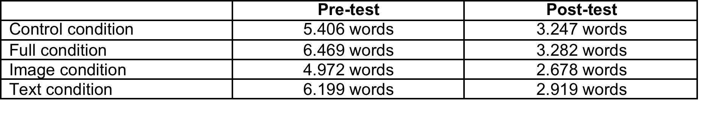
Linguistic analysis
Keyword and domain analysis
  8 sub-corpora
Notes:
We collected the anwers of the particpants from the different xp conditions and concatenated them into 8 different subcorpora and then perfomed 2 kinds of analyses
Keyword analysis is a standard function of the software Wordsmith Tools 6 (Scott 2012), aiming at comparing two text corpora and extracting the lexical items that are prominently present in one of the corpus in comparison to the other. In order to determine to what extent the participants that had been exposed to input material talked differently about Belgian federalism, various keyword analyses have been performed using the control condition corpus as reference corpus. The results of these analyses are summarized in the tables 10 to 12 for the pre-test descriptions and tables 13 to 15 for the post-test descriptions.
The blue-printed words are the words that are significantly more frequent in the reference corpus (control condition corpus). The red-printed words are the words that are significantly more frequent in the corpora that were compared to it (respectively the full condition corpus in table 10, the image condition corpus in table 11 and the text condition corpus in table 12). The level of significance has been calculated on the basis of log-likelihood ratio and has been set at 0.05.

Slide 47
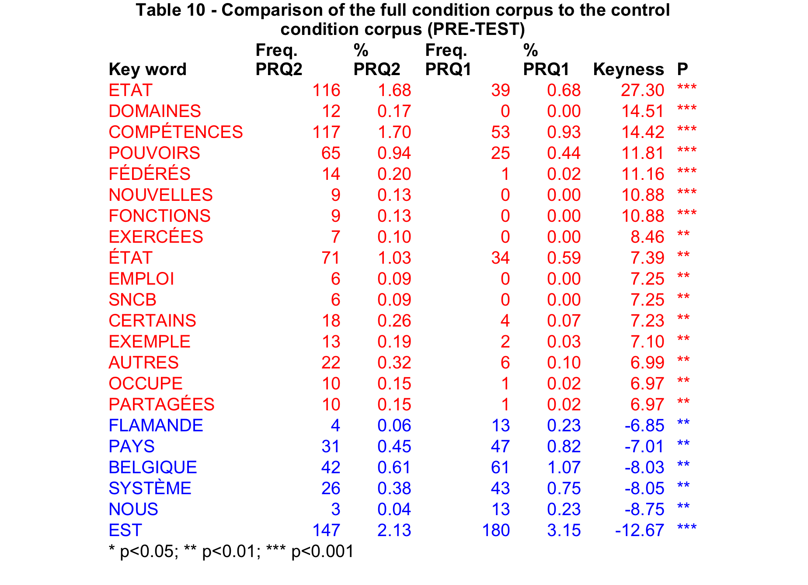
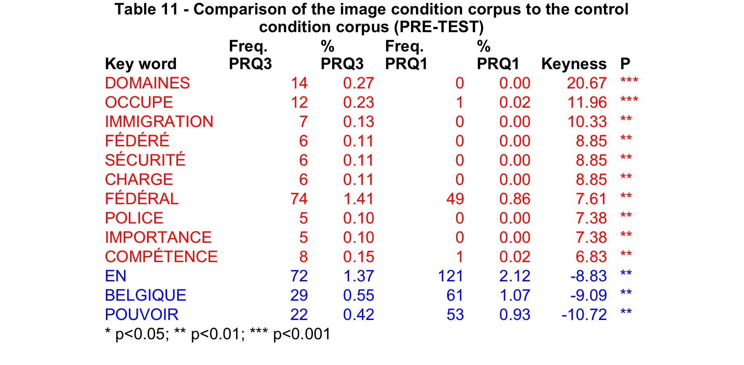
Keyword analysis (pre-test)
* p < .05, ** p < .01; *** p < .001
Notes:
Keyword analysis performed using Worsmith tools (corpus processor software)

Slide 48
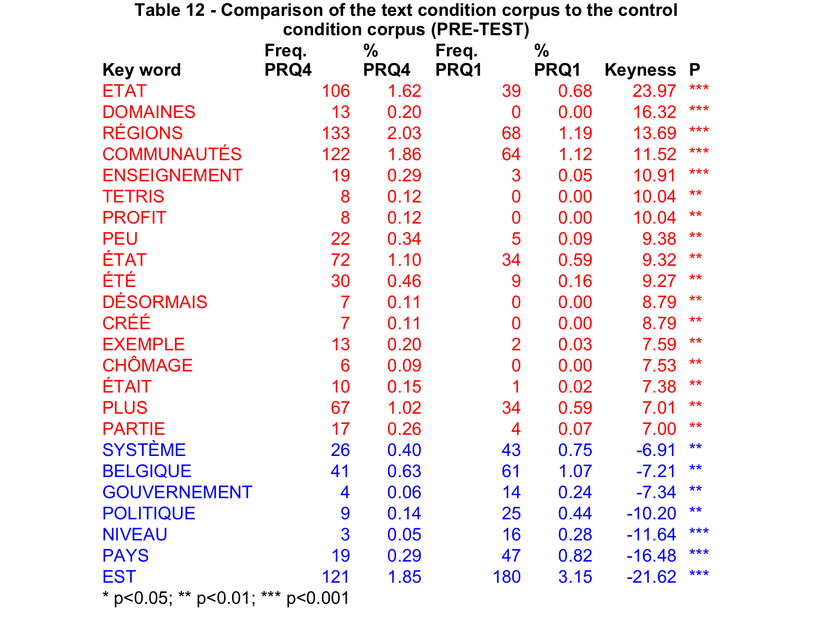
Keyword analysis (pre-test)
* p < .05, ** p < .01; *** p < .001

Slide 49
Keyword analysis
Control condition
  System, Belgium, government, country
Experimental conditions
  Competences, domains
  Text & full conditions
    State, region, communities, federal, Tetris
Notes:
The results of the keyword analyses suggest that the exposure to the input material, be it the textual material, the visual material or both, tend to significantly use different words in their own descriptions of Belgian federalism. However, more fine-grained analysis might suggest that the diverging nature of their descriptions is directly related to the type of material they have been exposed to (furhter work).

Slide 50
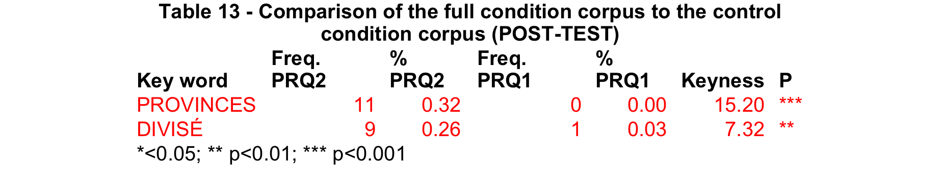
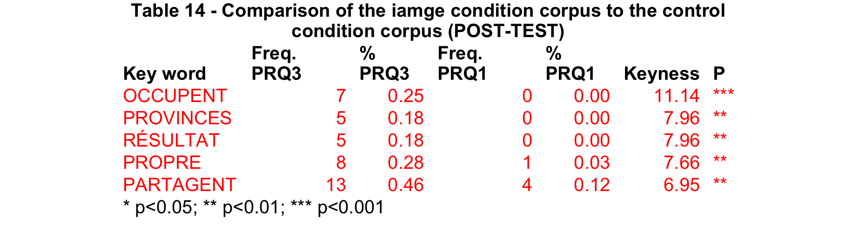
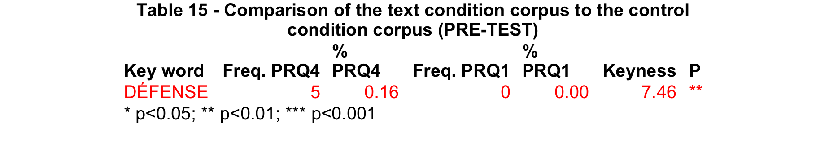
Keyword analysis (post-test)
* p < .05, ** p < .01; *** p < .001

Slide 51
Linguistic analysis
Free description task
Linguistic analysis
    1) Length of the productions
    2) Lexical influence of the experimental text
    3) Keyword analysis
    4) Corpus-based content analysis
Notes:
The results of the keyword analyses suggest that the exposure to the input material leads to a significantly different use of words. However, in order to qualify the more specific influence of the Tetris metaphor, we wanted to assess to what extent exposure to this metaphor might lead the participants to differently frame their description of Belgian federalism. To this end, we performed a semi-automatic content analysis based on the possible interpretations of the Tetris metaphor discussed in section 3.2 above.

Slide 52
Linguistic analysis
Domain analysis
  Different framing of the descriptions?
  Deconstructing the Tetris
    Tetris is a game
    Tetris is a puzzle game // complexity of the system
    Tetris includes levels (// federal entities) and blocks (// competences) moving between the different levels => construction domain
      Construction of the lower level
      Deconstruction of the upper level
Notes:
Firstly, Tetris is a game, and more specifically a puzzle game. Applied to the domain of politics, this mapping highlights to notion of complexity of the system. More specifically, it is complicated to get the right blocks (in this case the different federal state competences) at the right place (in this case the different substate entities).
When concentrating on the game’s scenario, we can consequently identify different levels, referring to the different federal entities, and different blocks, e.g. the competences, moving down from the higher level (federal government) to the lower level (the regional and community governments). These notions of blocks and levels relates to the conceptual domain of construction, which is reinforced by the fact the combination of the blocks at the lower level visually leads to the construction of a building. When applying this idea of construction to Belgian federalism, some more specific entailments can be derived, namely (i) the fact that the construction process only concerns the lower level, which, when transposed to Belgian federalism, suggest that the construction process is limited to the substate entities, and following from this, (ii) the idea that the construction of the substate entities occurs at the expense of the federal state, which is falling apart (or losing blocks). Besides these two main interpretations, some more specific entailments could be indirectly derived, such as (iii) the fact that it is impossible to win this game, suggesting that further federalization of the state is somehow an inevitable process; and (iv) the fact that this process is unidirectional and non-reversible (from the higher level to the lower level), whereas in the framework of the Belgian federal system, the reverse movement is possible, e.g. moving competences from the lower level to the higher level (known as a re-federalization process in Belgian terms)

Slide 53
Linguistic analysis
Domain analysis
  Different framing of the descriptions?
  Defining onomasiological profiles of 5 domains related to the Tetris metaphor (Unitex)
    Game domain
    Complexity domain
    Construction domain
    Deconstruction domain
    Transfer domain
Notes:
For each possible interpretation of the metaphor (respectively game, construction, deconstruction, transfer and complexity), we firstly designed an onomasiological profile, e.g. a list of lexical items possibly corresponding to a possible interpretation. It should be noted that these lists of lexical items have been designed in a subjective fashion, by collecting relevant lexical items from the descriptions of the participants and expanding them with possible synonyms and derivative forms It should be noted that the deconstruction interpretation of the metaphor does not only refer the idea of deconstruction of the federal state, but by extension, also to the notion of splitting the country.
Using the corpus processor Unitex, we subsequently calculated the frequency of each profile by running concordance analyses. The resulting concordances have then been manually disambiguated by suppressing possible duplicates and checking that each concordance matched the original interpretation of the metaphor (see Table 16 for some This stage has been performed independently by both authors. Problematic cases have been further discussed to come to an agreement.
The difference between the deconstruction and the transfer interpretation relates to the perspective from which the citizen tends to regard the further federalization process. In the case of the transfer interpretation, the participants tend to describe this federalization process from a neutral perspective, whereas in the deconstruction interpretation, they tend to express a negative opinion about it.

Slide 54
Onomasiological profiles
Game domain
  Tetris, puzzle, labyrinth, rule, tactic, match, competition, winner, loser, win, lose, participant, play, game,…
Complexity domain
  Complex, difficulty, puzzle, brain-teaser, reflection…
Construction domain
  Building, level, block, foundation, structure,…
Deconstruction domain
  Deconstruction, destruction, dividing, demolition, cutting-up,…
Transfer domain
  Passing, transition, repartition, going from … to …, …
Notes:
For each possible interpretation of the metaphor (respectively game, construction, deconstruction, transfer and complexity), we firstly designed an onomasiological profile, e.g. a list of lexical items possibly corresponding to a possible interpretation. It should be noted that these lists of lexical items have been designed in a subjective fashion, by collecting relevant lexical items from the descriptions of the participants and expanding them with possible synonyms and derivative forms It should be noted that the deconstruction interpretation of the metaphor does not only refer the idea of deconstruction of the federal state, but by extension, also to the notion of splitting the country.
Using the corpus processor Unitex, we subsequently calculated the frequency of each profile by running concordance analyses. The resulting concordances have then been manually disambiguated by suppressing possible duplicates and checking that each concordance matched the original interpretation of the metaphor (see Table 16 for some This stage has been performed independently by both authors. Problematic cases have been further discussed to come to an agreement.
The difference between the deconstruction and the transfer interpretation relates to the perspective from which the citizen tends to regard the further federalization process. In the case of the transfer interpretation, the participants tend to describe this federalization process from a neutral perspective, whereas in the deconstruction interpretation, they tend to express a negative opinion about it.

Slide 55
Onomasiological profiles
Fields | Expressions | Examples
Game | case (‘square’), compétition (‘competition’), défaite (‘defeat’), gagner (‘win’), jeu (‘game’), jouer (‘play’), joueur (‘player’), match (‘match’), participant (‘participant’), participer (‘participate’), perdant (‘loser’), perdre (‘loose’), pion (‘pawn’), puzzle (‘jigsaw’), règle (‘rule’), stratégie (‘strategy’), tactique (‘tactics’), Tetris (‘Tetris’), vainqueur (‘winner’), victoire (‘victory’),… | Tel un jeu de Tétris, de plus en plus de pouvoirs (de différents types) sont légués au "bas de l'échelle" (Pre-test-full condition-071) (Like a Tetris game, more and more powers (of different types) are handed down to the ‘bottom of the ladder’) Dans le cas de du fédéralisme belge, l'Etat est en train de perdre de plus en plus de compétences. (Post-test-control condition-128) (In the case of the Belgian federalism, the State is losing more and more competences)
Com-plexity | casse-tête (‘headache’, ‘puzzle’), cogitation (‘cogitation’), complexe (‘complex’), complexifier (‘make more complex’), complication (‘complication’), complexité (‘complexity’), compliqué (‘complicated’), difficile (‘difficult’), difficulté (‘difficulty’), ne pas comprendre (‘not understand’), peu/pas compréhensible (‘little or not understandable’), problème (‘problem’), réflexion (‘thinking’),… | le partage des pouvoirs s'avère un peu chaotique et complexe à comprendre (Pre-test-image condition-086) (power-sharing turns out to be a bit chaotic and complex to understand) le fédéralisme belge manque parfois de logique et crée des problèmes car il y a 3 langues différentes (Post-test-control condition-070) (Belgian federalism is sometimes lacking logic and creating problems because there are three different languages)
Cons- truction | base (‘basis’), bâtiment (‘building’), bâtir (‘build’), bloc (‘block’), brique (‘brick’), chantier (‘construction site’), ciment (‘cement’), construction (‘construction’), construire (‘build’), créer (‘create’), échafaudage (‘scaffolding’), édifice (‘building’), étage (‘floor’), fondations (‘foundations’), immeuble (‘building’), maison (‘house’), niveau (‘level’), pilier (‘pilar’), stable (‘stable’), structure (‘structure’),… | Le fédéralisme à la belge est bancal car il repose sur des conflits communautaires (Pre-test-text condition-120) (Belgian federalism is shaky since it is relying on community conflicts) Le fédéralisme en Belgique est particulier. Il s'est construit au fur et à mesure des revendications émises par les deux communautés. (Post-test-control condition-117) Federalism in Belgium is peculiar. It is constructing itself depending on the demands voiced by the two communities)

Slide 56
Onomasiological profiles
Fields | Expressions | Examples
De-construction | abattre (‘pull down’, ‘destroy’), clivage (‘divide’), décomposer (‘break down’), décomposition (‘decomposition’), déconstruction (‘deconstruction’), découper (‘divide’), découpage (‘division’), démolition (‘demolition’), démolir (‘demolish’), destruction (‘destruction’), détruire (‘destroy’), diviser (‘divide’), fracture (‘fracture’), morceler (‘divide ip’), scission (‘split’), séparation (‘separation’),… | On parle en Belgique de fédéralisme de dissociation ou de désagrégation, puisque la tendance est à l'autonomie plutôt qu'à la mise en commun. (Pre-test-image condition-045) (One speaks in Belgium of federalism of dissociation or of disagregation, since the tendency is for autonomy rather than for common-sharing) Chaque Réforme prélèvent compétences pour les attribuer au pouvoirs fédérés. Mais tout se décompose peu à peu en profit des autres pouvoirs. (Pre-test-text condition-111) (Each reform takes out competences in order to allocate them to the substate powers. But all is breaking down little by little to the benefit of the other powers)
Tran-sfer | attribuer (‘allocate’), confier (‘entrust’), déléguer (‘delegate’), délégation (‘delegation’), donner (‘give’), distribuer (‘’allocate’’), obtenir (‘obtain’), passer de … à … (‘pass on to’), recevoir (‘get’), redistribuer (‘reallocate’), répartir (‘share out’), répartition (‘sharing out’),… | Le pouvoir qu'elles reçoivent est pris à l'Etat fédéral pour ainsi le donner aux communautés et regions (Pre-test-full condition-003) (The power they receive is taken from the federal State in order to give it to communities and regions) une forme de fonctionnement d'un Etat où certaines compétences sont gérées par l'ensemble du pays alors que d'autres sont réparties par régions ou communautés (Post-test-text condition-013) (a form of functioning of a State where some competences are dealt with by the country altogether while others are distributed among regions or communities)

Slide 57
Domain analysis (pre)
***
*
***
**
Notes:
The results of the analyses for the pre-test (Table 17 and Figure 3) show that the participants from the different experimental conditions do indeed tend to stress different dimensions of Belgian federalism in their descriptions. Firstly, it turns out that the subjects who were submitted to the textual material tend to produce more utterances which relate to one of the possible interpretations of the Tetris metaphor (X²= 23.153, df = 3, p < .0001). This is even more strikingly the case for the participants from the text only condition than for the participants from the full condition. Secondly, it appears that the subjects who were exposed to the textual material (full condition and text condition) tend to significantly frame their descriptions around the notion of transfer of competences. To a lesser extent, both groups more frequently refer to the game domain. This tendency is mainly due to the explicit references to the notion of Tetris in the productions of the respondents from the full and text conditions. Interestingly these references to the game domain do not emerge in the descriptions of the subjects from the image condition. Thirdly, the subjects who were not exposed to the textual stimulus tend to behave similarly as well. For instance, they tend to highlight the complexity of the federal system significantly more frequently than the subjects who had been exposed to the textual input. Relating this observation to the high frequency of the notion of transfer of competence suggests that reading the text helps the subjects understand how Belgian federalism is working. Finally, the participants in the text condition also tend to emphasize the notion of deconstruction of the federal state.

Slide 58
Domain analysis (post)
**
Notes:
tendencies that were observed in the pre-test have disappeared. The participants from the different experimental conditions tend to behave similarly, considering that they refer as frequently to the game, complexity, deconstruction and transfer interpretations. This tendency however turns out to be different for construction, which appears significantly more prominently in the productions of the participants from the full condition than in the productions from the other conditions.

Slide 59
Linguistic analysis
Linguistic analysis of the description task
  To what extent do the participants talk differently about Belgian federalism when having been exposed to the input material?
  They do!
    In the pre-test condition
      Full condition & textual condition
        Longer descriptions
        Different words
        Different framing domains
      No impact of the image condition
    Not in the post-test condition
      Except for the construction domain (full condition)

Slide 60
Political science analysis
Free description task
What we know about metaphors in citizens’ discourses about Belgian federalism:
  Love relationship & Crazy machine
Free description task: “In ten lines and in your own words, we invite you to describe the Belgian federalism”
Each response was coded according to 32 variables, grouped along six dimensions:
  History, institutions, identities, languages, organization, nature of the federal

Slide 61
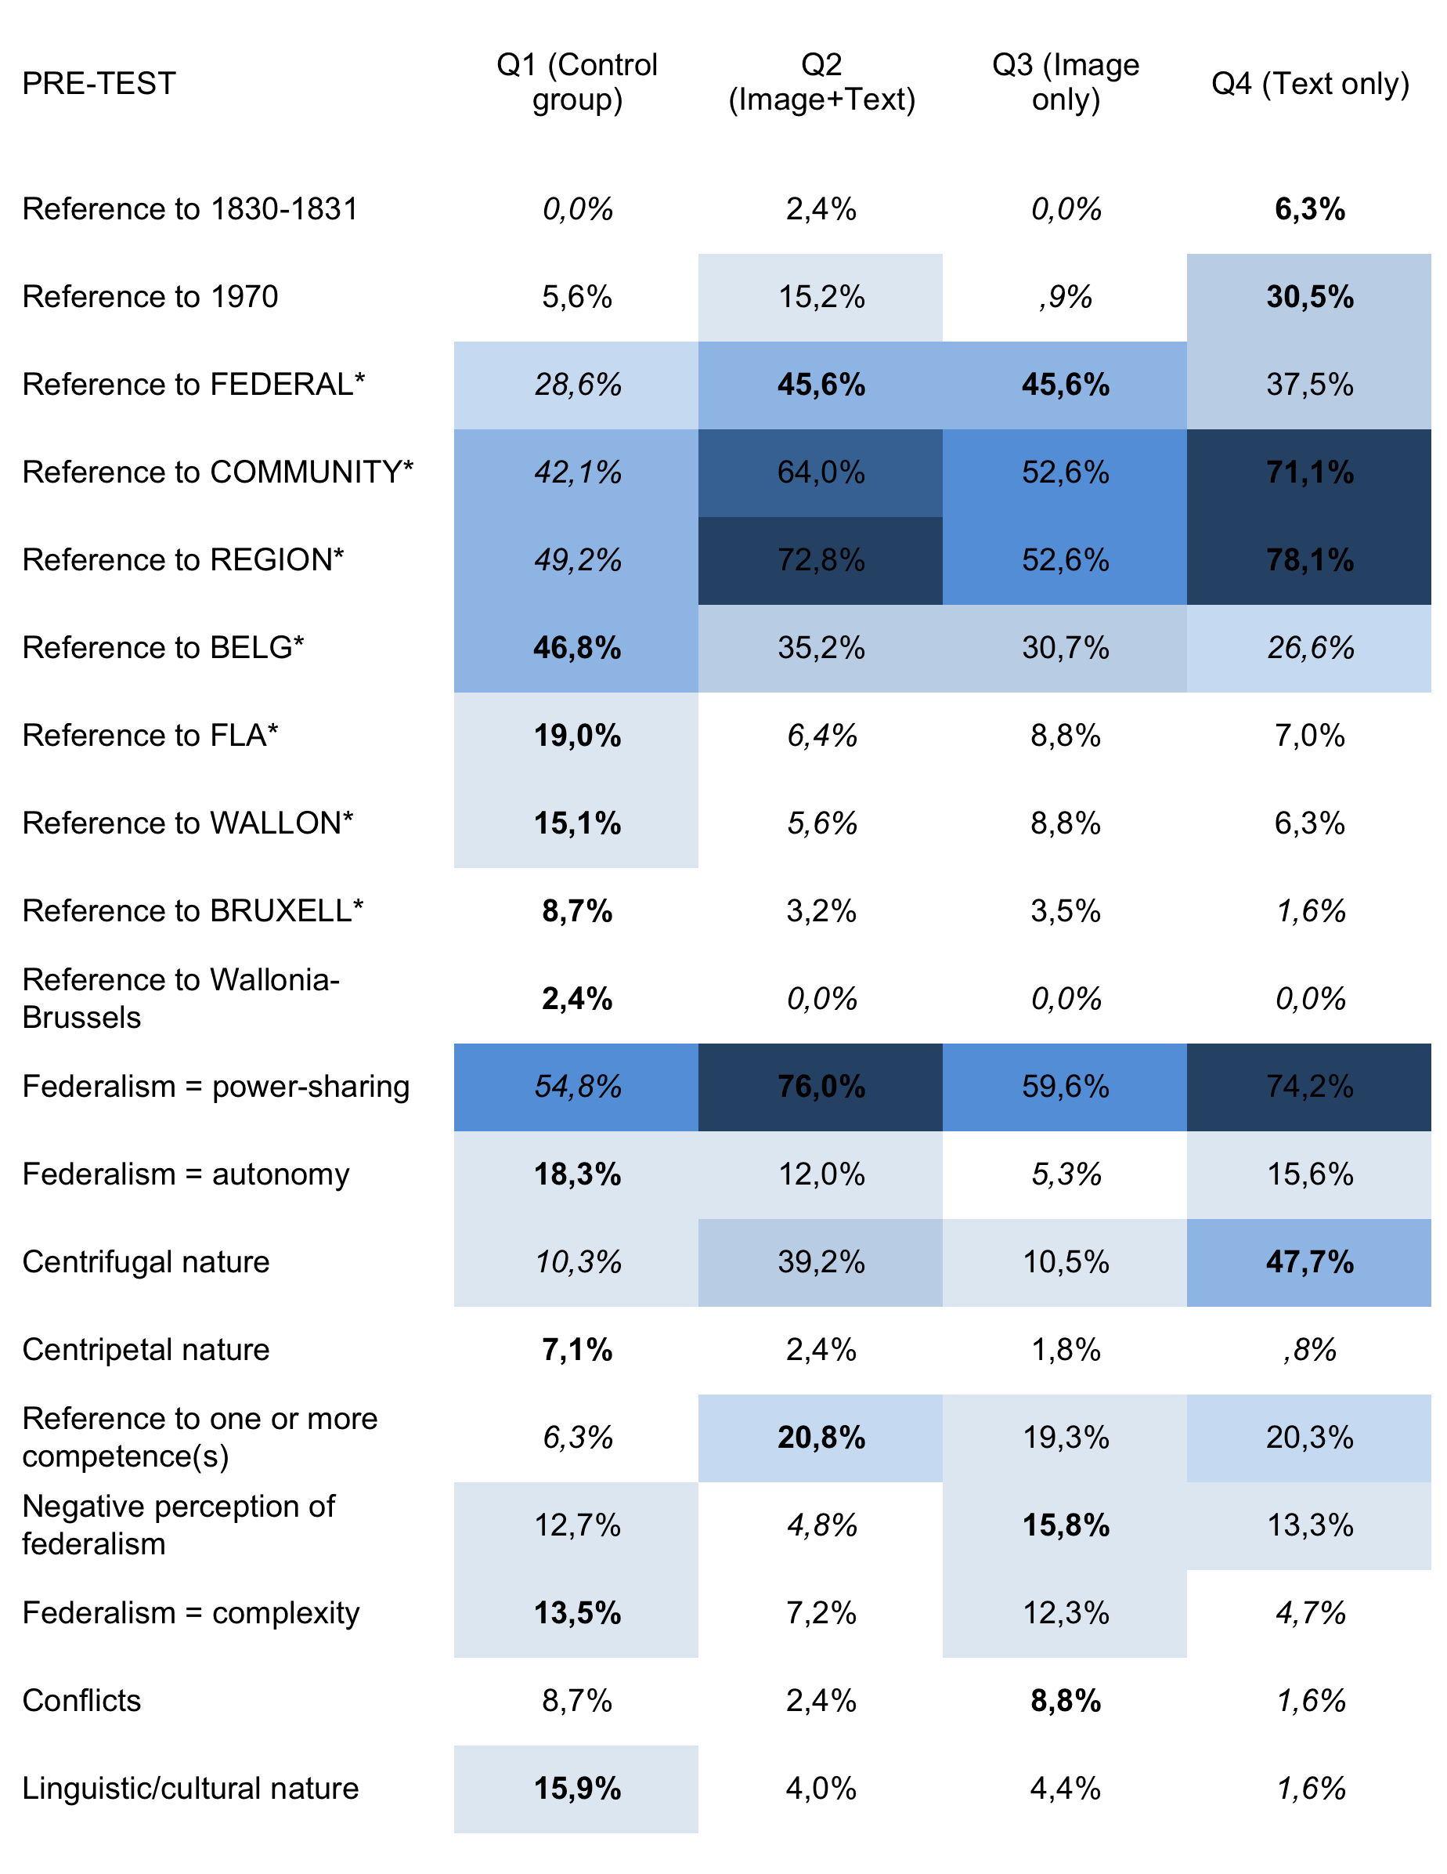
Political science analysis
Free description task (pre-test)

Slide 63
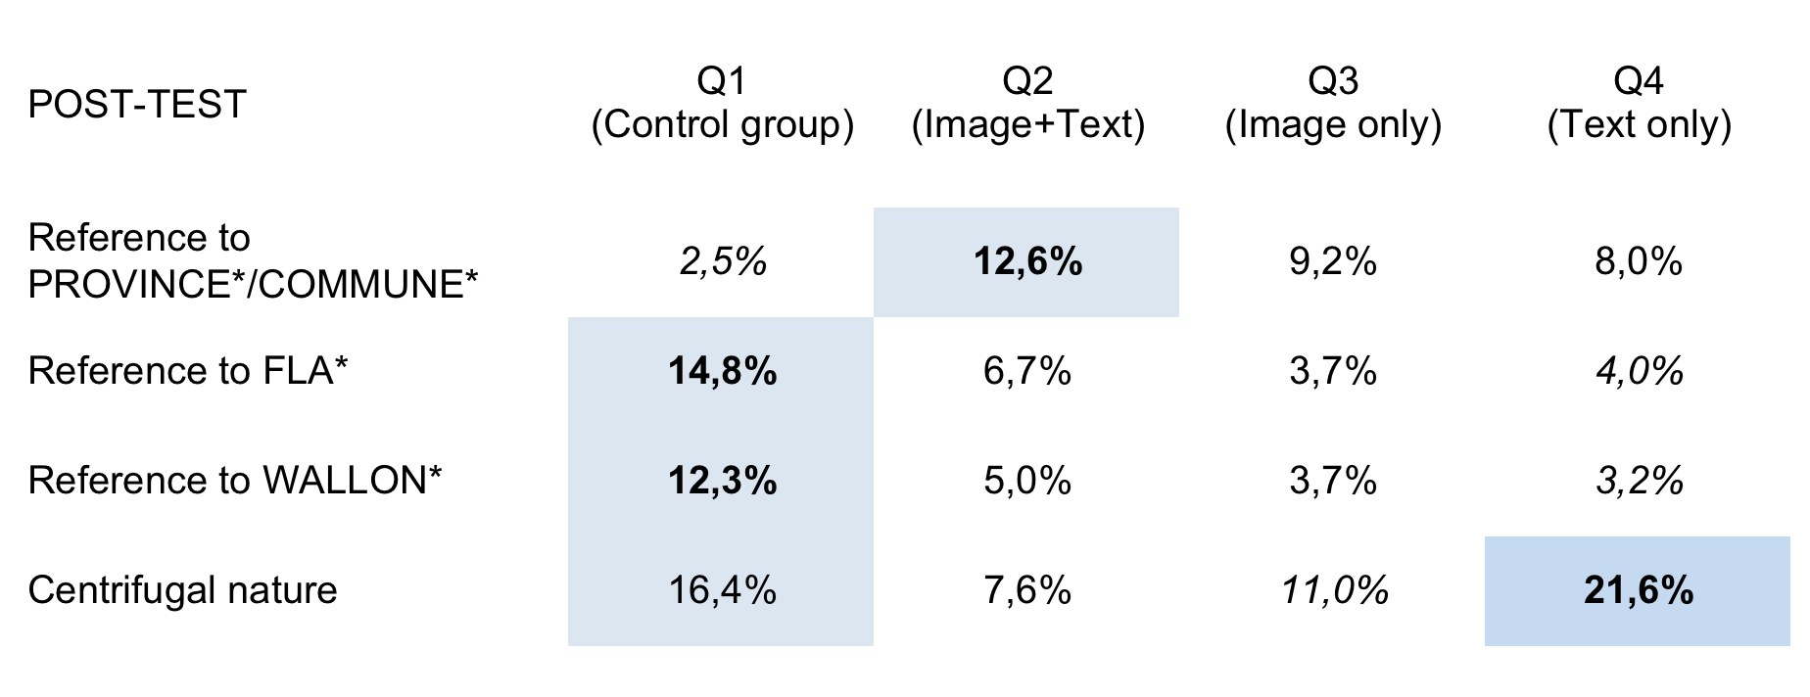
Political science analysis
Free description task (post-test)

Slide 64
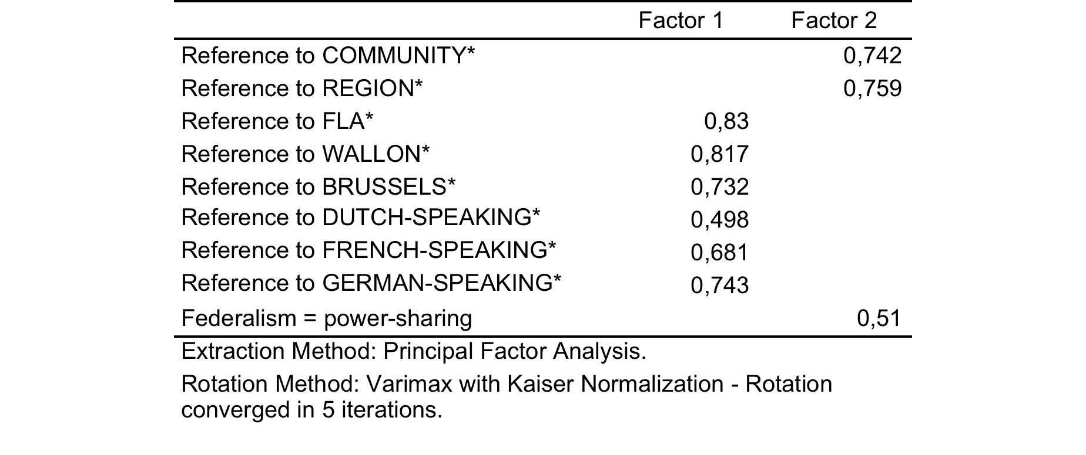
Political science analysis
Free description task – factor analysis
Finding: from an identity-loaded perspective to an institutions-based account
Need to check whether this is not a general pattern, regardless of the groups

Slide 65
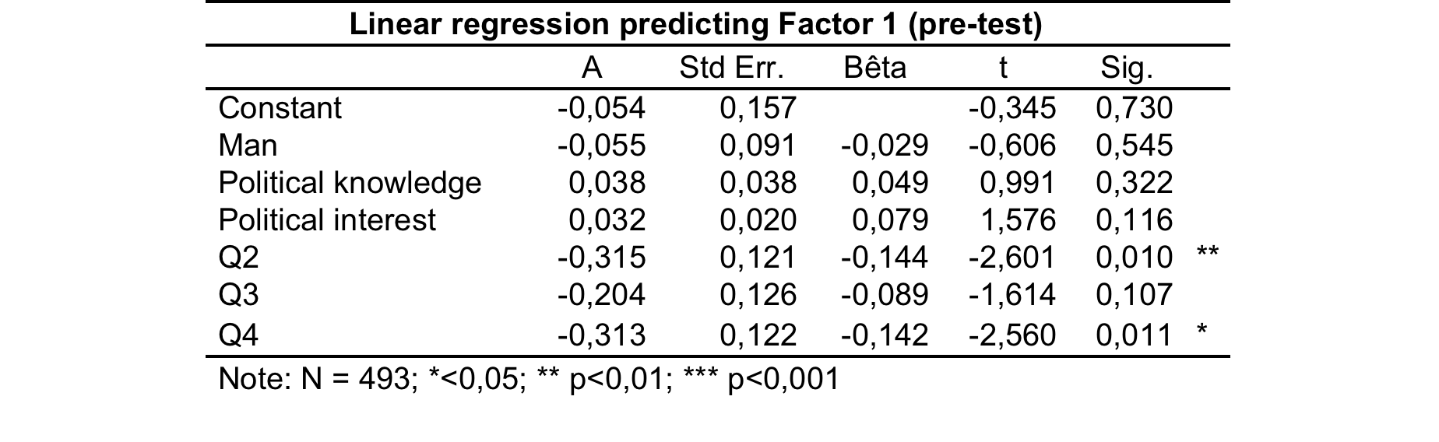
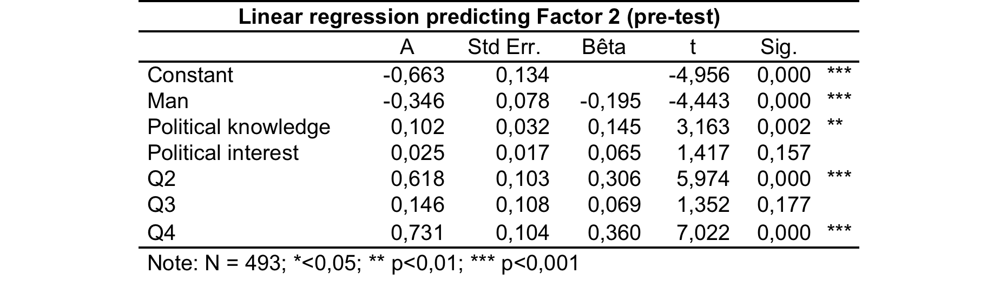
Political science analysis
Free description task – regression analysis

Slide 66
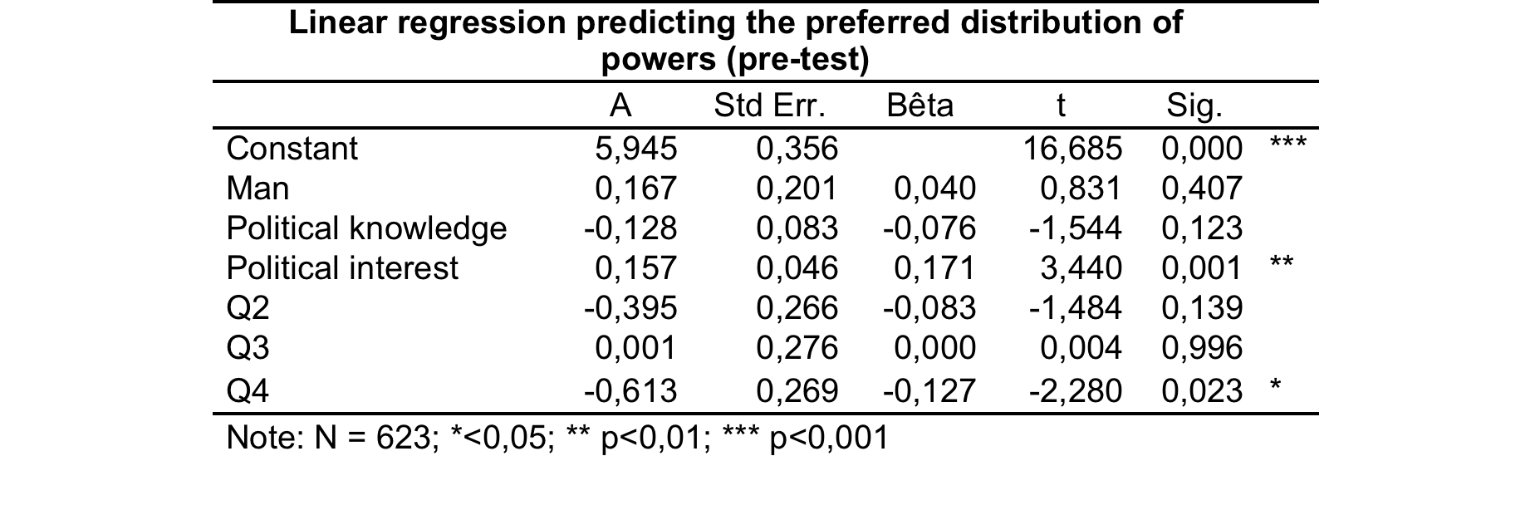
Political science analysis
Preferred distribution of powers
Key issue of Belgian federalism: the extent of the autonomy of the R. & C.
DV = scale from 0 to 10, where ‘0’ = all powers to the R. & C. and ‘10’ = all powers to the federal Authority

Slide 67
Discussion
Do metaphors have an impact?
  On the way people frame Belgian federalism
  On perception (picture task + description task)
  On opinion (question on autonomy)
Notes:
Textual material!

Slide 68
Results
Free description task
  Linguistic analysis
  Political science analysis
Image assocation analysis

Slide 69
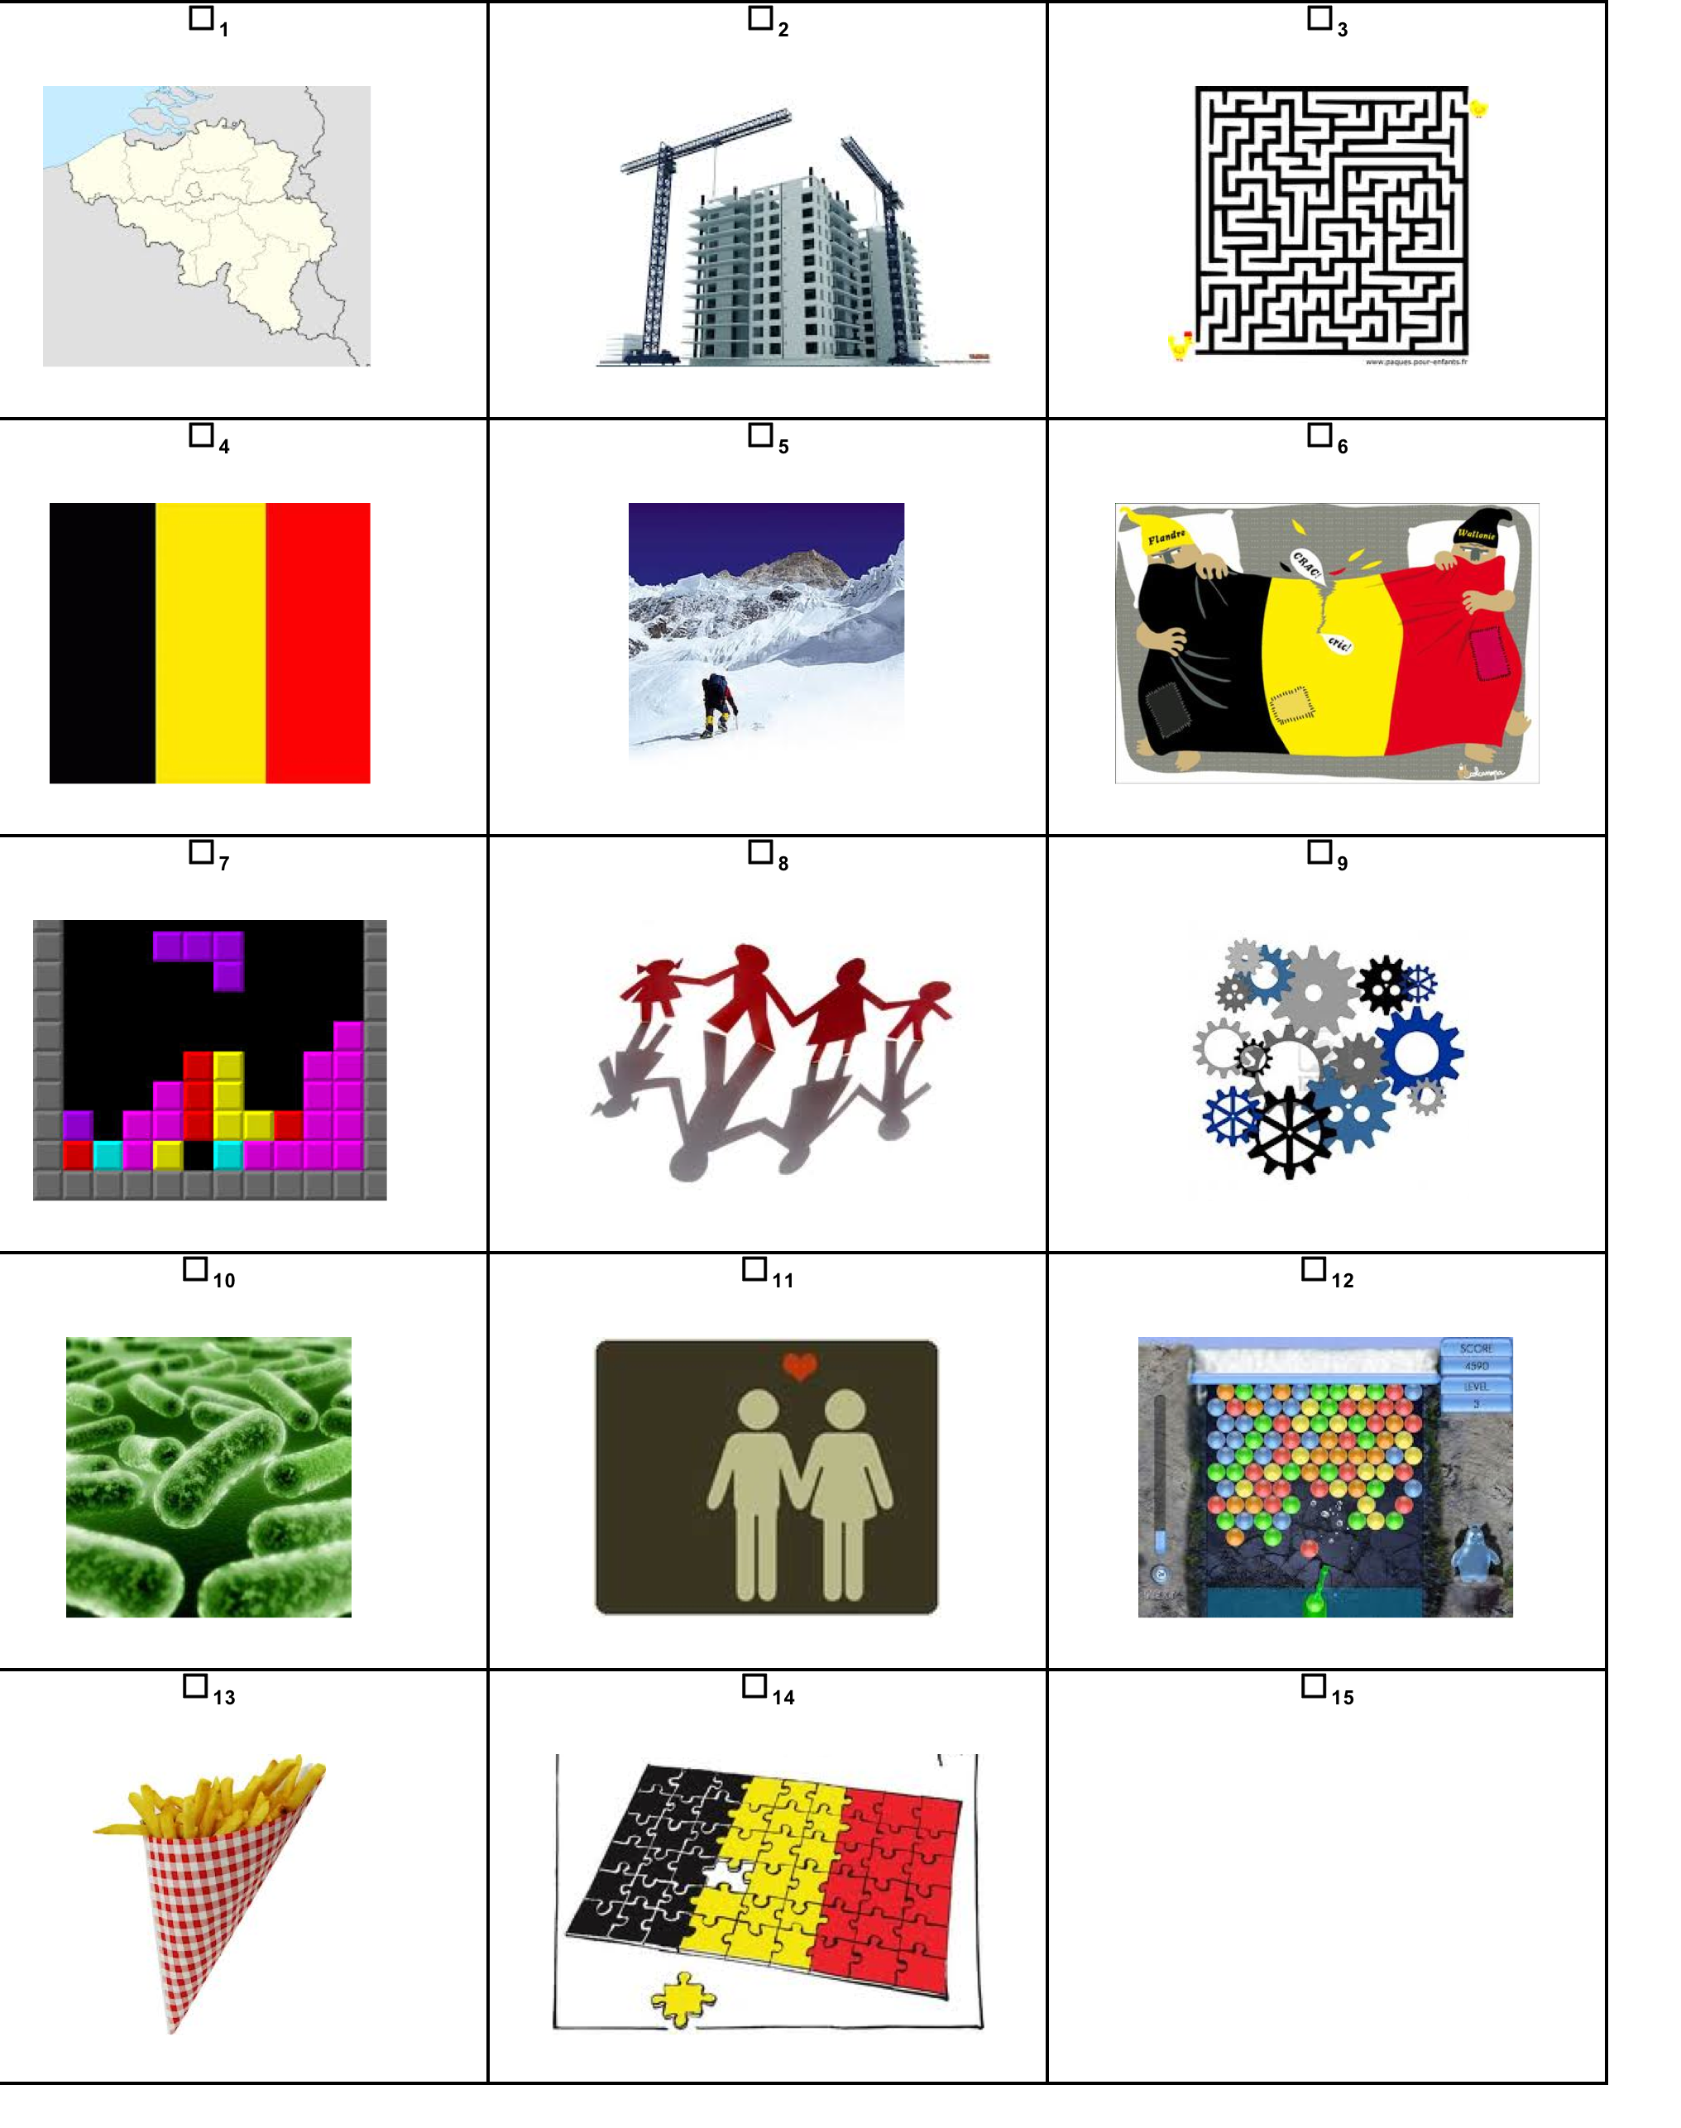
Images analysis – Set-up
Notes:
Some of them refer to classical source domains to describe poltiical systems, in particular belgian federalism (construction, divroce, familt, love relationshup, grames, amchine) other were meant as distractors (flags, french fries, the map of the country), and still others were related to the xp (tertsi, puzzle, )

Slide 70
Images analysis – Pre-test
Notes:
Control condition and Image condition tend to behave similarly & Text condition and full condition tend to behave similalry
Divorce image >< Tetris (interesting here, is that the people who have seen the image do not tend to pcik up the iamge if the Tetris
Jigsaw puzzle => emphasizing the complexity
Gears: mechanics (machine)
Beside the images of Tetris and divorce, an image that was also often chosen is the image of the jigsaw. Interestingly, this image is chosen by over 20% of the respondents in three groups: control condition, image condition and text condition but not in the full condition where only 10% of the respondents chose it. This difference is significant and seems to demonstrate that those who had the strongest treatment moved to other visual representations of Belgian federalism. The image of the Tetris is one of them (but then similarly to the text condition), but also the image of gears. Almost 20% of the full condition chose the gears, whereas it decreased to 15% for the group image only, 13% for the control group and 11% for the group text only. Thus reading the text and seeing the image moved the respondents into an understanding of Belgian federalism in terms of its mechanics, i.e. its internal and intricate functioning with a complex distribution of powers, rather than in an image of personal relations. This complexity is also suggested, even though in a lesser extent, in the choice of the labyrinth by 7% of the group text + image, 5% text only, 4% image only, and 2% control group.

Slide 71
Images analysis – Pre-test
Notes:
Control condition and Image condition tend to behave similarly & Text condition and full condition tend to behave similalry
Divorce image >< Tetris (interesting here, is that the people who have seen the image do not tend to pcik up the iamge if the Tetris
Jigsaw puzzle => emphasizing the complexity
Gears: mechanics (machine)
Beside the images of Tetris and divorce, an image that was also often chosen is the image of the jigsaw. Interestingly, this image is chosen by over 20% of the respondents in three groups: control condition, image condition and text condition but not in the full condition where only 10% of the respondents chose it. This difference is significant and seems to demonstrate that those who had the strongest treatment moved to other visual representations of Belgian federalism. The image of the Tetris is one of them (but then similarly to the text condition), but also the image of gears. Almost 20% of the full condition chose the gears, whereas it decreased to 15% for the group image only, 13% for the control group and 11% for the group text only. Thus reading the text and seeing the image moved the respondents into an understanding of Belgian federalism in terms of its mechanics, i.e. its internal and intricate functioning with a complex distribution of powers, rather than in an image of personal relations. This complexity is also suggested, even though in a lesser extent, in the choice of the labyrinth by 7% of the group text + image, 5% text only, 4% image only, and 2% control group.

Slide 72
Images analysis – Pre-test
Notes:
Control condition and Image condition tend to behave similarly & Text condition and full condition tend to behave similalry
Divorce image >< Tetris (interesting here, is that the people who have seen the image do not tend to pcik up the iamge if the Tetris
Jigsaw puzzle => emphasizing the complexity
Gears: mechanics (machine)
Beside the images of Tetris and divorce, an image that was also often chosen is the image of the jigsaw. Interestingly, this image is chosen by over 20% of the respondents in three groups: control condition, image condition and text condition but not in the full condition where only 10% of the respondents chose it. This difference is significant and seems to demonstrate that those who had the strongest treatment moved to other visual representations of Belgian federalism. The image of the Tetris is one of them (but then similarly to the text condition), but also the image of gears. Almost 20% of the full condition chose the gears, whereas it decreased to 15% for the group image only, 13% for the control group and 11% for the group text only. Thus reading the text and seeing the image moved the respondents into an understanding of Belgian federalism in terms of its mechanics, i.e. its internal and intricate functioning with a complex distribution of powers, rather than in an image of personal relations. This complexity is also suggested, even though in a lesser extent, in the choice of the labyrinth by 7% of the group text + image, 5% text only, 4% image only, and 2% control group.

Slide 73
Images analysis – Post-test
Notes:
Much less differences between the groups
Puzzle image and gears remain quite well represnted in the results
Still some interesting differences between the groups: divorce
Increase of the contrucrtion domain // anamysis of the free description task
The Figure 3 offers a quite different overall distribution. First of all the Tetris lost much of its appeal for the respondents who had in the pre-test the full condition and the text condition, it went down respectively from 21,1% to 8,0% and from 20,2% to 9,6%. Meanwhile in the control condition, the Tetris got slightly more support: from 7,8% to 10,8%. Thus the strong impact of the Tetris treatment was short-lived on the association of Belgian federalism with a Tetris. What’s more, while in the pre-test the full condition was not so much associated with the jigsaw, in the post-test this image comes first for all the groups.
Nonetheless, we can still find some interesting differences between the groups. The most striking one is about the divorce image. We find basically the same distribution in the pre- and in the post-test: strong impact in the control condition and in the image condition (both over 20%), weaker impact in the full condition and in the text condition (both around 10%). The construction image, which was hardly present in the pre-test, with only 2,4% in total, is now ranked fourth, and even second in the full condition with 17,2%. In combination with the results for the gears image, we find a significant difference the control condition and the treatment conditions: whereas the former has only 20% who chose the construction or the gears, the latter have over 30% who chose these two images. This points out that the treatment, while it had a short-lived impact on the Tetris specifically, has an underlying influence on the visual representation of Belgian federalism. Two dynamics can be captured here: in the control condition, respondents are more likely to put forward a representation of Belgian federalism in an identity-oriented approach (including typical symbols of Belgium), whereas the treatment groups (and in particular those including the text condition) are more lik

Slide 74
Conclusions
Subjects who were submitted to the textual stimulus (full and text conditions) tend to behave similarly
  Description task
  Picture association task
Subjects who were submitted to the visual stimulus (image condition) and subjects from the control condition tend to behave similarly
=> No impact of the image
=> Impact of the text

Slide 75
Conclusions
=> No impact of the image
=> Impact of the text
  Short-term impact
    (Except for the construction domain)

Slide 76
Discussion
  Central question
    (1) Does the Tetris metaphor have an impact on the representations of Belgian federalism by the citizens?
    Results for the image condition tend to suggest there is no direct impact of the Tetris metaphor on the representations of the participants
    However, reading the text appears to have an impact on the representations of the participants, which might suggest an indirect impact of the metaphor.
      To what extent does the Tetris metaphor contribute to a better integration of the textual information into the participants’ mental representation of the text?
Notes:
The development of a novel metaphor into a habitually constructed analogical schema therefore involves the repeated use of a particular form as the vehicle, and the accompanying negotiation of a shared figurative interpretation. Zinken 2007
The difference between a discourse metaphor and a creative metaphor is that the analogy evoked by a discourse metaphor is part of the primary cognitive model profile directly accessed by the given lexical concept in the appropriate context (Evans and Zinken 2005). While in the case of creative
9
metaphors, encyclopaedic knowledge has to be ‘searched’ for the hearer to construct a relevant meaning, the relevant analogical schema is easily recalled in the case of discourse metaphors.

Slide 77
Discussion
  Impact of the Tetris metaphor on the integration of textual information?
    Tetris metaphor = creative metaphor
    No conceptual frame available
    « Encyclopaedic knowledge has to be ‘searched’ for the hearer to construct a relevant meaning » (Zinken 2007)
    Process of meaning construction might in turn positively influence the construction of the mental representation of the text (at the level of the textbase)
  Communicative function of metaphor
    The use of such a metaphor to frame such political issues might help the reader to understand complex political issues in a given communication context, but do not have an impact on the long-term cognitive representation of the target domain
Notes:
Considering the nature of this metahor, one migt suggest that

Slide 78
Discussion
  Long-term impact?
    Interesting increase of the construction domain in the recall of the participants from the full condition (text + image)
      Selection of the image
      Onomosiological profile (linguistic analysis)
    Tetris metaphor might feed the conceptual metaphor political systems are buildings
Notes:
The development of a novel metaphor into a habitually constructed analogical schema therefore involves the repeated use of a particular form as the vehicle, and the accompanying negotiation of a shared figurative interpretation. Zinken 2007
The difference between a discourse metaphor and a creative metaphor is that the analogy evoked by a discourse metaphor is part of the primary cognitive model profile directly accessed by the given lexical concept in the appropriate context (Evans and Zinken 2005). While in the case of creative
9
metaphors, encyclopaedic knowledge has to be ‘searched’ for the hearer to construct a relevant meaning, the relevant analogical schema is easily recalled in the case of discourse metaphors.

Slide 79
THANK YOU FOR
YOUR
ATTENTION
Julien.Perrez@ulg.ac.be Min.Reuchamps@uclouvain.be

Slide 80
THANK YOU FOR
YOUR
ATTENTION
Julien.Perrez@ulg.ac.be Min.Reuchamps@uclouvain.be

