Slide 1
TA as gatekeeper? Ensuring and Legitimating a Democratic Decision-Making Process in NWM
February 27, 2015
Céline Parotte
SPIRAL Research Centre, University of Liege, Belgium
2nd European TA Conference, Berlin
Notes:
This presentation will question the role and the impact of TA in NWM issues in France.

Slide 2
A PTA in The nuclear france
February 27, 2015
58 reactors for 75% of French electricity (NWA, 2014)
Nuclear energy as a part of national identity (Hecht, 2009)
Massive construction of nuclear power plants and nuclear waste management used to be the decision of few experts closely related to Minister of Industry (Hecht 2009, Barthe and Meyer 2010, Topçu 2014)
Birth of first institutionalized Parliamentary Technology Assessment Office (PTA) in the nuclear France in 1983.
29 reports on nuclear issues among 10 on nuclear wastes
Notes:
The nuclear is a big issue in France. 75percent of the energy come from the 58reactors. As Hecht put it, nuclear energy is part of national identify. French Presidents and most of political parties (except the Greens) still support it.
Nuclear issues used to be managed on a technocratic way and important decisions such as nuclear one tended to espace to the democratic control.
French TA office was created in such context with a double purpose: providing the relevant information to Parliament about technological issues and improving the outreach capacity of the Parliament and its impact on the decision making process.
French TA has progressively become an important expertise centre of nuclear energy in France.
Follow this actor and its evolution to understand the NWM decision-making process in France overtime is then relevant.
But before, we briefly need to focus on the particularities of the Office.

Slide 3
Particularities of the French PTA
February 27, 2015
Democratic tool of and for the Parliament
Why in the other systems, it doesn’t work? They have no link with the parliamentarians! So, at a moment, they [the parliamentarians] say that they [others TA] only produce studies. (…) We are the only system where the parliamentarians are so much implicated. (President of OPECST, 2014)
Double status of its members: both TA practitioners and policy-makers
The OPECST is more followed because it’s an MP that convinces another MP (Past Director of French nuclear waste agency, 2014)
Reports are science-based but have a clear political tone (Laurent 2000)
Notes:
French Very different than other PTA in a sense that its links with Parliament are very strong.
The main client of the Office is the Parliament
The board of French TA and the staff are member of Parliament
TA practitioners are the MPs of the Parliament.
The MPS and rapporteur conduct the research, write the report.
-
Comprendre l’évolution de l’OPECST vis-à-vis du nucleaire comment il fonctionne.

Slide 4
Particularities of the French PTA (2)
February 27, 2015
Wish to impact the NWM decision-making process
“ The affair of nuclear waste: every member who comes at the Office did it because they want to influence. Then, OPECST’s members who come from the [Departments of] Haute Marne and Meuse are still here because they have the [NWM] underground laboratory.” (President of the Office 2014)
“I’m candidate at the Office because it is the best place for reflection, the most recognized one to talk about the wastes. (…) ” (OPECST member concerned by underground nuclear waste laboratory, 2014)
Notes:
Some MPs members of the Office desire impacting the decision-making process.
Then the next question is: is it really the case? What are the impact of PTA on NWM issues?

Slide 5
IMPACT of the French PTA in NWM
February 27, 2015
« Table: Typology of Impacts » by Ladikas and Decker (2004)
(TAMI project) in four periods
1990-1991: before the first political commitment
After 1991
2005-2006: before the second political commitment
After 2006
Notes:
To do so, we follow the table of Ladikas and Decker (2004) called “Typology of Impacts”.

Slide 6
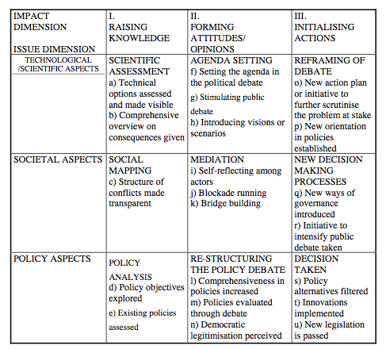
IMPACT of French PTA in NWM
Notes:
Blue is 1991: new way of governance. The Office is the key actor
Green represents the reports produced during fifteen years befors the second commitment.

Slide 7
Discussion: TA of Nwm in France
February 27, 2015
PTA (and its members) as a gatekeeper
At different steps of the decision-making process (upstream and downstream)
Filter the information (IN): selection control
With its own procedural rules and criteria
Translate it (OUT) to the Parliament: production control
→ Meta appraisal to the Parliament
But influence limited to the Parliament: what about of the Government?
Notes:
Over the years TA becomes a NWM gatekeeper of the Parliament.
Its functions regarding the field has increased. For example, the Office in now in charge to assess the national nuclear waste plan and to present the results to the Parliament.
It still produces appraisal but now it also produces meta-appraisal. It acts as a filter of the information.

Slide 8
3. Conclusion
February 27, 2015
NWM and OPECST are strongly related, and NWM is a key part of the TA’s influence but for how long?
Particularities of the French PTA as a success in the French context: fully alive and its existence unquestioned
Representative democracy versus participative democracy?
→ French political-cultural specificity and what about others countries?
→ Democratically debating issues is what matters.
Notes:
The story of NWM decision-making process is strongly related to the Office’s position but the next is: for how long?
The Office can be heard because of its strong relation with the Parliament through the MPs. The office doesn’t have to fight to live, it is fully alive.
The main critic today of French PTA: Over the time, the Office seems to be nothing more than a reproduction of other elite structure. But the integration of PTA in such field was an innovative practice in 1990 to pursuit the debate on NWM future. It is perceived as a democratic turn.

Slide 9
Thanks!
February 27, 2015
Celine.parotte@ulg.ac.be
www.spiral.ulg.ac.be
International Conference: « Trading Zones in Technological Societies »
University of Liège, 15-16 October 2015
One parallel track session on « Safety and nuclear energy »
Open call for papers. Deadline: April 30, 2015
http://events.ulg.ac.be/trading-zones/presentation/
Notes:
Regarder les deux en même temps.

Slide 10
References
February 27, 2015
Barthe and Meyer 2010. Identifying remaining socio-technical challenges at the national level: France, INSOTEC draft report
Hecht 2009. The radiance of France. Nuclear power and national identity after World War II.
Interview with the OPECST’s President, December 12, 2014, Paris.
Interview with the OPECST’s member concerned by underground nuclear waste laboratory, December 31, 2014
Interviews with Pierre-Benoit Joly, October 10 and December 15, 2014
Interview with the Past Director of French nuclear waste agency (ANDRA), November 10, 2014
Ladikas and Decker 2004. Assessing the impact of future-oriented technology assessment. EU-US Seminar: New Technology Foresight, Forecasting & Assessment Methods, Seville, 2004. 13-14.
Nuclear World Association (accessed January 2015)
Topçu 2013. La France nucléaire. L'art de gouverner une technologie contestée, Paris.

