Slide 1
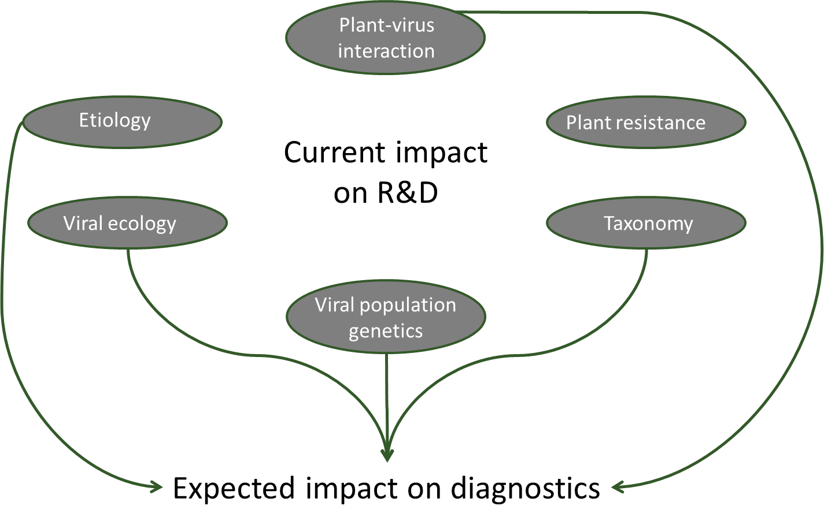
COST Action FA1407: Empowering NGS
technologies for the study and diagnostic of
plant viruses
Call to register on the Action website
PRESENTING AUTHOR, Antonio Olmos, Neil Boonham, Carmen Büttner, Thierry Candresse, Rosario Felix, Isabel Font, Miroslav Glasa, Risto Jalkanen, Petr Kominek, Margit Laimer, Tadeusz Malinowski, Varvara Maliogka, Angelanotio Minafra, Nelia Ortega Parra, Annalisa Poliverari, Maja Ravnikar, Dana Safarova, Rene Vandervlugt, Christina Varveri, Johanna Witzell, Ioan Zagrai, Thierry Wetzel and Massart, Sebastien ^{a1}
ª: the affiliations and addresses of the contributors of this communication are listed in the COST website at the following address: http://www.cost.eu/COST_Actions/fa/Actions/FA1407?management
¹: Corresponding author: sebastien.massart@ulg.ac.be - Laboratory of Phytopathology – University of Liège – Gembloux Agro-BioTech – Passage des déportés, 2 – 5030 Gembloux – Belgium
Viral thread:
Billions of damages on crops yearly amenacing grower income, food quality and food security
Current worstening factors :
The ability to provide fast, inexpensive and reliable diagnostics for any viral infection is a key
measure for cost-effective control of these ubiquitous pathogens
50 % of emergent pathogens are viruses (¹⁾
Worldwide trade
Climate change
Drivers of the Action:
Technological revolution of NGS
« Virus Rush » with
>50 new viruses
Bio-Informatic simplification
Challenges and Impact for diagnostic ⁽²⁾:
Technical challenges
Sampling protocol ?
Extraction and library
preparation ?
Bio-informatic pipeline ?
Validation challenge
Sensitivity ?
Repeatability and
reproducibility ?
Contamination ?
Impact on trade
For which diagnostic ?
New virus identified ?
Latent virus ?
Regulatory impact
Certification?
Quarantine ?
Legal framework ?
Objectives of the Action : Leveraging plant virus control through NGS
Designing research framework for characterization of new viruses & evaluation of their impact
Developing and validating NGS technological standards for plant virus diagnostic
Proposing decision schemes on plant virus diagnostic for policy makers, NPPO, EPPO, diagnostic lab
Evaluating impact of NGS on virus taxonomy and on the plant-virus interactions
Working Groups (WGs)
Contact us Action website: http://www.cost.eu/COST_Actions/fa/Actions/FA1407
Action Chair : sebastien.massart@ulg.ac.be
References
Anderson, 2004. Trends Ecol.
Massart et al (2014) Virus Research

