Slide 1
TREATMENT OF PNEUMONIA IN ADVANCED DEMENTIA
Sophie Allepaerts
CHU- Liège
Belgium
Notes:
Dear colleagues I’m going to discuss treatment of pneumonia in advanced dementia

Slide 2
Advanced dementia: features
Profound memory deficit
Speech limited
Total functional dependance
Incontinence
Inability to ambulate
  Mitchell SL et al. Alzheimer Dis Assoc Disord 2006
Lost interest to eating
Dysphagia
High mortality rate
  Susan L et al. N Engl J Med 2009
Last 6 months to 2 years
90 % require a nursing home
Notes:
Dementia is a clinical syndrome characterized by profound memory deficit, speech limited to a few word, total functional dependence, incontinence, inability to ambulate, lost interest to eating, dysphagia and high mortality rate.
This final phase can last from 6 months to 2 years.
Most of patient with advanced dementia require nursing home

Slide 3
Pneumonia
In elderly
Acute illness with cough + at least:
  new focal chest signs
  fever > 4 days
  dyspnea /tachypnea
  without obvious cause
+ chest radiography: new lung shadowing
Cough may be absent
Fever may be absent or lower than young
Chest difficult to obtain and to interpret
Changed mental status
Woodhead M et al. Clin Micobiol Infect 2011
Notes:
Pneumonia is an acute illness with cough and at least one of this parameters plus a new lung shadowing at chest radiology.
However in elderly, cough (COF), fever may be absent and chest radiology difficult to obtain and interpret. The main characterized is often change of mental status

Slide 4
Mortality in pneumonia
5th cause of death > 65 years old
6 month mortality in advanced dementia : 50 % - 74 %
1 st cause refer of hospital transfert from nursing home
El-Sohl et al. CID 2004
Foley NC et al. Dement Geriatr Cogn Disord. 2014
Notes:
Pneumonia is a major live event because
is the fifth leading cause of death after 65 in all patients but
The mortality at 6 months is 50 % to 74 % in advanced dementia and pneumonia is the first cause of hospital transfert from nursing home

Slide 5
Classification of pneumonia
Community Acquired Pneumonia (CAP)
Hospital Acquired Pneumonia or nosocomial pneumonia (HAP)
Ventiled acquired pneumonia (VAP)
Health Care Associated Pneumonia (HCAP)
Aspiration pneumonia (AP)
Notes:
There are several type of pneumonia. I’m going to focus on Health care associated pneumonia which are the most frequent in patients with advanced dementia who for majority live in nursing home

Slide 6
Health Care Associated Pneumonia (HCAP)
Hospitalization in the preceding 90 days
reside in a nursing home or an extended care facility
treated with chronic hemodialysis
Receive home wound care
Exposed to a family member with a drug-resistant pathogen infection
Higher frequencies of multidrug-resistant (MDR) pathogens
Anthony X et al. Lung 2013
Notes:
So Health care-associated pneumonia has been recognized as a new category of pneumonia since 2005. It’s refers to pneumonia acquired through recent contact with a health care environment. This category refers to patients that reside in a nursing home or an extended care facility.
It is characterized by a Higher frequencies of multidrug-resistant pathogens.
[envaieyeurment] [aquoiyeard]

Slide 7
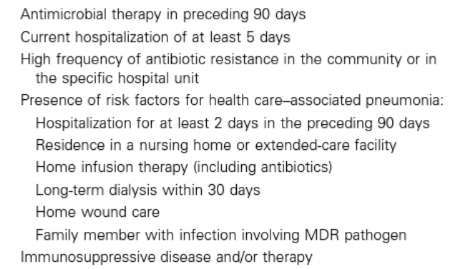
Risk factor for infection with multi-drug-resistant (MDR) pathogens
Guidelines for the management of adults with hospital-acquired, ventilator- associated, and healthcare- associated pneumonia. Am J Respir Crit Care Med 2005
Notes:
And you can note that HCAP is part of the risk factors for infection with multidrug-resistant pathogens.

Slide 8
Pathogens identified in HCAP: evolution of the literature
HCAP 2005 | HCAP 2013
Methicillin-resistant S. aureus (MRSA): 26.5 % Pseudomonas Aeruginosa: 25.3 % Haemophilus species: 5,8 % Streptococcus pneumonia: 3,1 % Kollef MH et al.Chest 2005 | S Aureus: 26-48 % Enterobacteriaceace: 12-32 % S. pneumonia: 10-27 % P. Aeruginosa: 10-19 % Anthony X et a.Lung 2013
Notes:
The most commun pathogens indentified in HCAP have significantly evolved over the time. Including more classical microorganisms as those involved in cummunity. You can see …

Slide 9
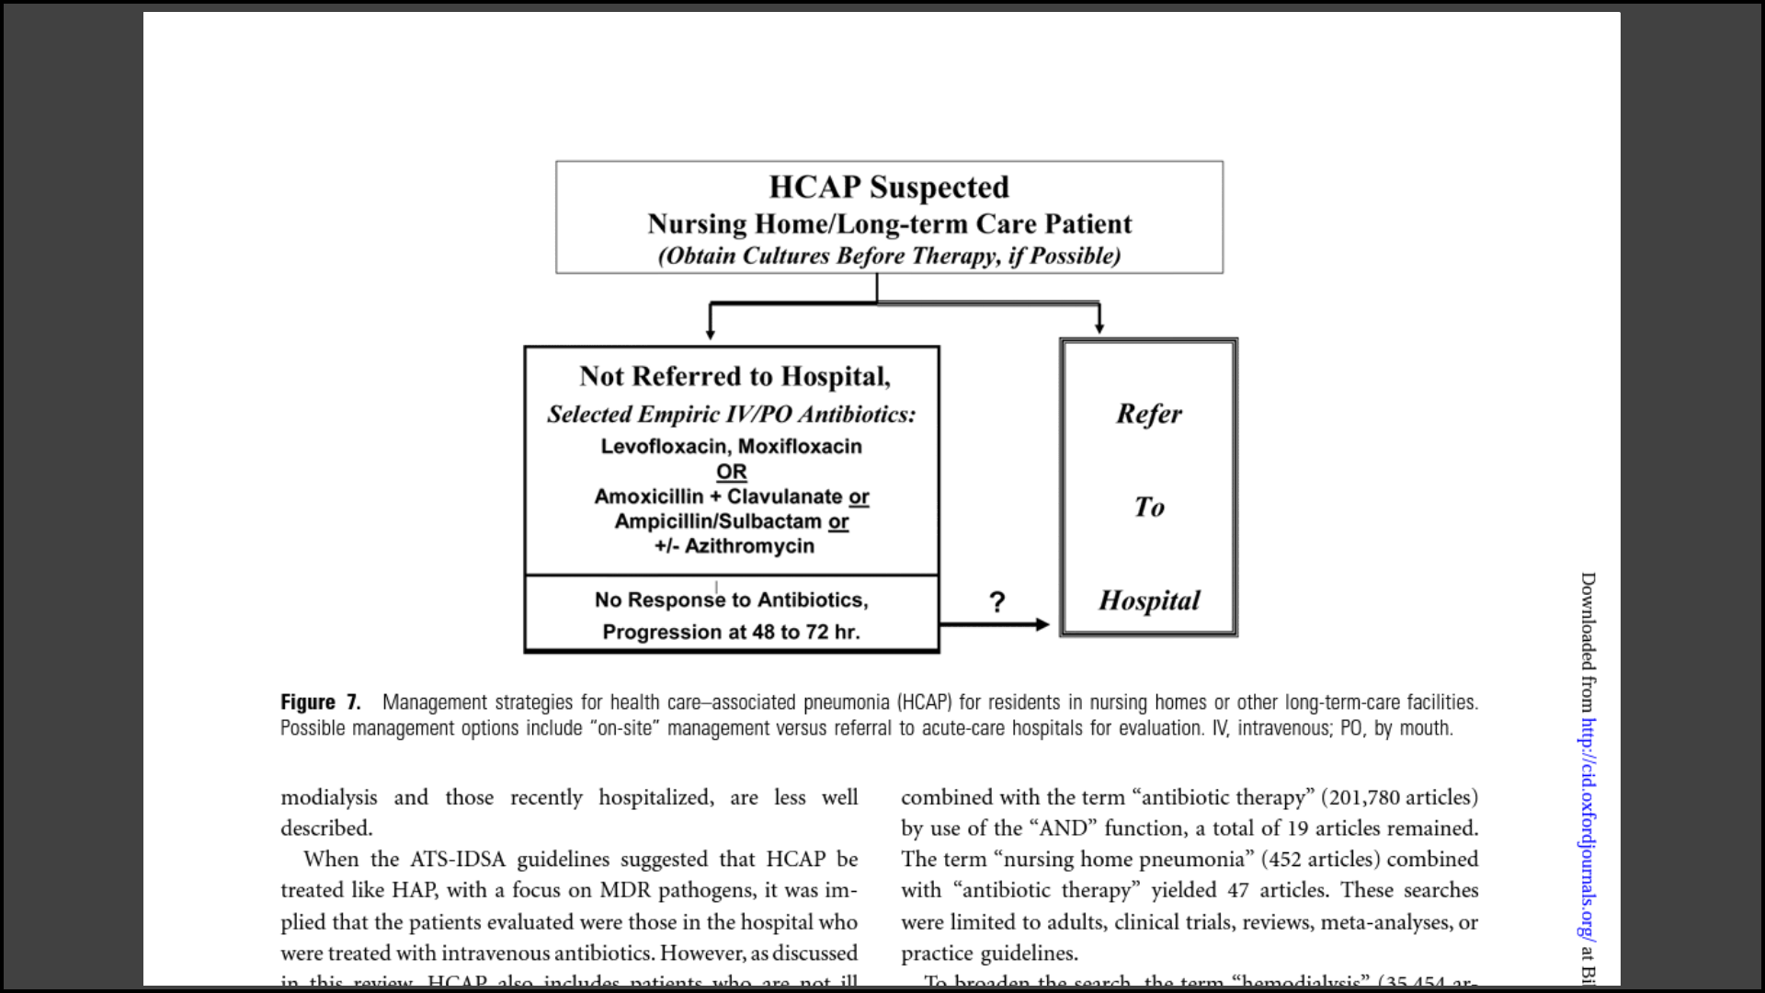
Management for HCAP for resident in nursing home
Guidelines for the management of adults with hospital-acquired, ventilator- associated, and healthcare- associated pneumonia. Am J Respir Crit Care Med 2005; 171 : 388–416
Notes:
When the nursing home or long term care patients are targeted it’s still suggested despite the common risk of MDR to start with conventional empirical antibiotic . In case of non response or progression after 48-72 h 00, admission of the patient to hospital and adaptation of the antibiotic treatment should be considered
The guideline for management of suspected HCAP in nursing home or long-term care patient suggested despite the common risk on MDR to start with conventional empirical antibiotic with

Slide 10
Side effects of antimicrobials
Method of administration
Adverse drug reaction
Oral treatment
  behavioral disorder
  swallowing disorder
IV treatment
  phlébitis
IM treatment
  pain
  Clostridium difficile infections
  Renal failure
  Drugs interaction
  Neurotixicity
  Multidrugs resistant organisms
Restraints – Disconfort – Iatrogenic desease
Notes:
But … Before starting the treatment we should take into account the potential side effects and interaction of antibiotic treatment
That could lead to discomfort, require restraint or lead to iatrogenic disease.
Colonization rates with multi-drug resistant organisms are three times higher among nursing home residents with advanced dementia compared with other residents

Slide 11
Potential impact of antibiotic use in advanced dementia
Antibiotic use can prolonge
life
Dying process
Can lead confort ? Fluid intake?
Jenny T. et al . JAMDA 2012
Givens et al. Arch Intern Med 2010
Steen JT et al . J Am Med Dir Assoc 10.1016
Notes:
There is a probable effectiveness of antibiotics to extend life in some cases and prolong the dying in other.
Effects of antibiotics on comfort at the end of life varies across studies and may depend on diagnosis, adequate adjustment for initial discomfort because physicians may treat for comfort, and other treatments provided as fluid intake

Slide 12
No treatment or treatment
For
Against
High mortality rate of pneumonia
Adverses effects of antimicrobial are frequent
Advanced dementia = terminal illness
Pneumonia is a potentially treatable disease
In presence of clear advanced directives: comfort
In absence of clear advanced directives: cure
Notes:
What should we do ? No treatment or treatment? Regarding the high mortality after pneumonia, the adverses effects of antimicrobial use and consider dementia as a terminal illness comfort treatment can be proposed.
In absence of clear advanced directives, we must exert our traditional attitude toward the cure

Slide 13
Prevention of pneumonia
Influenza vaccination
  ↓ Hospitalization – death from influenza and from other causes.
Pneumococcal vaccination
  ↓ morbidity and mortality in nursing home resident
Oral health
  Redue incidence of aspiration pneumonia of 40 %
  ↑cough reflex sensitivity
Woodhead M et al. Clin Micobiol Infect 2011
Mendel G et al. mandell textbook of infectious disease 2009
Wantando et al. Chest.2004
Notes:
Prevention is especially important in this patients. Since mortality is high and preventive treatments are efficient to reduce hospitalization and death. Vaccination should be encouraged for all elderly patients and mostly patient who reside in nursing home by influenza vaccination and pneumococcal vaccination
As well as oral health care
[effishient]

Slide 14
Conclusions
Pneumonia is frequent and serious illness
Diagnosis is difficult
Prevention with vaccination is efficient
Administration of the treatment remains difficult
Specific directive treat or confort treatment should decided, tailored to each individual and clinical situation

Slide 15
Conclusions
Pneumonia is frequent in advanced dementia
Pneumonia diagnosis is difficult
Mortality rate is high
Prevention with vaccination is efficient
Administration of the treatment remain difficult
Specific directive treat or confort treatment should decided, tailored to each individual and clinical situation

