Slide 1



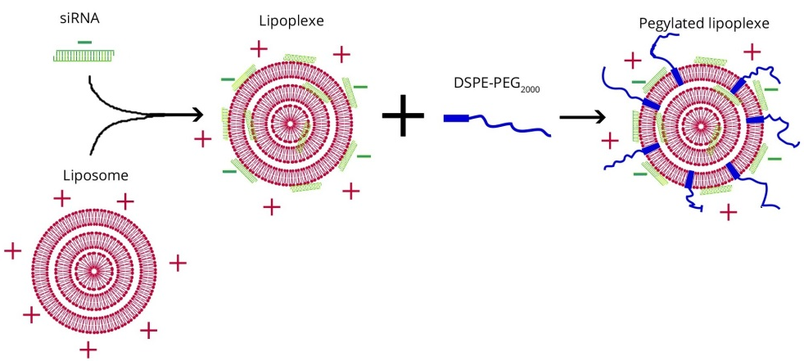
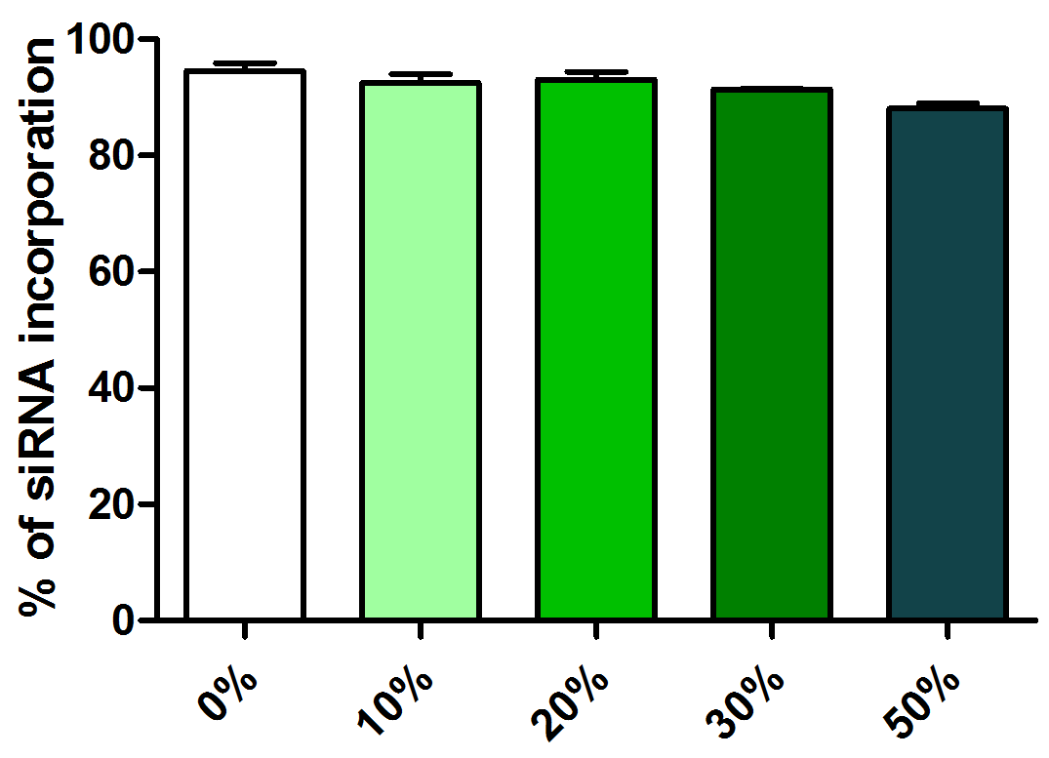
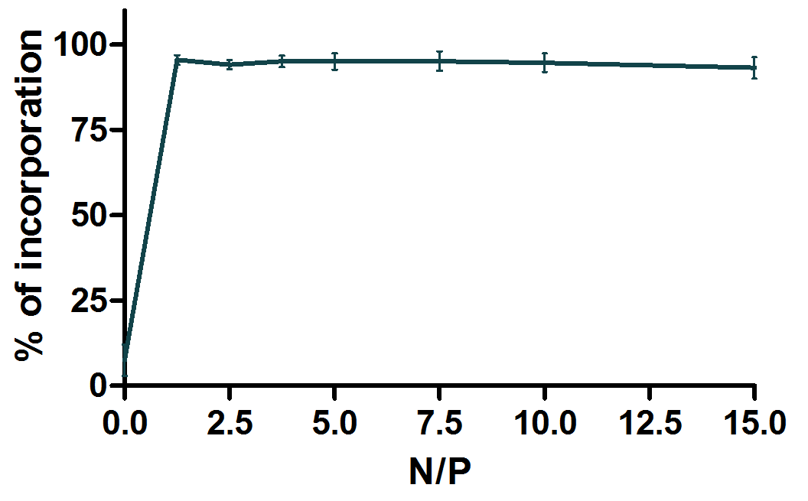
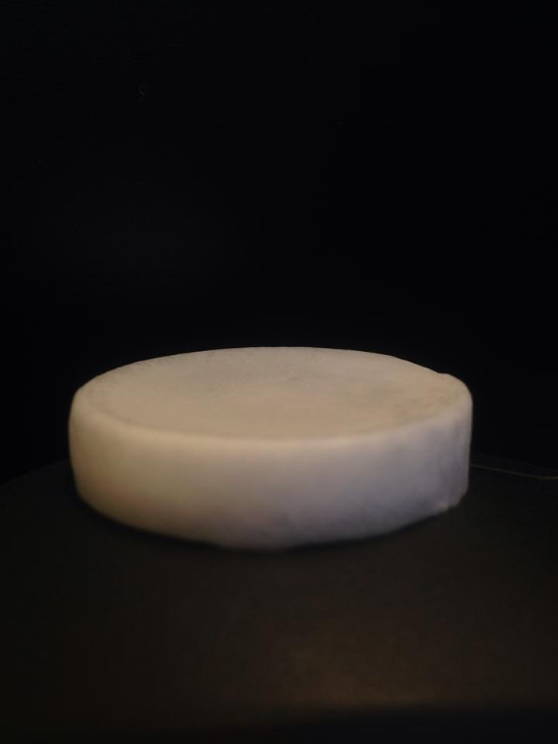
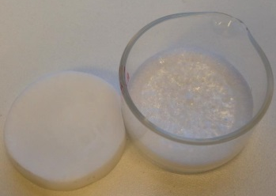
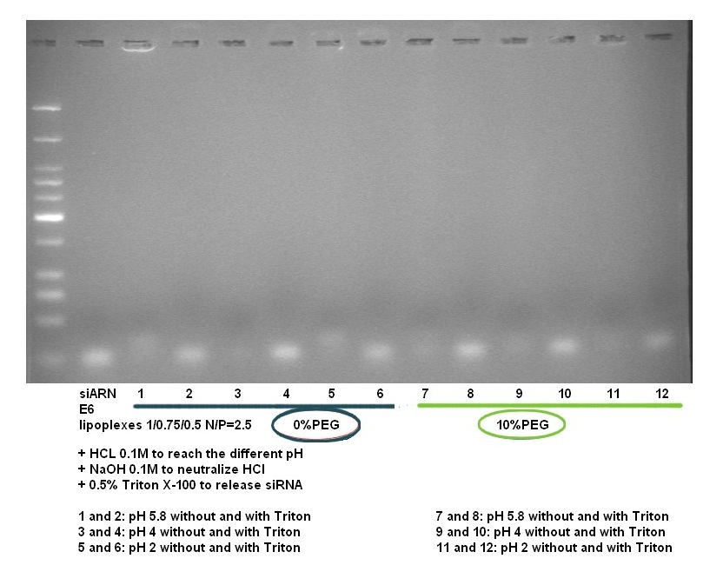
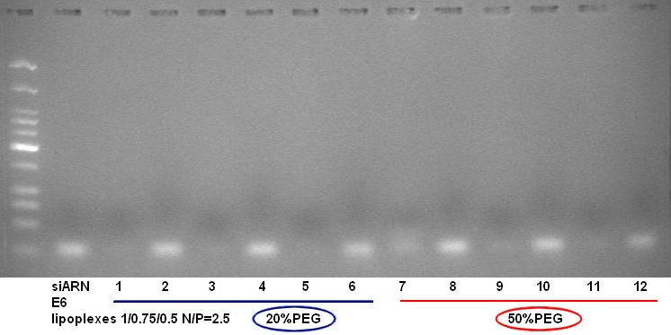
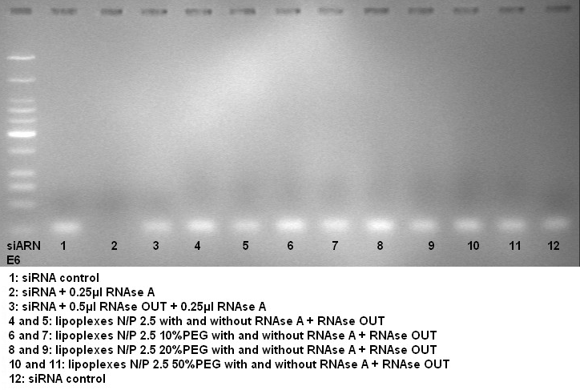
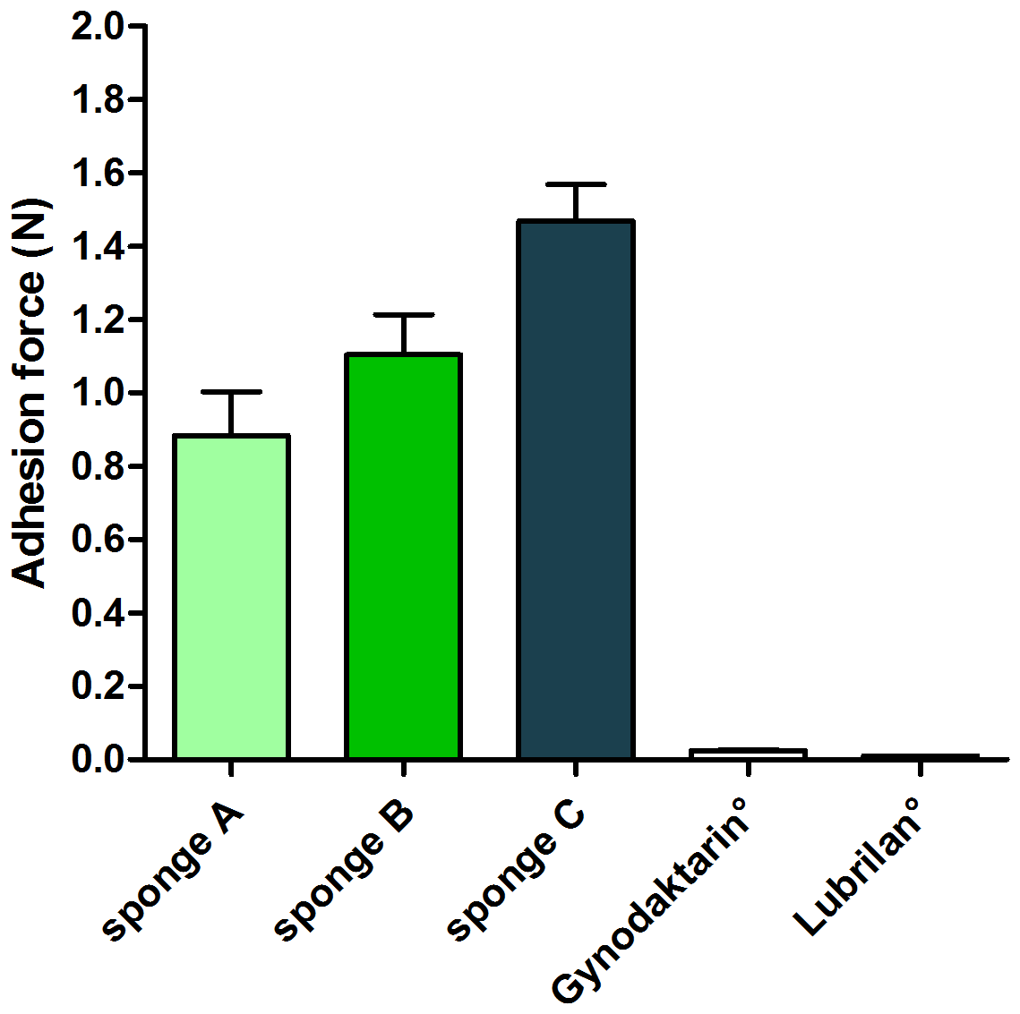
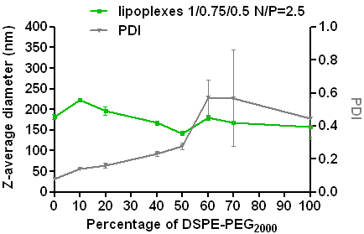
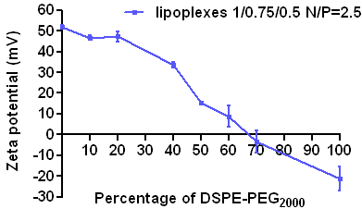
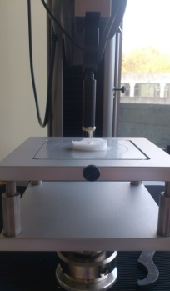
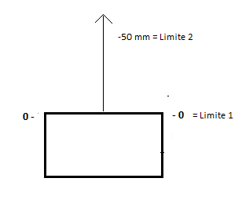
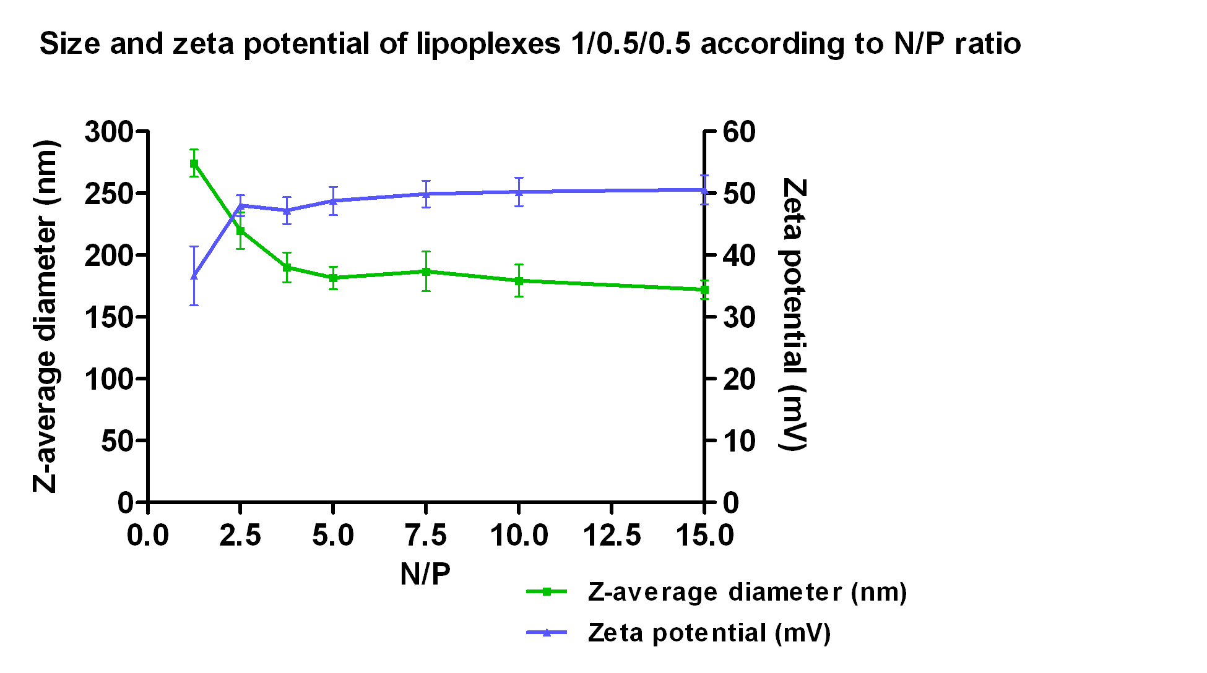


M1142
DEVELOPMENT AND CHARACTERIZATION OF PEGYLATED LIPOPLEXES TO BE ENTRAPPED IN HEC SPONGES FOR VAGINAL DELIVERY
A. Pestieau ¹, F. Krier ¹, P. Lebrun ^{2,3}, B. Evrard ¹
Tania Furst¹, Anna Lechanteur^{1,2}, Pascale Hubert², Brigitte Evrard¹, Géraldine Piel¹
¹Laboratory of Pharmaceutical Technology and Biopharmacy - CIRM, University of Liege, Liege, Belgium
² Laboratory of Experimental Pathology - GIGA Cancer, University of Liege, Liege, Belgium
E-mail : tania.furst@ulg.ac.be
¹ Laboratory of Pharmaceutical Technology and Biopharmacy, CIRM, University of Liège, Belgium
² Laboratory of Analytical Chemistry, CIRM, University of Liège, Belgium
³ Arlenda, Liège, Belgium
E-mail: Aude.Pestieau@ulg.ac.be
1. INTRODUCTION
3.2. Incorporation efficiency of unpegylated and pegylated lipoplexes
This research has a double objective:
Firstly, the preparation of cationic nanovectors, liposomes, which are elaborated for a topical administration into vagina. Liposomes are complexed with siRNA to form lipoplexes. DSPE-PEG₂₀₀₀, an hydrophilic polymer, is added to lipoplexes to facilitate their diffusion through cervico-vaginal mucus. These lipoplexes must have good physicochemical characteristics to be effective. They also have to be stable in acidic environment (vaginal pH 4 - 4.5) and in contact with RNAses and do not release the siRNA.
Secondly, we would like to incorporate these lipoplexes into hydroxyethylcellulose (HEC) gels, which will be freeze-dried to form sponges. For that, we must first characterize these sponges. They have to be malleable to facilitate their handling. They have to adhere to the vaginal mucosa and to rehydrate in a short time to allow the diffusion of lipoplexes.
Fig.3. Incorporation of siRNA into unpegylated lipoplexes according to N/P ratios. From the N/P 1.25, more than 95% of siRNA is encapsulated. (n=4)
Fig.4. Incorporation of siRNA into 10, 20, 30 and 50% pegylated lipoplexes at N/P 2.5. The addition of PEG does not decrease the encapsulation efficiency. (n=3)
4cm
2. MATERIALS AND METHODS
3.4. Stability of ipoplexes; in presence of acidic pH and RNases
2.1. Liposomes are prepared by hydration of lipidic film method: and extruded through polycarbonate mebranes with pores at 200nm
Lipids : - Cationic DOTAP
- Fusogenic DOPE
- Cholesterol
To form lipoplexes: siRNA is complexed with liposomes by spontaneous charge interaction, at different N/P ratios (from 0 to 15) in RNase free water
Lipoplexes are pegylated by addition of DSPE-PEG₂₀₀₀ at different % ( from 0 to 100 % /mol DOTAP) by the post-insertion technique (at 37°C)
2.2. Sponges are obtained after freeze-drying of a homogenous hydrogel (6g) composed by HEC 250M and PEG₄₀₀ in milliQ water.
. Fig.6. Lipoplexes at N/P 2.5 with 0, 10, 20 and 50% PEG in presence of RNAse A. The siRNA is protected into lipoplexes and not degraded when they are exposed to RNAse.
Physicochemical characterization : - size
- zeta
- incorportion efficiency
- stability
DOTAP/Chol/DOPE 1/0.75/0.5 → 5,6 mM
Characterization of the mucoadhesion with a Texture Analyzer, with mucin disc and with synthetic cervicovaginal mucus
Fig.5. Lipoplexes at N/P 2.5 with 0, 10, 20 and 50%PEG in presence of acidic pH (from 5,8 to 2).
There is no leakage and no degradation of siRNA when lipoplexes are in acidic environment. siRNA is protected by the unpegylated and the pegylated lipoplexes.
 | HEC 250M (mg) | PEG400 (mg)
A | 100 | 25
B | 200 | 25
C | 200 | 50
3. RESULTS AND DISCUSSION
2.2. Preparation and mucoadhesion of cellulose-derivative sponges
3.1. Z-average diameter (nm) and zeta potential (mV) of unpegylated and pegylated lipoplexes
Unpegylated lipoplexes according to N/P ratios
Lipoplexes at N/P ratio 2.5 with different % of PEG
Fig.7. Example of graph obtained with the TA to quantify the mucoadhesion. F_{min} represents the adhesion force of the sponge with the mucin disc
Fig.8. The mucoadhesion force (N) of the sponges (in comparaison with 2 commercialized gels) increases when the concentration of polymer increases. (n=20)
(A)
(B)
F min = adhesion force
4. CONCLUSIONS AND PERSPECTIVES
Fig.1. From the N/P ratio of 2.5, the diameter is ranged between 180 and 220nm and the zeta potential remains constant at around +50mV. (n=4).
Fig.2. (A) The diameter of the lipoplexes is ranged between 150 and 220nm, but from 50% of PEG the lipoplexes are too polydispersed (high PDI). (B) The zeta potential decreases when the % of PEG increases. (n=4)
Lipoplexes DOTAP/Chol/DOPE 1/0.75/0.5 at N/P=2.5 with and without DSPE-PEG₂₀₀₀ have optimal physicochemical characteristics in terms of size, charge and incorporation efficiency. They are able to protect the siRNA in presence of acidic environment or in presence of RNAse A. Their stability and diffusion ability will be studied in presence of mucus and HEC gel.
Regarding sponges, HEC 250M seems to be an ideal polymer to form a mucoadhesive system. The mucoadhesion of sponges containing lipoplexes will also be characterized.
ACKNOWLEDGEMENTS: The authors aknowledge the Belgium National Fund for Scientific Research (FNRS) for financial support

