Slide 1

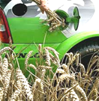
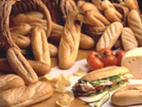
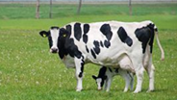


Environmental and socio-economic sustainability and pertinence of alternative scenarios for food and non food uses of cereal resources in Wallonia (Belgium)

Slide 2

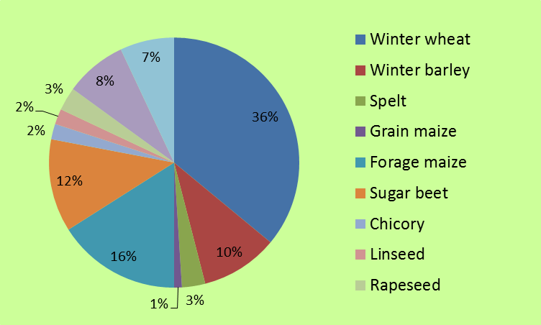
Walloon context
66%
Source: DGSIE (INS)- Recensement agricole
Wallonia = 50% of cereals grain belgian production

Slide 3
Walloon context

Slide 4
Walloon context
Walloon cereal production turns to animal feed industry
Decrease of FOOD use (quality non lucrative)
Development of biofuel industry
Transformation located in Flanders

Slide 5
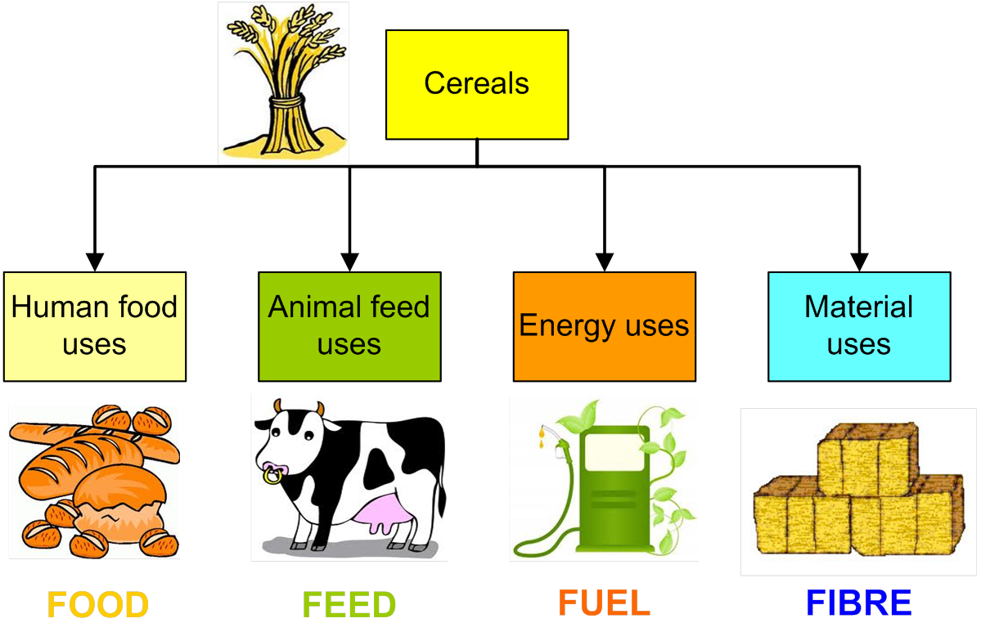
Scenarios 4F

Slide 6
Tools used for Alt-4-Cer : S-LCA, E-LCA,
multicriteria analysis
Alt-4-Cer
Opportunities
Evaluation & adaptation
Ponderation
Provide clues for most sustainable and pertinent uses of the cereal resources in Wallonia
Scenarios 4F
S-LCA
& E-LCA
MCA
Local data & advice
Local data
Criteria
Stakeholders involvement

Slide 7
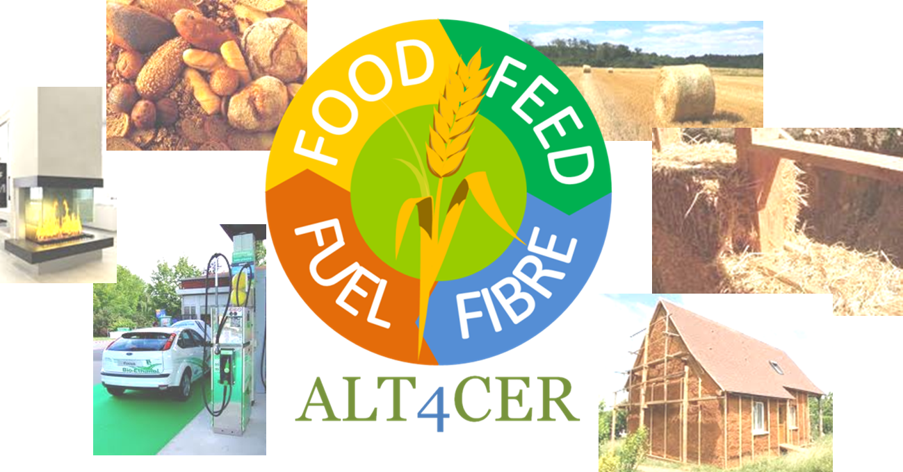
Thank you for your attention !
Alice DELCOUR
a.delcour@cra.wallonie.be
Walloon Agricultural Research Center

