Slide 1
Maintaining the coexistence of forest species of different shade tolerances with close-to-nature forestry
Gauthier Ligot¹, Philippe Balandier², Hugues Claessens¹
¹ Univ. de Liège, Gembloux Agro-Bio Tech, Forest Resource Management, Belgium
² Irstea, U.R. Ecosystèmes Forestiers (EFNO), France

Slide 3
Sustainable forest management
Continuous cover forestry
Natural regeneration
Uneven-aged forest structure
Species mixture

Slide 4
How can we maintain the coexistence of shade-tolerant species and
less shade-tolerant species?

Slide 5
Acidophile beech forests, in the Belgian Ardennes
Sessile oak
Quercus petraea (Matt) Liebl.
Less shade-tolerant
Scarce in natural regeneration
European beech
Fagus sylvatica L.
Shade-tolerant
Invade the understory

Slide 6
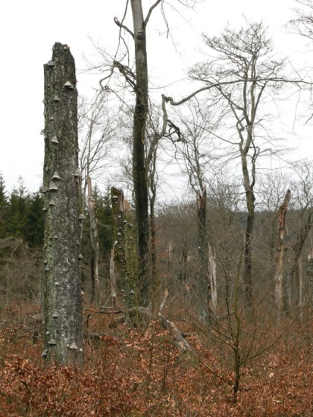
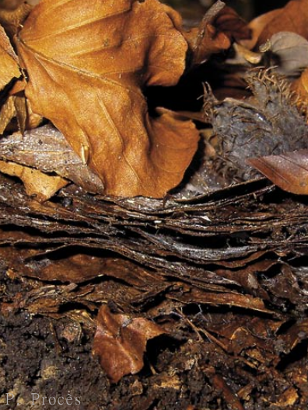
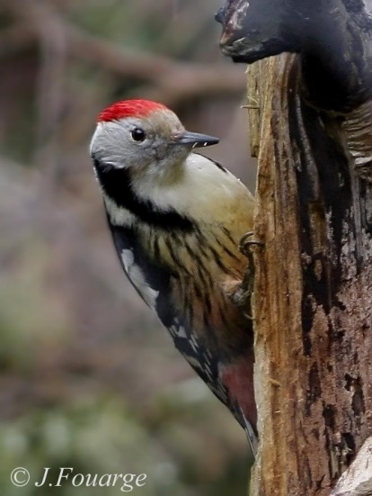
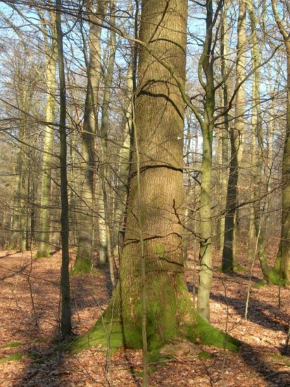
Why maintaining the mixture of oak and beech?
Resilience
Climate change
Fertility
Biodiversity
Timber

Slide 7
27 fenced sites
From early successional oak forests to late successional beech forests
Square subplots to monitor regeneration

Slide 8
What are the light conditions that promotes regenerations of either shade-tolerant species or less shade-tolerant species?

Slide 9
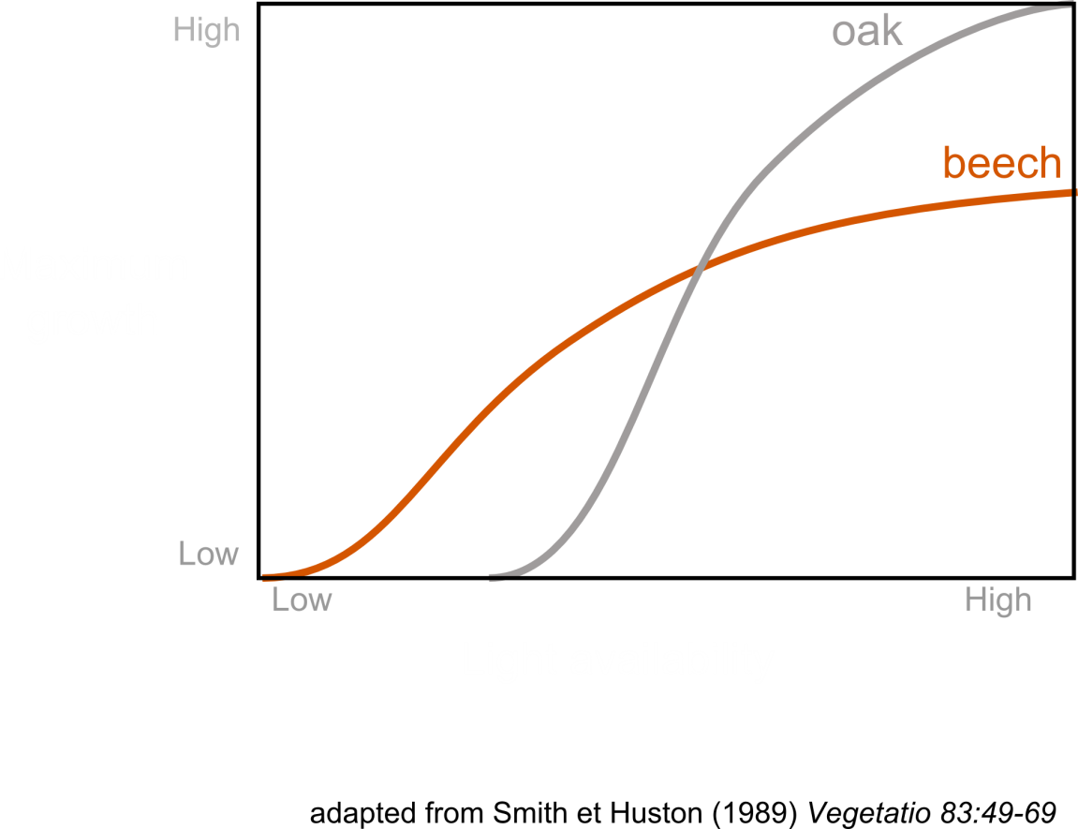
Hypotheses
Tradeoff between survival in shade and growth in high-light conditions
Sapling growth depends mainly on diffuse light rather than direct light

Slide 10
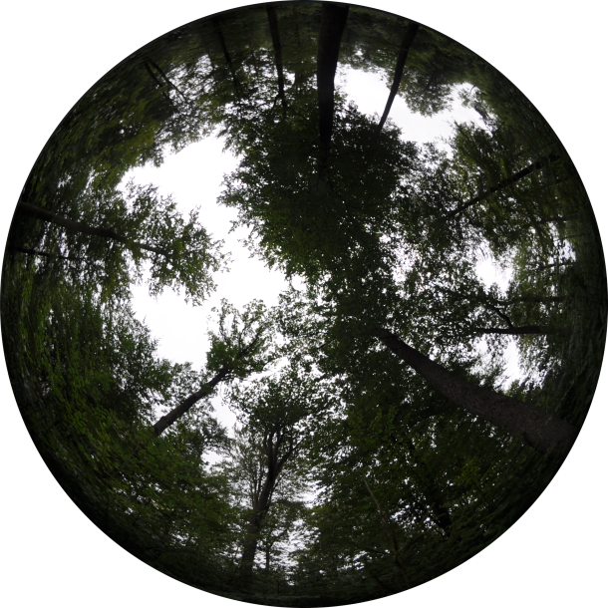
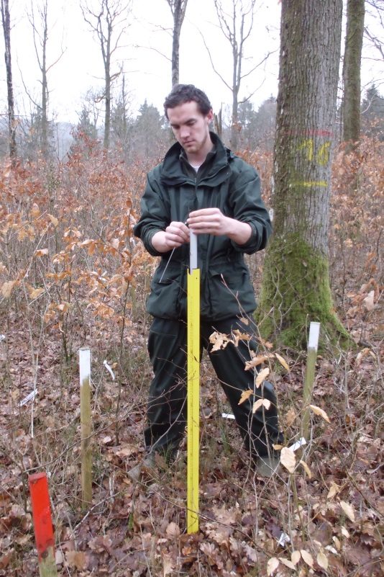
Material and Methods
Heights of the 3 tallest sapling in 2008 and 2010
Hemispherical photographs to estimate the percentage of above canopy light (PACL) transmitted to the understory
Non-linear mixed model of the height growth rate as a function of light conditions and initial height

Slide 11
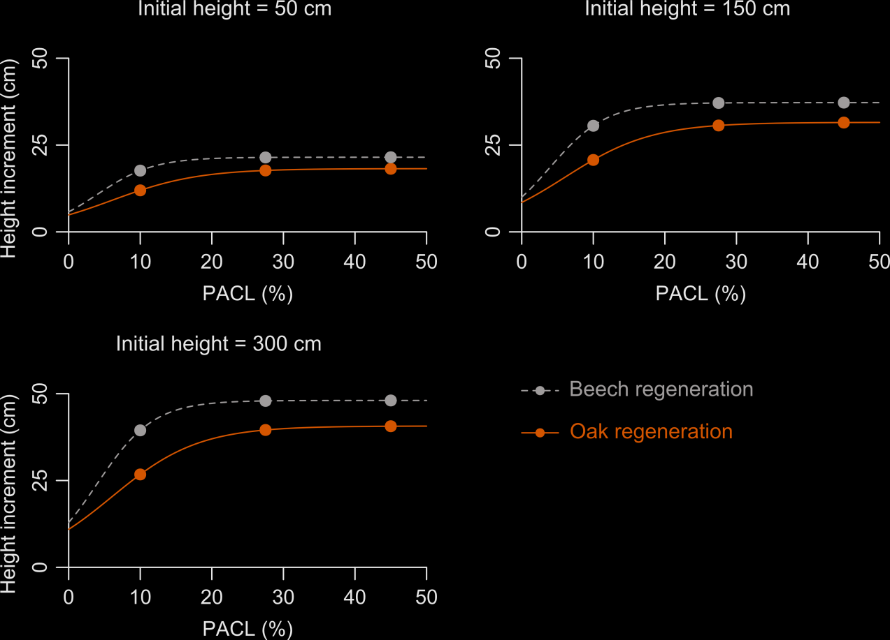
Beech regenerations grow faster than oak regenerations whatever the light conditions
No tradeoff
Oak needs twice more light than beech to reach its optimum growth
Beech responds better to diffuse light
Oak responds better to direct light
Ligot et al. 2013, For. Ecol. Manage. 304

Slide 12
Can understory light be controlled?

Slide 13
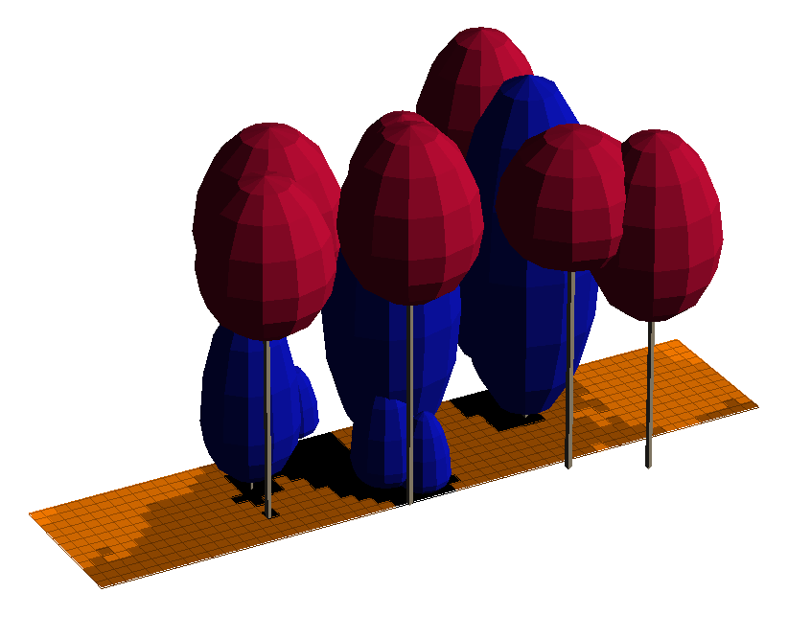
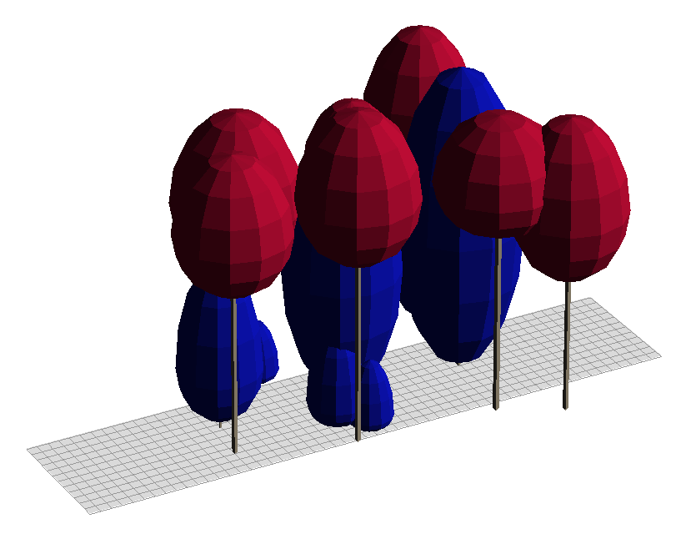
Modeling light interception
Inventory file
Light interception
Percentage of above canopy light
Ligot et al. 2014, Can. J. For. Res. 44

Slide 14
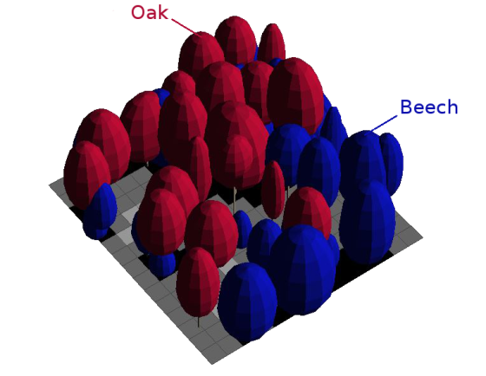
Simulations
Compare 5 cutting scenarios combined with 4 levels of cutting intensity on the 27 sites
Gain in average transmitted light
Gain in area favorable for oak (PACL of 20-40%)
Cutting simulation
Ligot et al. 2014, For. Ecol. Manage. 327

Slide 15
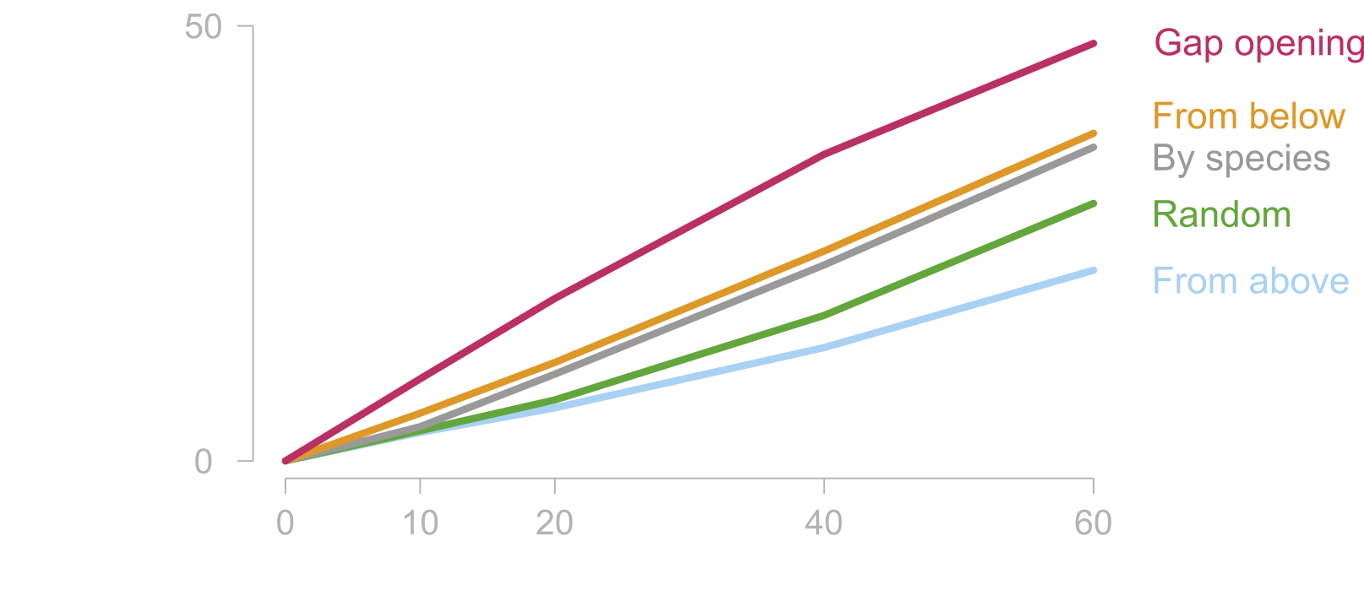
Light gain depends on cutting type
Ligot et al. 2014, For. Ecol. Manage. 327

Slide 16
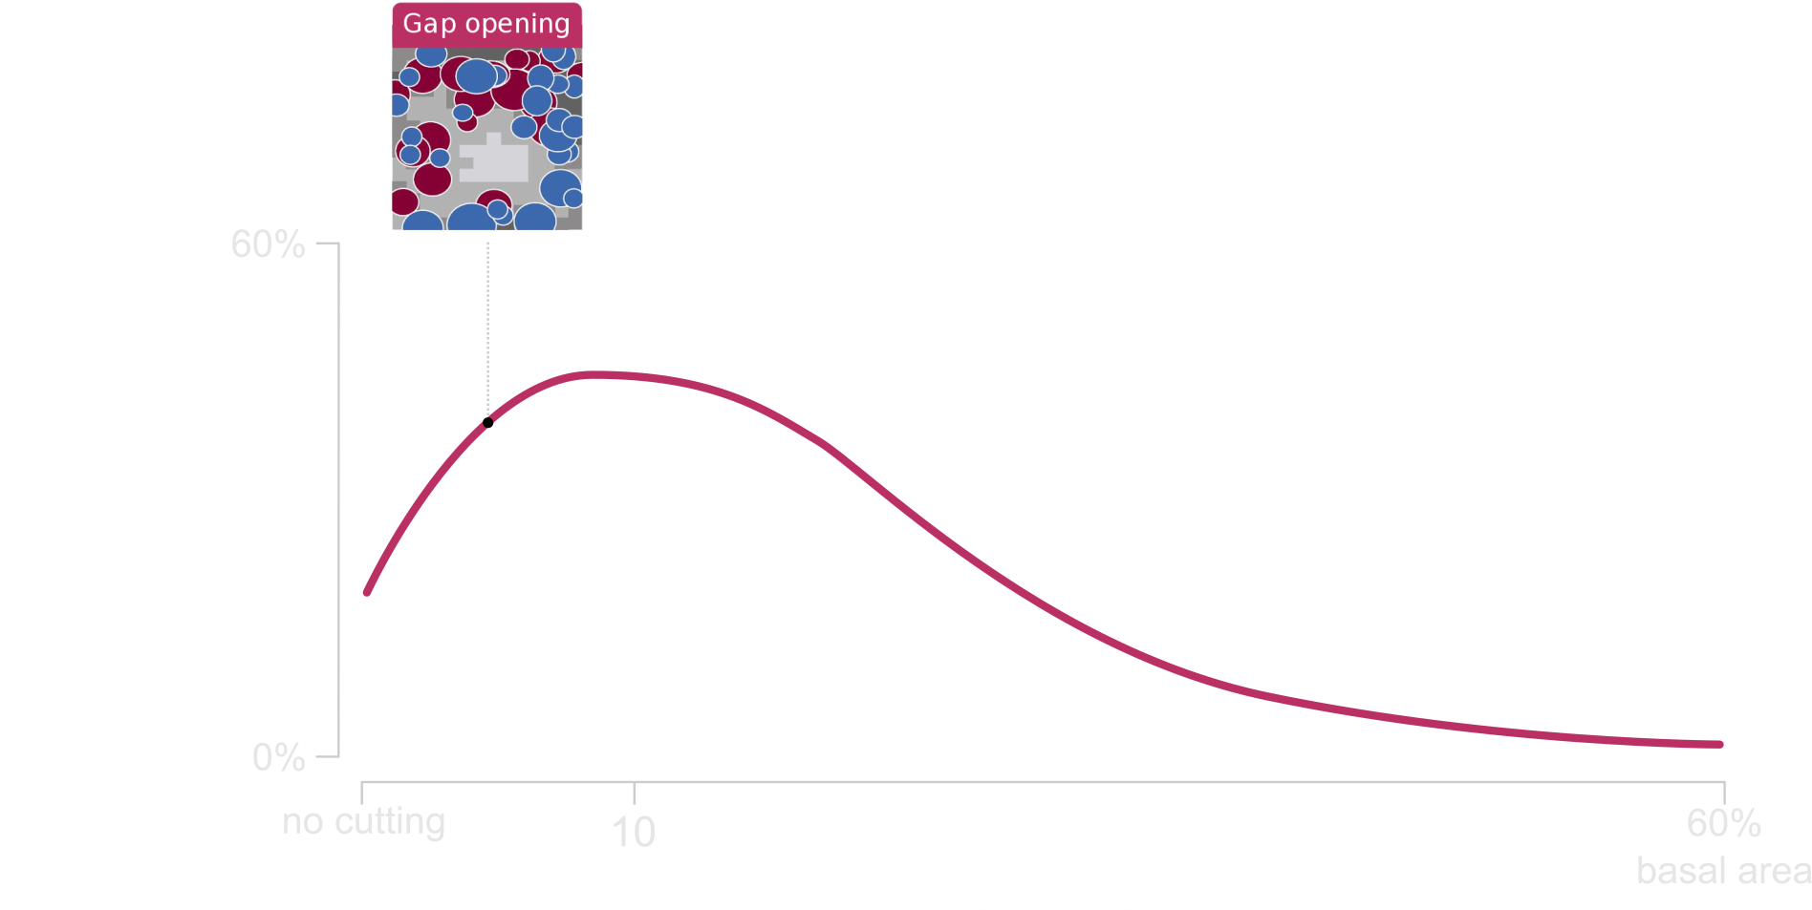
Gap must be of limited size (<500 m²)
If gaps are too wide,
a large part of the understory
receives too much light (>40%)
Ligot et al. 2014, For. Ecol. Manage. 327

Slide 17
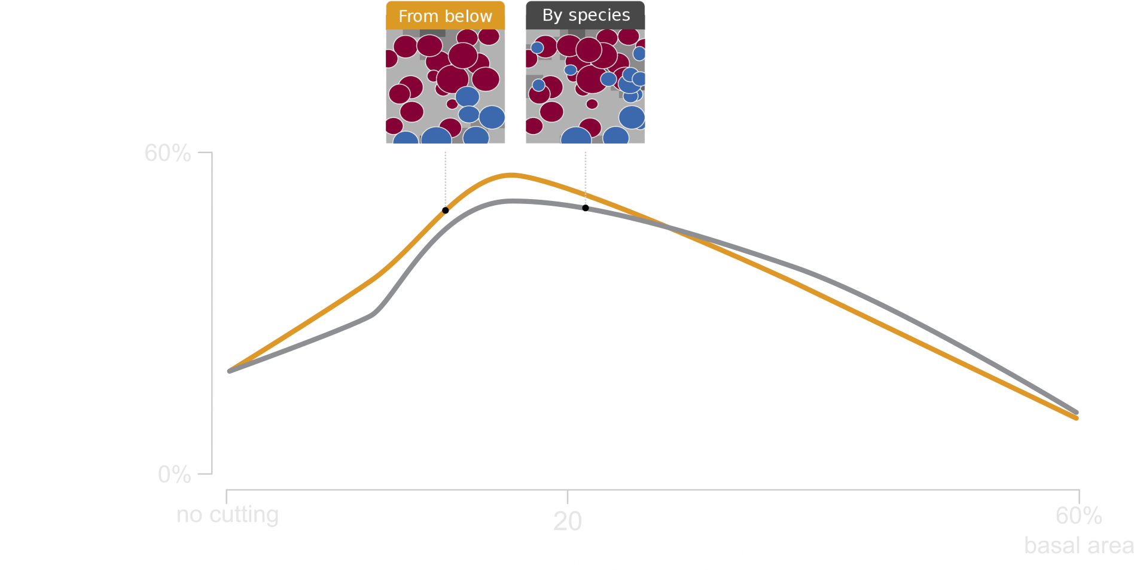
Cutting preferentially small trees maximizes the area favorable for less-shade tolerant species
Ligot et al. 2014, For. Ecol. Manage. 327

Slide 18
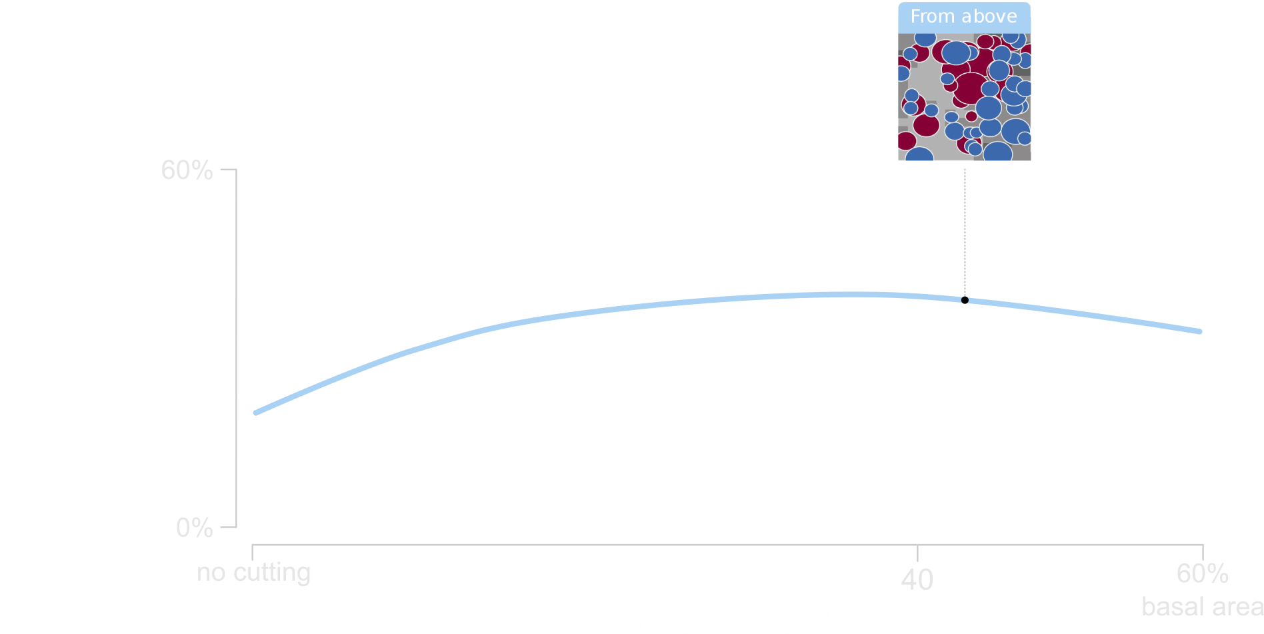
Cutting from above modifies only slightly understory light conditions
Ligot et al. 2014, For. Ecol. Manage. 327

Slide 19
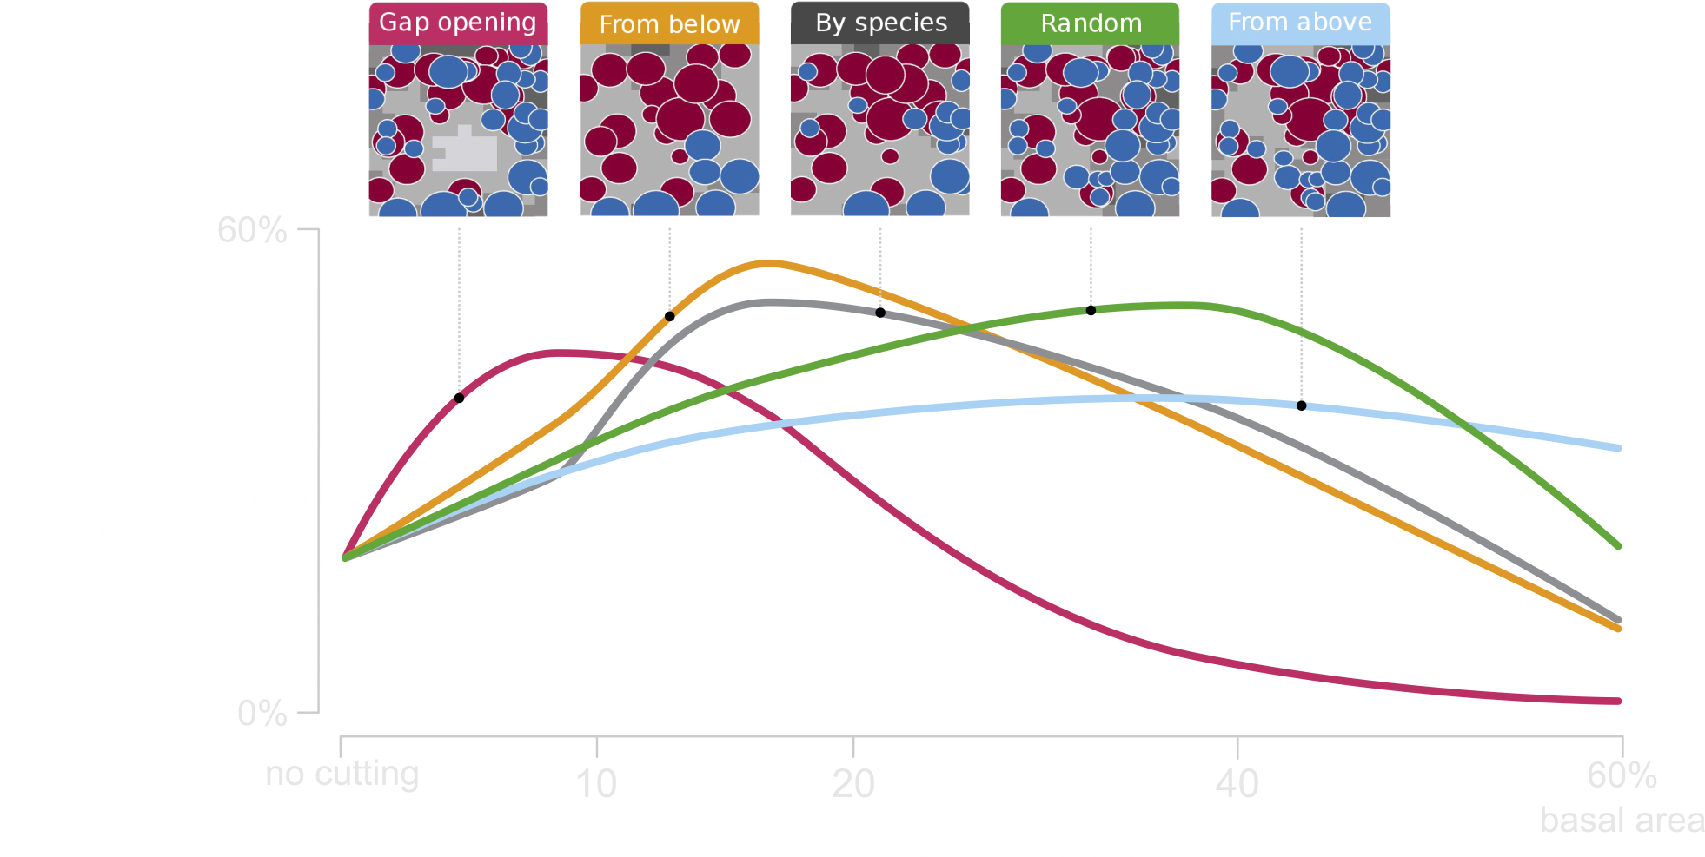
Several options to promote oak regeneration
Ligot et al. 2014, For. Ecol. Manage. 327

Slide 20
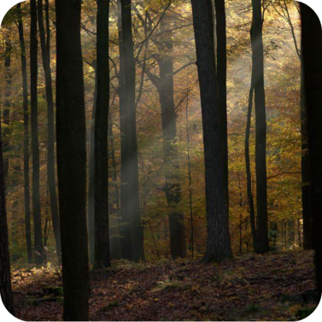
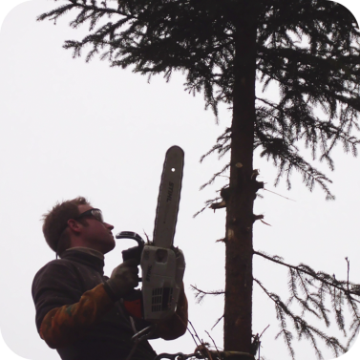
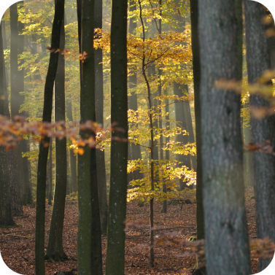
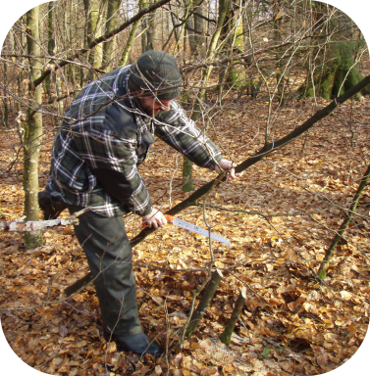
Conclusions
Light drives regeneration dynamics
Control of light is possible with the control of
density
spatial structure
vertical structure
But light is not the key factor
Continuous cover forestry maintain a particular microclimate
Manual control of beech competition
Maintaining an unstable ecological community is laborious

Slide 21
Thank you A. André, M. Alderweireld, A. Ameztegui, P. Balandier, Y. Brostaux, H. Claessens, G. Colinet, B. Courbaud, F. de Coligny, E. Dufays, A. Fayolle, J. Goijen, F. Henrotay, M. Jonard, B. Jourez, D. Kneeshaw, F. Lehaire, P. Lejeune, B. Mackels, A. Marquier, C. Mengal, F.J. Parsons, A. Schot, C. Vaianopoulos...

