Slide 1
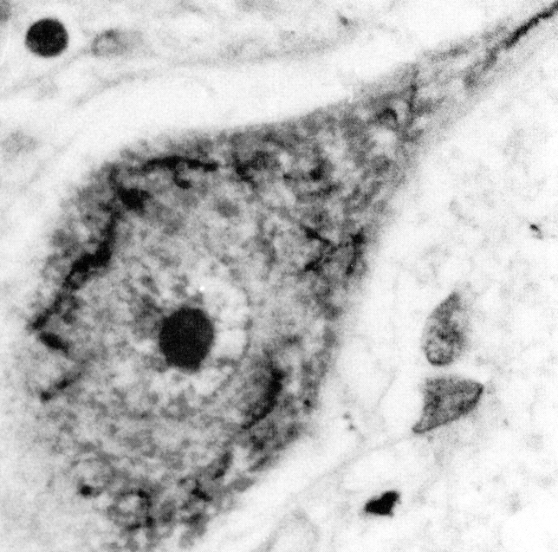
AND IF IT WAS NO ALS?
F.C. Wang

Slide 2
ALS in some figures
Amyotrophic lateral sclerosis (ALS) or
« Maladie de Charcot » is a progressive degeneration of upper (UMN) and lower (LMN) motor neurons
Incidence : 2/100.000 per year
Prevalence : 5/100.000 (orphan disease, less than 1/1000)
Onset : - bulbar (dysarthria, dysphagia) 15%-40% (F>M)
- upper limbs 40%
- lower limbs 20%-40%
- ventilatory 2%
AND IF IT WAS NO ALS ? 39

Slide 3
ALS in some figures
Features | Hereditary ALS | Sporadic ALS
Males:Females | 1:1 | 1.7:1
Disease duration | Bimodal : < 2 y. or > 5 y. | Unimodal : 3 – 4 y.
% ALS cases | 10% | 90%
Onset - Mean age | 46 years | 56 – 63 years
Juvenile | ALS 2 (alsin) ALS 4 (senataxin) ALS 5 (spatacsin! | rare
Bulbar | 25% (40% ALS-FTD C9orf72 – rare SOD1) | 15%
Legs | Common | Occasional
AND IF IT WAS NO ALS ? 38

Slide 4
Familial ALS (FALS)
Two genes are responsible for > 50% FALS
SOD1 (ALS1): 12 – 23% FALS
C9orf72 (FTDALS1): 23 – 46% (in France) FALS
4 – 21 % (8% in France) sporadic ALS
- large expansion of a GGGGCC hexanucleotide
- ALS-FTD
- bulbar signs
- late onset
But also : FUS (ALS6) and TARDBP (ALS10) …
AND IF IT WAS NO ALS ? 37

Slide 5
ALS criteria
El Escorial (Brooks et al, 1994)
Airlie House (Miller et al, 1997)
25% of ALS patients were still classified as having suspected or possible ALS at the time of their death (Forbes et al, 2001)
Awaji-shima consensus recommendations (de Carvalho et al, 2008)
AND IF IT WAS NO ALS ? 36

Slide 6
Awaji-shima consensus
recommendations
As needle EMG is an extension of the clinical examination, clinical and electrophysiological abnormalities have equal diagnostic significance
In presence of chronic neurogenic change on needle EMG, fasciculation potentials, preferably polyphasic (> 4 phases), are equivalent to fibrillations/PSW in their clinical significance
AND IF IT WAS NO ALS ? 35

Slide 7
Awaji criteria
Definite ALS : LMN and UMN signs in at least 3 body regions (bulbar, cervical, thoracic, lumbar)
Probable ALS : LMN and UMN signs in 2 body regions, UMN signs necessarily rostral to the LMN signs
Possible ALS : - LMN and UMN signs in 1 body region
- UMN signs in 2 or more regions
- LMN signs rostral to UMN signs
AND IF IT WAS NO ALS ? 34

Slide 8
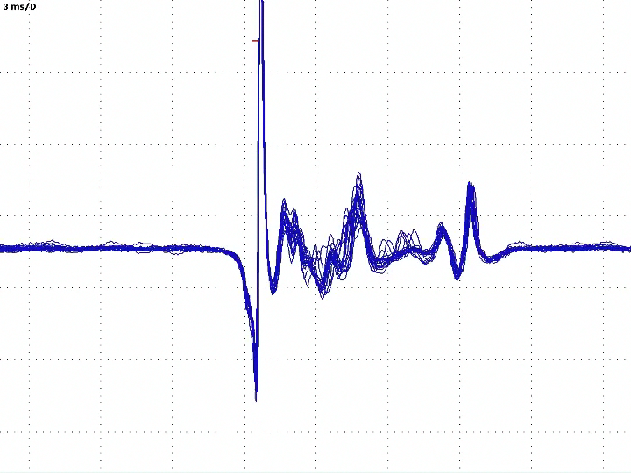
Neurogenic changes
on needle EMG
MUPs of increased amplitude/duration as assessed by qualitative or quantitative studies
Decreased motor unit recruitment
Unstable and complex MUPs by using a
narrow band pass filter (500 Hz – 5 KHz)
Fibrillations/PSW or fasciculations
recorded in strong muscles
AND IF IT WAS NO ALS ? 33

Slide 9
TMS (Transcranial magnetic stim)
to document UMN involvement
Increased central motor conduction time (CMCT)
Increased absolute latency to a tested muscle, provided that distal motor conduction slowing can be excluded
In patients with bulbar onset disease, an absent response to TMS in a limb is supportive of UMN lesion
The triple stimulation technique (TST) has proven sensitive in detecting impairment of UMN function, but is not yet available in every Lab
AND IF IT WAS NO ALS ? 32

Slide 10
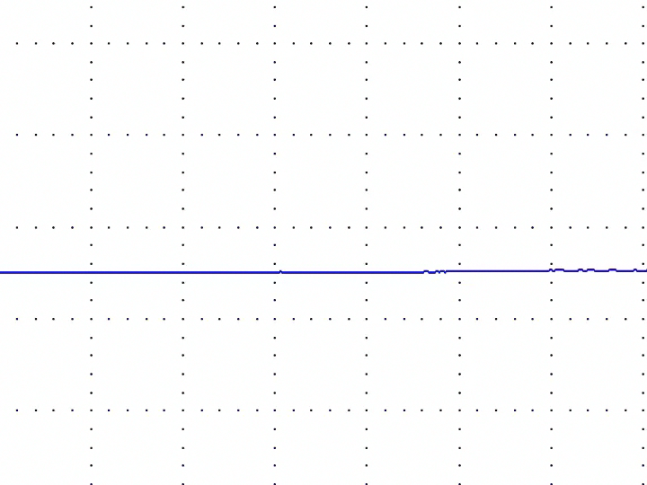
MUNE techniques
to document LMN involvement
“MUNE may have value in the assessment of progressive motor axon loss in ALS, and may have use as an end-point measure in clinical trials” (Bromberg and Brownell, 2008)
AND IF IT WAS NO ALS ? 31

Slide 11
To exclude others diagnosis
Neuroimaging, clinical laboratory and
nerve conduction studies will have been performed
Normal SNAP
MCV > 75% LLN
Minimal F-wave latencies < 130% ULN
DML and durations < 150% LLN
Absence of conduction block and of pathological temporal dispersion
Rapidly progressive amyotrophic lateral sclerosis initially masquerading demyelinating neuropathy
(NCCN, 2013)
AND IF IT WAS NO ALS ? 30

Slide 12
Awaji criteria sensitivity
By comparison to the revised El Escorial criteria (Airlie House), Awaji criteria led to a 23% increase in the population of patients classified as having probable/definite ALS
(Costal et al, 2012)
What about specificity ?
ALS patients (n=51) | Bulbar ALS
El Escorial + 40% | El Escorial + 43%
Awaji + 94% | Awaji + 83%
(Okital et al, 2011)
AND IF IT WAS NO ALS ? 29

Slide 13
False positive ALS diagnosis
Psychological stress
Implications for life and medical insurance and employment status
Curative treatment exist for some ALS mimic syndromes
Genetic implications resulting from delay in the diagnosis of inheritable diseases
In the context of clinical trials, appropriate inclusion and exclusion criteria is of crtical importance
AND IF IT WAS NO ALS ? 28

Slide 14
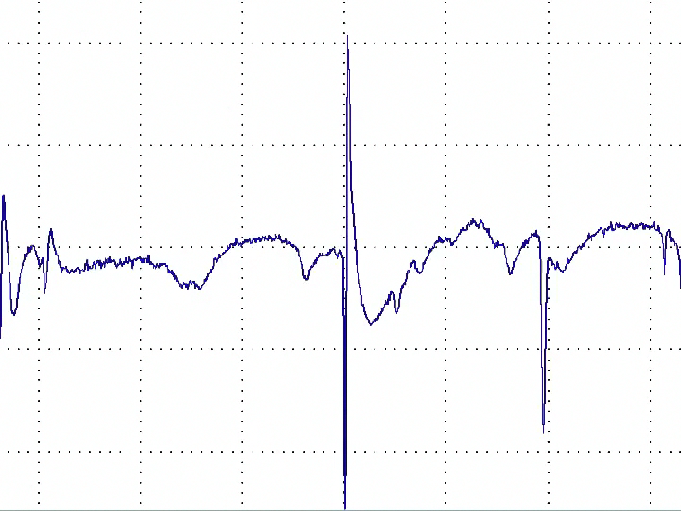
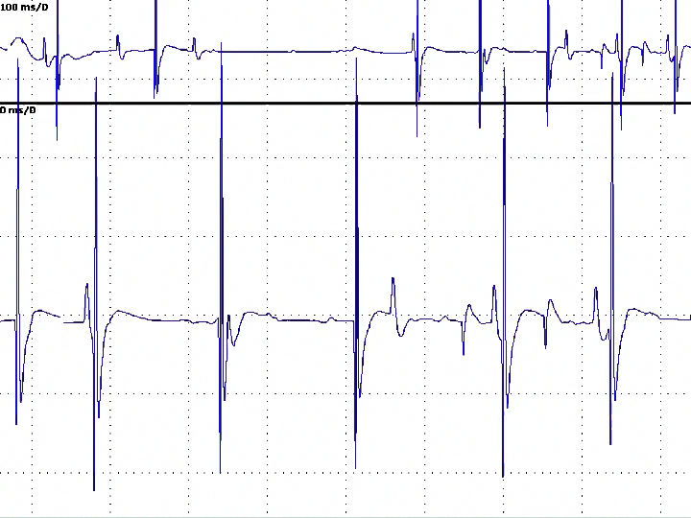
Differential diagnosis
Background :
radiotherapy, polio…
Borderline forms
ALS mimic disorders
Concomitant diseases
- false + ALS diagnosis : cervical + lumbar spine stenosis
falx meningioma + LSS
- false – ALS diagnosis : ALS + CSS (cervical laminectomy in 8%)
ALS + entrapment or neuropathies
AND IF IT WAS NO ALS ? 27

Slide 15
Borderline forms
Primary lateral sclerosis (PLS) : pure UMN syn.
Primary muscular atrophy (PMA) : pure LMN syn.
Progressive bulbar palsy (PBP) : bulbar -> pseudobulbar syn
With focal amyotrophy
- Flail arm syndrome (FAS)/Man-in-the barrel syn. :
scapular atrophy
- Flail leg syndrome (FLS)/pseudopolyneuritic ou Patrikios form of ALS : distal lower limb atrophy
AND IF IT WAS NO ALS ? 26

Slide 16
Primary lateral sclerosis
Rare, non-hereditary, DD > 3 years
Progressive spinobulbar spasticity
Wide spectrum from pure motor central involvement to forms which are not restricted to the central motor system
∆∆ : CSS or compression (MRI), MS (MRI, CSF), HSP,
syphilis, Lyme, HTLV
AND IF IT WAS NO ALS ? 25

Slide 17
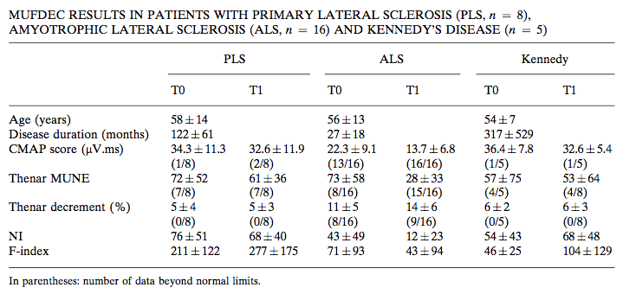
Primary lateral sclerosis
Wang et al, 2009
AND IF IT WAS NO ALS ? 24

Slide 18
ALS mimic disorders
The more frequent disorders
Myopathies Hirayama
Polymyositis MS
IBM Lacunar stroke
MMN PSP
Myasthenia Multi-system disorders
Kennedy’syndrome Prion diseases SCA
CMT 2F/dHMN (HSPB1), CMT 2L (HSPB8)
CMT 2D/HMN/Silver syndrome (GARS, BSCL2) (distal) SMA
Myelopathies Hexoaminidase A
Cervical spine stenosis Cramp-Fasciculation & Isaac’s syn
Syringomyelia Dys T & hyper PT, lymphoma, paraN
TOS and other compressive mononeuropathies
AND IF IT WAS NO ALS ? 23

Slide 19
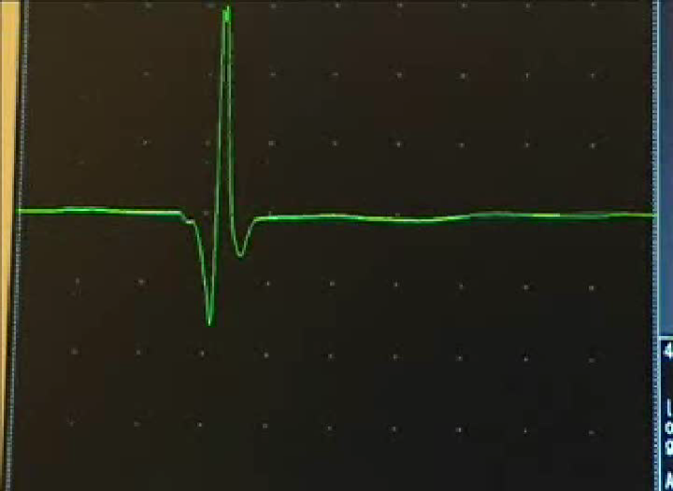
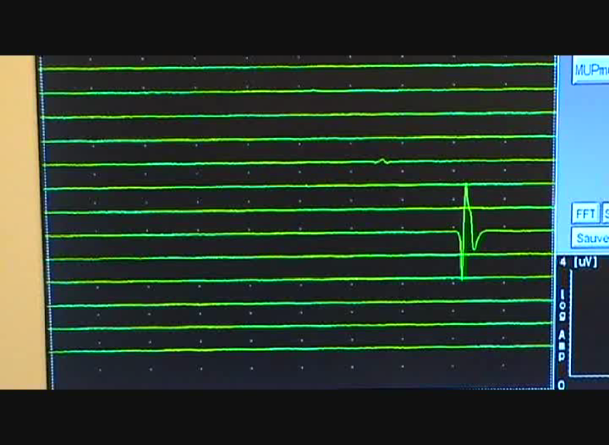
ALS mimic disorders
Fasciculation potentials
benign>< neurogenic
simple >< complex morphology
stable >< instable waveform
high >< low firing frequency
particularly after exercise >< even at rest
focal or distal muscles >< diffuse
Patients presenting with generalised fasciculations, even without neurological deficit, should be followed-up prior to excluding the diagnosis of ALS
AND IF IT WAS NO ALS ? 22

Slide 20
ALS mimic disorders
Onset
- proximal
- asymmetrical upper limb distal
- symmetrical upper limb distal
- lower limb distal
- bulbar or pseudo-bulbar
Sensory involvement, psy, before 30 years, fast progression
AND IF IT WAS NO ALS ? 21

Slide 21
ALS mimic disorders
Proximal onset (without pyramidal syndrome)
Myopathies Hirayama
Polymyositis MS
IBM Lacunar stroke
MMN PSP
Myasthenia Multi-system disorders
Kennedy’syndrome Prion diseases SCA
CMT 2F/dHMN (HSPB1), CMT 2L (HSPB8)
CMT 2D/HMN/Silver syndrome (GARS, BSCL2) (distal) SMA
Myelopathies Hexoaminidase A
Cervical spine stenosis Cramp-Fasciculation & Isaac’s syn
Syringomyelia Dys T & hyper PT, lymphoma, paraN
TOS and other compressive mononeuropathies
HBMNS (Fazio-Londe,
Brown-Vialetto-van Laere)
AND IF IT WAS NO ALS ? 20

Slide 22
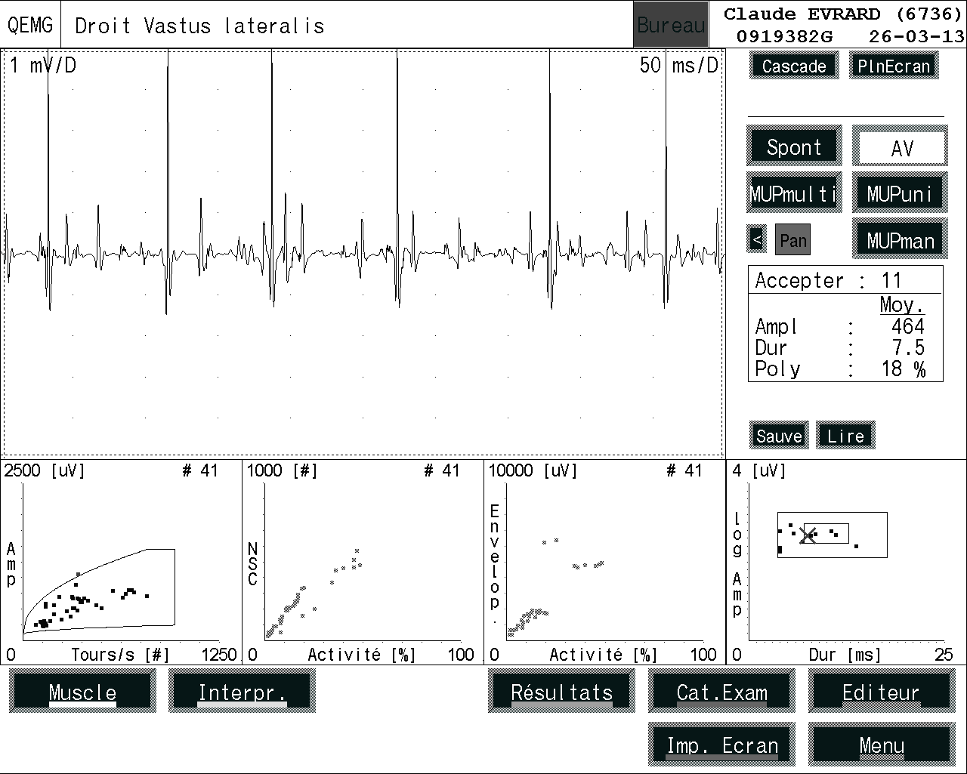
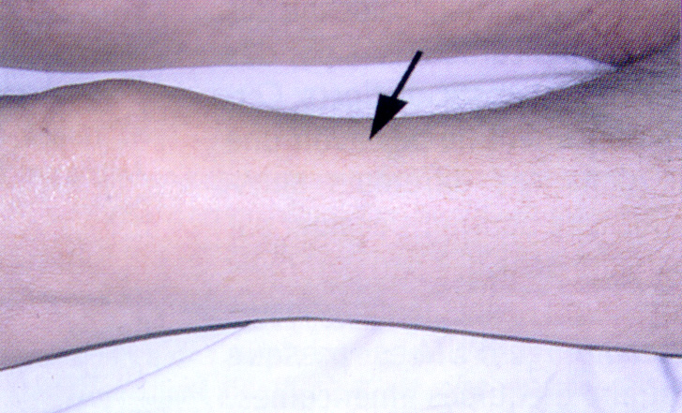
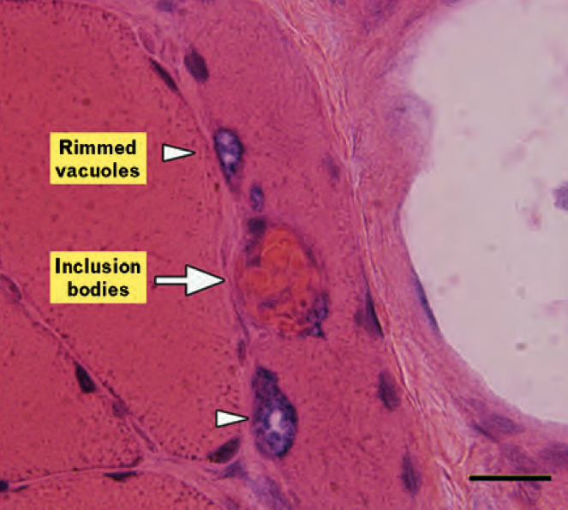
Inclusion Body Myositis
AND IF IT WAS NO ALS ? 19

Slide 23
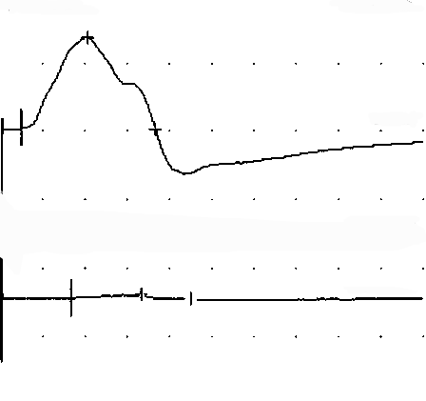
ALS mimic disorders
Asymmetrical upper limb distal onset, with cramps/fasciculations,
muscular weakness without atrophy (without pyramidal and bulbar syndrome)
Myopathies Hirayama
Polymyositis MS
IBM Lacunar stroke
MMN (TMS, TST) PSP
Myasthenia Multi-system disorders
Kennedy’syndrome Prion diseases SCA
CMT 2F/dHMN (HSPB1), CMT 2L (HSPB8)
CMT 2D/HMN/Silver syndrome (GARS, BSCL2) (distal) SMA
Myelopathies Hexoaminidase A
Cervical spine stenosis Cramp-Fasciculation & Isaac’s syn
Syringomyelia Dys T & hyper PT, lymphoma, paraN
TOS and other compressive mononeuropathies
HBMNS (Fazio-Londe,
Brown-Vialetto-van Laere)
AND IF IT WAS NO ALS ? 18

Slide 24
ALS mimic syndromes
Focal upper limb onset (sensory involvement, but pure motor nerves !)
ENMG +++ & cervical imagery +++
Myopathies Hirayama
Polymyositis MS
IBM Lacunar stroke
MMN PSP
Myasthenia Multi-system disorders
Kennedy’syndrome Prion diseases SCA
CMT 2F/dHMN (HSPB1), CMT 2L (HSPB8)
CMT 2D/HMN/Silver syndrome (GARS, BSCL2) (distal) SMA
Myelopathies Hexoaminidase A
Cervical spine stenosis Cramp-Fasciculation & Isaac’s syn
Syringomyelia Dys T & hyper PT, lymphoma, paraN
TOS and other compressive mononeuropathies (phrenic & deep ulnar)
HBMNS (Fazio-Londe,
Brown-Vialetto-van Laere)
AND IF IT WAS NO ALS ? 17

Slide 25
ALS mimic disorders
Focal upper limb onset with pyramidal syndrome (one tendon reflexe abolished,
little or no muscular atrophy) cervical imagery +++, MEP & SEP +++
Myopathies Hirayama
Polymyositis MS
IBM Lacunar stroke
MMN PSP
Myasthenia Multi-system disorders
Kennedy’syndrome Prion diseases SCA
CMT 2F/dHMN (HSPB1), CMT 2L (HSPB8)
CMT 2D/HMN/Silver syndrome (GARS, BSCL2) (distal) SMA
Myelopathies Hexoaminidase A
Cervical spine stenosis Cramp-Fasciculation & Isaac’s syn
Syringomyelia Dys T & hyper PT, lymphoma, paraN
TOS and other compressive mononeuropathies
HBMNS (Fazio-Londe,
Brown-Vialetto-van Laere)
AND IF IT WAS NO ALS ? 16

Slide 26
ALS mimic disorders
Symmetrical upper limb distal onset without bulbar syndrome
(familial history, vocal cord involvement in some dSMA)
Myopathies Hirayama
Polymyositis MS
IBM Lacunar stroke
MMN PSP
Myasthenia Multi-system disorders
Kennedy’syndrome Prion diseases SCA
CMT 2F/dHMN (HSPB1), CMT 2L (HSPB8)
CMT 2D/HMN/Silver syndrome (GARS, BSCL2) (distal) SMA
Myelopathies Hexoaminidase A
Cervical spine stenosis Cramp-Fasciculation & Isaac’s syn
Syringomyelia Dys T & hyper PT, lymphoma, paraN
TOS and other compressive mononeuropathies
HBMNS (Fazio-Londe,
Brown-Vialetto-van Laere)
AND IF IT WAS NO ALS ? 15

Slide 27
ALS mimic disorders
Lower limb distal onset
Myopathies Hirayama
Polymyositis MS
IBM Lacunar stroke
MMN PSP
Myasthenia Multi-system disorders
Kennedy’syndrome Prion diseases SCA
CMT 2F/dHMN (HSPB1), CMT 2L (HSPB8)
CMT 2D/HMN/Silver syndrome (GARS, BSCL2) (distal) SMA
Myelopathies Hexoaminidase A
Cervical spine stenosis Cramp-Fasciculation & Isaac’s syn
Syringomyelia Dys T & hyper PT, lymphoma, paraN
TOS and other compressive mononeuropathies
HBMNS (Fazio-Londe,
Brown-Vialetto-van Laere)
AND IF IT WAS NO ALS ? 14

Slide 28
ALS mimic disorders
Axonal Charcot-Marie-Tooth (CMT 2)
CMT 2L/HMN 2A (HSPB8)
Distal Hereditary Motor Neuropathies (dHMN)
(distal Spinal Muscular Atrophy – distal SMA)
- upper limb predominance (HMN 5)
HMN 5A (GARS)
HMN 5C (BSCL2)
- vocal cord paralysis (HMN 7)
HMN 7A & 7B
congenital (TRPV4)
- UMN involvement
HMN 5C (BSCL2)
HMN 2B/CMT 2F (HSPB1)
Spastic paraplegia + PNP
Silver syndrome/SPG 17 (BSCL2)
AND IF IT WAS NO ALS ? 13

Slide 29
ALS mimic disorders
Bulbar onset
ENMG +++ (SNAP, decrements, FUEMG)
Myopathies Hirayama
Polymyositis MS
IBM Lacunar stroke
MMN PSP
Myasthenia Multi-system disorders
Kennedy’syndrome Prion diseases SCA
CMT 2F/dHMN (HSPB1), CMT 2L (HSPB8)
CMT 2D/HMN/Silver syndrome (GARS, BSCL2) (distal) SMA
Myelopathies Hexoaminidase A
Cervical spine stenosis Cramp-Fasciculation & Isaac’s syn
Syringomyelia Dys T & hyper PT, lymphoma, paraN
TOS and other compressive mononeuropathies
HBMNS (Fazio-Londe,
Brown-Vialetto-van Laere)
AND IF IT WAS NO ALS ? 12

Slide 30
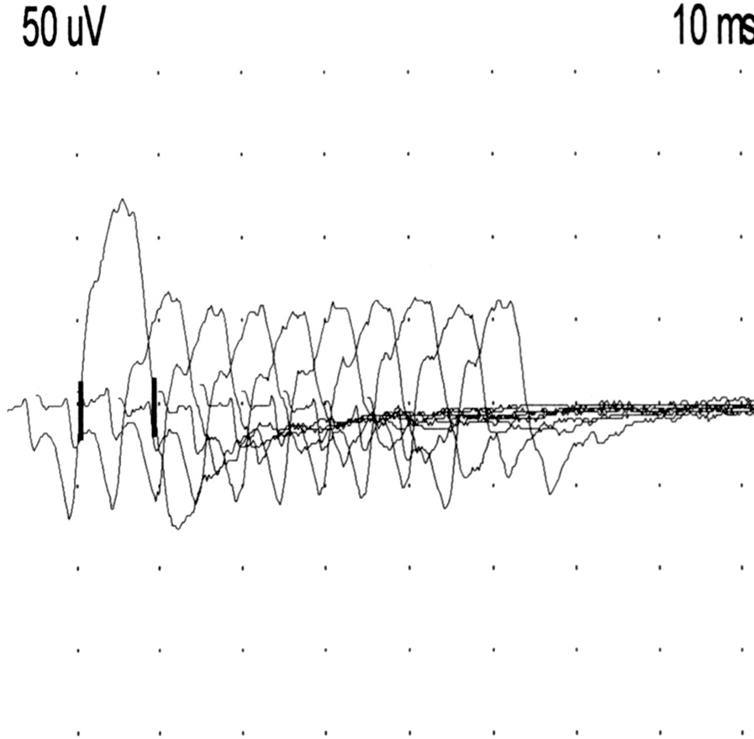
ALS mimic disorders
Bulbar onset
ENMG +++ (SNAP, decrements, FUEMG)
25
8/15 > 10 %
max. : 35 %
p < 0,005
Thenar decrements (%)
20
15
10
5
5,8
14,9
0
Controls
ALS
Wang et al, 2001
AND IF IT WAS NO ALS 11

Slide 31
ALS mimic disorders
Pseudo-bulbar onset (extrapyramidal and/or cerebellar syndrome,
urinary disturbance) Cerebral imagery +++
Myopathies Hirayama
Polymyositis MS
IBM Lacunar stroke
MMN PSP
Myasthenia Multi-system disorders
Kennedy’syndrome Prion diseases SCA
CMT 2F/dHMN (HSPB1), CMT 2L (HSPB8)
CMT 2D/HMN/Silver syndrome (GARS, BSCL2) (distal) SMA
Myelopathies Hexoaminidase A
Cervical spine stenosis Cramp-Fasciculation & Isaac’s syn
Syringomyelia Dys T & hyper PT, lymphoma, paraN
TOS and other compressive mononeuropathies
HBMNS (Fazio-Londe,
Brown-Vialetto-van Laere)
AND IF IT WAS NO ALS ? 10

Slide 32
ALS mimic disorders
Sensory involvement (SNAP decreased amplitude)
Myopathies Hirayama
Polymyositis MS
IBM (polyneuropathy) Lacunar stroke
MMN PSP
Myasthenia Multi-system disorders
Kennedy’syndrome Prion diseases SCA 3 (spasticity + PNP)
CMT 2F/dHMN (HSPB1), CMT 2L (HSPB8)
CMT 2D/HMN/Silver syndrome (GARS, BSCL2) (distal) SMA
Myelopathies Hexoaminidase A
Cervical spine stenosis Cramp-Fasciculation & Isaac’s syn
Syringomyelia Dys T & hyper PT, lymphoma, paraN
TOS and other compressive mononeuropathies
HBMNS (Fazio-Londe,
Brown-Vialetto-van Laere)
(M-prot, anemia, inflammatory syn, CF/elevated prot level)
AND IF IT WAS NO ALS ? 9

Slide 33
ALS mimic disorders
Dementia, psychiatric manifestations, familial history
Myopathies Hirayama
Polymyositis MS
IBM Lacunar stroke
MMN PSP
Myasthenia Multi-system disorders
Kennedy’syndrome Prion diseases SCA
CMT 2F/dHMN (HSPB1), CMT 2L (HSPB8)
CMT 2D/HMN/Silver syndrome (GARS, BSCL2) (distal) SMA
Myelopathies Hexoaminidase A
Cervical spine stenosis Cramp-Fasciculation & Isaac’s syn
Syringomyelia Dys T & hyper PT, lymphoma, paraN
TOS and other compressive mononeuropathies
HBMNS (Fazio-Londe,
Brown-Vialetto-van Laere)
AND IF IT WAS NO ALS ? 8

Slide 34
ALS mimic disorders
Onset : before 30 years
(Familial history)
Myopathies Hirayama
Polymyositis MS
IBM Lacunar stroke
MMN PSP
Myasthenia Multi-system disorders
Kennedy’syndrome Prion diseases SCA
CMT 2F/dHMN (HSPB1), CMT 2L (HSPB8)
CMT 2D/HMN/Silver syndrome (GARS, BSCL2) (distal) SMA
Myelopathies Hexoaminidase A
Cervical spine stenosis Cramp-Fasciculation & Isaac’s syn
Syringomyelia Dys T & hyper PT, lymphoma, paraN
TOS and other compressive mononeuropathies
HBMNS (Fazio-Londe,
Brown-Vialetto-van Laere)
AND IF IT WAS NO ALS ? 7

Slide 35
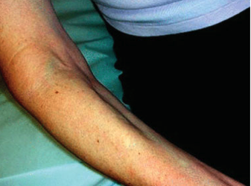
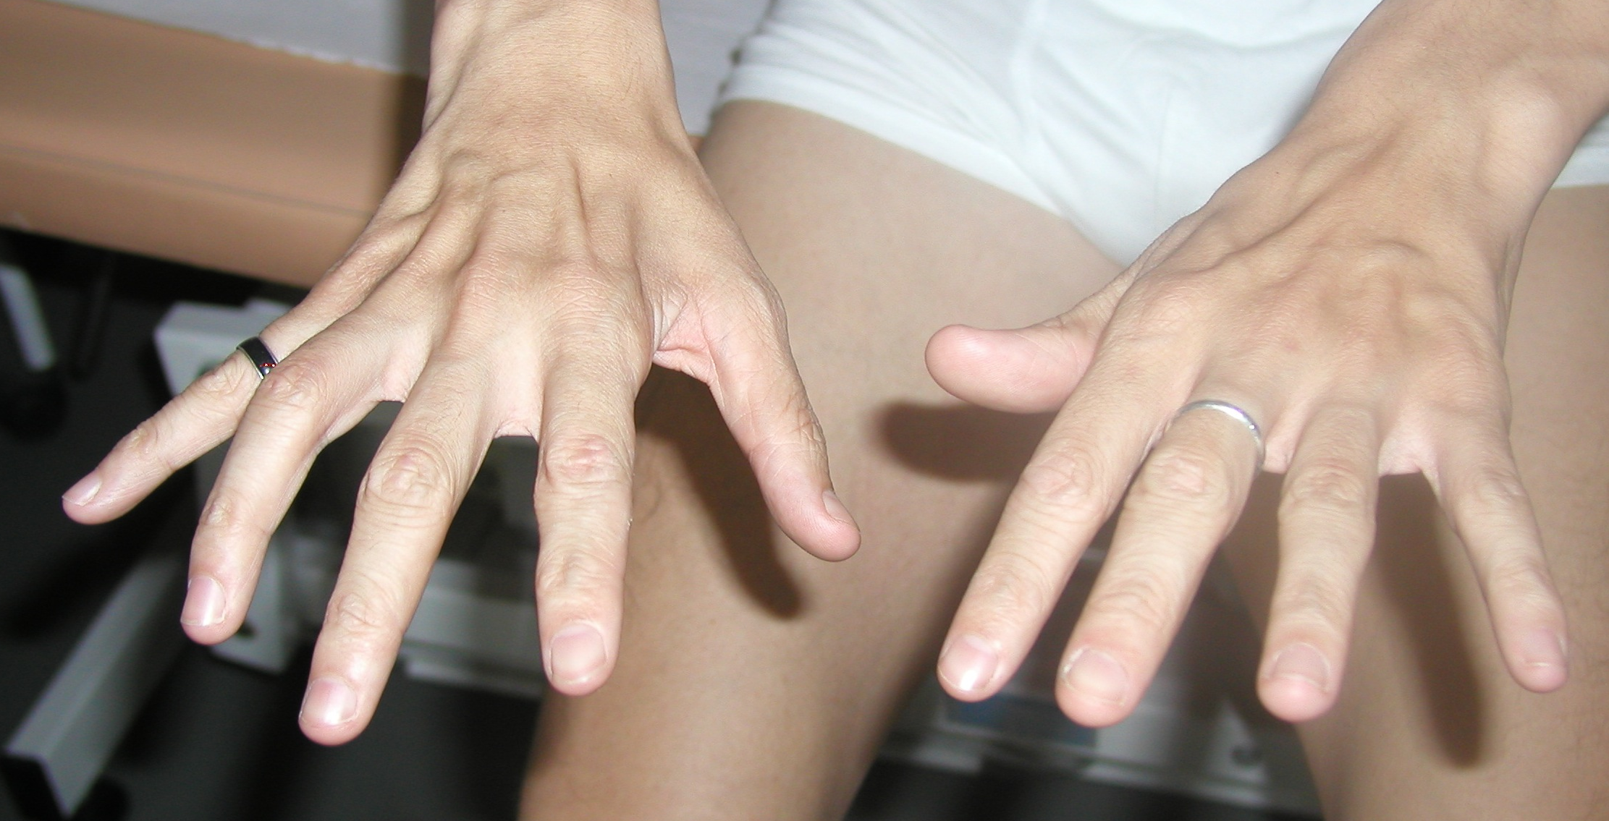
Hirayama’s disease
Hirayama’s disease occurs almost exclusively in males of 15-25 years
Insidious onset of oblique amyotrophy, distributed mainly to C7, C8 and T1 myotomes, unilateral in many cases or asymmetric
Progressive course and arrest within 3 to 6 years after onset
AND IF IT WAS NO ALS ? 6

Slide 36
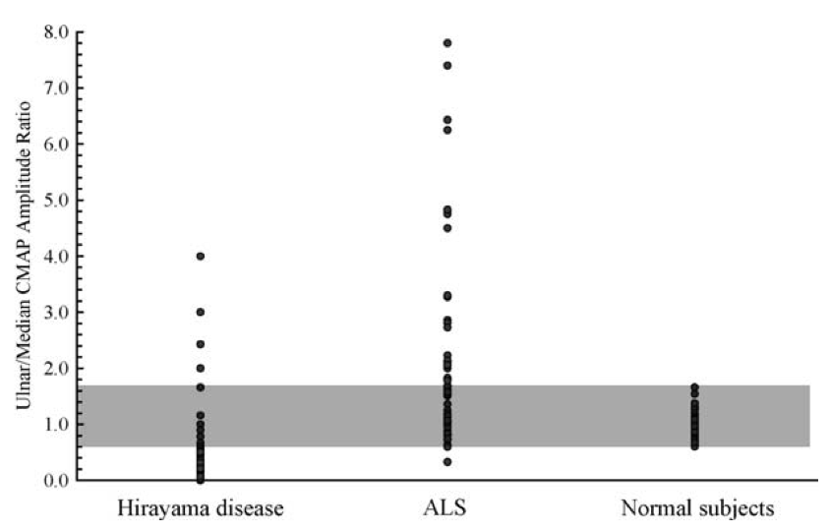
Hirayama’s disease
Ulnar territory is more affected than median territory
Ulnar/median CMAP amplitude ratio
(Lyu et al, 2011)
[0.6 – 1.7] : normal subjects
> 1.7 : ALS (< 0.6 in 1/60), TOS
< 0.6 : Hirayama’s disease (34/46)
cervical spondylotic amyotrophy
AND IF IT WAS NO ALS ? 5

Slide 37
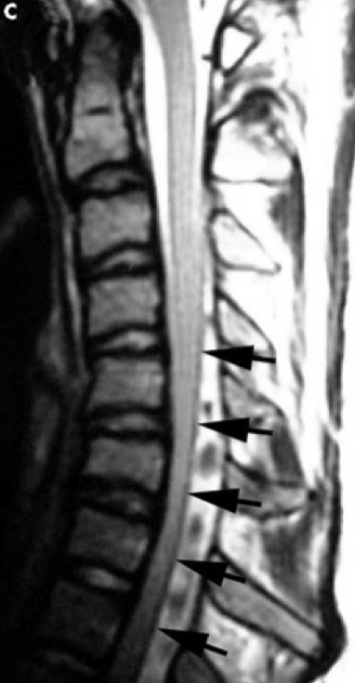
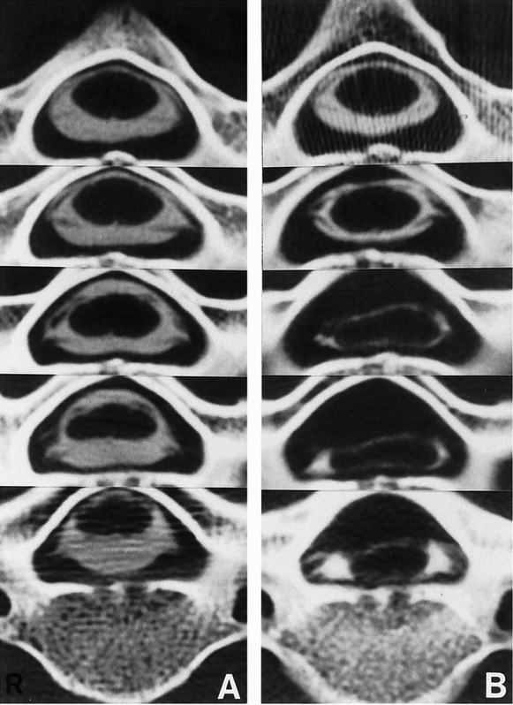
Hirayama’s disease
Localized and asymmetrical atrophy of the spinal cord at the lower cervical levels with forward displacement of the posterior wall of the dural canal in neck flexion
Hypothesis : increased intramedullary pressure resulting in microcirculatory disturbance in the anterior horn (the most vulnerable structure to ischemia)
AND IF IT WAS NO ALS ? 4

Slide 38
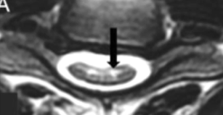
Hirayama borderline forms
Chronic segmental SMA
(O’Sullivan – Mc Leod syndrome)
- more progressive course
Partial spinal anterior artery syn.
- subacute or chronic course
- T2 hyperintense cord signal
in anterior horn
(snake eyes in MRI transversal plane)
AND IF IT WAS NO ALS ? 3

Slide 39
ALS mimic disorders
Fast progression
Myopathies Hirayama
Polymyositis MS
IBM Lacunar stroke
MMN PSP
Myasthenia Multi-system disorders
Kennedy’syndrome Prion diseases SCA
CMT 2F/dHMN (HSPB1), CMT 2L (HSPB8)
CMT 2D/HMN/Silver syndrome (GARS, BSCL2) (distal) SMA
Myelopathies Hexoaminidase A
Cervical spine stenosis Cramp-Fasciculation & Isaac’s syn
Syringomyelia Dys T & hyper PT, lymphoma, paraN
TOS and other compressive mononeuropathies
AND IF IT WAS NO ALS ? 2

Slide 40
Thank you
http://enmgblog.blogspot.be
AND IF IT WAS NO ALS ? 1

