Slide 1




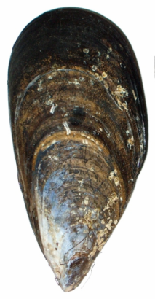

Ecology of trace elements
in
Mytilus galloprovincialis
Richir Jonathan
Lepoint Gilles
Lejeune Pierre
Gobert Sylvie

Slide 2
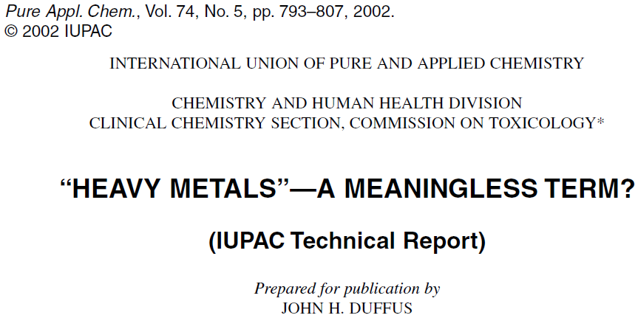
Trace elements
IUPAC Compendium of Chemical Terminology - the Gold Book
trace element
Any element having an average concentration of less than about 100 parts per million atoms (ppma) or less than 100 µg/g.
(goldbook.iupac.org)

Slide 3
Trace elements
(after Amiard 2011)

Slide 4
Trace elements
(after Amiard 2011)

Slide 5
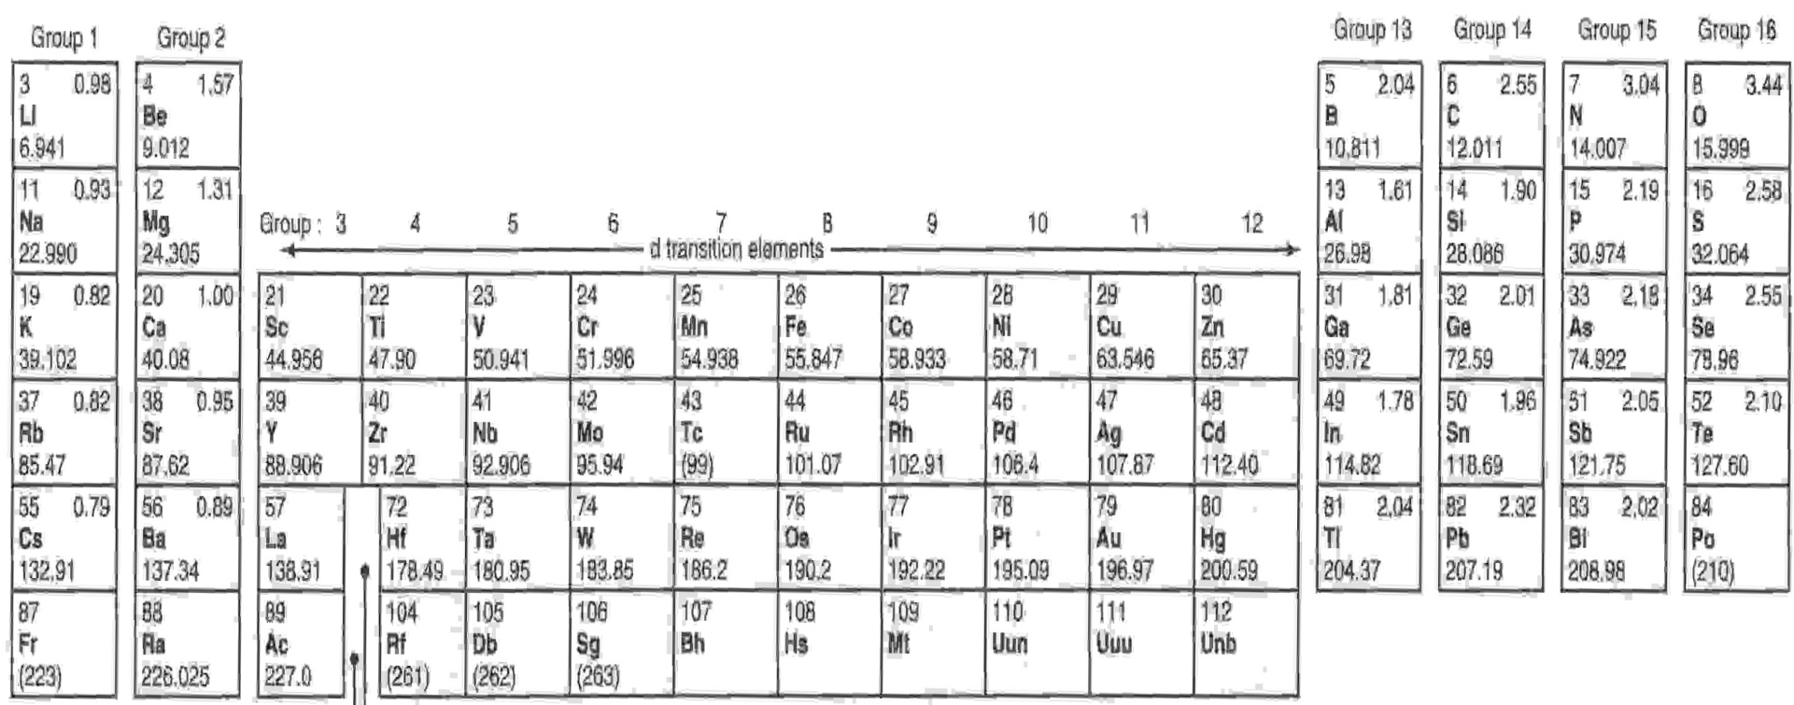
Trace element monitoring
trace elements
environmental contamination

Slide 6
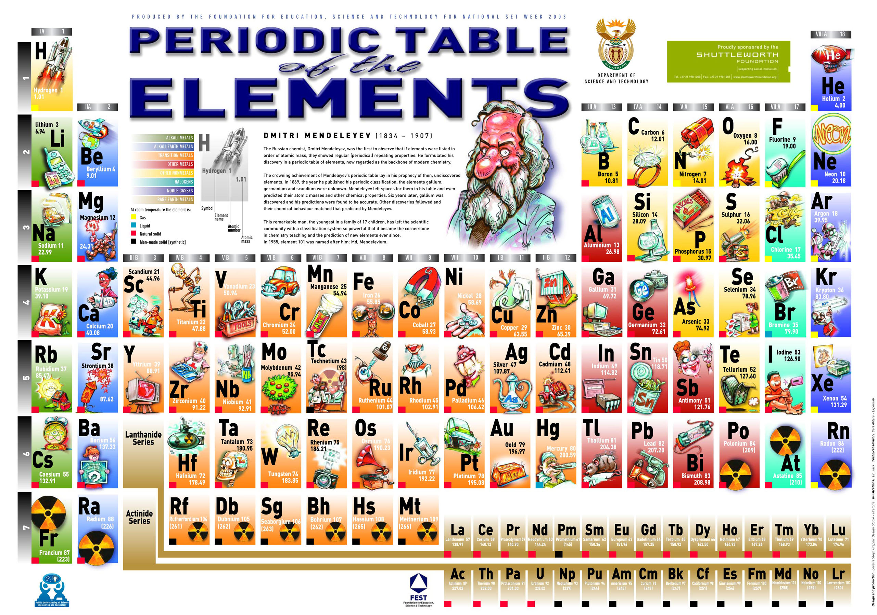

Slide 7
World production of trace elements
World production of V, Bi and Sb (in metric tons per year) from 1985 until 2011 (data compiled from the USSG website: www.usgs.gov).

Slide 8
World production of trace elements
X 2.0
X 3.1
X 3.1
World production of V, Bi and Sb (in metric tons per year) from 1985 until 2011 (data compiled from the USSG website: www.usgs.gov).

Slide 9
Trace element monitoring
trace elements
environmental contamination

Slide 10
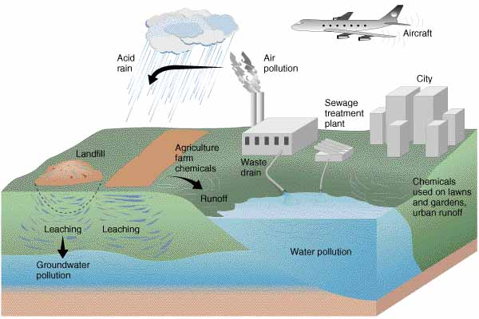
Coastal water pollution
Coastal water pollution
apesnature.homestead.com
(apesnature.homestead.com)

Slide 11

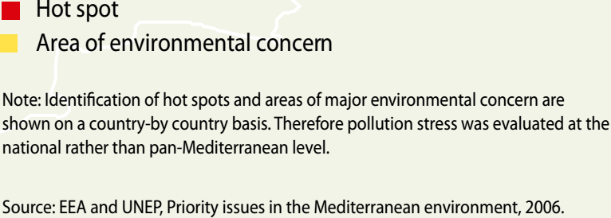
Coastal pollution of the Mediterranean
(UNEP/MAP, 2012)

Slide 12
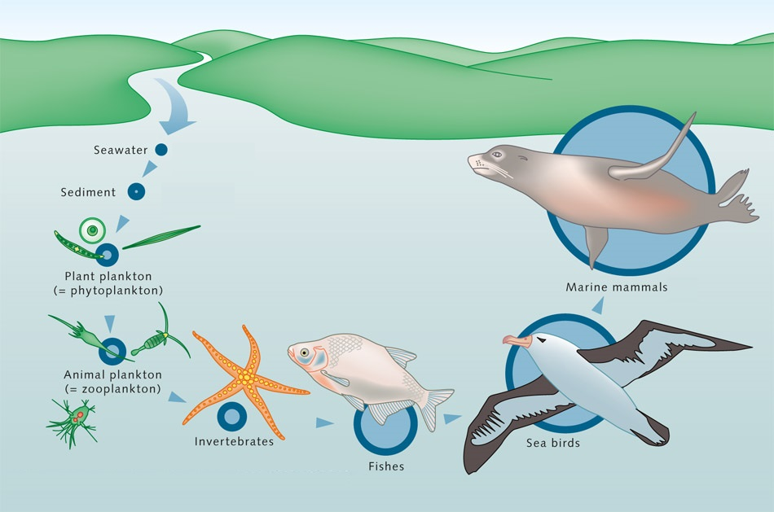
Bioaccumulation
(worldoceanreview.com)

Slide 13
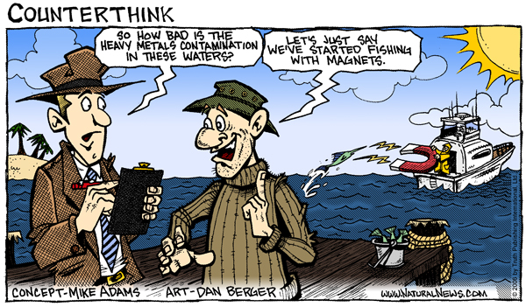
Public health issue

Slide 14
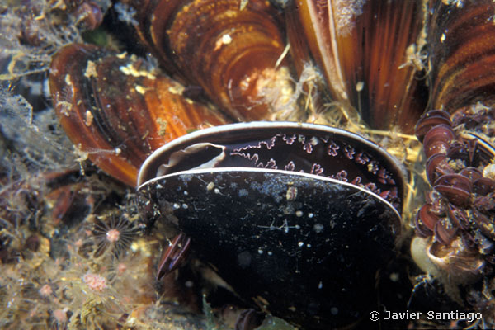
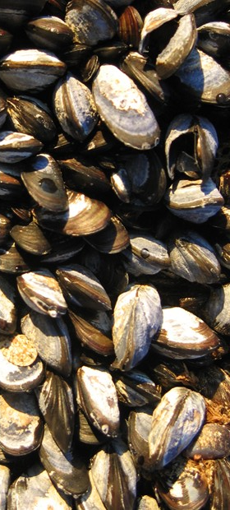
Mytilus galloprovincialis
www.wwfsassi.co.za/
www.vuvb.uniza.sk.

Slide 15
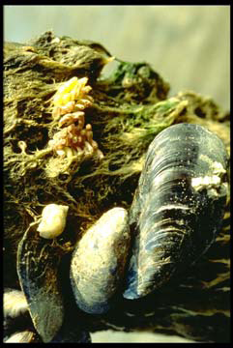
Mytilus spp. as bioindicator
Characteristics of a quantitative bioindicator
(Butler et al., 1971; Phillips et Rainbow, 1994)
Bioconcentration: [TE_{individual}] > [TE_{meadow}]
Accumulation of contaminants without letal effect
Utilisation of Mytilus spp.
Resistant to pollution
Concentration factor: 10⁴ in average.
Sessile spacies, wide distribution, stable population
Euryhaline organisms and contaminant vector to humans
www.wwfsassi.co.za/
[TE_{individual}] = f ( [TE_{meadow}] )
©Casas

Slide 16
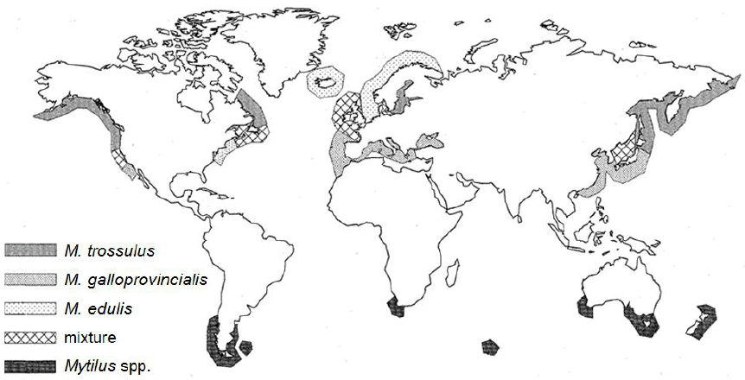
Mytilus spp. distribution
(modified after Hilbish et al., 2010)

Slide 17
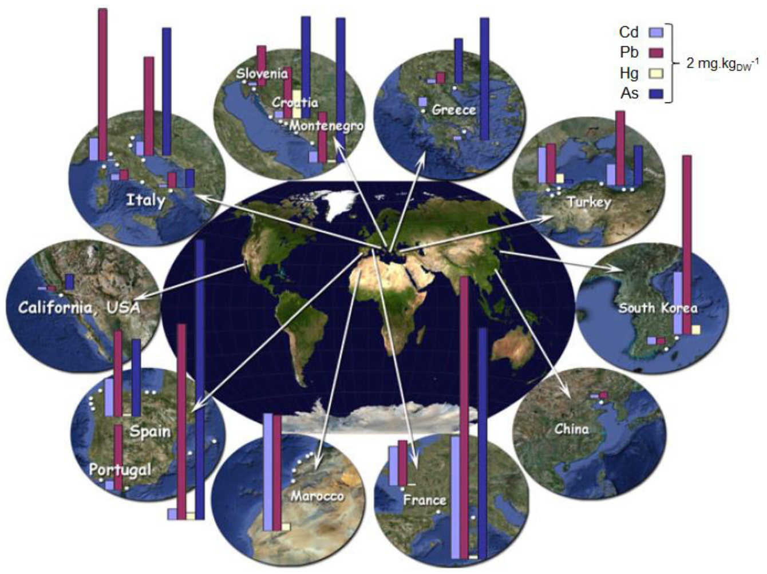
Mytilus galloprovincialis = shellfish product
= 0.4 mg.kg_{FW}⁻¹
(Stankovic and Jovic, 2012)
Maximum permissible limits fixed by the European Comission (EC, 2001) in edible tissues of mussels: 0.5 mg.kg⁻¹ for Hg and 1 mg.kg⁻¹ for Cd and Pb (related to fresh weight).

Slide 18
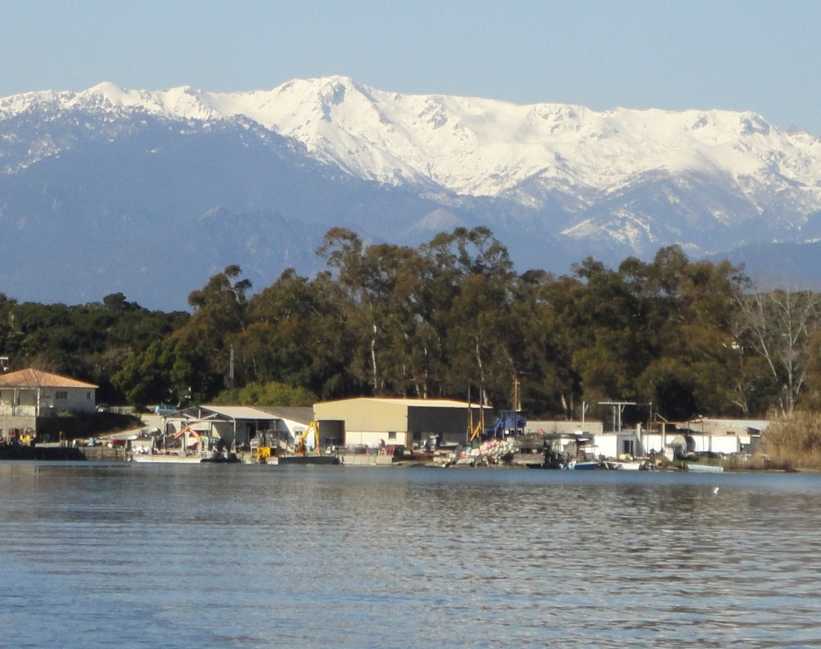
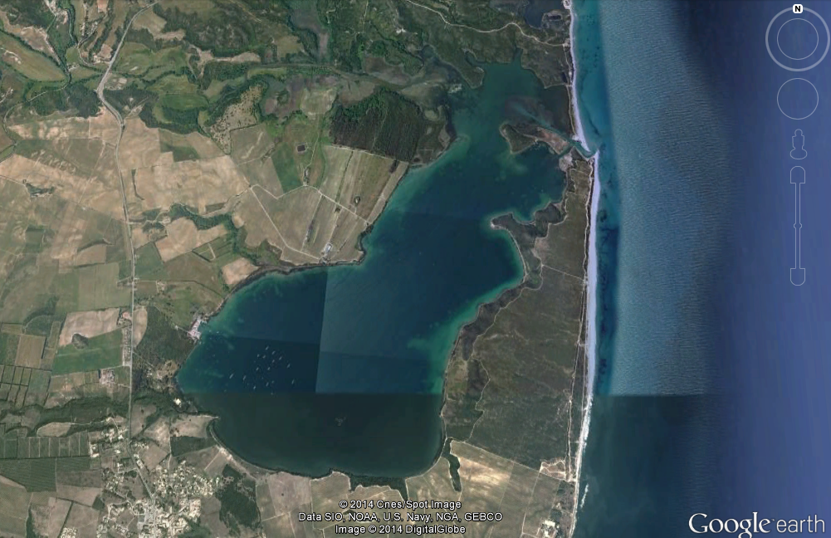
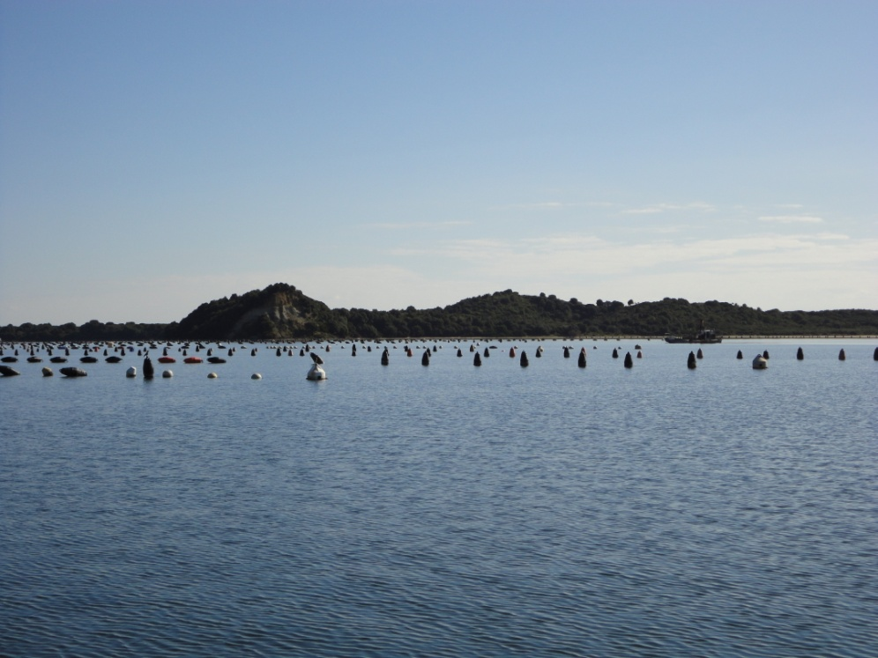
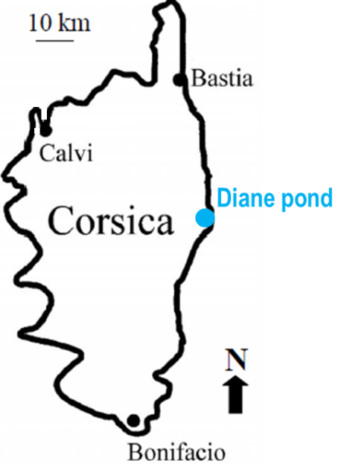
Diane pond

Slide 19
TE bioaccumulation in M. galloprovincialis

Slide 20
TE bioaccumulation in M. galloprovincialis

Slide 21
TE bioaccumulation in M. galloprovincialis

Slide 22
TE bioaccumulation in M. galloprovincialis

Slide 23
TE bioaccumulation in M. galloprovincialis
Average bioconcentration factor = 10⁴

Slide 24
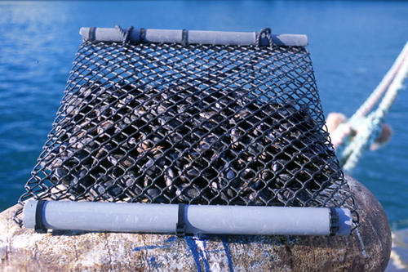
M. galloprovincialis monitoring station
©Ifremer

Slide 25
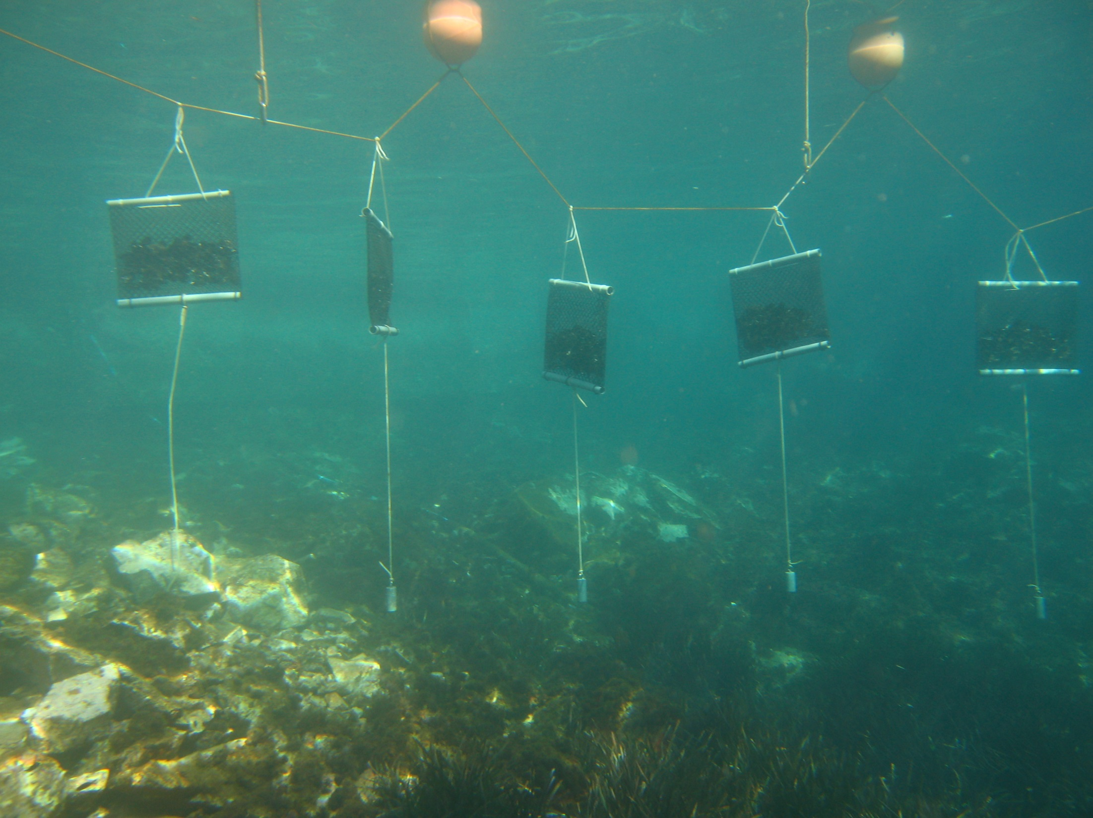

Slide 26
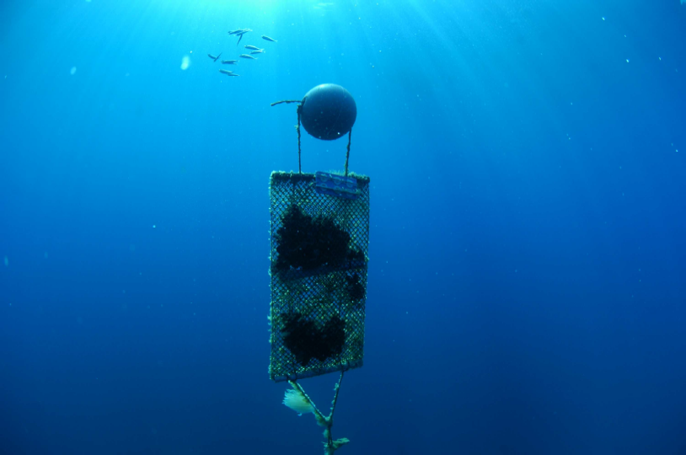
M. galloprovincialis monitoring station
www.wwfsassi.co.za/
©Ifremer/E. Emery

Slide 27
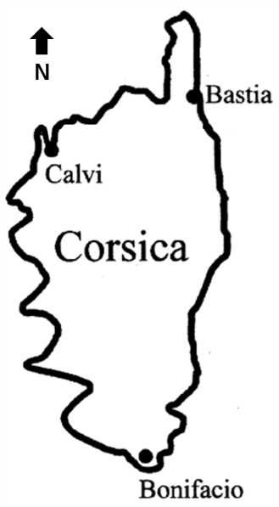
Mussel caging

Slide 28
Mussel caging
Lifestyle of bioindicator species
M. galloprovincialis = filter feeder

Slide 29
Mussel caging
Lifestyle of bioindicator species
M. galloprovincialis = filter feeder
→ homogenous and clean status of the water column of the Calvi Bay;

Slide 30

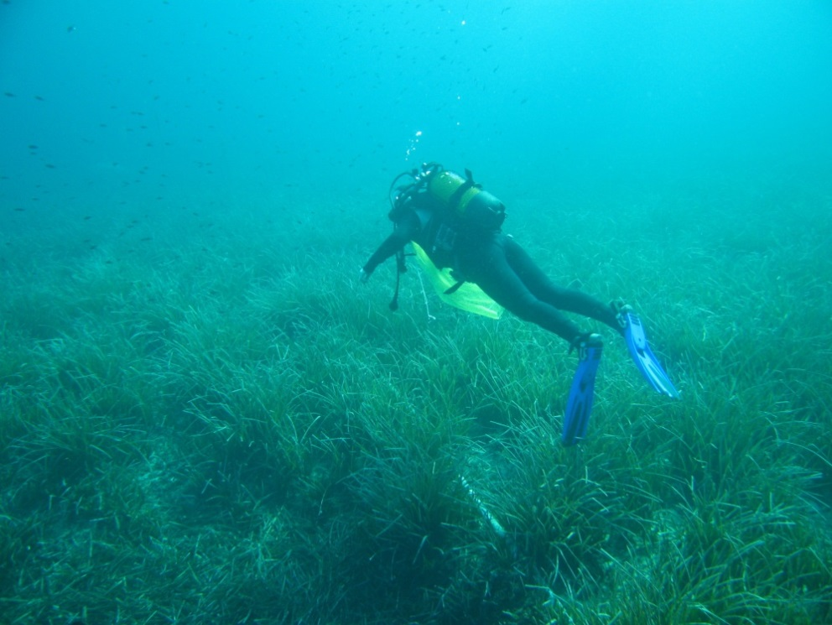
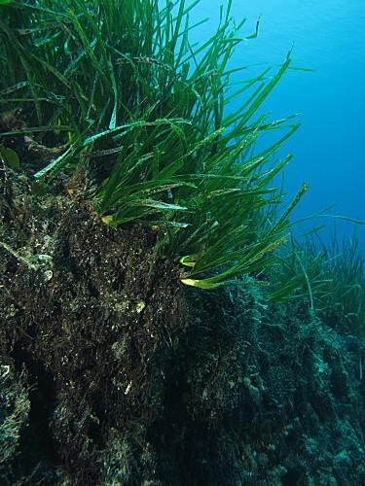
Posidonia oceanica
© A. Abadie
(after Boudouresque and Meinesz, 1982)

Slide 31
Bioindicator complementarity
Lifestyle of bioindicator species
M. galloprovincialis = filter feeder
→ homogenous and clean status of the water column of the Clavi Bay;
P. oceanica = rooted primary producer
→ weak point sources of long-term accumulations of pollutants in sediments.
► 2 complementary species concomitantly used.

Slide 32
Global contamination by Cd, Ni, Hg and Pb
France
Corsica
Italy
Western Mediterranean
Spain
Baleares
Sardinia
Sicily
Algeria
Tunisia
Morocco
© A. Abadie
©Ifremer/E. Emery

Slide 33

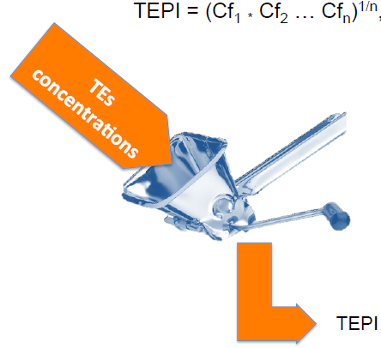
Trace Element Pollution Index (TEPI)
How to compare global pollution levels in TEs between several monitored sites ?
TEPI = (Cf₁ * Cf₂ … Cf_{n})^{1/n},
where:
Cf_{n} is the mean normalized concentration of the TE n in a given monitored site.
The highest the index value, the more the monitored site is globally contaminated by TEs compared to the others.
TEPI values

Slide 34
France
Corsica
Italy
Western Mediterranean
Spain
Baleares
Sardinia
Algeria
Tunisia
Morocco
France
Corsica
Italy
Western Mediterranean
Spain
Baleares
Sardinia
Algeria
Tunisia
Morocco

Slide 35
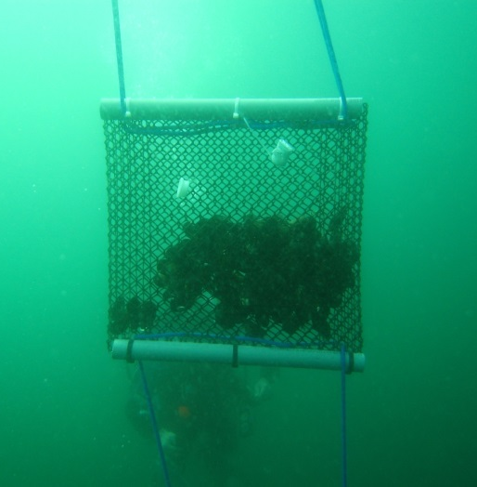
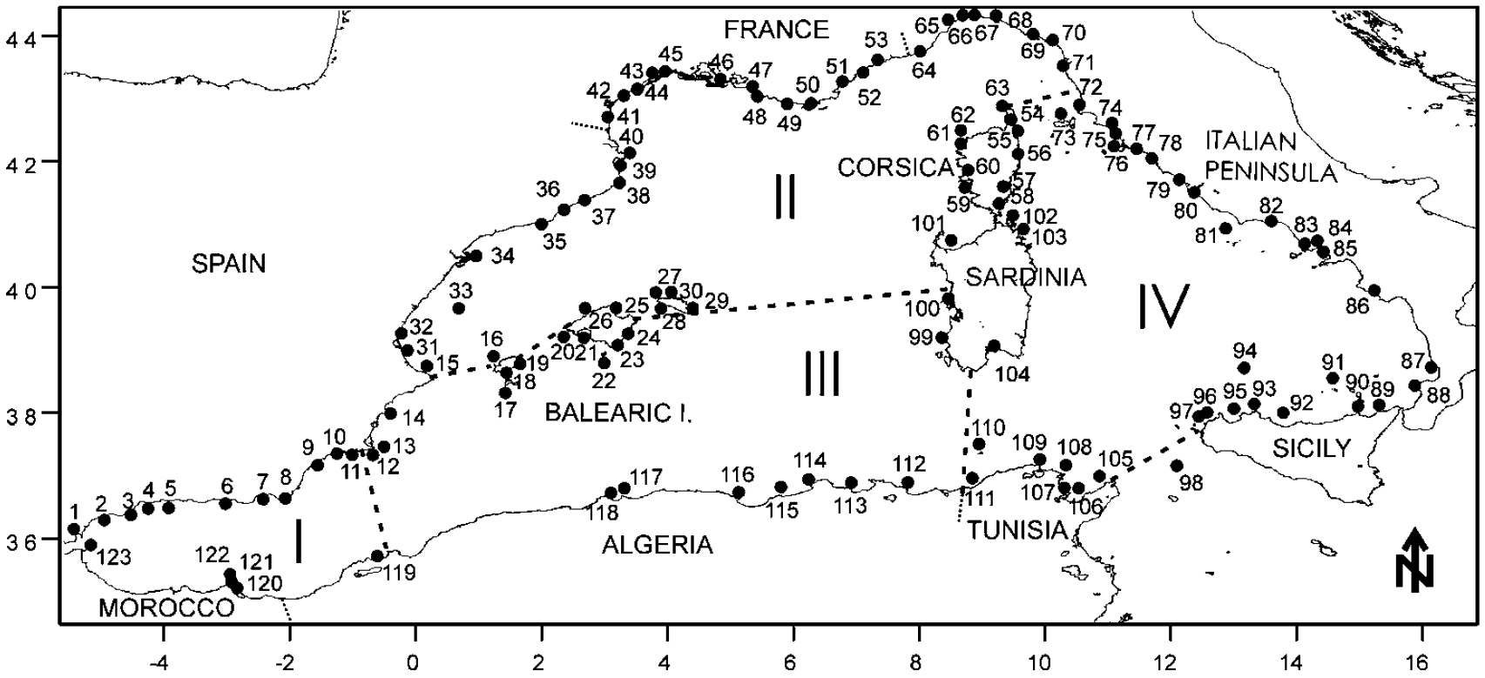
Trophic conditions
©Ifremer/E. Emery
(Benedicto et al. 2011)

Slide 36
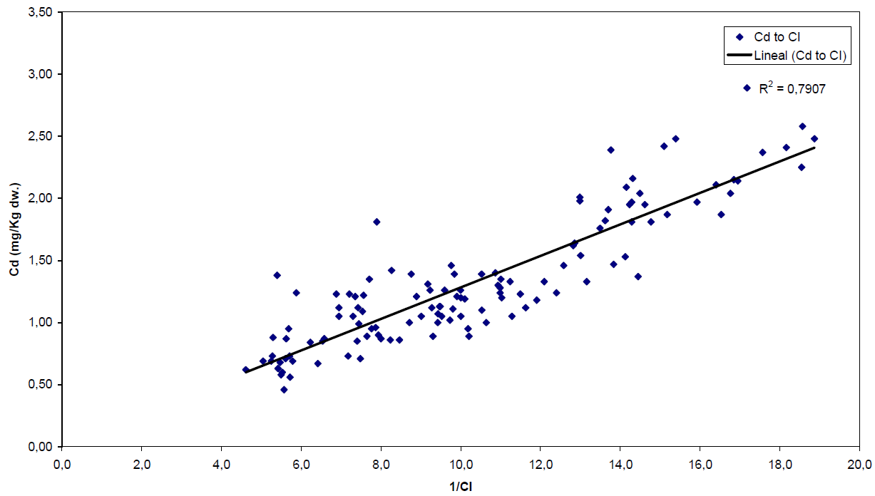

Trophic conditions
C = metal concentration
m = metal-specific linear regression slope
CI = condition index = flesh DW/shells DW
©Ifremer/E. Emery
(Benedicto et al. 2011)

Slide 37
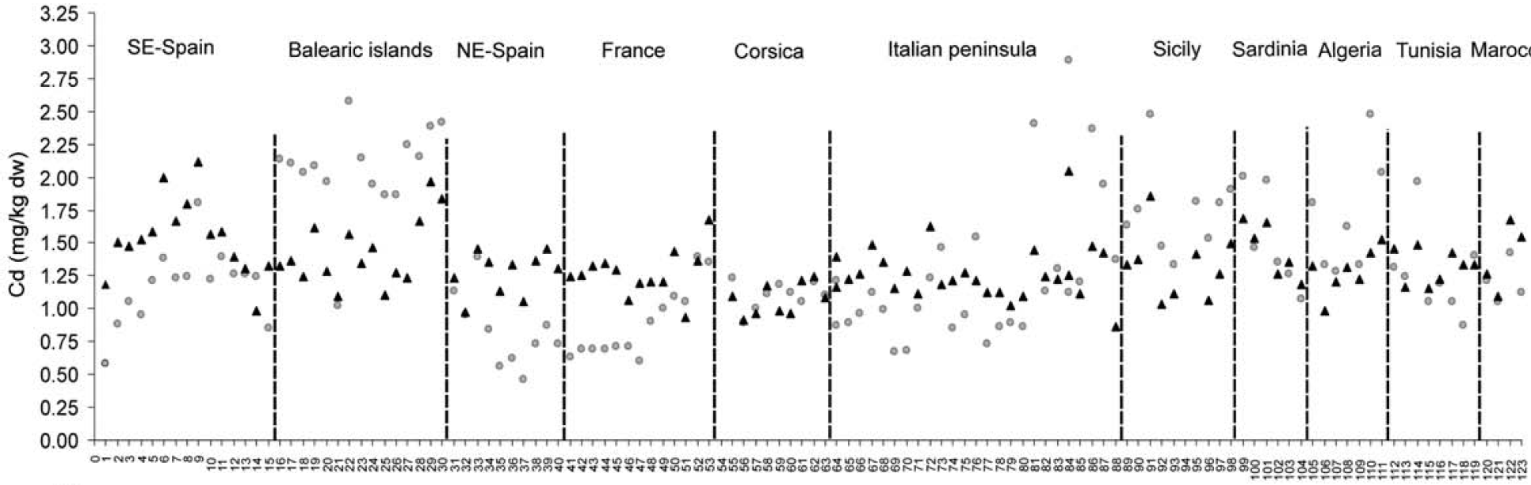
Raw O and adjusted ▲ [Cd] (Benedicto et al. 2011)

Slide 38
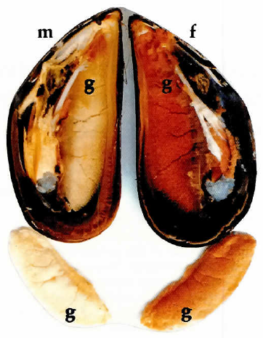
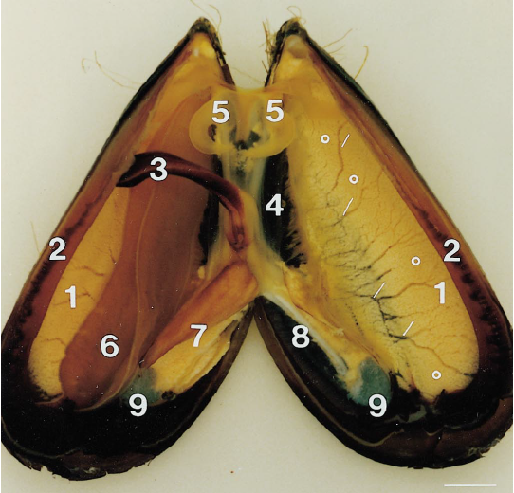
Compartmentalization
Tissue morphology in M. galloprovincialis. Left - opened sexually matured male (m) and female (f) mussels and isolated gonads (g) (Mikhailov et al. 1995). Right - 1 = mantle (gonad), 2 = muscular mantle edge, 3 = foot, 4 = hepatopancreas, 5 = labial palps, 6 = gills, 7 = visceral mass, 8 = foot retractor muscle, 9 = posterior adductor muscle, circles = gonad follicle regions spread over the mantle, small white lines = indicate gonad duct). Scale bar 1 cm (Torrado and Mikhailov, 2000).

Slide 39
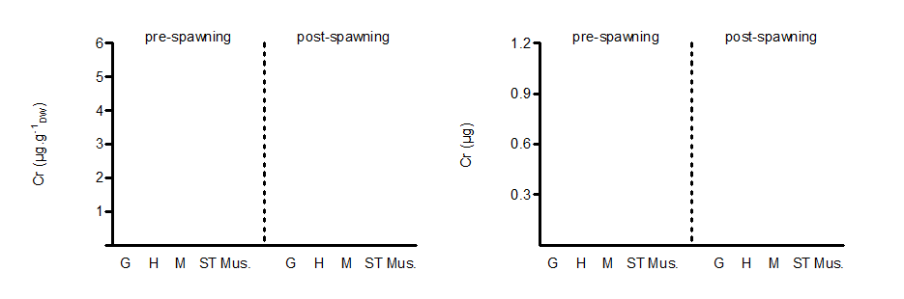
Compartmentalization
February
2011
March
2010
February
2011
March
2010
www.wwfsassi.co.za/

Slide 40
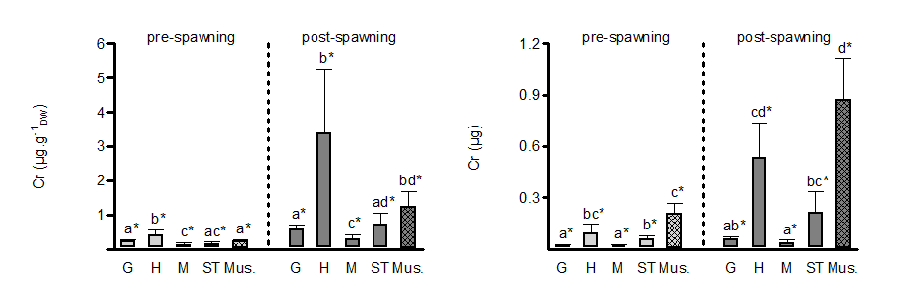
Compartmentalization
spawning + annual variability = increase
www.wwfsassi.co.za/

Slide 41
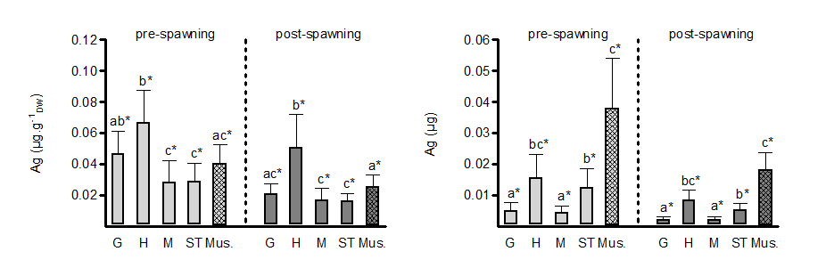
Compartmentalization
spawning + annual variability = increase
spawning + annual variability = decrease
www.wwfsassi.co.za/

Slide 42
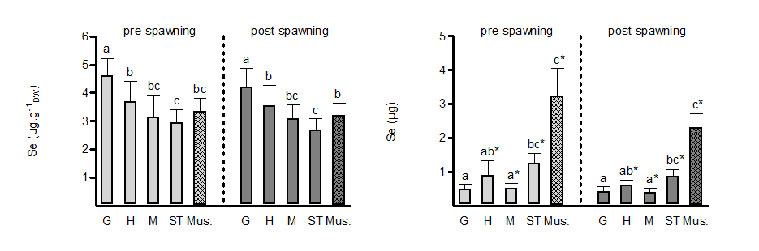
Compartmentalization
spawning + annual variability = conc. idem and content decrease

Slide 43
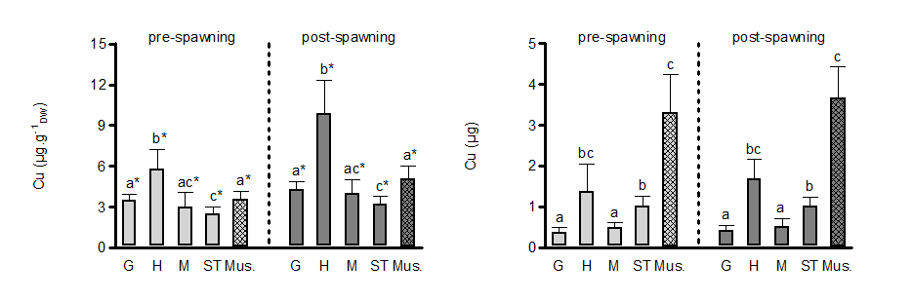
Compartmentalization
spawning + annual variability = conc. idem and content decrease
spawning + annual variability = idem

Slide 44

Sea, sex and size …
Influence of size on TE accumulation by mussels grown on ropes:
→ YES?
→ NO?
Influence of sex on TE accumulation prior to spawn:
→ males vs females.

Slide 45
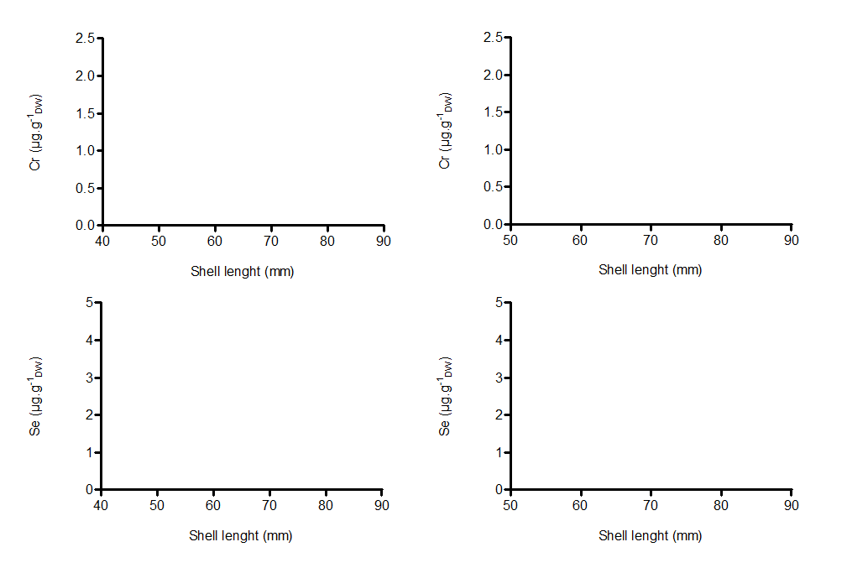
Sea, sex and size …

Slide 46
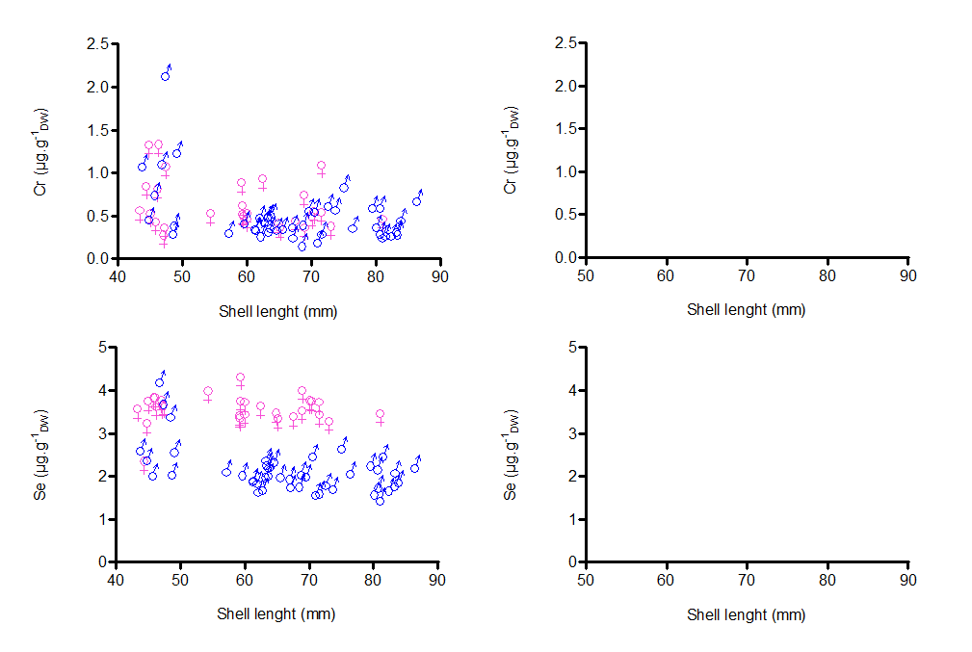
Sea, sex and size …

Slide 47
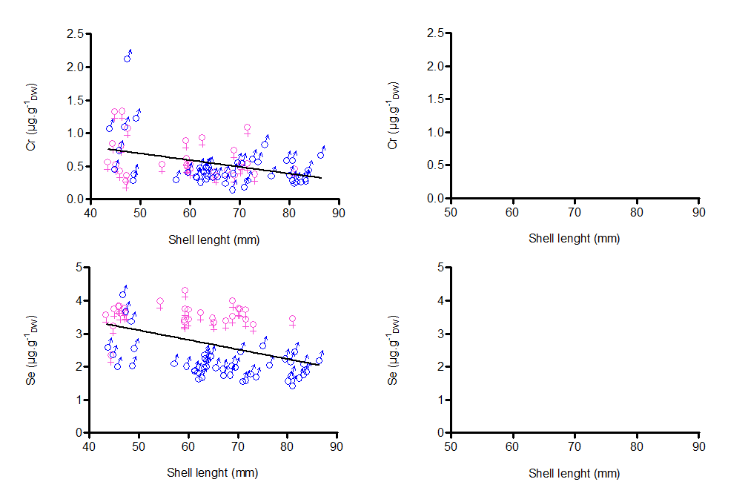
Sea, sex and size …
co: dev. from 0 = s.
p = 0.0007
co: dev. from 0 = s.
p < 0.0001

Slide 48
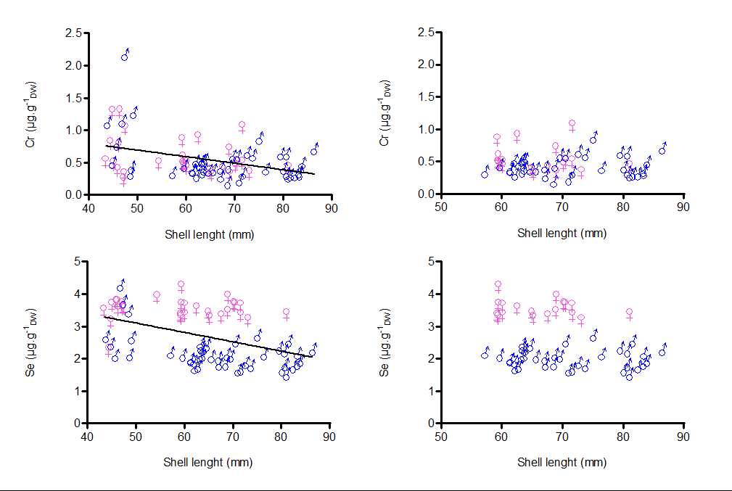
Sea, sex and size …
co: dev. from 0 = s.
p = 0.0007
co: dev. from 0 = s.
p < 0.0001

Slide 49
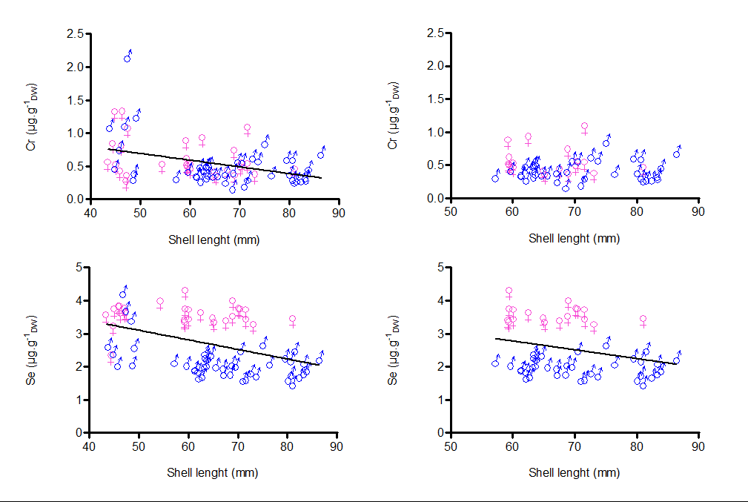
Sea, sex and size …
co: dev. from 0 = s.
p = 0.0007
co: dev. from 0 = n.s.
p = 0.9116
co: dev. from 0 = s.
p < 0.0001
fe: dev. from 0 = n.s.
p = 0.4864
co: dev. from 0 = s.
p = 0.0307
ma: dev. from 0 = n.s.
p = 0.7079

Slide 50
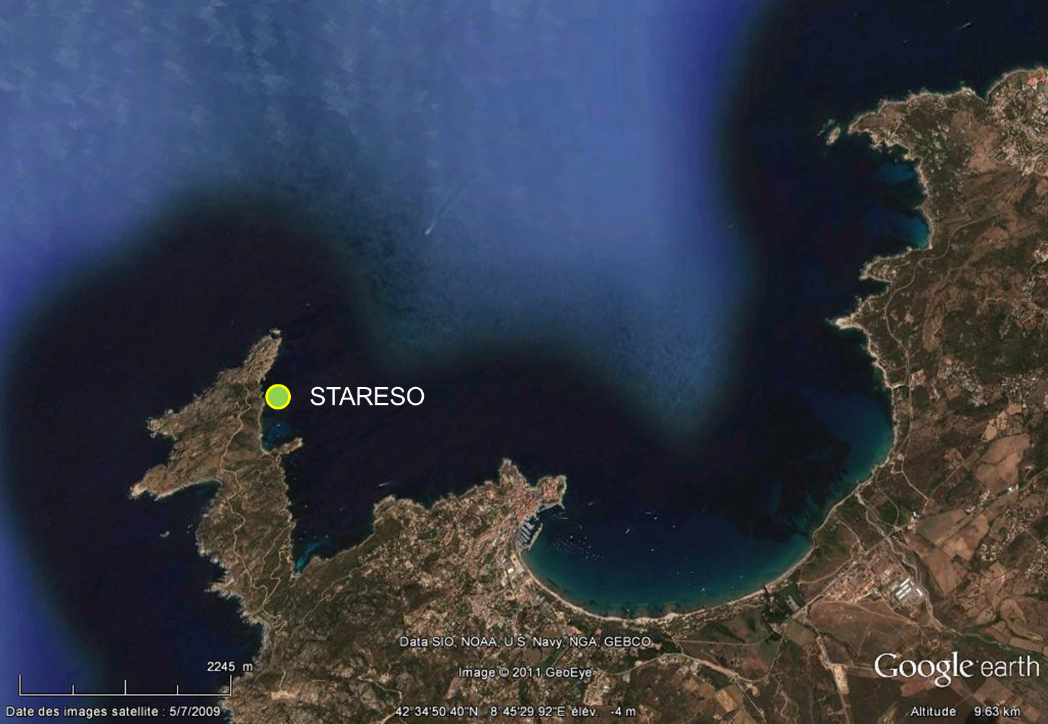
Temporal dynamics

Slide 51
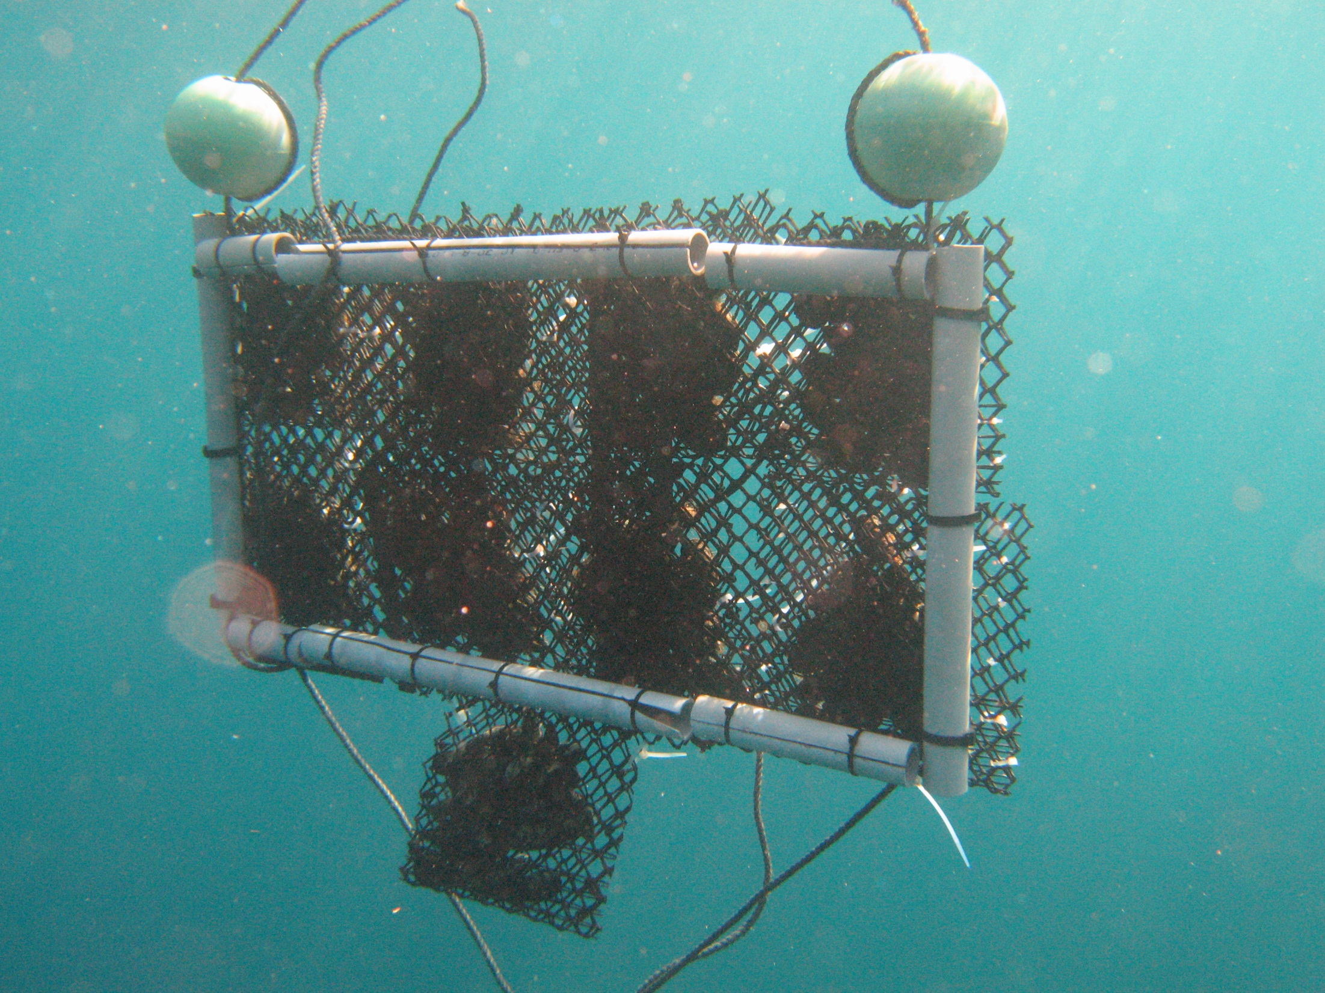

Slide 52
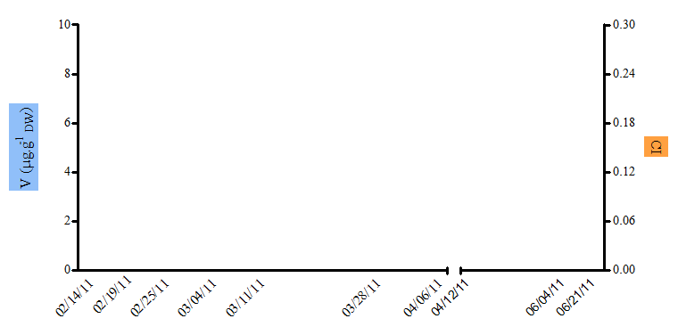
Temporal dynamics

Slide 53
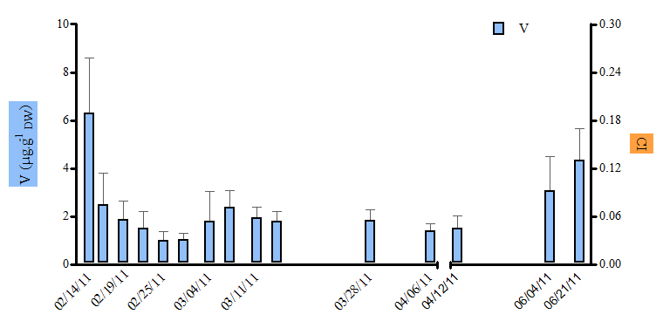
Temporal dynamics

Slide 54
Temporal dynamics

Slide 55
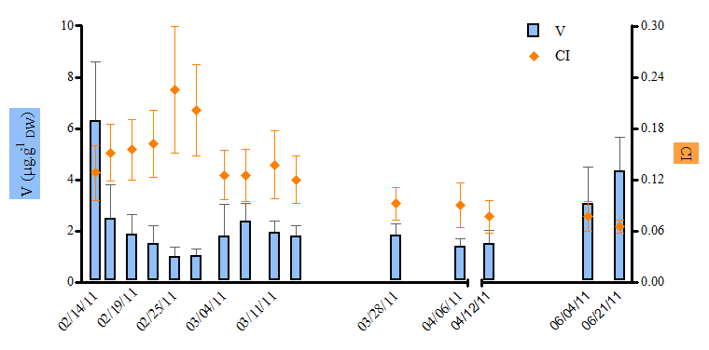
Temporal dynamics

Slide 56
Temporal dynamics

Slide 57

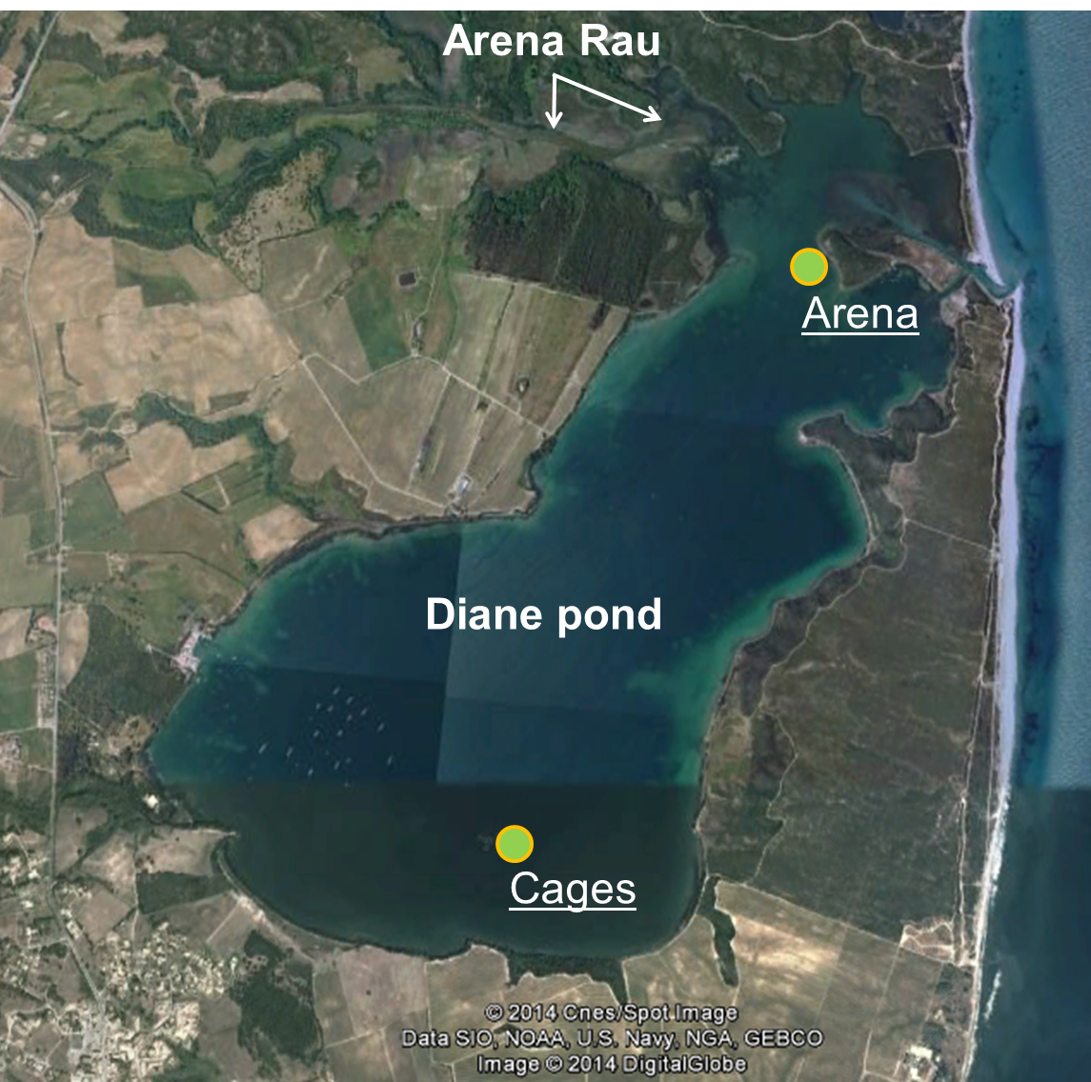
Temporal dynamics
And in confined environments …
Meteororology …
nutrients, PP and detritical matter
dissolved and particulate TE
TE accumulated in mussel flesh
Poster Richir et al.

Slide 58
Trace Element Temporal Variation Index (TETVI)
How to compare TEs according to the overall temporal variability of their environmental levels?
TETVI = [(x_{max}/x_{min}) / (∑(x_{max}/x_{i})/n)] * SD
where:
x_{max} and x_{min} are the max. and min. mean conc. among the n sites,
x_{i} are mean conc. recorded for each of the n sampling time,
SD is the standard deviation of the weighted sum ∑(x_{max}/x_{i})/n.
TETVI values
The highest the index value, the more environmental levels of a TE globally vary in time.

Slide 59
TETVI value calculation
Trace Element Temporal Variation Index (TETVI)
TETVI = [(x_{max}/x_{min}) / (∑(x_{max}/x_{i})/n)] * SD
…
∑(x_{max}/x_{i})
SD
x_{max}/x_{min}
n

Slide 60
TETVI in STARESO
max/min = 1.7
max/min = 4.6
max/min = 10.9

Slide 61
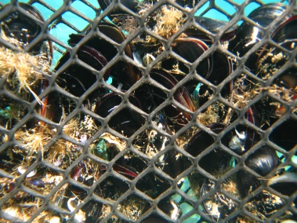
In summary
ABIOTIC FACTORS
trace element
nature and speciation (dissolved, particulate)
trace element chemistry
trophic conditions
temperature, salinity, nutrients
www.wwfsassi.co.za/
storage
growth and emaciation
reproduction
LIFE CYCLE
BIOTIC FACTORS
(modified after Casas, 2005)

