Slide 1




Estimating Relative Change in Ventricular Stroke Work from Aortic Pressure
Shun Kamoi¹, CG Pretty¹, YS Chiew¹, A Pironet², T Desaive²
GM Shaw³, JG Chase¹
¹Department of Mechanical Engineering, University of Canterbury, New Zealand
²GIGA Cardiovascular Science, University of Liege, Belgium
³Intensive Care Unit, Christchurch Hospital, New Zealand

Slide 2
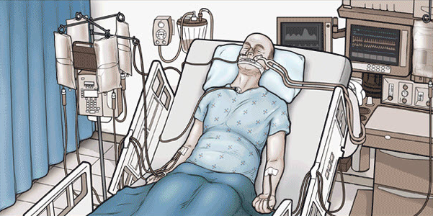
Introduction
Cardiac and circulatory disease are the largest cause of death in the western world, and are the leading cause of ICU admission and mortality (WHO Global report)
  Expected to increase with increasing elderly population
  1 in every 3 deaths are related to cardiovascular disease
  Accounts for 30% of all ICU admissions (and mortality)
Patients with cardiovascular disease require hemodynamic monitors to obtain patient information for diagnosis and treatment

Slide 3
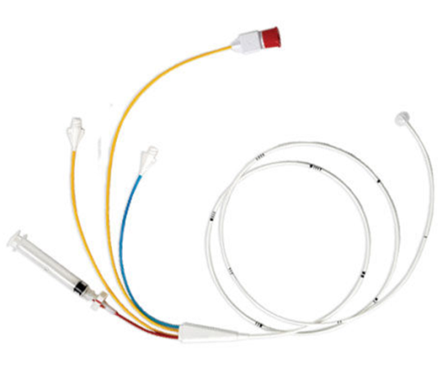
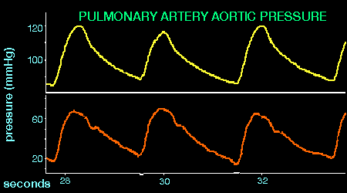
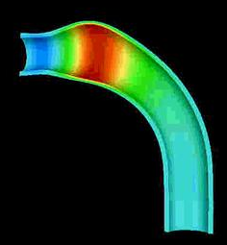
Hemodynamic Monitors
Pressure catheter Blood pressure displayed on monitor
Blood Pressure Value?
Main determinants of blood pressure
Blood volume
Arterial wall stiffness
Stroke volume
Peripheral Resistance

Slide 4
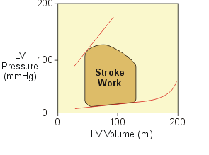

Ventricular Stroke Work
Considerations
Adding extra measurements are
clinically not feasible
“Humans are horribly variable”
(J.L Dickson et al)
Method
A model-based analysis of blood pressure waveform to estimate Stroke Work.
Analyse
Pressure
Contour
Estimate

Slide 5
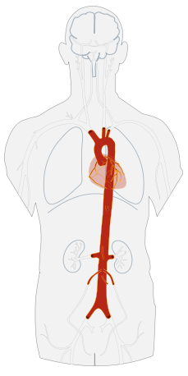
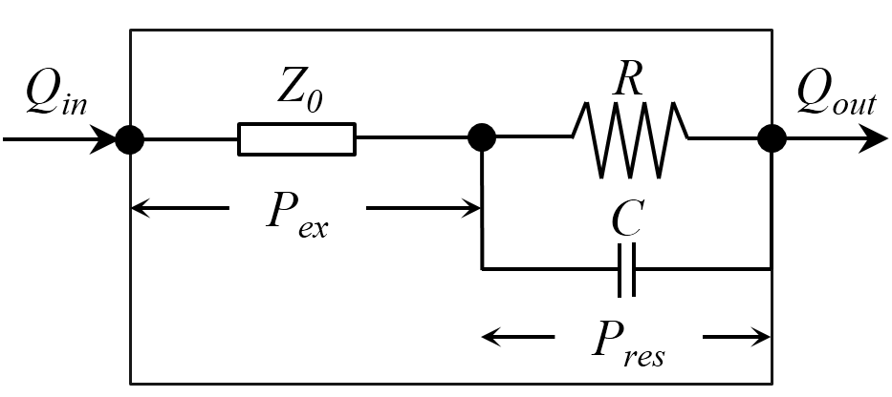


Aortic Pressure Model
Reservoir pressure concept
Aortic pressure (P_{ao}) can be represented as the sum of two pressure components
Reservoir pressure (P_{res}) accounts for the energy stored/released by the arterial wall
Excess pressure (P_{ex}) which is extra work done by the heart to produce blood flow into aorta
$$P_{ao}\left(t\right)= P_{res}\left(t\right)+ P_{ex}(t)$$
$$P_{ex}\left(t\right)∝ Q_{in}\left(t\right)$$
Three Element Windkessel
Z₀
R
C
- Characteristic impedance
- Peripheral resistance
- Aortic compliance

Slide 6
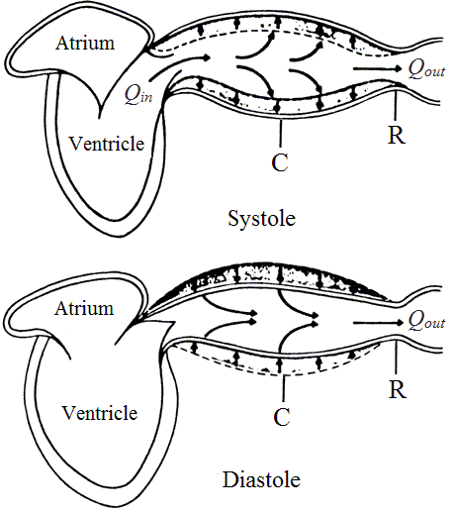
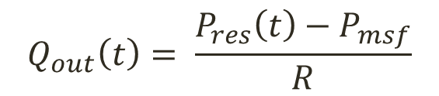
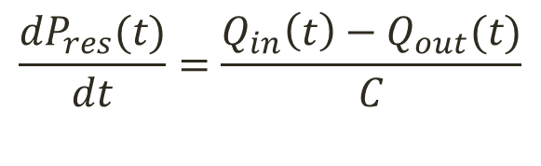
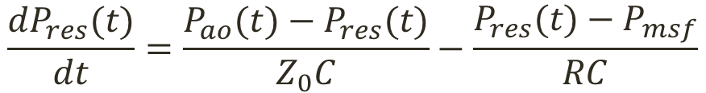
Parameter Relationships
Reservoir Pressure
$$\frac{{dP}_{res}(t)}{dt}=\frac{Q_{in}\left(t\right)−Q_{out}(t)}{C}$$
Flow Leaving Aorta
$$Q_{out}\left(t\right)= \frac{P_{res}\left(t\right)−P_{msf}}{R}$$
Combine
$$\frac{{dP}_{res}(t)}{dt}=\frac{P_{ao}(t)−P_{res}(t)}{Z_{0}C}−\frac{P_{res}(t)−P_{msf}}{RC}$$

Slide 7
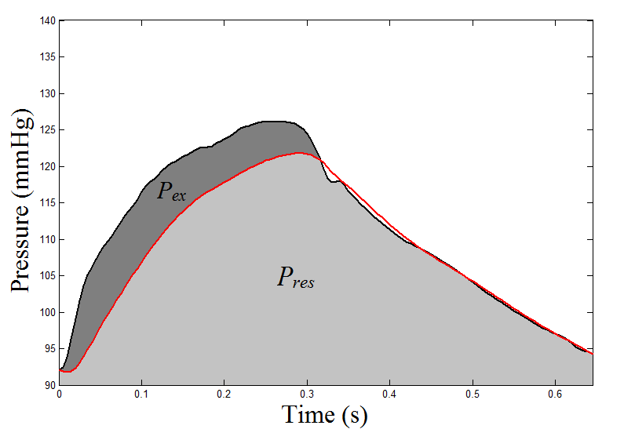



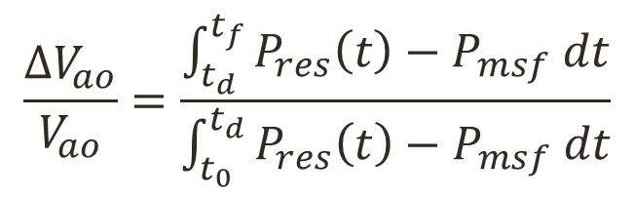
Pulse Wave Velocity
Distensibility
Bramwell-Hill equation Ventricular Stroke Work
$$\frac{∆V_{ao}}{V_{ao}}=\frac{\int_{t_{d}}^{t_{f}}{P_{res}\left(t\right)−P_{msf} dt}}{\int_{t_{0}}^{t_{d}}{P_{res}\left(t\right)−P_{msf} dt}}$$
$$D=\frac{∆V_{ao}}{{V_{ao}∆P}_{ex}}$$
α
$$VSW=\int^{v_{lv}}{P_{lv}(}v_{lv})dv_{lv}$$
$$PWV={(ρD) }^{−\frac{1}{2}}$$

Slide 8
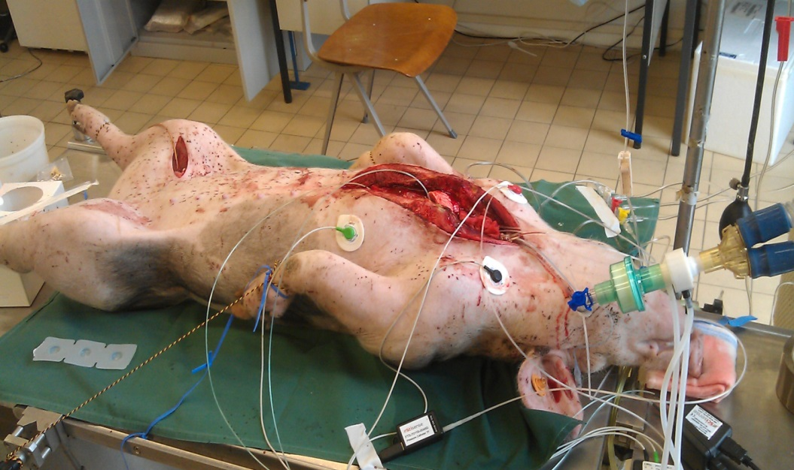
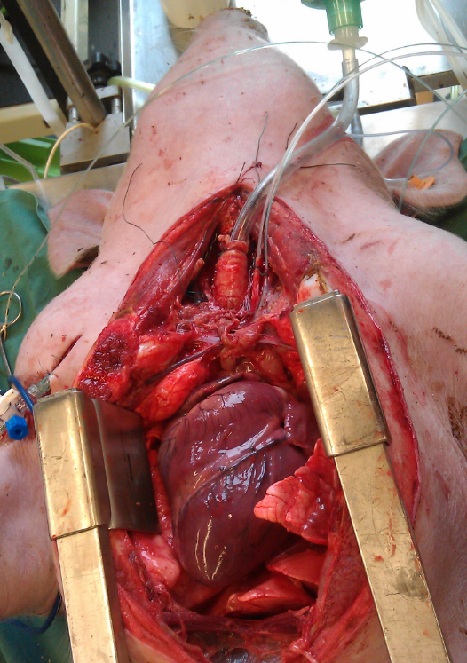

Experiment
To validate VSW estimation via aortic pressure model, data from porcine experiment were used.
GIGA Cardiovascular Science

Slide 9

Stroke Work Changes
Mechanical ventilation settings
Step-wise changes in positive end expiratory pressure were made
Preload
Airway pressure increase and decrease changes the amount of blood flowing into the ventricle during diastole.

Slide 10
Results
VSW trend was accurately captured
Estimated pc versus calculated VSW showing relationship between the two parameters. The plot indicates that there are high degree of agreement with correlation coefficient of R=0.71.

Slide 11
Clinical Benefit
Patients cardiovascular performance can be analysed more accurately than just Mean Arterial Pressure (MAP)
Stroke work trend can be used to guide treatment selection and to titrate therapy
  Fluid resuscitation
  Use of inotrope and vasoactive drugs
Does not require specialised
equipment and/or personnel
model
Clinical data
raw
Cost/Invasiveness

Slide 12
Limitation & Future Work
Sample data still too small
  Does the theory hold in afterload changes
  and/or different disease condition
  Could pulse wave velocity changes be validated using multiple pressure measurements
Aortic pressure measurements (Highly Invasive?)
  How much information can be retrieved from less invasive arterial pressure measurement
  Could the changes in transit time measured between ECG readings and radial arterial pressure.

Slide 13

Acknowledgement
Supervisors
Bioengineering Centre
Medical Team at Liege
Questions?

Slide 14






Parameter Identification
RC & Pmsf
Diastolic Condition:
$$P_{res}(t)=P_{ao}(t)$$
$$Since Q_{in}=0$$
Diastolic Reservoir
$$P_{res}\left(t\right)=\left(P_{ao}\left(t_{d}\right)−P_{msf}\right)e^{−\frac{\left(t−t_{d}\right)}{RC}}+P_{msf}$$
Z0C
Equilibrium Condition:
$$\frac{{dP}_{res}(τ)}{dt}=0$$
$$P_{res}\left(τ\right)=\frac{RCP_{ao}\left(τ\right)+Z_{0}CP_{msf}}{Z_{0}C+RC}$$
ODE
$$\frac{{dP}_{res}(t)}{dt}=\frac{P_{ao}(t)−P_{res}(t)}{Z_{0}C}−\frac{P_{res}(t)−P_{msf}}{RC}$$

