Slide 1

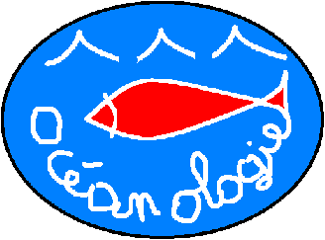
The conceptualization of trace element flows within Posidonia oceanica meadows: A collaborative
proposal to fill
knowledge
gaps
J. Richir and S. Gobert
Portorož,
Slovenia
10-2014
Notes:
Ladies and gentlemen, I would like to present you, during this talk, a collaborative conceptualization model in order to fill knowledge gaps regarding trace element flows with P. oceanica meadows.

Slide 2


Trace elements
(after Amiard ,2011)
Notes:
Among the diversity of contaminants are trace elements. We use the term trace element since the term heavy metal is meaningless term.
IUPAC (International Union of Pure and Applied Chemistry) definition: Any element having an average concentration of less than about 100 parts per million atoms (ppma) or less than 100 µg g-1.
In parallel to this abundance consideration must be taken into account their essential or non-essential aspect to living organisms.

Slide 3
World production of trace elements
X 2.0
X 3.1
X 3.1
Data compiled from the Mineral Yearbooks published by the US Geological Survey on www.usgs.gov

Slide 4
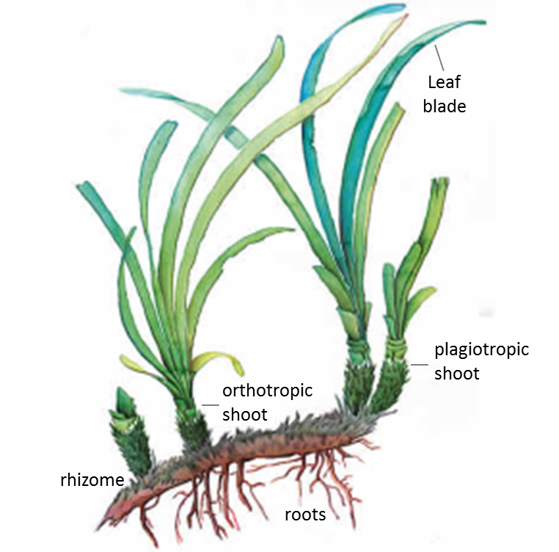
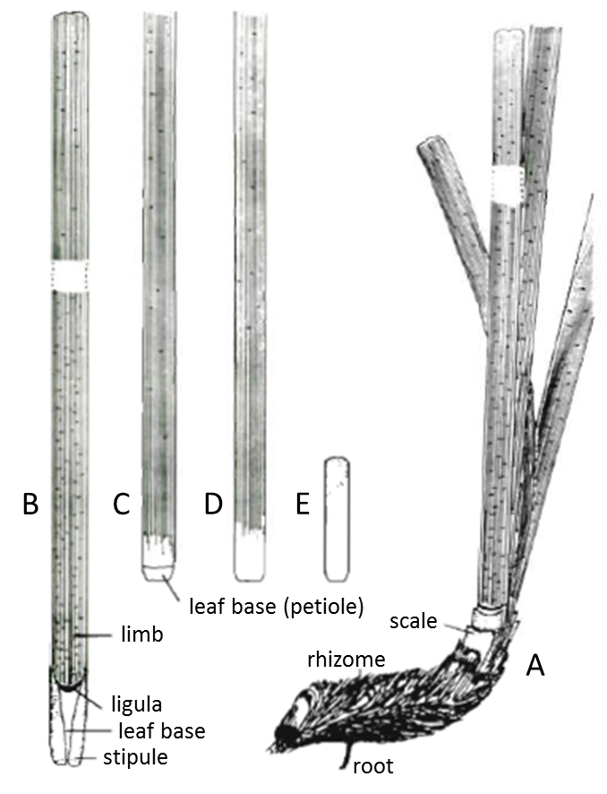
Posidonia oceanica: bioindicator species
Left: P. oceanica shoots fixed on a plagiotropic rhizome. Right: (A) shoot of leaves on a plagiotropic rhizome; (B, C) adult leaves; (D) intermediate leaf; (E) juvenile leaf (modified after Libes and Boudouresque, 1987).
Notes:
One of the most widely used bioindicator species in the Mediterranean is the seagrass Posidonia oceanica (and more precisely the shoots of leaves of that seagrass).

Slide 5
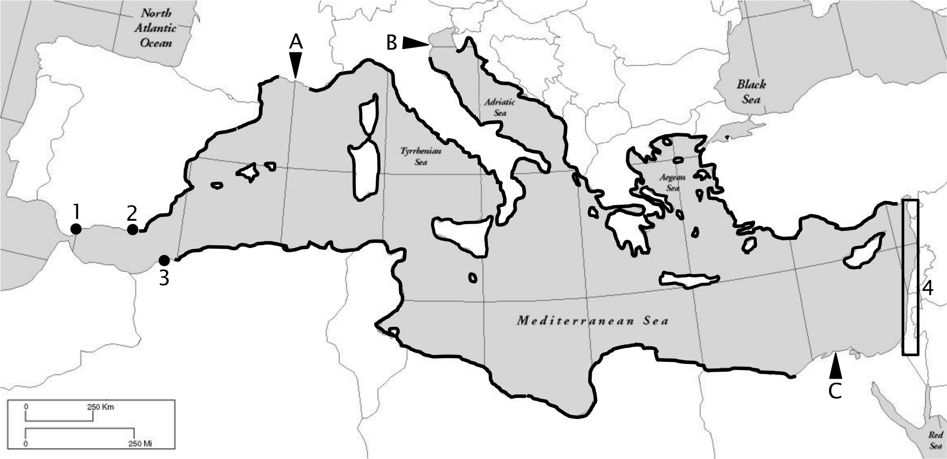
Posidonia oceanica distribution
Geographical distribution of Posidonia oceanica (Michel, 2012; redrawn using data from Lipkin et al., 2003 ; Procaccini et al., 2003; Boudouresque et al., 2006; Gobert et al., 2006; Meinesz et al., 2009). 1: Gibraltar; 2: Almeria; 3: Oran; 4: Coasts of Syria, Israel and Lebanon; A: Rhone estuary; B: Po estuary; C: Nile estuary.
Notes:
Posidonia oceanica is notably an interesting bioindicator because of its nearly circum-Mediterranean distribution. It therefore allows monitoring surveys at very different spatial scales …

Slide 6
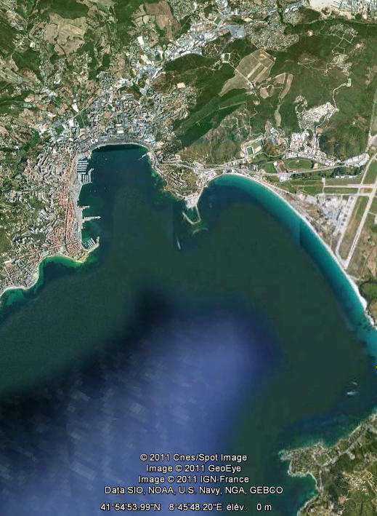
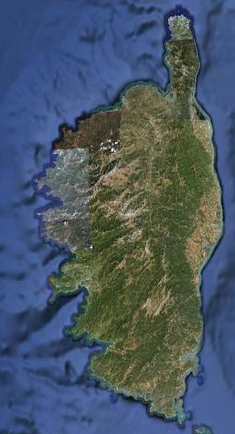
Local monitoring: Ajaccio Bay
A1
-A9
P. oceanica sampled in 9 stations along a radial located at the back of the Ajaccio Bay, with increasing distance from the port and urban centre of Ajaccio city (Richir and Gobert, in press).
Notes:
… from very local survey:
e.g. along a gradient of contamination, with increasing distance from the port and urban center of Ajjacio city, western Corsican coast; 9 sites sampled for P. oceanica shoots.

Slide 7
Global monitoring: Mediterranean Sea
Map showing 110 sites located along the coasts of 13 Mediterranean countries and sampled for Posidonia oceanica. Stars represent sites; roman numbers and dark grey arrows represent the subdivision of the Mediterranean into 6 sub-areas; the thick dark grey line across the Strait of Sicily separates the western and the eastern Mediterranean basins (Richir et al., in press)
Notes:
… to global scale, i.e. at the scale of the whole Mediterranean:
110 sites sampled for P. oceanica adult leaves.

Slide 8
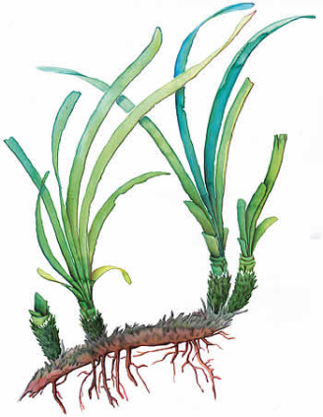

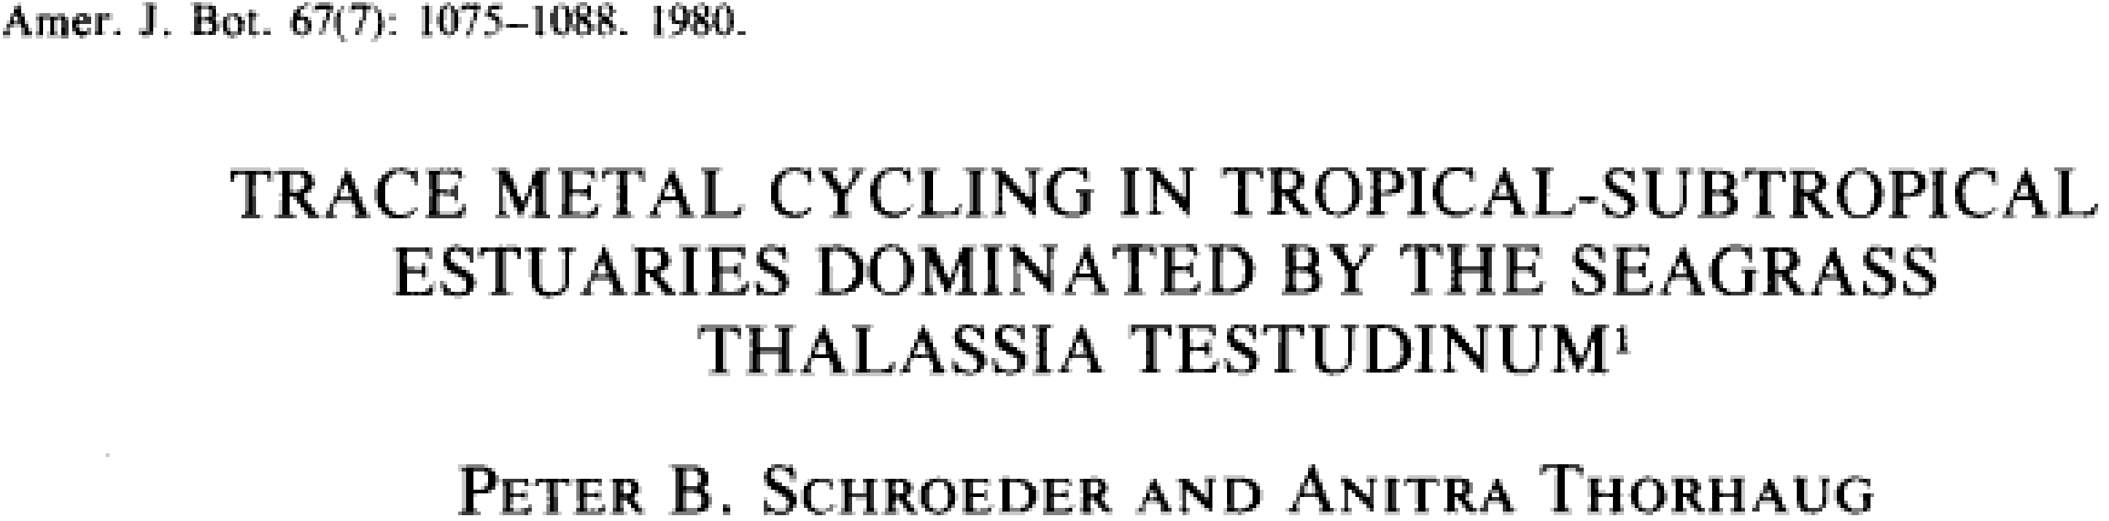
Questions?
What is the quantitative role played by Posidonia oceanica in the coastal cycling of trace
elements in the
Mediterranean?
P. oceanica

Slide 9
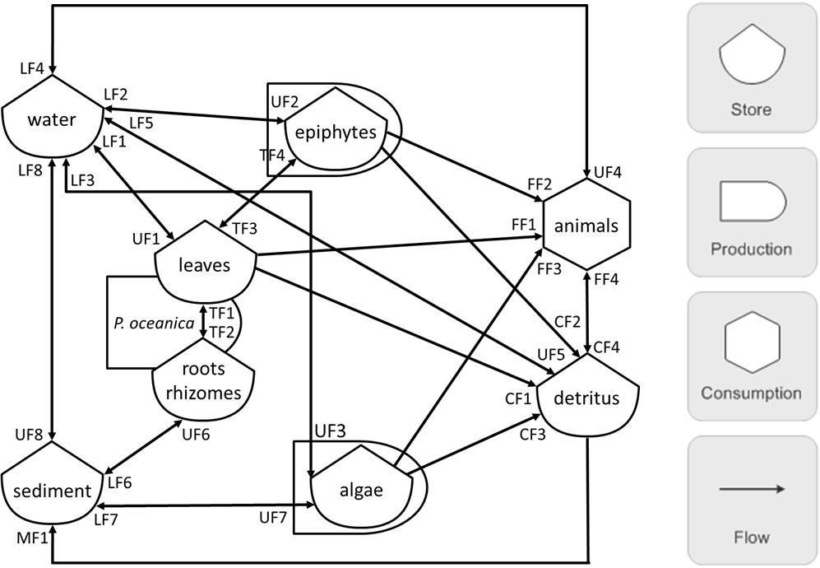
Trace element cycling model conceptualization
This trace element cycling model can be drawn in energy circuit language.
Each symbol (production, consumption, storage and flow) of the energy circuit language is rigorously and mathematically defined. By writing such a diagram, one, in essence, is writing equations describing a system.
Varying the size of symbols further indicates their physical size and their importance
(Odum and Odum, 2000; Brown, 2004)

Slide 10
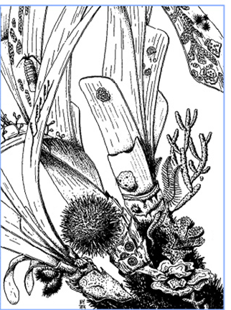
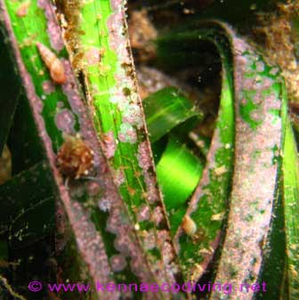
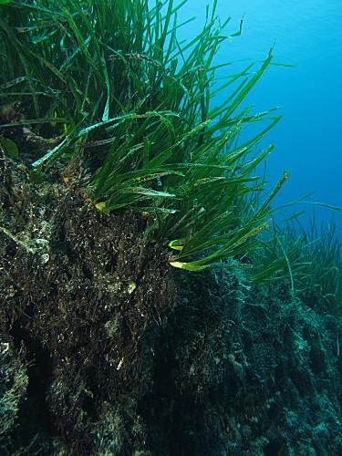
Seagrass meadow components
Seagrass meadows can be conceptualized as the juxtaposition of 5 separate components:
  seagrass shoots,
  epiphytes,
  associated algae and animals,
  detritus,
exchanging flows of TEs between themselves and with their environment:
  water,
  sediment.
(Schroeder and Thorhaug, 1980)
(After Boudouresque and Meinez, 1983)
© A. Abadie

Slide 11
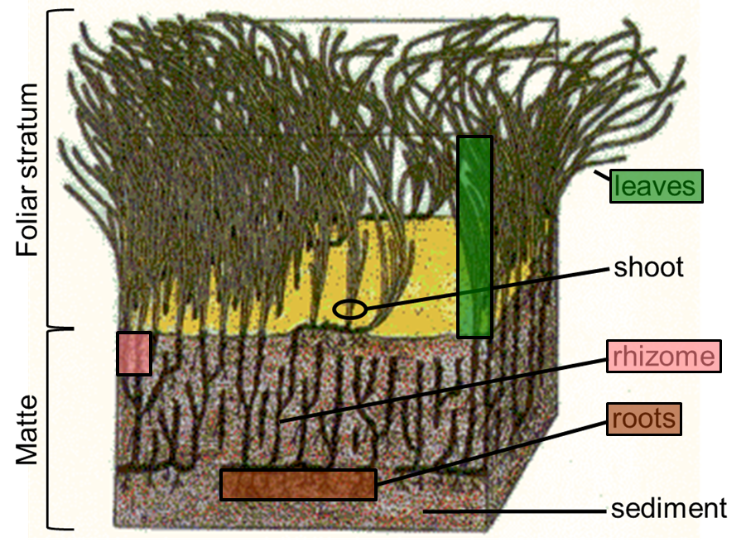
Posidonia oceanica
leaves
P. oceanica
roots
rhizomes
(After Boudouresque and Meinez, 1983)

Slide 12
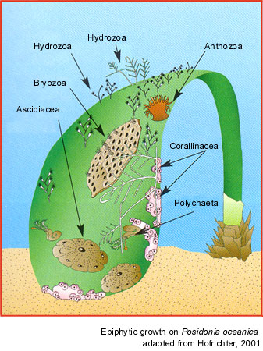
Epiphytes
epiphytes
(After Boudouresque and Meinez, 1983)

Slide 13
Environmental components
© A. Abadie
water
(After Boudouresque and Meinez, 1983)
sediment

Slide 14
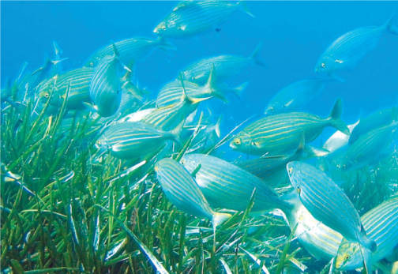

Associated algae and animals
© A. Abadie
animals
© S. Ruitton
(After Boudouresque and Meinez, 1983)
http://reflexions.ulg.ac.be/
algae

Slide 15
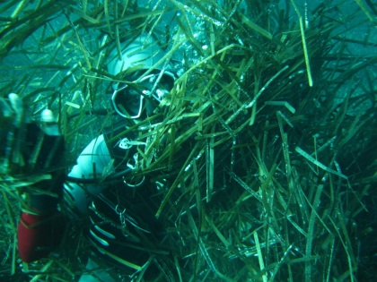
Detritus
© A. Abadie
© S. Ruitton
detritus
(After Boudouresque and Meinez, 1983)
http://reflexions.ulg.ac.be/

Slide 16
Model components
© A. Abadie
© S. Ruitton
(After Boudouresque and Meinez, 1983)
http://reflexions.ulg.ac.be/

Slide 17

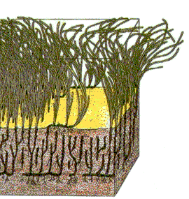
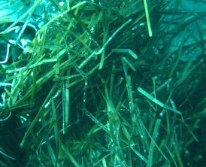
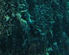
Diagram in energy circuit language
water
epiphytes
animals
leaves
P. oceanica
roots
rhizomes
detritus
sediment
algae
(Schroeder and Thorhaug, 1980)

Slide 18
Uptake/loss flows from/to water
LF4
LF2
UF2
water
LF5
epiphytes
LF1
LF8
LF3
UF4
UF1
animals
leaves
P. oceanica
UF5
roots
rhizomes
detritus
UF8
UF3
sediment
algae

Slide 19
Uptake/loss flows from/to sediment
LF4
LF2
UF2
water
LF5
epiphytes
LF1
LF8
LF3
UF4
UF1
animals
leaves
P. oceanica
UF5
roots
rhizomes
detritus
UF8
UF6
UF3
sediment
LF6
algae
LF7
UF7

Slide 20
Transfer between P. oceanica compartments
LF4
LF2
UF2
water
LF5
epiphytes
LF1
LF8
TF4
UF4
LF3
UF1
TF3
animals
leaves
P. oceanica
TF1
TF2
UF5
roots
rhizomes
detritus
UF8
UF6
UF3
sediment
LF6
algae
LF7
UF7

Slide 21
Animals feeding on producers
LF4
LF2
UF2
water
LF5
epiphytes
LF1
LF8
TF4
FF2
UF4
LF3
UF1
TF3
FF1
animals
leaves
FF3
P. oceanica
TF1
TF2
UF5
roots
rhizomes
detritus
UF8
UF6
UF3
sediment
LF6
algae
LF7
UF7

Slide 22
Flows to detritus and detritivory
LF4
LF2
UF2
water
LF5
epiphytes
LF1
LF8
TF4
FF2
UF4
LF3
UF1
TF3
FF1
animals
leaves
FF3
P. oceanica
FF4
TF1
CF2
TF2
CF4
UF5
roots
rhizomes
CF1
detritus
UF8
UF6
UF3
CF3
sediment
LF6
algae
LF7
UF7

Slide 23
Mineralization of detrital material
LF4
LF2
UF2
water
LF5
epiphytes
LF1
LF8
TF4
FF2
UF4
LF3
UF1
TF3
FF1
animals
leaves
FF3
P. oceanica
FF4
TF1
CF2
TF2
CF4
UF5
roots
rhizomes
CF1
detritus
UF8
UF6
UF3
CF3
sediment
LF6
algae
LF7
UF7
MF1

Slide 24
Diagram in energy circuit language
LF4
LF2
UF2
water
LF5
epiphytes
LF1
LF8
TF4
FF2
UF4
LF3
UF1
TF3
FF1
animals
leaves
FF3
P. oceanica
FF4
TF1
CF2
TF2
CF4
UF5
roots
rhizomes
CF1
detritus
UF8
UF6
UF3
CF3
sediment
LF6
algae
LF7
UF7
MF1

Slide 25
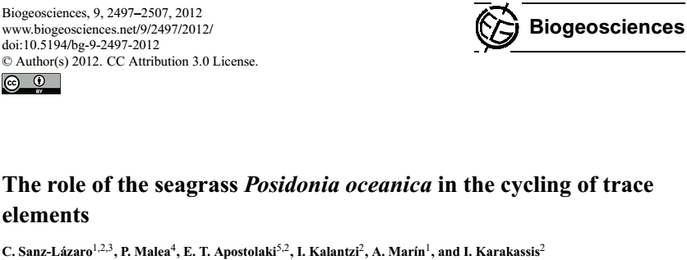
Flows - mass balance analysis
epiphytes
Trace element concentrations in P. oceanica compartments;
Trace element incorporation and loss rates;
Extrapolation to the whole Mediterranean.
leaves
P. oceanica
roots
rhizomes

Slide 26
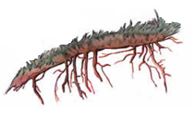
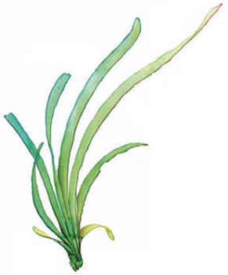
A sink or a source …
Annual balances of the amounts of some trace elements (TEs) in P. oceanica (tons y⁻¹) for the whole Mediterranean (Sanz-Lázaro et al., 2012). Positive or negative balance values indicate the incorporation (sink) or the release (source) of TEs by P. oceanica. These balances are expressed in equivalent % to the 2010 TE’s mean world production (tons y⁻¹; Mineral Yearbooks, US Geological Survey).

Slide 27

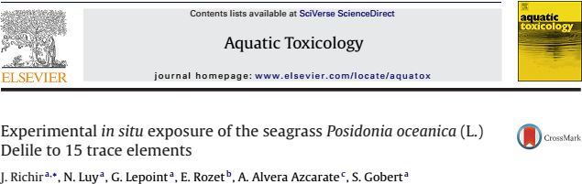
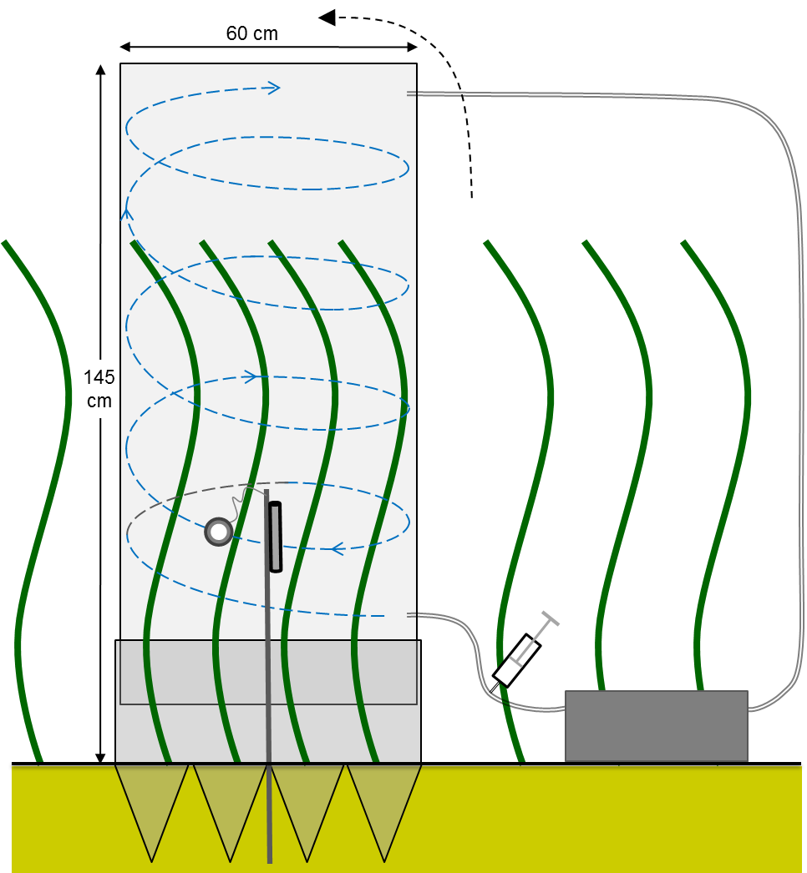
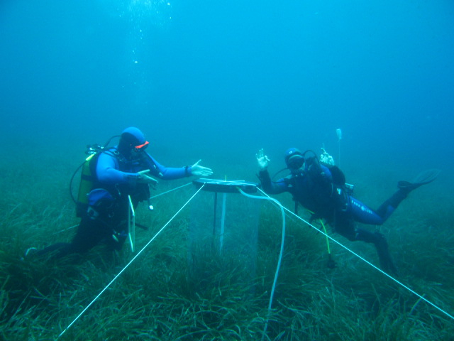
Flows - experimental design
Experimental exposure:
  In aquaria;
  In situ.
Trace elements:
  Contamination with radionuclides;
  Enrichment of the less abundant stable isotopes;
  High relevant concentrations in pristine conditions.

Slide 28
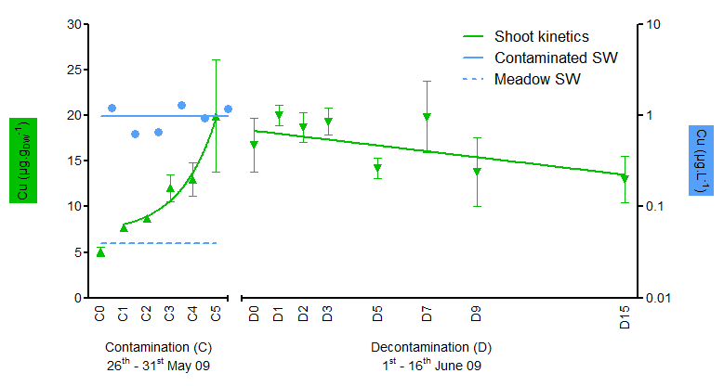
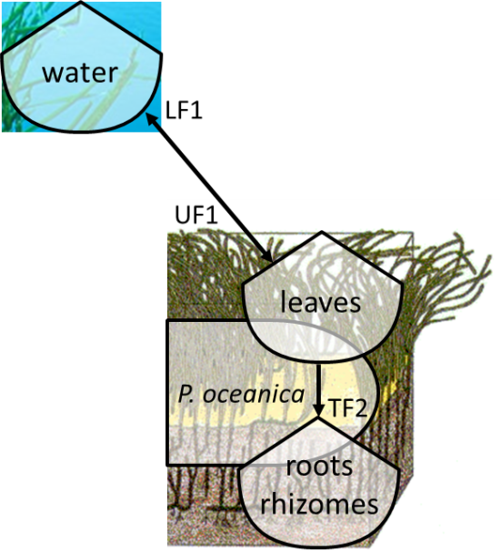
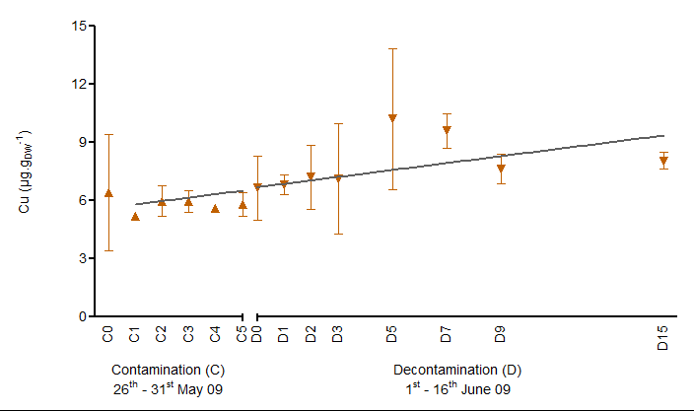
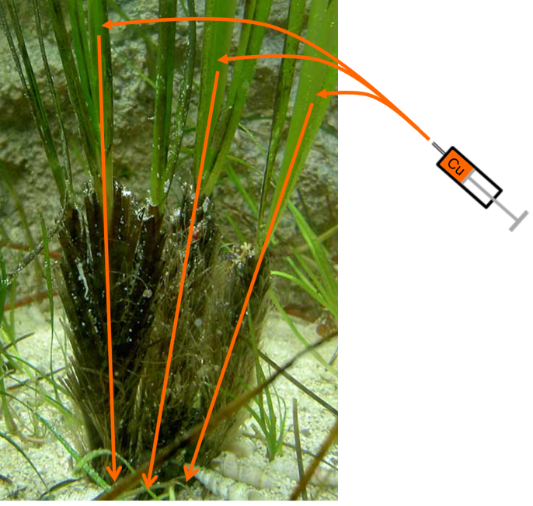
Flows - experimental design
water and leaves
rhizomes

Slide 29
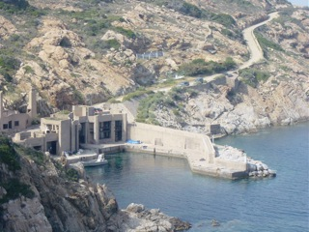
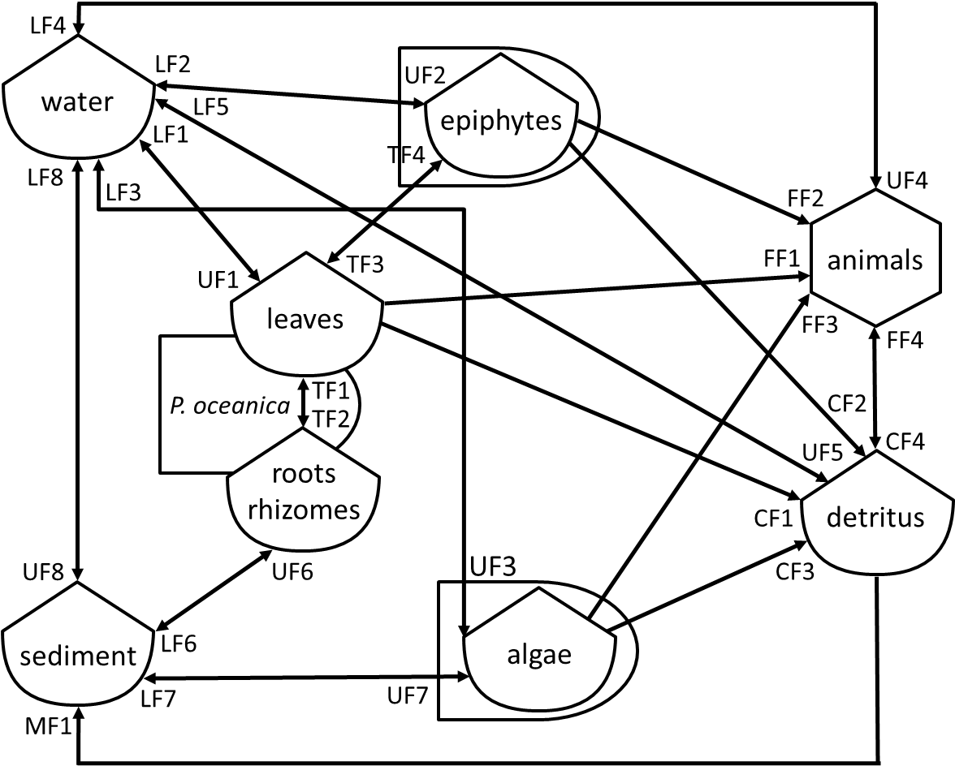
What’s next
Data compilation for the different components of the model;
Balance analyses;
Experiments.
The quantification of the role played by P. oceanica meadows in the coastal biogeochemistry of TEs in the Mediterranean.
A collaborative proposal … so why not a workshop in STARESO.
© A. Abadie

Slide 30
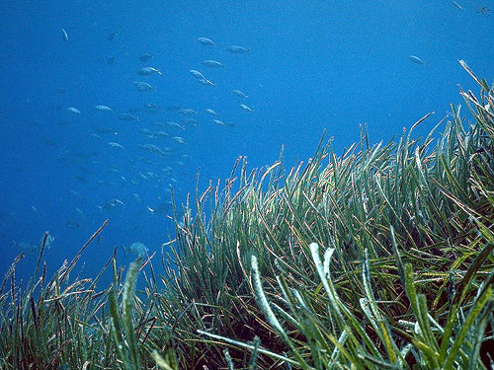
Thank you for your attention

Slide 31
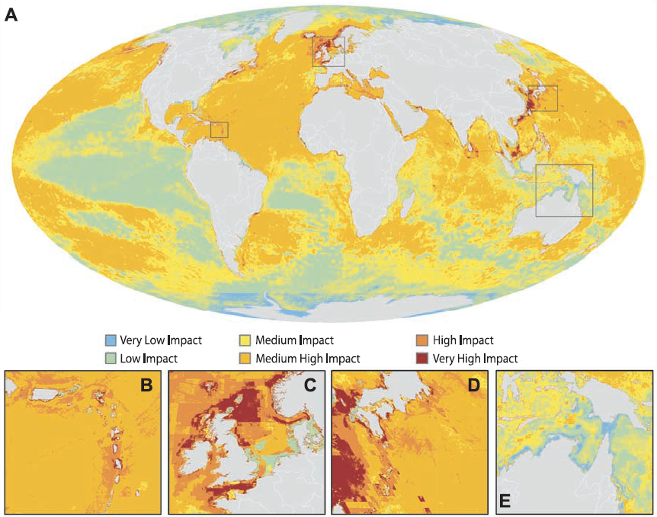
Coastal pollution of the Mediterranean
Global map (A) of cumulative human impact across oceans. Insets: highly impacted regions in the Eastern Caribbean (B), the North Sea (C), and the Japanese waters (D) and one of the least impacted regions, in northern Australia and the Torres Strait (E) (after Halpern et al., 2008)
Notes:
The Mediterranean is submitted to numerous anthropogenic threats, among them the chemical contamination of its densely anthropized coasts. The red circles on this map hilights pollution hot spots along Mediterranean coasts.

Slide 32
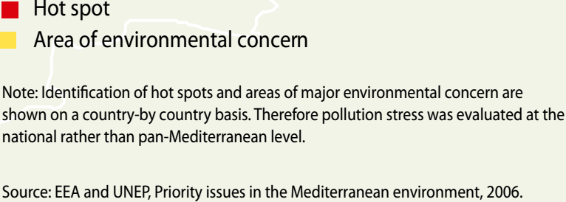
Coastal pollution of the Mediterranean
(UNEP/MAP, 2012; State of the Mediterranean Marine and Coastal Environment)
Notes:
The Mediterranean is submitted to numerous anthropogenic threats, among them the chemical contamination of its densely anthropized coasts. The red circles on this map hilights pollution hot spots along Mediterranean coasts.

Slide 33
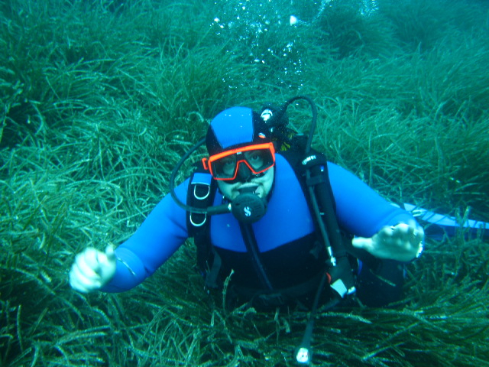
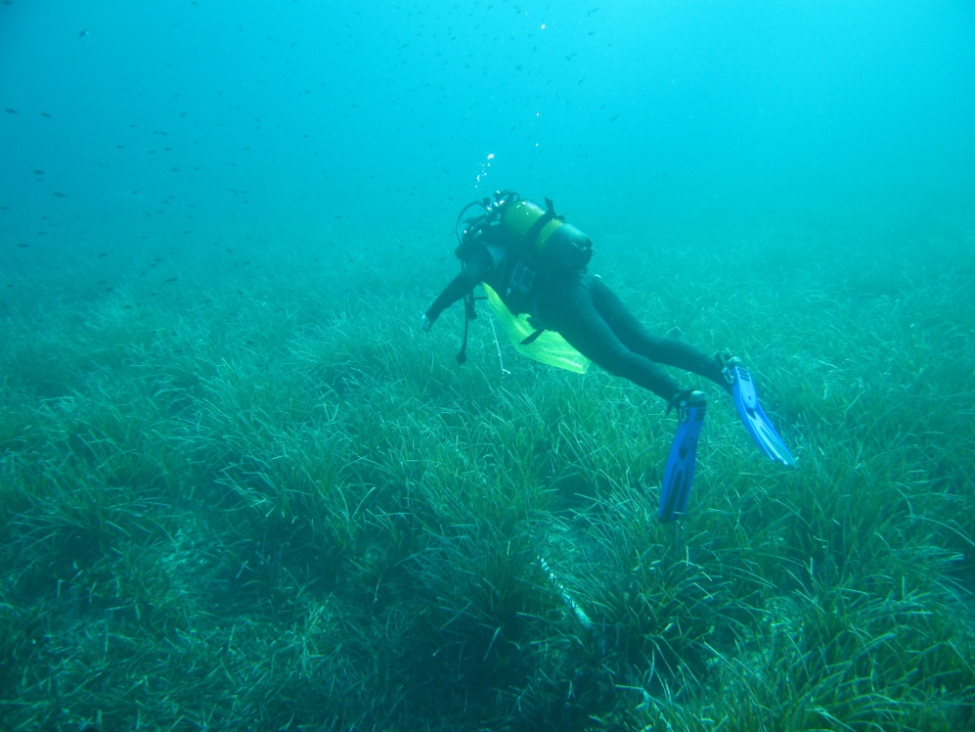
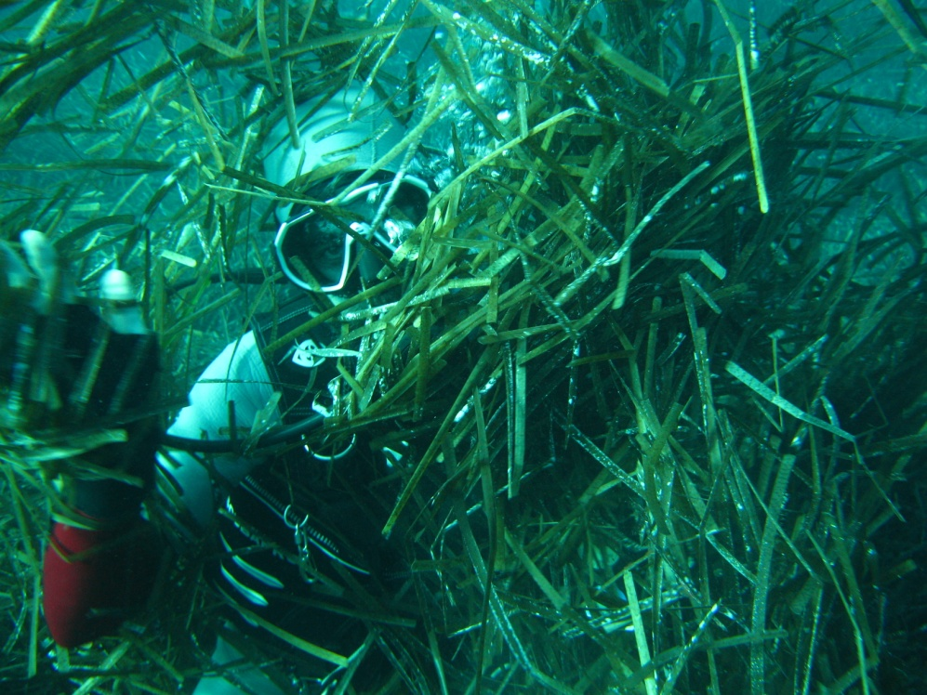
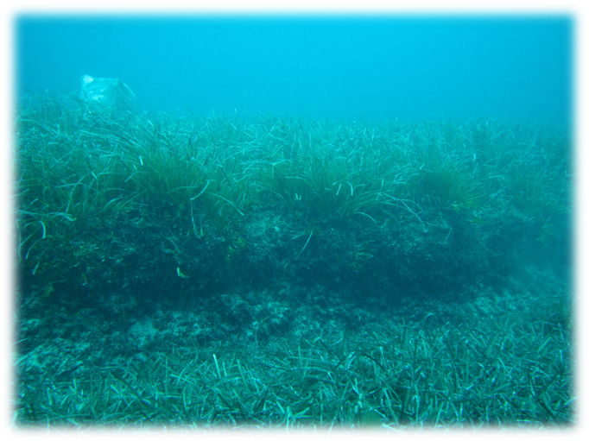

Slide 34
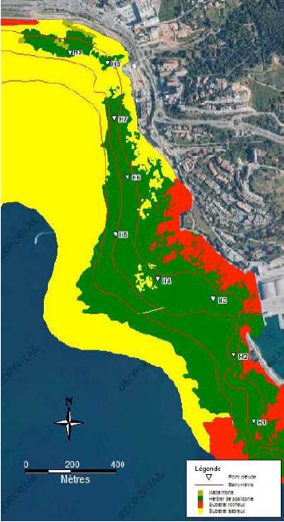
Local monitoring: Ajaccio Bay
A1
A2
A3
A4
A1
-A9
A5
A6
A7
The 9 stations are remote from one another of around 300 m along the radial (Richir and Gobert, in press).
A8
A9
Notes:
(stations A1-A9 are separated by a distance of 300 m along the transect)

Slide 35
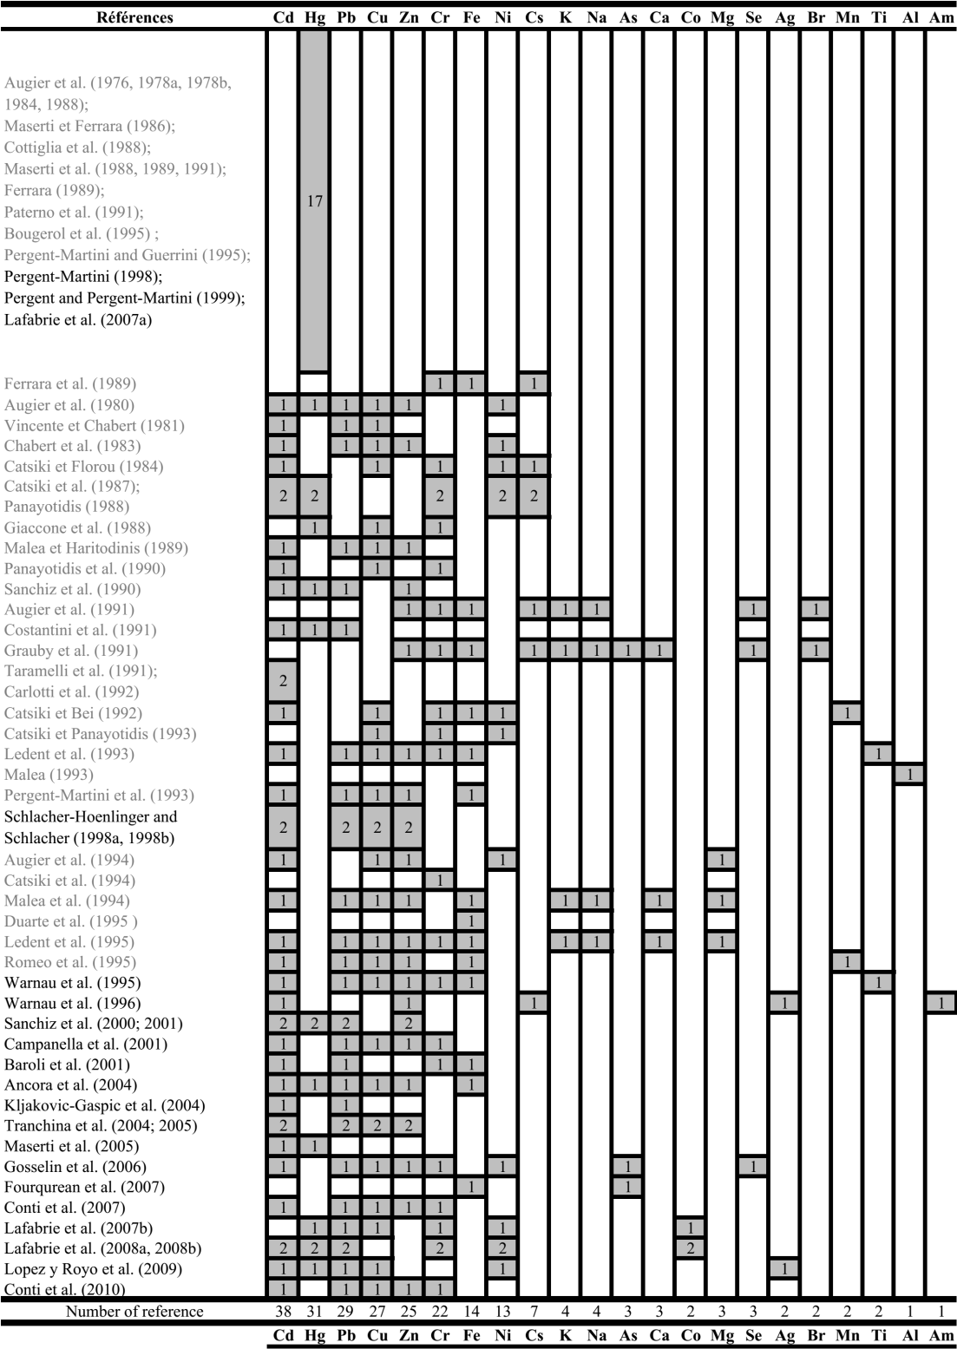

Trace element studies
Luy et al., 2012; non exhaustive number of references concerning trace elements studied in Posidonia oceanica tissues; completed (black references) from Pergent-Martini et al. (2000) summary table (grey references).

Slide 36
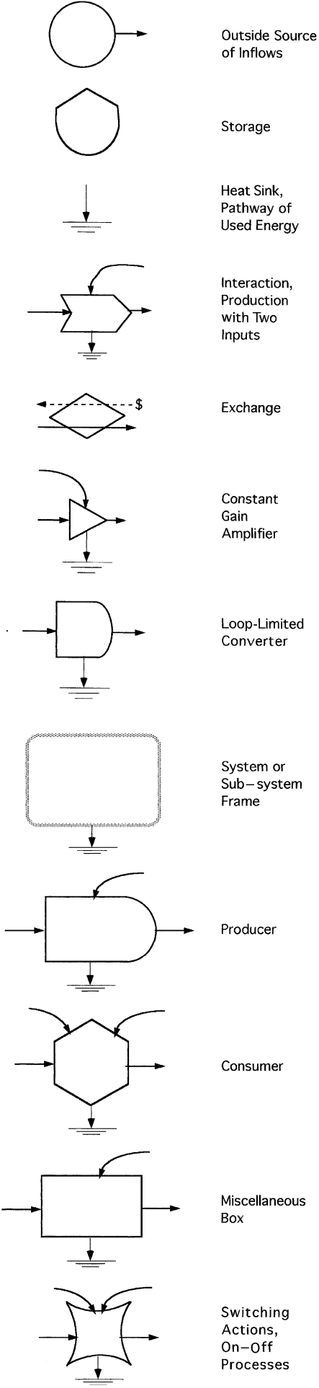
Energy systems diagram
a
b
Symbols of the energy systems language:
Sources, storages, and pathway interactions;
Composite symbols for representing units and processes in the aggregate
(Odum and Odum, 2000).

Slide 37
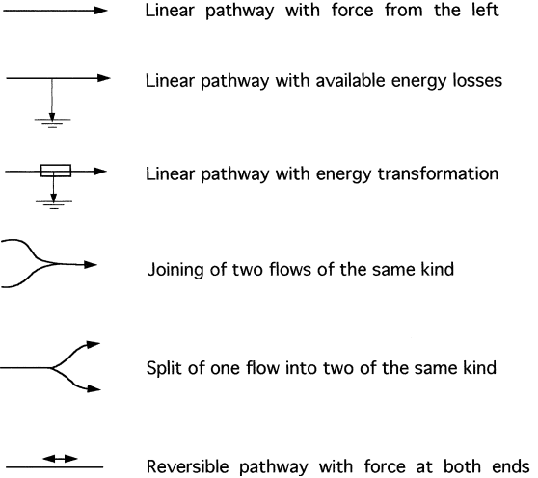
Energy systems diagram
Pathways in energy systems diagrams (Odum and Odum, 2000).

Slide 38
Diagram in energy circuit language
water
epiphytes
animals
leaves
P. oceanica
roots
rhizomes
detritus
sediment
algae
(Schroeder and Thorhaug, 1980)

Slide 39
Uptake/loss flows from/to water
LF4
LF2
UF2
water
LF5
LF1
epiphytes
LF8
LF3
animals
UF1
leaves
P. oceanica
UF5
roots
rhizomes
detritus
UF8
UF3
sediment
algae

Slide 40
Uptake/loss flows from/to sediment
LF4
LF2
UF2
water
LF5
LF1
epiphytes
LF8
LF3
UF4
animals
UF1
leaves
P. oceanica
UF5
roots
rhizomes
detritus
UF8
UF6
UF3
sediment
LF6
algae
LF7
UF7

Slide 41
Transfer between P. oceanica compartments
LF4
LF2
UF2
water
LF5
LF1
epiphytes
TF4
LF8
LF3
UF4
TF3
animals
UF1
leaves
P. oceanica
TF1
TF2
UF5
roots
rhizomes
detritus
UF8
UF6
UF3
sediment
LF6
algae
LF7
UF7

Slide 42
Animals feeding on producers
LF4
LF2
UF2
water
LF5
LF1
epiphytes
TF4
LF8
LF3
UF4
FF2
TF3
FF1
animals
UF1
leaves
FF3
P. oceanica
TF1
TF2
UF5
roots
rhizomes
detritus
UF8
UF6
UF3
sediment
LF6
algae
LF7
UF7

Slide 43
Flows to detritus and detritivory
LF4
LF2
UF2
water
LF5
LF1
epiphytes
TF4
LF8
LF3
UF4
FF2
TF3
FF1
animals
UF1
leaves
FF3
P. oceanica
TF1
CF2
TF2
UF5
CF4
roots
rhizomes
CF1
detritus
UF8
UF6
UF3
CF3
sediment
LF6
algae
LF7
UF7

Slide 44
Mineralization of detrital material
LF4
LF2
UF2
water
LF5
LF1
epiphytes
TF4
LF8
LF3
UF4
FF2
TF3
FF1
animals
UF1
leaves
FF3
P. oceanica
TF1
CF2
TF2
UF5
CF4
roots
rhizomes
CF1
detritus
UF8
UF6
UF3
CF3
sediment
LF6
algae
LF7
UF7
MF1

Slide 45
Diagram in energy circuit language
LF4
LF2
UF2
water
LF5
LF1
epiphytes
TF4
LF8
LF3
UF4
FF2
TF3
FF1
animals
UF1
leaves
FF3
FF4
P. oceanica
TF1
CF2
TF2
UF5
CF4
roots
rhizomes
CF1
detritus
UF8
UF6
UF3
CF3
sediment
LF6
algae
LF7
UF7
MF1

Slide 46
Biomass of P. oceanica meadow components
Flora | Biomass (kg_{DM} ha⁻¹) | Reference
P. oceanica leaves | 6 500 | Thelin and Bedhomme, 1981
Leaf epiphytes | 480 | Libes, unpubl.
P. oceanica rhizomes | 28 000 | Ott and Maurer, 1977
Rhyzome epiphytes | 14 | Drew, 1971
Fauna
Matte endofauna | 1 486 | Harmelin, 1964
Urchin Paracentrotus lividus | 1 250 | Boudouresque, unpubl.
Crabs | 25 | Vadon, 1981
Fish Sarpa salpa | 160 | Fagianelli and Cook, 1981
Remaining fauna | 100
Fauna and flora biomass in a theoretical Posidonia oceanica meadow (Augier, 2007)

Slide 47
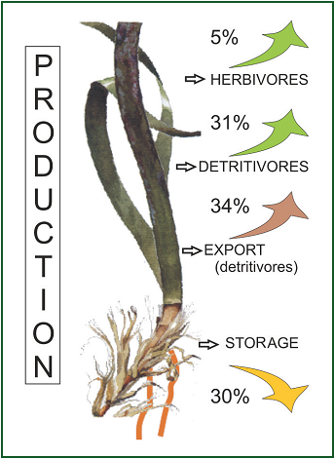
Future of the primary production (in percentage of carbon) of Posidonia oceanica (after G. Pergent, in Boudouresque et al., 2012).

Slide 48
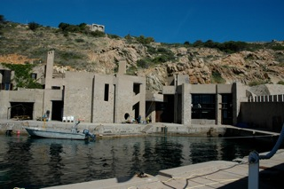
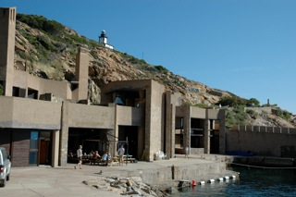
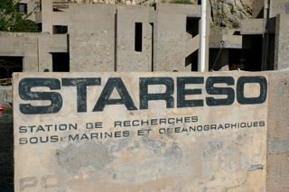
STARESO (Calvi, Corsica)

