Slide 1


Pollution and Siltation of Rivers in the Western Highlands of Cameroon: a Consequence of Farmland Erosion by Runoff Authors: Henri Grisseur Djoukeng, Christopher Mubeteneh Tankou and Aurore Degré
21st Century Watershed Technology Conference The University of Waikato New Zealand
November 3 – 6, 2014
Presented by: Henri Grisseur Djoukeng (PhD Candidate)
University of Liège – Gembloux Agro-Bio Tech, BIOSystems Engineering Department , Soil-Water-Plant Exchanges Axis, Gembloux, Belgium
November 5, 2014

Slide 2
Plan
What happened?
Why did it happen?
Who is it concerned?
When did it take place?
Where did it take place?
How much (by what means)?
How (in what way)?
Conclusion

Slide 3
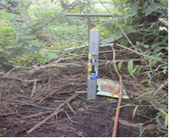
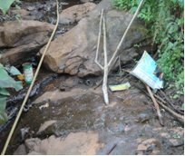
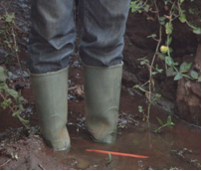
What happened?
Siltation
Pollution
Presentation of the sediments collection well
a
b
c

Slide 4
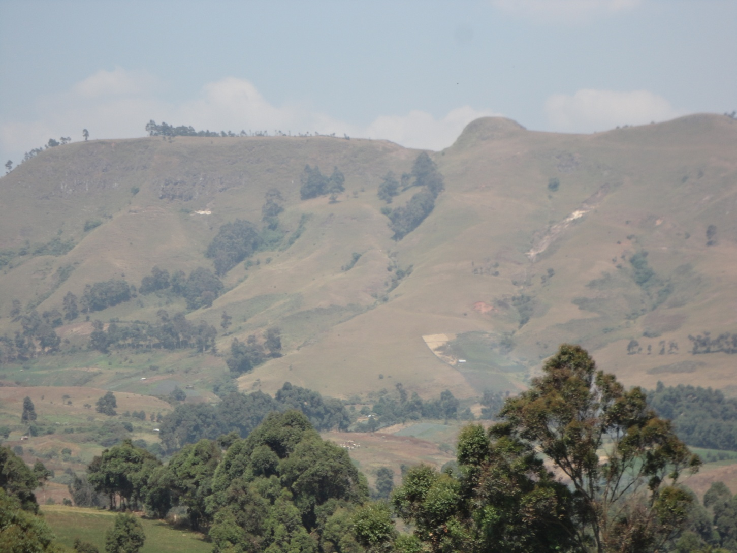
Why did it happen? 1/2
Exploiting steeply slopes (>25%)

Slide 5
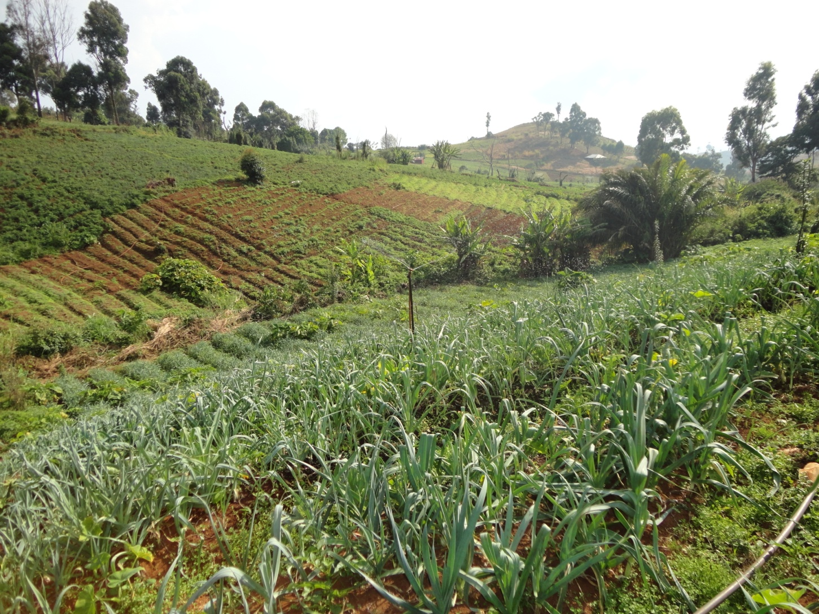
Why did it happen? 2/2
Ancestral agricultural practices

Slide 6
Who is it concerned?
Farmers
Entire community
Researchers (Observations)

Slide 7
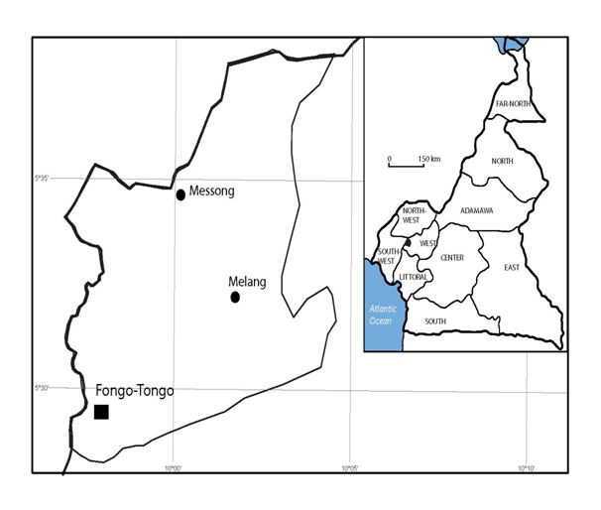


Where did it take place?

Slide 8
When did it take place?
2012 – 2013 Flatbed / ridging along
2013 Tied ridging experiment
2014 Tied ridging adopted

Slide 9
How much (by what means)? 1/3
Researchers (Solutions)
Farmers
Tied ridging
Tools

Slide 10
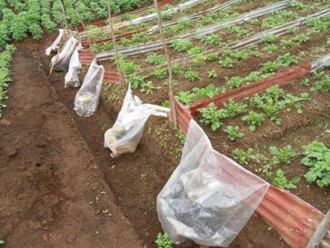
How much (by what means)? 2/3

Slide 11
How much (by what means)? 3/3
Sediment per cultivation method (t/ha)
Cultivation method | 11% slope | 29% slope
Flatbed | 13,40 | 22,45
Ridging along the steeply sloping | 17,30 | 33,45
Tied ridging | 2,66 | 6,30

Slide 12
How (in what way)? 1/3

Slide 13
How (in what way)? 2/3
Characterizing and quantifying sediment
Total quantities of collected sediment (t/ha)
Designation | 2012 | 2013 | 2014
Soil | 9,858 | 10,755 | 3,501
Plant residues | 0,127 | 0,092 | 0,080
Other | 0,012 | 0,014 | 0,005
TOTAL | 9,997 | 10,861 | 3,586

Slide 14
How (in what way)? 3/3

Slide 15
Conclusion
75% adoption tied ridging
65.61% reduction siltation
Siltation during hoeing and mounding
Monoculture experiment
Awareness and environmental education
Chemical analysis of water

Slide 16
THANKS

