Slide 1


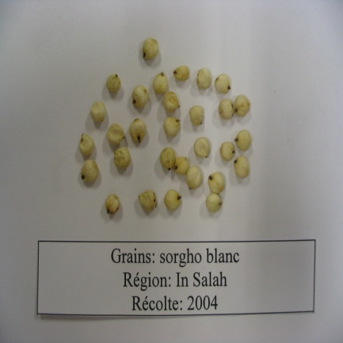
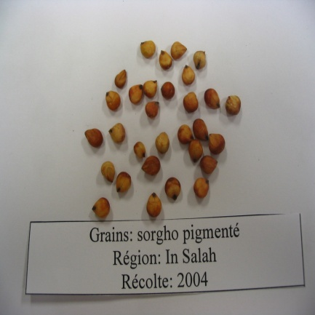
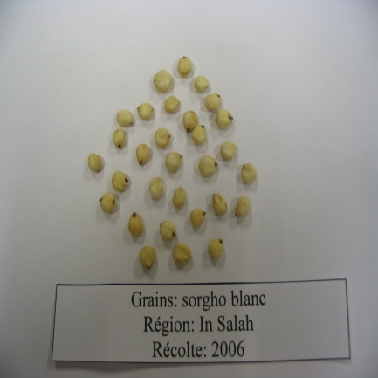
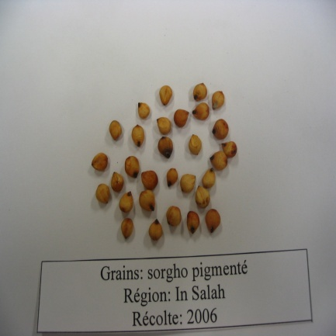
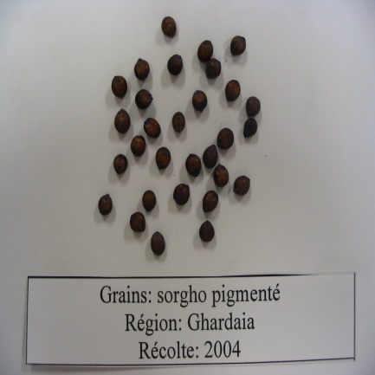
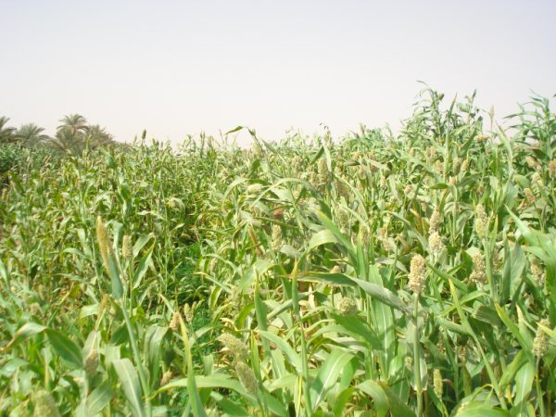
1st International Congres of Food Technology, 3-6 November 2010 Antalya, Turkey
FUNCTIONAL AND PHYSICOCHEMICAL PROPERTIES OF
STARCHES ISOLATED FROM SORGHUM CULTIVARS
CULTIVATED IN ALGERIAN HYPER ARID REGIONS
N. Boudries^{1, 2, 3}, M. Sindic¹, N. Belhaneche-Bensemra², B. Nadjemi³
¹ University of Liege, Gembloux AGRO-BIO TECH, 02 Passage des déportés, Belgium
² Department of Environmental engineering, National Polytechnic School of Algiers, 10 Hacene Badi, El Harrach , Algiers, Algeria
³ Bioactive Products and Biomass Valorization Research Laboratory,Chemistry Department, High School, BP 92 Vieux Kouba, Algiers, Algeria
nboudries@yahoo.fr
Abstract:
The pure starches were isolated from white and red sorghum (Sorghum bicolor (L.) Moench) cultivated in Tidikelt, a hyper arid regions situated in south Algeria. Color, size, Amylose content, rheological and thermal properties of isolated starches were examined. The amylose content showed that the genotype was normal (22.6-27.1%). The pasting properties of starches measured by RVA showed that the starches have different viscosity peaks. Red sorghum starch had a high value (371-4602 cP). The results showed that physicochemical and functional properties of sorghum cultivar starches were influenced by the genotype and the environment.
Keywords: Sorghum, starch, functional properties, physicochemical properties, Sahara of Algeria.
Introduction:
The most important sources of starch are cereals. Corn, wheat and potato starch has been extensively characterized but little interest has been given to the sorghum starches.
The Sahara of Algeria which is a hyper arid regions bordering the Sahel countries known to be important sorghum producer countries, include many genotypes of Sorghum bicolor (L.) Moench). Theses cereals components as starch, protein and fiber present a good potentialities for food and industrial uses.
Data on Algerian sorghum starch properties were nonexistent so the aims of this study were isolation and partial characterization of local Sorghum bicolor starches for their applications and transformations.
Many samples of sorghum grains are collected in 2004-2006 harvests. Some functionality and physicochemical properties of isolated starches as color, size distribution, amylose content, and rheological properties are studied for their competitive potential to satisfy specific technological and nutritional needs for target market.
The particularity of these starches properties are lies to the grain growth in hyper arid ecosystem where the maturity temperature is very high reaching a monthly mean of 45.2 °C and their irrigation using saline underground water.
2 Material and methods
2.1 Materials
Sorghum grain cultivars were grown in Tidikelt hyper arid region situated in the Sahara of Algeria and known to have temperatures ranging from 7.8 to 45.2°C and low annual rainfall rate (16.9 mm). The grain sorghum (Figure 1) were purchased from the 2004 to 2006 harvests.
Figure 1: grain sorghum photographies
2.2 Methods
Starch was isolated from the two sorghum cultivars by alkali extraction as proposed by Pérez Sira et al. (2004), Beta et al. (2000) and Beta & Corke (2001). The color of the extracted starches and the granule size distribution was determined respectively using a spectrocolorimeter Miniscan of Hunterlab (Virginia, USA) and the of isolated starches was determined with a laser diffraction particle size analyzer (Malvern Mastersizer 2000, Malvern Instruments Limited, Worcestershire, UK). Amylose content was determined by the method of Morrison and Laignelet (1983). . A Rapid Visco Analyzer RVA (Newport scientific Pty. Ltd., Warriewood, Australia) was employed to measure the pasting properties of starch (3±0.01g db, 28 g total weight). Experiments were performed using the ICC-Draft- Standard method (1995).
3 Results and Discussion
The starch granules present a satisfatory whitness , it means that the purification is effective. The blanch treatment with sodium hypochlorite gives a good effect on whitening
Sorghum starches had the same thermal behavior except at the peak, starches of the sorghum cultivated in 2004 showed the highest viscosity value at the peak (4093 and 4731cP respectively). Beta et al, (2000) found, for the four varieties of sorghum cultivated in Zimbabwe, lower peak times (300-450 s) and lower peak viscosities than those obtained for the starches isolated from the local sorghum cultivars.
Compared to viscosities of sorghum starches, the potato starches showed a similar behavior. However, they presented at the peak a higher viscosity than wheat starch where the peak is nearly absent; on the other hand the breakdown viscosity was then quite higher for the starches of sorghum, millet and potato (Roudot, 2002).
The genotype and the environmental conditions can explain theses differences.
4 Conclusion
The starches of two sorghum cultivars of white and pigmented kernels growing in hyper arid environmental conditions showed significant differences in granule size, amylose content and thermal behavior which ultimately affect the physicochemical and functional properties.
The characterization of the grain and its components is particularly relevant considering their high drought resistance and capacity to grow using low-input agricultural fertilizers which may stimulate local populations to enhance their cultivation and transformation and so contribute to the socioeconomic development of these regions.
5 References
Beta, T., Coke, H., Rooney, L., & Taylor, J. R. N. (2000). Starch properties as affected by sorghum grain chemistry. Journal of science and food agriculture 81, 245-251.
Beta, T., & Coke, H. (2001). Genetic and environmental variation in sorghum starch properties. Journal of cereal science. 34:261-268.
ICC-Draft-Standard N162 (1995). Rapid pasting method using the Newport Rapid Visco Analyser
Morrison, W.R., & Laignelet, B. (1983). An improved colorimetric procedure for determining apparent and total amylose in cereal and other starches. Journal of cereal science 1:9-20.
Pérez Sira, E., & Amaiz, M. L. (2004). A laboratory scale method for isolation of starch from pigmented sorghum, Journal of food engineering 64, 515-519.
Table 2: Characteristic values of isolated sorghum starches diameters
Starch | SBI03 | SBI04 | SPI04 | SBI06 | SPI06 |  | SG06
minimale value(µm) | 6,607 | 6,607 | 6,607 | 5,754 | 6,607 | 5,754
maximale value(µm) | 39,811 | 39,811 | 39,811 | 39,811 | 39,811 | 34,674
The local sorghum starch granule size is higher than other sorghum starch cultivated in other region of America and Asia, and near the size granule of wheat (1-45 µm ), maize (2-30 µm) and cassava (4 -34 µm).
Table 3: amylose content of local sorghum starches
Starch | ASBI04 | ASPI04 | ASBI06 | ASPI06 | ASG06
Amylose (%) | 27,10 | 24,80 | 22,64 | 23,92 | 24,13
Amylopectine (%) | 72,90 | 75,20 | 77,36 | 76,08 | 75,87
Ratio | 0,40 | 0,30 | 0,29 | 0,31 | 0,32
The amylose content of starches isolated from the two sorghum cultivars showed a significant difference. The sorghum starches analyzed are considered as normal types since the rate was ranging from 21 to 34 % (Beta et Coke 2001).
Table 4: Pasting properties of native starch from local sorghum cultivars
Starch | Peak viscosity (cP) | Minimal viscosity (cP) | Breakdown (cP) | final viscosity (cP) | Setback (cp) | Peak time (min) | Tg (°C)
SBI04 | 4093,00 | 1330,00 | 2763,00 | 3718,50 | 2388,50 | 9,60 | 81,87
SPI04 | 4634,50 | 1342,00 | 3292,50 | 3562,50 | 2220,50 | 8.47 | 84,70
SBI06 | 3978,00 | 1755 | 2223 | 3920 | 2165 | 9,77 | 74,67
SPI06 | 3712,00 | 1569,50 | 2142,50 | 3778,50 | 2209,00 | 10,00 | 76,05
SPG06 | 4602,00 | 1507,50 | 3094,50 | 3778,50 | 2271,00 | 9,13 | 72,05
White sorghum Red sorghum White sorghum Red sorghum Brown sorghum
(2004) (2004) (2006) (2006) (2006)
Table 1: Color parameters of isolated sorghum starches
Starch | SBI03 | SBI04 | SPI04 | SBI06 | SPI06 | SG06
L | 90,14 | 92,91 | 91,06 | 89,04 | 91,98 | 90,46
a | -0,11 | -0,26 | -0,48 | -0,1 | -0,28 | -0,11
b | 3,52 | 3,58 | 4,15 | 4,23 | 3,46 | 3,5

