Slide 1
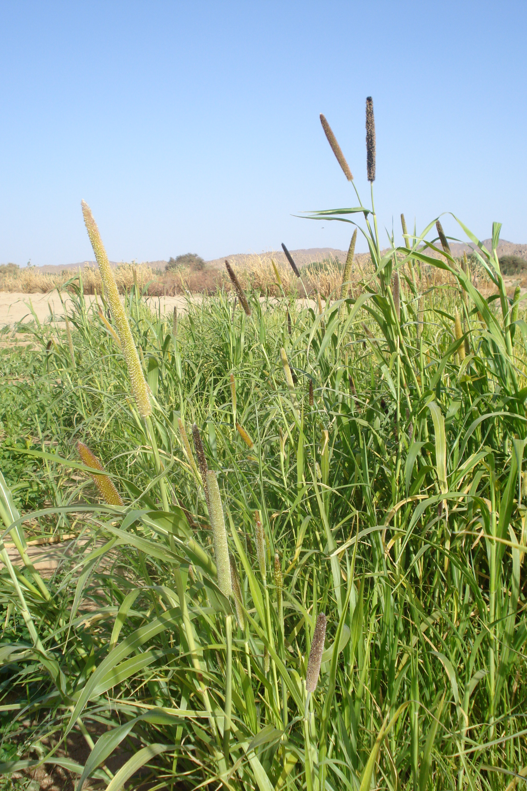


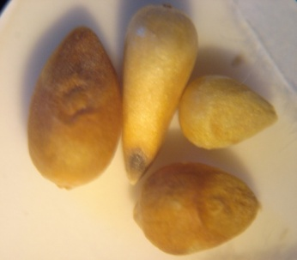
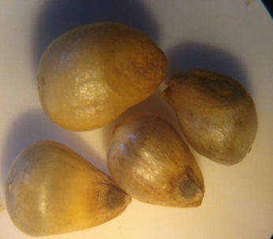
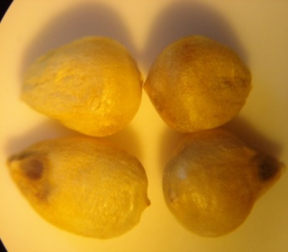
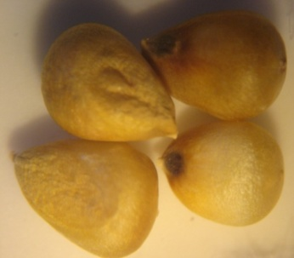
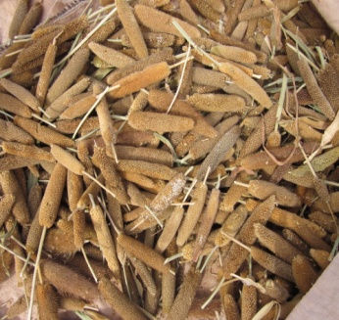
C & E Spring Meeting. May 29-31, 2013. LEUVEN, BELGIUM
FUNCTIONAL AND PHYSICOCHEMICAL PROPERTIES OF STARCHES ISOLATED FROM PEARL MILLET LANDRACES GROWN IN HYPER ARID ECOSYSTEM
Nadia Boudries^{1. 2}. Marianne Sindic¹ Boubekeur Nadjemi² . Naima Belhaneche-Bensemra³
¹University of Liege. Gembloux AGRO-BIO TECH. 02 Passage des déportés. Belgium
²Laboratory of Research on Bioactive Products and Biomass Valorization, High School Teacher training, BP 92 Kouba, Algiers, 16050 Algeria.
³Department of Environmental engineering. National Polytechnic School of Algiers. 10 Hassen Badi. El Harrach . Algiers. Algeria
Abstract:
The pure starches were isolated from pearl millet (Pennisetum glaucum (L.)) cultivated in In Saleh and Tamanrasset a hyper arid regions situated in south of Algeria. Color, amylose content, pasting and thermal properties were examined. The amylose content showed that the genotypes were normal (21.20-26.80%). The pasting and thermal properties measured respectively by RVA and DSC showed that the starches have a significant viscosity peaks (2985 and 3809 cP) and gelatization temperatures. The results showed that physicochemical and functional properties of sorghum cultivar starches were influenced by the genotype and the environment.
Keywords: Starch. Pearl millet, functional properties, physicochemical properties, Sahara of Algeria
1. Introduction
Starch is the primary component of most plant storage organs. Two polymers are present in starch granule: amylose and amylopectin. They contribute greatly to the structure of wide range of food and constitute a raw material for production of many modifications. Thus increased understanding of biopolymer structure and behavior is of vital importance in modern food processing. Corn, wheat and potato starches have been extensively characterized but little interest has been given to the pearl millet starches. The Sahara of Algeria which is a hyper arid region bordering the Sahel countries as Niger include many cultivars of Pennisetum glaucum (L.). Data on Algerian pearl millet cultivars and their isolated starches properties were nonexistent so the aims of this study were starches isolation and partial characterization. Samples of 2002-2006 pearl millet harvests were collected and some functional and physicochemical properties of isolated starches were studied for their competitive potential to satisfy specific technological and nutritional needs for target market.
4.3. Pasting properties
The results showed a significant difference between the harvests and genotypes. Starch viscosity was affected by the ecosystem conditions and genotype. The peak viscosity rang was 2985-3809 cP. Compared to other cereals, Algerian pearl millet starches gave higher viscosities and gelatinization temperatures.
Table 3: Pasting properties of pearl millet starches
4.4. Thermal properties
Starches | PV (cP) | HPV (cP) | BD (cP) | FV (cP) | SB (cP) | PT (min) | Tg (°C)
PMI02 | 3809 | 1066 | 2743 | 3062 | 1996 | 9.33 | 75.07
PMI04 | 2985 | 967 | 2018 | 3147 | 2180 | 9.97 | 76.70
PMI05 | 3694 | 1125 | 2569 | 3030 | 1905 | 9.17 | 73.85
PMJI06 | 3514 | 951 | 2563 | 2675 | 1724 | 8.80 | 74.25
PMOI06 | 3402 | 1089 | 2313 | 2938 | 1849 | 9.47 | 76.00
PMT06 | 3254 | 892 | 2362 | 2670 | 1778 | 9.40 | 74.65
2. Materials
Pearl millet cultivars were cultivated in In Salah and Tamanrasset (South ofAlgeria) known to have temperatures ranging from 11 to 47°C and low annual rainfall rate (2-29 mm). A sample was impoted from Agadez (Niger). The spike and kernel pearl millet (Figure 1) were purchased from the 2002 to 2006 harvests.
T_{onset} was the same for almost starches cultivars, whereas, T _{peak} were fairly different. The high value suggest that the amylopectin molecules has a long chain and a great stability of crystal lattices according to Taylor (2003) and Moorty (2002) . The enthalpy of gelatinization depend of the intermolecular connections in the crystalline structure as well as genetic and environmental factors . It can be deduced, consequently that the environment of the southern areas of Algeria affect the gelatinization properties of pearl millet starches, which could explain the high values of gelatinization temperature.
Table 4: Thermal properties of pearl millet starches
PMI04,El Bechna c. PMN04,local c. PMJI06, Jafo c. PMOI06, Ouaini c. Pearl millet spikes
In Salah (2004) Agadez (2004) In Salah (2006) In Salah (2006) In Salah (2006)
Fig.1: Pearl millet kernel and spike photographies
3. Methods
Starches were isolated by alkali extraction (Pérez Sira et al. (2004), Beta et al. (2000) and Beta & Corke (2001)). The starches color and amylose content were determined using respectively a spectrocolorimeter Miniscan (Virginia. USA) and the Morrison and Laignelet method (1983). RVA4 (Newport scientific Pty. Ltd. Warriewood. Australia) and DSC 2920 analyzer enthalpy differential (TA Instruments, New Castle DE, USA) were used respectively for of pasting properties and thermal behavior.
Starches | PMI02 | PMI04 | PMI05 | PMJI06 | PMOI06 | PMT06 | PMA04
T_{onset} (°C) | 69.60 | 69.88 | 69.32 | 68.92 | 69.07 | 67.97 | 68.89
 | ±0.00 | ±0.04 | ±0.21 | ±0.11 | ±0.06 | ±0.47 | ±0.12
T _{peak} (°C) | 74.145 | 73.44 | 73.37 | 73.445 | 74.09 | 73.015 | 72.49
 | ±0.01 | ±0.04 | ±0.28 | ±0.09 | ±0.00 | ±0.13 | ±0.07
ΔH (J/g) | 12.865 | 8.93 | 12.83 | 12.445 | 12.81 | 12.285 | 9.044
 | ±0.389 | ±0.143 | ±0.339 | ±0.148 | ±0.184 | ±0.672 | ±0.078
4. Results and Discussion
Native starches were isolated from local Pearl millet grain cultivars with high purity (88-97% ) and lower extraction yield (54-62%).
4.1. Starch color
The starches granules present a satisfatory whitness, L was higher than 90. the isolation and purification process used were so effective.
Table 1: Color parameters of isolated pearl millet starches
4.2. amylose content
The amylose content of starches showed a significant difference. They are considered as normal types since the rate was ranging from 21 to 34 % (Beta & Corke 2001). Starch of Agadez cultivar showed the highest amylose content. The amylose plays an important role in the properties of swelling, gelatinization and gel firmness (Tester et Morrison, 1990).
The FAO (1995) gave a rang of 21,9-28,8 % for starches pearl millet.
Table 2: amylose and amylopectin content in pearl millet starches
5. Conclusion
The starches of pearl millet kernels growing in hyper arid environmental conditions showed significant differences. amylose content, pasting and thermal behavior which ultimately affect the physicochemical and functional properties.
The characterization of the isolated starches showed an interesting functional and physicochemical properpties. The valorization of Algerian pearl millet cultivars is particularly relevant considering their high drought resistance and capacity to grow using low-input agricultural fertilizers which may stimulate local populations to enhance their cultivation and transformation and so contribute to the socioeconomic development of these regions.
Starches | PMI02 | PMI04 | PMI05 | PMJI06 | PMAI06 | PMT06 | PMN04
L | 91.76 | 90.52 | 92.49 | 89.98 | 90.73 | 91.34 | 89.66
a | -0.43 | -0.24 | -0.29 | -0.37 | -0.12 | -0.4 | -0.25
b | 3.14 | 3.42 | 2.77 | 3.3 | 4.07 | 2.96 | 4.43
5. References
Beta, T., Corke, H., Rooney, L. & Taylor, J.R.N. 2000. Starch properties as affected by sorghum grain chemistry. Journal of the science of food and agriculture, 81: 245-251.
Beta, T. & Corke, H. 2001. Genetic and environmental variation in sorghum starch properties. Journal of cereal science, 34:261-268.
FAO. 1979. Nutrition humaine en Afrique tropicale. Manuel pour le personnel de santé. http://www.fao.org/docrep/X0081F/X0081F0h.htm. 2009
Moorthy, S.N. 2002. Physico-chemical and functional properties of tropical tuber starch: A review. Starch/ Stärke, 54, 559-592.
Morrison, W.R., & Laignelet, B. 1983. An improved colorimetric procedure for determining apparent and total amylose in cereal and other starches. Journal of cereal science 1: 9-20.
Pérez Sira, E. & Amaiz, M. L. 2004. A laboratory scale method for isolation of starch from pigmented sorghum, Journal of food engineering, 64, 515-519.
Taylor, J.R.N. 2003. Overview: importance of sorghum in Africa http://www.afripro.org.uk/papers/Paper01Taylor.pdf 2006
Tester, R.F. & Morrison, W.R. 1990. Swelling and gelatinization of cereal starches. I. Effects of amylopectin, amylose and lipids. Cereal chemistry, 67: 551-557.
Starches | PMI02 | PMI04 | PMI05 | PMJI06 | PMOI06 | PMT06 | PMA04
Amylose (%) | 21.2 | 23.1 | 21.5 | 21.0 | 21.1 | 21.4 | 26.8
Amylopectin (%) | 79.8 | 77.0 | 78.5 | 79.0 | 78.9 | 78.6 | 73.2
Ratio | 0.3 | 0.3 | 0.2 | 0.3 | 0.3 | 0.3 | 0.4

