Slide 1





NITROGEN FERTILISATION RECOMMENDATIONS : COULD THEY BE IMPROVED USING STOCHASTICALLY GENERATED CLIMATES IN CONJUNCTION WITH CROP MODELS ?
B. Dumont₁, B. Basso₂, V. Leemans₁, JP. Destain₃, B. Bodson₁, MF. Destain₁
1, ULg - Gembloux Agro-Bio Tech, Gembloux, Belgium
2, Michigan State University, East Lansing, Michigan, USA
3, Walloon Agronomical Research Center (CRA-W), Gembloux, Belgium

Slide 2

Context : History
Since
1950
Intensification of agricultural systems
➔ Intensification of fertilizer application
1991
European Nitrate Directive 91/6/76/EEC
➔ Maintain productivity – Decrease N environmental pressure
2002
Sustainable Nitrogen Management in Agriculture Program (PGDA)
➔ Transposition of EEC 91/6/76 : a guide of « good practices »
2009-2013
N fertilizer use would have increased by 6% in 10 / 27 EU state members
➔Agriculture could be responsible for 50% of total N in surface water in EU
2014-???
With CC : Increasing frequencies of extreme weather events
➔ Quantifying the climatic uncertainty impacting cropping systems
For the
future
➔ There’s a need for Tools and Decision support systems
2

Slide 3

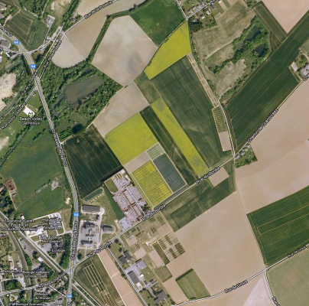
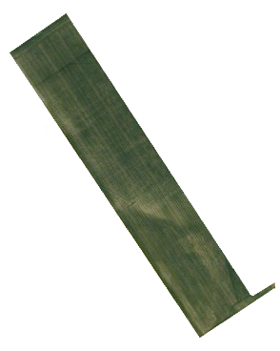
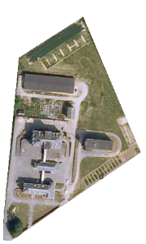
Context : Case study (1/4)
An original experiment was designed to study the winter wheat growth under different growing conditions :
Soil types : sandy loam vs. classical loam
Nitrogen fertilisation level : 0-120-180-240uN 7 protocols
Nitrogen fertilisation rate : 2 or 3 applications
Climatic variability : Since 2008 – Till 2014
CRA-W
3

Slide 4
Context : Case study (2/4)
Crop and environmental measurements :
What ? When ?
# plants, after emergence
# tillers, after tillering stage
# grains per ear, after flowering stage
LAI development, once a month
Total biomass and grain yield, once every 2 weeks
Final grain yield, at harvest
N soil profile (by 15cm layer), once every 2 weeks
N concentration in plant organs, at harvest
Soil Water content, continuously (Microsensors)
4

Slide 5
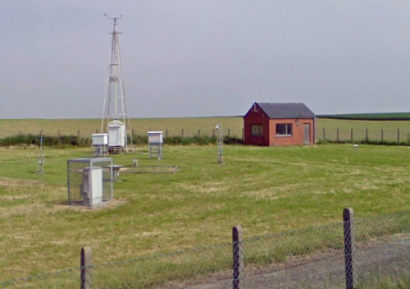
Context : Case study (3/4)
The Ernage weather database
Part of the national observation network :
Royal Meteorological Institute (IRM) of Belgium
30-years of historical records
Located 2 kilometers from the field
Available measurements :
  Temperature
  Vapor pressure
  Solar radiation
  Rainfall
  Wind spedd
5

Slide 6
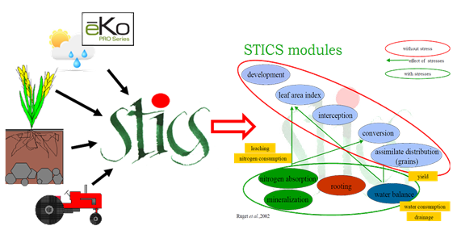
Context : Case study (4/4)
The STICS soil-crop model (Inra, France)
Simulateur mulTIdisciplinaire pour Culture Standard
(Multidisciplinary model for standard culture)
6

Slide 7
Context : Case study (4/4)
The STICS soil-crop model validation
➔ A correctly calibrated crop model is a key solution !!!
Plant parameters were optimised, BUT soil was parameterised !!!
RMSE = 1.91 ton ha⁻¹
EF = 0.87
ND = 0.1
Simulated biomass [ton ha⁻¹]
Observed biomass [ton ha⁻¹]
7

Slide 8
Objectives
FROM
TOOLS
Crop models are effective to assess different cropping systems inputs
  Agro-environmental conditions
  Management practices
  Climatic conditions
Weather generators can be used to evaluate the climatic uncertainties
  Based on historical records
  Stochastically derived weather time series
  Probability risk assessment
TOWARDS
DSS
Developping a promising methodology
  based on the concomitant use of crop models and weather generators
  allowing to study the effect of different N fertilisation practices
➔ Design an OPTIMAL strategic approach
➔ Optimisation of the economic and environmental N-Use efficiencies
8

Slide 9
Material and Method (1/4)
Defining Nitrogen management strategies
Historical Belgian farmer current N practice : 60-60-60 kgN ha⁻¹
9

Slide 10
Material and Method (1/4)
Defining Nitrogen management strategies
Historical Belgian farmer current N practice : 60-60-60 kgN ha⁻¹
  The timing of application was maintained
  The two first N doses are kept at 60 kgN ha⁻¹
  Only the Flag-Leaf application will be modified
  ➔ Wheat is able to compensate early climatic stresses (tiller, #grains, …)
  ➔ Need to avoid early N stress
10

Slide 11
Material and Method (1/4)
Defining Nitrogen management strategies
Historical Belgian farmer current N practice : 60-60-60 kgN ha⁻¹
  The timing of application was maintained
  The two first N doses are kept at 60 kgN ha⁻¹ MODULO-60 Strategies
  Only the Flag-Leaf application will be modified
11

Slide 12
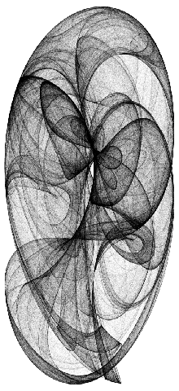
Material and Method (2/4)
Synthetic weather time series : The LARS-WG
(Semenov and Barrow, 2002)
Deconstructing the Ernage WDB
  Analysis of the daily mean, std, maxima/minima
  Decomposition in wet and dry series
  Return time of rainy events
Ernage WDB
# 30 years
Stochastically derived
Climatic conditions
# 300 time series
➔
➔
12
12
Semenov, M.A., Barrow, E.M., 2002. LARS-WG - A stochastic weather generator for use in climate impact studies. User manual, version 3.0, August 2002. Tech. rep., Rothamsted Research, Harpenden, Hertfordshire, AL5 2JQ, UK.

Slide 13
Material and Method (3/4)
Defining decision criteria
Agronomical criterion
Maximal Yield
Agro-Economic criterion
Marginal Net Revenue (MNR)
Y_{N} = Yield obtained under given N level
G_{P} = Grain selling price ~ 200 eur ha⁻¹
N = Amount of N fertilised
N_{P} = Cost of N ~ 300 eur ha⁻¹ @ 27%N
13

Slide 14
Material and Method (3/4)
Defining decision criteria
Agronomical criterion
Maximal Yield
Agro-Economic criterion
Marginal Net Revenue (MNR)
Agro-Economico-Environmental criterion
Environmental-Friendly Net Revenue (ENR) – designed according to PGDA
SNC = Soil N content in the 0-90 cm profile after harvest
14

Slide 15
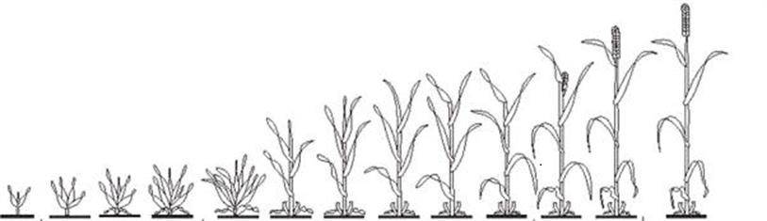
Material and Method (4/4)
Designing a Strategic approach
  A Strategic management aims to achieve a global and long-term objective
  → Only the climatic hazards will be of interest
  → Weather generators will be used to derive synthetic time series
  → The impact of two fixed and one variable N practice will be evaluated
Climatic dataset necessary to simulate a complete crop season
…
Synthetic
weather
! Action !
? Action ?
15

Slide 16
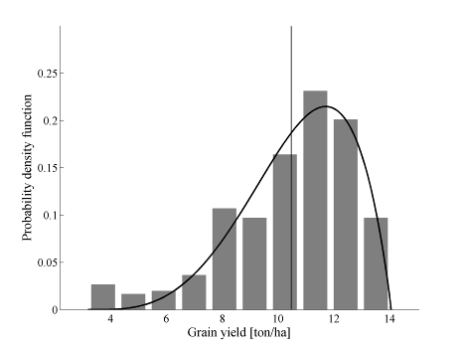
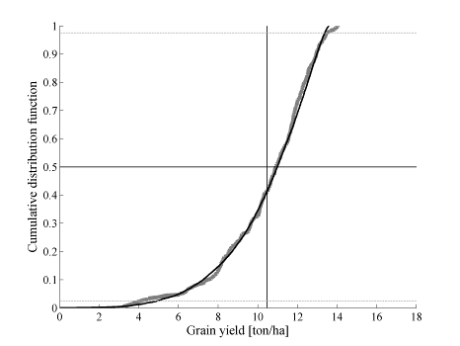
Results (1/8)
Simulating the Modulo-60 strategies
Example with the Belgian farmers’ current N practice : 60-60-60 kgN ha⁻¹
16

Slide 17
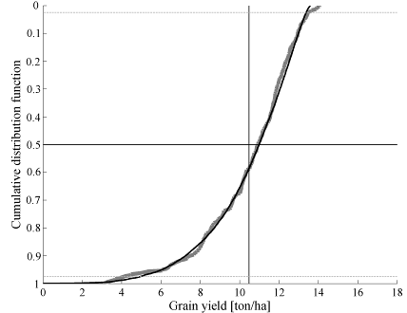
Results (2/8)
Simulating the Modulo-60 strategies
Example with the Belgian farmers’ current N practice : 60-60-60 kgN ha⁻¹
➔ In terms of risk for the farmers
  The worst climate is the more likely to happen
  Climate ‘+’ = Probability of 0
  Climate ‘-’ = Probability of 1
Climat “+”
Climat “-”
17

Slide 18
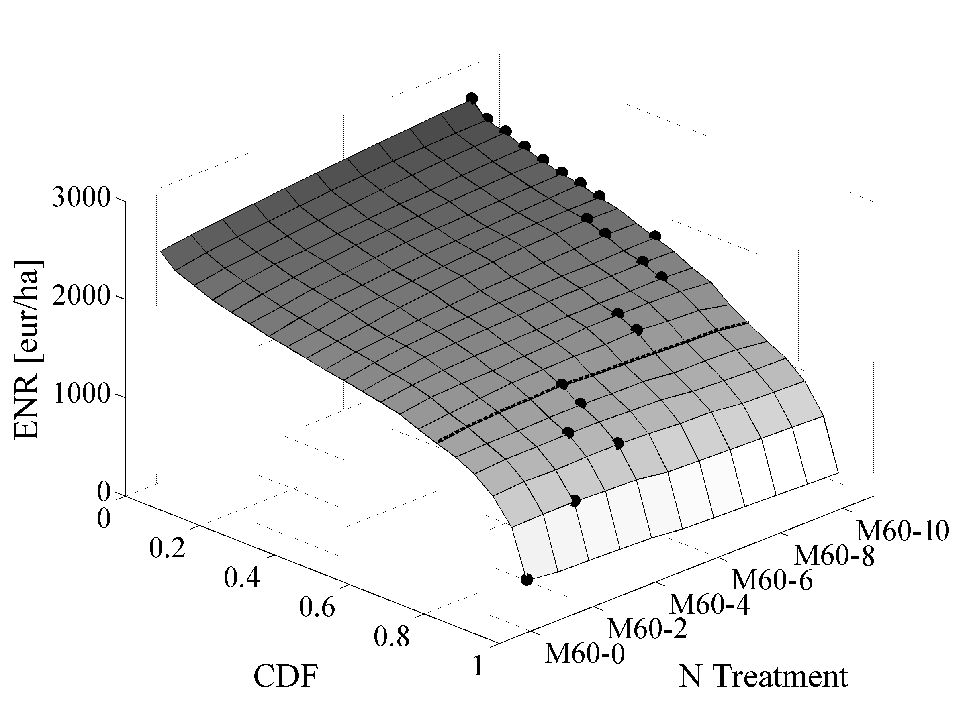
Results (3/8)
Constructing the 3D-response surface
➔ Wheat culture
➔ Given agro-pédological conditions
➔ Under local climate conditions
➔ Under different N treatment
Climate ‘+’
N +
Climate ‘-’
N -
18

Slide 19
Results (4/8)
Optimising N management
➔ It is impossible to determine the climatic conditions that will occur till harvest !
➔ It is impossible to determine the best N practice for that given year !
Climate ‘+’
N +
Climate ‘-’
N -
19

Slide 20
Results (5/8)
Optimising N management
➔ Linear relationship between the optimal N (•) and the corresponding climatic probability
Climate ‘+’
N +
Climate ‘-’
N -
20

Slide 21
Results (6/8)
Optimising N management
➔ According to Basso et al. (2012), one has to determine the optimal N practice has the one that outperforms the others 75% of the time (3years out of 4)
➔ 60-60-50 kgN ha⁻¹
➔ 60-60-40 kgN ha⁻¹
Climate ‘+’
N +
Climate ‘-’
N -
21

Slide 22
Results (7/8)
➔ According to the graphical analysis
one could decrease the flag-leaf application up to 60-60-40 kgN ha⁻¹
→ Obviously fonction of genotype and soil properties
→ Mainly linked to N costs and grain selling prices
22

Slide 23
Results (8/8)
A Wilcoxon test to compare statistically equivalent distributions
➔ According to the graphical analysis
one could decrease the flag-leaf application up to 60-60-40 kgN ha⁻¹
➔ According to the statistical analysis
one could decrease the flag-leaf application up to 60-60-20 kgN ha⁻¹
23

Slide 24
Conclusions
An optimal strategic N management DSS was developed, allowing
  To quantify the risk for farmers
  To maximize farmers revenues
  To reduce the environmental pressure
  To optimize N practice
24

Slide 25
Conclusions
An optimal strategic N management DSS was developed, allowing
  To quantify the risk for farmers
  To maximize farmers revenues
  To reduce the environmental pressure
  To optimize N practice
➔ Easy coupling with SPATIAL soil maps
25

Slide 26
Conclusions
An optimal strategic N management DSS was developed, allowing
  To quantify the risk for farmers
  To maximize farmers revenues
  To reduce the environmental pressure
  To optimize N practice
➔ Easy coupling with SPATIAL soil maps
➔ Easy coupling with REAL-TIME data acquisition
(either in-season sensors measurements or climatic records)
26

Slide 27
Conclusions
Defining the climate Positioning the yield
27
27

Slide 28
Conclusions
An optimal strategic N management DSS was developed, allowing
  To quantify the risk for farmers
  To maximize farmers revenues
  To reduce the environmental pressure
  To optimize N practice
➔ Easy coupling with SPATIAL soil maps
➔ Easy coupling with REAL-TIME data acquisition
(either in-season sensors measurements or climatic records)
➔ And then, this is even more PA !!
28

Slide 29



NITROGEN FERTILISATION RECOMMENDATIONS : COULD THEY BE IMPROVED USING STOCHASTICALLY GENERATED CLIMATES IN CONJUNCTION WITH CROP MODELS ?
-
Thank you for your attention
Benjamin Dumont
Benjamin.dumont@ulg.ac.be
29
Notes:
29

