Slide 1
Master-narratives for science policy
The interplay of political discourses on Science in Wallonia
EASST conference 2014 - Situating Solidarities
Notes:
Présentation perso rapide: PhD in political sciences, University of Liège, Belgium, working on the evolution of science policy in Flanders and Wallonia

Slide 2
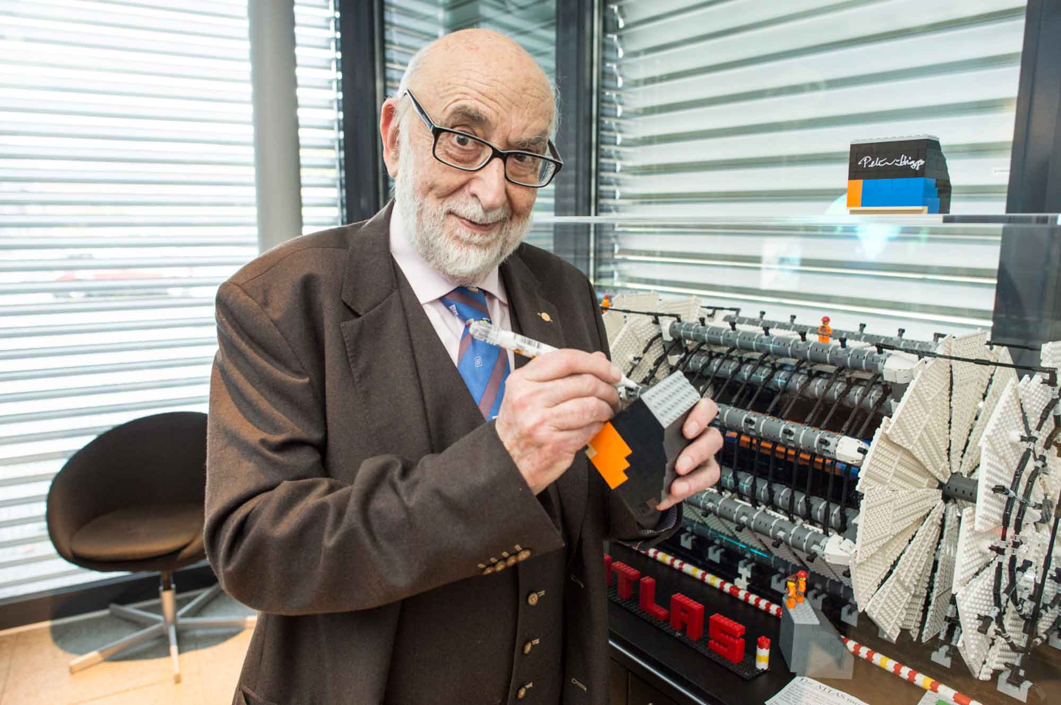
“It is essential to privilege basic research in a climate of total freedom and of independence regarding short term political and economic imperatives”
“Directly and indirectly, basic research is the source of almost every technical developments”
“[Basic research] provides an access to rationality. Therefore, it can be a bulwark against irrational, destructive and dangerous ideologies”
François Englert, Le Soir, 2014-03-14, p.27
Notes:
I’d like to start with some food for thought : François Englert, Nobel Prize in Physics, and now with this new status he is very present in the medias to support the public funding of a basic, indenpentent, bottom up research

Slide 3
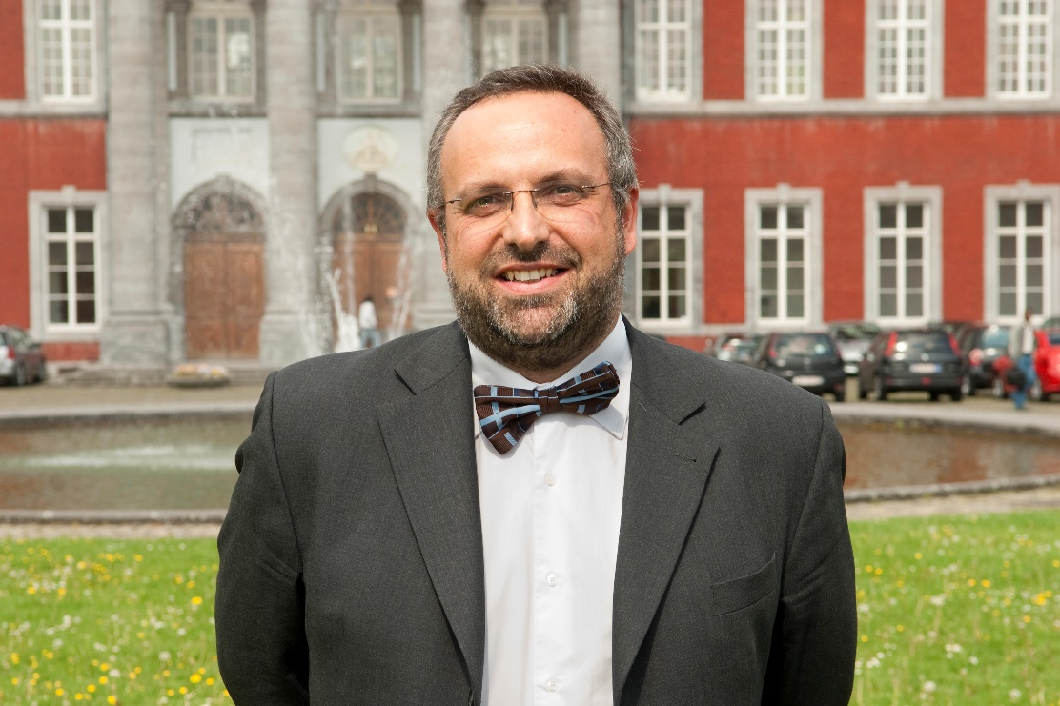
“There has been a new funding opportunity, […] the ‘competitiveness clusters’, with projects where companies are increasingly involved in our research scheme. I believe that this model is a very good one.”
“It is a mix of industries and universities, they meet to build new R&D projects and to create new products. This is typically what ‘innovation’ means.”
“This, I would say, is the new way to conduct scientific research, and yet, not everyone does it.”
Interview with E. Haubruge, Vice-Rector of the University of Liege, 2014-08-21
Notes:
Food for thought: Science as a site of struggle, a political issue with conflicting visions

Slide 4
Aims of the paper
To study the « political understanding of Science » (Nowotny in PUS, 2014) / the political discourses on Science:
How should scientific research be organized? How should it be funded? what are its aims?
Providing a conceptual/analytical framework : analyzing the interplay of “science policy narratives” and their enactments in a local context
Notes:
Narratives: I’ll come to that later on

Slide 5
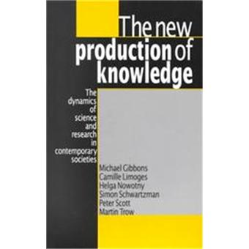
Wallonia – Belgium : variety vs. litterature
Notes:
Point of departure of my reflection : transition litterature does not fit the complex walloon context: a variety of policy instruments, overlapping institutions, various research practices, multiple discourses and trajectories (give examples: FNRS, UIPs, ). How to make sense of it ? How is the global transition of STI systems taking place at the regional level? How can we give a better account of local enactments, with a political reading of the evolution

Slide 6
Science policy narratives
Studying « common figures » in situated, grounded discourses on science
Narrative form:
a script/ a plot
a logical/temporal sequence
Enrolling characters
explanatory + mobilizing resources
Notes:
Studying the multiple policy narratives that circulate as rationales for science policy

Slide 7
Master-narratives as ideal types
Notes:
Briefly explain the different M-N, why those, where do they come from + refering to the first examples slide 2-3
+ general trajectory : toward economisation and heteronomy. Science for the sake of science is absent of litterature

Slide 8
Main hypotheses:
Importance of the context of enunciation
Dynamic use of narratives as resources:
A narrative is rarely specific to one actor/group
Multiple narrative can be conveyed to make sense of the STI system:
Depending on the situation, stakeholders use different (combination of) narratives, regarding the policy instrument they are defending or the reform they are calling, regarding the audience and the context, etc.
Notes:
particular attention for the author of the discourse, the type of discourse, the context, the audience, the expected goal and the dynamic of interaction between the stakeholders (of conflict, of consensus, etc.): who is telling what, to whom, why, when, where, in which form: all of these questions matter
Ref. slides exemples 1 et 2 : il y a certes une tension entre les moyens pour la recherche fondamentale libre et les moyens pour la recherche appliquée – mais vu la diversité de pratiques et d’instruments, il n’y a pas lieu d’avoir une conception dichotomique : usage multiples des récits en contexte

Slide 9
Illustrations: following the actors in various situations
University Rector praising the work of the technology transfer office – proud of the spin-offs and patents
“It was an innovative concept in 1989”, recalls the rector of the University of Liège, Bernard Rentier. “Only ten years had passed since the idea to valorize University know-how was born in the USA. We had plenty of unexploited things in our drawers and boxes.”
Interview of B. Rentier, Le Soir, 14th of March, 2009, p.9
A clear example of KBE

Slide 10
Illustrations (2)
In contrast: public mobilization against a new criterion for selection of research projects
“potential societal impacts” for bottom-up, basic research (July, 2013)
“predicting social impact is extremely complex in basic research. Examples of major developments stemming from research devoid of societal goals are countless.” […] “potential applications are […] only speculations, it belongs more to literature than to science” (open letter/petition)
Science, the Endless Frontier ?

Slide 11
Conclusions
analysis of narrative in context = enriched description for local situations
Linear conception of innovation and distinction between basic vs. applied research are still very powerful narratives in certain situations
Multiple variants of master-narratives are intertwined, and if they compete, they also are used by various actors in different contexts

Slide 12
Thank you for your attention
ncharlier@ulg.ac.be

