Slide 1

SFX Knowledge Base Advisory Board (KBAB)
IGeLU 2014 Conference Oxford
September 15-17, 2014
Goals And Achievements After One Year
François Renaville, University of Liege
Mark Needleman, Florida Virtual Campus
Download: http://hdl.handle.net/2268/171986

Slide 2
Abstract
Founded in 2013 as a result of discussions at the 2012 Zurich Conference, the goal of the SFX Knowledge Base Advisory Board (KBAB) is to promote first class quality of the data stored in the SFX Knowledge Base by reviewing the quality assurance policies and processes together with Ex Libris. During its first year, the group identified several issues in order to improve the CKB quality. They shared them with Ex Libris which agreed to work on or to take a look at some. This session will explain how KBAB has been working, and present some of the issues and the improvements brought by Ex Libris.

Slide 3
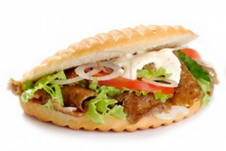
Goals
Founded in 2013 as a result of discussions at the 2012 Zurich conference
Goal: to promote first class quality of the data stored in the SFX Knowledge Base by reviewing the quality assurance policies and processes together with Ex Libris
In the long run the SFX KBAB is supposed to:
  Create its own ideas for new KB policies and/or processes and propose them to Ex Libris
  Receive, review, and forward to Ex Libris any such ideas submitted from the SFX user community
  Provide feedback and advice on intended extensions or changes of KB policies and/or processes on according requests from Ex Libris.

Slide 4
Working Body
The SFX KBAB is a joint IGeLU and ELUNA group.
IGeLU
  François Renaville, University of Liege Library, Belgium, Coordinator
  Mark Needleman, Florida Virtual Campus, USA, Deputy Coordinator
  Yosef Branse, University of Haifa Library, Israel
  Holly Thomason, Stanford University, USA, liaison IGeLU SFX PWG
ELUNA
  Stephanie Nicely Aken, University of Kentucky, USA
  Erika Banski, University of Alberta, Canada
  Xiaotian Chen, Bradley University, USA
  Ann Ercelawn, Vanderbilt University, USA
  Marina Oliver, Texas Tech University, USA, liaison ELUNA SFX PWG
Contact with Christine Stohn, SFX Product Manager

Slide 5
Under the Microscope
+/- 35 discussed issues (9 in a priority list) during the year
Related to CKB
Sometimes software issues -> out of scope -> frustrating
Focus on some issues:
  E-books metadata
  SFX subject categories
  Undef
  Individual volume names for monographic series
  Initial articles at the end of titles
  Language + initial article
  Beginning and ending dates
  MISCELLANEOUS_FREE_EJOURNALS

Slide 6
(1) E-books metadata
More complete metadata
  E-books authors are too often missing
  Categories are missing
  Publication date
  Subtitles
  …
Encouraging vendors to enhance metadata
  By Ex Libris
  By SFX Community
Possible to come up with a letter to vendors?

Slide 7
Ex Libris’ feedback
KBART recommendations Phase II include the addition of author information for E-Books.
However, it is still often missing or the information is very difficult to manage and inconsistent.
→ Ex Libris promotes the use of KBART II recommendations to content providers.
Also investigating if ExL can enrich the data from other places (but this is a longer project).

Slide 8
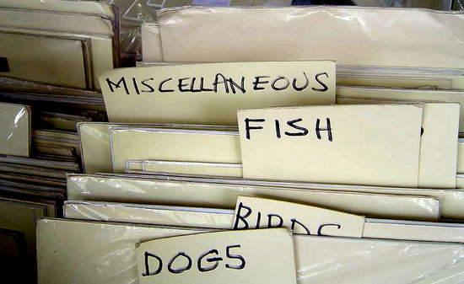
(2) SFX subject categories
SFX subject categories are not systematically added to objects
Known problem for e-books (see above)
But also concerns many e-journals
Next to the quantity of categories, category assignation should be logical, relevant and accurate (quality aspect).

Slide 9
Analysis 1
University of Haifa Library (January 2014)
  146,185 active object portfolios (journals) -> 97,043 distinct objects after de-duplication.
  56,771 (58.4%) have no category at all
Thanks to Yosef Branse!

Slide 10
Analysis 2
University of Liege Library (January 2014)
  81,881 active object portfolios (journals) -> 62,769 distinct objects after de-duplication.
  34,449 (54.9%) have no category at all

Slide 11
From those 34,449 objects with no category:
ISSN?
  17,494 (50.8%) have got a print ISSN
  5,405 (15.7%) have got a online ISSN
  4,615 (13.4%) have both
→Almost 65% have got at least one ISSN
Publishers?
  Elsevier: 262
  Springer: 249
  Taylor & Francis: 55
  Wiley: 49
  SAGE Publications: 36
  NPG: 15

Slide 12
Ex Libris’s feedback
Ex Libris is testing options to add substantially more categories by using CONSER as the basis and map the categories to SFX.
  If successful → can be done on an ongoing basis.
  Mapping table and process are created
  Ex Libris is in the midst of testing the result (a few more weeks) and might have to adjust the process several times.
No plan to add subject categories to e-books – given the large number of e-books as opposed to e-journals

Slide 13
(3) Undef
Thresholds should avoid "undef" when possible
  Some journals start or end full text in the middle of a year, and targets vendors may have clearly stated that.
  Eg: Journal of Nursing Regulation on CINAHL.
    EBSCO says on CINAHL that the full text coverage is "10/01/2010 to present" (October 2010-present)
    but SFX KB says "$obj->parsedDate('>=',2010,undef,undef)".
    → Dead links happen when earlier 2010 issues are needed.
  Double ‘undef’ is especially source of trouble
  → Analysis of samples from SFX 4 Revision 20143200

Slide 14
Double ‘Undef’ Publishers Targets
getFullTxt Targets | portfolios with (e)ISSN | At least 2 ‘undef’ (for volume and issue) in THRESHOLD_GLOBAL
AMERICAN_CHEMICAL_SOCIETY_JOURNALS | 75 | 0 | 0%
ANNUAL_REVIEWS_COMPLETE | 58 | 0 | 0%
BRILLONLINE_JOURNALS | 252 | 0 | 0%
CAMBRIDGE_UNIVERSITY_PRESS_JOURNALS_COMPLETE | 469 | 0 | 0%
ELSEVIER_SD_SCIENCE_DIRECT_COMPLETE | 3,698 | 24 | 0,6%
EMERALD_EJOURNALS_PREMIER | 350 | 1 | 0,3%
OXFORD_UNIVERSITY_PRESS_COMPLETE | 324 | 14 | 4,3%
SAGE_COMPLETE | 803 | 26 | 3,2%
SPRINGER_LINK_JOURNALS_STANDARD | 2,983 | 1,107 | 37,1%
SPRINGER_LINK_ONLINE_JOURNALS_ARCHIVE_COMPLETE | 1,251 | 223 | 17,8%
TAYLOR_FRANCIS_ONLINE_COMPLETE | 2,457 | 76 | 3,1%
WILEY_ONLINE_LIBRARY_JOURNALS | 2,490 | 85 | 3,4%

Slide 15
Double ‘Undef’ in Third Parties Targets
getFullTxt Targets | portfolios with (e)ISSN | At least 2 ‘undef’ (for volume and issue) in THRESHOLD_GLOBAL
CAIRN_GENERAL | 425 | 10 | 2,4%
HIGHWIRE_PRESS_JOURNALS | 1,647 | 1,596 | 96,9%
INGENTA_CONNECT_JOURNALS | 7,797 | 611 | 7,8%
JSTOR_ARTS_AND_SCIENCES I -> XIII | 2,473 | 103 | 4,2%
METAPRESS_JOURNALS | 2,140 | 3 | 0,1%
OVID_JOURNALS_AT_OVID | 3,020 | 7 | 0,2%
PROJECT_MUSE_STANDARD_COLLECTION | 343 | 6 | 1,7%

Slide 16
Double ‘Undef’ in AggregatorsTargets
getFullTxt Targets | portfolios with (e)ISSN | At least 2 ‘undef’ (for volume and issue) in THRESHOLD_GLOBAL
EBSCOHOST_ACADEMIC_SEARCH_COMPLETE | 6,762 | 6,741 | 99,7%
EBSCOHOST_ART_ARCHITECTURE_COMPLETE | 349 | 348 | 99,7%
EBSCOHOST_BUSINESS_SOURCE_COMPLETE | 3,856 | 3,847 | 99,8%
EBSCOHOST_COMM_MASS_MEDIA_COMPLETE | 497 | 494 | 99,4%
GALEGROUP_ACADEMIC_ONEFILE | 5,515 | 5,496 | 99,7%
GALEGROUP_GENERAL_ONEFILE | 8,482 | 8,466 | 99,8%
PROQUEST_ABI_INFORM_COMPLETE_NEW_PLATFORM | 4,300 | 4,287 | 99,7%
PROQUEST_ENVIRONMENTAL_SCIENCE_COLLECTION_NEW_PLATFORM | 1,093 | 1,091 | 99,8%
PROQUEST_EDUCATION_COMPLETE_NEW_PLATFORM | 1,027 | 1,026 | 99,9%
PROQUEST_CENTRAL_NEW_PLATFORM | 5,791 | 5,765 | 99,6%

Slide 17
Ex Libris’ feedback
Ex Libris KB team does give this issue special attention
Verifies with vendors if this information is missing but obviously they need their cooperation.
Alternatives under analysis:
  Conversion of date information into volume/issue.
    Difficult to do if there is no indication of what issue was published in what month.
    ExL is looking at options (not a quick fix!)
  Also considering:
    Rule that checks if there already is a volume and issue in the KB,
    If the year is the same → ‘undef’ overwritten with it.
    !! May have the implication that volume/ issue is wrong!!

Slide 18
(4) Individual volume names for monographic series
Many monographic series have individual titles for volumes
  Problem:
    Library may not subscribe to the entire series
    Even if entire series is subscribed to user may only have the title of an individual volume
    Need invidual titles and ISBNs in KB for these
    Some progress has been made in this area – more work needs to be done

Slide 19
Ex Libris’ feedback
Ex Libris does add those, and specifically asks vendors to provide them if they are missing.

Slide 20
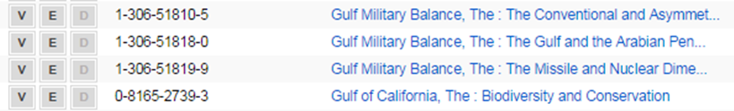
(5) Initial articles at the end of titles
Problem:
  Some publishers put the initial article at the end of the title
  Nice to have more standard practice on handling this
  Possible to have some sort of Normalization done when loaded into KB?

Slide 21
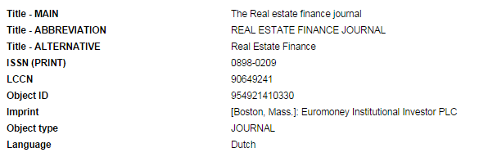
(6) Language + initial article
Problem:
  Many cases of initial articles in non-English languages not being skipped
  Problem with journals being in one language but the language in KB is different
→ Causes problems with searching and with facets in Primo
→ Impact on users & their perception of Primo
  Batch processes when loading/updating CKB possible?
    Must be done carefully!

Slide 22
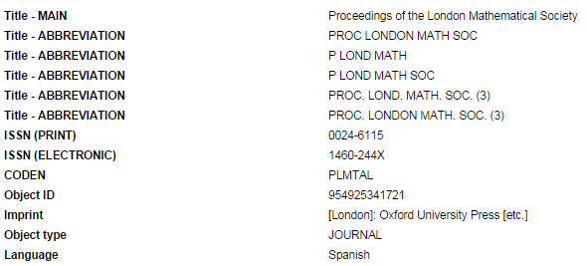
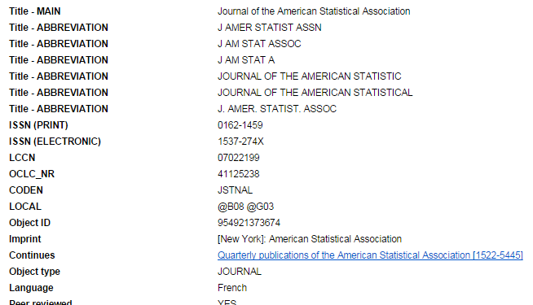

Slide 23
(7) Beginning and ending dates
< came late under discussion >
ISSN Register has beginning and ending dates
This information should be added into KB:
  Would help avoid portfolios being attached to the wrong title when journals have the same title
  Would also help with creation of thresholds or portfolios

Slide 24
Ex Libris’ feedback
Ex Libris:
    “This is out of scope for the time being I’m afraid. We can get back to it later but it also requires a technical change in the database, it’s not just about KB data.“

Slide 25
(8) MISCELLANEOUS_FREE_EJOURNALS
Many problems
  Not all journals are free
  Incorrect thresholds
  Bad or outdated parse params
    Analysis of a sample of the 24,236 portfolios (April 2014)
    Sample of 2% (484 portfolios)
      96 cases (19,8%) with an incorrect parse param (like 404 File Not Found, no journal page anymore, no platform anymore).
      388 cases (80,2%) with a correct parse param: linking to the home page of the journal, to the last issue, to the archive or to a search form
    (Thanks to Myriam Bastin)
  Duplication with titles in other free targets
  A lot of work to maintain

Slide 26
KBAB carried out a survey among SFX Users
  About 120 responses
  Most respondents do use the target
  Slight majority do selective activation
  About half do Auto-Activate
Full analysis available in autumn 2014
Some desired changes from Ex Libris:
    More sytematic checking of thresholds and Parse Params
    Creating a new Target for Miscellaneous Academic Journals
      Also suggested: new subtargets per language
    Deleting journals that exist in another Free or Open Access Target
    Getting the CONTRIBUTE button more used by the clients (promotion…)

Slide 27

Conclusions
Very long-term task (if not endless)
More work could have been done, but
  Also a time-consuming task for KBAB volunteers & KB Team
Sometimes frustrating when KB quality and metadata issues are so closely linked with software issues
For Ex Libris, “the priorities help the KB team to specifically look for things and change their processes accordingly. So even if there is no big leap forward, this is very helpful”.
For the future
  So far, KBAB has worked with few outside contact
  Should certainly start to open to the SFX community (without getting bogged down in hundreds of requests!)
  Suitable way to work has to be found!!

Slide 28

francois.renaville@ulg.ac.be | mneedlem@ufl.edu
http://hdl.handle.net/2268/171986

