Slide 1
Implications of microbial phenotypic heterogeneity in large-scale bioprocessing conditions
Frank Delvigne¹, Nathalie Gorret², Carole Molina-Jouve²,
Quentin Zune¹, Alison Brognaux¹
¹ Université de Liège, Gembloux Agro Bio Tech
Passage des Déportés, 2
5030 Gembloux BELGIUM
F.Delvigne@ulg.ac.be
² Université de Toulouse , UPS, INSA, INP, LISBP, INRA, UMR792, CNRS, UMR5504, F-31077 Toulouse, France

Slide 2
Red biotechnology

Slide 3
Green biotechnology

Slide 4
White biotechnology

Slide 5
Outline
1. What are the sources of microbial phenotypic heterogeneity (in bioprocessing conditions) ?
How to measure phenotypic heterogeneity (in bioprocessing conditions) ?
How to control microbial phenotypic heterogneity ?
3.1. Single cell analysis in process conditions : design of GFP biosensors
3.2. Single cell analysis in process conditions : membrane permeability and protein leakage

Slide 6
What are the sources of microbial phenotypic heterogeneity ?
Impact of microbial phenotypic heterogeneity on process productivity
Accepted picture : only a fraction of the population (non productive phenotypes) affects the global production profile
Productive phenotypes
Metabolite concentation
Global production profile
Non productive phenotypes
Time

Slide 7
Single-species
microbial population
Mutation
(long-term effect)
Noise in biological reactions/processes
(short-term effect)
Genetic heterogeneity
Phenotypic heterogeneity
1. Cell cycle/division
2. Epigenetics
3. Stochasticity of biochemical reactions
First class of reactions : gene expression and protein synthesis
Second class of reactions : metabolic network

Slide 8
How to measure microbial phenotypic heterogeneity ?
Single cell studies are of great importance both from a fundamental and from an applied perspective:
Two fields with two distinct perceptions of microbial phenotypic heterogeneity :
Chemical engineering : focused on the effect of external perturbations on biological noise
System biology : focused on the intrinsic and extrinsic source of noise
Each discipline integrates only a fraction of the knowledge and have evolved by considering distincts (cultivation and analytical) tools for the determination of microbial phenotypic heterogeneity

Slide 9
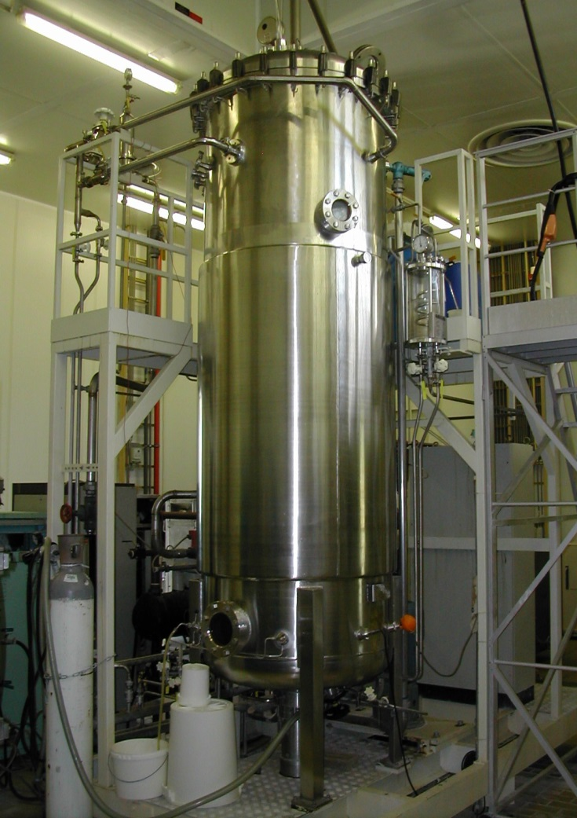
(Bio)chemical engineering approach :
Distribution of fluorescence among cell population
GFP coding sequence
Time
Promoter
GFP synthesis

Slide 10
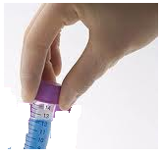
Flow cytometry (FCM) : different modes of operation
FCM
Q_{FC}
Manual sampling
On-line
FCM
Q_{FC}
Sampling pump
Real time
Brognaux, A., Han, S., Sorensen, S. J., Lebeau, F., Thonart, P., Delvigne, F., (2013) A low-cost, multiplexable, automated flow cytometry procedure for the characterization of microbial stress dynamics in bioreactors. Microbial cell factories 12, 1475-2859
Notes:
Can be connected to bioreactor with advanced mode of analysis : on-line, real time
But loss of cell history (e.g., cell cycle dependent phenomena cannot be observed)

Slide 11
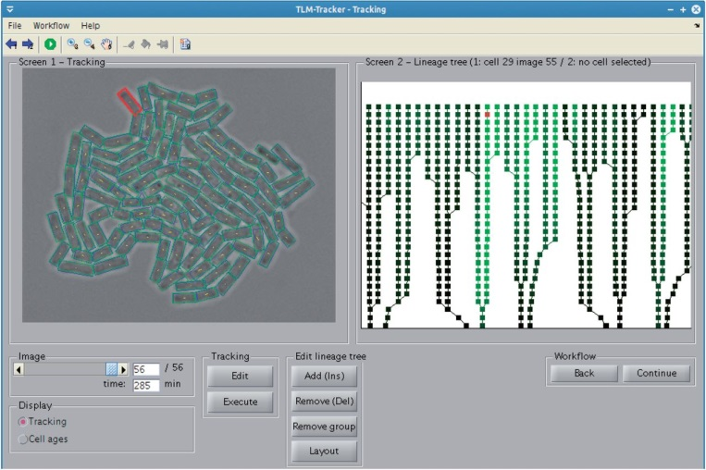
System biology approach :
Distribution of fluorescence among cell population
Clone number
Taniguchi Y, Choi PJ, Li GW, Chen H, Babu M, Hearn J, Emili A and Xie XS, Quantifying E. coli proteome and transcriptome with single-molecule sensitivity in single cells. Science 329: 533-538 (2010).
Massively parallelized micro-cultivation devices
Time
Klein J, Leupold S, Biegler I, Biedendieck R, Munch R and Jahn D, TLM-Tracker: software for cell segmentation, tracking and lineage analysis in time-lapse microscopy movies. Bioinformatics 28: 2276-2277 (2012).

Slide 12
Integrating mcirofluidics (and single cell microfluidics) in the scale-up/down loop ?
Grunberger A, Wiechert, W., Kohlheyer, D.,, Single-cell microfluidics: opportunity for bioprocess development. Current opinion in biotechnology 29: 15-23 (2014).
Notes:
Scalable process from microdevices to large-scale ?
Flow regime is not the only difference

Slide 13
BUT, flow regime is not the only difference between microfluidic-based micro-bioreactors and large-scale bioreactors
Some examples reported from the litterature :
Cell density effect (Quorum sensing)
Competition for metabolically efficient phenotypes
Differences in growth rate
Transition to « solid-culture » phenotypes (biofilm, floculation)
…
Boedicker J, Vincent, ME, Ismagilov, RF., Microfluidic confinement of single cells of bacteria in small volumes initiates high-density behavior of quorum sensing and growth and reveals its variability. Angewandte chemie 48: 5908-5911 (2009)
Bachmann H, Fischlechner, M, Rabbers, I, Barfa, N, Branco dos Santos, F, Molenaar, D, Teusink, B.,, Availability of public goods shapes the evolution of competing metabolic strategies. Proc Natl Acad Sci U S A 110: 14302-14307 (2013)
Dusny C, Fritzsch, F.S.O., Frick, O., Schmid, A., Isolated Microbial Single Cells and Resulting Micropopulations Grow Faster in Controlled Environments. Applied and environmental microbiology 78: 7132-7136 (2012).
Kortmann H, Blank, LM, Schmid, A.,, Single cell analysis reveals unexpected growth phenotype of S. cerevisiae. Cytometry Part A 75: 130-139 (2009).

Slide 14
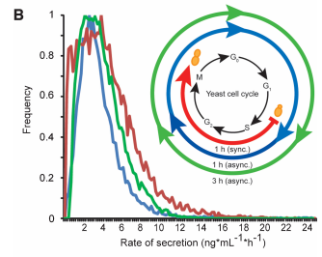
But gives usefull informations at the level of history dependent mechanisms
Recombinant protein secretion is cell-cycle dependent (swith between producer/non producer state)
Love K, Panagiotou, V, Jiang, B, Stadheim, TA, Love, JC., Integrated single-cell analysis shows Pichia pastoris secretes protein stochastically. Biotechnology and bioengineering 106: 319-325 (2010)

Slide 15
Metabolite concentation
Time
Impossible to point out this phenomenon in process conditions (history independent techniques)

Slide 16
How to control microbial phenotypic heterogeneity ?
Single cell analysis in process conditions : design of GFP biosensors
E. coli whole cell biosensor
ATP -> ADP + Pi
GFP
Protease system
e.g. ClpXP
ssrA
P
gfpAAV

Slide 17
On-line flow cytometry analysis : E. coli pfis::gfpAAV in chemostat
Batch phase
Chemostat D = 0.14 h⁻¹
Glucose pulses

Slide 18
Well-mixed / scale-down comparative analysis
Feed
Feed

Slide 19
E. coli whole cell biosensor : effect of energy status of the cell
ATP -> ADP + Pi
GFP
Protease system
e.g. ClpXP
ssrA
P
gfpAAV

Slide 20
Flow Cytometry
30°C
Q_{FC} = 33 µL/min
T-junction
37°C
Sampling loop
42°C

Slide 21
GFPmut3
(stable variant)
GFPAAV
(unstable variant)
GFPLAA
(very unstable variant)

Slide 23
Batch bioreactor at 37°C
Bistability

Slide 24
How to control microbial phenotypic heterogeneity ?
Single cell analysis in process conditions : membrane permeability and protein leakage
BACKGROUND
Extracellular perturbations increases cell viability
Analysis performed by flow cytometry with propidium iodide exclusion test and thus related to cell membrane permeability
Enfors SO, et al. Physiological responses to mixing in large scale bioreactors. Journal of biotechnology 85: 175-185 (2001)

Slide 25
Intermediate PI uptake :
Fed-batch, well-mixed reactor

Slide 26
Effect of substrate limitation on membrane partial permeabilization : chemostat experiment
Chemostat (substrate limitation)
Pulses of glucose

Slide 27
Link between mixing quality and population segregation :
Trade-off effect - microbial cells have to choose between :
→ Well-mixed, lab-scale bioreactors
Improvement of the nutritional level – growth rate
Stress sensitivity
Improvement of stress resistance
Lower nutritional status– growth rate
→ Scale-down bioreactors

Slide 28
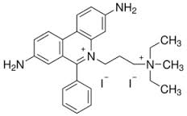
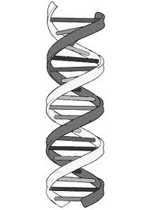
Propidium iodide (PI) uptake and appearance of an intermediate subpopulation with reduced red fluorescence
Hypothesis : accumulation of PI in the periplasm when cells are exposed to substrate limitation (increased expression of porins)
OmpF
OmpC
PI
PI (MW = 668 Da)
Cut-off < 800 Da
Cut-off < 600 Da
Cytoplasm
Periplasm
LamB
Extracellular env.

Slide 29
Well-mixed / scale-down comparative analysis
Ref. bioreactor
SDR bioreactor
t_{R} = 38s
SDR bioreactor
t_{R} = 79s

Slide 30
GFP leakage : comparative analysis
Feed
Feed

Slide 31
Extracellular proteome analysis of the impact of bioreactor performances
Well-mixed/scale-down comparative analysis : 2-D differential in-gel electrophoresis
PERSPECTIVES
OmpC
Brognaux A, Francis F, Twizere JC, Thonart P and Delvigne F, Scale-down effect on the extracellular proteome of Escherichia coli: correlation with membrane permeability and modulation according to substrate heterogeneities. Bioprocess Biosyst Eng 14: 14 (2014)

Slide 32
Interesting results but without any control at the level of the substrate limitation and growth (batch)
Validation is needed (chemostat)
Ferenci T., Hungry bacteria - definition and properties of a nutritional state. Environmental microbiology 3: 605-611 (2001)
FCM
Multiplex

Slide 33
ΔompC
ΔlamB

Slide 34
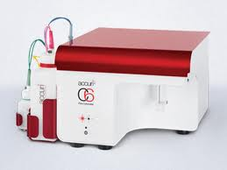
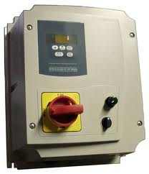
Next step
How to control microbial phenotypic heterogeneity ?
First solution : in situ control of microbial phenotypic heterogeneity
Sampling interface
Processed data to the biroeactor control loop
Specific software for analysis of complex data in real time

Slide 35
Limitation of the actual fluorescent reporter system : global view of physiology. There is a need to be closer to the metabolism :
By appropriately choosing promoter sequences (expanding the GFP toolbox)
By using new generation of promoter independent fluorescent reporter
Subpopulations omics
Subpopulations → Metabolically relevant ?
Switch between subpopulations ?

Slide 36
Second solution : metabolic engineering for decreasing phenotypic switch related to metabolic burden
Very recent work point out the « metabolic component » of the stochasticity of physiology
(ATP and NADH availability)
Several metabolic engineering (co-factor engineering) are available :
Chen et al. [2014] Trends in biotechnology
Notes:
We an also solve the problem by remodelling microbial phsyiology
But even then, we need single cell tools to assess of the efficiency of the metabolic engineering strategies

Slide 37
Thank you

