Slide 1


Scriptorium, a retro-cataloguing tool to easily and quickly encode older book items
IGeLU 2014 Conference Oxford
September 15-17, 2014
François Renaville, University of Liege Library
with Sylvain Danhieux, University of Liege Library
Download: http://hdl.handle.net/2268/171960

Slide 2
Abstract
The University of Liège Library’s books collection is composed of some 2,000,000 print volumes, of which only 60% are catalogued. Most of the uncatalogued books have been published before 1970 and cataloguing these according usual standards and norms would certainly take decades. To decrease the cost of treatments and increase the number of catalogued volumes, the Library developed a light PHP/MySQL application, Scriptorium, that enables non-catalogers (mostly students) to quickly encode the books (ca 3 min. per item) by providing the most essential information. References are then daily exported in MarcXML to the ILS. Scriptorium has been developed to permit to easily create new independent instances for different parallel retro-cataloguing projects and also to be used by other libraries.

Slide 3
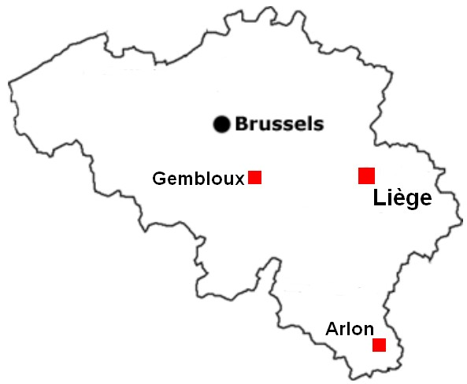
University of Liege Library
University founded in 1817
5 main libraries:
Arts & Humanities Library
Agronomy Library
Law & Social Sciences Library
Life Sciences Library
Science & Technology Library
18 library facilities (branches)
+ 1 Remote Storage
4 campuses:
Liège Sart-Tilman (main campus)
Liège City centre
Gembloux
Arlon

Slide 4
Library Print Collections
More than 2,000,000 books
1,200,000 catalogued books
800,000 uncatalogued books
Automation started in the 1960s
But only in the 1990s for some HS branches (big collections)
Many books located in the Remote Storage
+/- 300,000 catalogued books
+/- 500,000 uncatalogued books
Also:
50,000 maps
30,000 dissertations
6,500 manuscripts
565 incunables
…

Slide 5
RFID as a catalyst
In Spring 2014, RFID project for a library branch
History Library: more than 80,000 books
Around 10,000 not yet catalogued (12,5%)
Documents related to the national or local history
Produced between 1800 and ca 1970
Items to keep (not for pulp!), even if not on loan for years!
Types
Published books
Reports
Master dissertations
Offprints
For the RFID project, all items had to be catalogued (organisational reasons)

Slide 6
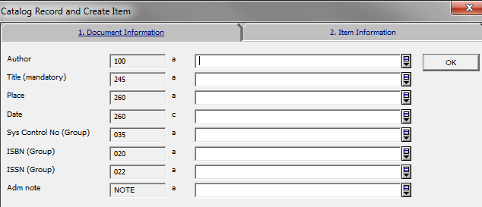
Aleph Quick Catalog function
Not very happy with Aleph Quick Catalog function
Two tabs (doc info + item info) -> no global view
Same configuration for all -> not very flexible, not context sentive
Few possibilities for default values (only for item info)
Limited number of ccu (40 in our case)
Drop down lists may have irrelevant content
No duplicate function
…

Slide 7
Homemade Quick Catalog Web Application
Requested specifications
Flexible and context sensitive
For an unlimited number of users
Easy to use, especially made for non-cataloguers
Students
Low qualified library agents
Non-librarian staff (accountants, secretaries…)
Trainee librarians
Heads of sections, heads of services…
Not only for BIB records and items, but also able to provide info in HOL records
To be used for any retro-cataloguing project to come (eg. Remote Storage): each retro-cataloguing project has its own instance
Also available for non ULg libraries: easy to deploy in other contexts
Developed with PHP/MySQL

Slide 8

Leitmotiv for the Application
For those older and un-catalogued collections:
VISIBILITY
Better in the ILS than not in the ILS
QUANTITY over Quality
Better in the ILS, even with poor metadata, than not in the ILS
As many items catalogued as possible
SPEED
ASAP added into the ILS

Slide 9

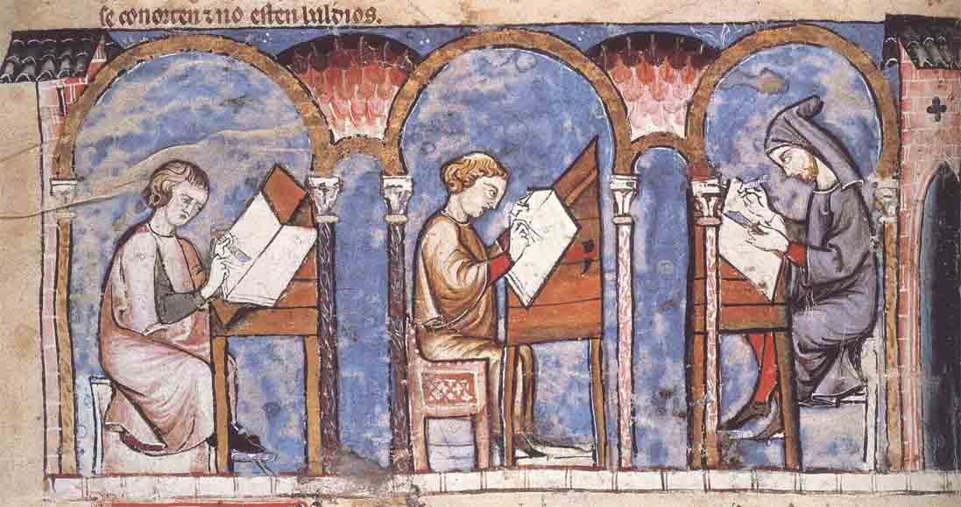
Where anyone (employed students, library staff, low qualified agents…) could encode older uncatalogued books….

Slide 10
4 Roles defined
ENCODER can
create new items
delete/modify items he/she has created
define default values for encoding
MANAGER can
Same as ENCODER
+ delete/modify any items created by any encoder
+ export records
ADMIN can
Same as MANAGER
+ manage the accounts
+ manage the encoding form (metadata structure, mandatory or not, mapping with Marc fields)
SUPERADMIN can
Same as ADMIN
+ manage ADMIN accounts
+ create instances
+ manage backup
+ manage export rules

Slide 11
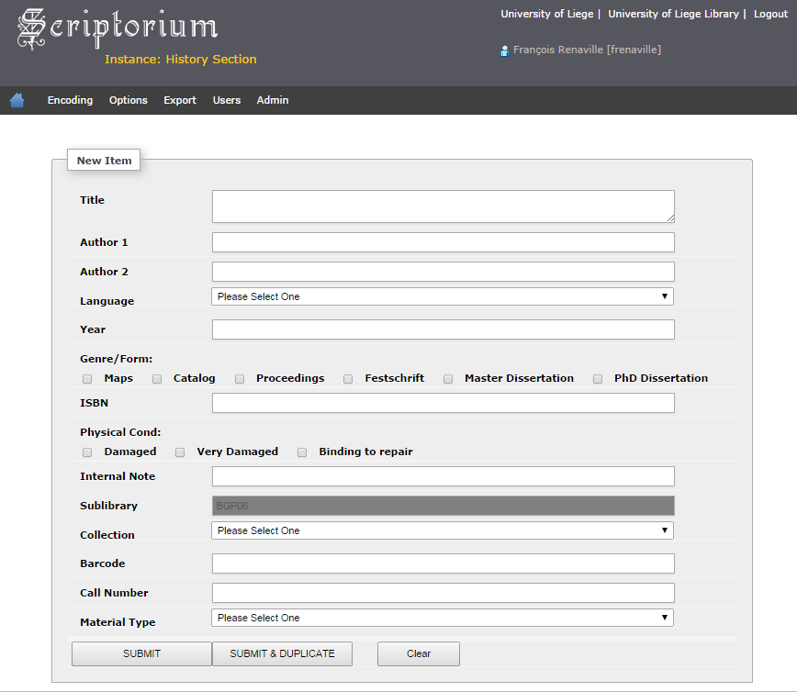

Slide 12
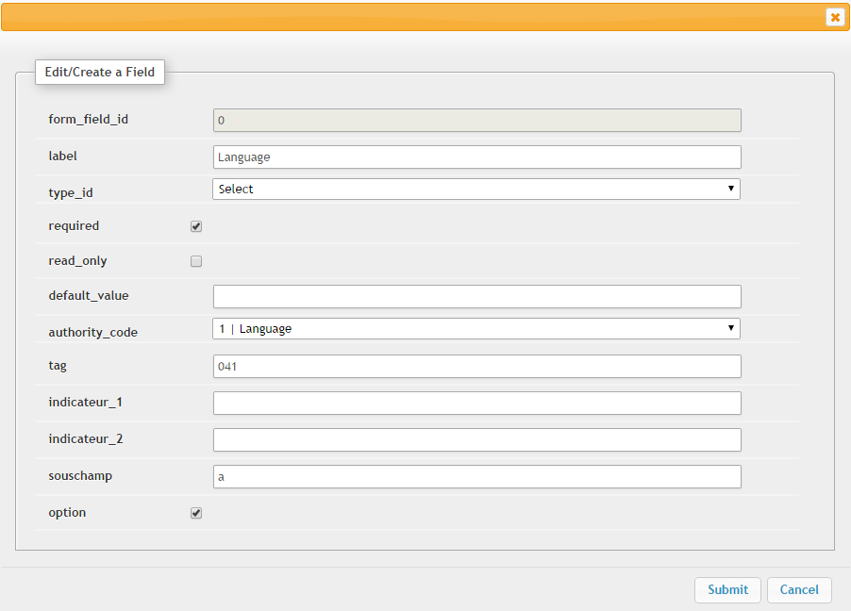
How the Admin Can Edit/Create a Field
Other types:
Textbox, Textarea, Checkbox, Radio, Hidden
Option: Allows the encoder to define default content within a session

Slide 13
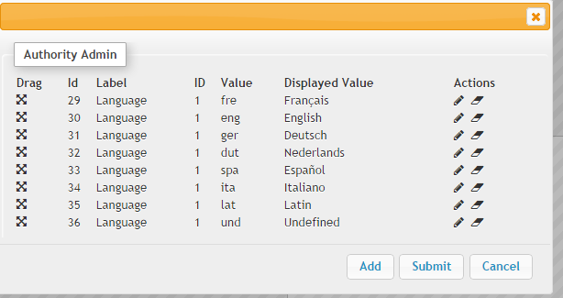
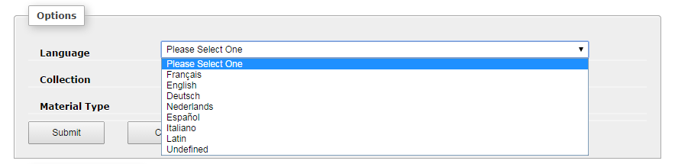
authority_code
options

Slide 14
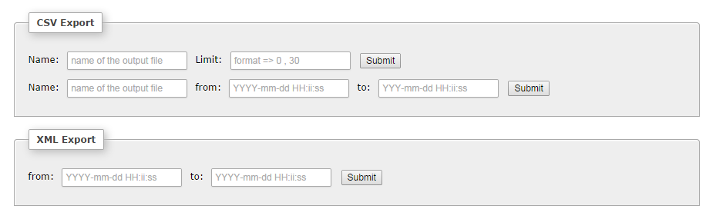
Exports
Automatic daily export from Scriptorium to Aleph
Manual export is also possible (csv or MarcXML)

Slide 15
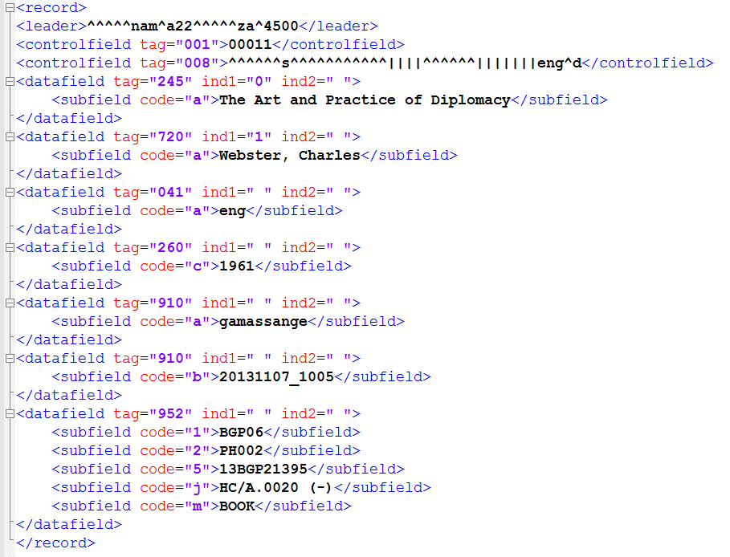
Year in 008/7-10 and 245 2nd ind. are added with Aleph programs (tab_fix)
910 = admin values (encoder account + creation date)
Hidden in the New Item form
In the export rules, any content that should be in a 952 is concatenated into one single 952.

Slide 16
Aleph Scripts
BIB records, holdings and items created with Aleph services
No deduplication verification with existing Aleph records
job_list:
p_file_02
USM01,script_%DATE.xml,script_%DATE_alseq,06,
p_manage_18 USM01,script_%DATE_alseq,script_%DATE_alseq.reject,sc ript_%DATE_alseq.doc_log,NEW,SCR,,FULL,APP,M,,,SCRI PTORIU,
p_ret_03 USM01,script_%DATE_man50,WCDA=SCRIPTORIU AND WCDA=%DATE,
p_manage_50 USM01,script_%DATE_man50,000000000,999999999,USM51,US M61,,952##,tab_hol_item_create_scriptorium,,A,A,N,SCR IPTORIU,30,SCRIPTORIU,30,Y,N,
p_manage_37 USM01,DOC_LIST,,001914034,999999999,script_%DATE_man3 7,SCRI2,Y,,

Slide 17
p_file_02
USM01,script_%DATE.xml,script_%DATE_alseq,06,
Where:
USM01 = Bibliographic Base
script_%DATE.xml = input file
(%DATE creates date relative to the current date)
script_%DATE_alseq = Output File
06 = MarcXML Format

Slide 18
p_manage_18
USM01,script_%DATE_alseq,script_%DATE_alseq.reject,script_%DATE_alseq.doc_log,NEW,SCR,,FULL,APP,M,,,SCRIPTORIU,
Where:
USM01 = Bibliographic Base
script_%DATE_alseq = Input File (from file_02)
script_%DATE_alseq.reject = Output File for Rejected Records
script_%DATE_alseq.doc_log = Output File for Logging System Numbers
NEW = Add new records
SCR = Fix Routine
FULL = Full Indexing
M = Multi-user
SCRIPTORIU = Cataloger Name
tab_fix
SCR fix_doc_do_file_08 fix_scriptorium
SCR fix_doc_create_fmt
SCR fix_doc_001
SCR fix_doc_005
SCR fix_doc_tag_008_open_date
SCR fix_doc_tag_008
SCR fix_doc_punctuation_usm
SCR fix_doc_non_filing_ind
SCR fix_doc_delete_empty
SCR fix_doc_sort

Slide 19
p_ret_03
USM01,script_%DATE_man50,WCDA=SCRIPTORIU AND WCDA=%DATE,
Where:
USM01 = Bibliographic Base
script_%DATE_man50 = Output File to be used with man-50
WCDA=SCRIPTORIU AND WCDA=%DATE = CCL search phrase

Slide 20
p_manage_50
USM01,script_%DATE_man50,000000000,999999999,USM51,USM61,,952##,tab_hol_item_create_scriptorium,,A,A,N,SCPIPTORIU,30,SCRIPTORIU,30,Y,N,
Where:
USM01 = Bibliographic Base
script_%DATE_man50 = Input File (from ret-03)
USM51 = Admin base
USM61 = HOL base
952## = Main Field
tab_hol_item_create_scriptorium = Item Creation Table
! 1 2 3 4 5 6 !!!!!!!!!!!!!!!!!!!!!!!!!-!!!!!!!!!!-!-!!!!!!!!!!-!!!!!-!!!!!!!!!!
HOL-040 Y a 040 d
CALL-NO-TYPE a N
HOL-852 b Y a
HOL-852 1 Y b
HOL-852 2 Y c
HOL-852 j Y j
HOL-852 q Y q
HOL-852 x Y x
Z30-BARCODE 5 N
Z30-ITEM-STATUS f N
Z30-MATERIAL m N
Z30-NOTE-CIRCULATION N 590 b

Slide 21
p_manage_37
USM01,DOC_LIST,,001914034,999999999,script_%DATE_man37,SCRI2,Y,,
Where:
USM01 = Bibliographic Base
DOC_LIST = Input File Type
001914034 = From Document Number <001914034> (must be updated regularly to avoid too large ranges!!)
999999999 = To Document Number
script_%DATE_man37 = Output File
SCRI2 = Fix Routine
tab_fix
SCRI2 fix_doc_do_file_08 fix_scriptorium_delete
(deletes fields become useless)

Slide 22
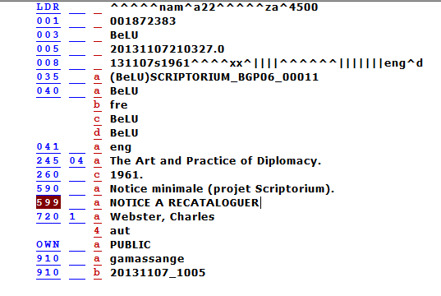
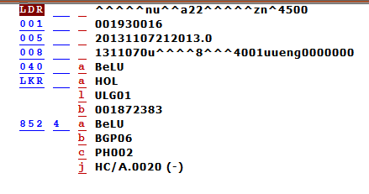
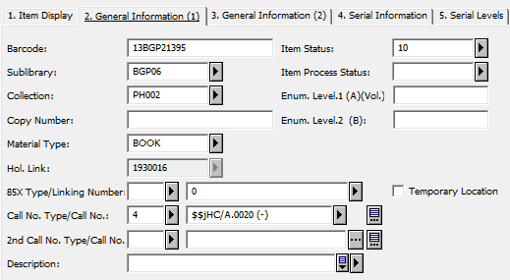
+ Circulation Note added with
tab_hol_item_create
→ BIB can be recatalogued after loan

Slide 23
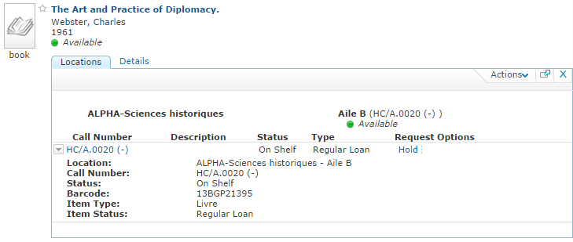
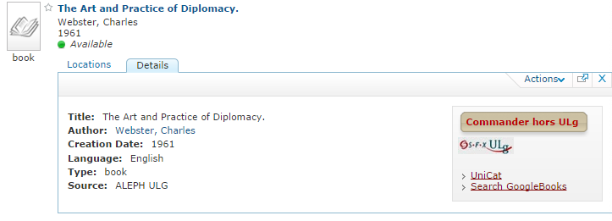

Slide 24
Results
Deployed in 3 library branches
-> 3 instances
1st Instance for the History Section
10,000 books to encode
Started in Mid-November 2013, finished less than 5 months later
Ready for the RFID Project
For the 3 instances, more than 20,600 books added in the ILS in 9 months time:
No encoding everyday!
Most of them published between 1950 and 1979
Some were also published in the 2000s!!
1,882 have got an ISBN
Most recent books are properly recatalogued!
Better to check every morning if night import ran successfully

Slide 25
Publication Years of All Scriptorium Items

Slide 26
How many minutes per record?
Stud = Students ; Staff = (Low Qualified) Library Staff ; Lib = Librarians/Cataloguers

Slide 27
Conclusions
Probably not achieved with Aleph Quick Catalog
Project well accepted by the librarians
Even by catalog specialists
Opportunity to have less uncatalogued items
Some other library branches would like an instance
Positive side effects
Team spirit: Collaborations between librarians have become more intense (some from other libraries came to help)
Low qualified colleagues happy to help -> work acknowledged
Additional jobs to enrich the metadata of the most recent books?
Open to create instances for any external partner/library

Slide 28

francois.renaville@ulg.ac.be | S.Danhieux@ulg.ac.be
http://hdl.handle.net/2268/171960

