Slide 1
Mineralogy of fine particles in slurry from multispectral imaging
Sophie LEROY
G. Dislaire, P. Barnabé, E. Pirard

Slide 2
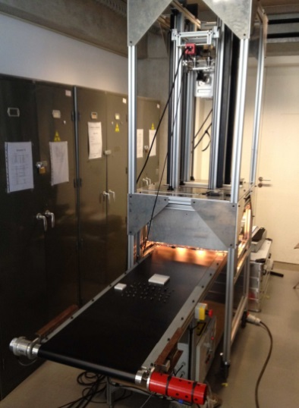
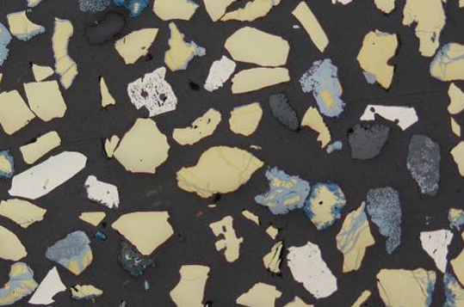
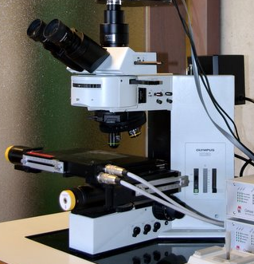
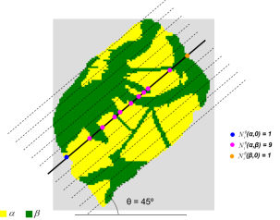
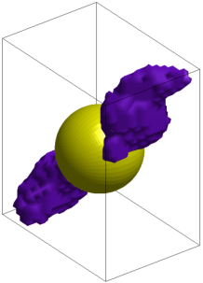
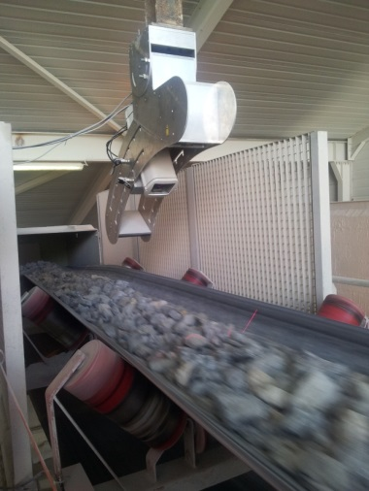
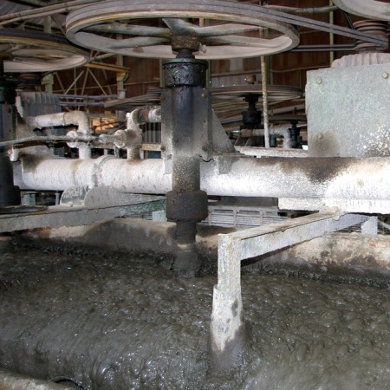
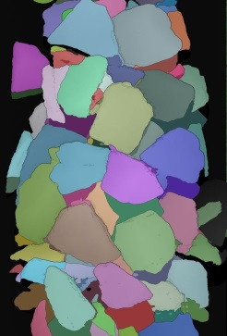
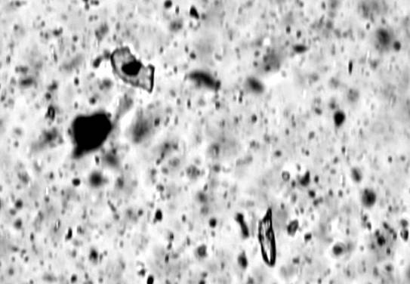
University of Liège (BE)
Georesources & Geo-Imaging Research Group
Core Scanning
Quantitative Microscopy
© CSIRO
Exploration
Remote Sensing
Reserve Estimation
Predictive Mineralogy
Process Control
3D particle
size & shape
On Line Vision

Slide 3
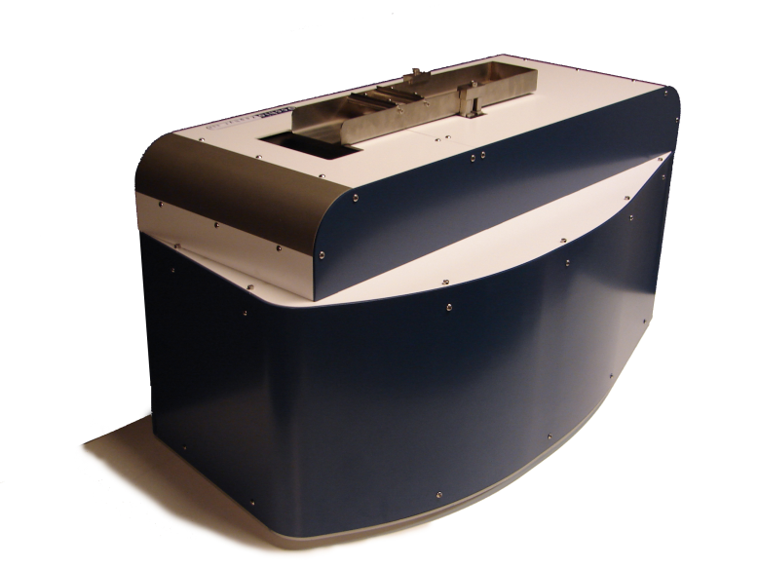
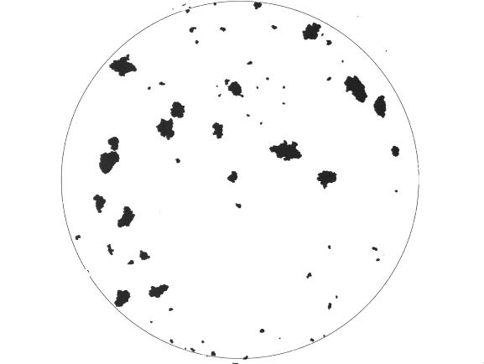
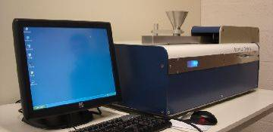
2D Particle Imaging
Free flowing powders
Range 50µm -> 5mm⁺
    10⁴ particles/min
  Mechanical dispersion
    Vibration (tray)
    Acceleration (conveyor)
  Suction
    Laminar air flow

Slide 4
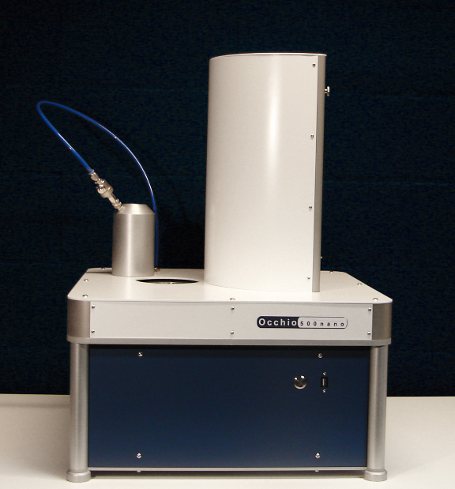

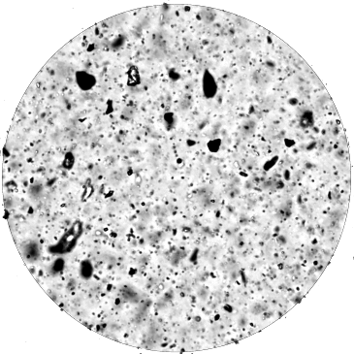
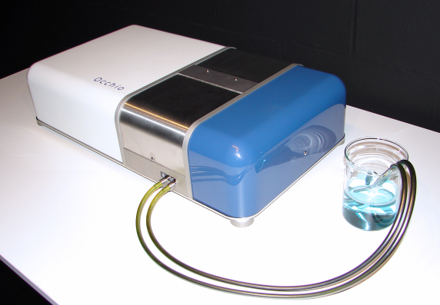
2D Particle Imaging
Non free flowing powders
Range 500nm - 150µm⁺
    10⁵ particles / min
  Vacuum dispersion
    For dry powders
  Flow cell
    For wet powders
    suspensions
    emulsions,…

Slide 5
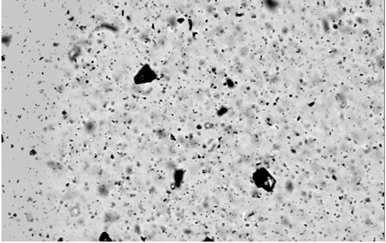
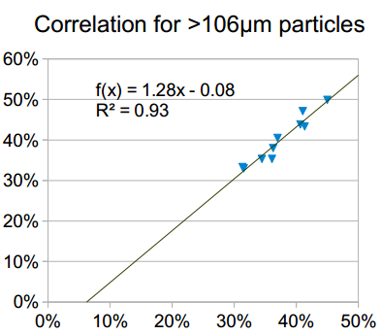
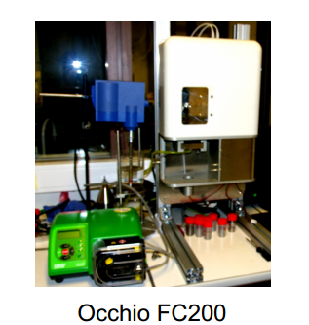
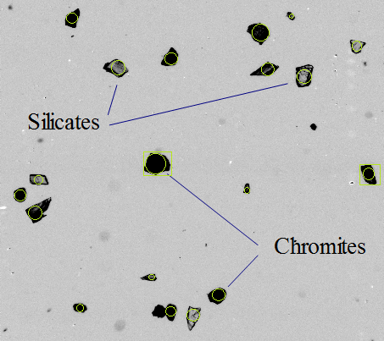
2D Particle Imaging
Size and Mineralogy
Estimation of chromite content in UG2 slurries
  Modified flow cell
    Identification of chromite grains (opaque)
    Real time estimation of chromite content and liberation
[chromite] from IMAGE
[chromite] from AA

Slide 6
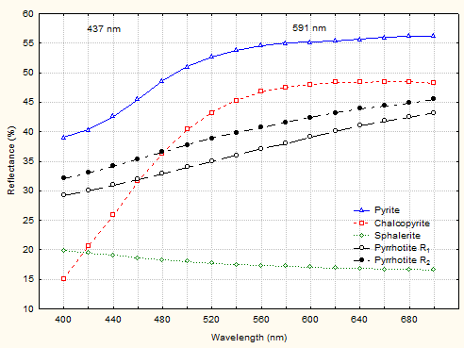
Reflectance of particles
Mineralogy & Particle Size
Existing spectral databases
  Specular reflectance of ore-forming minerals
    QDFIII 400nm-700nm (Criddle & Stanley, 1993)
    Extended to 1000nm (Brea et al., 2010)

Slide 7
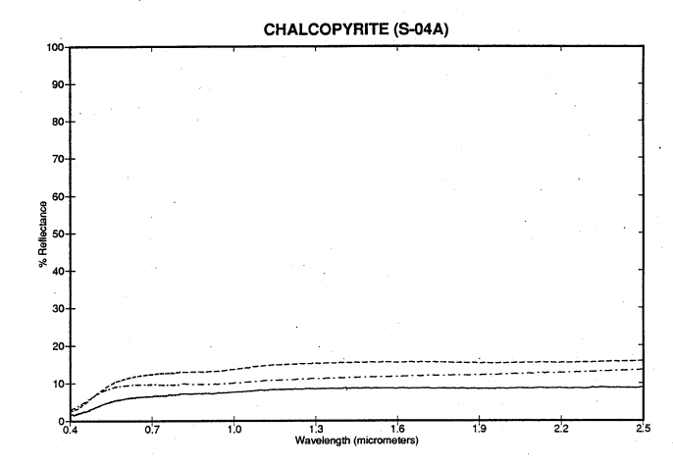
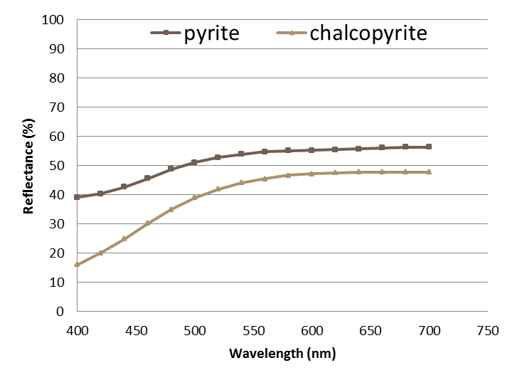
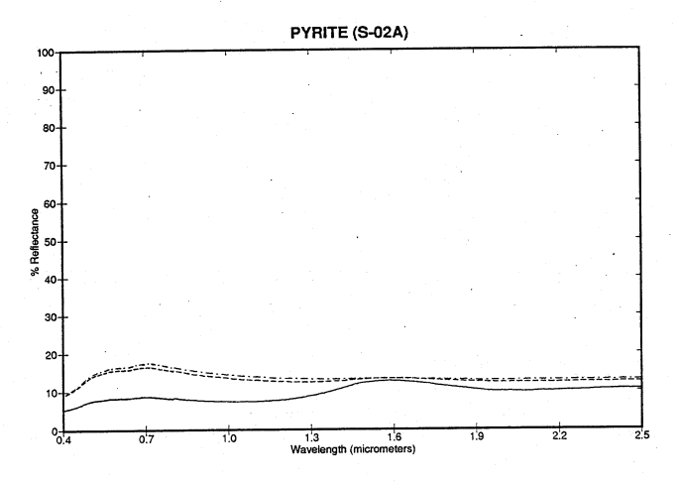
Reflectance of particles
Mineralogy & Particle Size
Existing spectral databases
  Diffuse reflectance of rock forming minerals
    Speclab USGS, Grove et al. (1992)
Chalcopyrite
Specular (QDFIII)
< 45 µm
< 125 µm
< 500 µm
Pyrite

Slide 8
Imaging System
Multispectral Set Up
Best of both worlds
  Diascopic imaging for opaques
    White LED illumination
  Episcopic imaging
    Selected LEDs
      Eight wavelength
    Dichroic mirrors
    Dark field objective

Slide 9
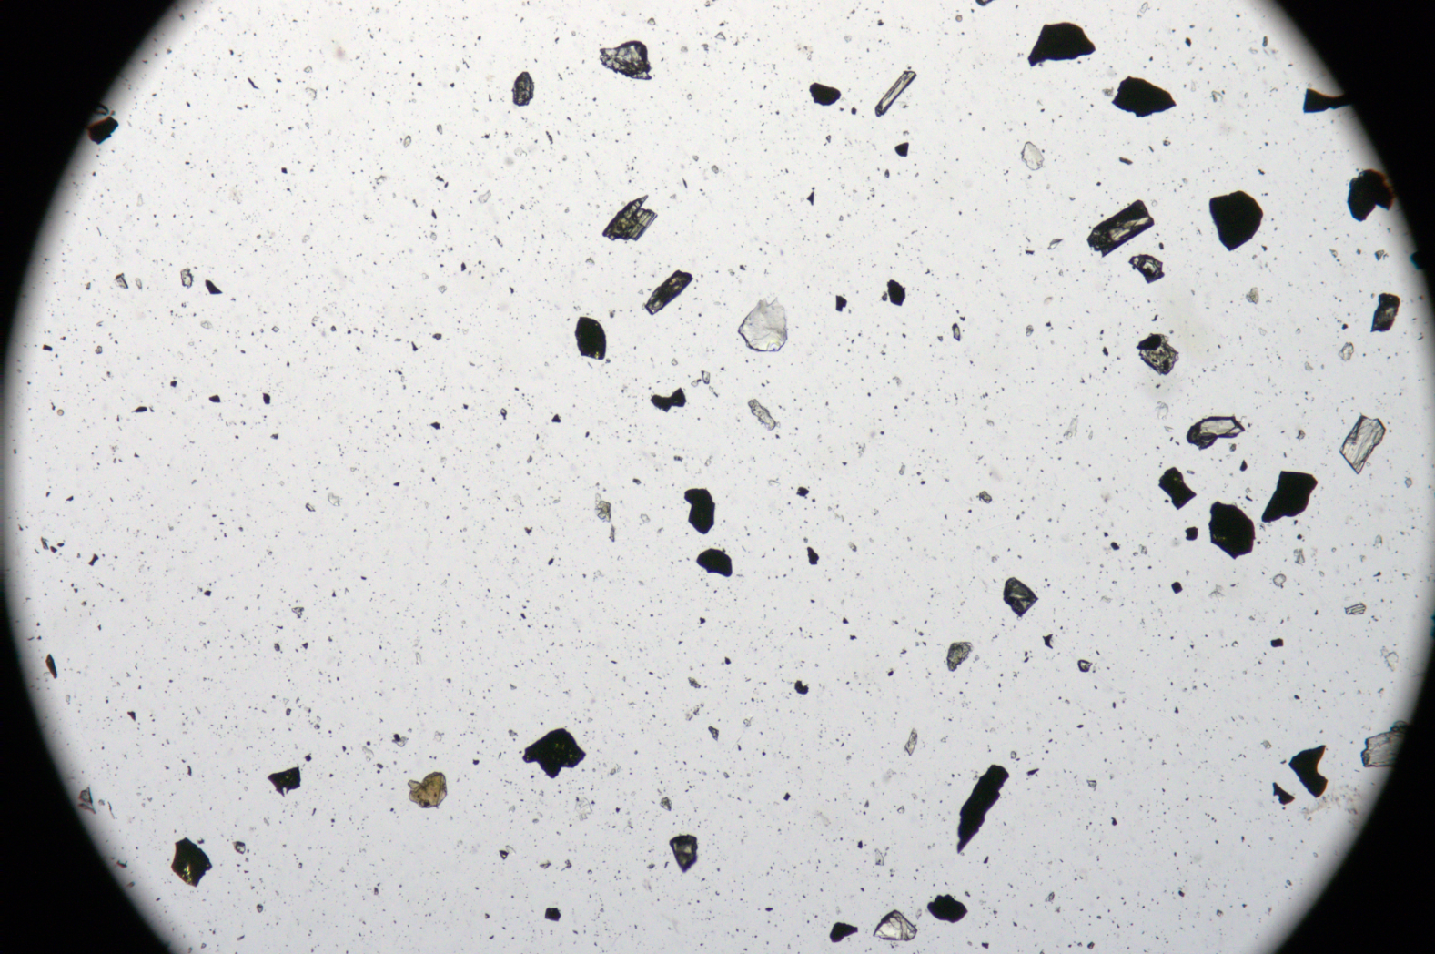
Imaging System
Diascopic Imaging
Gangue Silicates vs Sulphides

Slide 10
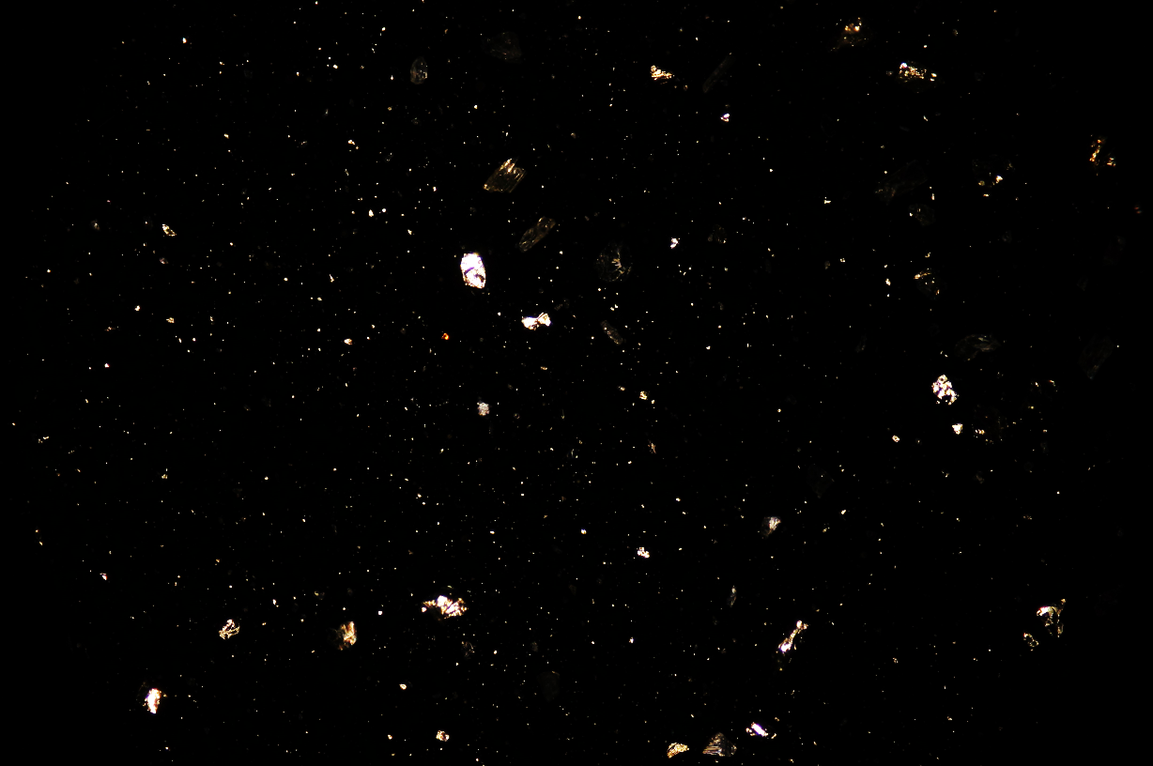
Imaging System
Episcopic Darkfield RGB Imaging
Oxides vs Sulphides

Slide 11
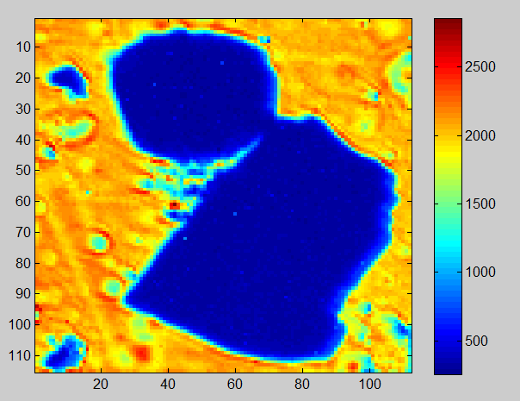
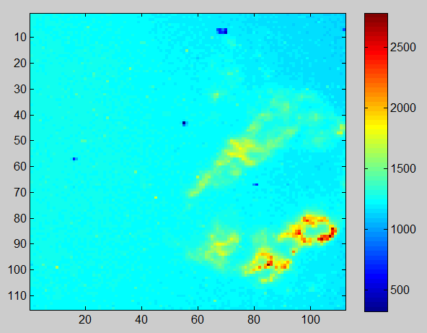
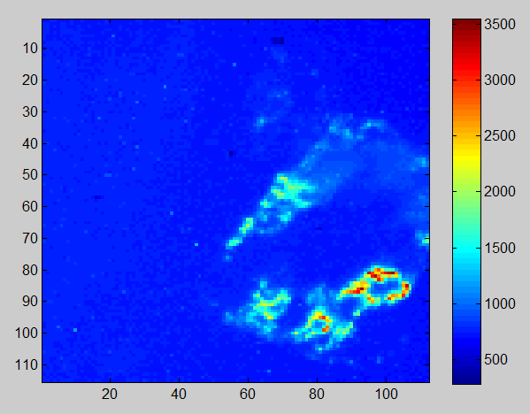
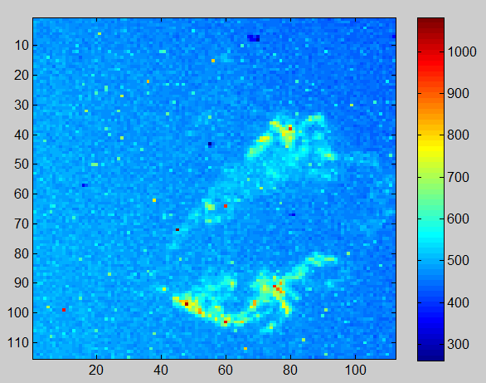
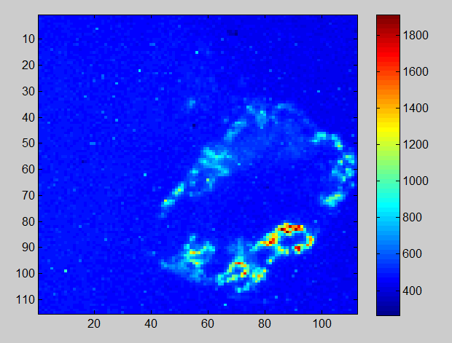
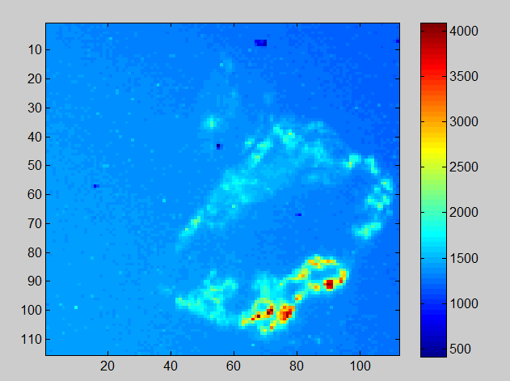
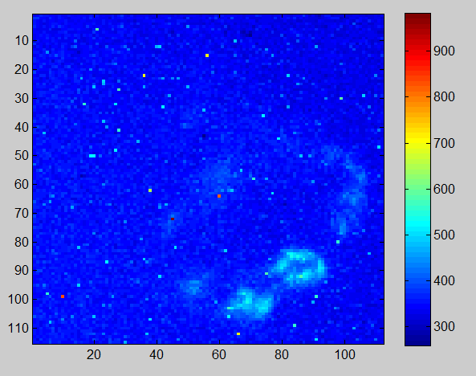
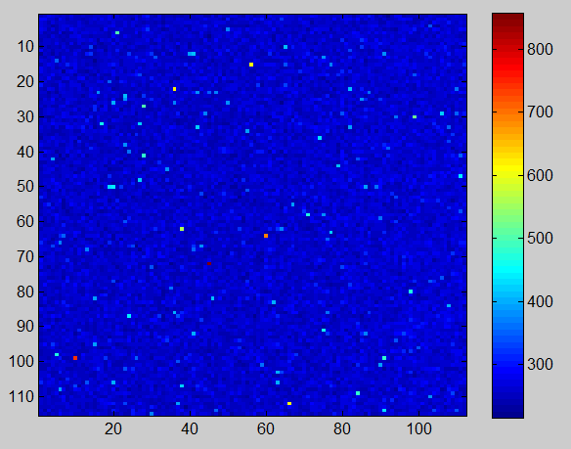
Imaging System
Episcopic Darkfield Spectral Imaging
Chromite vs Pyrite
  Photonfocus MV1 D1312ie
    1312x1082 (binning)
    3,1 µm/pixel
    400 ms
Backlit image
F0=405 nm
F1=455 nm
F2=530 nm
F3=590 nm
F4=617 nm
F5=735 nm
F6=950 nm

Slide 12
Mineralogical Mapping
Calibration and discrimination
Darkfield imaging
  Reflectance angles
    Maximum reflectance depends on particle shape and λ
Cu wire Ø=100 µm

Slide 13
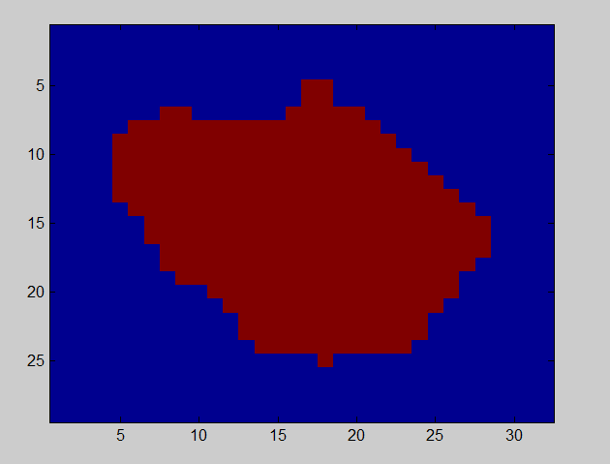
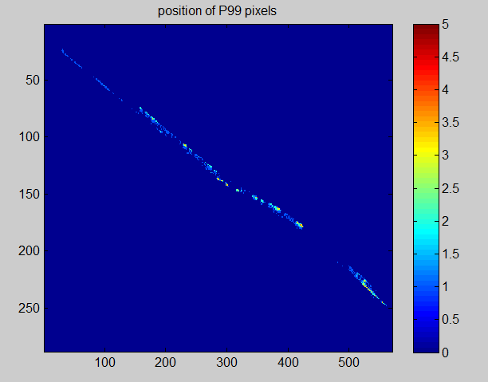
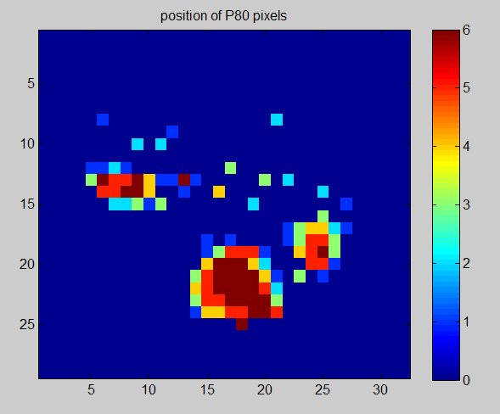
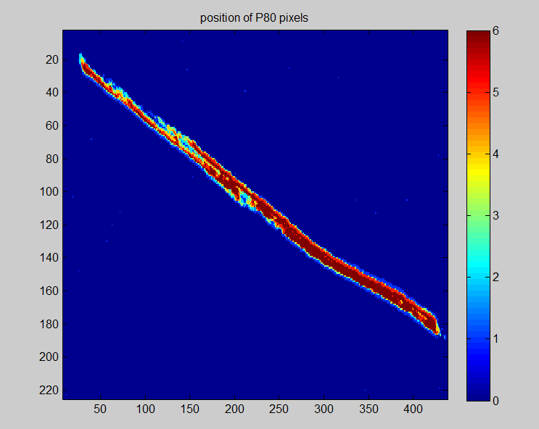
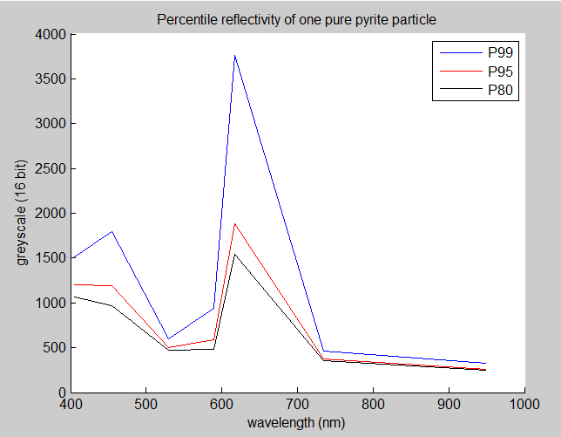
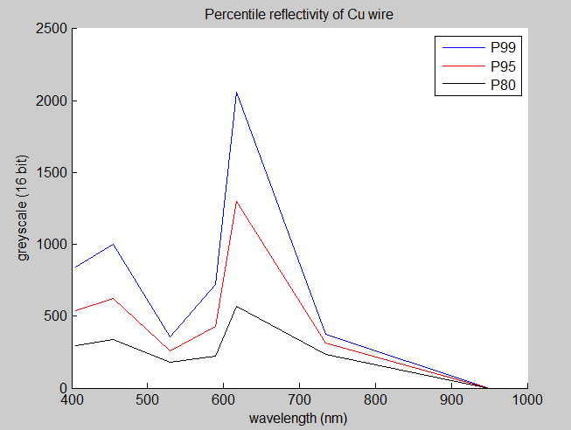
Mineralogical Mapping
Discrimination
Darkfield imaging
  Pyrite vs. Copper
    Percentile P₈₀ of intensity distribution within particle
      Combination of > P₈₀ per wavelength
Pyrite Ø=52 µm
Cu wire Ø=100 µm
Pixels voted > P₈₀ for every λ
Mask
P₉₉
Raw spectrum
Raw spectrum
P₈₀
P₈₀

Slide 14
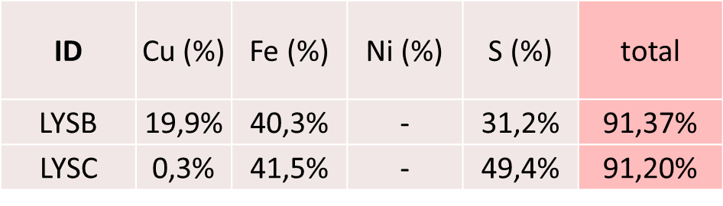
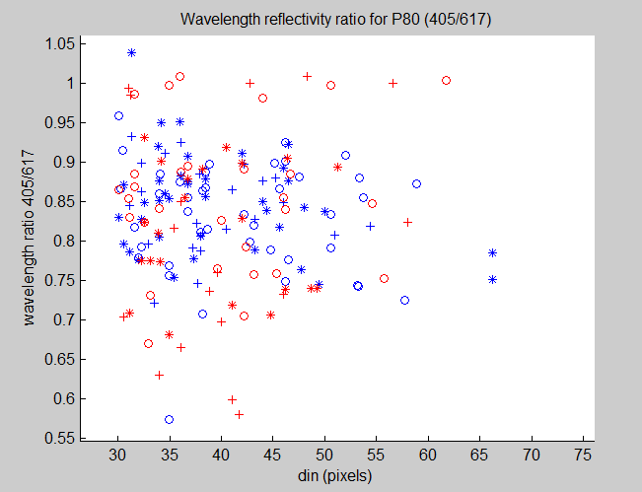
Test on Sulphide Slurries
Discrimination
LYSC: Pyrite-rich (> 91%)
LYSB: Mixed sulphides (Py+Cp+…)
Particle sizing vs. 405nm/617nm band ratio
Pyrite-rich (LYSC )
Mixed sulphides (LYSB)

Slide 15
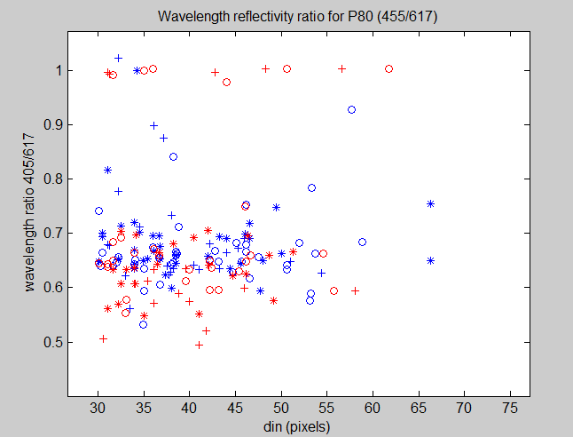
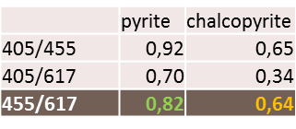
Test on Sulphide Slurries
Discrimination
LYSC: Pyrite-rich (> 91%)
LYSB: Mixed sulphides (Py+Cp+…)
Particle sizing vs. 455nm/617nm band ratio
Pyrite-rich (LYSC )
Mixed sulphides (LYSB)
Py
Cp

Slide 16
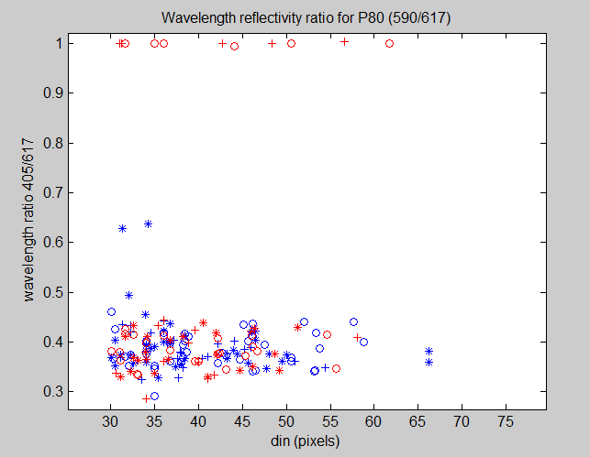
Test on Sulphide Slurries
Discrimination
LYSC: Pyrite-rich (> 91%)
LYSB: Mixed sulphides (Py+Cp+…)
Particle sizing vs. 405nm/617nm band ratio
Pyrite-rich (LYSC )
Mixed sulphides (LYSB)
Grey sulphide
(sphalerite, galena, arsenopyrite,…) (tbc)
Yellow sulphides mix
(pyrite,chalcopyrite,…)

Slide 17
Conclusions
Online mineralogy
Improved flow cell imaging system
  Combined dia- and episcopic imaging
  Particle size, shape + mineralogy, (liberation)
Multispectral imaging
  Simple and flexible
  Tunable to dedicated minerals
Image processing
  Spectra of brightest pixels (> P₈₀) to limit size and shape influence
Mineralogy
  Band-ratio discrimination

Slide 18
Perspectives
Online mineralogy
Mineralogical Analysis
  Needs further calibration
  Cross-validation with chemistry and XRD
Discrimination limits
  Gangue
    Carbonates vs. Silicates
  Sulphides
    Cp, Py, Ga, Sp, Po,…
  Oxides
    Hem vs. Goe; Ilm vs. Lcx vs. Rut; …
Sample Preparation
  Dilution needed for dirty and dense pulps
Multimodal imaging
  Add other imaging modules (i.e. SWIR, Raman,…)

Slide 19
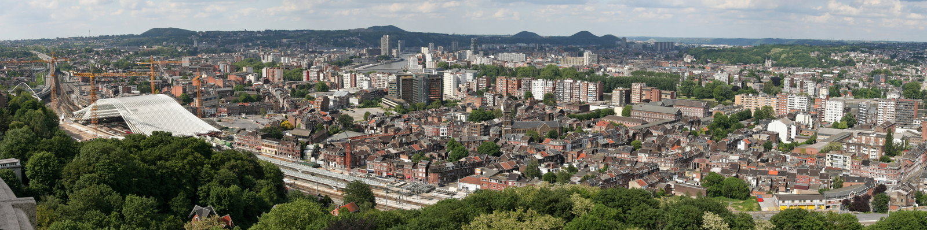



Thank You
See you in Liège in 2015
Liège, Belgium
www.em-georesources.eu

