Slide 1
From Geometallurgy to Ecometallurgy
Building mines for the future
Eric PIRARD Dr. Ir.
Rafaël CONTRERAS, Godefroid DISLAIRE, Laura PEREZ-BARNUEVO,
Xavier DECAMP, Maxime EVRARD, Sophie LEROY,
Pierre BARNABÉ, Fanny LAMBERT, David BASTIN

Slide 2
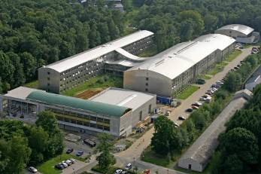

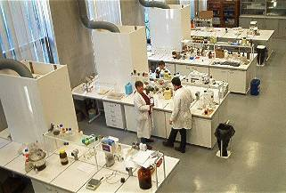






GeMMe
Minerals Engineering, Materials & Environment
GeMMe operates on the characterization, beneficiation, transformation, use and recycling of mineral materials at any stage of their life cycle.
EDUCATION
RESEARCH
CReSus
Centre for Resource Efficiency
& Sustainability
INNOVATION

Slide 3
Applied Mineralogy
Choosing the right perspective

Slide 4
Applied Mineralogy
Choosing the right perspective
What is a mineral ?
  Dana’s definition encompasses :
    Naturally occurring
    Stable at room temperature
    Represented by a chemical formula
    Usually abiogenic
    Ordered atomic arrangement
  Nickel,E. (IMA 1995)
    A mineral is an element or chemical compound that is normally crystalline and that has been formed as a result of geological processes.
  … and industrial processes
    Addition needed for process and applied mineralogists
    ex. Wüstite FeO
      named for Fritz Wüst (1860–1938), a German… metallurgist
      (not Ewald the geologist)

Slide 5
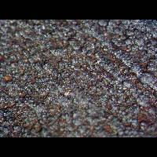
Applied Mineralogy
Choosing the right perspective
A DIAGNOSTIC perspective
  Geology
    Chemical and mineralogical analysis for each rock specimen
    Occurrence of a particular and very rare mineral => (P,T°)
    Can only observe the final result (output).
    Speculation about the geological process
Wüstite from Sikhote-Alin
© Kartashov
A geologist can (sometimes) extract pertinent information from the smallest and most exotic features!

Slide 6
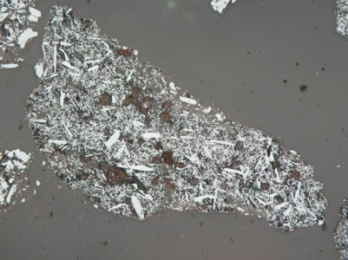
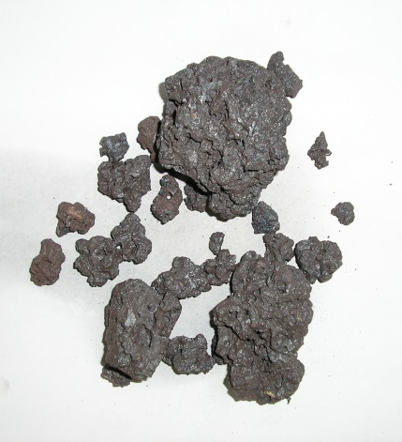
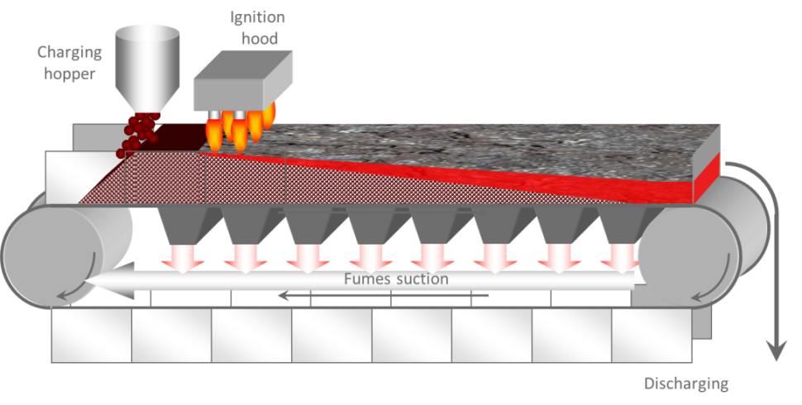
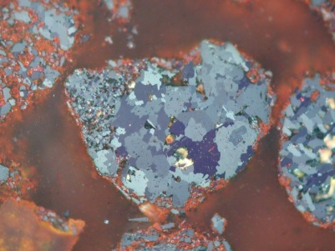
Applied Mineralogy
Choosing the right perspective
A DIAGNOSTIC perspective
  Process Mineralogy
    Unit process monitoring
    Input/Output analysis
      Differences intepreted in terms of process impact / deficiency,…
Microspecular(granular) : < 20 µm grains
© JF Douce, ArcelorMittal
Recrystallized : < 50 µm irregular grains
Sinter with relict Hem, Mgt
+ Neoformed Hem
+ Ca ferrites + Si glass
A process mineralogist is interested by microscopical properties of materials daily fed to the plant in thousands of tons!
Critical sampling issues!
Do more less well

Slide 7
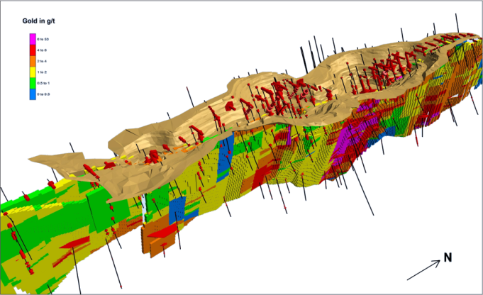
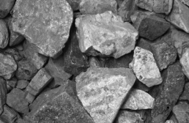
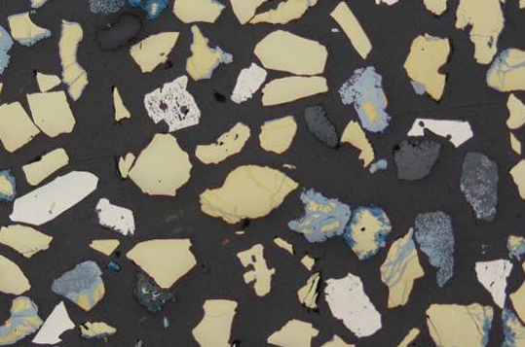
Applied Mineralogy
Choosing the right perspective
A PROGNOSTIC perspective
  Geometallurgy
    Deposit
      Regional Variability,…
      Zonation, stratification,…
      Faults, Geomechanical testing,…
    Rock/Ore
      Local Variability,…
      Grade and Mineralogy
      Pores, Fractures,
      Grain size, shape, arrangements, …
      Mineralurgical testing,…
    Particulate system
      Interparticle variability (Liberation)
      Microchemical probing,…
A geometallurgist gathers quantitative data as input to models for predicting behaviour in several industrial processes (blasting; grinding; leaching; flotation;…)
He considers valuable, deleterious and gangue-forming minerals
Sampling, Geostatistics and Stereology:
  3D from cores
  3D from sections
  3D from tomography

Slide 8
Geometallurgy
Developing the right tools

Slide 9
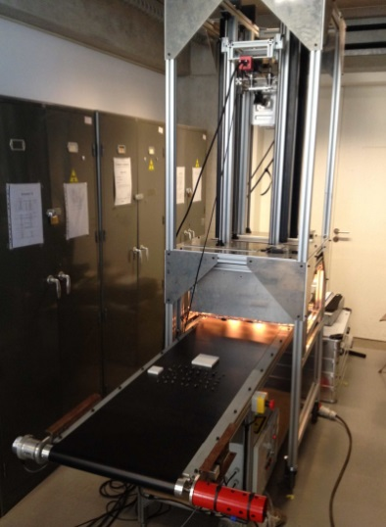
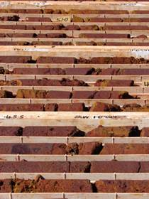
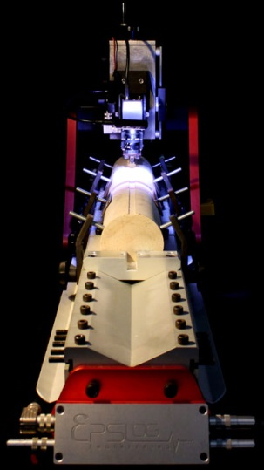
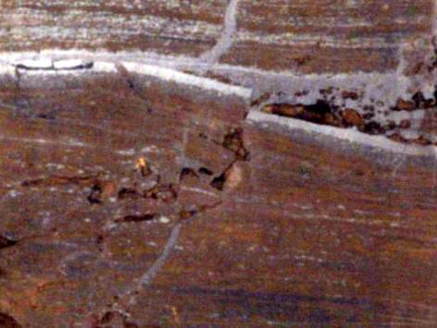
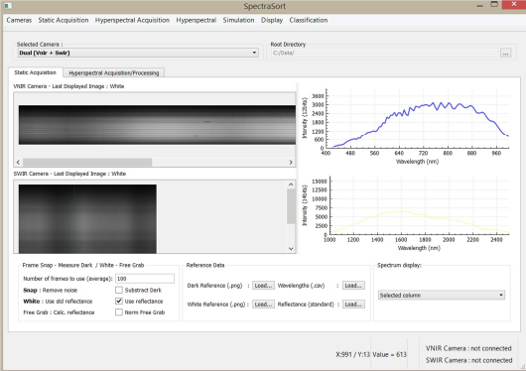
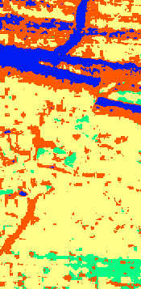
Geometallurgy
Developping the right tools
Macro scale (Deposit)
  Opto-Mechanical Core-scanning
    Decamp X., Barnabé P., Pirard E., IMA (2014)
    LITHOLOGICAL MAPPING FROM OPTICAL & MECHANICAL MEASUREMENTS
    HYPERSPECTRAL IMAGING & 3D SENSING
Co-registered diffuse reflectance imaging
Cam 1 : 400 nm - 1000 nm
Cam 2 : 970 nm – 2500 nm
EPSLOG
Scratch test

Slide 10
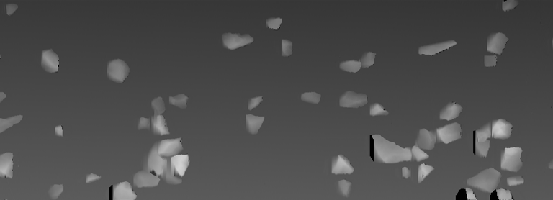
Geometallurgy
Developping the right tools
Macro scale (Deposit)
  3D chips scanning
    Destructive drilling generate cuttings whose size and shape
    can be used to estimate tensile and shear type failure modes.
    3D image analysis of chips induced by core scratch testing indicate strong correlations with the intrinsic grain size and the cutting depth
    Pirard, E. et al., WCPT Nürnberg (2010)
    3D AND 2D PARTICLE IMAGE ANALYSIS OF ROCK CHIPS GENERATED BY CORE SCRATCH TESTS
EPSLOG

Slide 11

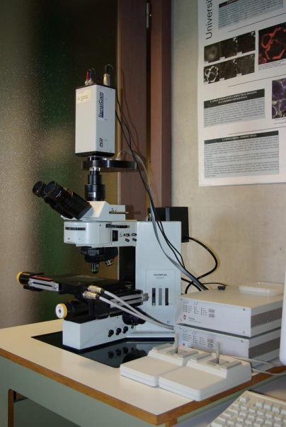
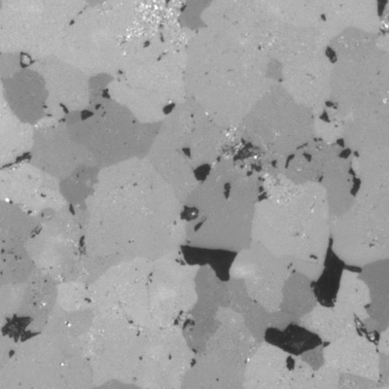

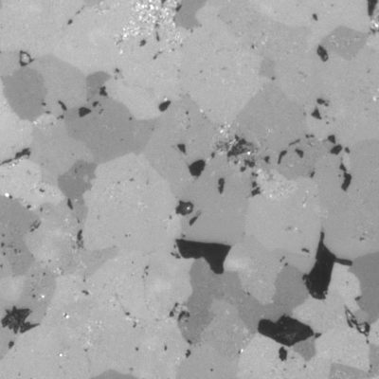
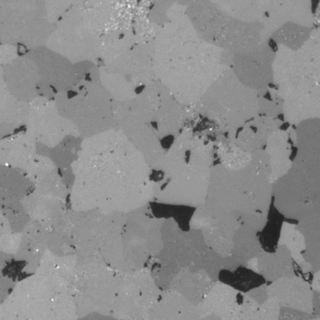
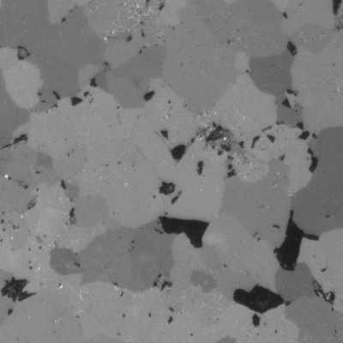

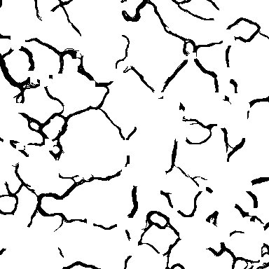
Geometallurgy
Developping the right tools
Meso scale (Rock/Ore)
  Multiradial Microscopy
    Contreras R., Pirard E., S4G Prague (2012)
    FABRIC ANALYSIS OF CARBONATE ROCKS USING MULTIRADIAL IMAGING AND INTERCEPTS
Porosity
Multiradial Image
Grain Boundaries (gradient)

Slide 12
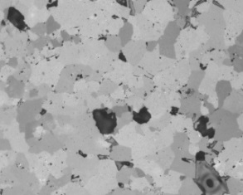
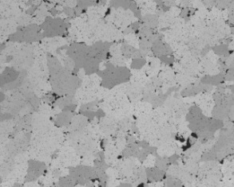
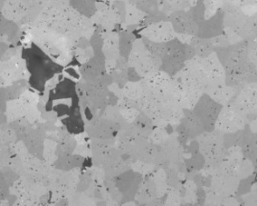
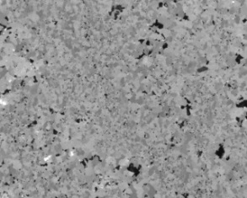
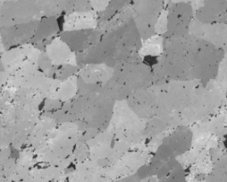
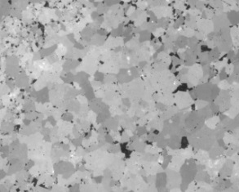
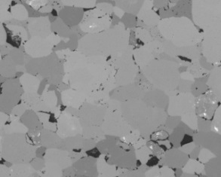
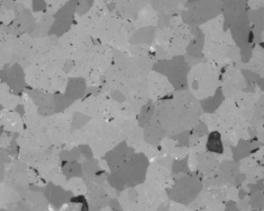
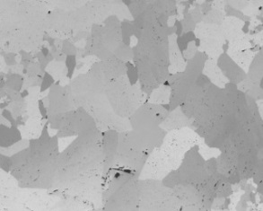
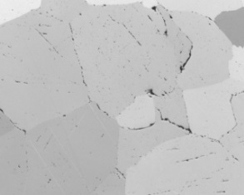


Geometallurgy
Developping the right tools
Meso scale (rock)
  Multiradial Microscopy
    Crystal Size Distribution to predict decrepitation
Percentiles of Intercept Length (Crystal Size CSD)

Slide 13
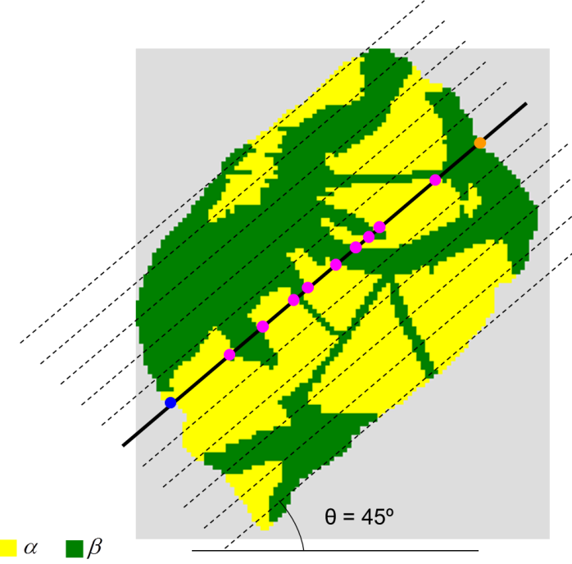
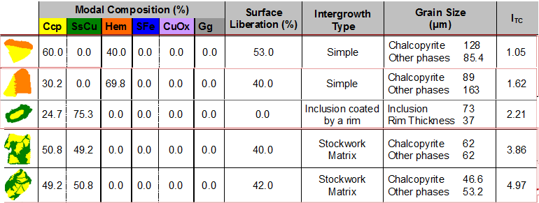
Geometallurgy
Developping the right tools
Micro scale (particle)
  MicroTexture Indices
    Perez-Barnuevo L., Pirard E., Castroviejo R. Min. Eng. (2013)
    AUTOMATED CHARACTERISATION OF INTERGROWTH TEXTURES IN MINERAL PARTICLES

Slide 14
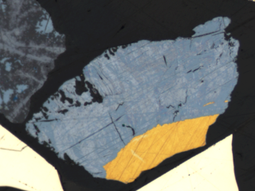
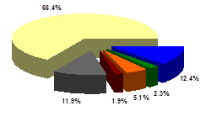
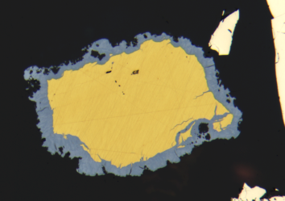
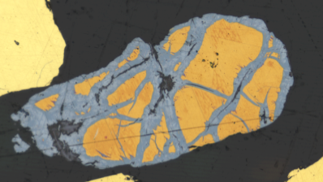
Geometallurgy
Developping the right tools
Micro scale (particle)
  MicroTexture Indices
    Perez-Barnuevo L., Pirard E., Castroviejo R. Min. Eng. (2013)
    AUTOMATED CHARACTERISATION OF INTERGROWTH TEXTURES IN MINERAL PARTICLES
CC-MIX
CC- RIM
LIB CP
CC-MIX
CC-RIM
Kansanshi Mixed Zone
CC-STWK
CC-STWK
CC-RIM+STWK
Ex_Class

Slide 15
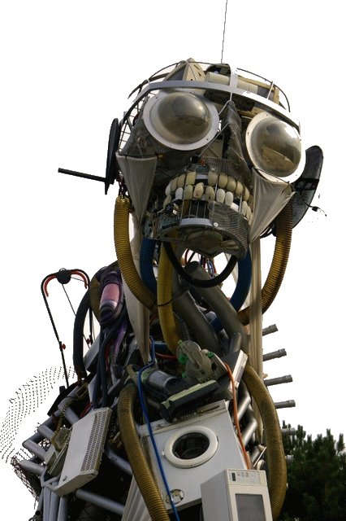
From Geometallurgy to Ecometallurgy
Getting ready for a new cycle
WEEE sculpture (Eden Project, UK)

Slide 16
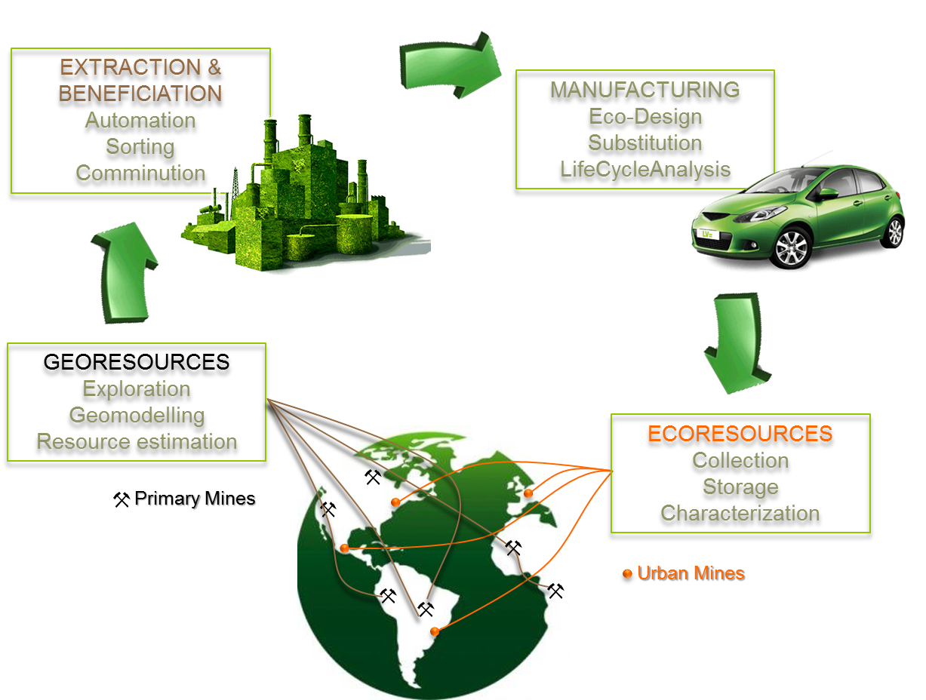
Ecometallurgy
Getting ready for a new cycle
From Georesources to Ecoresources

Slide 17
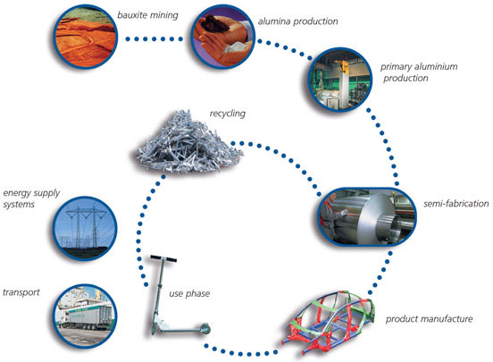
Ecometallurgy
Getting ready for a new cycle
Material Centric Perspective
  Aluminium life-cycle
Ga
Al
Al
Cradle-to-cradle © ALCOA

Slide 18
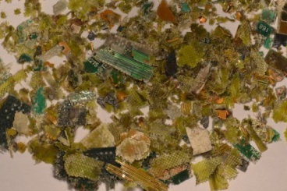
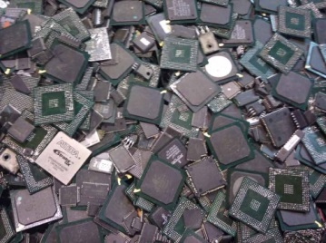
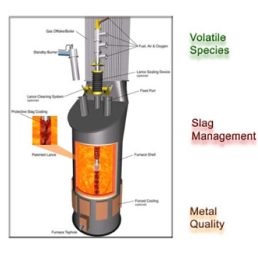
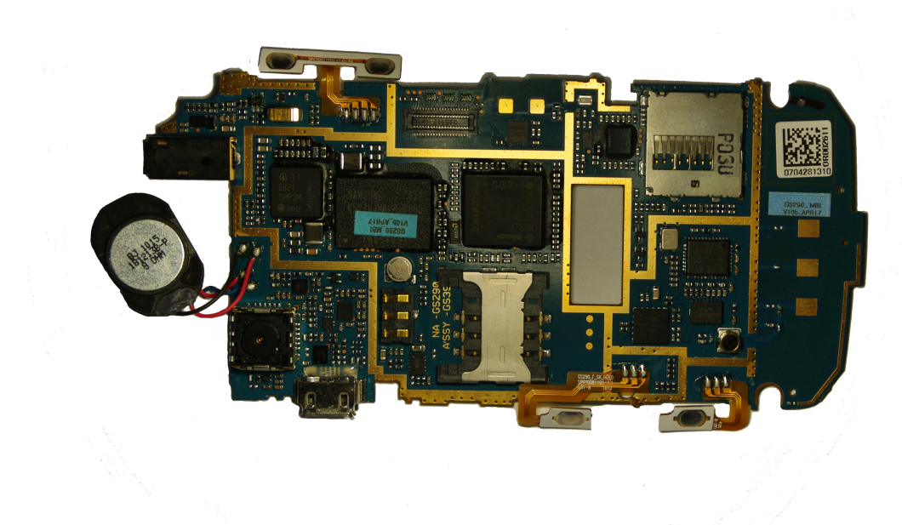
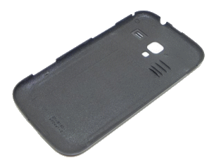
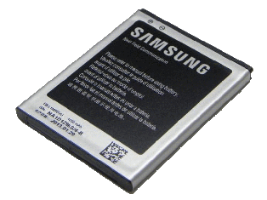
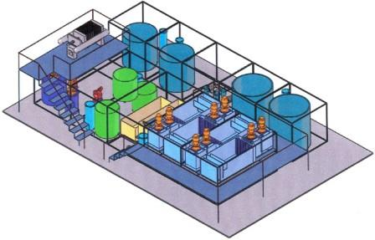
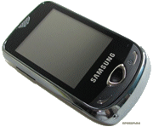
Ecometallurgy
Getting ready for a new cycle
Product Centric Perspective
  Cellphone life-cycle
Shredding
Screening
Sorting
Flue dust
Slag
Pyrometallurgy
Cu, PM
Outotec TSL
© Reuter 2011
Hydrometallurgy
Disassembly
Complex Leachate
Cu
PM
Pb
Zn
End of Life
RE
Ga
Ta
Li
…

Slide 19




Evolution of Products
Is this progress ?
Future products will not only be optimized with regard to their functionality but also their recyclability and the sustainable availability of resources
Incandescent
Halogene
Fluo-compact
LED
12-20 lm/W
18-25 lm/W
60-80 lm/W
25-140 lm/W
Tungsten
Glass,…
Tungsten
Iodine, Bromine, …
Glass,…
Tungsten
Mercury, Rare Earths,… Glass, Plastics,…
Gallium
Indium, Cerium, Yttrium, Copper, Silver, Silicium, …
Plastics, …

Slide 20
Building Mines for the Future
Ecometallurgy
Metal concentrations
  Maintain grade above a technological cut-off
Metal speciation
  Metal, alloy, salt , organic compound,…
Metal paragenesis
  Unexpected metal assemblages,…, contamination
Textural assemblage
  Liberation and dismantling
Volume of mine
  Make sure large enough quantitities can be collected
Homogeneity
  Zonation, Blending

Slide 21


Building Mines for the Future
Ecometallurgy
Metal concentrations in Urban Mines
  Maintain grade above a technological cut-off
    Often only precious metals (Au, PGM) pay for recycling
  Composition of PCB
    Base metals (35%): Cu, Zn, Al, Pb, Sn, …
      Rare Metals
        Au 100-1000g/t
        Ga 30g/t; In 30g/t; Nd 300g/t
    Cellphones : 50 g/t Ga
      Up to 1000 g/t Ga in IC
      How to separate IC from PCB ?
    Ge doped optical fibers (14mg/km)
    Ge lost in PET bottles (dispersive use)

Slide 22
Building Mines for the Future
Ecometallurgy
Metal speciation
  Metal, alloy, salt , organic compound,…
    Wide variety of alloys (Ni, Al,…)
    Hard to separate by physical means (=> innovative optical sorting needed)
Metal paragenesis
  Unexpected metal assemblages
    Copper coated aluminium wires
  Association with deleterious elements
    InGaAs
    As toxic, low value, impacts process costs
Textural assemblage
  Liberation and dismantling
    Separate core from cladding and jacket in optical fibers
    Need for « design for recycling »; smart joints;…

Slide 23
Building Mines for the Future
Ecometallurgy
Volume of mine (resource evaluation)
  Make sure large enough quantitities can be collected
    Collectables not collectibles
    Infrastructure (lighting LEDs), Building (Electric wires; Cu tubes),… (OK)
    Specialized IR lenses; (?)
  Urban mines are mobile
    Tax, legislations, trading,…
Homogeneity of the deposit (4D⁺ problem)
  Zonation, Blending
    Technological evolution with time changes deposit
      From Compact Fluo lamps to LEDs !
    Need for flexible and adaptive processing plants

Slide 24

Perspectives
Geo/Ecometallurgy
Resource Efficiency
  Mineralogists and geologists have to contribute to a « resource efficient » society
  Excellent background to adress the circular economy (LCA, MFA,…)
    Resource characterization & Evaluation
    Predictive approach to processing
Education
  Multidisciplinary training
  From « geology to mineral processing »
  From « orebody modelling to metallurgical simulations »
  EMerald Master in Georesources Engineering
    Liege > Nancy > Lulea > Freiberg
www.em-georesources.eu

Slide 25



Perspectives
Geo/Ecometallurgy
Creating KICs « Knowledge Innovation Communities »
  European Raw Materials Initiative
  EIT call for a KIC on Raw materials: sustainable exploration, extraction, processing, recycling and substitution
  250 M€ + for innovation
EU Decision 09 DEC 14

Slide 26



Thank You
See you in Liège, 2015
Liège, Belgium
Exploring new dimensions in imaging…
Session 11 : Geometallurgy (Pirard, Lamberg, Bradshaw)

