Slide 1



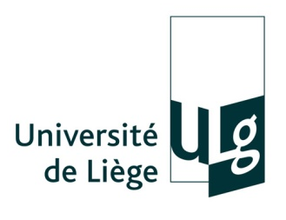
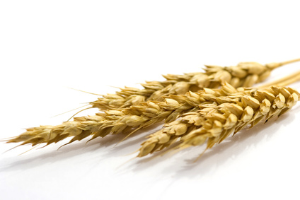
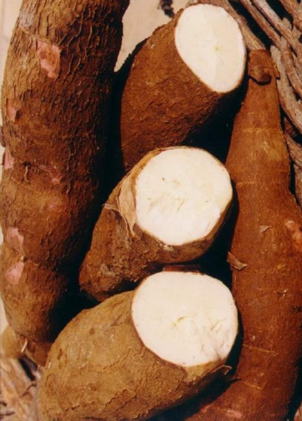
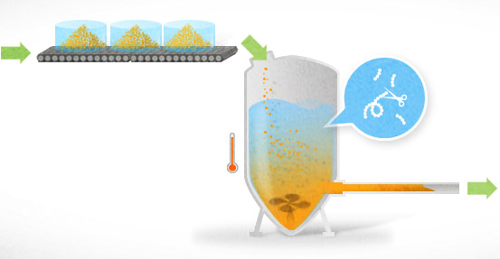
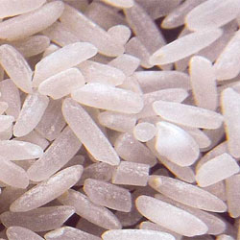
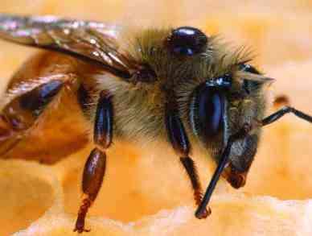
A sustainable method inspired by nature for the production of original bi-functional nutraceuticals containing prebiotic fibers and highly bio-available forms of calcium and magnesium.
Dorothée Goffin ^{1,2}, Christophe Blecker ², Michel Paquot ¹
¹ Department of Industrial Biological Chemistry, University of Liège, Gembloux Agro-Bio Tech, Passage des Déportés, 2, B-5030, Gembloux, Belgium
² Department of Food Technology, University of Liège, Gembloux Agro-Bio Tech, Passage des Déportés, 2, B-5030, Gembloux, Belgium
Isomaltooligosaccharides (IMOs) are non-digestible oligosaccharides, considered as prebiotics and constituted of glucose monomers linked by at least one α-(1-6), or in a lower proportion α-(1-3) or α-(1-2) linkages. They are produced from either corn, tapioca, or rice hydrolyzed starch using a transglucosidase (EC 2.4.1.24) from Aspergillus niger ①. It results in complex mixtures of DP 2-10 oligosaccharides of different linkage types.
However, during the process only yields between 40-75 % are reached mainly due to glucose inhibition, leaving residual digestible α-(1-4) oligosaccharides and glucose released during the transglucosylation. In industry, selective ethanolic fermentation is used to purify IMO, but presents many drawbacks (unselective fermentation, ethanol and side products generation, residual digestible maltooligosaccharides...) while loosing the digestible fraction for the final product yield.
A sustainable method inspired by nature is thus proposed leading to an original bifunctional product active on gut health, metabolism regulation, immunity and mineral fortification, fighting against topical chronic diseases (type2 diabetes, osteoporosis, colon cancer…). Residual glucose is first converted to gluconic acid and its salts (Ca, Mg, Zn, Se…) using a glucose-oxydase (EC.1.1.3.4) combined with a catalase (EC.1.11.1.6) ②. Transglucosylation can then restart after conditions modification ③, followed by another glucose-oxydation ④. The conditions fine optimization of this sequenced enzymatic process allows to obtain a bifunctional product with less than 5% digestible oligosaccharides without generating waste.
The sustainable process is inspired by nature as two enzymatic reactions done by bees in honey are reproduced on the industrial scale.
Starch hydrolysis
Starch from various sources
Maltose rich syrup
4
Reducing end
OH
O
H
O
HO
H
O
H
1
H
O
O
O
O
H
H
O
O
H
H
x
Glucose-oxydation
x
Transglucosylation
2
Lactic acid
glucose
3
Mg²⁺
Zn²⁺
Ca²⁺
Mg²⁺
Digestible fraction
Zn²⁺
Alcoholic fermentation
 Production of ethanol…
 loss of fraction
 unselective fermentation
Ca²⁺
Highly bioavailable minerals
Prebiotic
Gluconic acid
Prebiotic
IMO fraction
On a nutritional point of view, gluconic acid (C₆H₁₂O₇) is also considered as a prebiotic compound which particularly enhances the production of butyrate acting on the gut wall integrity. The presence of two different types of prebiotic confers a larger prebiotic effect to the final product. Besides the prebiotic function, the presence of gluconates (Ca, Mg, Fe, Zn, Se…) allows mineral fortification as they are highly bio-available mineral forms. Moreover, when adding lactic acid after the process, lacto-gluconate complexes are formed which allow even higher levels of fortification due to their higher solubility.
Remarkably, this new natural process is sustainable because it generates no waste while fulfilling organic specifications. In addition to their unique nutritional properties, both compound show singular techno-functional properties (low calorie sweetener, low glycemic index, natural biostatic, water retention properties, masking sweeteners bitterness and resistant to thorough conditions). These properties allow an easy incorporation in a wide range of food matrix, especially those undergoing high temperature (cooked products) and low pH (beverages) unlike other prebiotics on the market. This overall process, is an elegant solution, from an economical, an environmental, a nutritional and a techno-functional point of view.
  Patent : Process for the production of a composition, the composition and the use there-of as food additive’. Goffin D., Paquot M., Blecker C., Robert C. European patent, n°PCT/EP2010/050596 published on 22 july 2010 under number 2010/081913.
  Prices : 3rd place of the INNOVACT european campus awards 2011, awarding the most innovative european start-up project, Best scientific poster NutriAward 2011, Salon NutrEvent, Lille, 1,2,3 GO Business plan program 2011 laureat, Enterprize spin-off of the year
  Review article : ‘Will Isomaltooligosaccharides, a well established functional food in Asia, break through the European and American market : the status of knowledge on these prebiotics’. Goffin D., Delzenne N., Blecker C., Hanon E., Deroanne C., Paquot M., 2011. Critical Reviews in Food Science and Nutrition, 00, 1-16

