Slide 1
Modeling the hygrothermal response of a prefabricated straw bale wall Assessing its impact on indoor climate
2014 ASABE and CSBE/SCGAB Annual International Meeting
Samuel DUBOIS, Arnaud EVRARD, Frédéric LEBEAU
Environmental Sciences & Technologies Dpt.
Liege University, Gembloux Agro-Bio Tech

Slide 2
Presentation outline
2014 ASABE and CSBE/SCGAB Annual International Meeting
1
Context
Materials and methods
Results
Conclusions
2
3
4

Slide 3
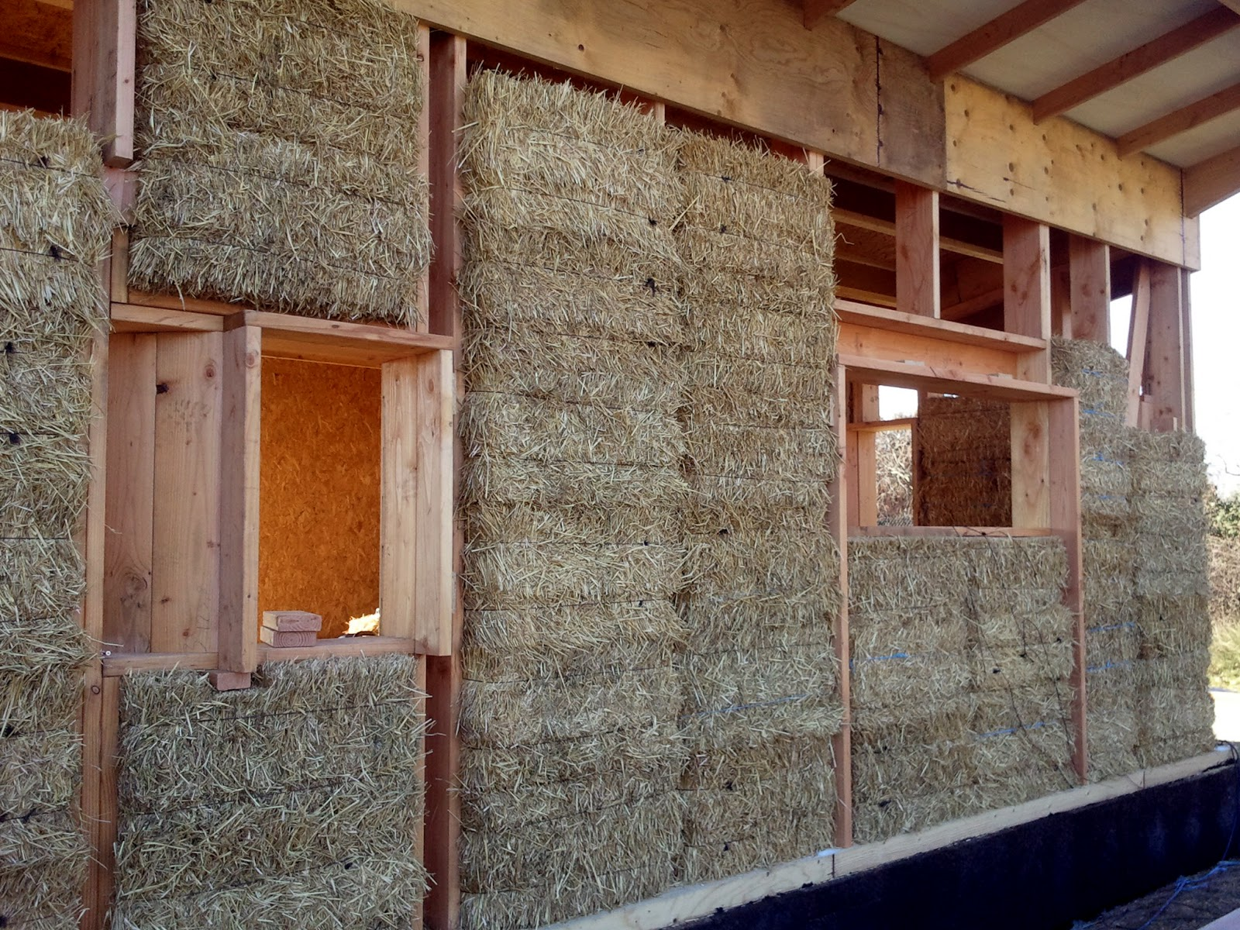
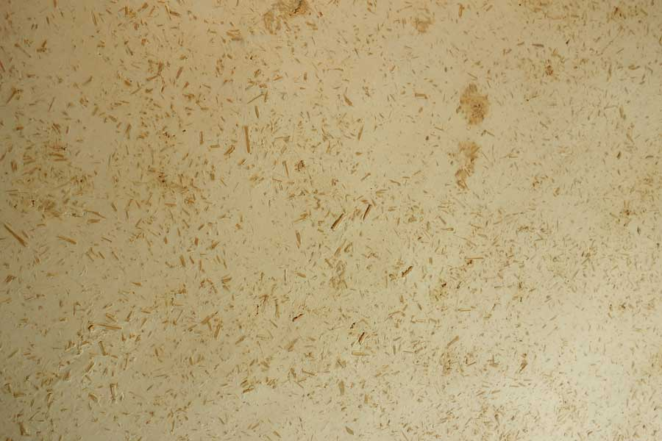
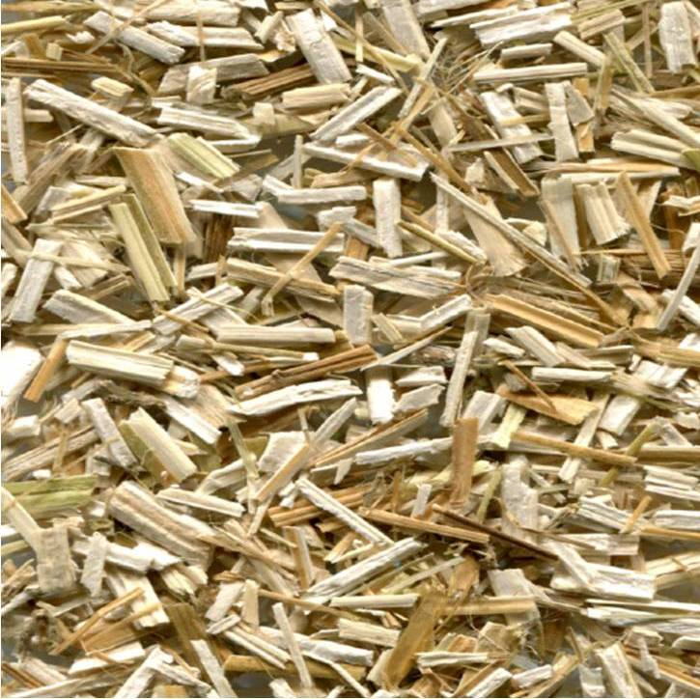
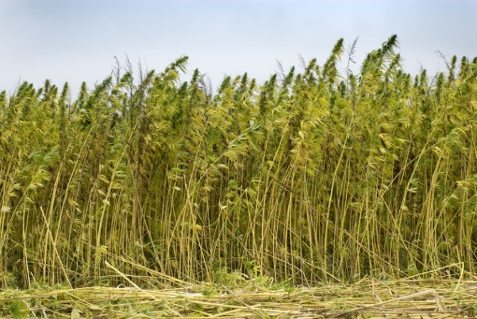
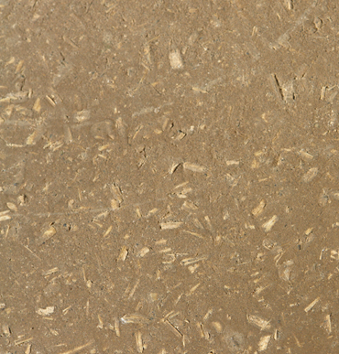
Context
2014 ASABE and CSBE/SCGAB Annual International Meeting
Crop based materials
Numerous crops can be transformed into various construction materials
Straw bale construction is gaining visibility!

Slide 4
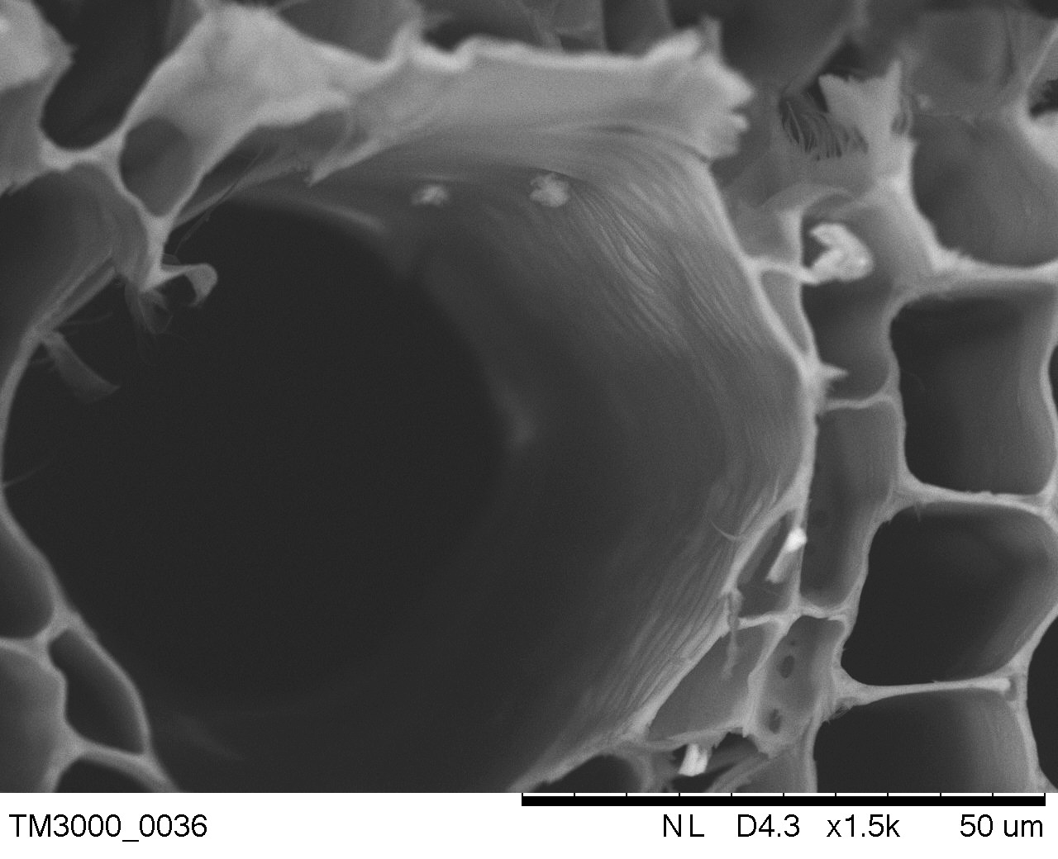
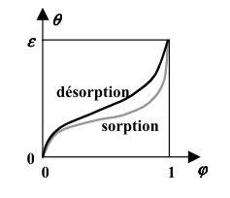
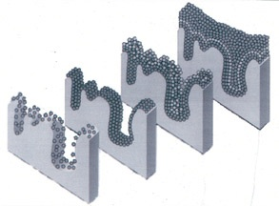
2014 ASABE and CSBE/SCGAB Annual International Meeting
Context
Crop based materials
Complex porous structure
Multiphase media
Capillarity + hygroscopicity…
Latent heat…
Specific hygrothermal behavior!
Benefits for buildings?

Slide 5
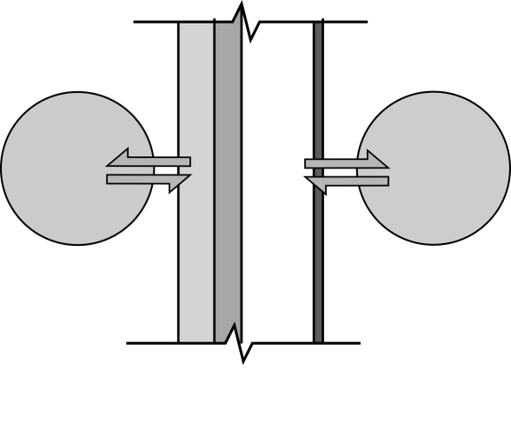
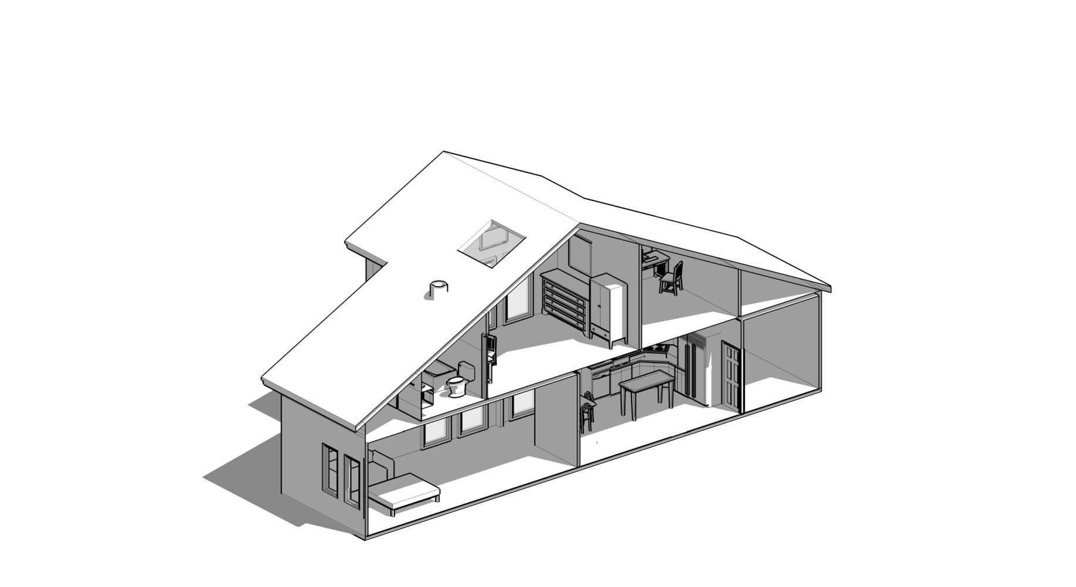
Context
2014 ASABE and CSBE/SCGAB Annual International Meeting
The modeling tools are precious for the building designer
Understanding and predicting the CBM behavior under imposed solicitations (Stage 1)
Evaluating the impact on indoor comfort and building energy performance (Stage 2)

Slide 6
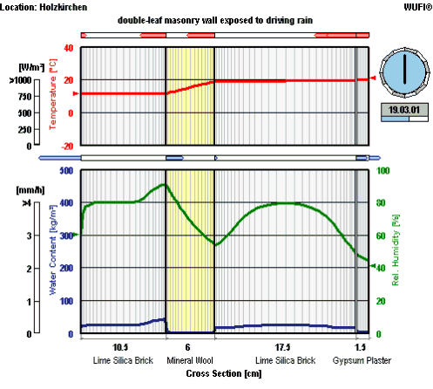
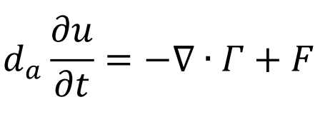
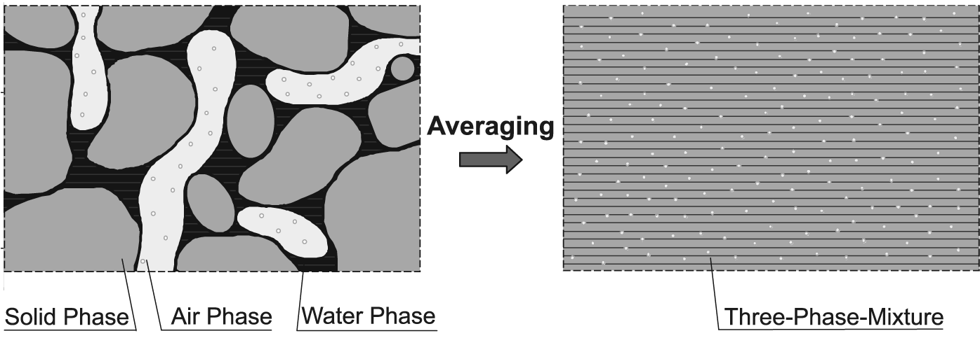
2014 ASABE and CSBE/SCGAB Annual International Meeting
Context
Stage 1 –behavior @Wall scale
Conditions inside the wall
WALL
BEHAM models (PDE’s)
Indoor climate as one of the boundary conditions
The impact of heat and mass fluxes on indoor air?
No mutual exchange!
INDOOR
CLIMATE
OUTDOOR
CLIMATE

Slide 7
2014 ASABE and CSBE/SCGAB Annual International Meeting
Context
Stage 2 – Impact @Building scale
Conditions in indoor air volumes with actual participation of the envelope
Need to combine BEHAM models with zone balance (ODE’s)
Upgrade of Building Energy Simulation tools
Integration of models in General computational tools (Matlab, Simulink, SPARK, …)

Slide 8
Université de Liège, Gembloux Agro-Bio Tech
Context
Objectives
Develop a room-scale hygrothermal model with a BEHAM description of the envelope
Validate the model with two simple experiments performed on a straw bale wall in a bi-climatic chamber
Quantify the benefits of the straw bale wall during the proposed scenarii

Slide 9
2014 ASABE and CSBE/SCGAB Annual International Meeting
Materials and methods
A straw bale wall…

Slide 10
2014 ASABE and CSBE/SCGAB Annual International Meeting
Materials and methods
… in a bi-climatic chamber

Slide 11
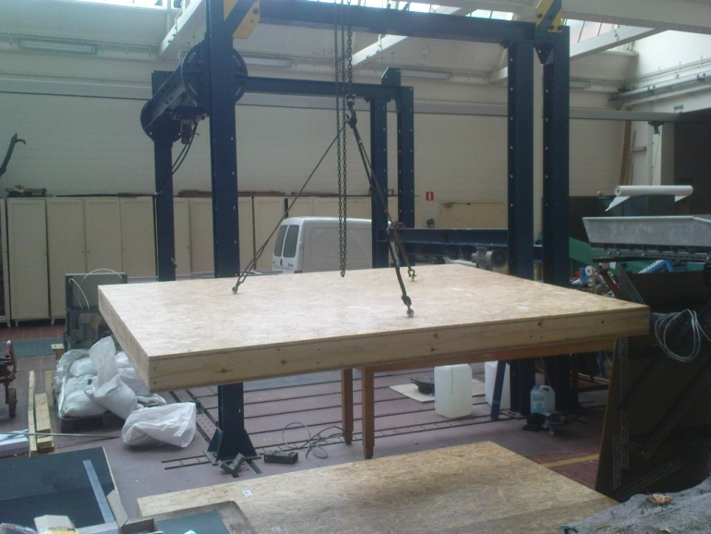
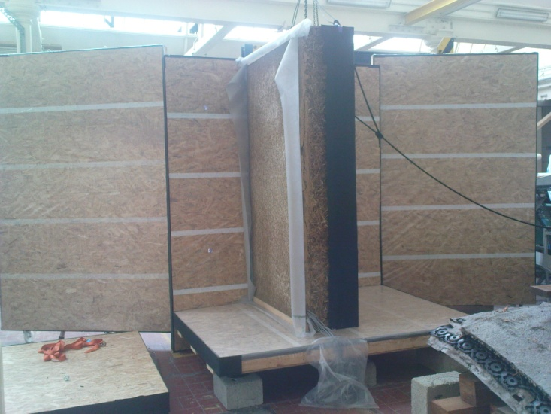
2014 ASABE and CSBE/SCGAB Annual International Meeting
Materials and methods
… in a bi-climatic chamber

Slide 12
2014 ASABE and CSBE/SCGAB Annual International Meeting
Materials and methods
Two 12 days case studies
T/HR sensors
Heat shock
(20-35°C)
Hydric shock
(+/- 50 g/h)

Slide 13
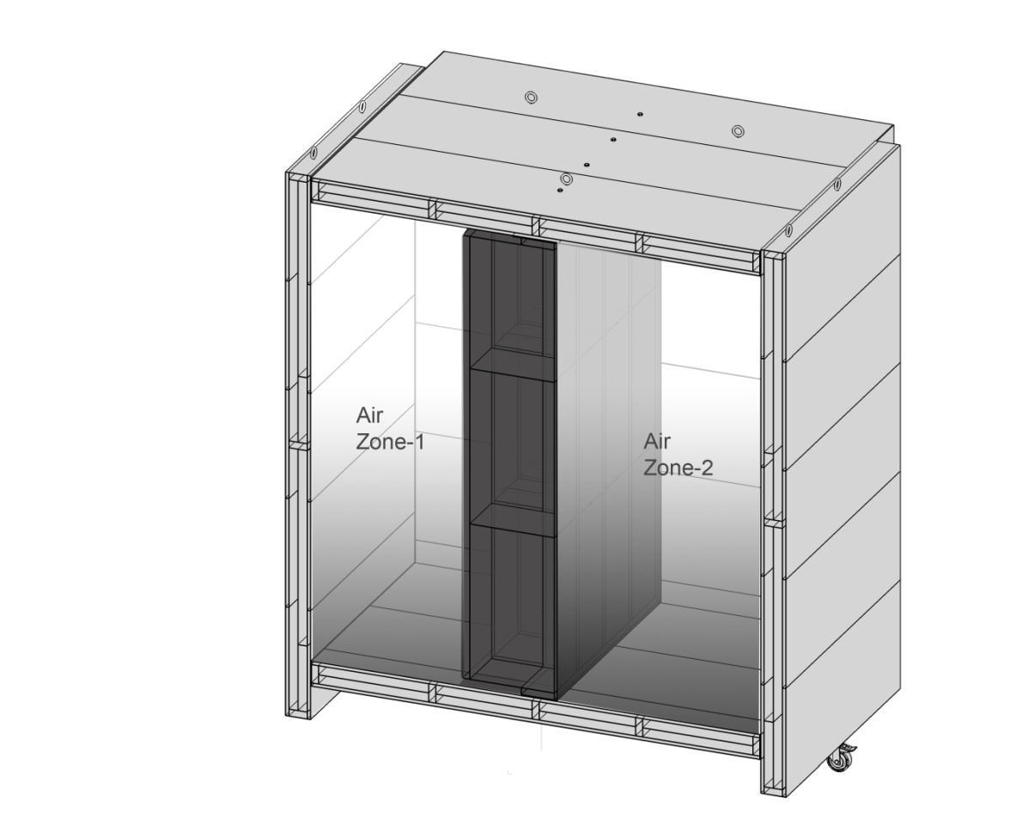
2014 ASABE and CSBE/SCGAB Annual International Meeting
Materials and methods
Hygrothermal model
Predict T and Pv in zone-1
2 subparts
BEHAM part in COMSOL Multiphysics
Modularity, interoperability
Two versions of the model
BEHAM-H = heat transfer only
BEHAM-HM = heat + moisture
Air zones balance in Simulink
Modularity, interoperability
ODE based modeling

Slide 14
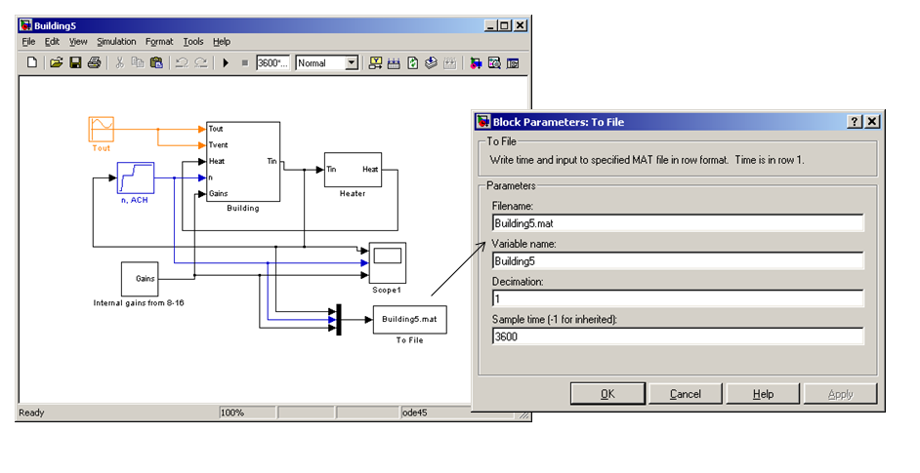
2014 ASABE and CSBE/SCGAB Annual International Meeting
Materials and methods
Hygrothermal model
Integration of the COMSOL subpart in Simulink using S-Functions
Hybrid model (continuous and discrete time stepping)

Slide 15
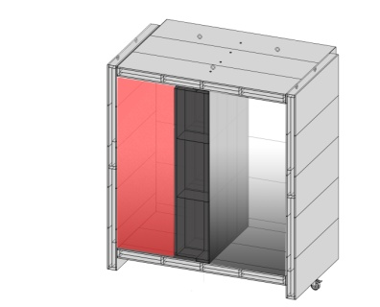
2014 ASABE and CSBE/SCGAB Annual International Meeting
Results
Case study 1 / vapor press. in zone 1
Experimental
Rise of pv due to heat shock
→ Moisture buffer!
With moisture transfer in straw
Numerical
Without…
Good prediction of the complex model
The simple model overestimates the impact of ventilation

Slide 16
2014 ASABE and CSBE/SCGAB Annual International Meeting
Results
Case study 1 / vapor press. in zone 1
The room scale model allows evaluating actual and mutual fluxes between the envelope and the indoor air
Flux from zone-1 to straw bale wall

Slide 17
2014 ASABE and CSBE/SCGAB Annual International Meeting
Results
Case study 2 / vapor press. in zone-1
Experimental
Rise of pv below saturation values → Moisture buffer!
Numerical
Good prediction of the complex model
The simple model predicts saturated pressure values for the entire period

Slide 18
2014 ASABE and CSBE/SCGAB Annual International Meeting
Conclusions
Good correspondence between observed and simulated data
The room-scale model allows to quantify the benefits of hygroscopic materials
The moisture buffer can play a significant role in heat transfer

Slide 19
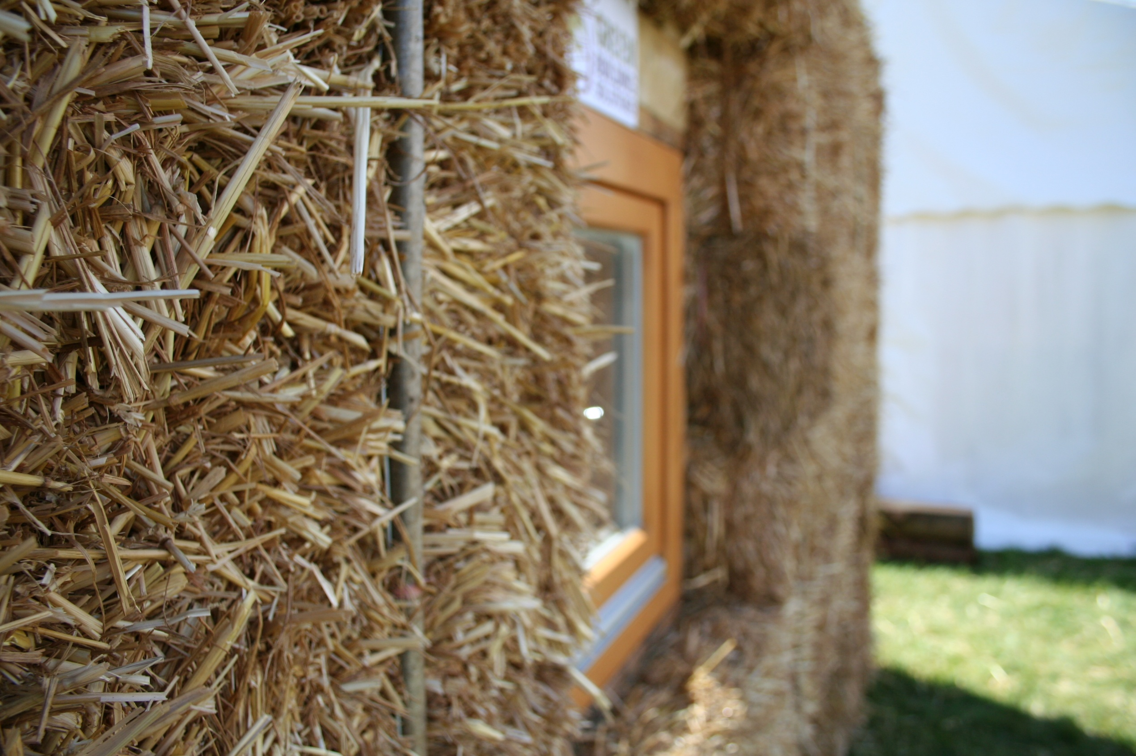
2014 ASABE and CSBE/SCGAB Annual International Meeting
Thank you

