Slide 1
Let’s Talk Ambiguity: Citizen Science in New and Emerging Technologies
Michiel van Oudheusden, ULg
July 4, 2014
Science in Society - VUB

Slide 2
nanotechnology

Slide 3
BAN: Body Area Network nano as enabling technology

Slide 4
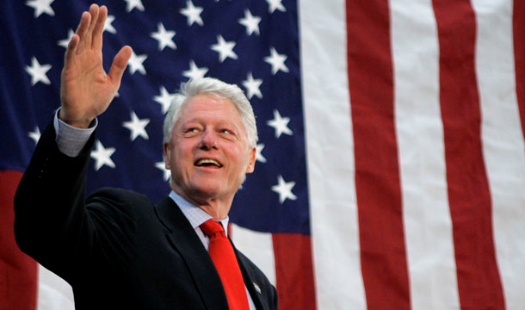

Slide 5
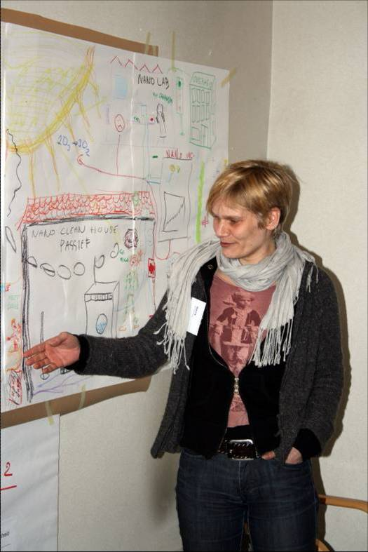
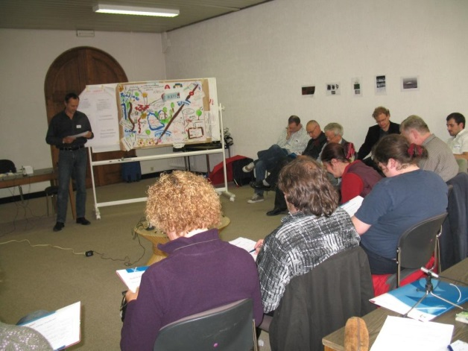
1. NanoSoc (2006-2011)
Nano-scientists
Stake-holders
Citizens

Slide 6
2. Nanotech Festival, Flemish Parliament 2007

Slide 7
So why engage citizens in science?
Listen to citizens’ concerns
Educate citizens about nano
Excite citizens!
Downplay unwarranted fears
Involve citizens but…
… do not slow down innovation
Explore choices
Decide together

Slide 8
“Let’s talk science”:
Citizen science is the general public engagement in scientific research activities. Citizens actively contribute to science either with their intellectual effort or surrounding knowledge or with their tools and resources. Participants provide experimental data and facilities for researchers, raise new questions and co-create a new scientific culture. While adding value, volunteers acquire new learning and skills, and deeper understanding of the scientific work in an appealing way.

Slide 9
Clearly, not so unambiguous…

Slide 10
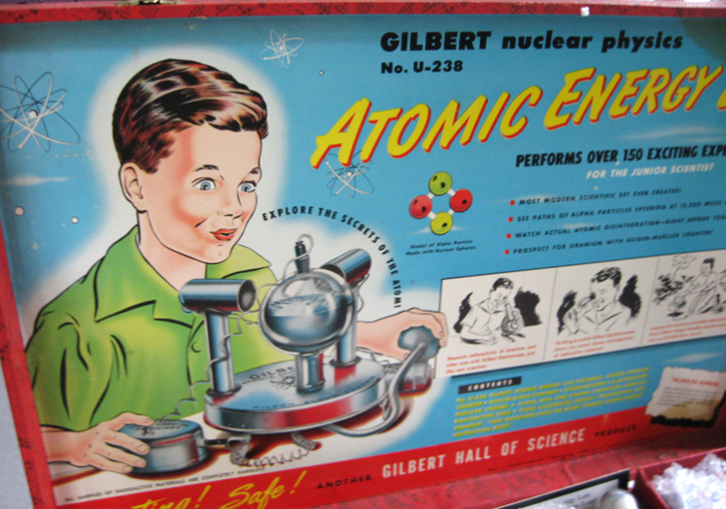
Recognize + work with tensions
Problem framings and agendas
NEST: unstructured problems, endless debates
Political / institutional
Notes:
Similar instruments can be used for diff. agendas. / No simple risk problems. Unknown unknowns. / Research in the wild. P-mkrs embrace CS.

Slide 11
Not the perfect ending
Take advantage of the ambiguity in the world. Look at something and think what else it might be.
- R. van Oech
Notes:
Ambiguity: perjorative. Optimistic ending. Multiple. Complex.

Slide 12
michiel.vanoudheusden@ulg.ac.be

