Slide 1

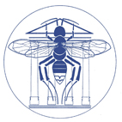



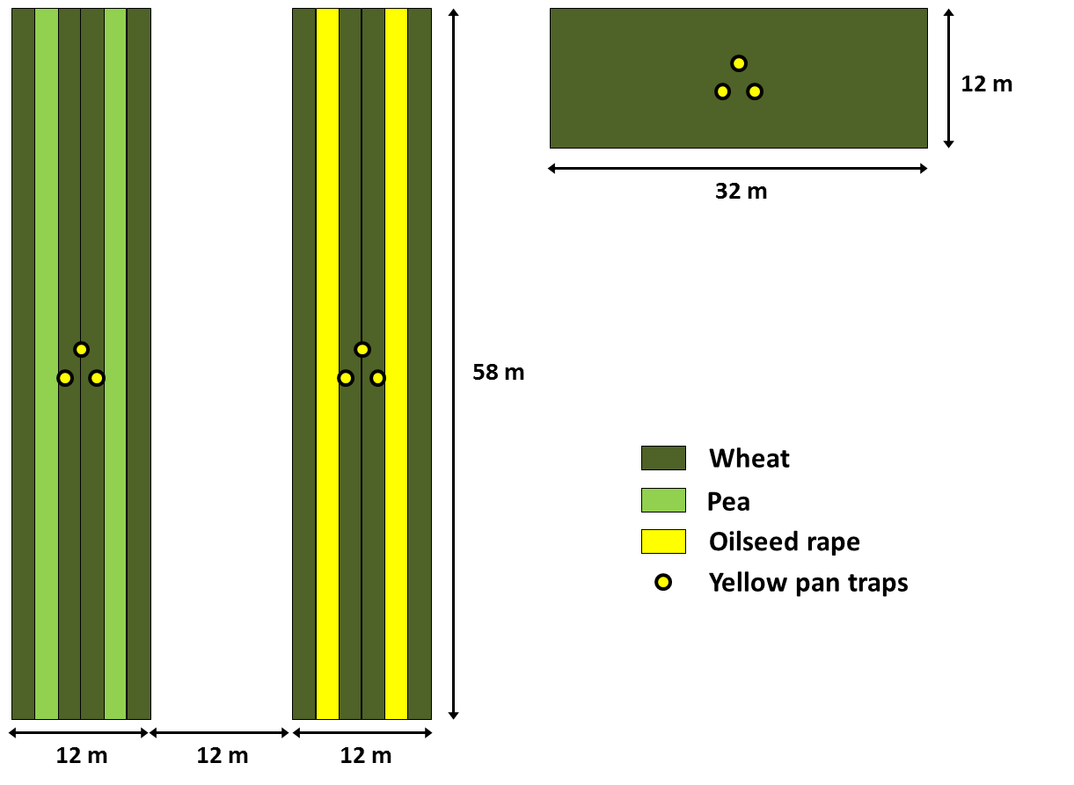

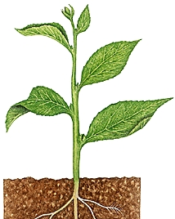
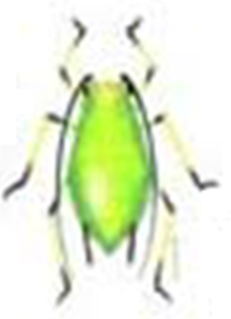
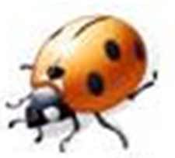
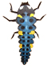

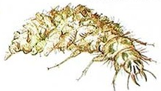
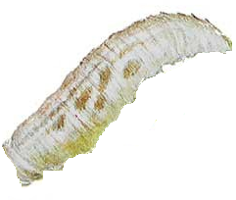
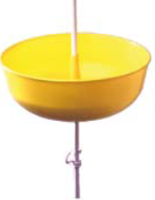
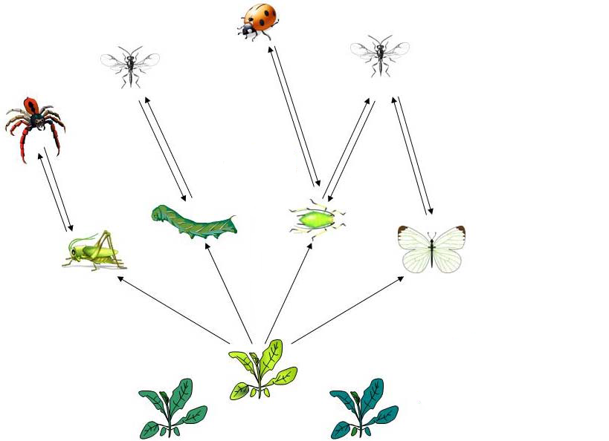
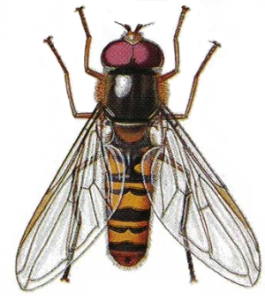
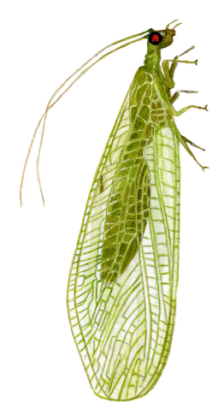
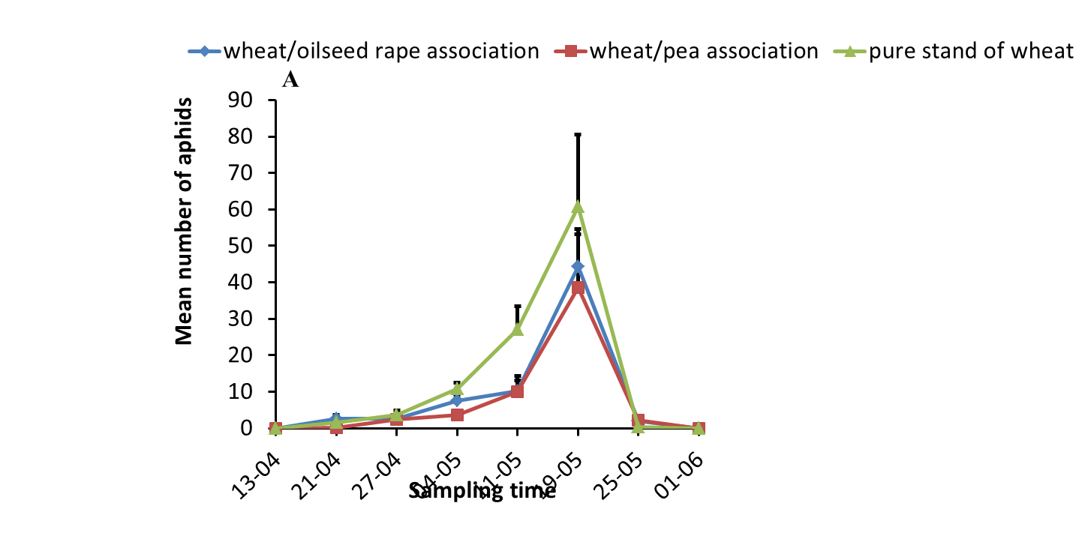
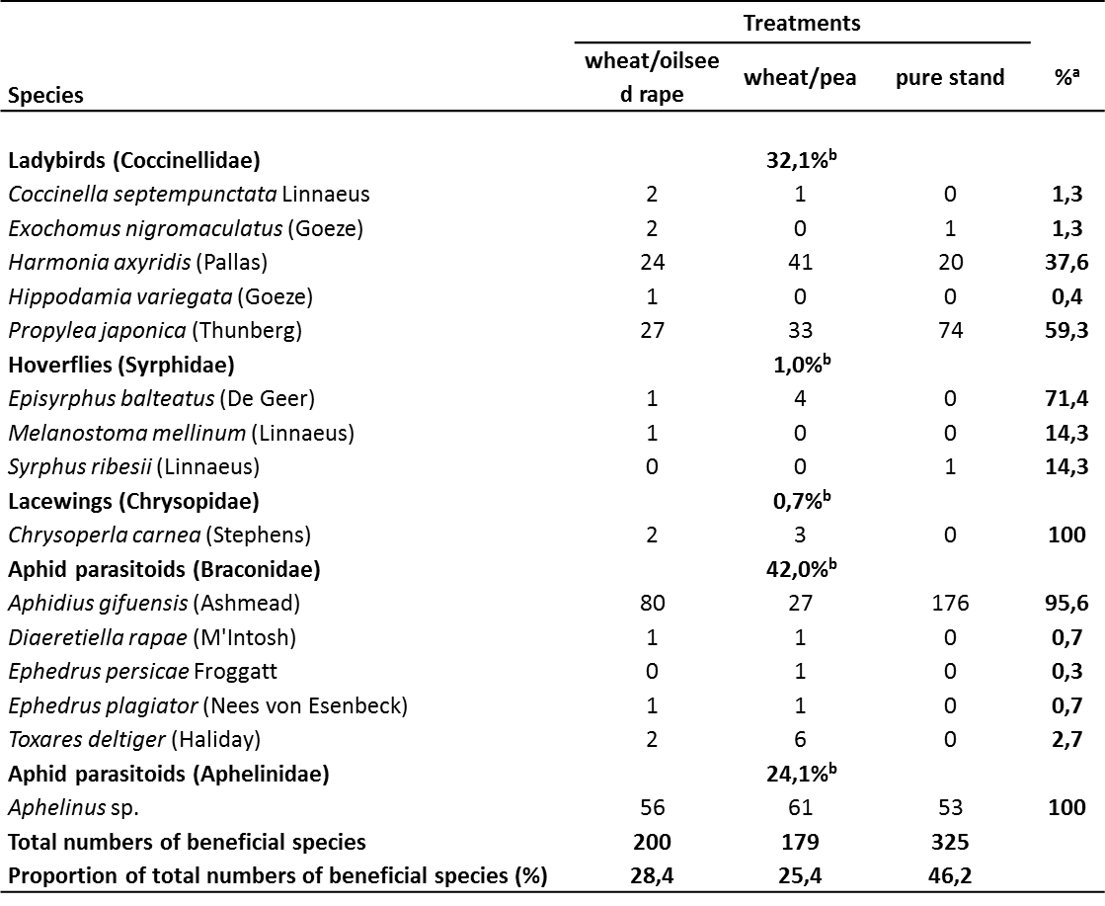
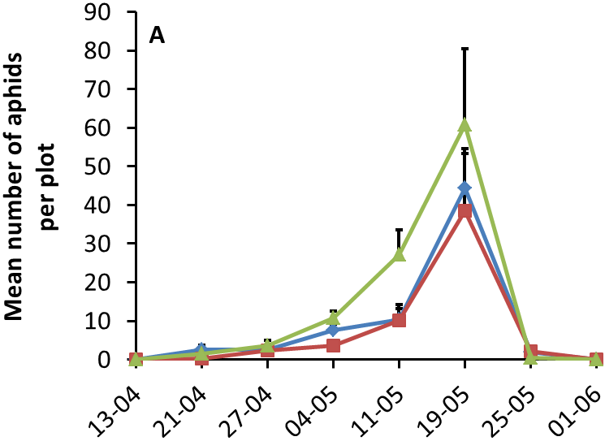
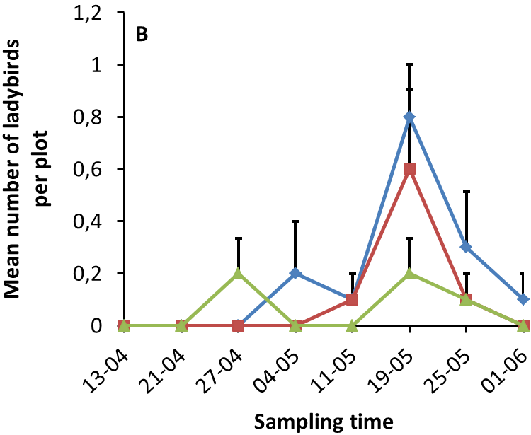
Effects of wheat/oilseed rape and wheat/pea associations on the diversity of aphids and aphidophagous beneficials
Thomas Lopes^{1*}, Emilie Bosquée¹, David Honba¹, Laurent Serteyn¹, Ju Lian Chen², Liu Yong³ & Frédéric Francis¹
1. Functional & Evolutionary Entomology, Gembloux Agro-Bio Tech, University of Liège, Passage des Déportés 2, B-5030 Gembloux, Belgique. *E-mail: entomologie.gembloux@ulg.ac.be
2. State Key Laboratory for Biology of Plant Diseases and Insect Pests, Institute of Plant Protection, Chinese Academy of Agricultural Sciences, 2 West Yuanmingyuan Road, Beijing 100193, P.R. China.
3. College of Plant Protection, Shandong Agricultural University, Taian, Shandong 271018, P.R. China.
Introduction
The economic growth of China led to some changes in the agricultural model of the country.
Chinese farmers invested in mechanization and abandoned some traditional practices, like crop associations. However, increasing plant diversity within crops can be beneficial for pest control:
resource concentration hypothesis (Root, 1973): specialist herbivores are more likely to find and remain on host plants that are concentrated in dense or pure stands (their visual and olfactory location is expected to be more complex in diverse environments)
enemy hypothesis (Root, 1973): natural enemies are more abundant in complex environments (they can benefit from alternative sources of prey, nectar and pollen, as well as shelter and moderate microclimate)
Objective: this study was conducted in the Shandong province (China) to better characterize the effect of wheat/oilseed rape and wheat/pea associations on the populations of aphids and aphidophagous beneficials.
Materials and methods
Experimental design: Sampling method (each week):
Observations on 10 wheat tillers :
Trapping (Yellow pan traps):
Aphids Aphidophagous beneficials
Collection and identification of adult predators and parasitoids
Results
Observations on wheat tillers
Trapping
***
Most abundant
ladybird species
**
***
Most abundant
Parasitoid specie
ª Proportional representation of each species by family
^{b} Relative occurrence of each family in the beneficial population
Few hoverfly larvae
were observed
No lacewing larvae
were observed
No significant differences were
found for parasitoid mummies
Few hoverflies and lacewings were trapped
Discussion
Observations of aphids on wheat tillers confirm the resource concentration hypothesis during the two weeks that preceded their abundance peak.
One week later, the enemy hypothesis was also confirmed for ladybirds (adults + larvae) in both associations. They probably benefited from the presence of other aphid species in oilseed rape and pea.
If observations on plants give a more realistic idea of the evolution of populations in crops, yellow traps are efficient to evaluate the entomological diversity.
Results show that parasitoids are the most abundant beneficials, followed by ladybirds. Comparing to Europe, few hoverflies and lacewings were trapped.
Perspectives: Combine crops associations with semiochemical releasers to attract more aphidophagous beneficials.
Référence: Root R.B. (1973). Organization of a plant-arthropod association in simple and diverse habitats: the fauna of collards (Brassica oleracea). Ecological Monographs, vol. 43, 95–124.

