Slide 1




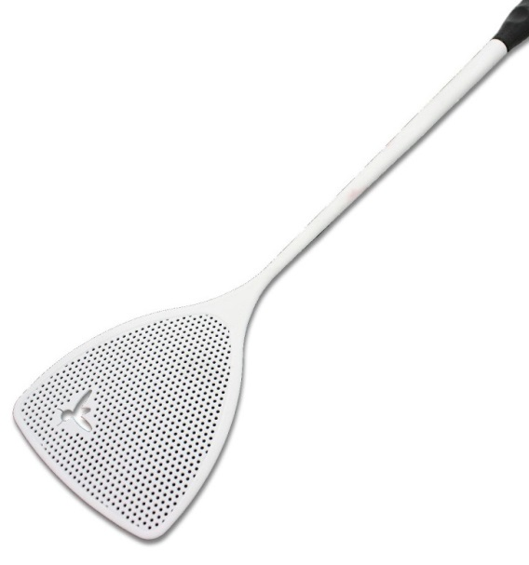
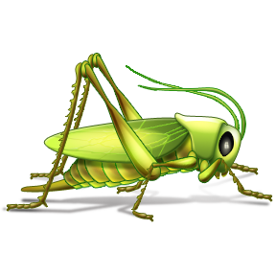

Notes:
Imagine on a sunny day, you decide to open your window and take some fresh air. But as you open your window a grasshoppers pops in. What will you do? Smash it? But lets rewind, and look it from a different perspective, imagine that you are someone who lives in tropical region…..

Slide 2

Notes:
Again you open your window and a grasshopper pops in…. What you will do know?? Eat it….
So why there is difference in mentality and these actions?? Ok I will try to develop a bridge between the two mentalities…. With my presentation….

Slide 3

Locusts and Grasshoppers: Future Foods?
Aman Paul¹, Michel Frederich², Roel Uyttenbroeck¹, Severin Hatt¹, Christophe Blecker³, Frederic Francis³, Arnaud Monty³, Eric Haubruge³ & Sabine Danthine³
¹Agricultureislife Platform, University of Liege (Belgium)
² Institute of Pharmacy, University of Liege (Belgium)
³ Gembloux Agro-Bio Tech, University of Liege (Belgium)
Notes:
So today I will present on Locusts and Grasshoppers: Future Foods?
This our team, we have people from food technology, entomology, pharmacy and biodiversity units working together.

Slide 4
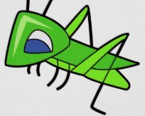
Flow of presentation
Introduction
Nutrition
Health
Environment
Miscellaneous
Summary
Notes:
This is the flow of my presentation. I will first present the context of my presentation, then explain you the nutritional, health, environmental and some miscellaneous aspects of eating grasshoppers and locusts. Hope I will not bore you during my presentation and we will develop an understanding towards insects as food.

Slide 5
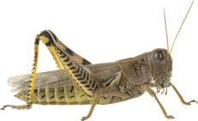
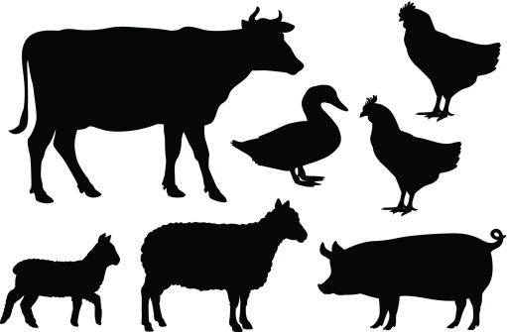
Introduction
Health
Miscellaneous
Nutrition
Environment
Summary
Need for Alternate Sources of Protein
Entomophagy
Rapid Urbanization
Teaming Millions
Edible Insect Species Overview
Notes:
There has been a strong need to discover alternate sources of protein in the recent year. Due to rapid urbanization, more and more people are coming to cities, they have now high salaries then before and need more and more meat. On the other hand the teaming million populations have really diminished the total area under agriculture. But for more population we need more meat, to produce meat we need the feed, but the area under agriculture is declining, so it is expected that meat prices will rise upto two times in next 10years. So what can we do now? Ok lets throw some light on entomophagy, it is the science on eating insects. Its not something not new, for eg these number of species are eaten in these parts… 542 in Africa…..

Slide 6
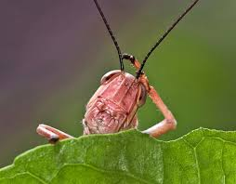

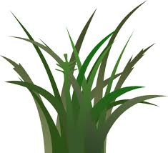
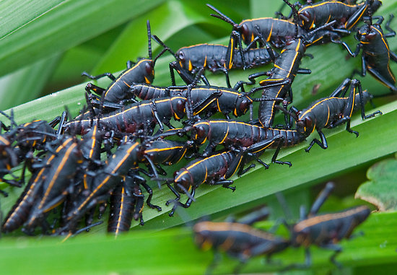
Introduction
Health
Miscellaneous
Nutrition
Environment
Summary
Why me?
Advantages
Utilization of Solar Energy
Tettigoniidae
Acrididae
Romaleidae
Pyrgomorphidae
80 edible species
Enormous Biomass
Nutrition
Health
Percentage share of different insect groups
Environment
Miscellaneous
Notes:
But out of some many insects, why only grasshoppers? This chart shows you the share of insect categories in global entomophagy. So grasshopper and locusts come in 4th position. So out of 60% population of the world who consume insects, grasshopper and locusts have a share of 13%. This is a big deal. But when I say grasshoppers, I strictly stick to these four families. And out of these 4 families total 80 species are edible.
Now what can be the advantages of eating grasshopper?
Firstly, it’s a way to utilize the solar energy. Then the constitute an enormous biomass. (Common guys, we are humans, we have exploited almost everything, why not grasshoppers? Then there grasshoppers provide good nutrition, associated with positive health and low damage to environment. We will see all these four categories one by one in the slides to follow….

Slide 7
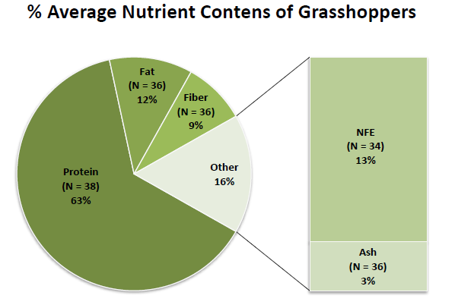
Introduction
Health
Miscellaneous
Nutrition
Environment
Summary
N.A.
Notes:
Here is the nutritional composition of four species of grasshopper (popularly consumed). So you can clearly see that all of them are rich source of proteins and some of them are rich in lipids. Now this is the average nutritional composition of grasshoppers derived from literature. N presents the number of data taken into account. NFE is nitrogen free extract which corresponds to carbohydrates. So you can clearly see that grasshoppers are rich protein source and have considerable amount of lipids.

Slide 8
Introduction
Health
Miscellaneous
Nutrition
Environment
Summary
Essential Amino Acid Content of Some Edible Grasshopper Species (mg/g protein)
Species | His | Ile | Leu | Lys | Met | Phe | Try | Thr | Val
Boopendon flaviventris | 24 | 47 | 88 | 55 | 18 | 41 | 74 | 44 | 57
Patanga succinata | 13.5 | 32.7 | 59.5 | 35.7 | N.A. | N.A. | N.A. | 22.3 | 35.6
Sphenarium purpurascens | 22 | 42 | 89 | 57 | 25 | 103 | 63 | 31 | 57
Taeniopoda auricornis | 14.8 | 41.2 | 42.5 | 41.5 | 18.9 | 51.2 | 76.4 | 20.6 | 49
Requirements in human | 15 | 30 | 59 | 45 | 16 | N.A. | N.A. | 23 | 39
Notes:
So here we see the essential amino acid content of grasshoppers, in the last row, we have the recommended daily uptake levels from WHO. So you can clearly see that grasshoppers are rich in essential amino acids.
In the graph below you see the fatty acid composition of some grasshopper species. To simplify I have grouped fatty acids into Saturated Fatty Acids, Monounsatured Fatty Acids and Polyunsaturated Fatty Acids. So you can clearly see the most of the grasshoppers are Rich in MUFA+PUFA.

Slide 9
Introduction
Health
Miscellaneous
Nutrition
Environment
Summary
Other components
Minor Component | Species | Amount | Requirement in Humans
Calcium | Zonocerus variegatus | 552 mg/100g | 1300 mg/day
Iron | Melanoplus femurrubrum | 37 mg/100g | 7.5-58.8 mg/day
Vitamin A (Retinol) | Zonocerus variegatus | 814.5 µg/100g | 500-600 µg/day
Vitamin B2 (Riboflavin) | Ruspolia differens (brown) | 1.4 mg/100g | 1.2-1.3 mg/day
Other components
Analysis of lipids from Ruspolia differens revealed the presence of 7.4% and 9.3% phospholipids (based on total lipids) in the green and brown variant respectively.
Sphingolipids (glucocerebrosides) were reported in the head of differential grasshopper, Melanoplus differentialis.
Notes:
Ok now lets quickly talk about other components. I have taken 4 examples from the literature about the minerals and vitamins & compared them with the recommend daily intake by WHO. So we can see that some grasshoppers are rich source of minerals like Ca and Fe and also vitamins.
Besides, they have been also detected with some minor components like phospholipids and sphingolipids. They are responsible for lowered cholesterol adsorption in body, for healthy skin, etc.

Slide 10
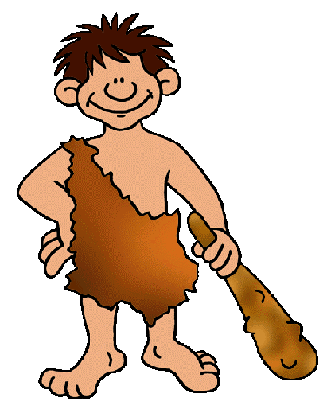

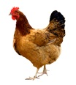

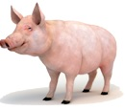
Introduction
Health
Miscellaneous
Nutrition
Environment
Summary
Risk of Zoonotic Infections
Risk of Zoonotic Infection via Livestock as Food
Bovine Spongiform encephalopathy
BSE
Avian Influenza
H5N1
Swine Influenza A
Genetically much more distant to grasshoppers so risk of infections from them is lower
Notes:
Now moving on to the health part. We have seen that the consumption of conventional meats has always been associated with some infections. Consumption of chicken is associated with avian flu, pork with swine flu and beef with BSE. But the cases of such zoonotic infection have never been reported from the insect eating population. Probably because insects are genetically much more distant to humans. We and all other animals come in animilia kingdom and for there viruses to grow in our body is really easy.

Slide 11




Introduction
Health
Miscellaneous
Nutrition
Environment
Summary
Therapeutical Uses
Lip cracking remedy
(Schistocerca gregaria )
Bring cattle into heat
(unspecified species)
Treatment of kidney disease (Sphenarium spp., Taenipoda sp. and Melanoplus sp. )
Treatment of nutritional disorders, post birth anemia and some lung disease (Schistocerca spp.)
Treatment of violent headache
(unspecified species)
Notes:
Grasshoppers are also used for medications in many part of the world.
For example in India body oil from Schistocerca gregaria is used as a remedy for lip cracking. While in Gujarat when the cattle don’t come in heat, people make them eat 2-3 grasshoppers and they come to heat within few days.
In Mexico, the legs of these 3 species are powdered and mixed with water. This mix is consumed for treatment of some kidney disease. Grasshopper are commonly consumed to treat mal nutritiona, post birth anemia and some kind of lungs disease
In Zaire, grasshopper powder is used to treat some kind og violent headaches.

Slide 12
Introduction
Health
Miscellaneous
Nutrition
Environment
Summary
Bioaccumulation- specially heavy metals
Some grasshoppers (Zonocerus variegtus nymphs) are toxic- proper cooking required
Legs need to be removed- else surgery required after ingestion
Food Safety
Notes:
Now common even virat kohli is not able to march towards victory in every match. So even some food safety are associated with grasshopper as food.
The grasshopper typically feed on the crops which have been treated with pesticides, so there are case of bioaccumulation. The heavy metals accumulated in grasshoppers have been a matter of concern. They can cause heavy matter induced disorders in humans.
Some species of grasshopper at some stage of life produce some metabolite which can be toxic to humans. Proper cooking is required to deactivate these toxin. For example in the case of Zonocerus variegtus, its nymps are toxic. But they are still a delicacy in central africa.
Legs of the grasshoppers need to be removed before consumption, else surgery is required to take them out.

Slide 13
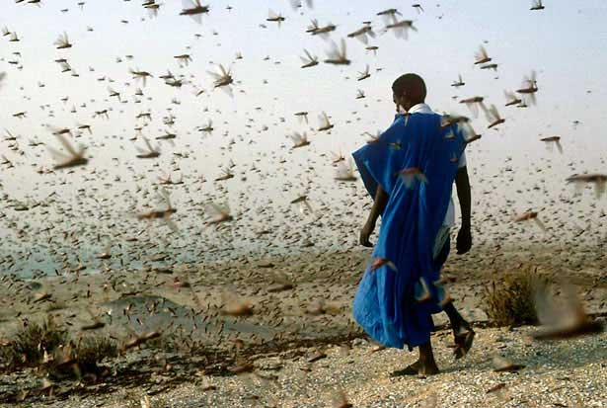
Introduction
Health
Miscellaneous
Nutrition
Environment
Summary
Grasshoppers as pests
Sphenarium purpurascens
(Mexico)
Patanga succinata
(Thailand)
Case Studies
Notes:
Grasshopper usually appear as pests, they accumulate in large number and make large locusts swarms. They destroy all the crops which come in the way. The mention of these swarms is also there in bible. So if eat them we reduce there population and resist them to do harm to the crops. I will explain this with two case studies.
Case study from Mexico. Sphenarium purpurascnes is a pest in Mexico and they is commonly eaten as food. The control fields in this study were one with pesticides used and the experimental fields were the one with no pesticides used. So in the control fields we had the crops, that also with the risk of pesticide residues in the crops. In the experimental fields we had the crops (with lesser risk of pesticide residue) and grasshoppers. The economic and ethical provisioning was much more from the experimental fields then control fields.
Like 40 years back, in Thailand there was an outbreak of Patanga succinata. They sprayed pesticides but grasshoppers were becoming resistant to pesticides and risk of pesticide residues in crops was increasing. So Thai govt launched a system campaign to promote this species as food. As a result the population was significantly reduced, less harm to crops and now this is one of the delicacy in Thailand.

Slide 14
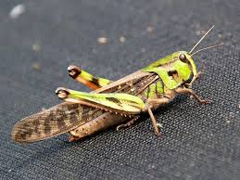
Introduction
Health
Miscellaneous
Nutrition
Environment
Summary
Greenhouse Gas and Ammonia Emission
Total Human Induced Emissions
Livestock Production
Greenhouse gas and Ammonia Emissions
CH₄ from enteric fermentation and manure
NO₂ from feed production and manure
Locusta migratoria
Much less greenhouse gases and Ammonia emission than commercially reared livestock
Other Consequences
Atmospheric NH₃ emission
Eutrophication of surface water
Acidification of soil
Notes:
Out of total human induced greenhouse gas and ammonia emissions, emission from livestock production has the major share. Methane from enteric fermentation and manure & nitrogen dioxide from feed production and manure have major impact on environment. These emission are maximum in case of cows, then pigs and lastly poultry. Some other consequences are atmospheric amonia emission, eutrophication of surface water and acidification of soil.
There is only one grasshopper which is breeded commercially Locusta migratoria, which has much lower ammonia emissions in comparison to conventional livestock.

Slide 15

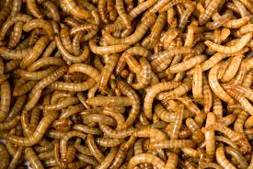
Introduction
Health
Miscellaneous
Nutrition
Environment
Summary
Water Requirement
Disposal of Dead Organic Waste
Schistocerca gregaria
Carnivory or Necrophagy
Melanoplus foedus
Taneniopoda eques
Thousands of litre of water is required to produce 1kg of meat (for beef 22,000 – 43,000 l/kg).
Commercial breeding models can be developed, where dead organic waste or probably even household waste can be used for their production
Yellow mealworms
(no water required for production)
Research is required to confirm this for grasshoppers.
Notes:
Around 20000 to 40000 liters of water are required to produce 1kg meat. Some kinds of insects like yellow mealworm require virtually no water for production. We require research to confirm this thing for grasshoppers.
Some species of grasshoppers follow carnivory or necrophagy. They feed on dead oraganic matter, even on there own dead sibblings. Commercial models may be develop where these grasshoppers can be feed on dead organic matter or even the house hold waste for production.

Slide 16
Introduction
Health
Miscellaneous
Nutrition
Environment
Summary
Religion and Culture
Christianity
1. ´´Yet these may ye eat of every flying creeping thing that goeth upon all four, which have legs above their feet, to leap withal upon earth (Leviticus XI:21)´´
2. ´´Even these of them ye may eat; the locust after his kind, and the bald locust after his kind, and the cricket after his kind, and the grasshopper after his kind (Leviticus XI:22)´´
Islam
´´It is permissible to eat locusts (Sahih Muslim, 21.4801)´´
´´Locusts are game of the sea; you may eats them (Sunaan ibn Majah, 4.3222)´´
´´Locusts are Allah´s troops, you may eat them (Sunaan ibn Majah, 4.3219, 3220)´´.
Jewish Culture
There are many citings in Jewish literature indicating many insects as kosher
With modernization the culture is declining.
Notes:
Religion and culture have also the influence of the consumption of grasshopper as human food. Out of all the insects religious literature of Christian and Muslims only support eating grasshoppers. There is also mention of grasshopper as food in jewish literature but, is decreased with modernization.

Slide 17
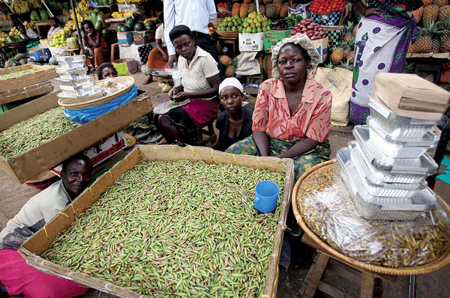
Introduction
Health
Miscellaneous
Nutrition
Environment
Summary
Improvement of Livelihood
Unemployed women and children involved
Nutrition
No investments
Good returns
Food security
Notes:
Grasshopper food supply chain has played an important role in improving the livelihood of the third world countries. Unemployed women and children are majorly involved in this trade. They wake up early in the morning and go to catch grasshoppers.
It play an important role in there nutrition. No investment is required, just go to fields to catch them. They also sell it in the market, in Uganda 1kg grasshopper is even expensive then 1kg chicken or beef. Grasshopper have played an important role in assuring food security.

Slide 18

Introduction
Health
Miscellaneous
Nutrition
Environment
Summary
Farming of Grasshopper
Eating grasshopper is common practice is the tropical parts of world because there:
Insects tend to be larger in size (less quantity can yield large biomass)
Insects often congregate in large numbers (facilitate harvesting)
Large variety of insects are available throughout the year
Farming of Grasshoppers
A laboratory based study on the farming of grasshopper Oxya fuscovittata resulted in a production of 1 kg of biomass in 29-35 days by 84 females.
Future directions
More Research required
Special diets to feed grasshopper for improving biomass quantity and quality

Slide 19
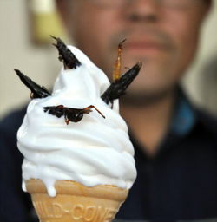
Introduction
Health
Miscellaneous
Nutrition
Environment
Summary
Preparation, Preservation and Marketing
Most of the people eat when and wherever they catch
Legs removed
Cooked with condiments, fried or roasted
Sometimes dried, powdered and mixed with flour
Some tribes make powder and mix with maize flour in porridge
Many companies are trying to develop value added products incorporated with grasshoppers or made completely using grasshoppers to encourage them as food

Slide 20




Introduction
Health
Miscellaneous
Nutrition
Environment
Summary
80 edible species
Important role in food security
Important source of proteins and lipids
Also good source of some vitamins and minerals
Lesser risk of infections & used in some medications
Some health risks also involved
Consumption could result in controlling population without use of harmful pesticides
Production usually generate lower amount of greenhouse gases
Lesser water requirement
Some species feed on dead organic matter, which may reduce environmental load
Consumption is also supported by some religious literature
Grasshopper food supply chain plays important role in improving livelihood in the developing world
Commercial breeding needs to be established to generate sufficient biomass for human consumption
More research is required to promote grasshoppers as future food source

Slide 21
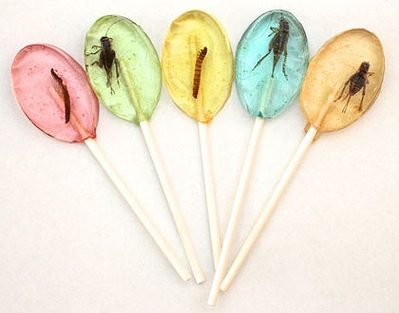
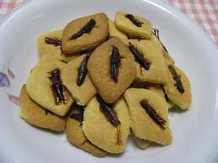
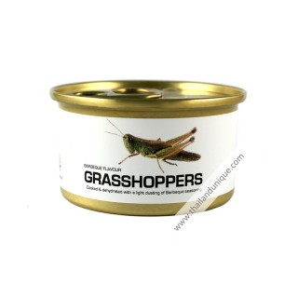
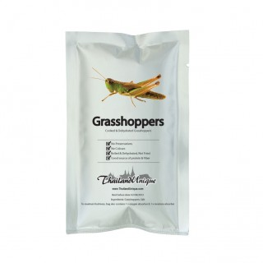
Some Commercially Available Grasshopper Products
Grasshopper Candies
Grasshopper Cookies
Canned Grasshoppers
Dried Grasshopper Sachets
Notes:
These are some of the grasshopper products which are commercial available in the market. The first pic is from a belgian manufactuer, second one is from our lab, last two are processed grasshopper products are from thailand.

Slide 22

Sponsored by
Contact details
AgricultureIsLife project 4B
Field border flowering strips as a source for food or non-food compounds
http://www.gembloux.ulg.ac.be/agricultureislife/?page_id=200
Email id: paul.aman@ulg.ac.be
Notes:
So this our sponsorer…. Agricultureislife is a interdisciplinary platform where 20 people coming from 10 different countries are working to improve the global agriculture practices… And these are my contact details…..

Slide 23

Hope I’ll play an important role in future food security

