Slide 1
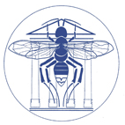
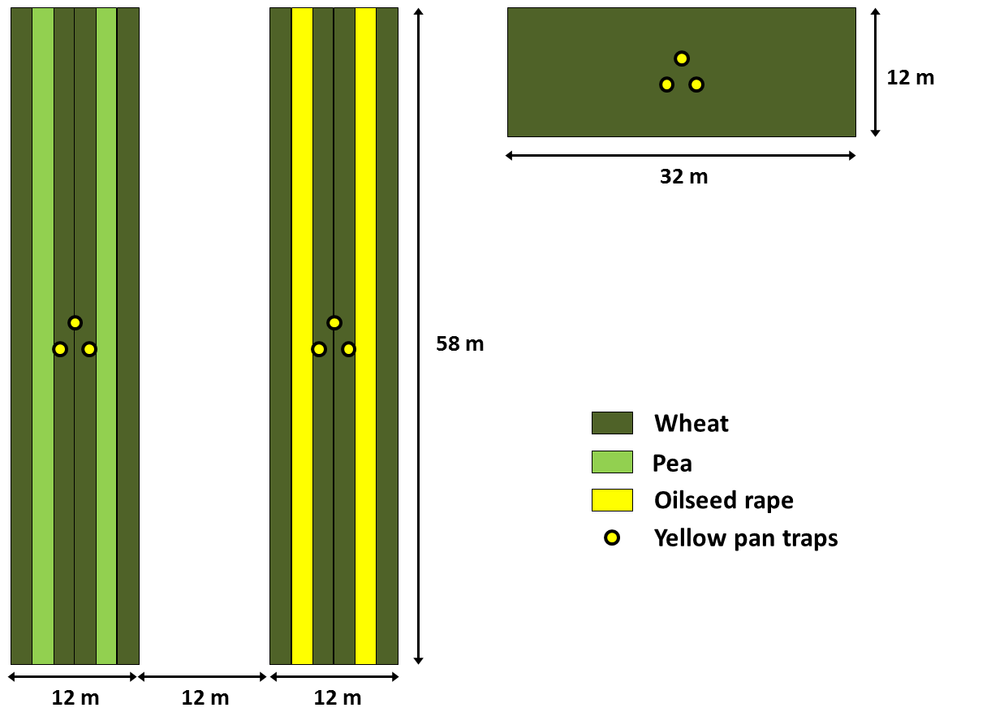
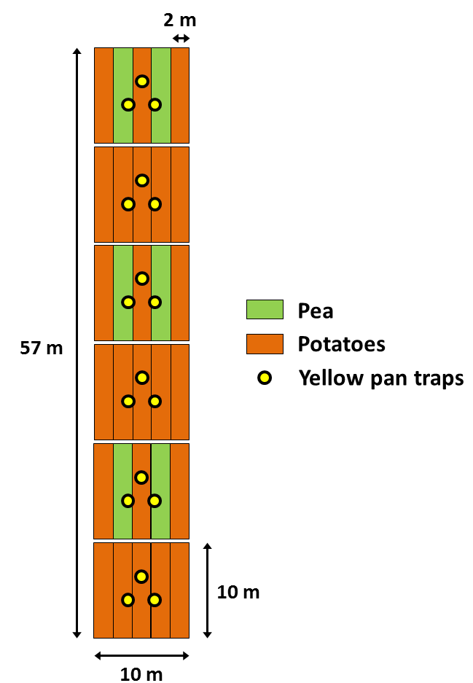
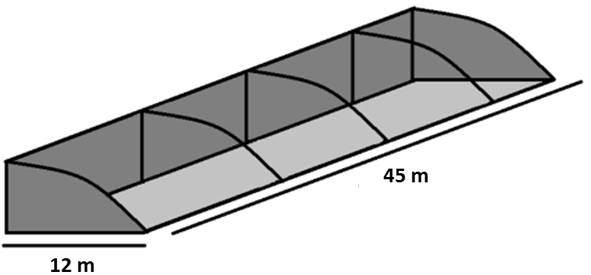
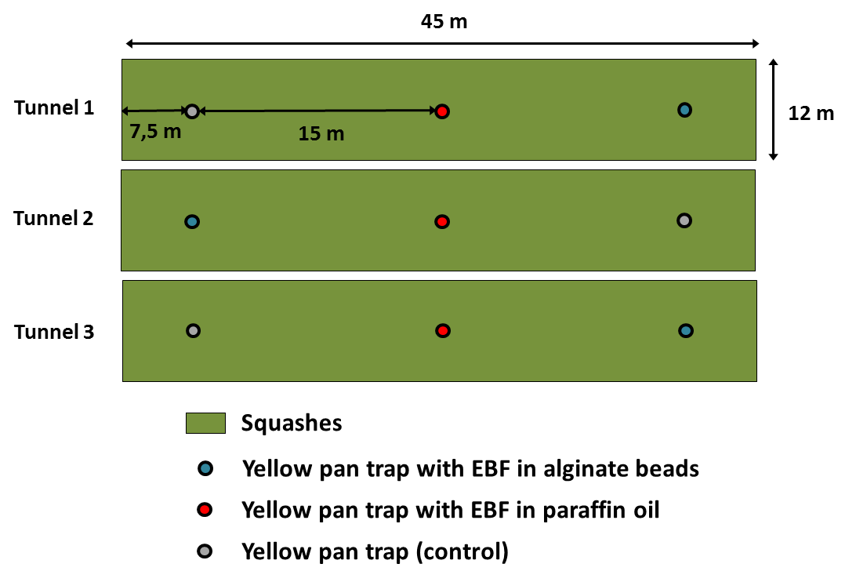
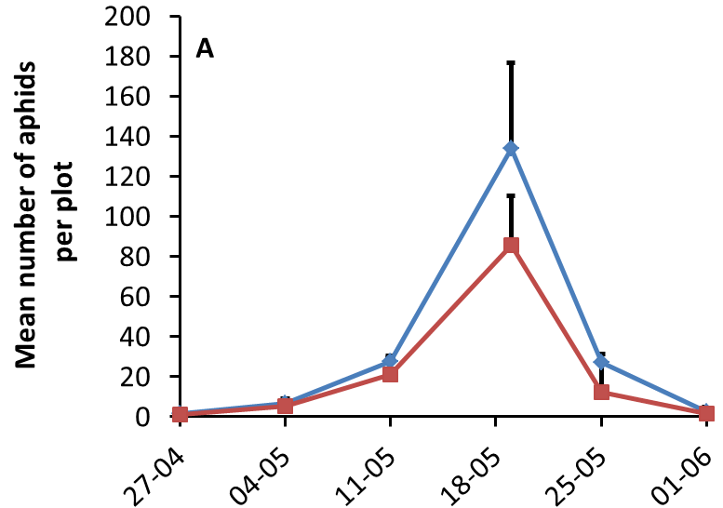
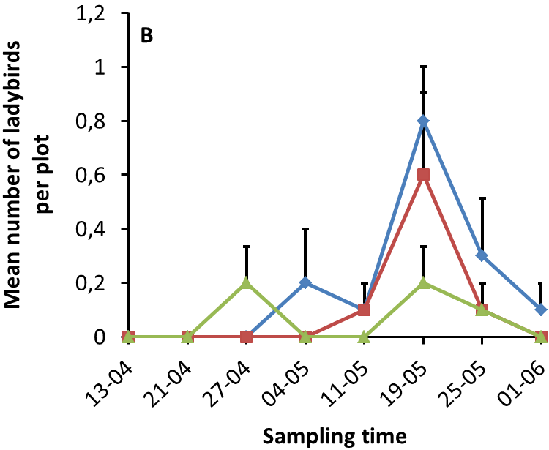
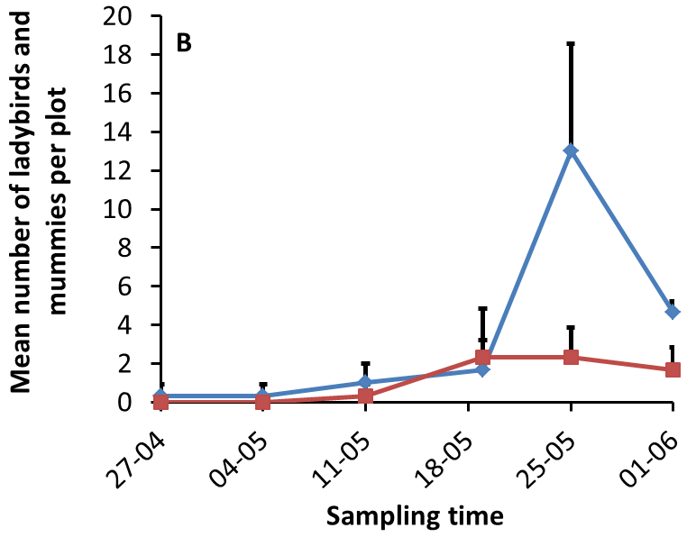
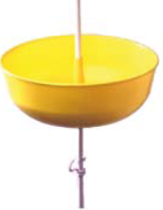
Biological control of aphids in wheat and vegetable crops: a multi-approach case study in Shandong province (China)
Thomas Lopes¹, Emilie Bosquée¹, Julian Chen², Liu Yong³, Claude Bragard⁴ & Frédéric Francis¹
1. Unité d’Entomologie fonctionnelle et évolutive, Gembloux Agro-Bio Tech, Université de Liège, Passage des Déportés 2, B-5030 Gembloux, Belgique. E-mail: entomologie.gembloux@ulg.ac.be
2. State Key Laboratory for Biology of Plant Diseases and Insect Pests, Institute of Plant Protection, Chinese Academy of Agricultural Sciences, 2 West Yuanmingyuan Road, Beijing 100193, P.R. China.
3. College of Plant Protection, Shandong Agricultural University, Taian, Shandong 271018, P.R. China.
4. Earth & Life Institute, Unité de Phytopathologie, Université Catholique de Louvain, Croix du Sud, 2 bte L7.05.05, B-1348 Louvain-la-Neuve, Belgique.
Introduction
Increasing plant diversity within crops can be beneficial for pest control:
resource concentration hypothesis (Root, 1973): specialist herbivores are more likely to find and remain on host plants that are concentrated in dense or pure stands (their visual and olfactory location is expected to be more complex in diverse environments)
enemy hypothesis (Root, 1973): natural enemies are more abundant in complex environments (they can benefit from alternative sources of prey, nectar and pollen, as well as shelter and moderate microclimate)
Semiochemicals can also promote pest control:
The aphid alarm pheromone (E-β-farnesene) has a good potential to repel aphids and simultaneously attract their natural enemies ("push-pull“ effect)
Objective: assess the effect of different crop associations and E-β-farnesene on the populations of aphids and aphidophagous beneficials
Materials and methods
(1) wheat/oilseed rape and wheat/pea associations (2) potatoes/pea association (3) E-β-farnesene in squashes under open plastic tunnels
Each week:
Observation of aphids and aphidophagous beneficials on 10 wheat tillers
Identification of aphid predators and parasitoids collected in the traps
Idem on 10 potato plants
Idem
Idem on 10 squash plants
Idem
Results
(1) wheat/oilseed rape and wheat/pea associations (2) potatoes/pea association (3) E-β-farnesene in squashes under open plastic tunnels
No significant
differences
No significant
differences
***
**
***
**
*
No aphidophagous beneficials were observed
Aphidius gifuensis (Parasitoid) ; Propylea japonica (Predator) ; Harmonia axyridis (Predator)
Few hoverflies and lacewings were trapped
Main species collected in the traps for all experiments:
Discussion
The resource concentration and enemy hypotheses were confirmed for both wheat associations. Therefore, these have the best potential to reduce aphid infestations .
Only the enemy hypothesis was confirmed for the potatoes/pea association . No significant differences were observed for aphids.
None of the hypotheses were confirmed for the E-β-farnesene. The fact that no aphidophagous beneficials were observed is probably due to low plant diversity around the tunnels.
The trapping of adult aphid natural enemies allowed to determine which are the most abundant species in this region.
Référence: Root R.B. (1973). Organization of a plant-arthropod association in simple and diverse habitats: the fauna of collards (Brassica oleracea). Ecological Monographs, vol. 43, 95–124.

