Slide 1
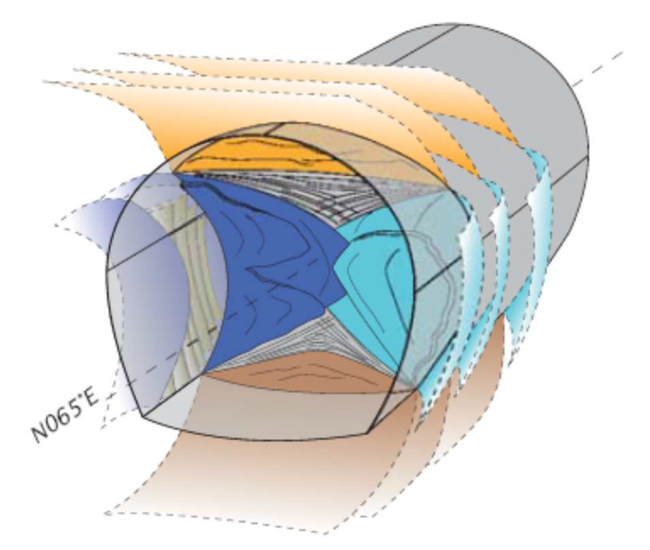
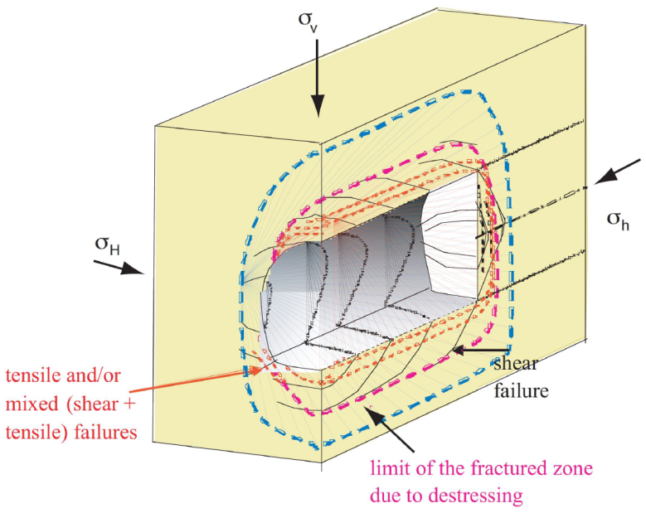
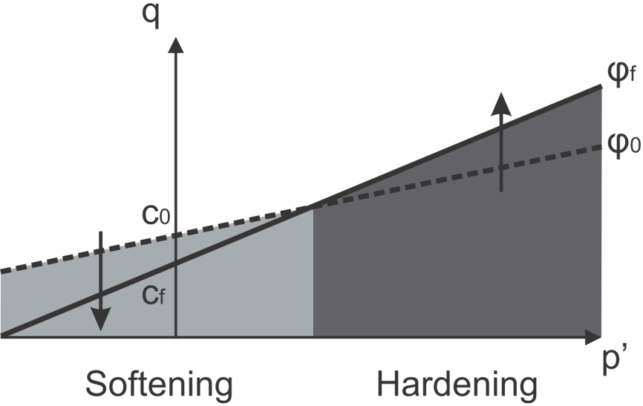
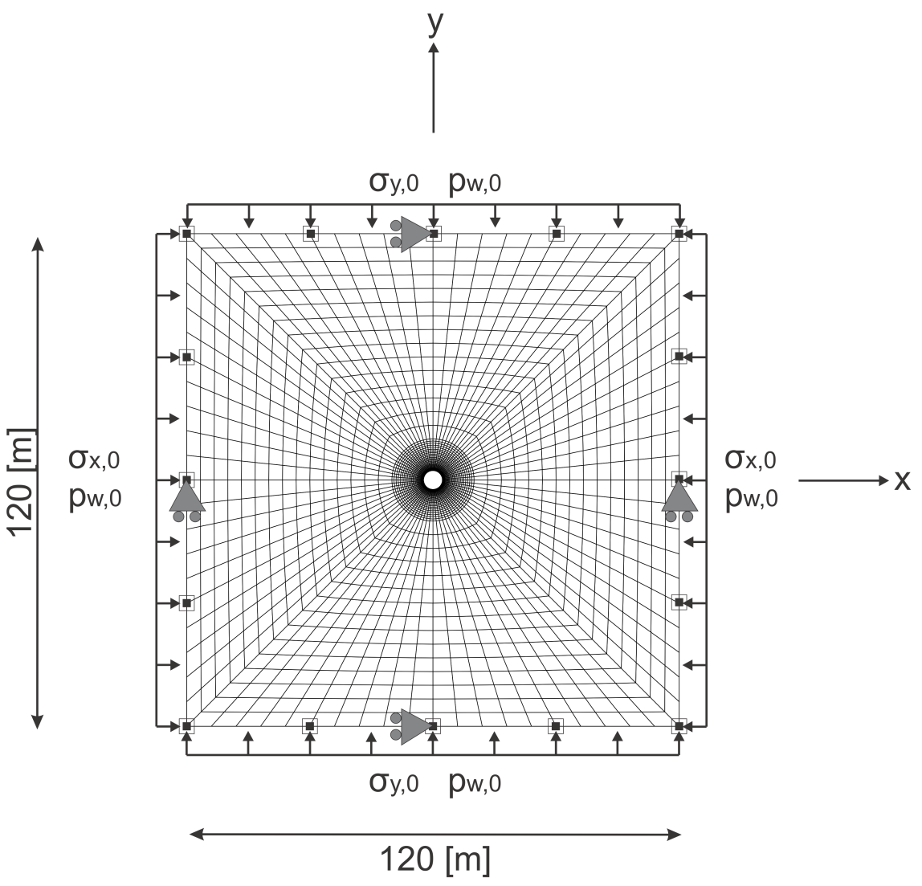
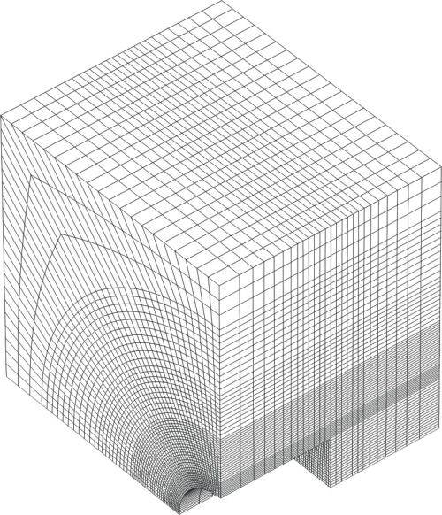
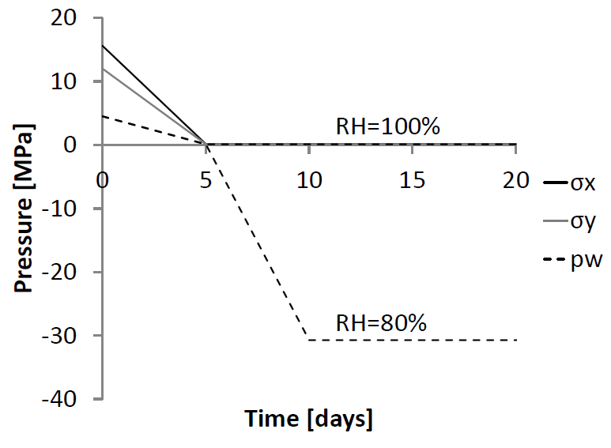
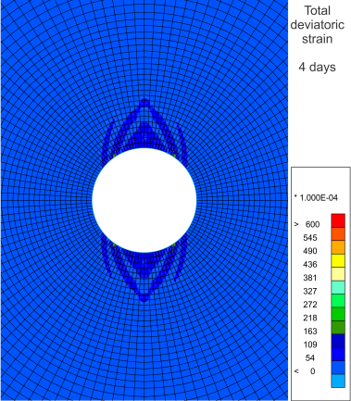
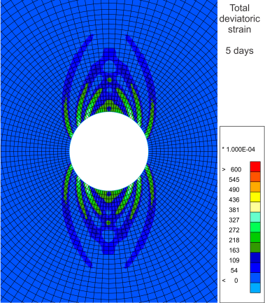
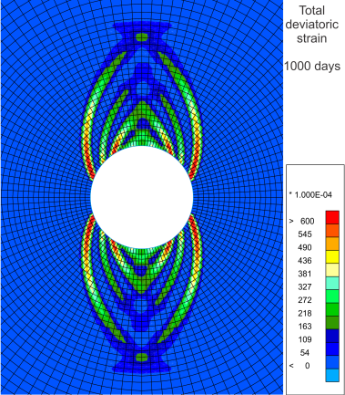
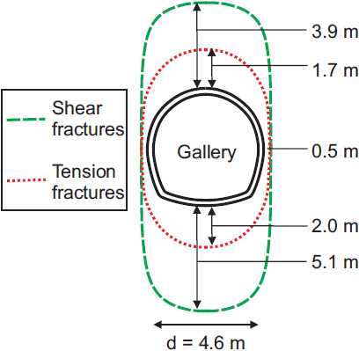
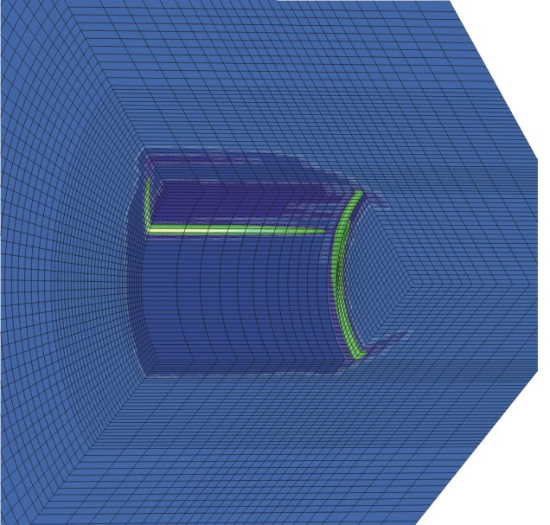
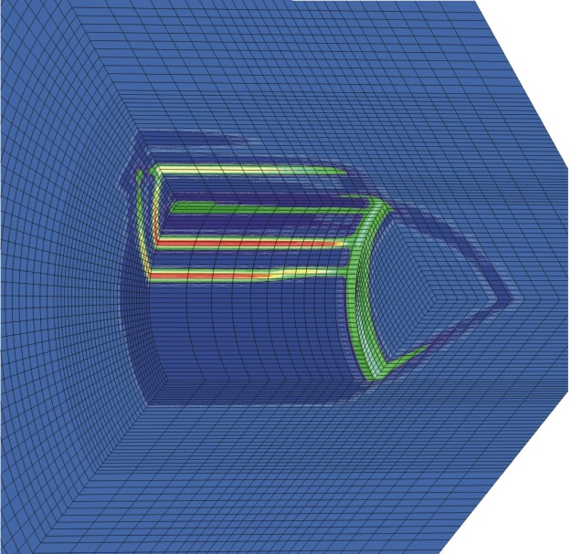
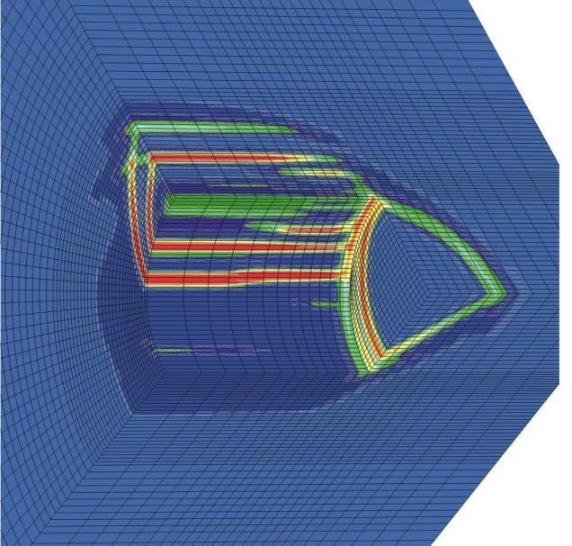
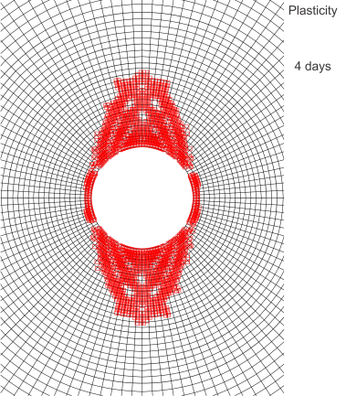
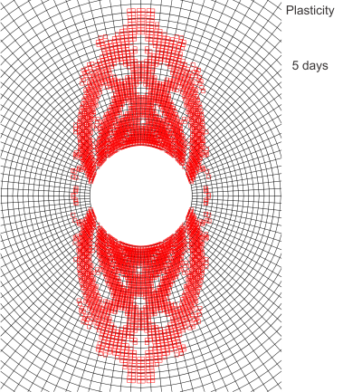
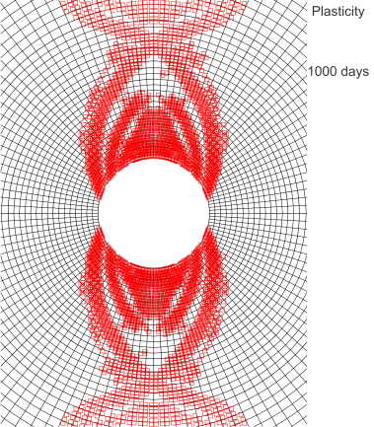
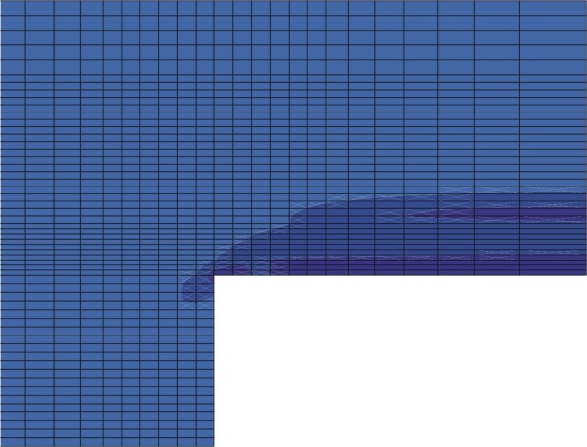
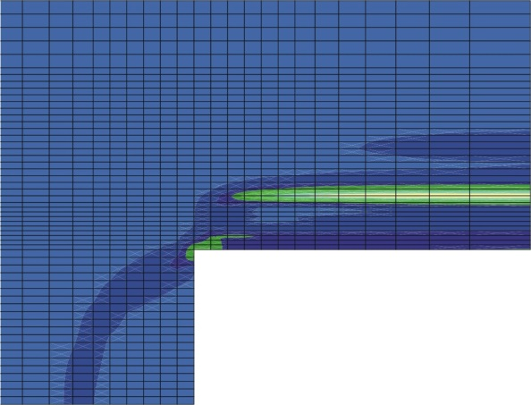
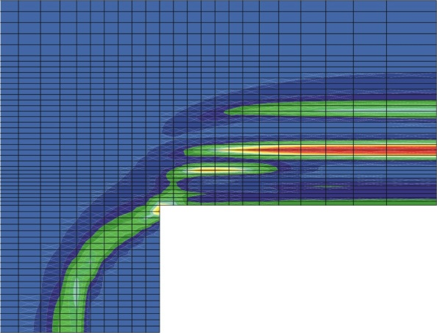
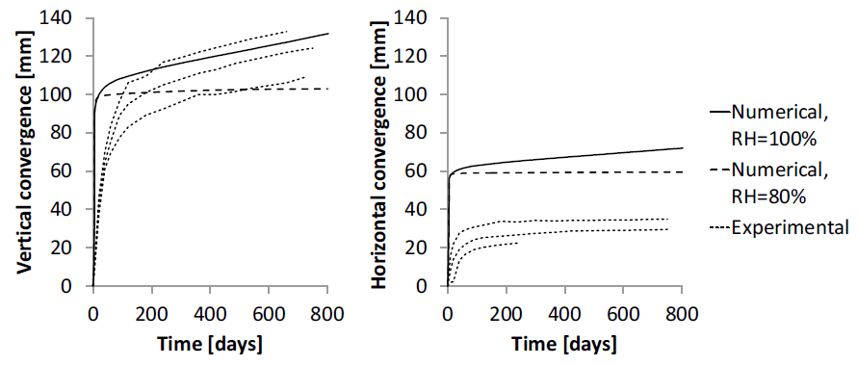
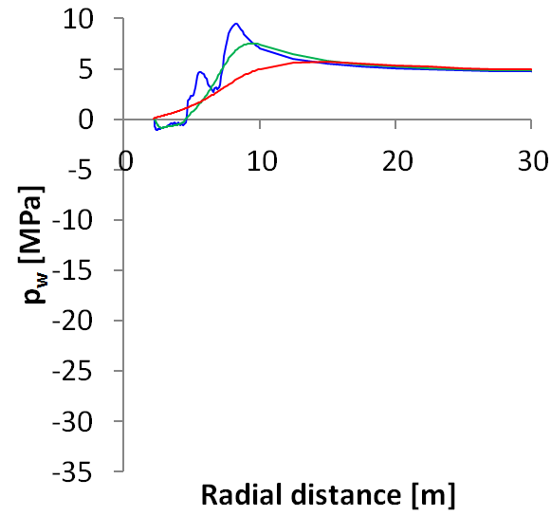
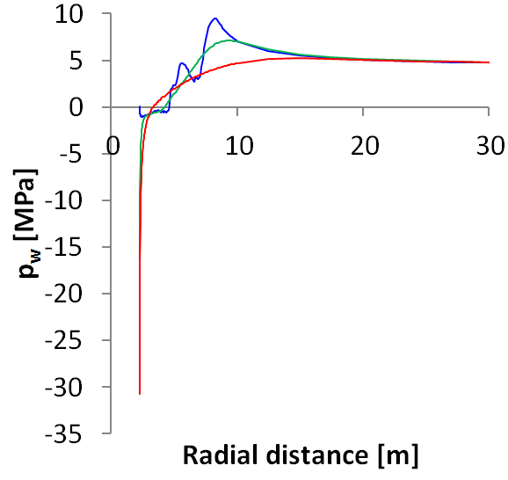
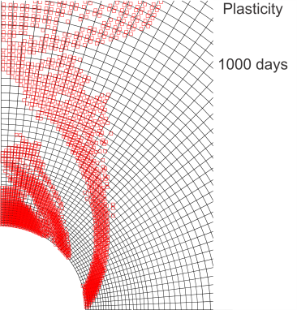
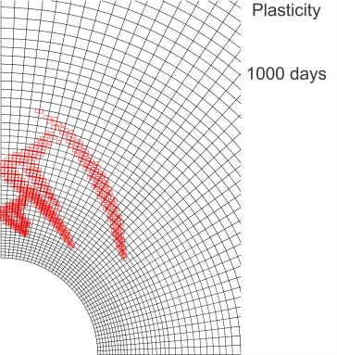
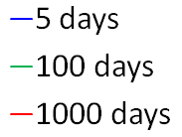
Damage zone modelling due to underground drilling in unsaturated argilaceous rock with shear strain localisation
B. Pardoen¹, S. Levasseur, F. Collin, ULg, Belgium
¹FRIA, F.R.S.-FNRS scholarship holder, b.pardoen@ulg.ac.be
Excavation damaged zone
Origin : Fractures and damage appear around underground
galleries due to drilling and stress redistribution.
Major issues : Prediction of extension and fracturing structure.
Study : EDZ development with shear strain localisation
and gallery ventilation.
Fractures around and at the front of a gallery of the Andra URL (left), extension of shear and mixed fractures zone (right) [1].
Constitutive models
A regularisation method is required to correctly Recent improvements : Elasto-plastic internal friction model.
model the shear strain localisation. The coupled - unsaturated condition (p_{g}=cst) Drucker-Prager yield surface
second gradient local model [2] is chosen. - compressibility of the solid grain skeleton with φ hardening and c softening.
The balance equations are : - permeability anisotropy
Numerical modelling
- 2D plane strain state, HM coupling :
Excavation, ventilation (Kelvin’s law),
anisotropy of permeability and stress state
of the Callovo-Oxfordian claystone.
- 3D state, mechanics only :
Excavation and anisotropy.
No ventilation
Air RH = 100%
12 m
Ventilation
Air RH = 80%
Imposed total stresses and pore water pressure on the gallery wall to model the excavation and ventilation.
12 m
R: 2.3 m
5 m
5 m
Results
- Localisation zone :
Fracturing pattern and extension as in situ. Localisation bands appear during excavation.
Chevron fractures concentrated above the gallery due to the anisotropic stress state.
- Convergence : - Pore water pressure : - Plasticity zone :
Anisotropic because of the shear strain localisation. Influence of the localisation bands Ventilation inhibits the localisation
Ventilation limits the convergence after excavation. Influence of the ventilation. close to the gallery.
Good matching in the vertical direction.
Meshes and boundary conditions in 2D plane strain (left) and 3D (right) state.
4 days | 5 days | 1000 days
σ/σ₀ = 0.2 | σ/σ₀ = 0.0 | σ/σ₀ = 0.0
3.25 days | 3.75 days | 4.25 days
σ/σ₀ = 0.35 | σ/σ₀ = 0.25 | σ/σ₀ = 0.15
0.066
4.6 m
3.9 m
1.7 m
0.5 m
2.0 m
5.1 m
y
0.5 m
Shear fractures
Mixed fractures
x
z
0.025
0
d = 4.6 m
y
0
2D HM, development of the localisation zone : total deviatoric strain (up), plasticity zone (down) and comparison with in situ measurements (right).
z
3D M, development of the localisation zone : total deviatoric strain in 3D view from the inside of the gallery (up) and longitudinal view (down).
no ventilation
ventilation
Vertical (left) and horizontal (right) convergence with comparaison to experimental measurements [1].
Influence of localisation bands and ventilation on pore water pressure along vertical cross-section : no ventilation (left), ventilation (right)
Influence of ventilation on the plasticity zone : no ventilation (left), ventilation (right)
References : [1] Armand G, Leveau F, Nussbaum C, de La Vaissiere R, Noiret A, Jaeggi D, Landrein P, Righini C (2013 in press) Geometry and properties of the excavation induced
fractures at the Meuse/Haute-Marne URL drifts. Rock Mech Rock Eng
[2] Collin F, Chambon R, Charlier R (2006) A finite element method for poro mechanical modelling of geotechnical problems using local second gradient models. Int J
Numer Meth Eng 65(11):1749–1772

