Slide 1

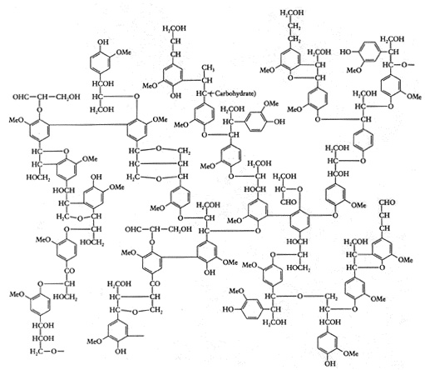
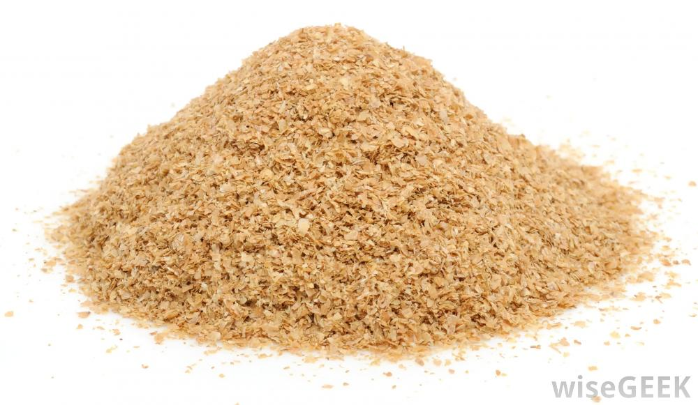
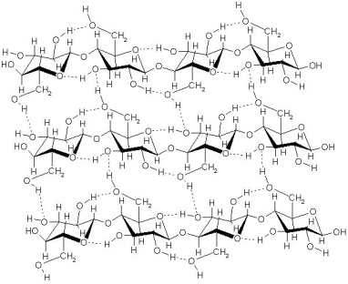
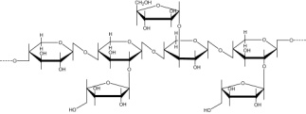
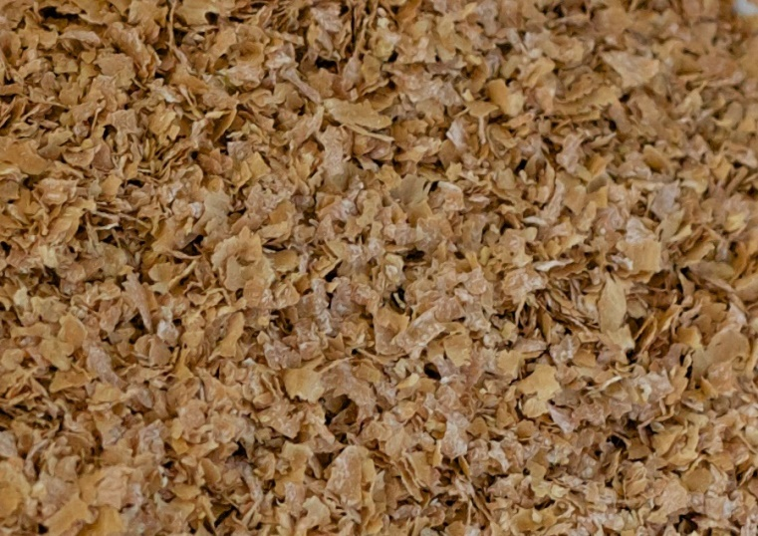
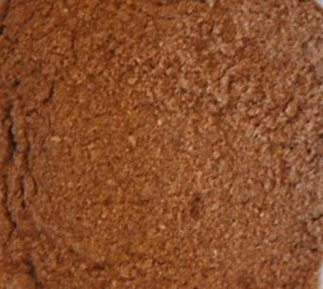
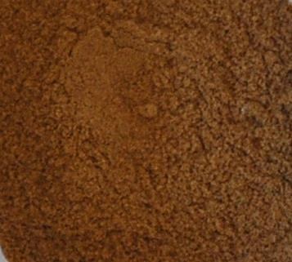
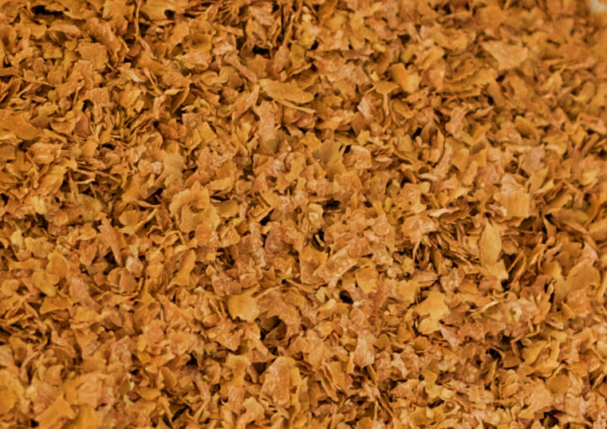
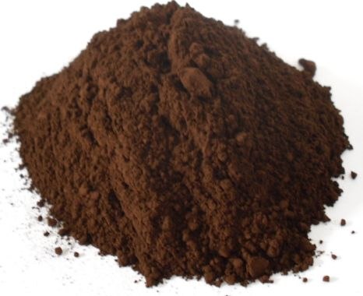
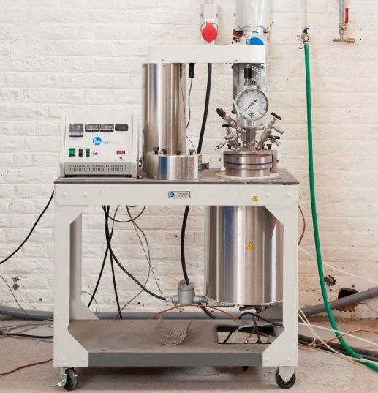
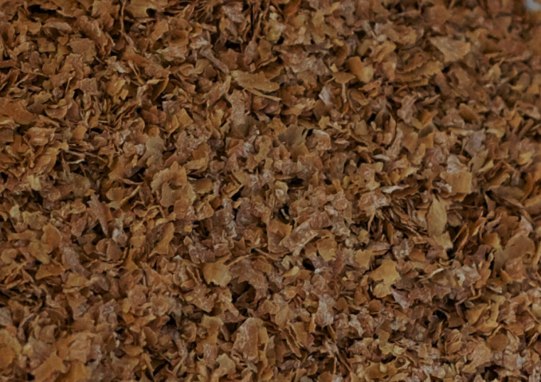
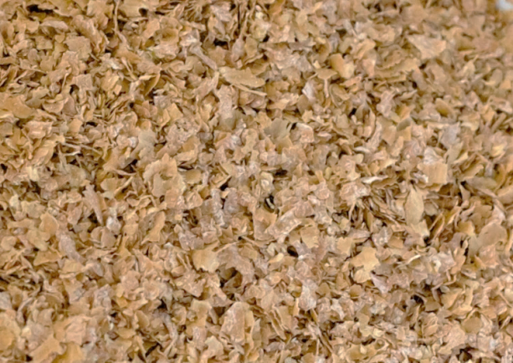
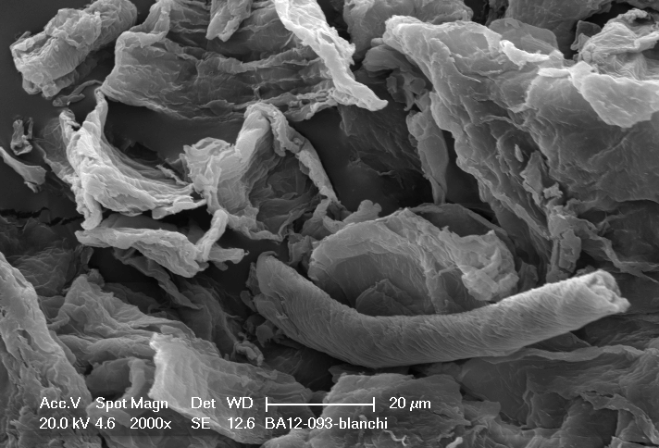





A multi-step process for an alternative wheat bran biorefinery
Unit of Biological and Industrial Chemistry
Mario Aguedoª*, Christian Fougnies^{b}, Aurore Richelª
ªUnit of Biological and Industrial Chemistry, Gembloux Agro-Bio Tech - University of Liège, 5030 Gembloux, Belgium
^{b}Cosucra Groupe Warcoing S.A., Rue de la Sucrerie 1, 7740 Warcoing, Belgium
*mario.aguedo@ulg.ac.be
Wheat bran (WB) is a highly available and cheap agriculture byproduct that constitutes a feedstock of choice for biorefineries. Classical WB biorefining is premised on the fermentation of the monosaccharides from starch and hemicellulose into fuel and chemicals. Here is presented an alternative concept based on a multi-step process aiming at the production of three fractions with high added-value from destarched wheat bran (DWB).
After WB destarching (10 min in water at 95 °C), the DWB underwent an extraction of its arabinoxylans (AXs), then in a second step its lignin was recovered, leaving a solid residue rich in cellulose which could be further bleached and hydrolysed.
LIGNIN
DESTARCHED WHEAT BRAN
CELLULOSE
HEMICELLULOSE
Step 1 : Extraction of arabinoxylans (AXs)
Deesterified Axs, Molecular mass >670 kDa Arabinose/xylose ≈ 1
+ ≈ 7% proteins
DWB
0.44 M NaOH, 80 °C/15 h, under srring
AXs
~20
100
Yields
Solid residue
Water, pH 5, Thermal reactor, 5 °C/min to 180 °C/3 min, 3 times
Ethanol precipitation, filtration 25 μm
Esterified Axs,
2 populations: one main with mol. mass ≈ 5-12.5 Da and a smaller one at 140-160 kDa
Arabinose/xylose ≈ 0.5
+ ≈ 7% proteins
Green polymers for: materials, cosmetics, pharmaceutics,
food,…
Hemicellulose: 47%
Cellulose: 15%
Lignin (van Soest): 8%
Proteins: 12%
AXs + AXOS (AX-oligosaccharides)
Solid residue
~15-20
Food grade
commercial
prebiotic AXOS
Step 2 : Extraction of lignin
Organosolv (107 ºC / 3 or 4.5 h)
formic acid/acetic acid/water (20, 30,40/40, 50, 60/20)
X
No efficient lignin extraction
EDWB
(=DWB exhausted in extractable-AXs)
Hydrothermal treatment in reactor: heating at 148 °C/5 min,
in ethanol/water/H₂SO₄ 6 M (18.4/0.53/1.07)
Mol. mass ≈ 1-2 kDa (THF as eluent by laser light scattering)
Saccharides (gluc.) ≈ 1-3%
Proteins ≈ 2.4-8%
Syringyl/Guaiacyl/p-Hydroxyphenyl ≈ 3.9/3.6/1
~30
Lignin
Cellulose: 50%
Lignin (Klason or van Soest): 30-31%
Hemicellulose: <2%
~8
Solid residue
High-purity lignin for potential high-added-value applications in materials…
Properties to be tested
Step 3 : Obtaining of a cellulose fraction
~15-25
Crystallinity by RX-Diffraction:
NaOH 30%, 80 °C/30 min
Cellulose
85-95%
Bleached and hydrolysed with HCl
FD100* (80-90% cryst.)
Cellulose-rich residue
Hydrolysis HCl 9%, 30 min/100 °C
Cellulose with increaded crystallinity
NaOH-treated and hydrolysed with HCl
~20-25
Bleaching (H₂O₂ 3%/NaOH pH 11.5, 1 h)
Cellulose
85-95%
~5-10
Typical shoulder from crystalline cellulose
Cellulose: 80-90%
Lignin (van Soest): <0.5%
Hemicellulose: <2%
Proteins: 5-6%
SEM image
~13-15
Marketable cellulose fractions for: cosmetics, pharmaceutics, materials, food,…
C200* (50-60% crystallinity)
*commercial cellulose
Conclusions
Here is described an up-scalable multi-step process that could constitute an alternative biorefinery approach to recover high added-value products from wheat bran. Thus, AX fractions of various molecular masses, a high-purity lignin and cellulose fractions of various qualities can be obtained with good yields from destarched wheat bran. The biomass treatments used NaOH and fast and efficient thermal heating; the whole process yields marketable bio-based polymers.
This study was financially supported by the Walloon Region through BARCELONE project (number SPW 6511)
www.gembloux.ulg.ac.be/chimie-biologique-industrielle
Unit of Biological and Industrial Chemistry
Passage des déportés, 2
5030 Gembloux
Tel: +32 81 62 22 31
© CBI – Gembloux Agro-Bio Tech – Université de Liège
Unit of Biological and Industrial Chemistry
© 2014 CBI - Gembloux Agro-Bio Tech - Université de Liège

