Slide 1
From SPUTNIK to Beanie Babies & CubeSats to OUFTI
Prof. Jacques G. Verly
University of Liège, Belgium
TEDxLiège, “Rebirth” event, 12 May 2014

Slide 2
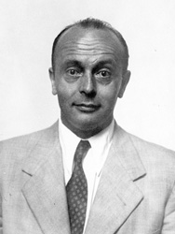
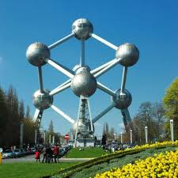
International Geophysical Year
Presided by Belgian
Marcel Nicolet
PhD from
University of Liège
1937
Notes:
International scientific project: 1 Jul 1957 – 31 Dec 1958
Presided by Belgian Marcel Nicolet (PhD in Astrophysics, 1937, University of Liège, Belgium)
Aurora & airglow, cosmic rays, geomagnetism, gravity, ionospheric physics, longitude & latitude determination, meteorology, oceanography, seismology, solar activity
Discovery of Van Allen radiation belts and solar wind
Satellite launches
Eisenhower had indicated that the US would launch artificial satellites during the IGY.

Slide 3
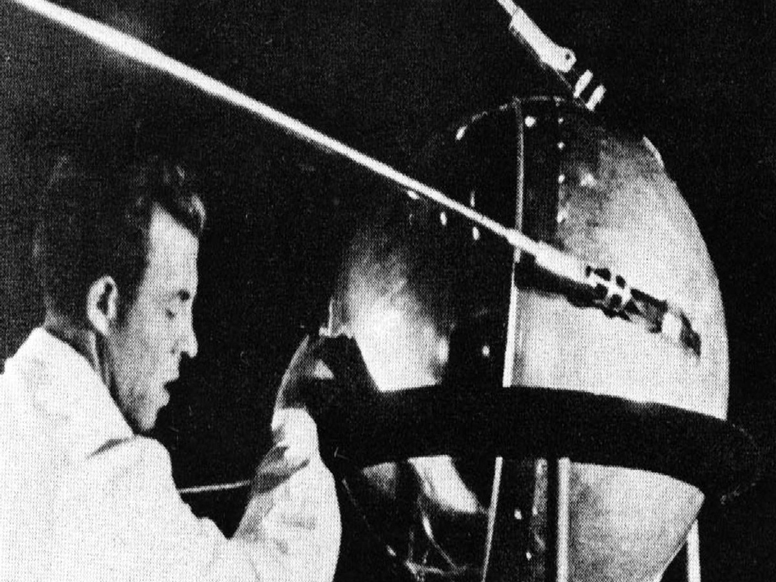
SPUTNIK-1 - 4 Oct 1957
58 cm
83.6 kg

Slide 4
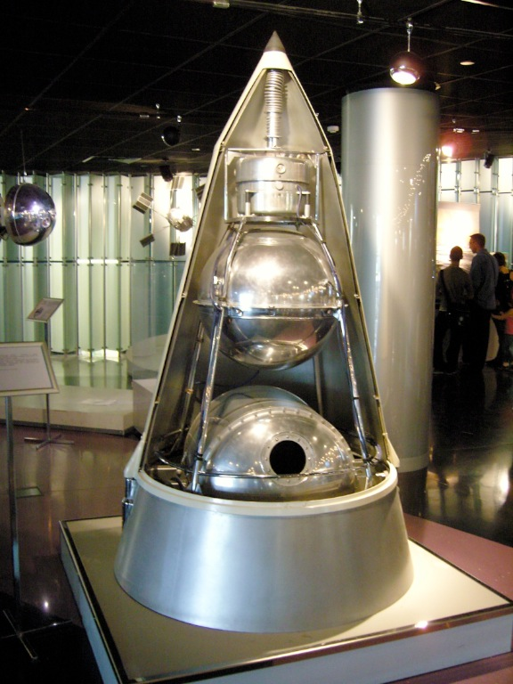
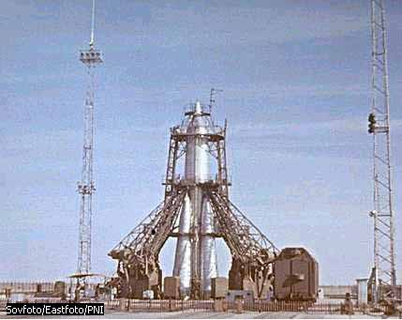
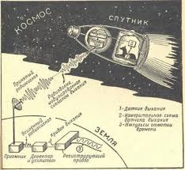
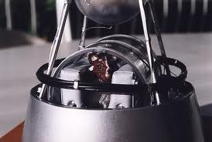
SPUTNIK-2 – 3 Nov 1957
2 x 4 m
508.3 kg
Dog Laika

Slide 5
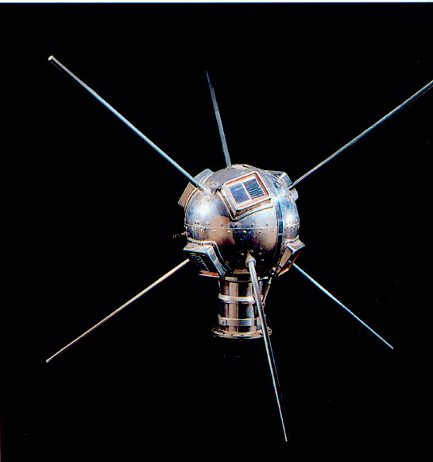
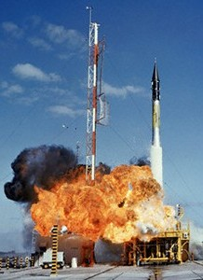
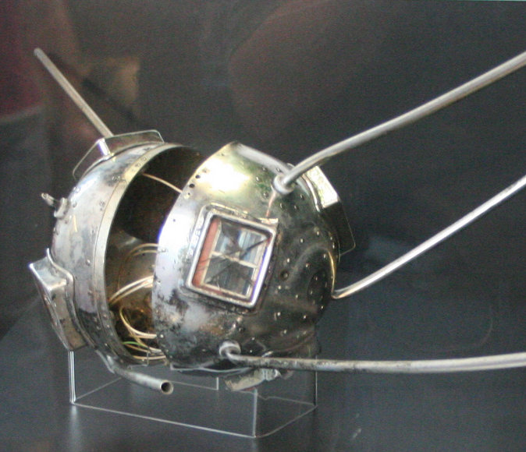
Vanguard TV3 – 6 Dec 1957
16.5 cm
1.47 kg

Slide 6
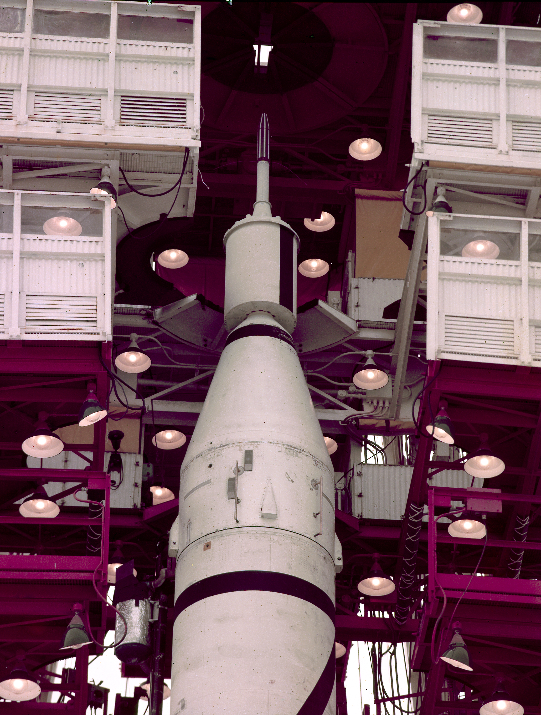
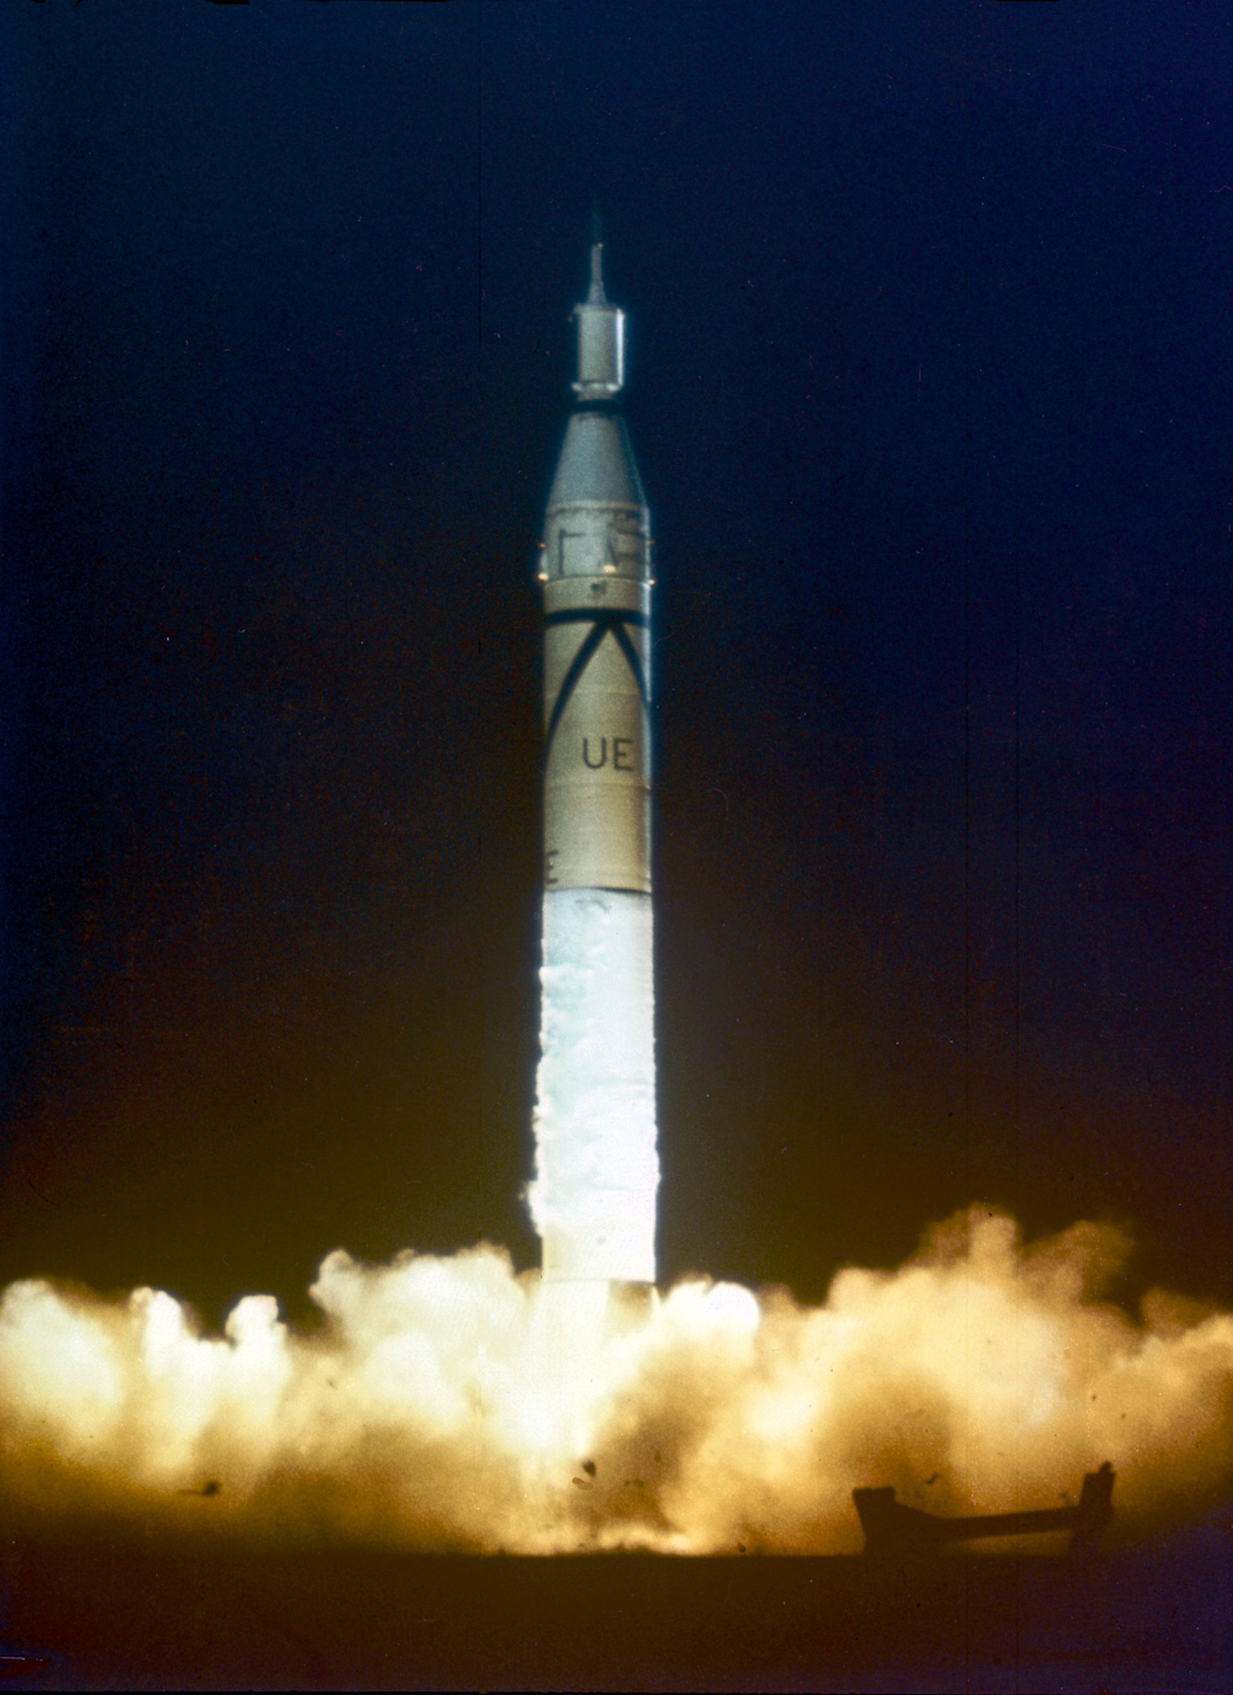
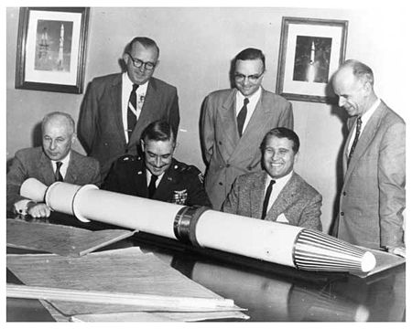
Explorer 1 – 30 Jan 1958
16.5 x 94.6 cm
13.97 kg

Slide 7
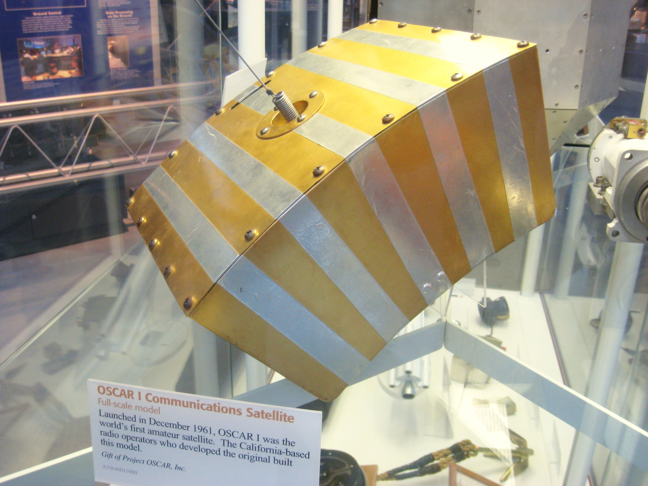
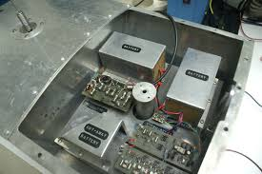
Oscar 1 (amateur radio) – 12 Dec 1961
Orbiting
Satellite
Carrying
Amateur
Radio
30.5 x 30.5 cm
4.5 kg

Slide 8
Big satellites

Slide 9
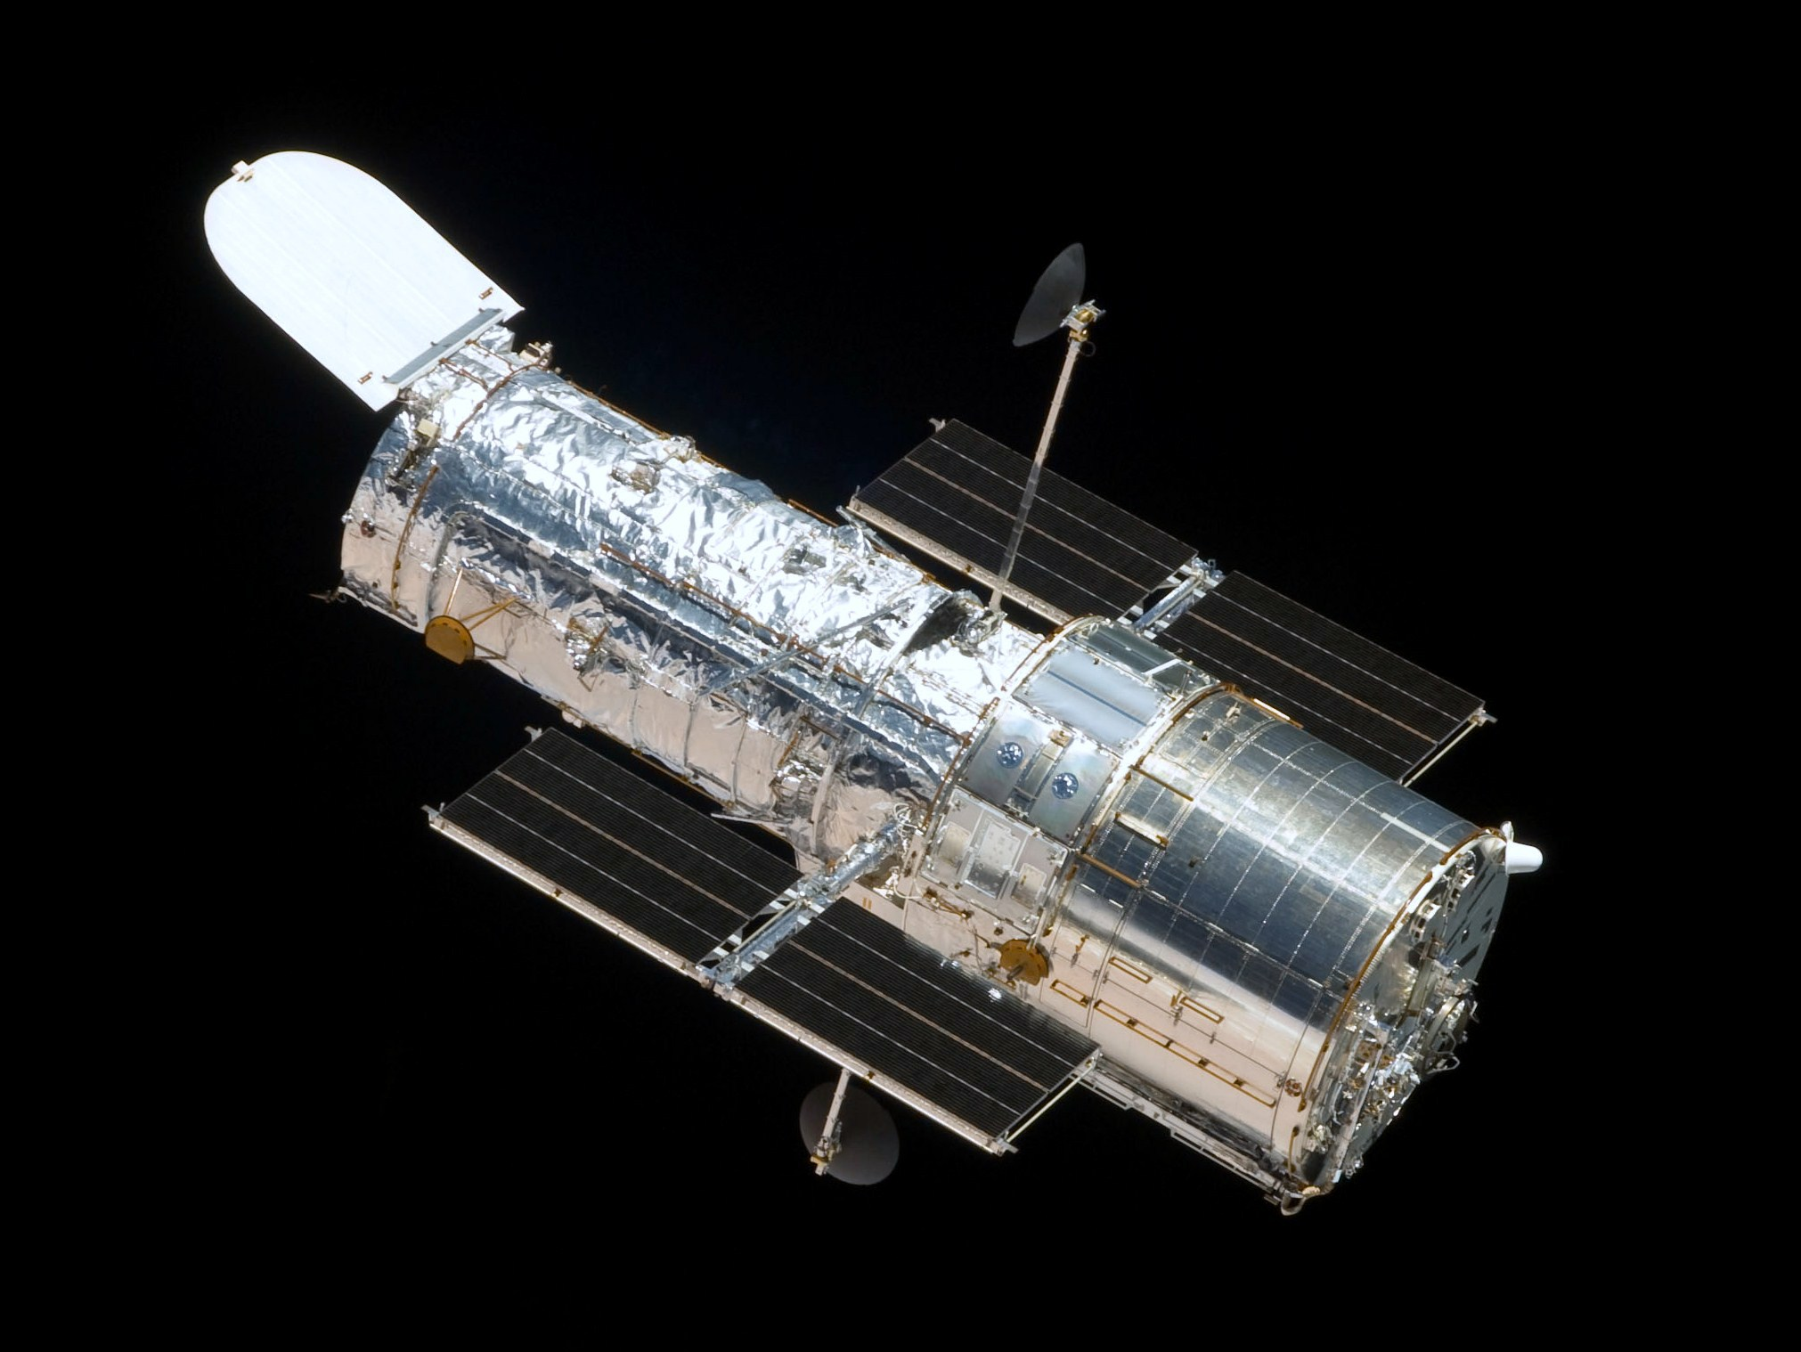
Hubble Space Telescope – 24 April 1990
2.4 x 13.2 m
11,110 kg

Slide 10
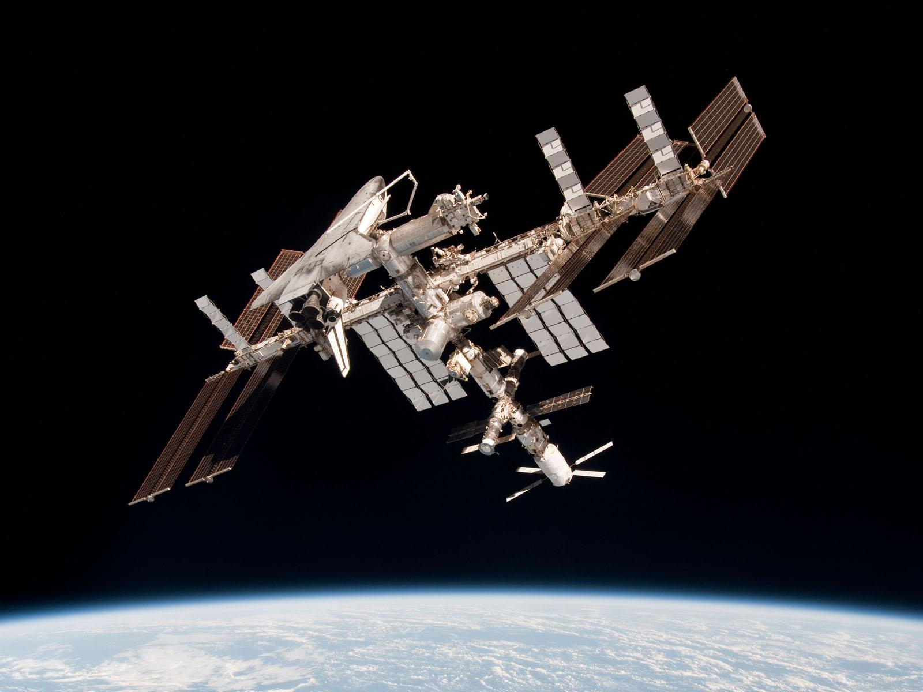
International Space Station (ISS) – 20 Nov 1998
108.5 x 72.5 x 20 m
450,000 kg

Slide 11
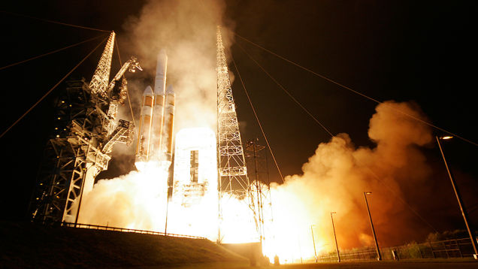
USA-233 (or NRO L-32) – 21 Nov 2010
Thought to be the world’s largest satellite
Operated by US National Reconnaissance Office (NRO) for CIA
7th in Magnum/Orion/Mentor series of spy satellites
Electronic signals intelligence (ELINT)
Large antennas: 100 meters!

Slide 12
USA-233 (or NRO L-32) – 21 Nov 2010
Thought to be the world’s largest satellite
Operated by US National Reconnaissance Office (NRO) for CIA
7th in Magnum/Orion/Mentor series of spy satellites
Electronic signals intelligence (ELINT)
Large antennas: 100 meters!
TOP SECRET

Slide 13
1995: rebirth!

Slide 14
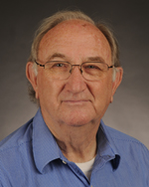
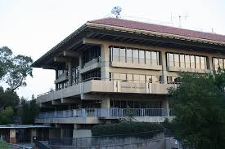
Stanford University, California
Big Dish
Space Systems
Development Laboratory
Prof. R. Twiggs

Slide 15
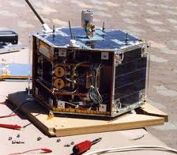
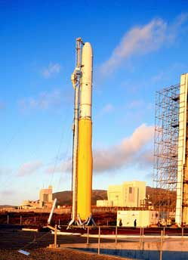
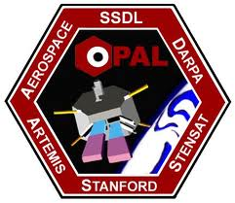
Opal (Stanford University) – 26 Jan 2000
23.5 x 42.0 cm
25 kg
Mothership +
6 daughtership
picosatellites

Slide 16
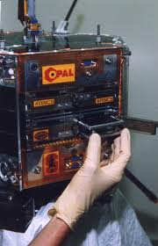
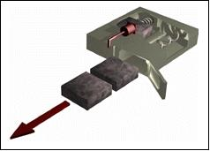
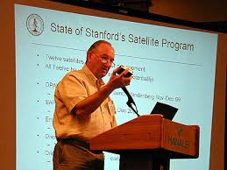
Opal (Stanford University) – 26 Jan 2000
3 x (4 or 8) x 1 inches
7.5 x (10 or 20) x 2.5 cm

Slide 17
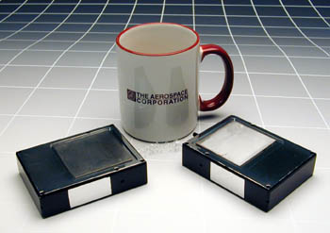
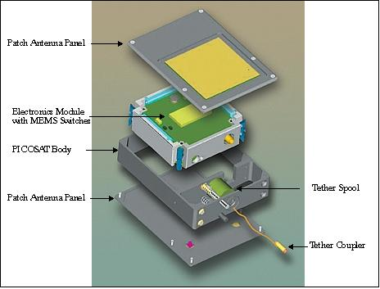
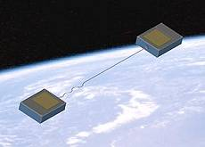
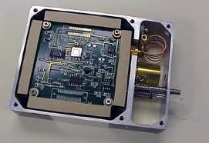
Opal’s daughter picosatellites from Aerospace Corp.
7.5 x 10 x 2.5 cm
250 g

Slide 18
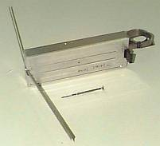
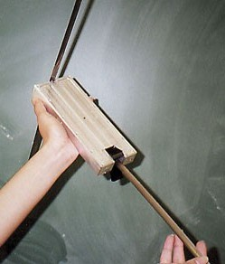
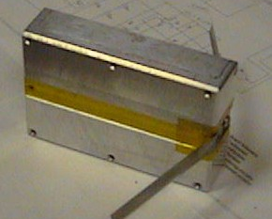
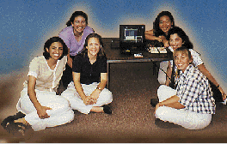
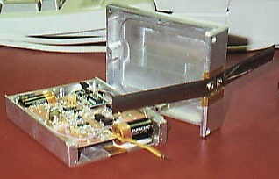
Opal’s daughter picosatellites from Santa Clara Univ.
Thelma & Louise 7.5 x 20 x 2.5 cm
Jak 7.5 x 10 x 2.5 cm
611 gr total
Artemis team

Slide 19
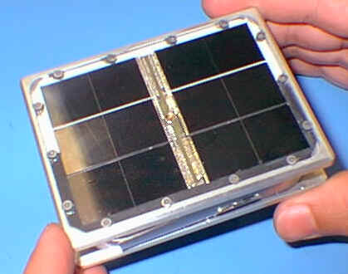
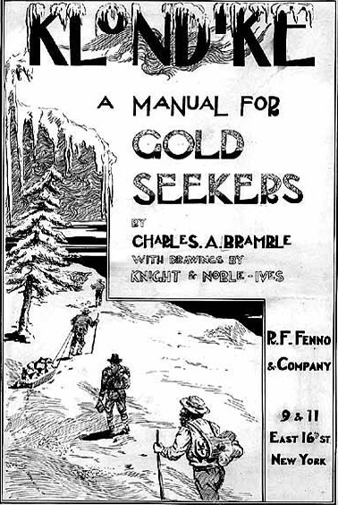
Size of Klondike ice-cream bar!
Stensat 7.5 x 10 x 2.5 cm

Slide 20
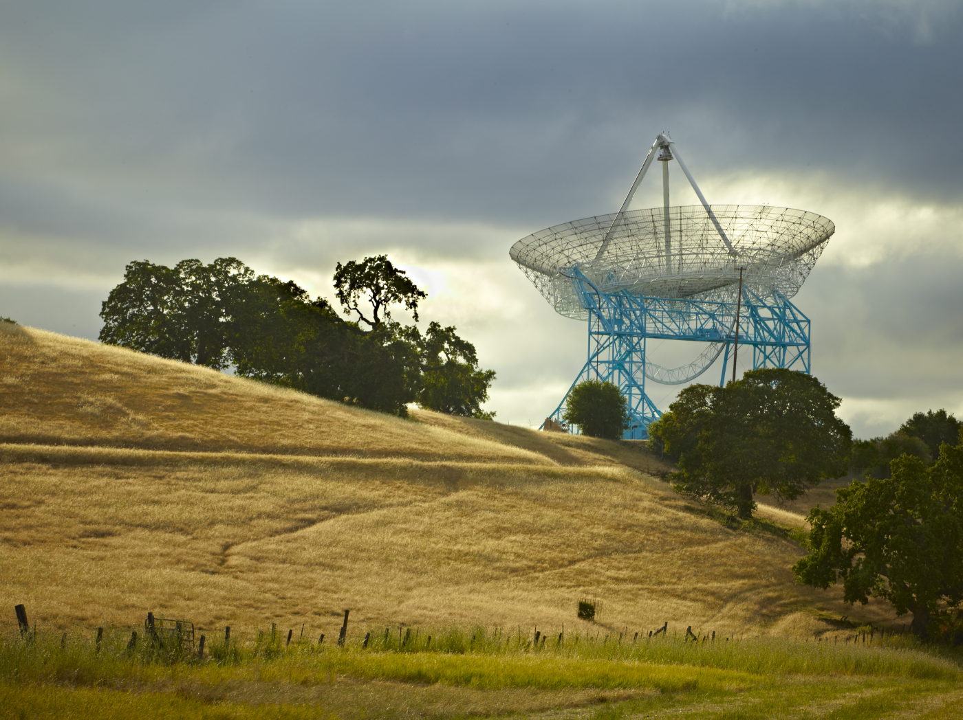
Big Dish (Stanford University) – Build in 1966

Slide 21
The father of (educational) nanosatellites:
Prof. Robert J. Twiggs (Stanford University)

Slide 22
Beanie Babies – late 1993

Slide 23
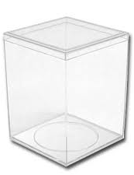
Beanie Baby box – late 1993
4 x 4 x 5 inches
10 x 10 x 12.5 cm
Inspiration for CubeSat shape and size!

Slide 24
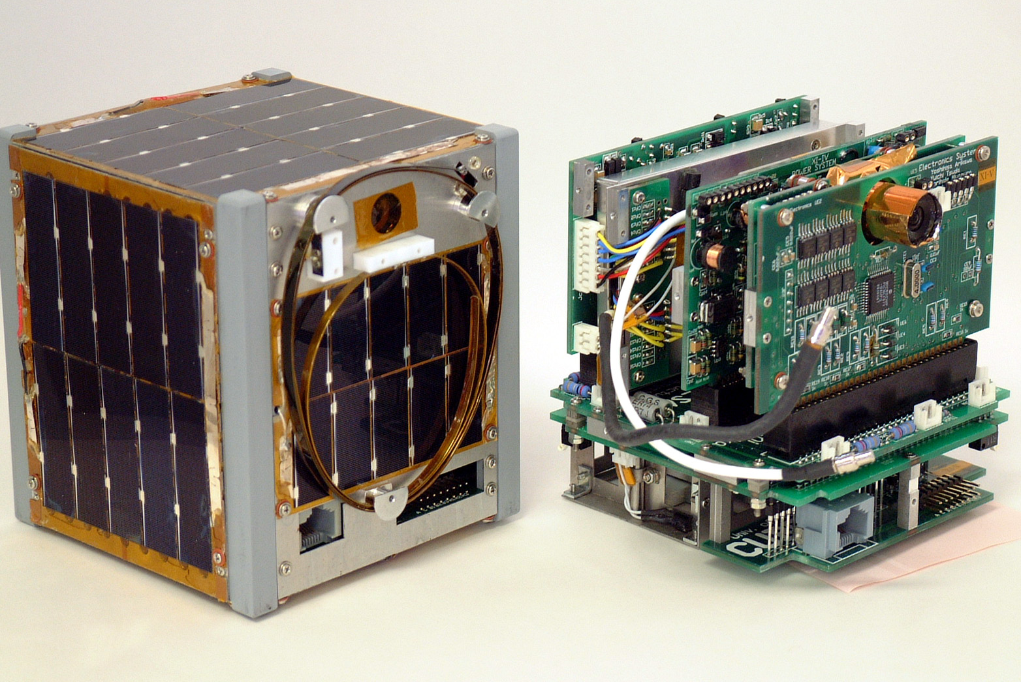
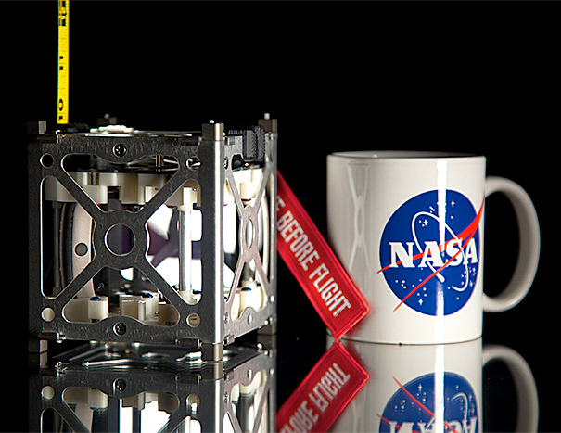
Birth of CubeSat concept – 10-12 Nov 1999 (Hawaii)
Prof.
Bob Twiggs
(Stanford
University)
10 x 10 x 10 cm
(1 liter)
1 kg
1 watt

Slide 25
First CubeSats
launched on
30 June 2003
Notes:
Launched on Rokot launcher.

Slide 26
18 Sept 2007,
University of Liège:
fateful phone call
& start of
OUFTI educational
nanosatellite project

Slide 27
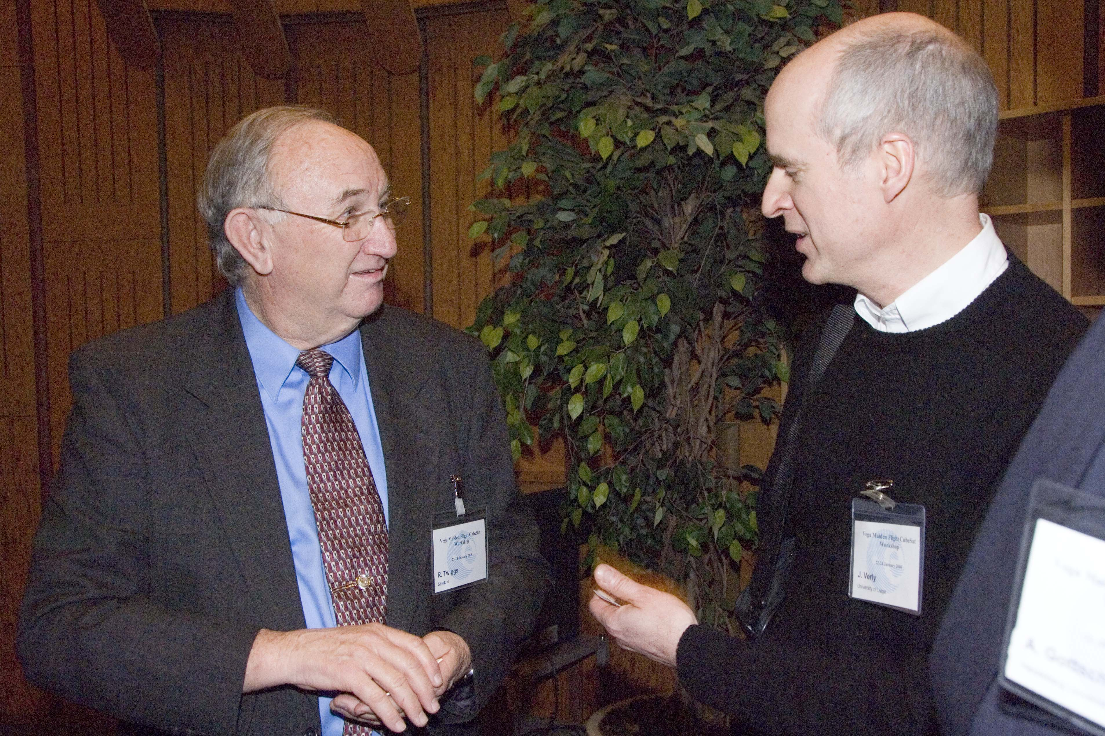
2nd “Vega Maiden Flight” Workshop, NL, 20 Jan 2008
Prof. Twiggs
Prof. Verly
At ESA/ESTEC

Slide 28
OUFTI-1 system
OUFTI-1
VHF
VHF
UHF
UHF
Sat. ext.
Controller
Controller
Gateway
Gateway
Repeater
Internet
Repeater
User 2
User 1
D-STAR zone for University of Liège, Belgium
D-STAR zone

Slide 29
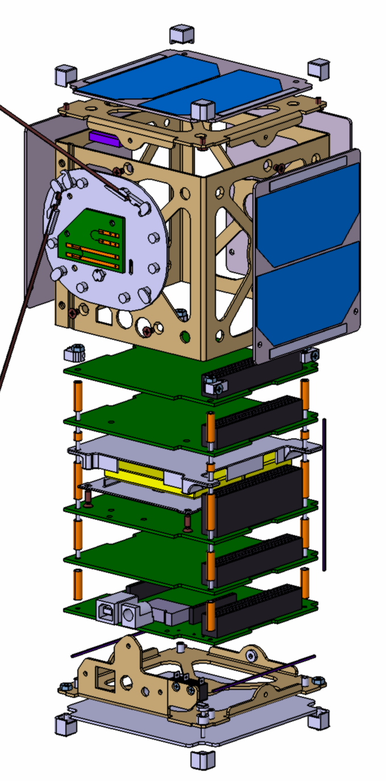
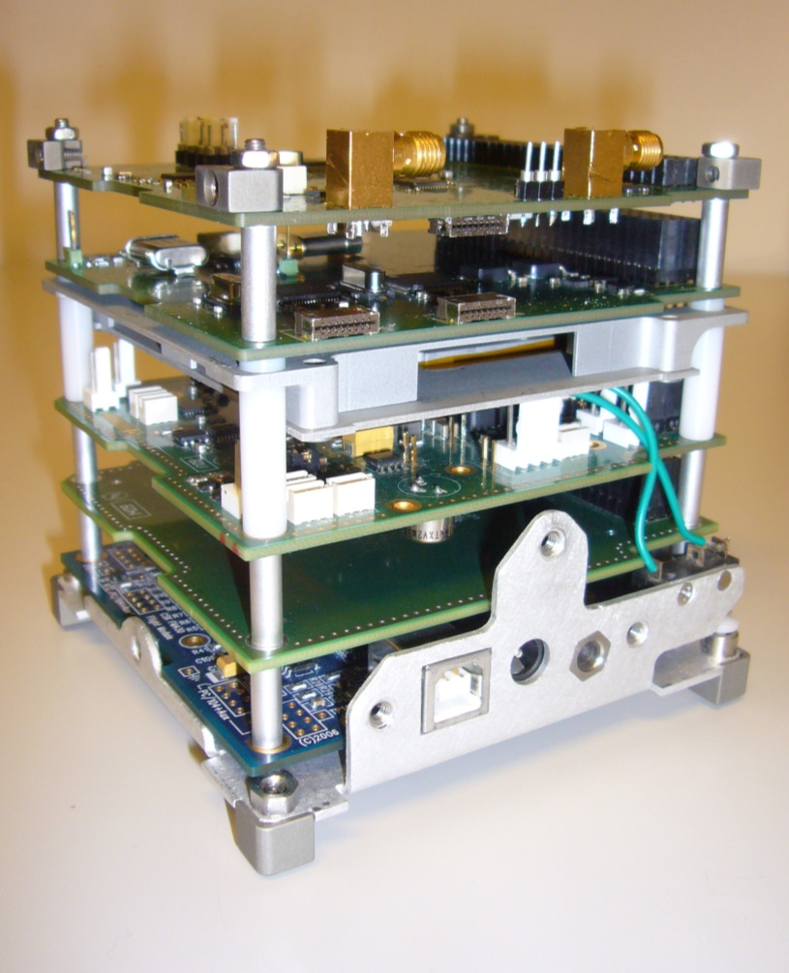
OUFTI-1 nanosatellite/CubeSat
COM
BCN
BAT
EPS
OBC 1
OBC 2

Slide 30
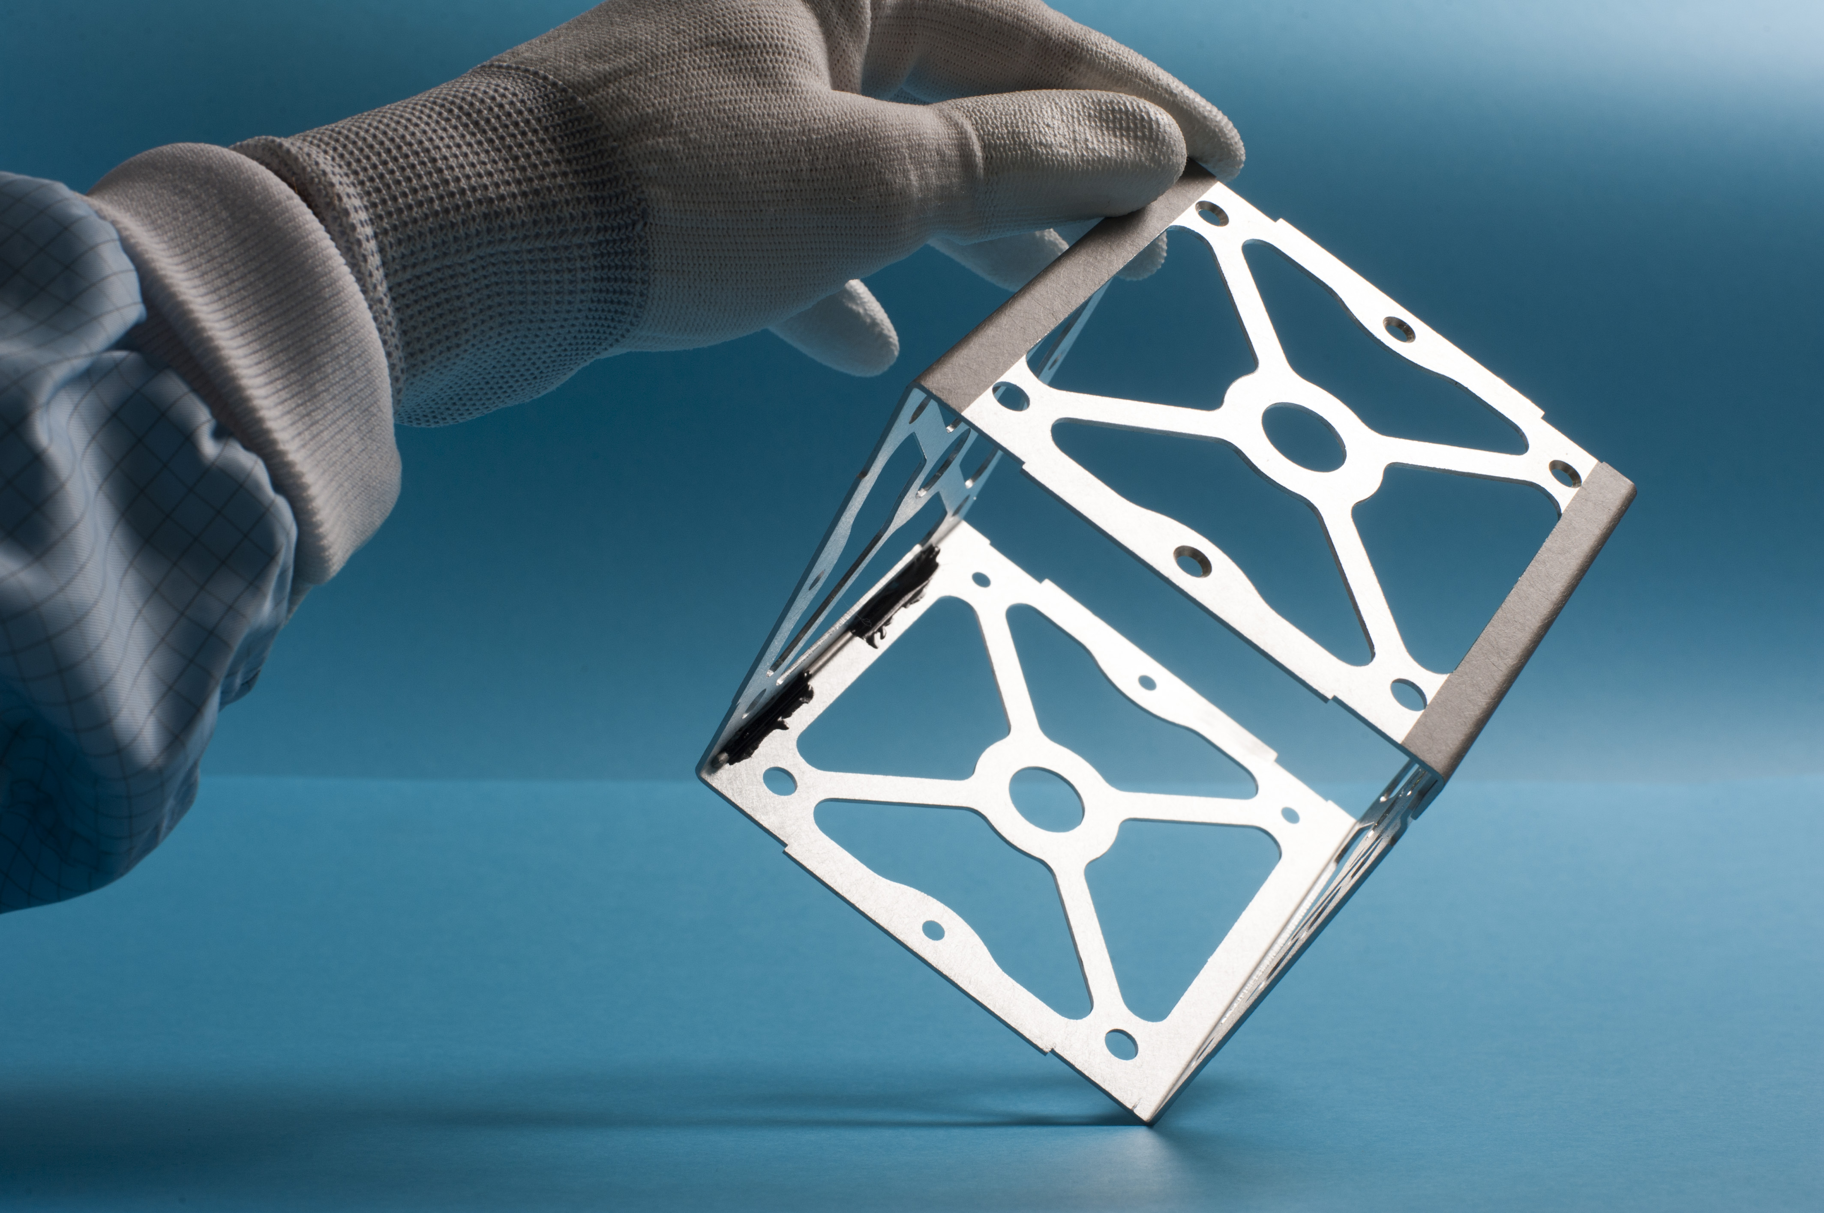
Integration of OUFTI-1 – 21-24 Nov 2013
Photo by Jean-Louis Wertz

Slide 31
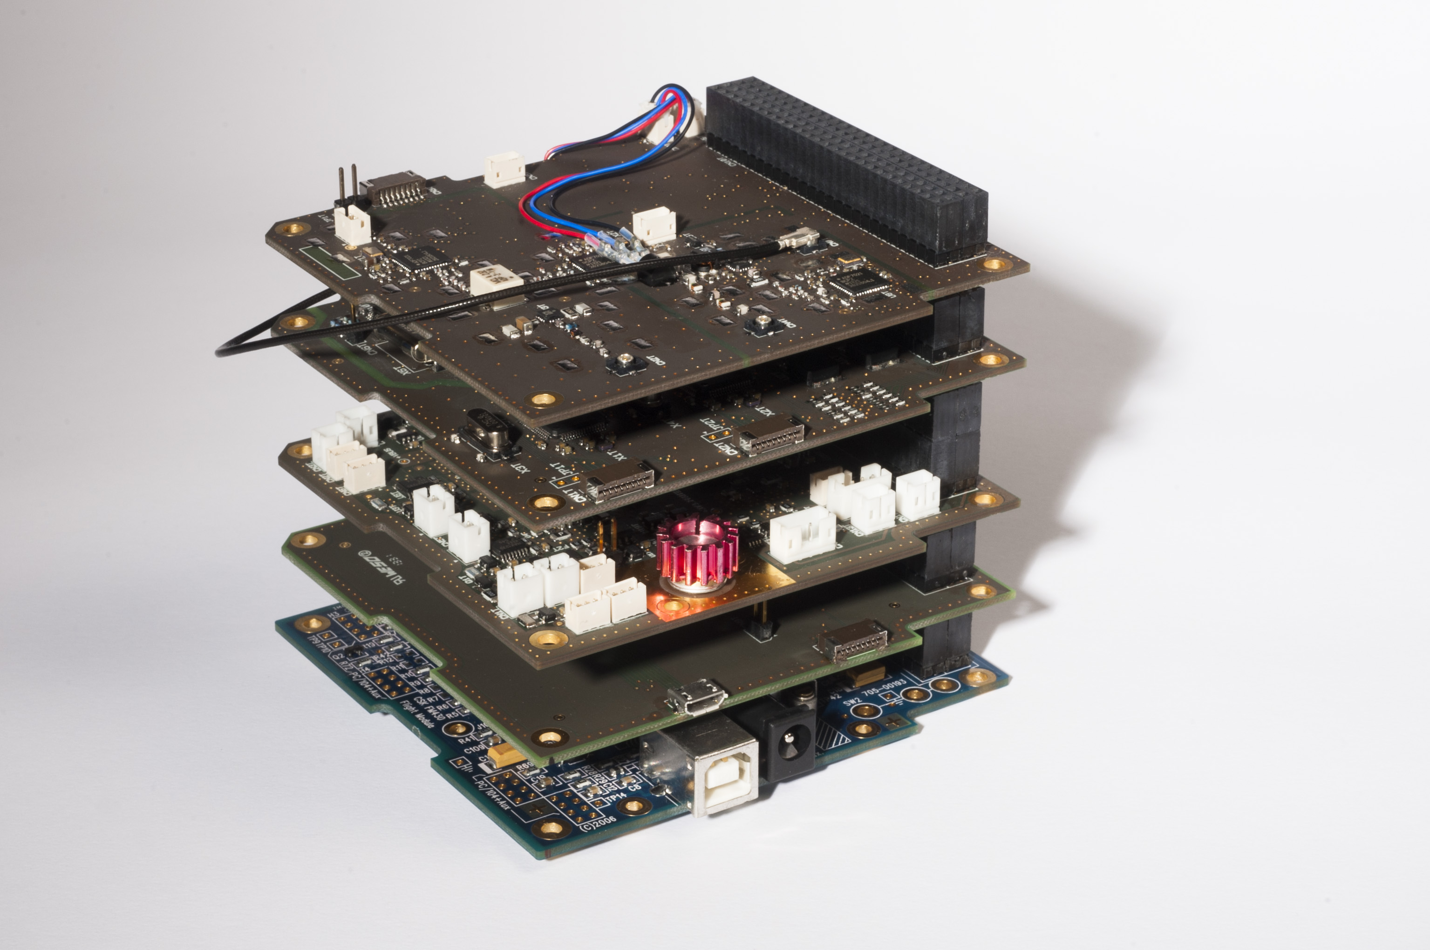
OUFTI-1
Photo by Jean-Louis Wertz

Slide 32
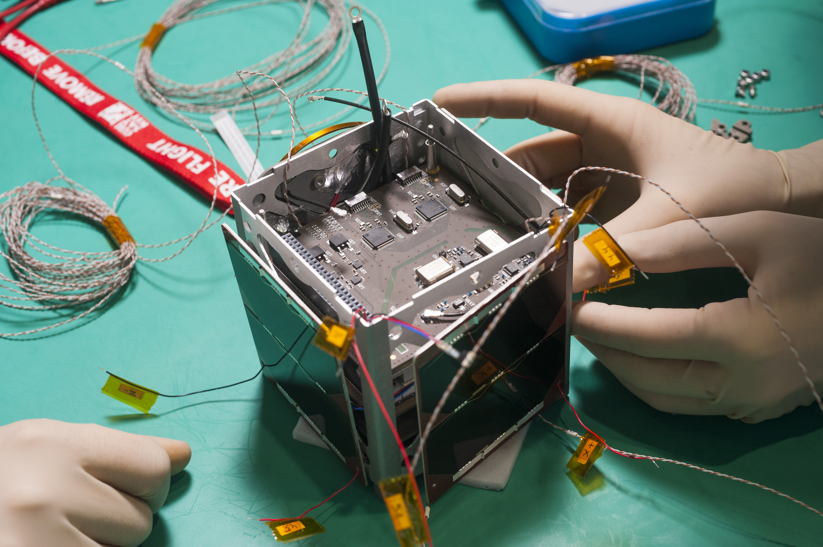
OUFTI-1
Photo by Jean-Louis Wertz

Slide 33
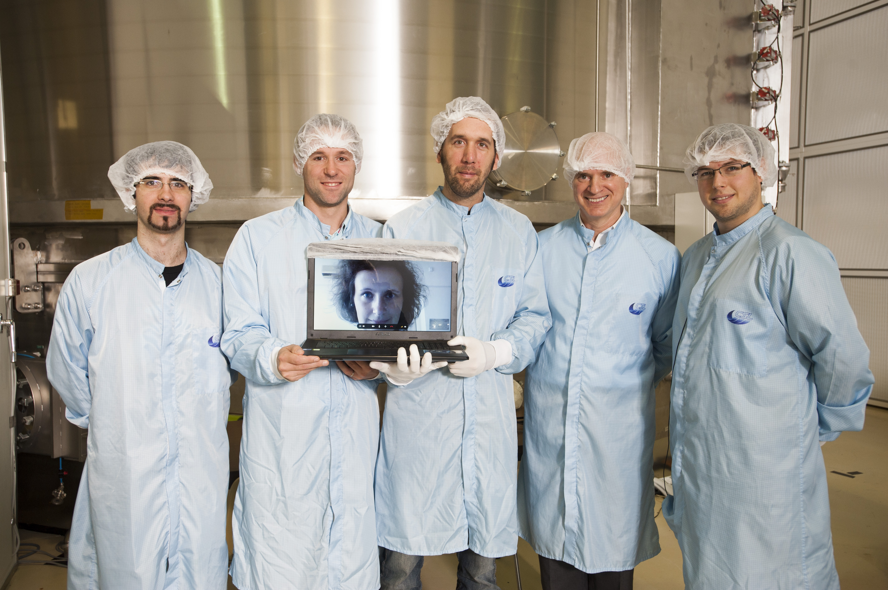
OUFTI-1 integration team – 24 Oct 2013
Photo by Jean-Louis Wertz

Slide 34
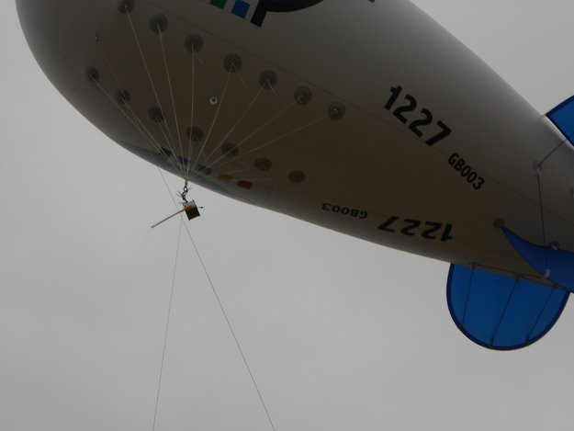
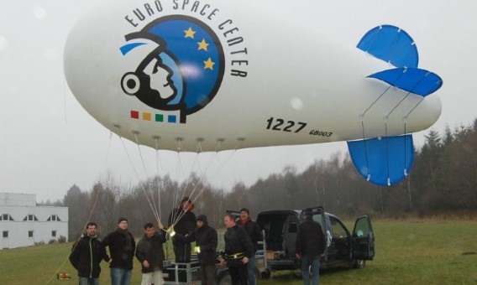
Airborne test of OUFTI-1 – 18 Dec 2013
Euro Space Center,
Transinne,
Belgium

Slide 35
Poly-Picosatellite Orbital Deployer (P-POD)
Developed by Prof. Jordi Puig-Suari at Cal Poly, California

Slide 36
Launch expected in 2015

Slide 37
OUFTI-1: first and foremost educational!

Slide 38
Big innovations
start small…
Quote from
National Reconnaissance Office (NRO) CubeSat Program
Notes:
Launched on Rokot launcher.

