Slide 1

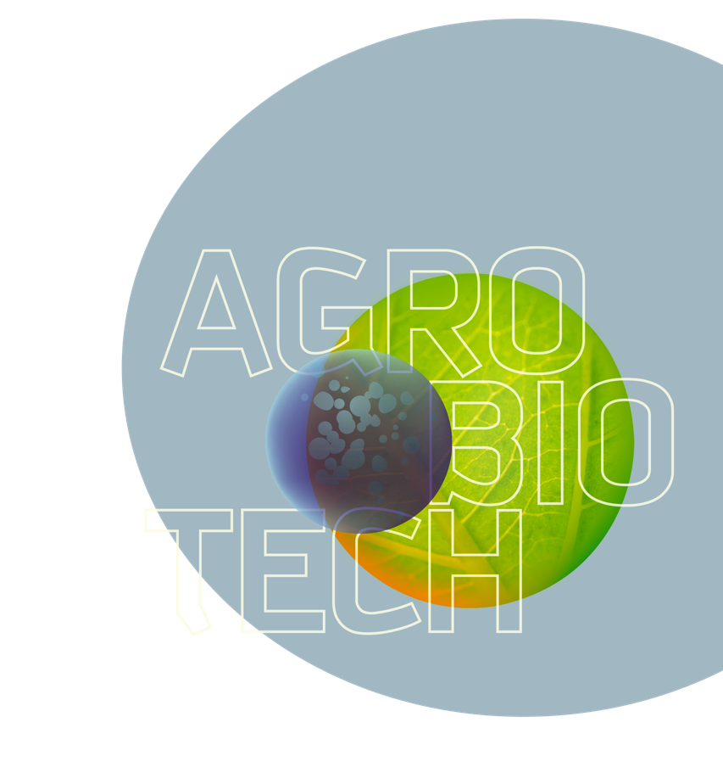


UNIVERSITY OF LIÈGE
Gembloux
Agro-Bio Tech
A Faculty advanced towards sustainable development

Slide 2
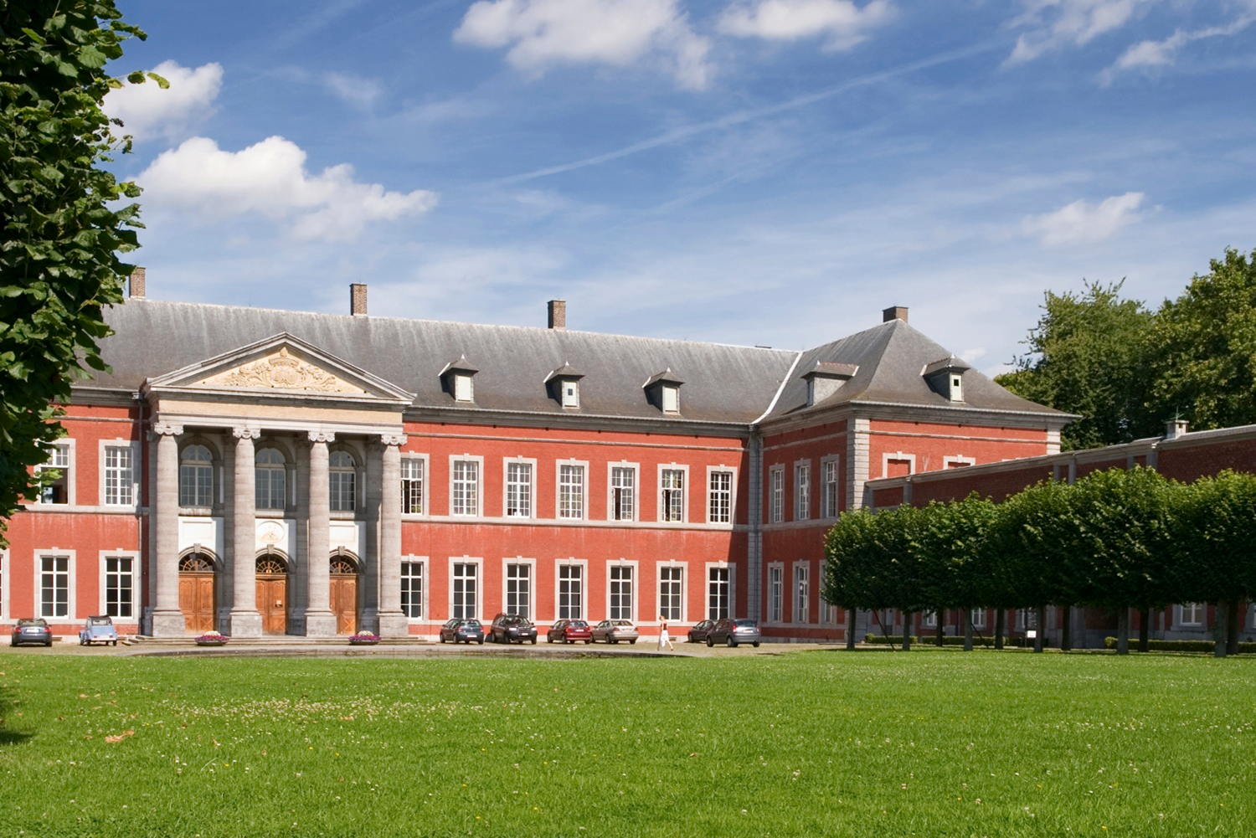
The institution

Slide 3

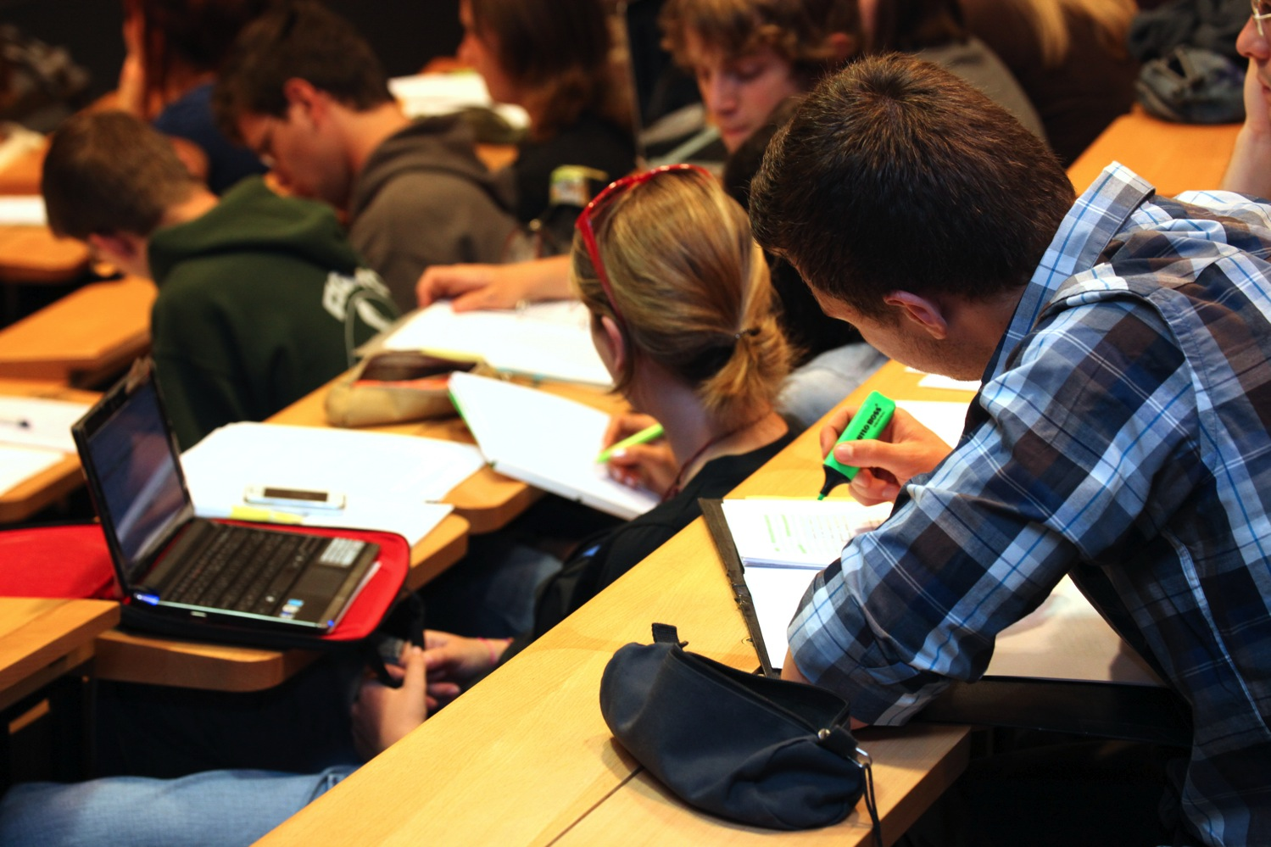
1.038
Students in Gembloux Agro-Bio Tech
227
PhD students/researchers
99
Academic staff members
457
Scientific, administrative and technical staff members

Slide 4
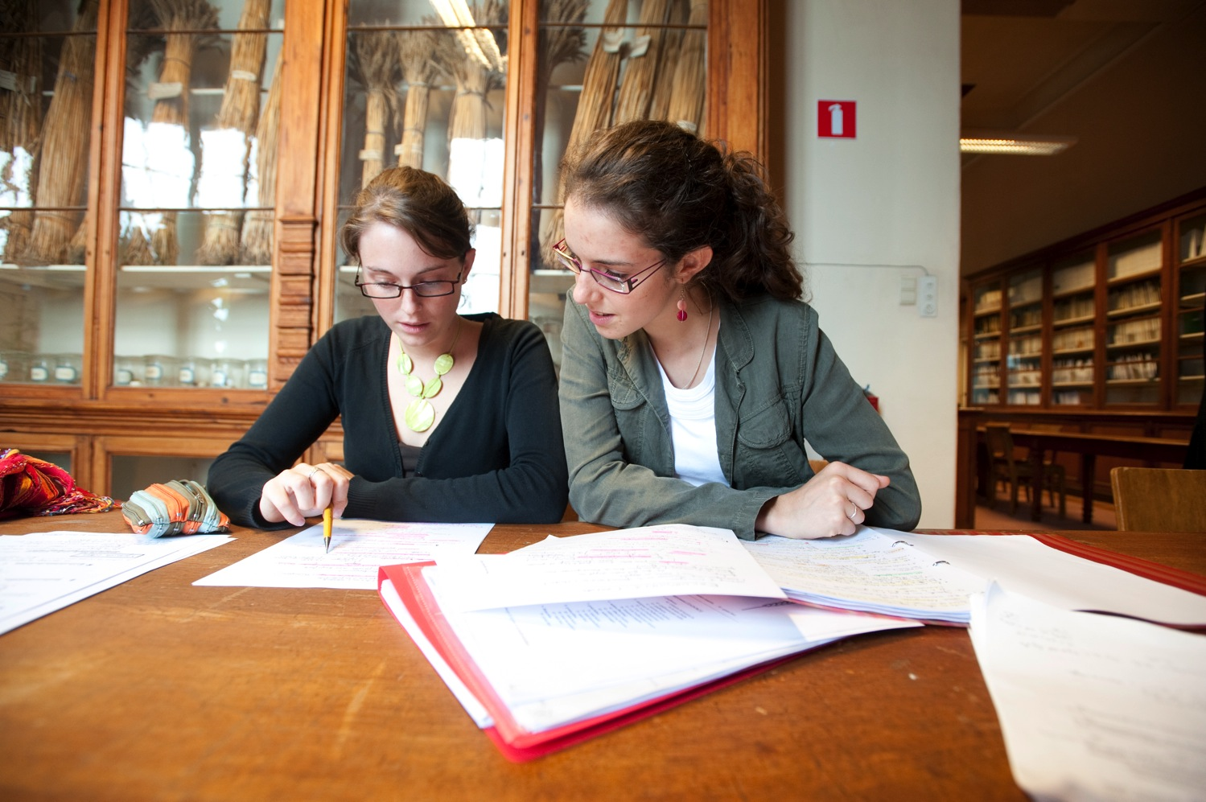
40%
Of female students
243
New students in 1st year of bachelor
+19%
Compared to academic year 2011-2012
26%
Of foreign students, from which 44% from outside the EU

Slide 5
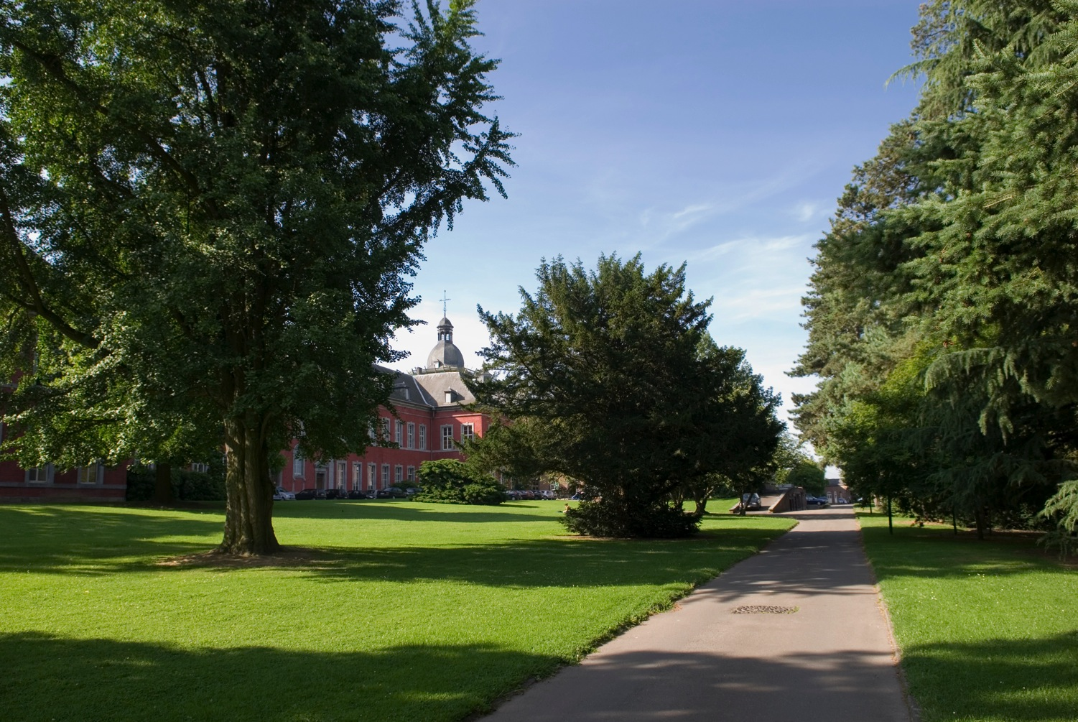
A unique atmosphere: The campus of Gembloux Agro-Bio Tech occupies the buildings and a park from an old Benedictin abbey, established in the 11th century.

Slide 6
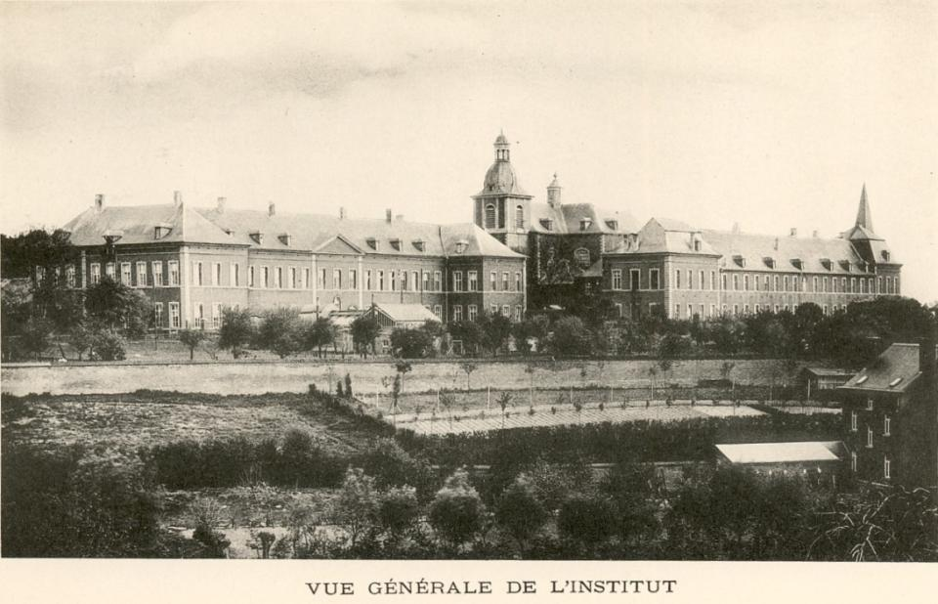
1860
The oldest Belgian institution of teaching and research in agronomy and bioengineering

Slide 7
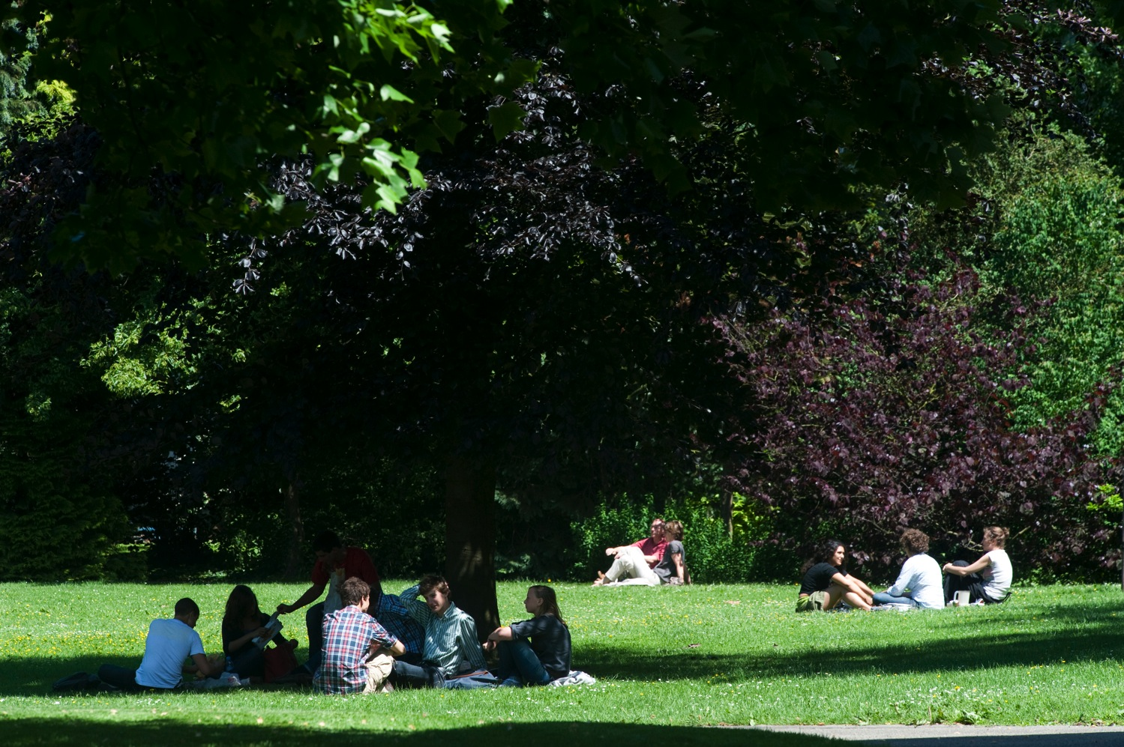
2009
Gembloux Agro-Bio Tech
A campus of the University of Liège

Slide 8
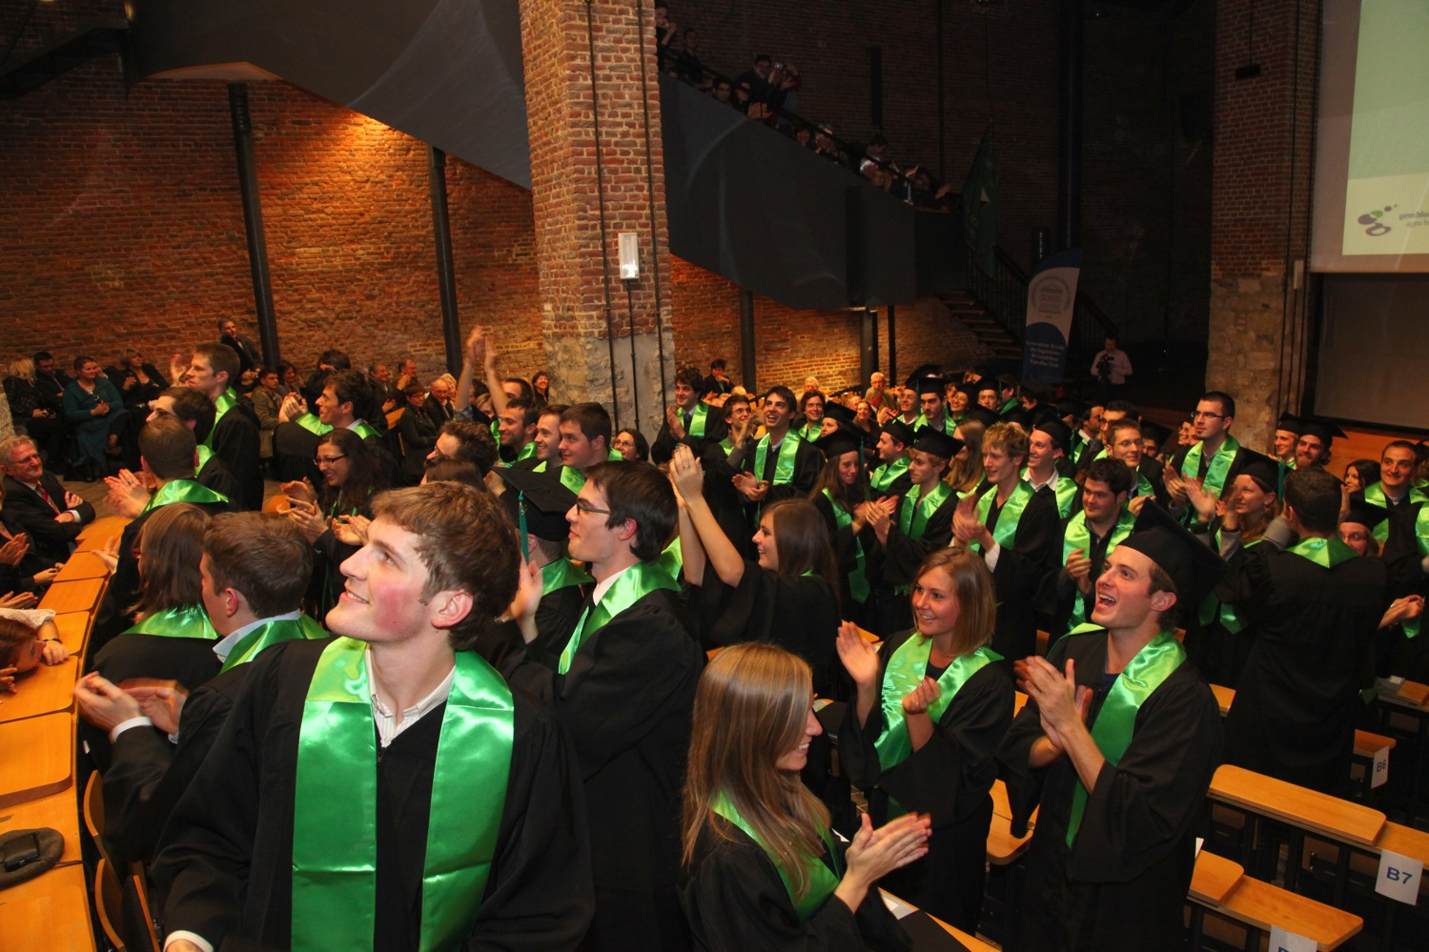
Studies

Slide 9
Teaching in Belgium
6 YEARS
Primary
School
6 YEARS
Secondary
School
Higher Education
Bachelor – Master – PhD
« Haute-Écoles »
University
Professional Bachelor (3 years)
For specific cases: Master (2 years)
1st cycle: Bachelor (3 years)
2nd cycle: Master et Advanced Master (1 or 2 years)
3rd cycle: PhD training/PhD

Slide 10
1st CYCLE
3 YEARS
180 ECTS
1
Bachelor en engineering sciences, orientation bioengineer
2
3
2nd CYCLE
2 YEARS
120 ECTS
Master bioengineer
4
• Environmental Sciences and Technologies
• Forests, Nature and Landscape
5
• Agricultural Sciences
• Chemistry and Bio-industries

Slide 11
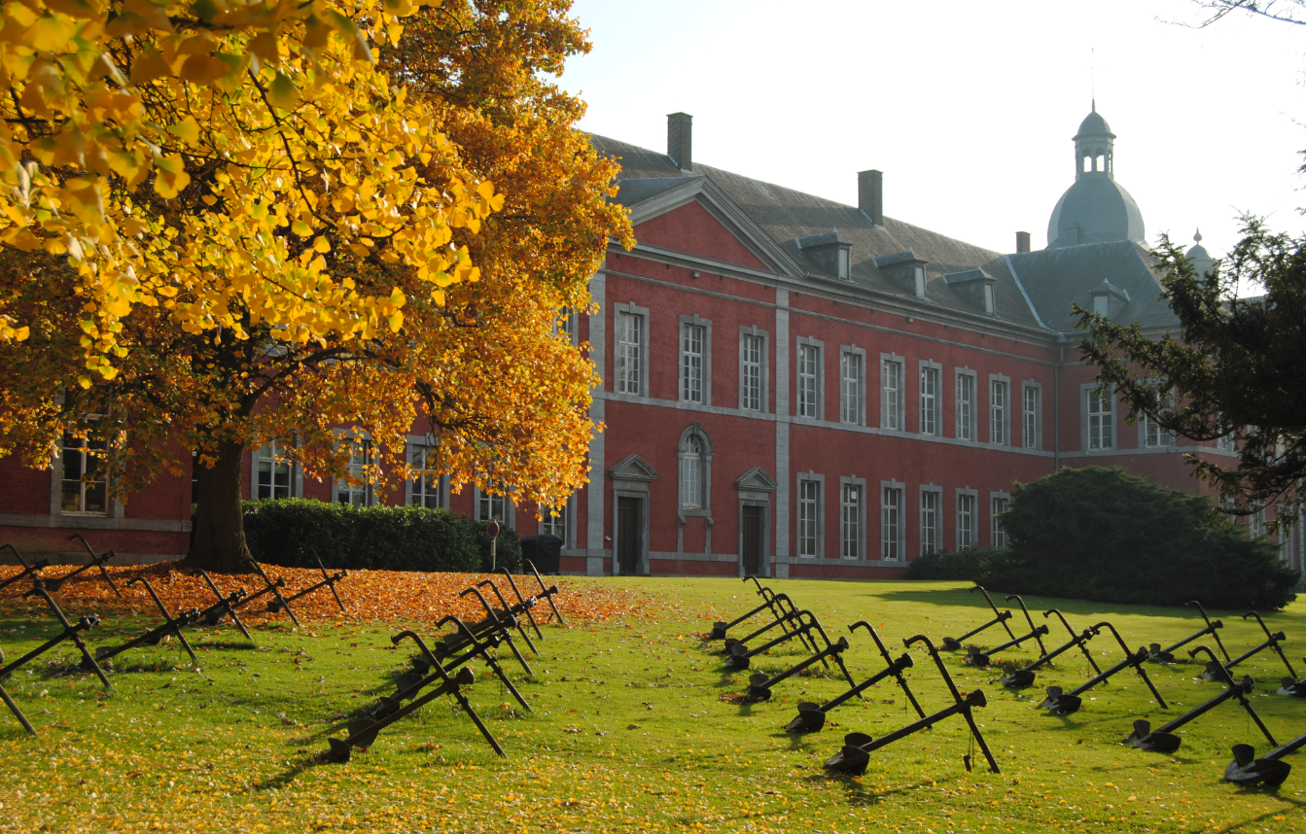
International agreements

Slide 12
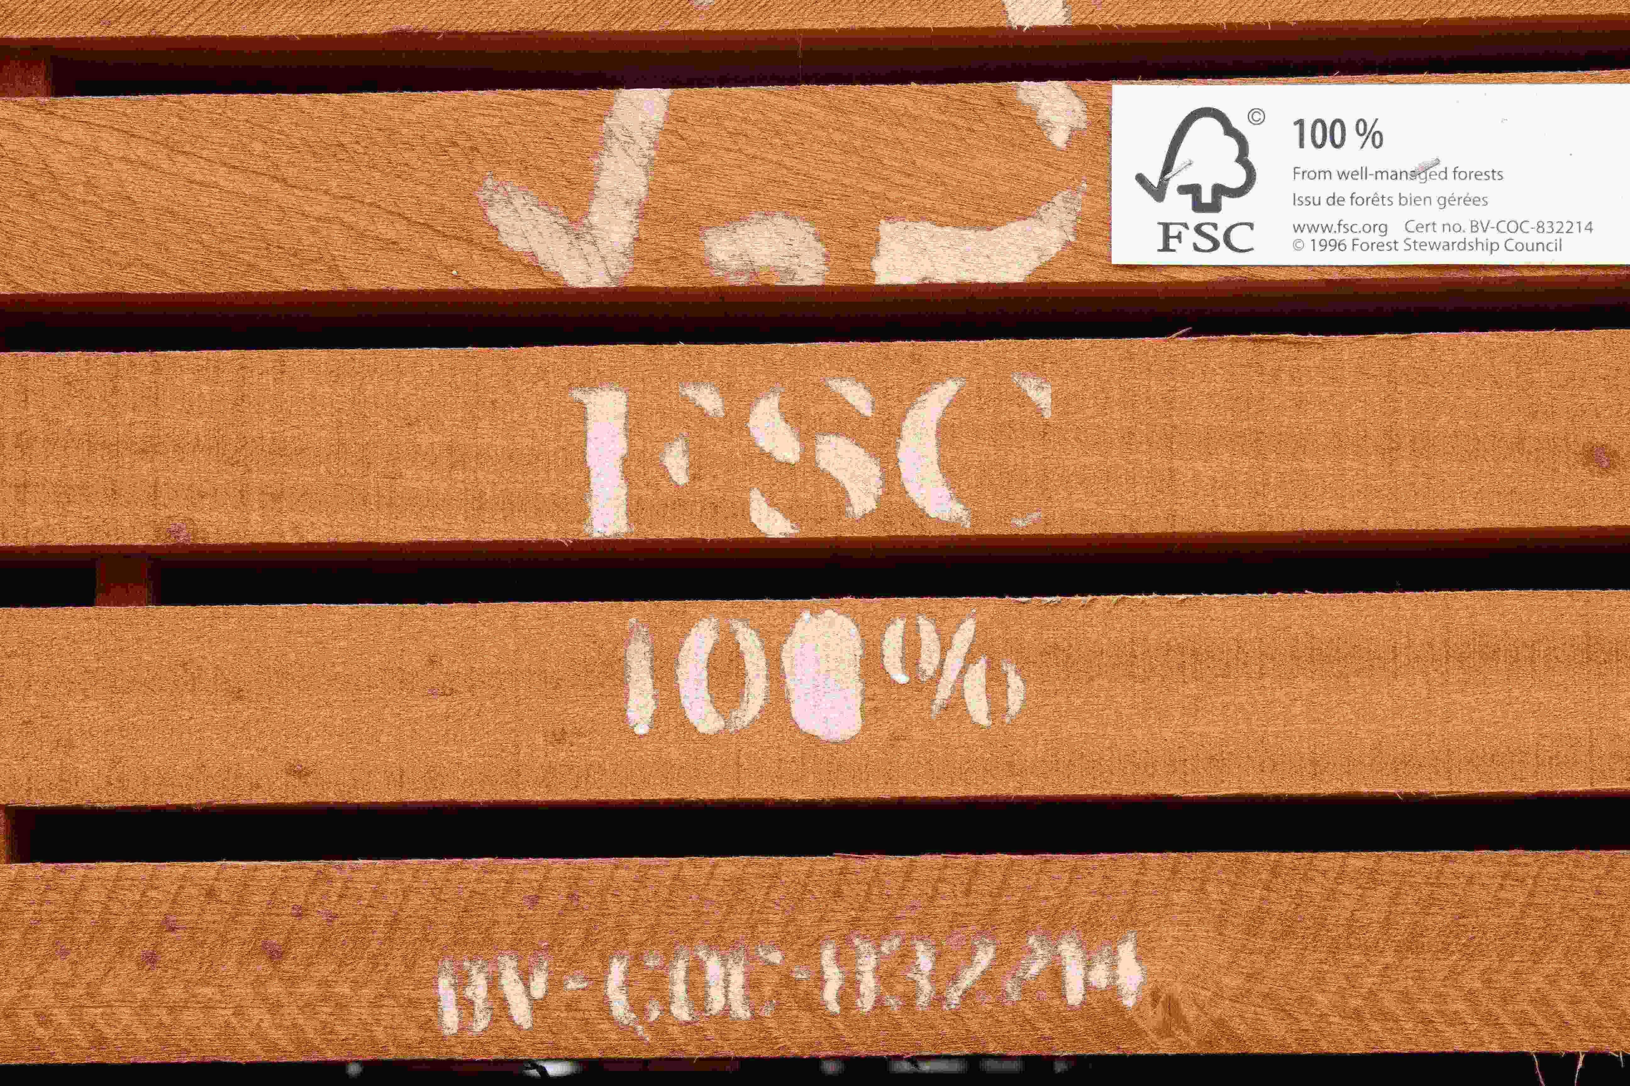
International cooperation in Gembloux Agro-Bio Tech : + Mainly with countries from the South (over 50 countries) + 250 research projects in 2011 + 820 scientific articles published between 2006 and 2010 + 355 international missions in 2011 + International networks of teaching and research + Recruitment of foreign students mainly coming from the South

Slide 13
946 international missions
between 2008 and 2011

Slide 14

Scientific missions
made by professors / researchers from Gembloux campus between 2008 & 2011
51-99
26-50
11-25
6-10
1- 5

Slide 15
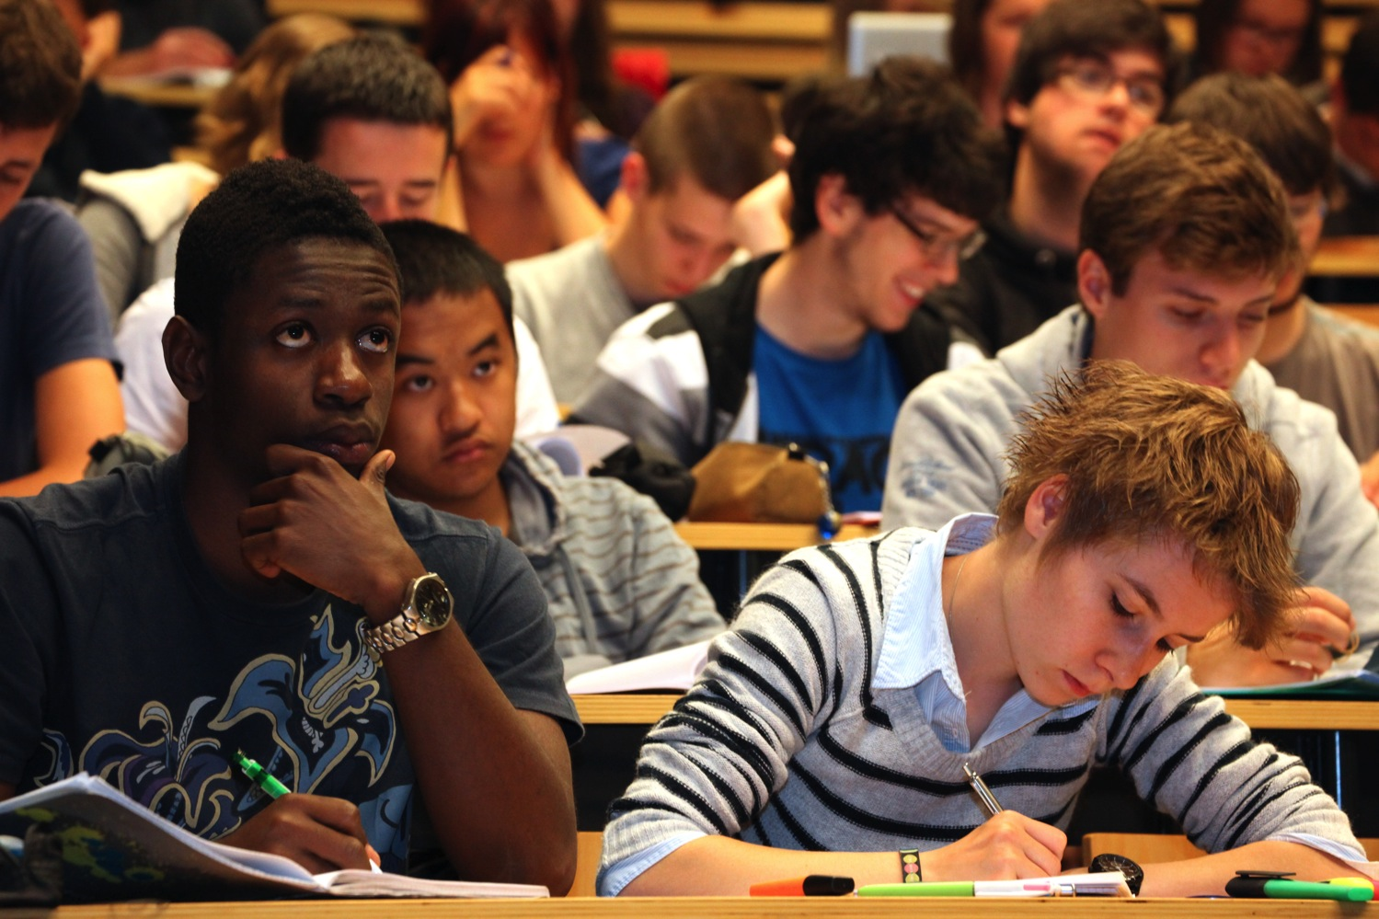
Student mobility + Incoming mobility: over 25% of students coming from abroad + Outgoing mobility: over 30% of students are going abroad during their studies – Internships, study period, master thesis

Slide 16
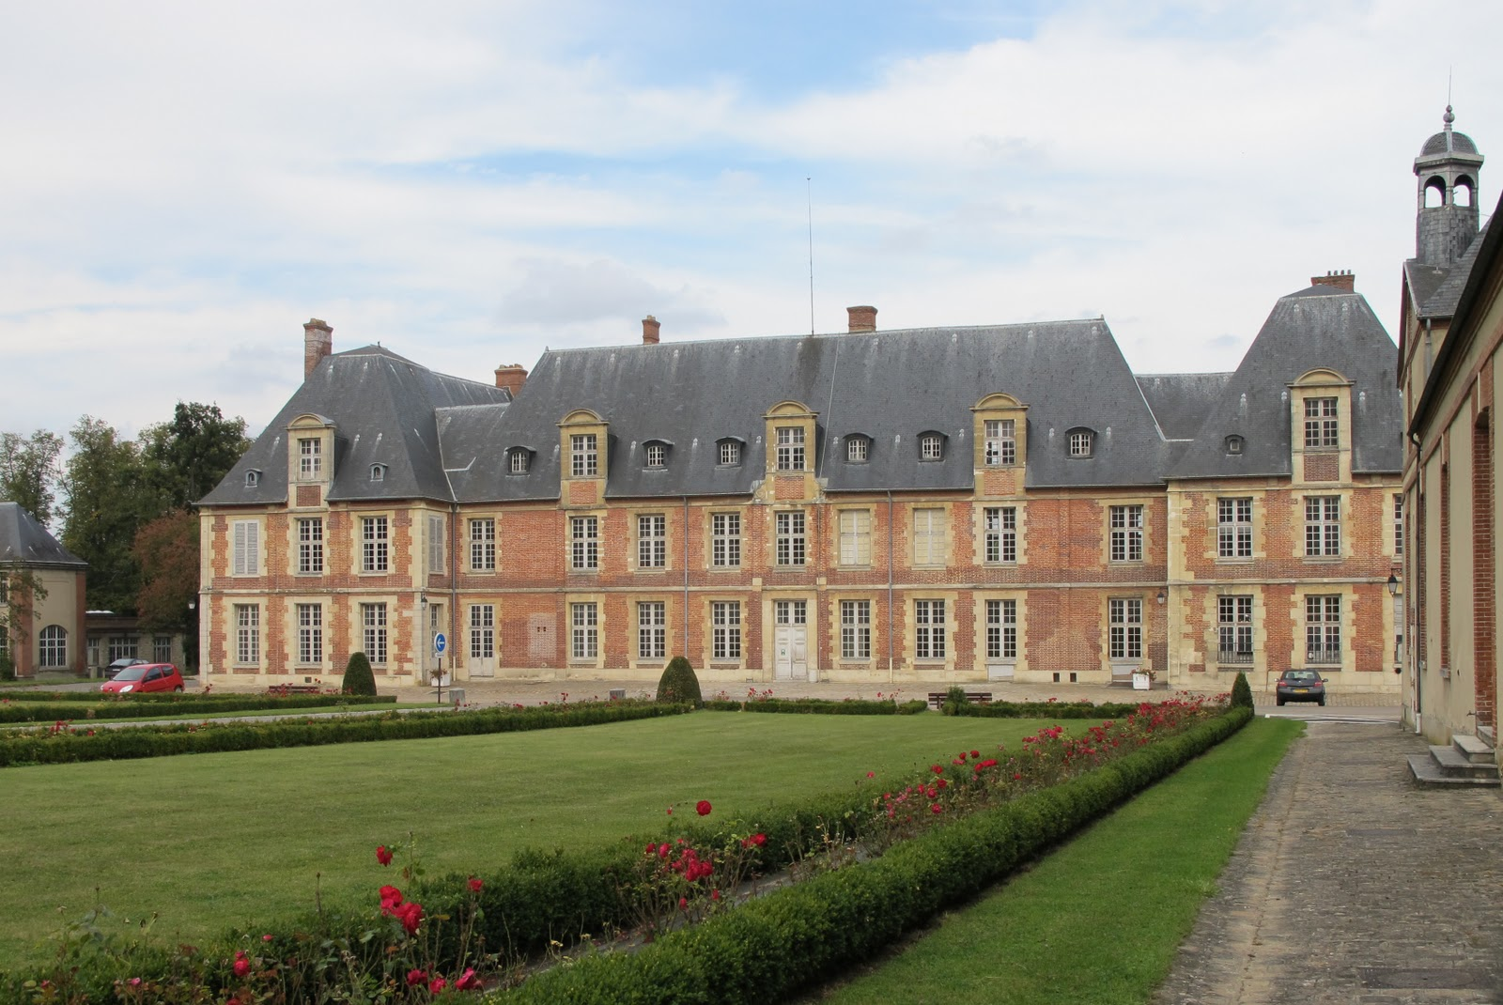
Double-degree agreements: + Agro Paris Tech (France) + Universidad Politécnica de Madrid (Spain) + Cranfield University (United Kingdom) + Co-tutelle agreements usually made on individual basis with countries such as Chile, China, DR Congo, France, South Africa, etc.
AgroParisTech

Slide 17
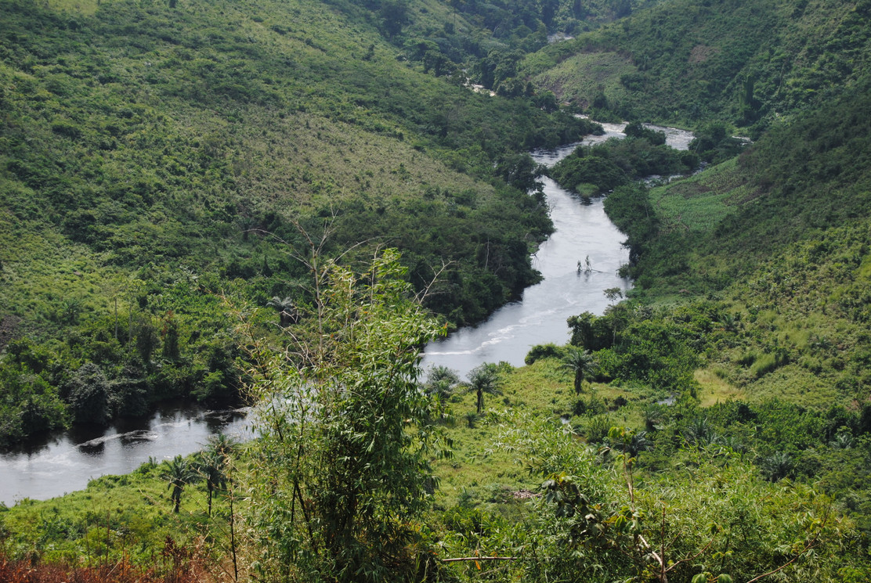
Development cooperation

Slide 18
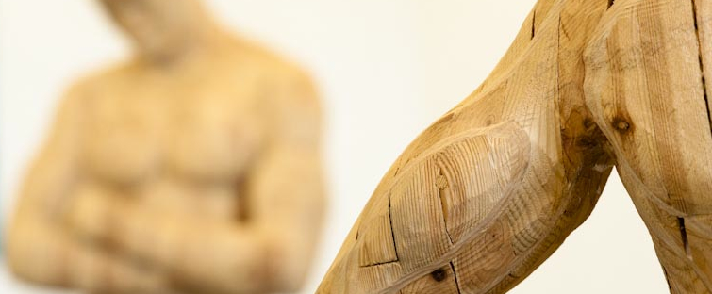
Development cooperation in the ULg, a long field experience: + From 1900: - Creation of the Universidad Agraria de la Molina (Lima, Peru) - Creation of ESALQ (part of the USP, Piracicaba, Brazil) + From 1930: - Creation, development and direction of the Institut National pour l’Étude Agronomique au Congo (INEAC) - Important cooperation with the Katanga Province (DR Congo) * With the Université d’Élisabethville (Lubumbashi) * With the Magombo community (FULREAC) + From 1997: - Creation of the Tropical Veterinary Institute (IVT, Liège)

Slide 19




Slide 20
Human forces
Academics - Dr Ir Christophe BLECKER - Dr Ir Sabine DANTHINE
Research staff (50-60 people) - Research associates - Postdoctoral fellows - MSc. And Ph.D. graduate students - Technicians

Slide 21
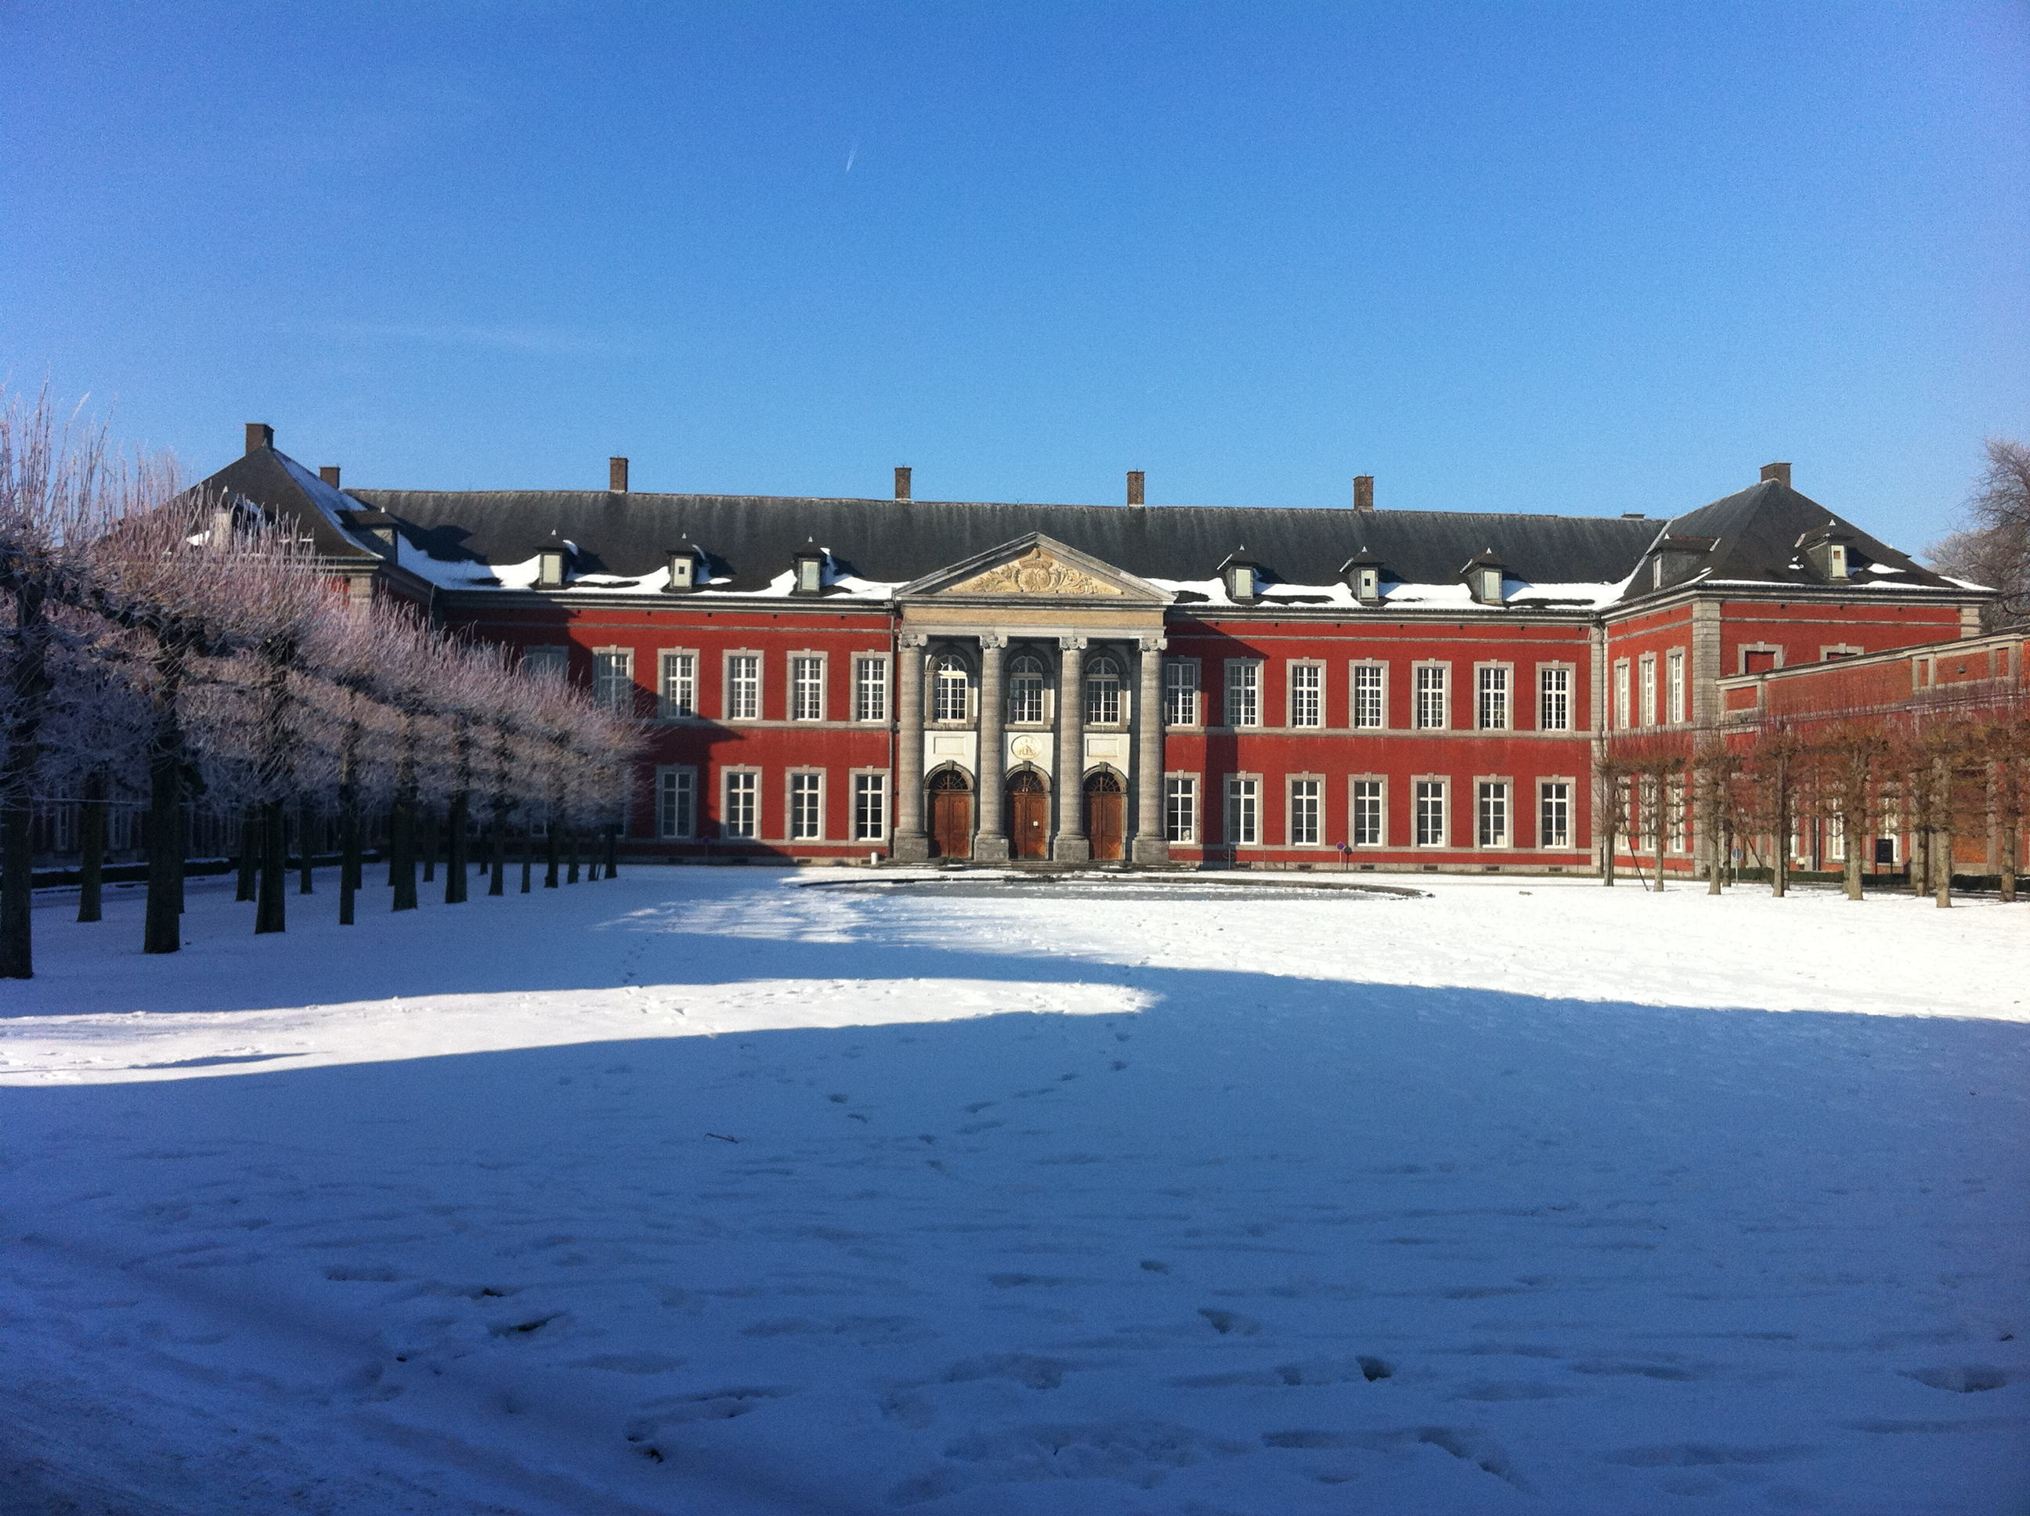
Infrastructure

Slide 22
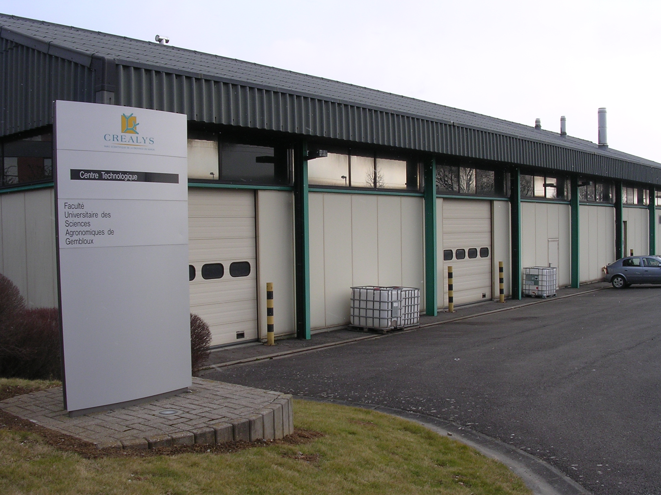
Technological center

Slide 23
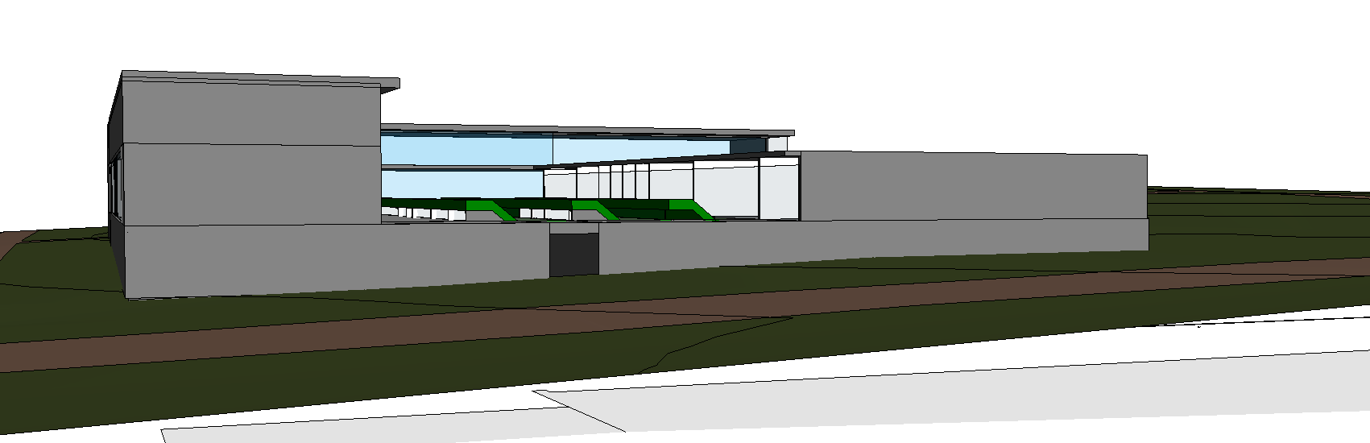
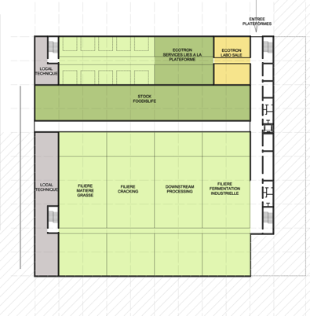
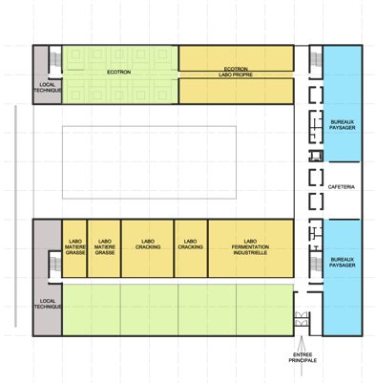
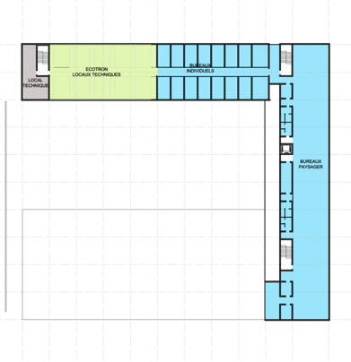
Soon …
Food Is Life

Slide 24
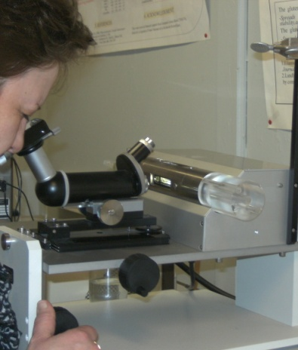
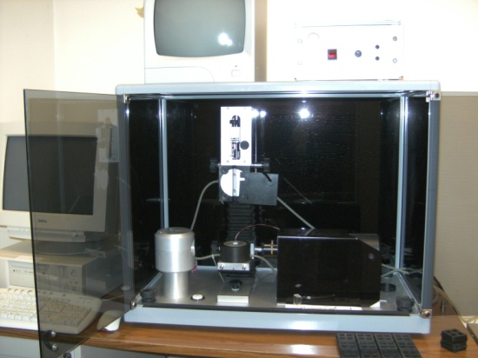
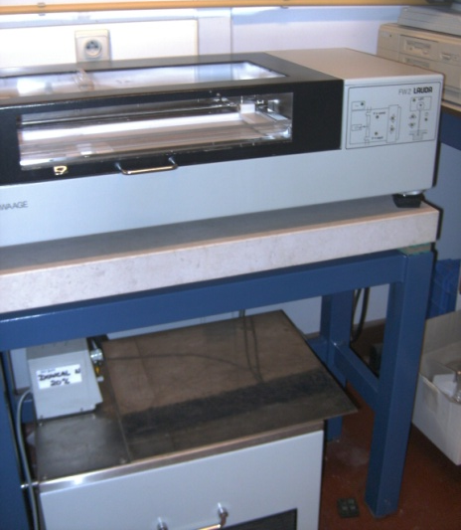
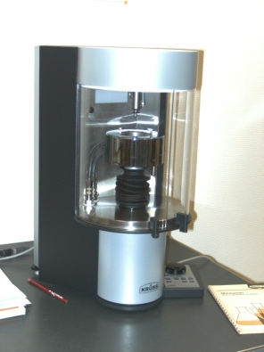
Analytical techniques
Interfacial properties - Adsorption kinetics, monolayers, interfacial rheology, …
Spinning drop
Hanging drop Tensiometer
Bubble pressure
Langmuir film

Slide 25
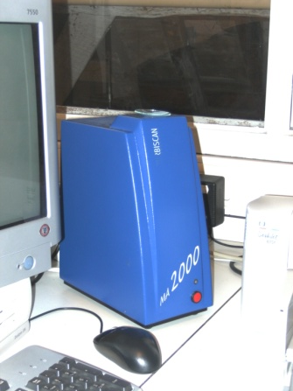
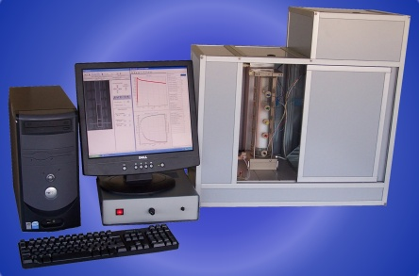
- Emulsions, foams, …
Turbiscan
Foam scan

Slide 26
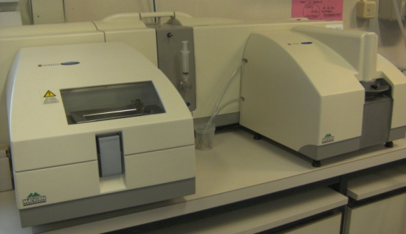
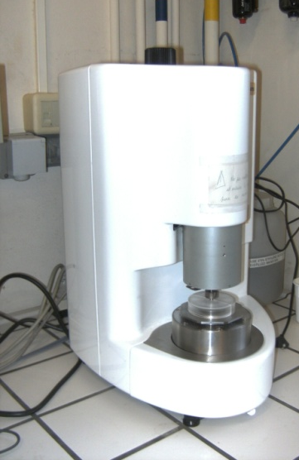
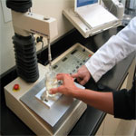
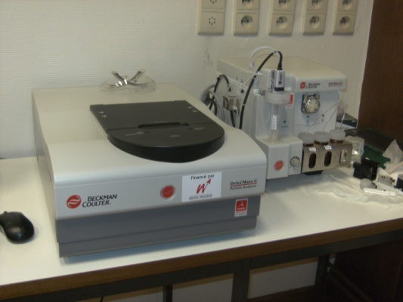
Rheology, texture analysis, particule/globule sizer, zeta potential,…
Master sizer
Rheometer
Texturometer
Beckman coulter-Delsa Nano

Slide 27
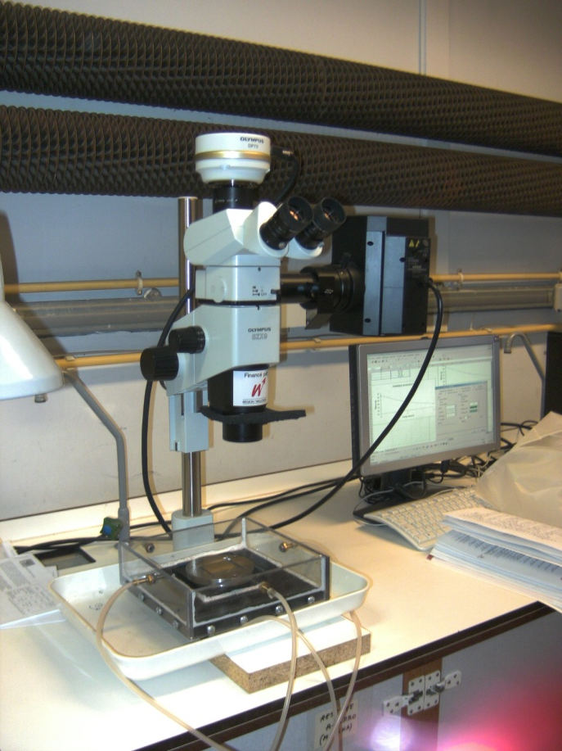
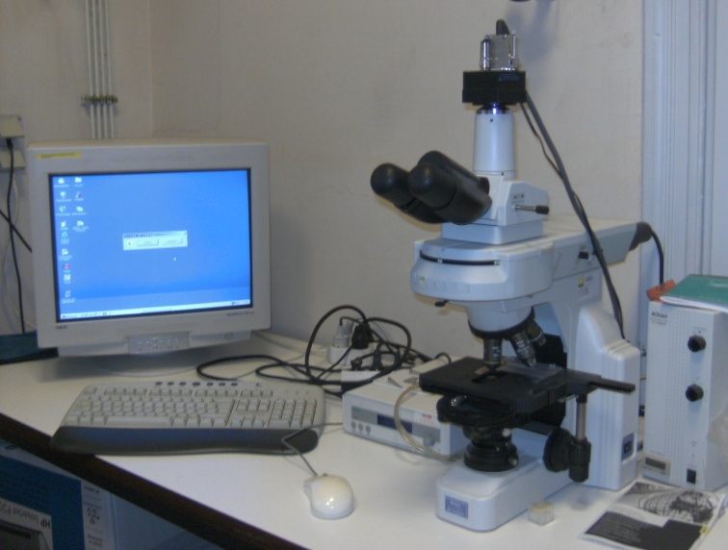
Microscopy

Slide 28
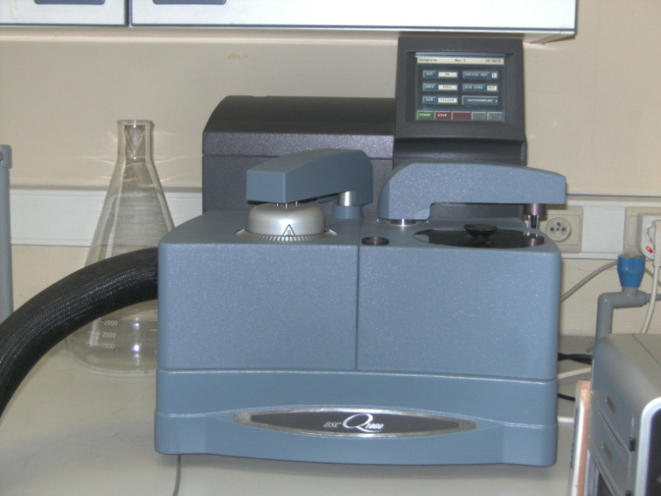
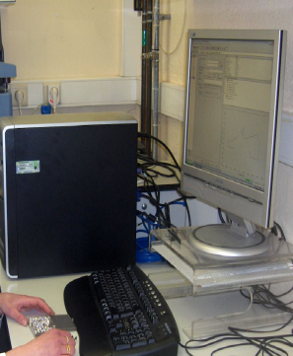
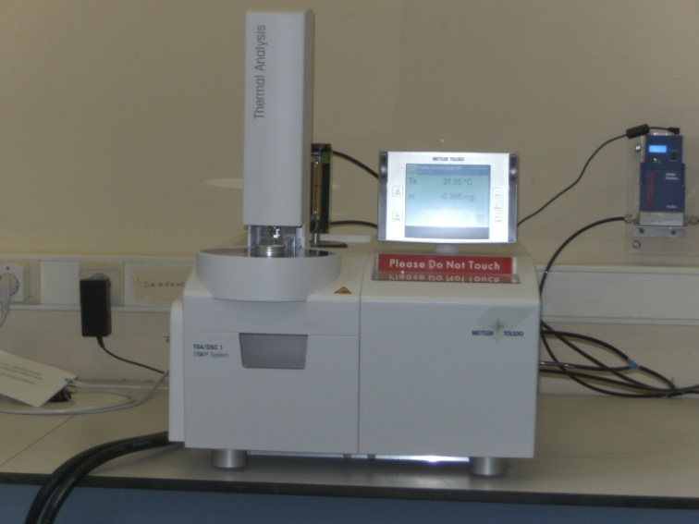
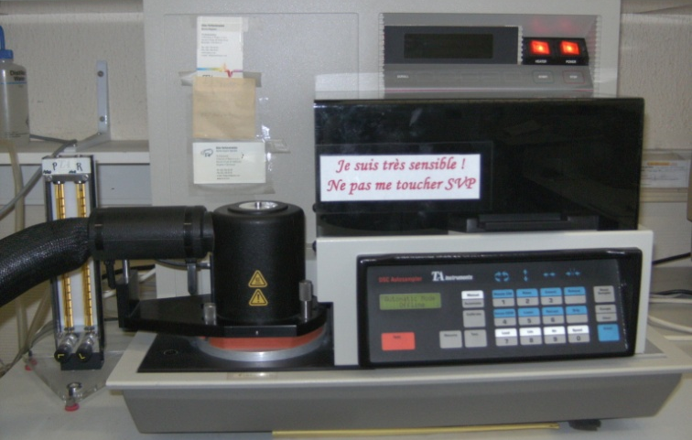
Thermal properties
MDSC Q1000
TGA
MDSC TA2920

Slide 29
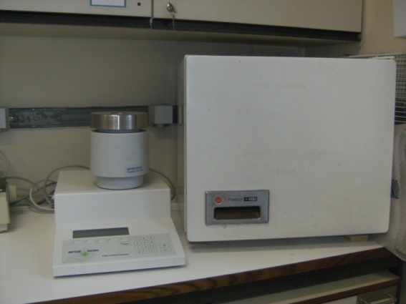
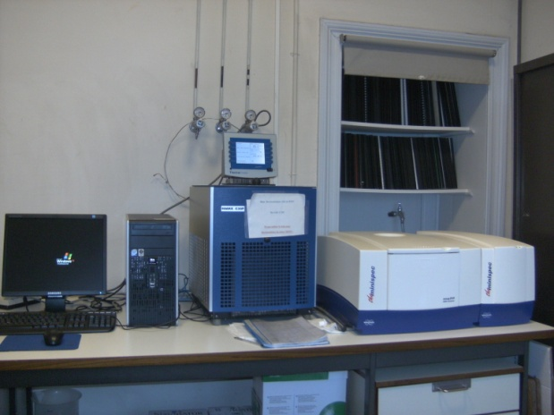
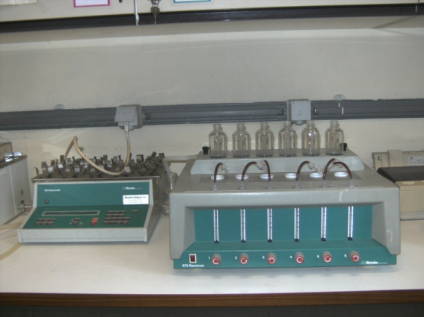
Oils & fats
Mettler (CP-DP-…)
P NMR
Rancimat

Slide 30
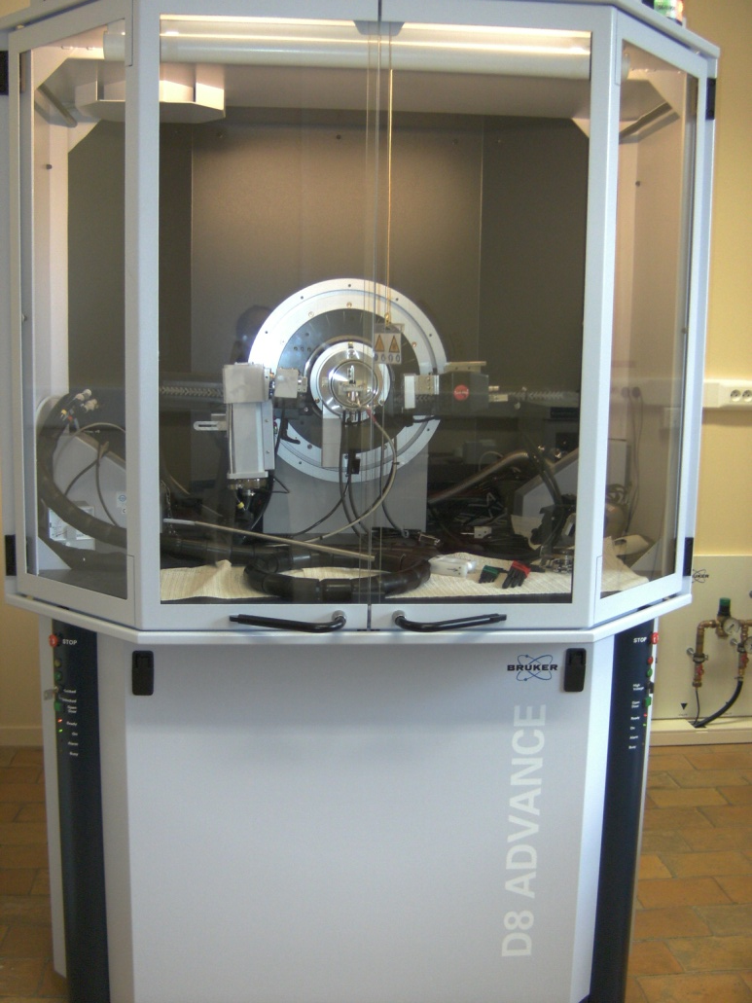
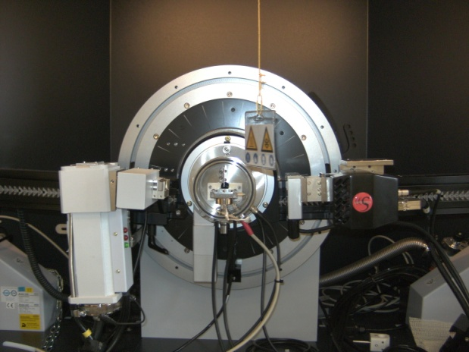
X-Ray diffraction
XRD with controlled temperature

Slide 31
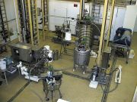
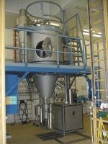
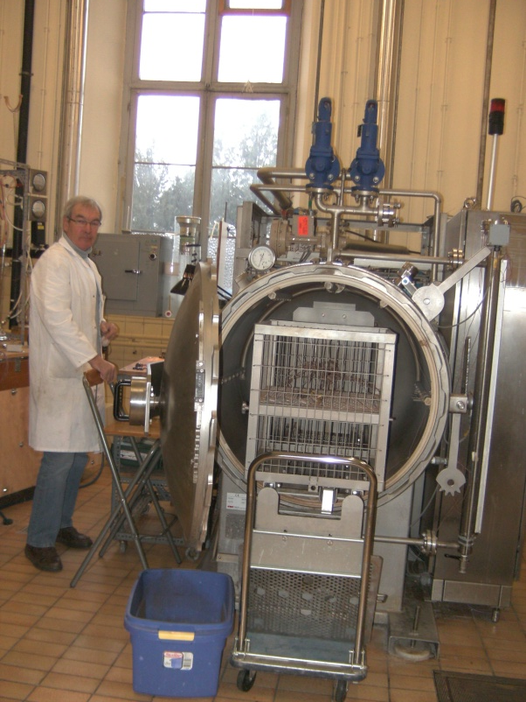
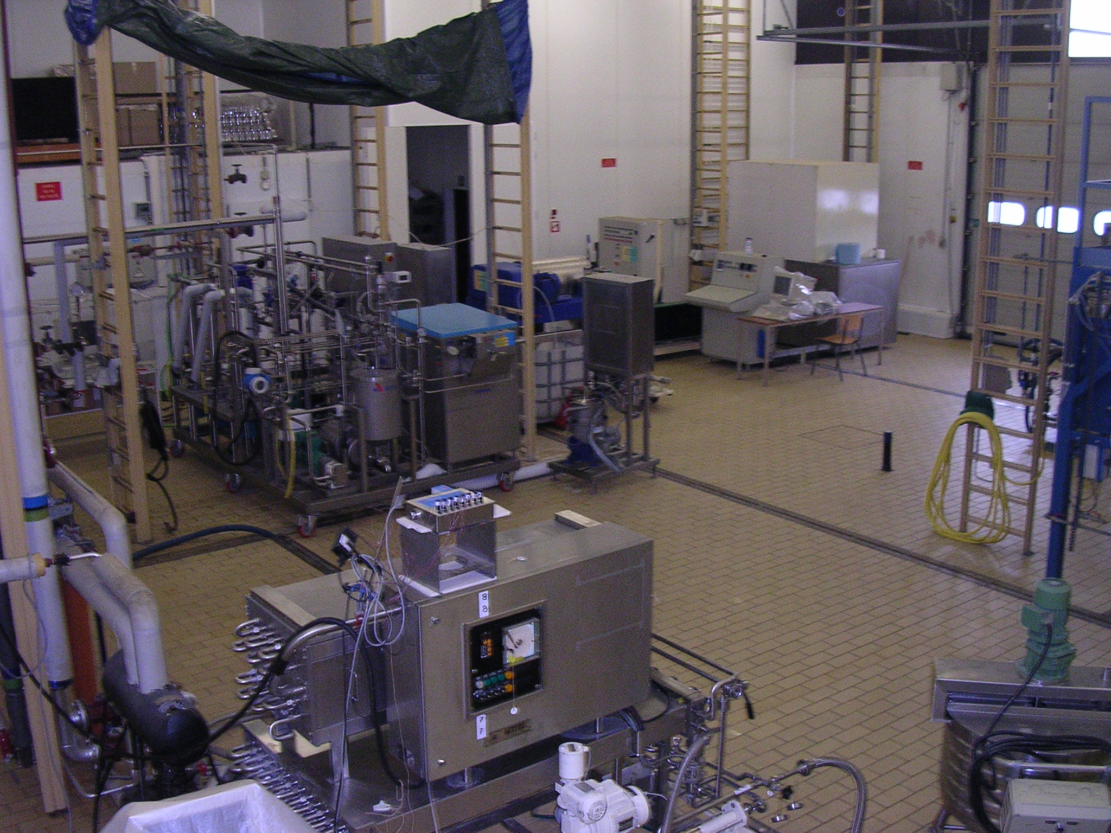
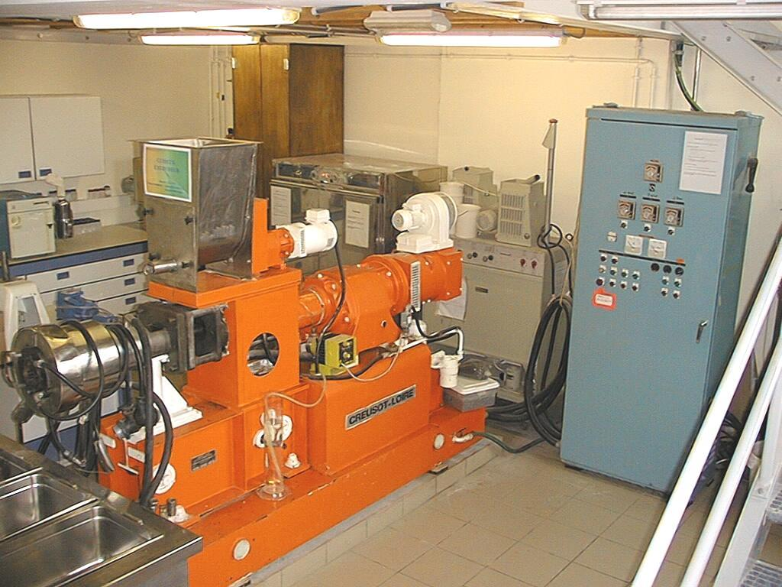
Pilot equipment

Slide 32
Field of activities
Extraction
Cracking
Transformations
Functionalization of ingredients
Physical and enzymatical modifications
End Products
Formulation engineering
Use of soft technologies
Studies of interactions between ingredients
Full characterization (physical and sensorial properties)
Development of models
Co-products
Researches linked to health and environmental concens

Slide 33
More specifically
“Cracking” of biological raw materials
Physical state of food materials
Techno-functionality of ingredients
Dairy science

Slide 34
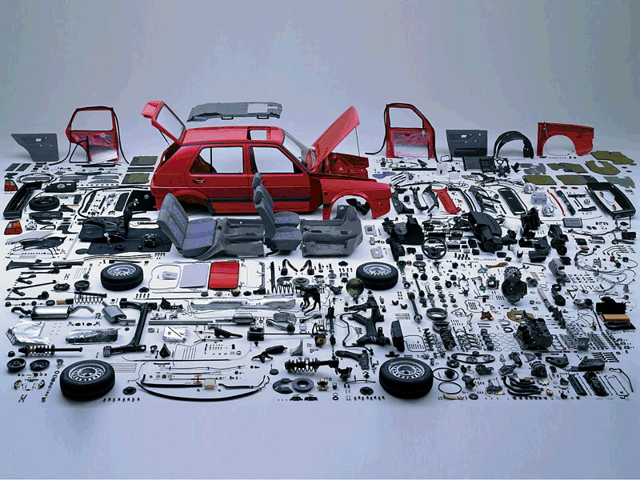
“Cracking”

Slide 35
Dry Pea Seeds
Cleaning
Classification
Dehulling
Grinding
Extraction
Sieving
Decantation
Pasteurization
Ultrafiltration
Concentration
Drying
Bagging
Pea Protein Isolate
Grinding
Bagging
External Pea Fibre
Purification
Concentration
Drying
Bagging
Native Starch
Heat treatment
Instant Starch
Concentration
Drying
Bagging
Internal Pea Fibre Grinding
Micronized Fibre
Industrial fractionation of pea

Slide 36
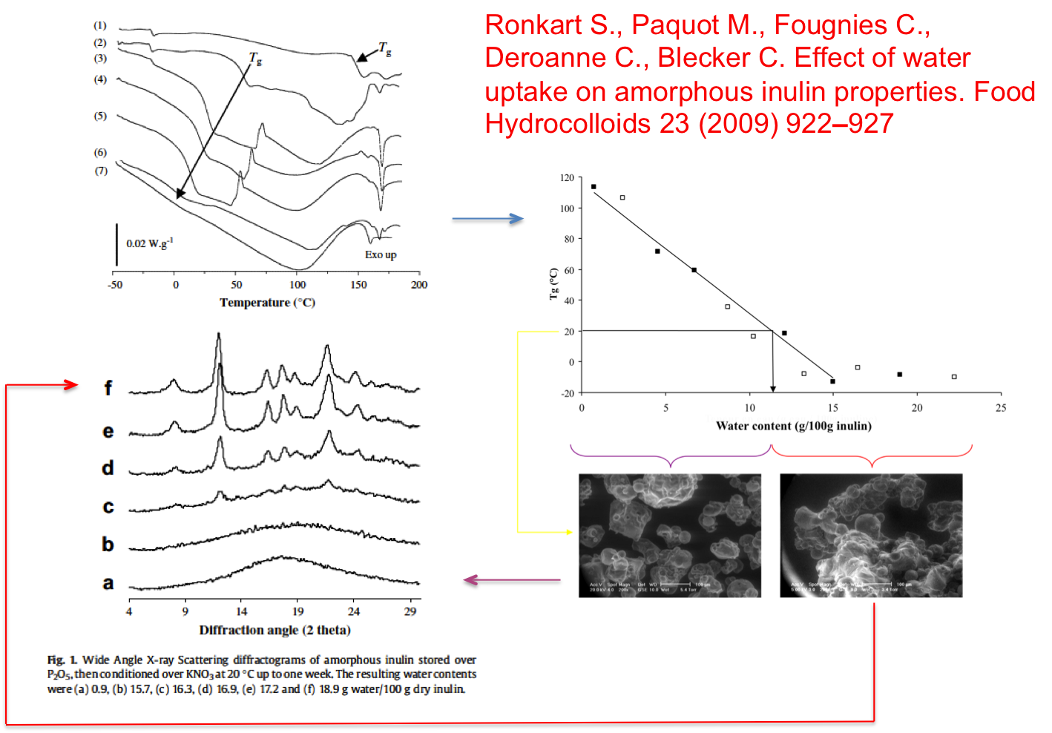
Physical state of food materials
Glass transition, water sorption, caking

Slide 37
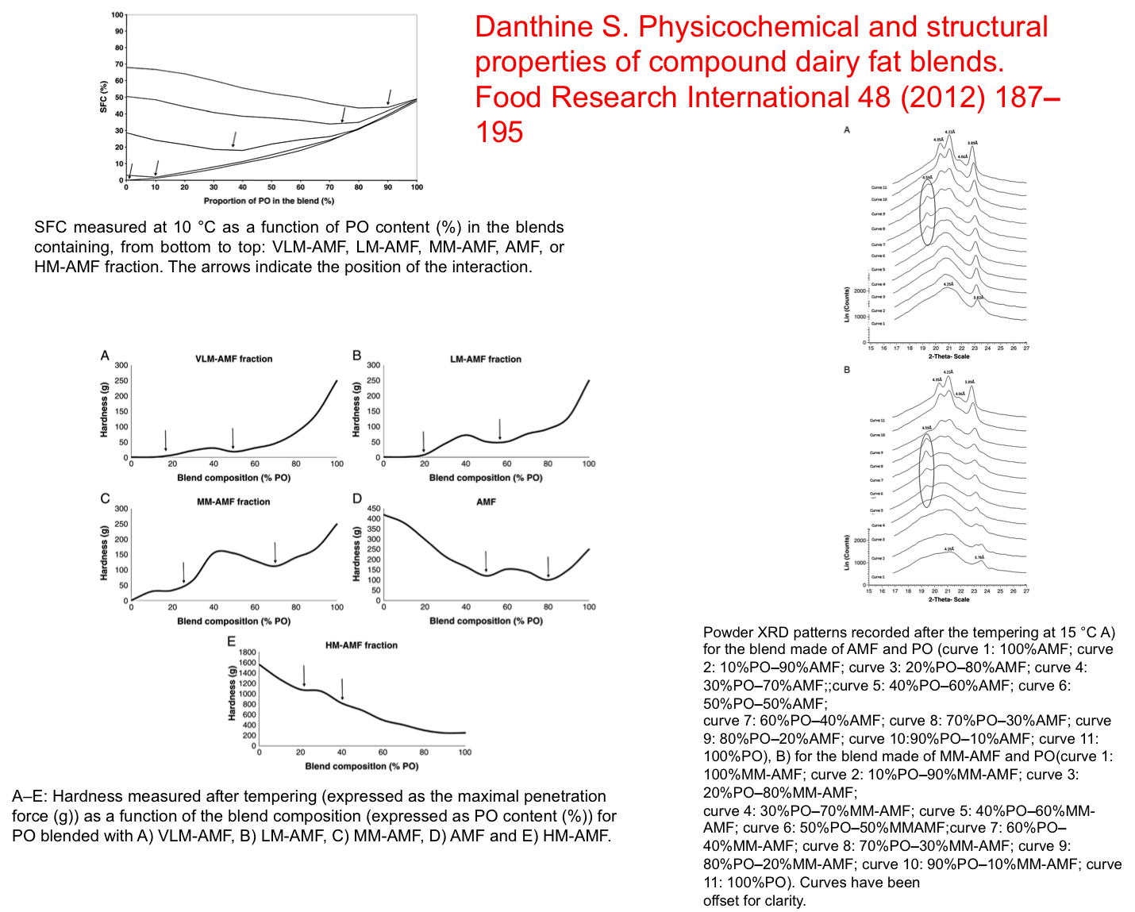
Formulation of compound dairy fat blends

Slide 38
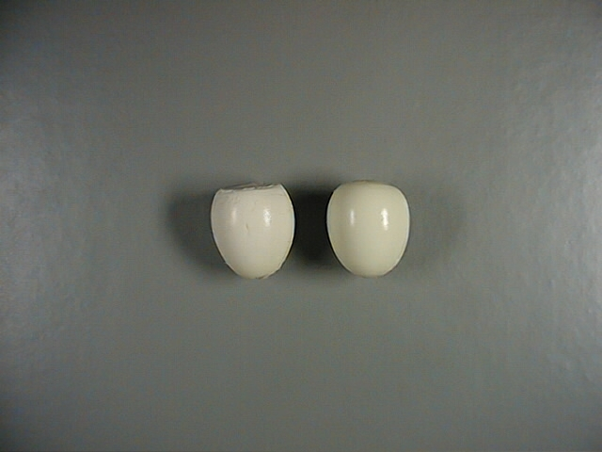
Technofunctionality
Ceci n’est pas un œuf

Slide 39

Dairy science
Fundamental understanding :
last MFGM models (2000 & 2010)
Specific research towards purification & fractionation to get new products with added value
Scaling-up (industrial level)
By-product valorization (buttermilk)
Formulation of new products
Patent : Dalemans D., Blecker C., Bodson P., Danthine S., Deroanne C., Paquot M. (2008). Milk ingredient enriched in polar lipids and uses thereof. International Patent, WO/2008/009636

Slide 40
Conclusion
Analytical tools from biophysics + pilot scale processing => Better fundamental knowledge on food material + applied results for industrial partners
We are open to collaboration
Contact : christophe.blecker@ulg.ac.be
Phone : 32 81 62 23 08

Slide 41

DIA23 Champs
Thank you for your kind attention

