Slide 1
Mealworms: Alternate Source of Lipids
Danthine, S.¹, Blecker, C.¹, Paul, A.^{1*}, Caparros Medigo, R.¹, Haubruge, E.¹, Taofic, A.¹, Lognay, G.¹, Fauconnier, M-L.¹, Frédérich, M.² & Francis, F.¹
¹Gembloux Agro-Bio Tech, Université de Liège, Passage des déportés, 2, 5030 Gembloux, Belgique
²Department of Pharmacy, Pharmacognosie, Université de Liège, Avenue de l'Hopital 1, 4000 Liège, Belgique
Notes:
The world is talking about proteins from insects. They have high quantity of good quality proteins.
But in this competitive market where every company is trying to put their product at the lowest cost, producing insects just for their protein will not be worth.
So we thought of extracting and exploring commercial potential of lipids from mealworms, which could be a by-product of mealworms protein industry. And the results were surprising.
So, I will explain you this story what exactly happened……

Slide 2
Flow of presentation
Introduction
Objectives
Material and Methods
Result and Discussion
Conclusion
Notes:
So this is the flow of my presentation, first I will give you a short introduction to this presentation, then the objectives, materials and methods, results and finally the conclusion.

Slide 3
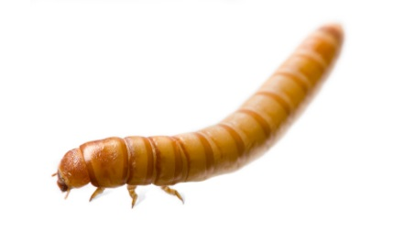
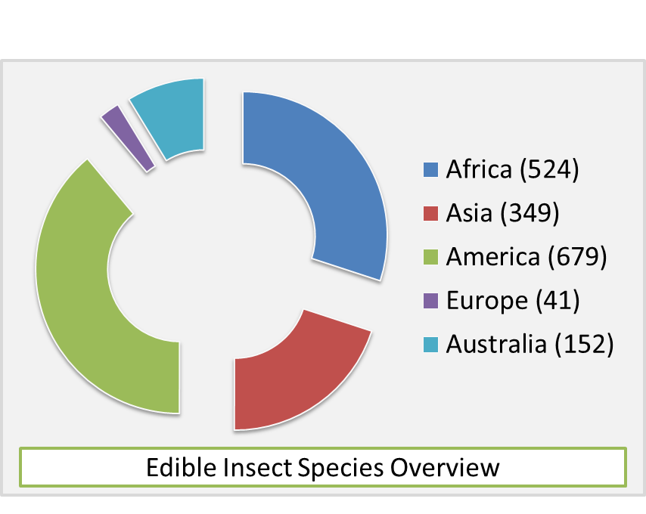
Introduction
Material and Methods
Conclusion
Objectives
Result and Discussion
Entomophagy
Consumption of insects as human foods
More than 1900 species of insects are edible
Heavily influenced by local religious and cultural beliefs
Why us?
Nutritionally superior to most conventional meats
Production may result in lesser greenhouse gases and ammonia emission
Risk of zoonotic diseases maybe less
Much less water requirement
Feed conversion ratio and percentage edibility much higher
Notes:
Entomophagy is the consumption of insects as human food
More than 1900 species of insects are edible throughout the world
Entomophagy is heavily influenced by local cultural and religion practices
The practice is entomophagy is not new, for example around 524 species of insects are edible in Africa and so on….
But why insects?
-Literature supports the fact that they are nutritional superior to most conventional meats
- Production of insects may result in lesser greenhouse gases and ammonia emission
-Lesser risk of zoonotic diseases
-Some insects like yellow mealworms are almost drought resistant
-Feed conversion ratio and percentage edibility is much higher

Slide 4
Introduction
Material and Methods
Conclusion
Objectives
Result and Discussion
Nutrient Richness
1. Proteins- 15% to 81% on dry basis (Ramos - Elorduy et al., 1997)
Lipid Content
1. Fat- 1.5% (Coleoptera) to 77% (Lepidoptera) on dry basis (Raksakantong et al., 2010)
Unsaturated Fatty Acids
1. PUFA were most predominant fatty acids in all the investigated insects (Raksakantong et al., 2010)
2. Also rich sources of fat, vitamins and minerals, especially iron and zinc (Akinnawo & Ketiku, 2000)
2. Insects often establish metabolic reserves, such as fats, especially during immature stages, for example larvae
2. Insects are good source of important fatty acid, which should be considered for human consumption
Notes:
Insects are really rich source of protein, some of them contain almost 80% proteins
Besides this they are also source of lipids, vitamins and minerals
Upto 77% lipids have been reported in some insects
During the larvae stage the insects accumulate metabolic reserves of fat
PUFA were found to be dominant in most of the insects

Slide 5
Introduction
Material and Methods
Conclusion
Lipids from Tenebrio molitor larvae (mealworms)
Quantity & Quality
Substitute of oilseeds
Objectives
Result and Discussion
Notes:
The main objective of this study was to extract lipids from Tenebrio molitor larvae that are mealworms. To analyze the quantity and quality of lipids from them. And finally to access their potential as substitutes to conventional oilseeds.

Slide 6
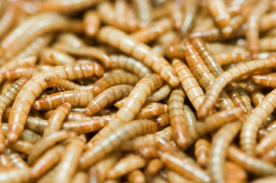
Introduction
Material and Methods
Conclusion
Objectives
Result and Discussion
Samples
2 batches
2 batches
Tenebrio molitor larvae
Purchased from local supplier
Notes:
2 batches of mealworms were produced in the entomology lab based at Gembloux, while 2 other batches were produced from a local Belgian supplier

Slide 7
Introduction
Material and Methods
Conclusion
Objectives
Result and Discussion
Material and Methods
Proteins
Protein estimation was done using dumas method
Lipids
Lipid extraction was done by a cold extraction technique using 2:1 chloroform/methanol as solvent
Thermal Profile of Lipids
Thermal profile was analyzed by differential scanning calorimetry Q1000 DSC connected to refrigerated cooling system
Note- All the samples were freeze dried (during 48hrs) and store at 4°C before examination
Notes:
The protein estimation was done using the dumas method.
Lipid extraction was done by a cold extraction technique utilizing 2:1 ration of Chloroform/methanol as solvent
Thermal profile was analyzed using differential scanning calorimetry

Slide 8
Introduction
Material and Methods
Conclusion
Objectives
Result and Discussion
Material and Methods (continued)
Fatty Acid Profile
TAG Profile
Fatty acid compositions were determined by GC on a HP 6890 Series GC System fitted with a HP 7683 Series injector and flame ionization detector
TAG compositions were analyzed by reversed phase HPLC (Agilent technologies 1200 series with a Evaporative Light Scattering Detector (Agilent Technologies 1200 Series ELSD)
Notes:
The fatty acid composition was determined using Gas chromatography
Triacylglycerol profile was analysed using reversed phased HPLC with a Evaporative light scattering detector

Slide 9
Introduction
Material and Methods
Conclusion
Objectives
Result and Discussion
Protein & Fat Content
(% dry matter)
% MUFA & PUFA
Sample | Protein content | Fat content
Commercial | 58% | 30%
Lab reared | 52% | 36%
Sample | MUFA | PUFA
Commercial | 41% | 31%
Lab reared | 53-56% | 16%
Notes:
Moving on to the results
The % protein in commercial and lab reared samples were 58% and 52%.
The % lipids in commercial and lab reared samples were 30% and 36%
The %MUFA and %PUFA in commercial and lab reared samples were 41% and 31%
The %MUFA in lab reared samples varied between 53-56% and %PUFA was 16%.

Slide 10
Introduction
Material and Methods
Conclusion
Objectives
Result and Discussion
% Fatty Acid Composition
Note: Unsaturated fatty acids represent 70% of total fatty acids in both commercial and in lab reared samples.
Notes:
The below graph represents the %Fatty acid composition of the mealworms. You can clearly see that it is dominated by the unsaturated fatty acids.
You can see that lab produced samples are rich in MUFA especially C 18:1 (Oleic acid). While those procured from local supplier are rich in PUFA especially C 18:2 (n6 linoleic acid).

Slide 11
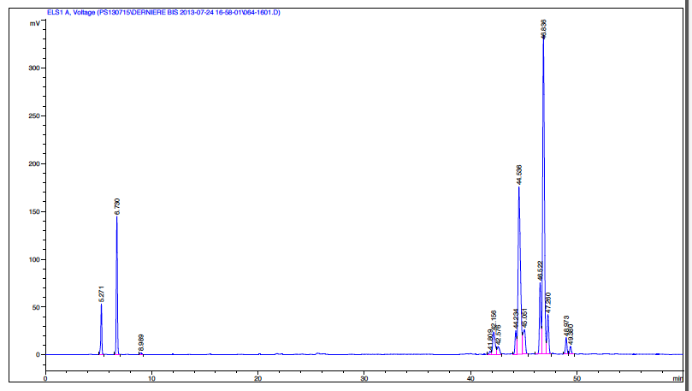
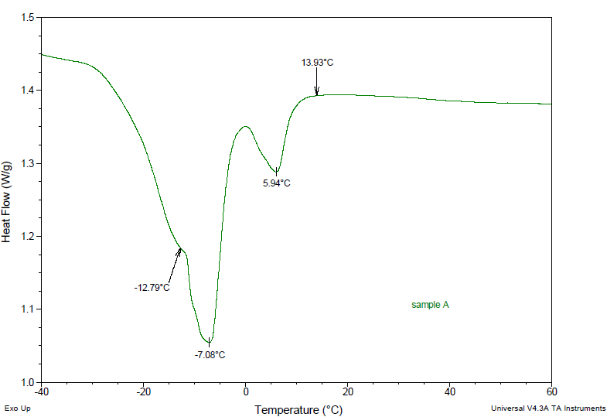
Introduction
Material and Methods
Conclusion
Objectives
Result and Discussion
Thermal Profile and TAG Profile (Lab 1)
Notes:
In the left you can see the melting profile of the lipids extracted from sample produced in lab (lab 1). You can see that the lipids are liquid at room temperature. In the right you can see the Triacylglycerol profile of lipids. Triacylglycerols contain three fatty acid molecules, where one, two or all three can unsaturated fatty acids. In the beginning you can the signal of low carbon chain saturated TAG and as we move on in the last you can see the high carbon triunsaturated TAGs. And the TAG profile is in contrast with the melting profile of lipids. The depression in the melting graph is in contrast to the peaks in the TAG profile.

Slide 12
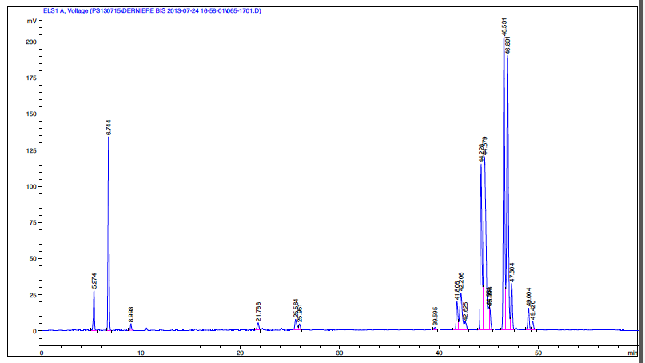
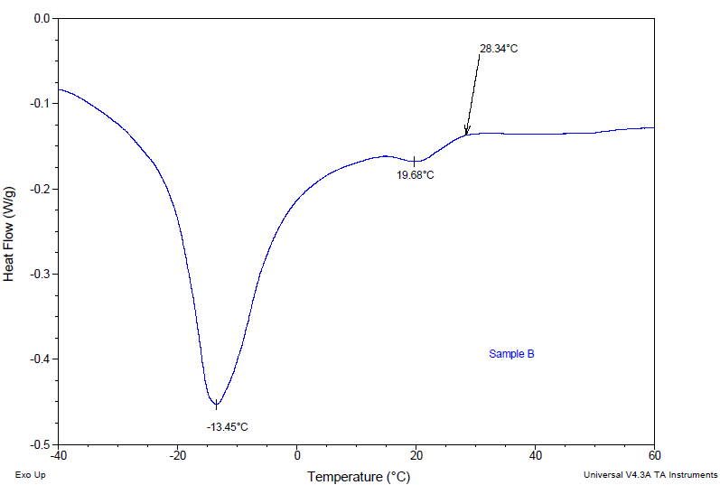
Introduction
Material and Methods
Conclusion
Objectives
Result and Discussion
Thermal Profile and TAG Profile (Lab 2)
Notes:
Lipids from sample 2 produced in labs are also liquid at room temperature. They are also rich in unsaturated TAG. The depressions in the melting profile are congruent to peaks in TAG profile.

Slide 13
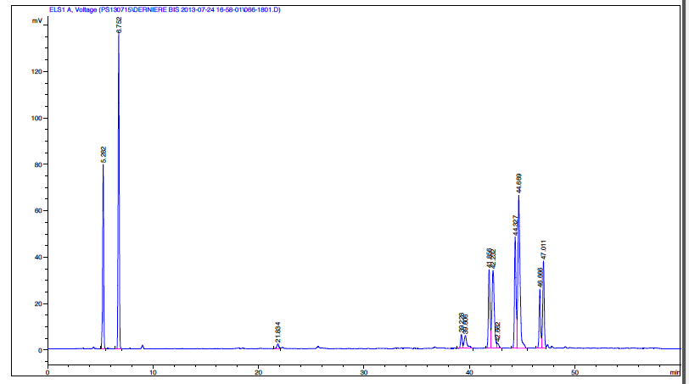
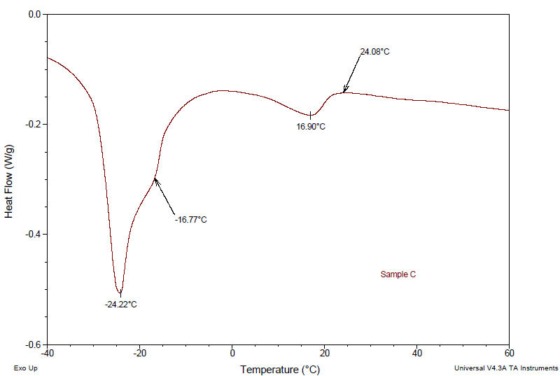
Introduction
Material and Methods
Conclusion
Objectives
Result and Discussion
Thermal Profile and TAG Profile (External 1)
Notes:
Similarly for sample 1 procured from local supplier

Slide 14
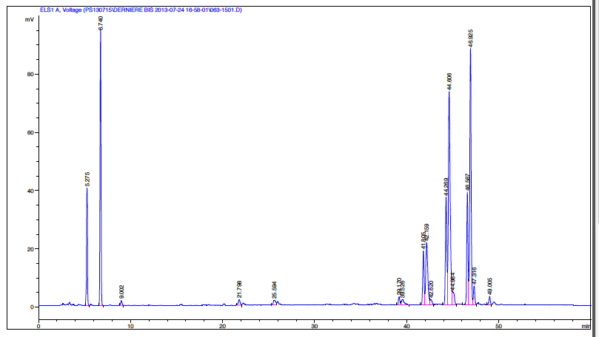
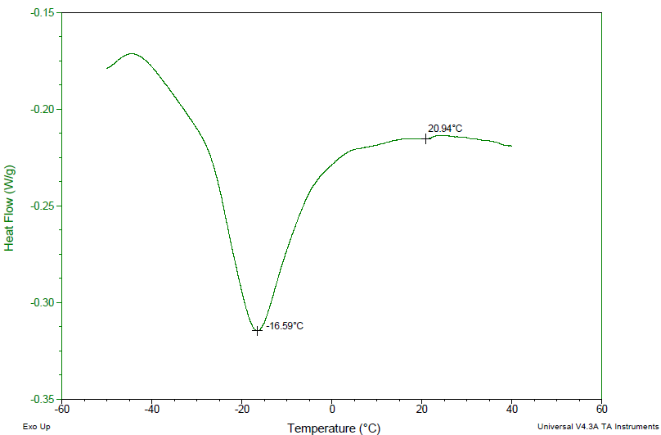
Introduction
Material and Methods
Conclusion
Objectives
Result and Discussion
Thermal Profile and TAG Profile (External 2)
Notes:
And for sample 2 procured from local supplier

Slide 15
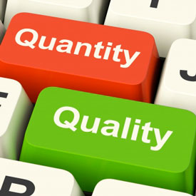
Introduction
Material and Methods
Conclusion
Objectives
Result and Discussion
Mealworms are important source of lipids especially the unsaturated lipids
With this fatty acid, TAG and thermal profiles mealworms can be really a potential oilseed substitute
The chemical composition and thermal properties varied with source, further it could be interesting to study effect of diet on the lipid composition

Slide 16
Sponsored by
Contact details
Email id: paul.aman@ulg.ac.be

Slide 17
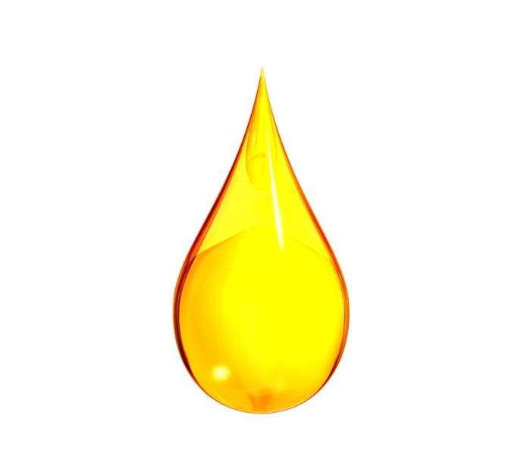
Hope I will be a substitute to oilseeds in future

