Slide 1
A Gene Regulatory Network model to assess the stability of the cartilage phenotype
J. Kerkhofs^{1,2,3}, H. Van Oosterwyck^{1,3}, L. Geris^{2,3}
1. Biomechanics Section, KU Leuven, Belgium; 2. Biomechanics Research Unit, University of Liège, Belgium; 3. Prometheus, the Leuven R&D division of skeletal tissue engineering, Belgium

Slide 2
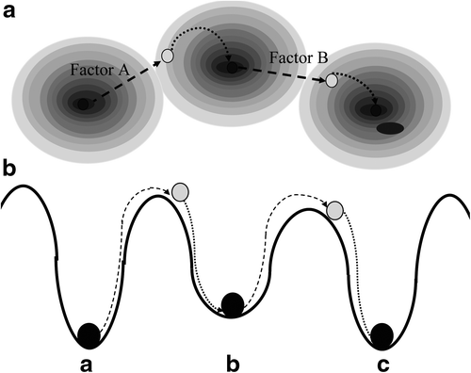
Developmental engineering
An approach to tissue engineering
A developmental process as a flow through attractors
Modelling
Identification of attractors
How to crest the ridges?
Lenas, 2009

Slide 3
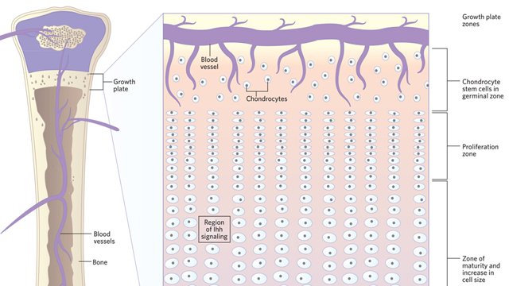
Endochondral ossification
Notes:
The new scientist

Slide 4
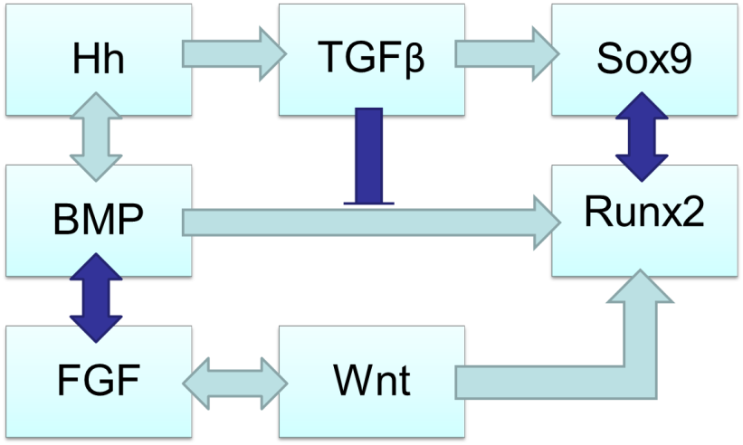
Hypertrophic switch
Focus on changes in the differentiation network accompanying these phenotypic changes
Middle-out approach: Sox9-Runx2

Slide 5
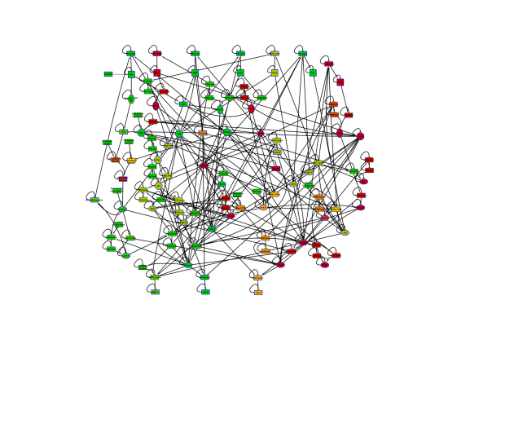
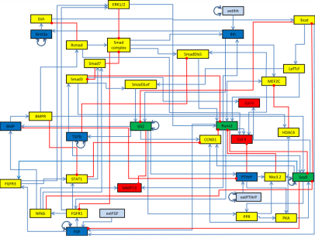
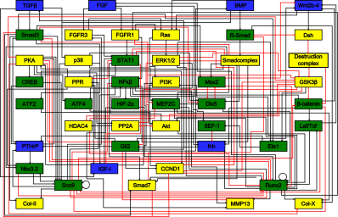
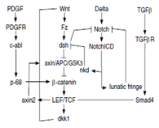
A few Network Model Types
Data required
Scope
Complexity
Phenomenological modelling
Mechanistic modelling
ANIMO
/ODE
Additive
Boolean
Graph
Notes:
To model edge quantitatively

Slide 6
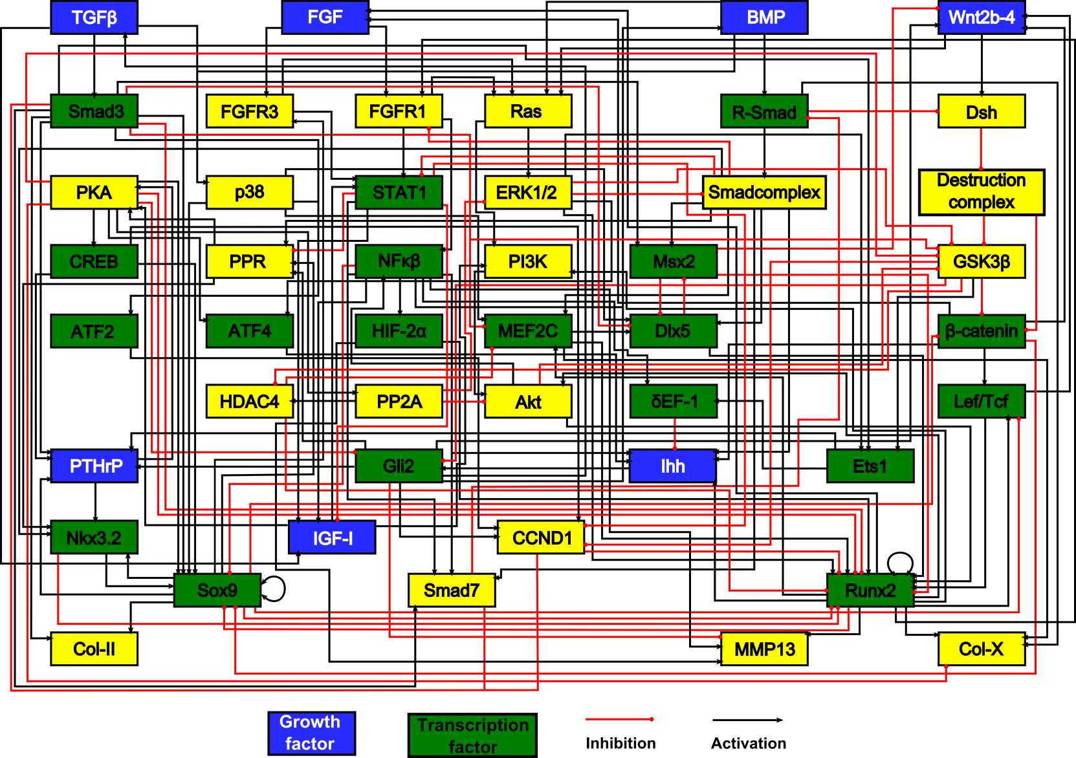
Chondrocyte gene network

Slide 7
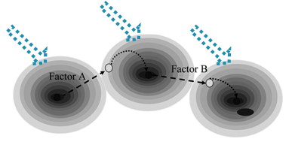
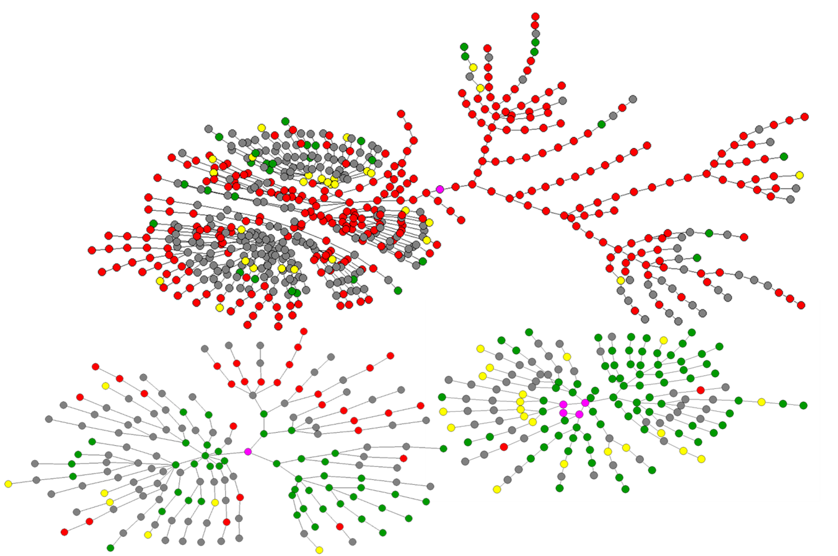
Attractor Stability
Attractor basin size estimated by Monte Carlo approach
Notes:
Parallel coordinate plot (matlab)

Slide 8
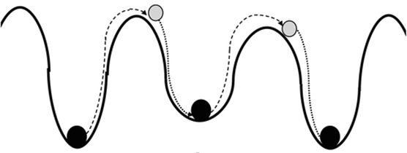
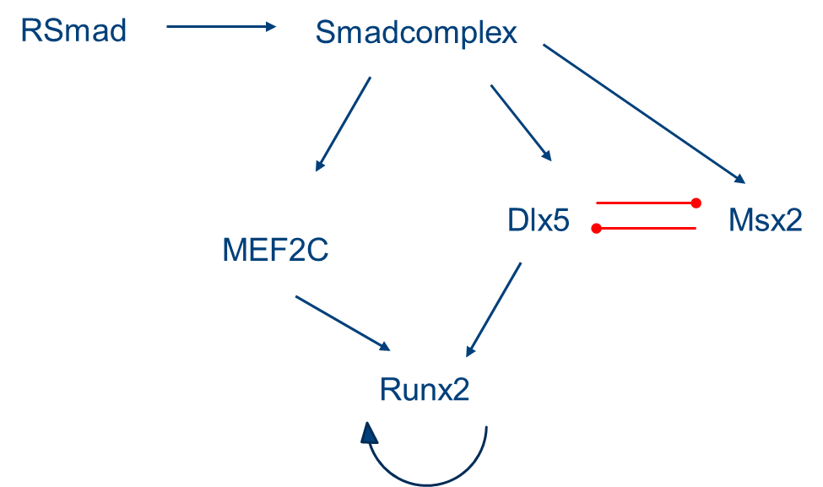
State transitions
Smad7
RSmad
Smadcomplex
Smad3
Sox9
PPR
STAT1

Slide 9
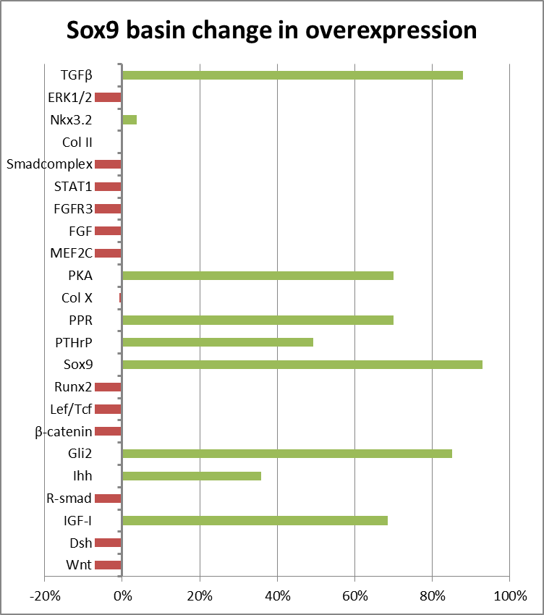
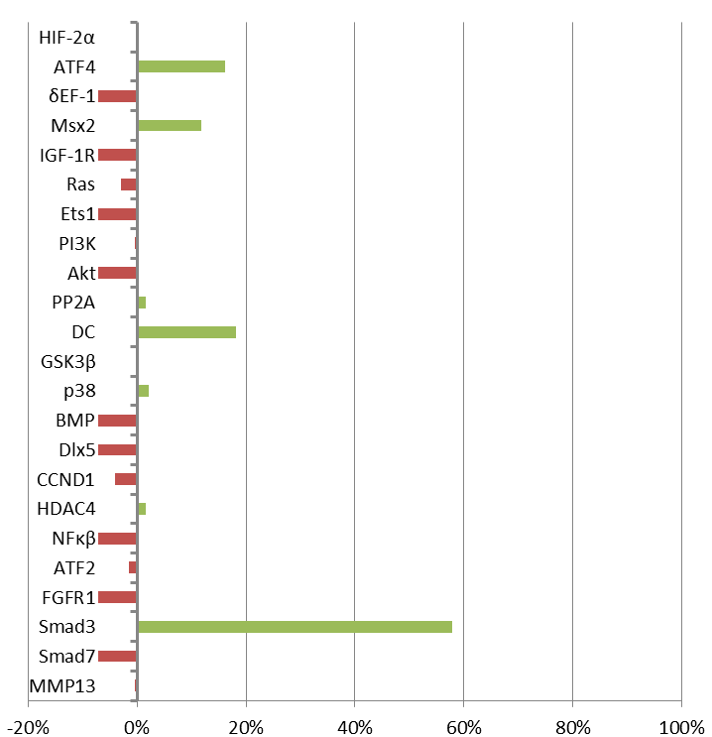
Individual factors

Slide 10
Conclusions
Qualitative information & results
Judgment on overall stability is not robust
Suggestion of most plausible mechanisms
Validation required

Slide 11
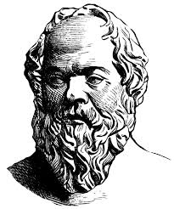
"The only thing I know is that I know nothing.“
̶ Socrates
Funding

Slide 13
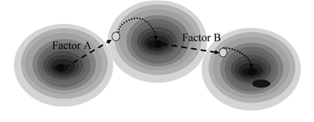

Slide 14
Attractor Stability
Attractor basin size estimated by Monte Carlo approach
Notes:
Parallel coordinate plot (matlab)

