Slide 1

What about Google Scholar when searching information in Human and Physical Geography?
        Simona STIRBU (Ms.)
        Library of Sciences and Technologies Geosciences Section
        12 April 2014

Slide 2
Google Scholar’s devise:
“Stand on the shoulders of giants”

Slide 3
Bibliographic Searches in:
Web of Science
GeoRef
FRANCIS
AND
Google Scholar
search engine
?

Slide 4
Bibliographic searches & databases
Search results
- repeatability, DB performances
- geographical ref., unique results
- overlap
Findings & Conclusions

Slide 5
Human Geography
Physical Geography
urbanization transportation
gentrification
immigration
tourism
sedimentation
earthquake
tsunami
erosion
flood

Slide 6
KEYWORDS
searched in the TITLE field
and
identically repeated monthly from 11/2010 to 05/2011
to find publications of the years 2005 to 2009
in
Physical Geography and Human Geography
RESULTS
bibliogr. tool contents
overlap
references number and type

Slide 7
Google Scholar:
Breadth of coverage | Coverage years | Resources | Information Type
500M records | Unknown | peer-reviewed papers, theses, books, abstracts and articles, reports from academic publishers, professional societies, preprint repositories, universities and other scholarly organizations | Citations Abstracts Full Text
Source: http://scholar.google.com

Slide 8
 | Web of Science | FRANCIS | GeoRef
Breadth of coverage | 40 million records 10,000 titles Journals (240 open access) & conference papers | 2.5 million records(journal articles, books, conference proceedings, dissertations, and reports) | 3 million records (3,500 journals, books, maps, government reports, conference papers, theses and dissertations)
Coverage years | A&HCI: 1975-present SCI: 1900-present SSCI: 1956-present | 1972-present | 1933-present 1669- present(for North America)
Source | http://isiwebofknowledge.com | http://support.ebsco.com | http://support.ebsco.com

Slide 9
Bibliographic searches & databases
Search results
- repeatability, DB performances
- geographical ref., unique results
- overlap
Findings & Conclusions

Slide 10
When the same search is repeated over time there is little variation in the number of hits retrieved by the traditional bibliographic tools, while the results retrieved by GS increases constantly (except for the last search)

Slide 11
When considering the publication years over the eight searches, the number of results retrieved remains quite similar. The averages computed in GS for 2009 show a more variable pattern than the other years

Slide 12
The number of hits retrieved by the traditional databases is low, while GS reached averages lying between 2000 and 2500 results

Slide 13
The variations for the keywords “earthquake”, “tsunami”, and “tourism” in all the bibliographic tools, are directly linked to events such as tsunami and earthquakes

Slide 14
For all the keywords searched, GS yields many more results than the other bibliographic databases, both in human and physical geography

Slide 15
GS seems to be more efficient in human geography while WoS performs better in physical geography. GeoRef and FRANCIS yield results which are in accordance with their subfield specificities

Slide 16
Bibliographic searches & databases
Search results
- repeatability, DB performances
- geogr. ref., type & unique results
- overlap
Findings & Conclusions

Slide 17
Case study: “urbanization” and “sedimentation”
urbanization
No of ref. Geogr. Ref. Grey Lit. Book/ Book Unique
‘05 – ‘09 % % Chapter % Ref/DB
GS 4791 57 15 6 2473
WoS 585 47 -- -- 83
GeoRef 99 98 47 4 39
FRANCIS 64 70 -- -- 11
sedimentation
GS 4123 45 34 5 904
WoS 1445 42 -- -- 72
GeoRef 1307 97 32 2 466
FRANCIS 39 85 -- -- 6

Slide 18
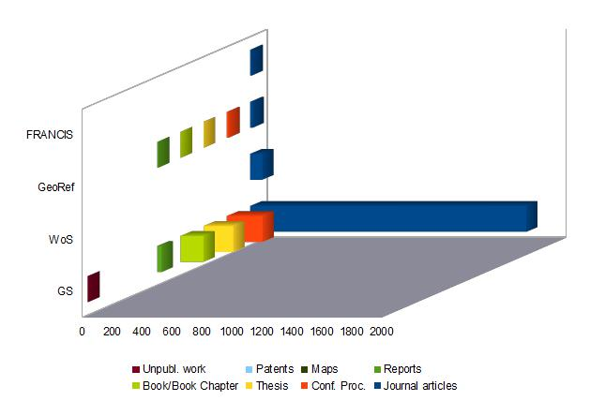
Journal articles represent the most important part of the unique references
Unique reference’s type – urbanization

Slide 19
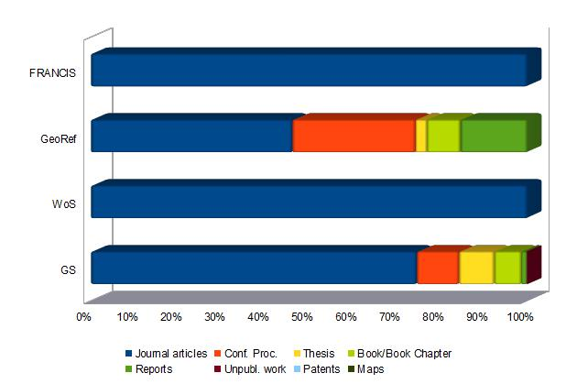
% of unique reference’s type - urbanization
Proportionally to the results number, conf. proceedings, reports, and book chapters percentages are significant in GeoRef

Slide 20
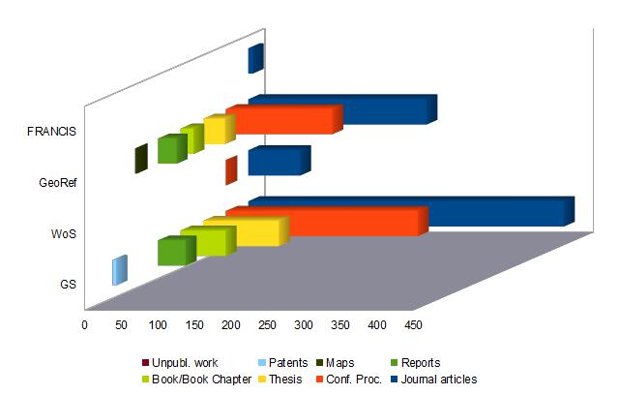
GeoRef provides an important number of unique references, and despite journal articles dominance, other types of literature is also significant
Unique reference’s type – sedimentation

Slide 21
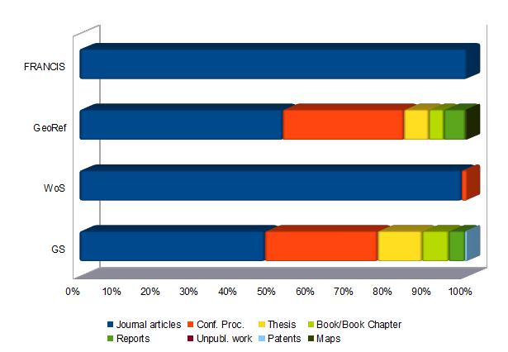
% of unique reference’s type - sedimentation
Conf. proceedings, thesis, book chapters, and reports percentages are significant in GeoRef but even more in GS

Slide 22
Bibliographic searches & databases
Search results
- repeatability, DB performances
- geographical ref., unique results
- overlap
Findings & Conclusions

Slide 24
Bibliographic searches & databases
Search results
- repeatability, DB performances
- geographical ref., unique results
- overlap
Findings & Conclusions

Slide 25
Conclusion & findings
Results provided by commercial DB’s is stable through time, while GS encounter more variations
Results correspond to the DB’s specificity.
GS seems to be more efficient in retrieving unique references in human geography, although both domains are well represented.
Geographers can use GS at least as a complementary tool, for their bibliographic research. After testing, it may become the principal tool.

