Slide 1






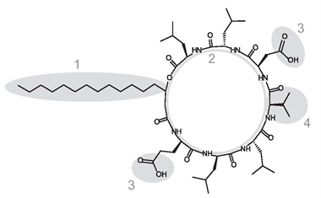
Bacterial lipopeptides as elicitors of plant defence
W.P. Luzuriaga, L. Franzil, M-L. Fauconnier, M. Deleu, L. Lins, M. Ongena & M.N. Nasir*
Gembloux Agro-Bio Tech, University of Liege. 5030 Gembloux, Belgium
*Corresponding author: Dr. Mehmet Nail NASIR, mn.nasir@ulg.ac.be.
Attention on beneficial plant microorganisms (BCA) has increased in last years as an eco-friendly alternative in crop protection. At this point, the BCA Bacillus subtilis is interesting because of its capacity to induce a long-term « vaccination effect » (ISR) in the host plant. Previous works showed that the most efficient ISR elicitor of Bacillus sp. is surfactin (SF), a lipopeptide with high affinity for the plant plasma membrane (PPM).
Tobacco cells in suspension were treated with a solution of SF in DMSO. SF interacts with the PPM and promotes the production of H₂O₂, an early mechanism of defence in plants.
Fluorescence in tobacco cells. Cells were previously loaded with the oxidant-sensing probe DCFH-DA.
Chemical structure of Surfactin (SF)
Plant plasma membrane
Highest fluorescence was observed 5 minutes after treatment
1: fatty acid chain
2: peptidic ring
3: polar groups
4: hydrophobic residue
Henry et al. 2011. Cellular Microbiology 13: 1824-1837
PLPC is the major phospholipid of plant plasma membrane (PPM), representing more than 40% of the total lipidic composition of PPM. Therefore, a first approach consists in verify the interactions between PLPC and SF.
Phosphate group
C=O esther group
CH₂ group
2nd derivative
2nd derivative
2nd derivative
There is an increase of free P=O groups, involvement of phosphate groups in SF-PLPC interactions
There is an increase of free C=O esther groups, in SF-PLPC interactions
There is a shift in CH₂ alkyl groups
Langmuir isotherms showing differents percentages of PLPC-SF
The interaction SF-PLPC is observed from 30% surfactin concentration
W.P.L., L.F. and M.N.N. are working for the ARC-FIELD project supported by the Wallonia-Brussels Federation. M.D. and L.L. thank the F.R.S.-F.N.R.S. (National Funds for Scientific Research, Belgium) for their positions as Research Associate and Senior Research Associate, respectively. The authors thank to Mary … and Justine … for their excellent technical support

