Slide 1
EXPERIMENTAL TESTS AND NUMERICAL MODELLING
ON EIGHT SLENDER STEEL COLUMNS
UNDER INCREASING TEMPERATURES
Jean-Marc FRANSSEN*, Bin ZHAO** and Thomas GERNAY*
* University of Liège, Belgium
** CTICM, France

Slide 2
1) Introduction
Name | Class in EN 1993-1-1 | Behaviou
STOCKY | 1 | Global buckling
…. | 2 | Global buckling
…. | 3 | Global buckling + local buckling
SLENDER | 4 | Local buckling + Global buckling

Slide 3
At elevated temperature, stiffness of steel decreases faster than strength.
The likelyhood of local buckling is even higher
(factor 0,85 in Eurocode 3)
Design method based on 0,2% proof strength
or critical temperature of 350°C in Eurocode 3.
RFCS project FIDESC4 on class 4 sections (beams and columns)

Slide 4
FIDESC4
CTICM
Technalia
Lindab
Univ. of Liege
Univ. of Aveiro
Univ. of Prague
Experimental tests
Numerical models
Parametric analyses
Design equations

Slide 5
2) Test set-up
Heating was achieved by electrical resistances (30 KVA):
Better control of the temperature increase
More uniform temperature distribution

Slide 6
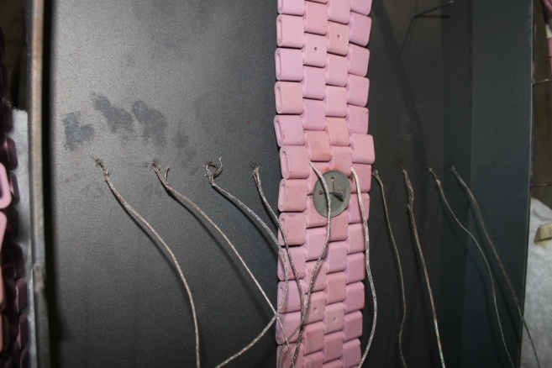
One heating mat + thermocouple tree

Slide 7
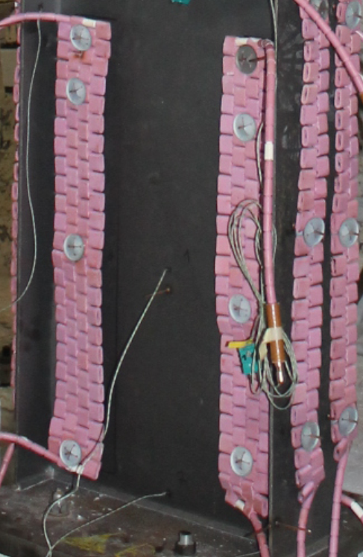
2 heating mats on the web
2 heating mats on one flange

Slide 8
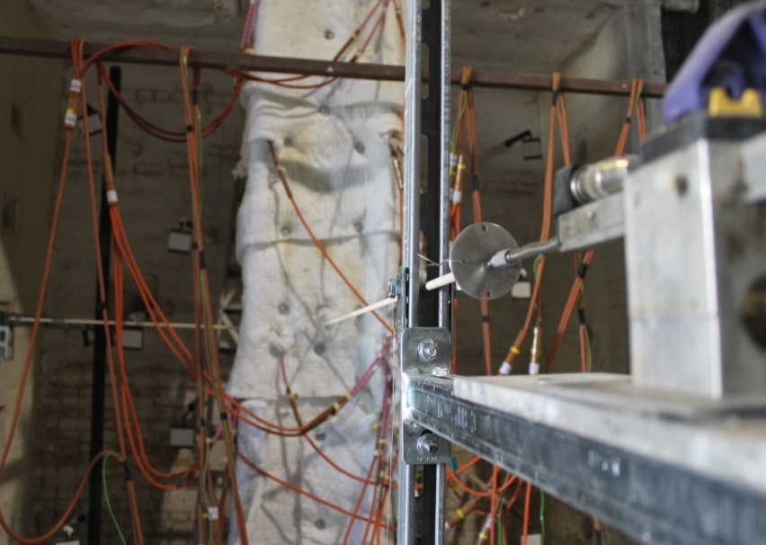
Column wrapped in ceramic mats + displacement transducer

Slide 9
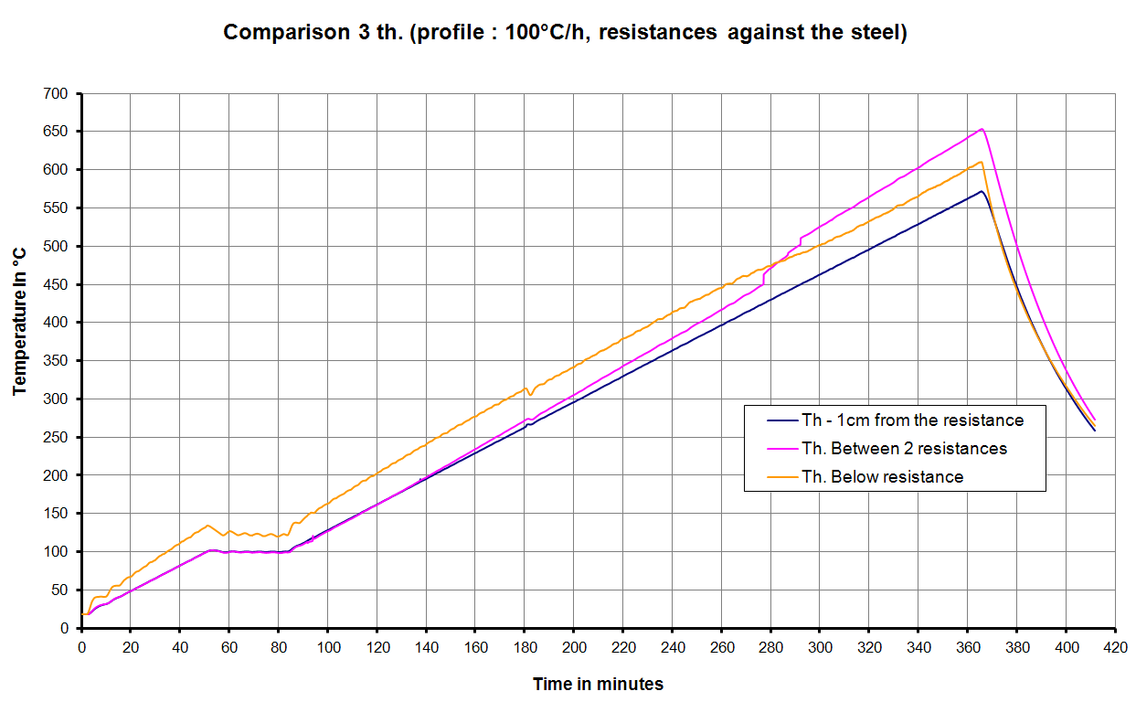
First blank test @ 100°C/h to control the uniform character of the temperature field.
Differences up to 70°C !

Slide 10
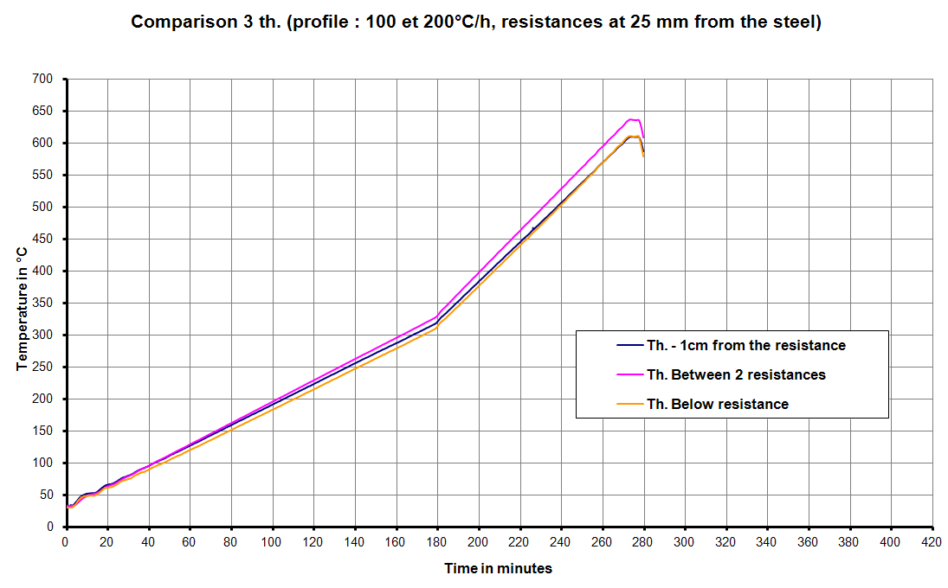
Second blank test @ 100 and 200°C/h with a 10 mm gap between the ceramic pads and the steel member.
Differences ≤ 30°C

Slide 11
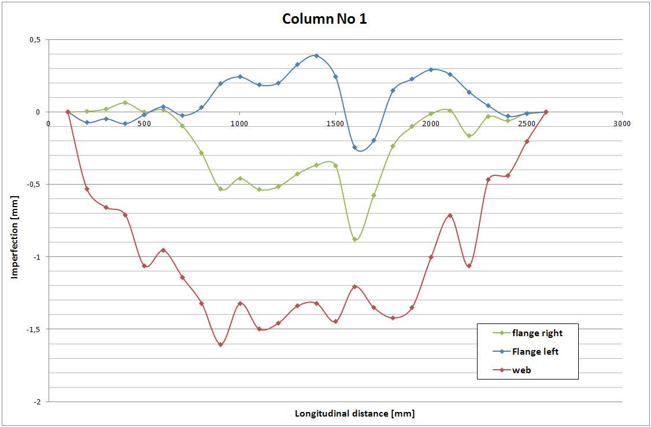
Geometrical imperfections have been measured

Slide 12
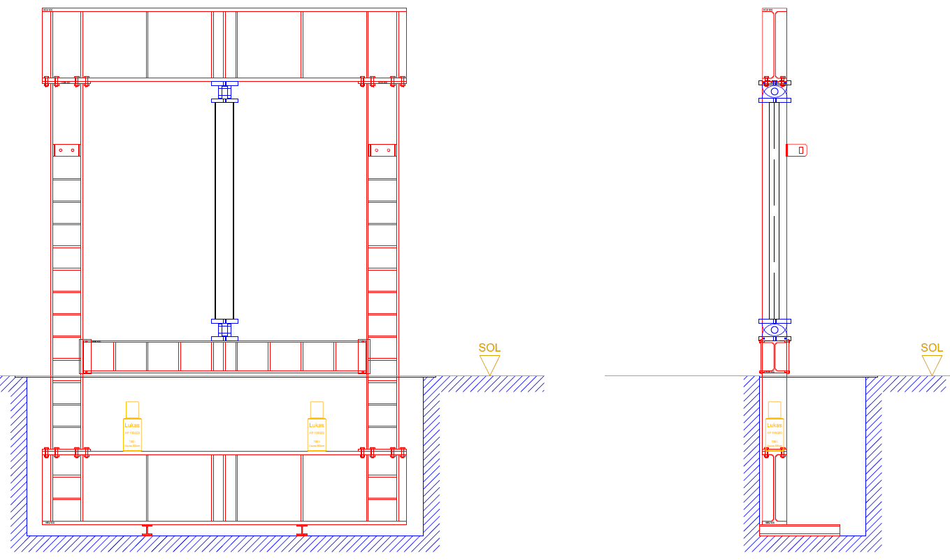
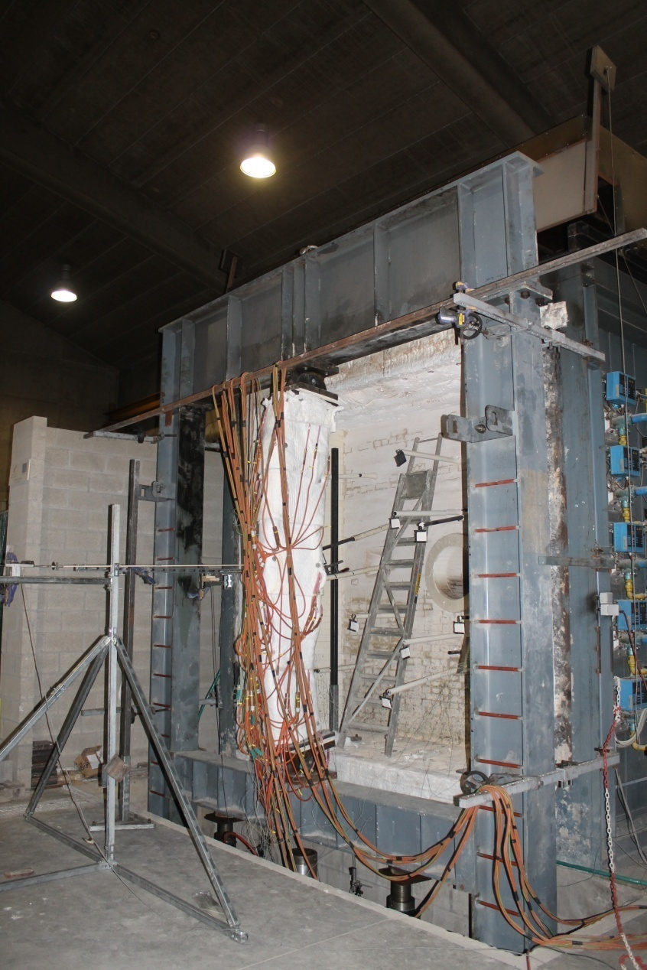
Boundary conditions: Pinned-pinned in one plane, fixed-fixed in the other plane Elongation unrestrained.
Note: preliminary numerical modeling showed that no lateral support was necessaery at mid level.

Slide 13
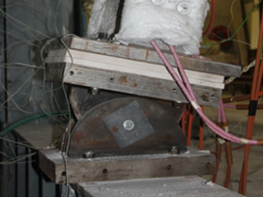
Hinged support (nylon bearings)

Slide 14
Section | Class of the web | Class of the flange | Eccentricity [mm] and direction | Applied load [kN]
IPE240AA 237/120/5,2/8,3 | 4 | 1 | 5 – 5, weak | 145
450/150/4/5 | 4 | 4 | 5 – 5, weak | 122
450/150/4/5 | 4 | 4 | 5 – 5, weak | 204
500-300/300/4,5/5 | 4 | 4 | 6 – 6, strong | 348
360/150/4/5 | 4 | 4 | 71 – 71, strong | 231
360/150/4/5 | 4 | 4 | 178 – 178, strong | 166
HE340AA 320/300/8,5/11,5 | 3 | 3 | 100 – 0, strong | 761
450-300/150/4/5 | 4 | 4 | 150 – 0, strong | 219

Slide 15
Length of the columns | 2740 – 2760 mm
Global imperfection | 1 – 5 mm
Local imperf. In the web | 0 – 5 mm
Local imperf. In the flanges | 0 – 5 mm
f_{y} in the web | 445 -580 N/mm²
fy in the flanges | 398 – 531 N/mm²

Slide 16
3) Main results
http://hdl.handle.net/2268/163773
Or Google « FRANSSEN ORBI »

Slide 17
Section | Eccentricity [mm] and direction | Applied load [kN] | Test result [°C]
IPE240AA 237/120/5,2/8,3 | 5 – 5, weak | 145 | 610
450/150/4/5 | 5 – 5, weak | 122 | 608
450/150/4/5 | 5 – 5, weak | 204 | 452
500-300/300/4,5/5 | 6 – 6, strong | 348 | 520
360/150/4/5 | 71 – 71, strong | 231 | 510
360/150/4/5 | 178 – 178, strong | 166 | 530
HE340AA 320/300/8,5/11,5 | 100 – 0, strong | 761 | 623
450-300/150/4/5 | 150 – 0, strong | 219 | 505

Slide 18
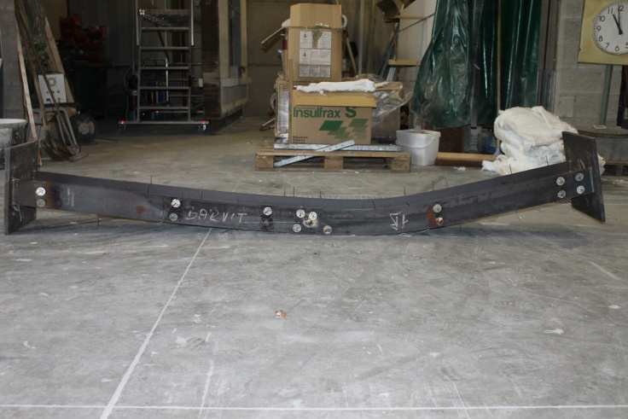
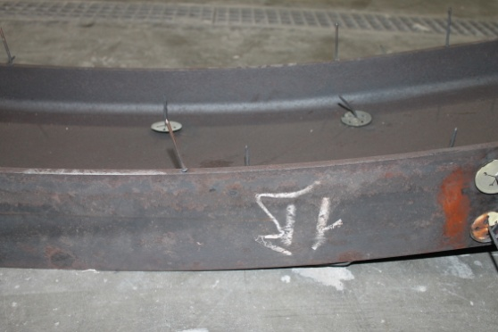
Test No 1 – IPE240A
Failure modes: global buckling along the weak axis without local buckling

Slide 19
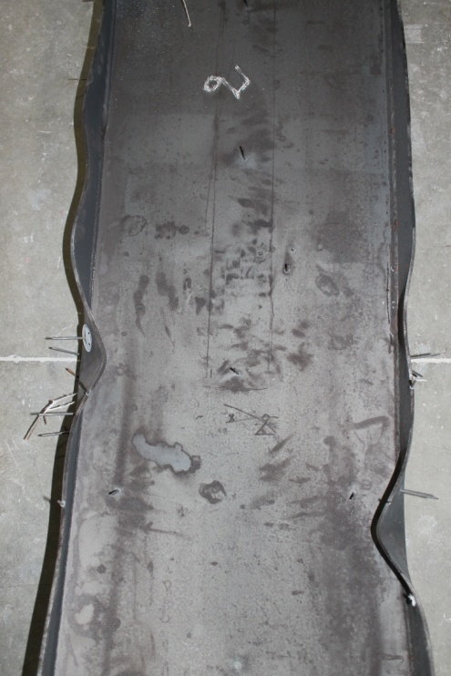
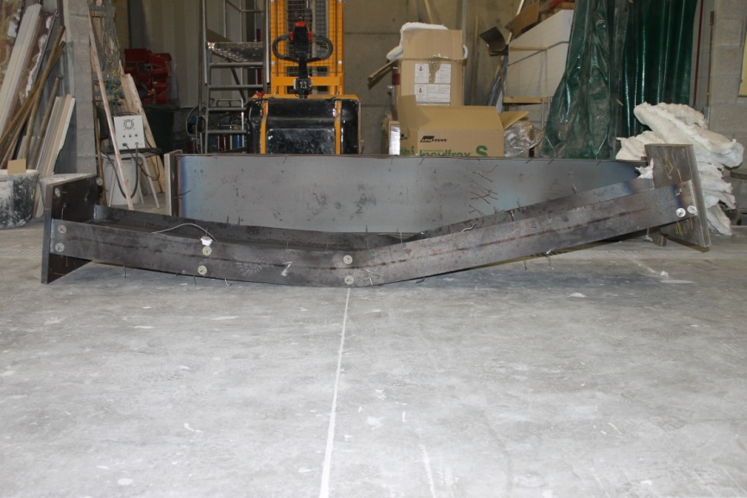
Test No 2
Failure modes: global buckling along the weak axis with local buckling of the flanges

Slide 20
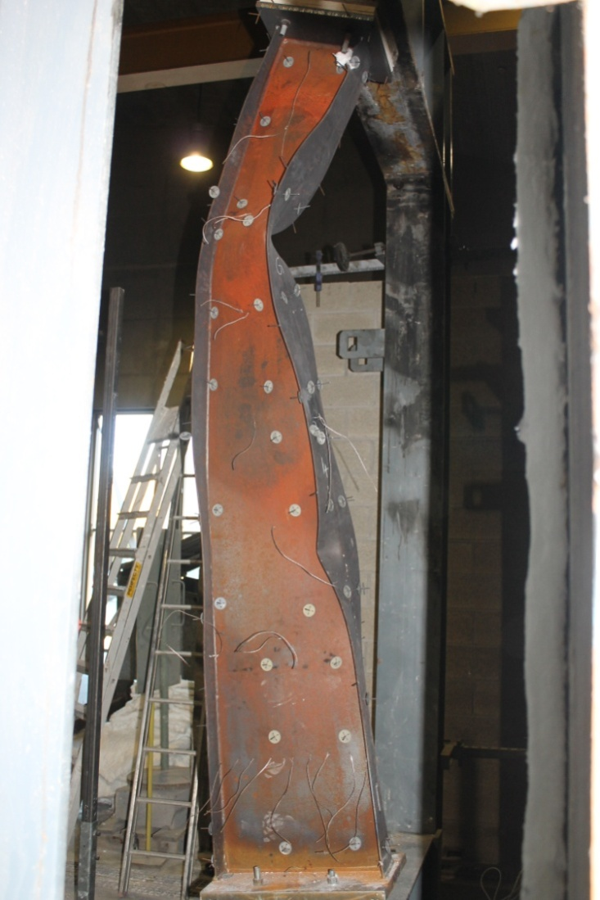
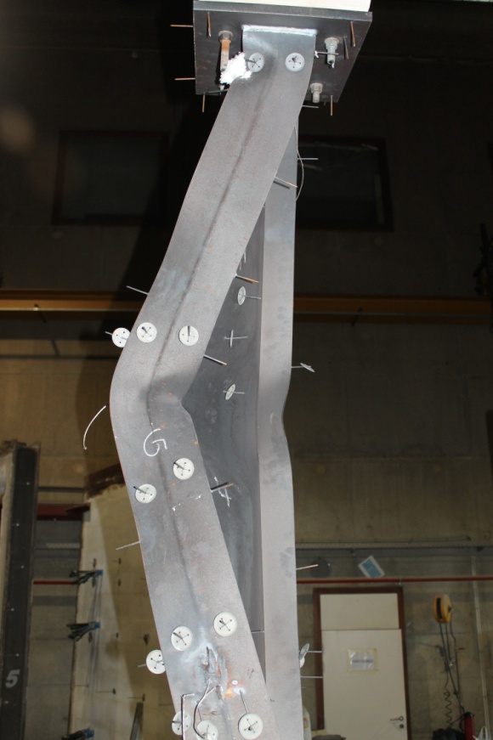
Test No 4
Failure modes:

Slide 21
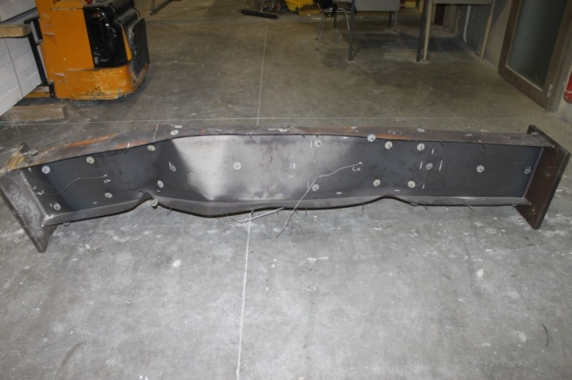
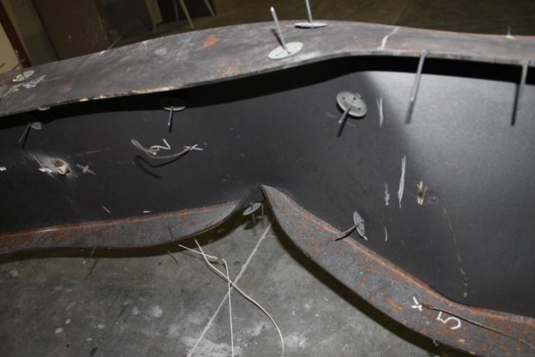
Test No 5
Failure mode:

Slide 22
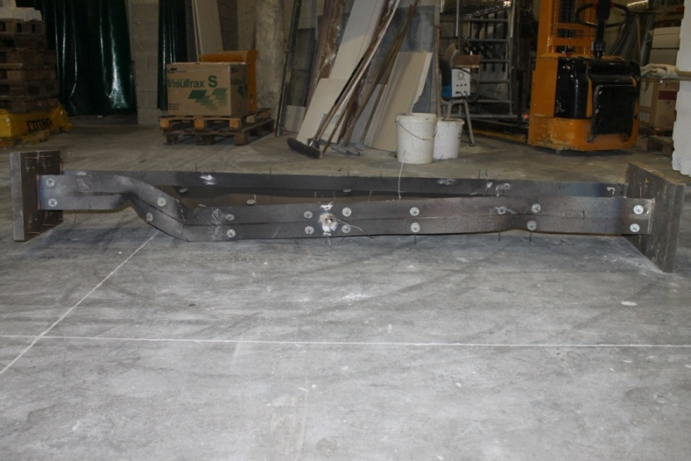
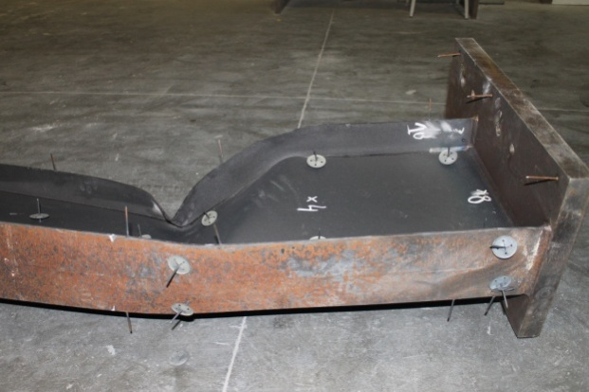
Test No 6
Failure mode:

Slide 23
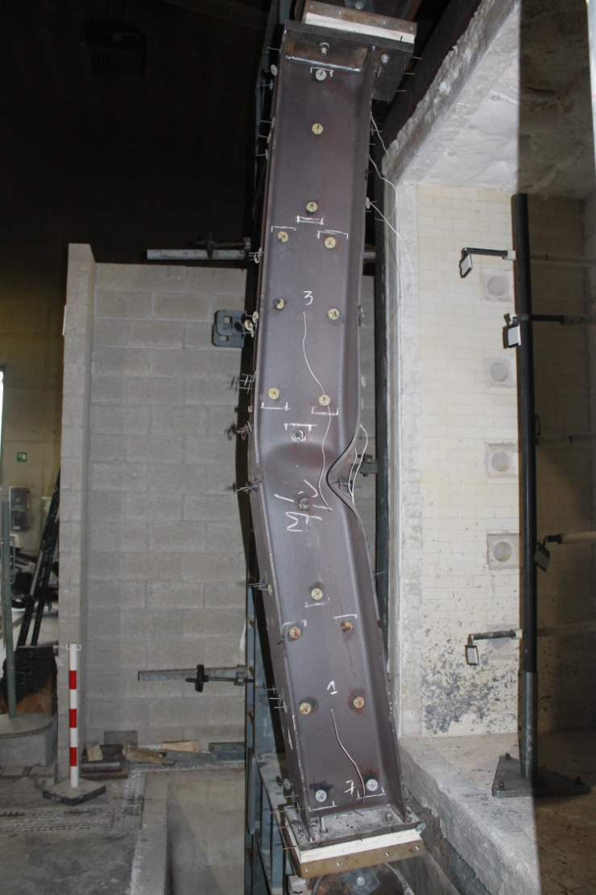
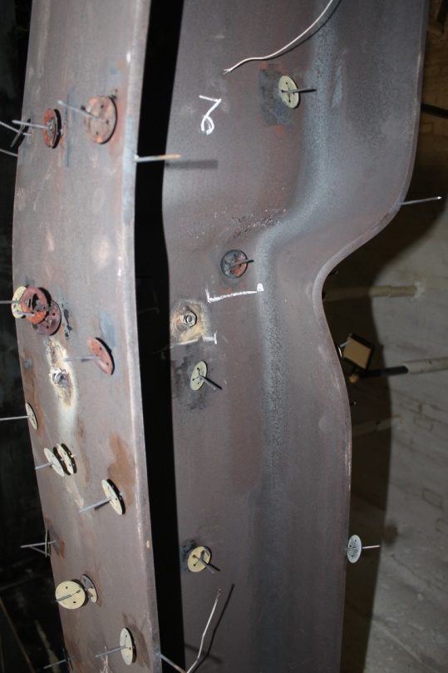
Test No 7
Failure mode:

Slide 24
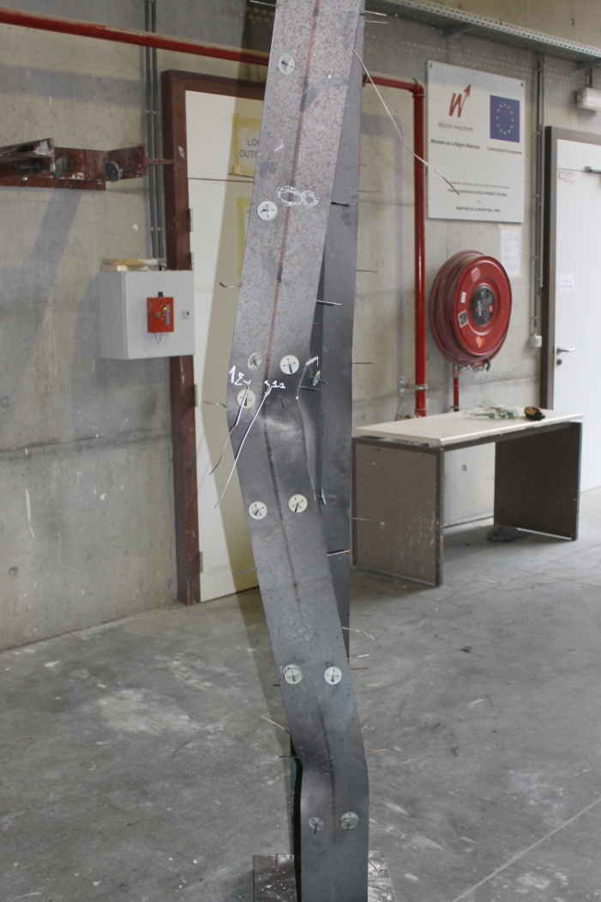
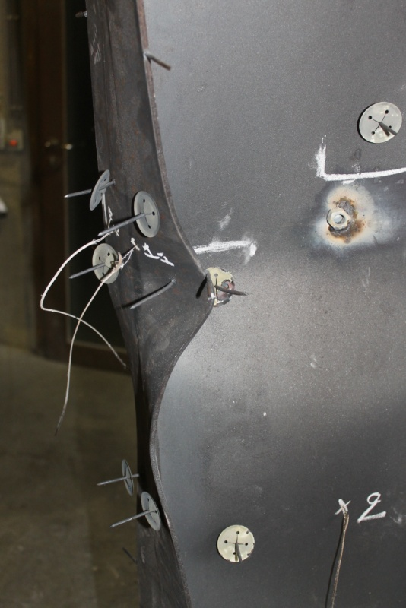
Test No 8
Failure mode:

Slide 25
4) Numerical modelling
Based on measured values of
yield strength
Geometry (length, thickness, imperfections)
SAFIR shell finite element (8 elements for the flange, 8 elements for the web, 100 elements on the length)

Slide 26
Geometrical imperfections First 2 Eigen modes from CAST3M

Slide 27
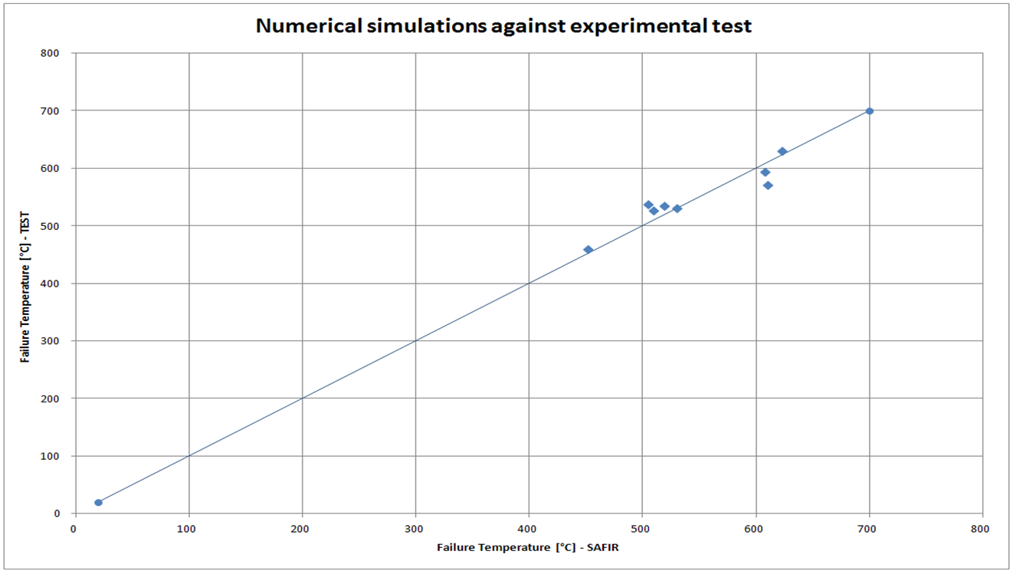
Numerical simulations / test results Average: 1,01 – standard deviation: 0,04

Slide 28
5) What’s next?
Data base made in Liege of 5 000⁺ numerical tests performed on centrically loaded welded section steel columns
Note: other data bases built by other partners
Design equations under construction.

Slide 29
6) Conclusions
8 experimental tests performed under well controlled conditions
Well documented: all detailled results (will be) published in an « open data » phylosophy
Can be used to verify numerical models or design equations.

