Slide 1



New insights for an old topic: seagrasses as bioindicators
of coastal trace element
pollution.
J. Richir, P. Lejeune and
S. Gobert
Olhão, Portugal
03-2014

Slide 2


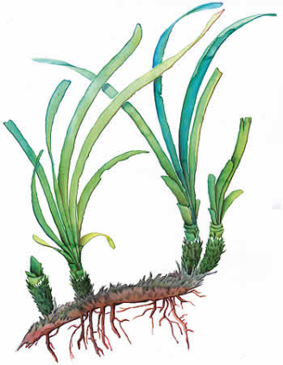
Introduction
Mediterranean anthropic pressures
I
N
T
R
O
D
U
C
T
I
O
N
pollution
trace elements
P. oceanica
direct measurements in the environment
bioindicators =
organisms accumulating pollutants to levels representative of their habitat pollution status

Slide 4
11
1
I
P. oceanica sampled in 18 sites at 15 m depth in April 2007
19 TEs analysed by DRC-ICP-MS: Be, Al, V, Cr, Mn, Fe, Co, Ni, Cu, Zn, As, Se, Mo, Ag, Cd, Sn, Sb, Pb, Bi
VII

Slide 5
e.g. 1 - V pollution
COASTAL
POLLUT
ION

Slide 6
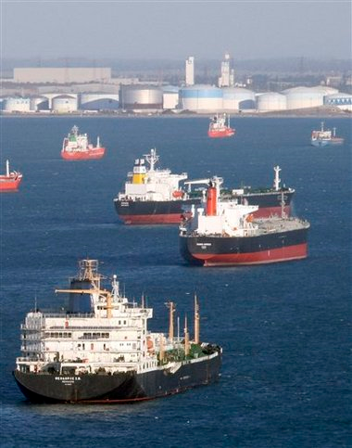
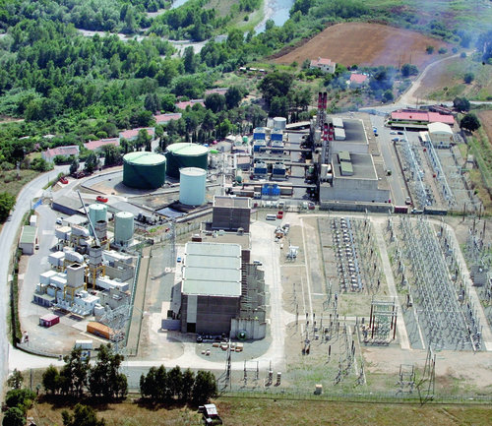
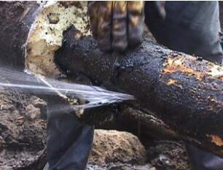
e.g. 1 - V pollution
COASTAL
POLLUT
ION
newsvine.com
corsematin.com
aria.developpement-durable.gouv.fr

Slide 7
e.g. 1 - V pollution
COASTAL
POLLUT
ION
newsvine.com
corsematin.com
Marseille oil refinery
Antibes oil-exporting harbour
Taglio-Isolaccio petroleum depot
aria.developpement-durable.gouv.fr

Slide 8
e.g. 1 - Sb pollution
COASTAL
POLLUT
ION

Slide 9
e.g. 1 - Sb pollution
COASTAL
POLLUT
ION

Slide 10
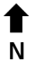
2 – mining (Sb, Zn) / industrial (As) activities
e.g. 1 - Sb pollution
V
Culioli et al. (2009)

Slide 11
V vs. Sb
COASTAL
POLLUT
ION

Slide 13


Slide 14
How to order and to compare TEs according to the overall spatial variability of their environmental levels through the whole of a studied area ?

Slide 15
How to order and to compare TEs according to the overall spatial variability of their environmental levels through the whole of a studied area ?
How to compare global pollution levels in TEs between several monitored sites ?

Slide 16
Trace Element Spatial Variation Index
How to order and to compare TEs according to the overall spatial variability of their environmental levels through the whole of a studied area ?
Trace Element Spatial Variation Index (TESVI)
TESV
I
TESVI = [(x_{max}/x_{min}) / (∑(x_{max}/x_{i})/n)] * SD

Slide 17
Trace Element Spatial Variation Index
How to order and to compare TEs according to the overall spatial variability of their environmental levels through the whole of a studied area ?
Trace Element Spatial Variation Index (TESVI)
TESV
I
TESVI = [(x_{max}/x_{min}) / (∑(x_{max}/x_{i})/n)] * SD
where:
x_{max} and x_{min} are the maximum and minimum mean concentrations recorded among the n sites,
x_{i} are mean concentrations recorded in each of the n sites,
SD is the standard deviation of the weighted sum ∑(x_{max}/x_{i})/n.
The highest the index value, the more environmental levels of a TE globally vary (punctual contaminations and overall coastal spatial heterogeneity of TE levels taken into account) through the whole of the studied area the index is applied to.

Slide 18
TESVI value calculation
Trace Element Spatial Variation Index (TESVI)
TESVI = [(x_{max}/x_{min}) / (∑(x_{max}/x_{i})/n)] * SD
TESV
I

Slide 19
TESVI value calculation
Trace Element Spatial Variation Index (TESVI)
TESVI = [(x_{max}/x_{min}) / (∑(x_{max}/x_{i})/n)] * SD
TESV
I
x_{max}/x_{min}

Slide 20
TESVI value calculation
Trace Element Spatial Variation Index (TESVI)
TESVI = [(x_{max}/x_{min}) / (∑(x_{max}/x_{i})/n)] * SD
TESV
I
…
∑(x_{max}/x_{i})
SD
x_{max}/x_{min}

Slide 21
TESVI value calculation
Trace Element Spatial Variation Index (TESVI)
TESVI = [(x_{max}/x_{min}) / (∑(x_{max}/x_{i})/n)] * SD
TESV
I
…
∑(x_{max}/x_{i})
SD
x_{max}/x_{min}
n

Slide 22
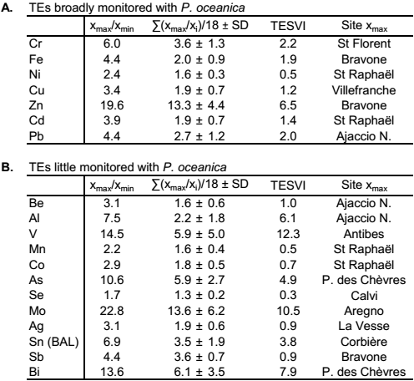
TESV
I

Slide 23
TESV
I
TESVI values were listed in ascending order :
Se, Ni, Mn, Co, Sb, Ag, Be, Cu, Cd, Fe, Pb, Cr, Sn, As, Al, Zn, Bi, Mo, V

Slide 24
TESVI graphical representation
TESVI values were listed in ascending order :
Se, Ni, Mn, Co, Sb, Ag, Be, Cu, Cd, Fe, Pb, Cr, Sn, As, Al, Zn, Bi, Mo, V

Slide 25
TESVI graphical representation
* highest x_{max}/x_{min} value
* highest x_{max}/x_{min} value
* highest x_{max}/x_{min} value
* highest x_{max}/x_{min} value
TESVI values were listed in ascending order :
Se, Ni, Mn, Co, Sb, Ag, Be, Cu, Cd, Fe, Pb, Cr, Sn, As, Al, Zn, Bi, Mo, V

Slide 26
TESV
I
22.8
TESVI values were listed in ascending order :
Se, Ni, Mn, Co, Sb, Ag, Be, Cu, Cd, Fe, Pb, Cr, Sn, As, Al, Zn, Bi, Mo, V

Slide 27
TESVI graphical representation
TESVI values were listed in ascending order :
Se, Ni, Mn, Co, Sb, Ag, Be, Cu, Cd, Fe, Pb, Cr, Sn, As, Al, Zn, Bi, Mo, V

Slide 29
Trace Element Pollution Index
How to compare global pollution levels in TEs between several monitored sites ?
Trace Element Pollution Index (TEPI)
TEPI = (Cf₁ * Cf₂ … Cf_{n})^{1/n},
TEP
I

Slide 30
Trace Element Pollution Index
How to compare global pollution levels in TEs between several monitored sites ?
Trace Element Pollution Index (TEPI)
TEPI = (Cf₁ * Cf₂ … Cf_{n})^{1/n},
TEP
I
a weighted version of the Metal Pollution Index (MPI) of Usero et al. (1996, MPB)
where:
Cf_{n} is the mean normalized concentration of the TE n in a given monitored site.
The highest the index value, the more the monitored site is globally contaminated in TEs compared to the others.

Slide 31
Mean normalization
TEP
I

Slide 32
Mean normalization
Random list 1:
Be, Al, V, Cr, Mn, Fe, Co, Ni, Cu, Zn, As, Se, Mo, Ag, Cd, Sn, Sb, Pb, Bi
Random list 5:
Sb, V, Sn, Se, Be, Pb, Ni, Mo, Mn, Fe, Cu, Cr, Co, Cd, Bi, Zn, As, Ag, Al

Slide 33
Mean normalization
Random list 1:
Be, Al, V, Cr, Mn, Fe, Co, Ni, Cu, Zn, As, Se, Mo, Ag, Cd, Sn, Sb, Pb, Bi
Random list 5:
Sb, V, Sn, Se, Be, Pb, Ni, Mo, Mn, Fe, Cu, Cr, Co, Cd, Bi, Zn, As, Ag, Al

Slide 34
TEPI for the French Mediterranean littoral
TEP
I

Slide 35
TEPI for the French Mediterranean littoral
TEP
I

Slide 37
P. oceanica

Slide 38
P. oceanica

Slide 39
P. oceanica

Slide 40
Conclusion
Conclusion
Trace Element Spatial Variation Index
Trace Element Pollution Index
TESVI = [(x_{max}/x_{min}) / (∑(x_{max}/x_{i})/n)] * SD
TEPI = (Cf₁ * Cf₂ … Cf_{n})^{1/n}

Slide 41
Conclusion
Conclusion
Trace Element Spatial Variation Index
Trace Element Pollution Index
TESVI = [(x_{max}/x_{min}) / (∑(x_{max}/x_{i})/n)] * SD
TEPI = (Cf₁ * Cf₂ … Cf_{n})^{1/n}
TESVI and TEPI efficient complementary indices to monitor the pollution in TEs, since they successfully led:
to the ordering of TEs according to the overall spatial variability of their environmental levels along the French Mediterranean littoral;
to the quantification of the global pollution in TEs between monitored sites.

Slide 42
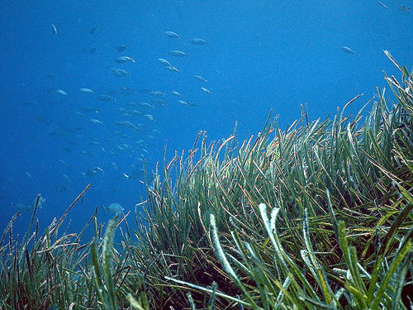
Thank you for your attention
QUEST
IONS

Slide 43
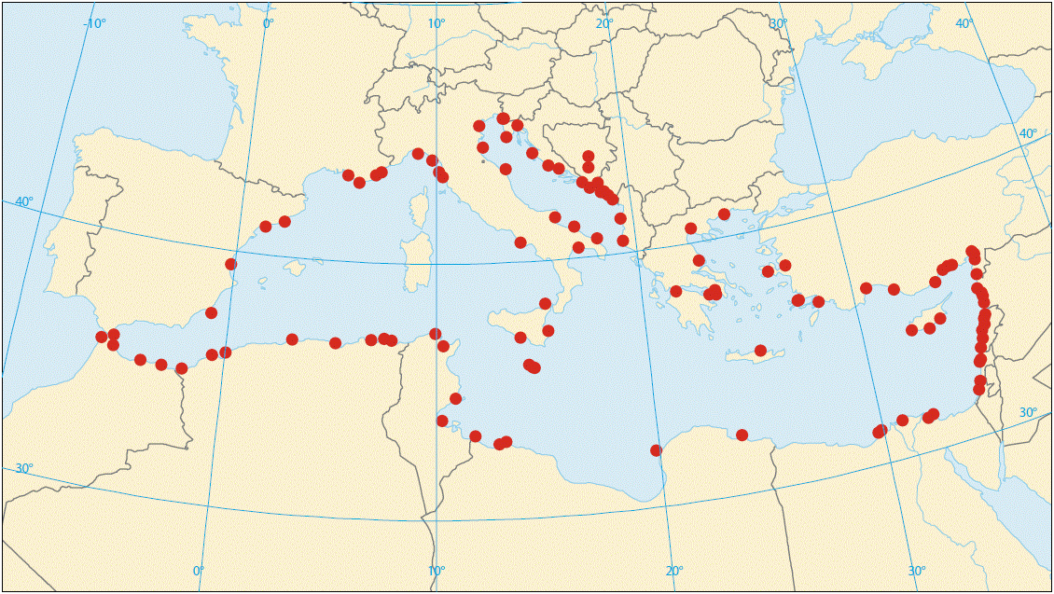
Coastal pollution of the Mediterranean
I
N
T
R
O
D
U
C
T
I
O
N
Pollution hot spots (full red circles) along the Mediterranean coasts (EEA 2006)

Slide 44
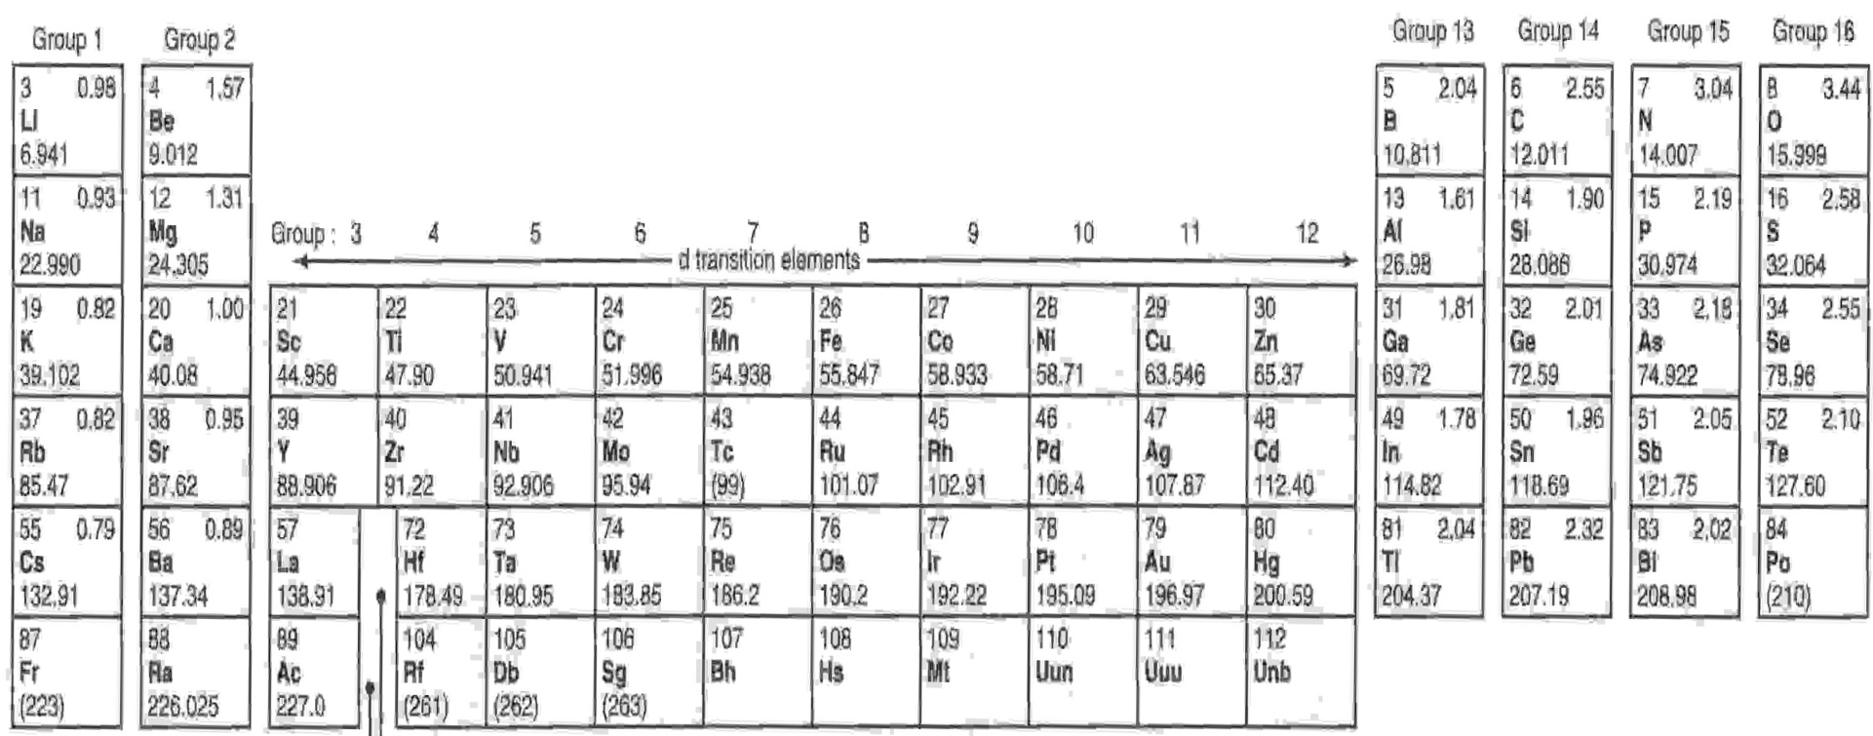
Monitoring of the pollution by trace elements
pollution
I
N
T
R
O
D
U
C
T
I
O
N
trace elements

Slide 45
Monitoring of the pollution by trace elements
pollution
I
N
T
R
O
D
U
C
T
I
O
N
trace elements

Slide 46
Monitoring of the pollution by trace elements
pollution
I
N
T
R
O
D
U
C
T
I
O
N
trace elements

Slide 47

Monitoring
Number of references (1975-2012) on trace elements studied in Posidonia oceanica
I
N
T
R
O
D
U
C
T
I
O
N
TE | Cd | Pb | Cu | Zn | Cr | Fe | Ni
# ref. | 34 | 29 | 27 | 25 | 22 | 14 | 13
TE | As | Se | Ag | Co | Mn | Al
# ref. | 3 | 3 | 2 | 2 | 2 | 1
TE | Be | Bi | V | Mo | Sn | Sb
# ref. | 0 | 0 | 0 | 0 | 0 | 0
Luy et al. (2012; Ecological Indicators)

Slide 48
World production of trace elements
I
N
T
R
O
D
U
C
T
I
O
N

Slide 49
World production of trace elements
X 2.0
I
N
T
R
O
D
U
C
T
I
O
N
X 3.1
X 3.1

Slide 50
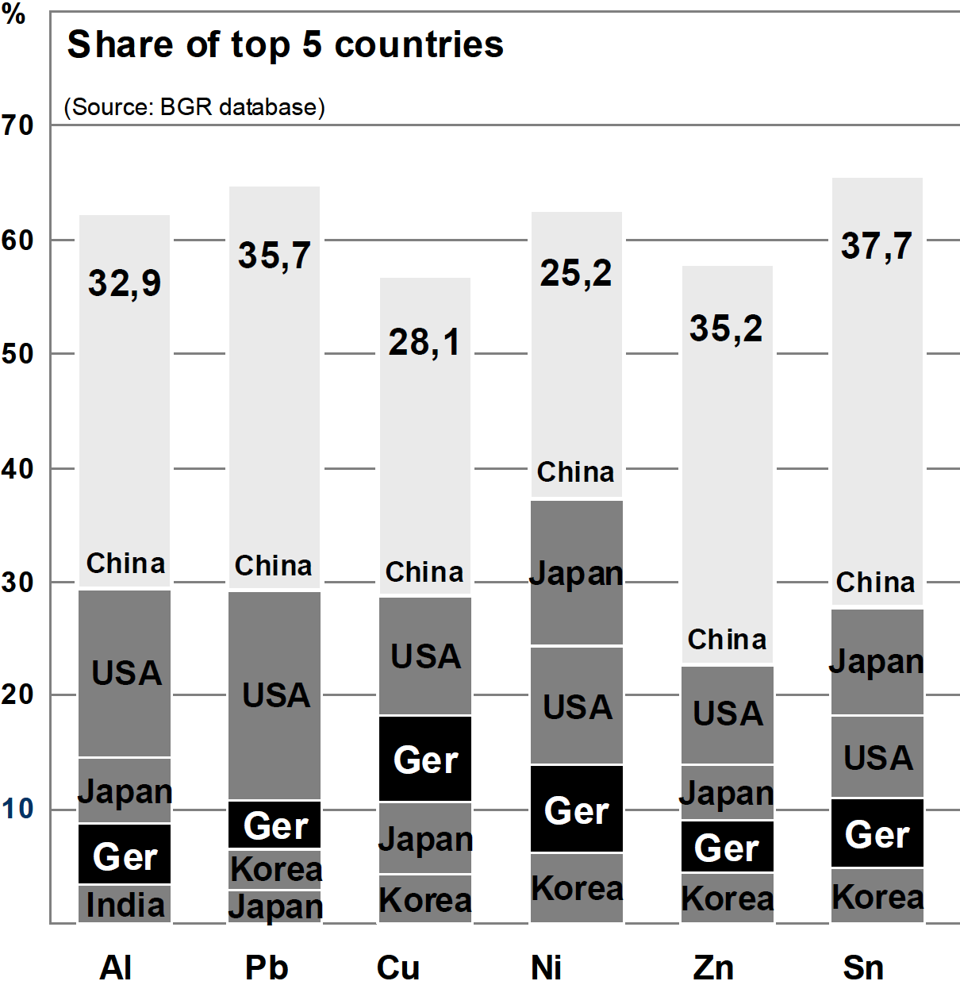
World consumption of trace elements
I
N
T
R
O
D
U
C
T
I
O
N
(modified after Sievers et al. 2010)

Slide 51
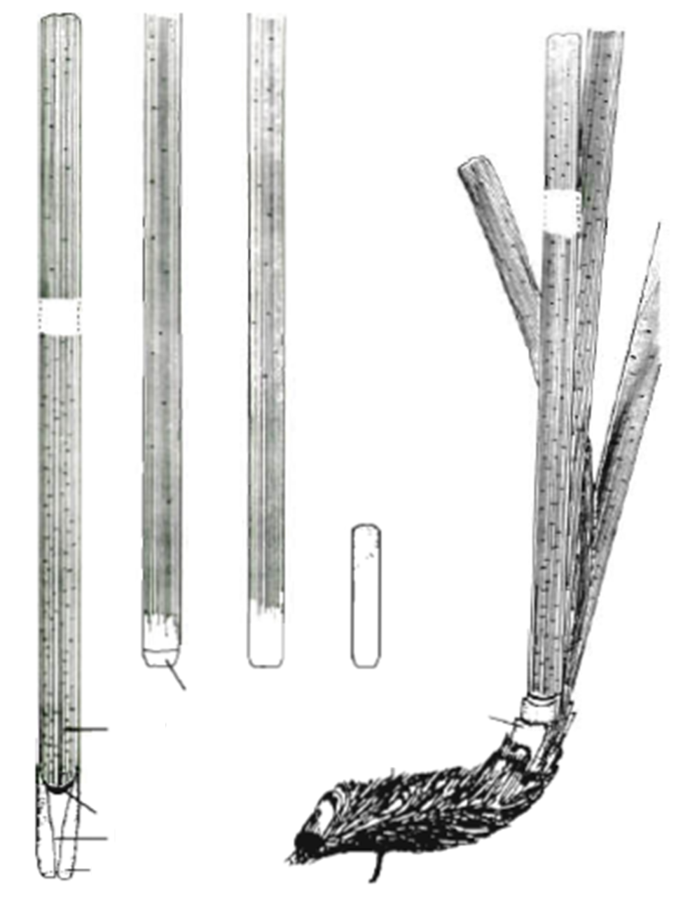

Posidonia oceanica
blade
I
N
T
R
O
D
U
C
T
I
O
N
B
C
D
E
plagiotropic shoot
orthotropic shoot
leaf base (petiole)
limb
scale
rhizome
A
rhizome
ligula
roots
leaf base
stipule
root
Left: P. oceanica shoots fixed on a plagiotropic rhizome. Right: (A) shoot of leaves on a plagiotropic rhizome; (B, C) adult leaves; (D) intermediate leaf; (E) juvenile leaf (modified after Libes and Boudouresque 1987).

Slide 52

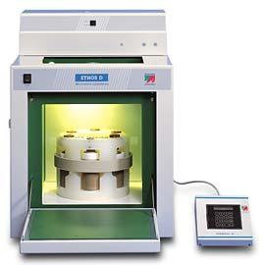


Laboratory analyses
M
A
T
E
R
I
A
L
-
METHODS
Analytical steps:
homogeneous sample
acidic digestion in a microwave oven
measures :
inductively coupled plasma mass spectrometer
Ethos D
ELAN DRCII

Slide 53
Mean normalization
Random list 1:
Be, Al, V, Cr, Mn, Fe, Co, Ni, Cu, Zn, As, Se, Mo, Ag, Cd, Sn, Sb, Pb, Bi
Random list 1:
Sb, V, Sn, Se, Be, Pb, Ni, Mo, Mn, Fe, Cu, Cr, Co, Cd, Bi, Zn, As, Ag, Al

Slide 54
Mean normalization
Random list 1:
Be, Al, V, Cr, Mn, Fe, Co, Ni, Cu, Zn, As, Se, Mo, Ag, Cd, Sn, Sb, Pb, Bi
Random list 5:
Sb, V, Sn, Se, Be, Pb, Ni, Mo, Mn, Fe, Cu, Cr, Co, Cd, Bi, Zn, As, Ag, Al

Slide 55
Data pre-treatment
Random list 5: Sb, V, Sn, Se, Be, Pb, Ni, Mo, Mn, Fe, Cu, Cr, Co, Cd, Bi, Zn, As, Ag, Al

Slide 56
TEPI comparison
max diff. 85 %
max diff. 85 %
max diff. 85 %
max diff. 29 %

