Slide 1
Neurographies sensitives et motrices
Bases techniques
François Wang

Slide 2
Fils & Câbles
Pré-amplificateur (analogique) Amplificateur (analogique) Filtres
Electrodes
Digitalisation du signal
(échantillonnage)
Imprimante Sauvegarde des données
…..
Représentation graphique et sonore
Traitement numérique du signal (filtres digitaux) et analyses
Electromyographe moderne
Notes:
This illustration shows the signal flow in a typical modern digital EMG system. The electrodes are used to register the neurophysiologic potentials. The leads and cables bring it to the amplifier input. The amplifier may be divided in to “pre-amplifier” and “main amplifier” sections. For the sake of simplicity, we will treat these sections as one entity. The amplifiers are analog devices and may contain some signal conditioning circuits called filters. Once the signals are amplified, they are fed in to a device called “analog to digital” converter. This converts the EMG signal into a record of voltage values at different times.

Slide 3
Echantillonnage
Tous les échantillons sont reliés entre eux pour construire le signal digitalisé
Permet de : sauver les traces d’y retourner ultérieurement de les geler sur l’écran de faire des mesures automatiques et des analyses complexes
Digitalisation
Notes:
This is the most critical component of the digital EMG instruments. The analog to digital converter, called the ADC, measures the EMG signal amplitude at regular intervals. Each measurement is called a sample. These samples are connected by straight lines to construct the digitized EMG signal. The samples of an EMG recording can be saved as on the computer as a file. It allows the user to review the signals in an “off-line” fashion, freeze the trace on the screen, make automated measurements, perform complex analysis that could not be performed manually, etc. Indeed, the digitized EMG record offers many benefits that were not available from the previous generation analog EMG systems. At the same time, one must be aware of some technical problems that can arise in digital EMG systems. Failure to recognize them may result in some incorrect inferences about the underlying pathology.

Slide 4
Intervalle
d’échantillonnage
Taux d’échantillonnage = 1 / intervalle d’échantillonnage
Digitalisation
Notes:
The time interval between the samples is the “sampling interval”. Reciprocal of sampling interval is the sampling frequency. In this illustration, there is a good concordance between the analog and digital versions of the EMG. Let us now double the sampling interval. The EMG record contains only half the samples compared to the earlier record. The digital EMG signal looks quite different from the analog signal. Specifically, the amplitude is reduced, the rise time is increased and sharp peaks appear smooth and some peaks are missing. This type of distortion, called aliasing, would clearly affect our EMG signal interpretation.

Slide 5
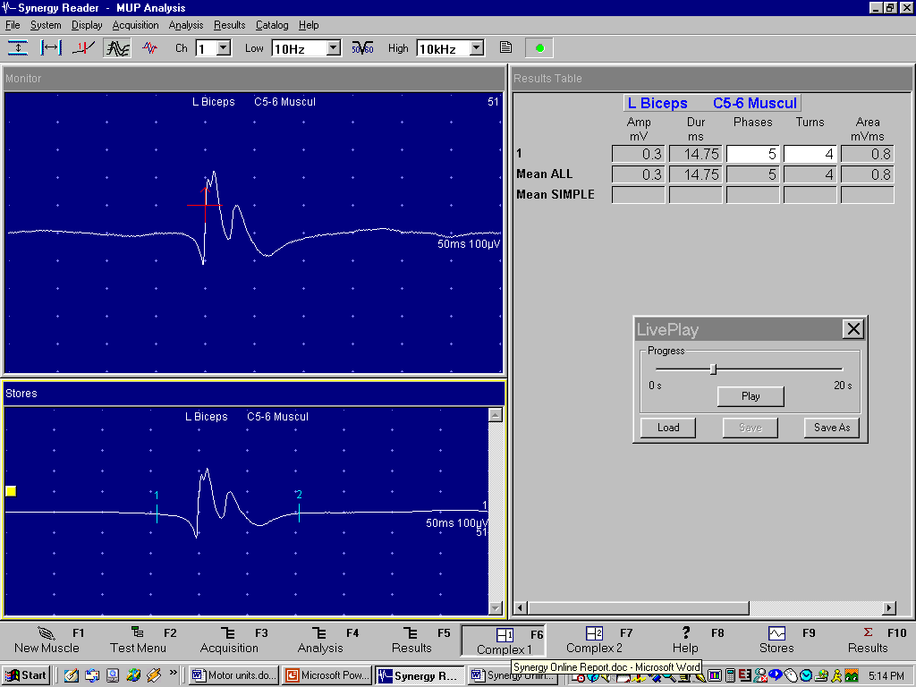
Echantillonnage
DS
Temps Voltage
(ms) (µV)
0.0 0
0.5 0
1.0 3
1.5 5
2.0 10
2.5 40
3.0 19
3.5 2
4.0 -22
Signal analogique
TNS
Analyse
Electromyographe moderne
Notes:
The digitized record is the foundation of the EMG instruments. These records can be analyzed using the “digital signal processing” (DSP) systems. This includes filtering the signals to get rid of noise and interference. These are called the digital filters. One can also write applications to process the signals, enhance the signal to noise ratio, make automated measurements, etc.

Slide 6
Analog
Digital
Digitalisation : au moins 5 KHz
Notes:
In this illustration, there is a good concordance between the analog and digital versions of the EMG.

Slide 7
Intervalle d’échantillonnage doublé
Notes:
Let us now double the sampling interval. The EMG record contains only half the samples compared to the earlier record. The digital EMG signal looks quite different from the analog signal. Specifically, the amplitude is reduced, the rise time is increased and sharp peaks appear smooth and some peaks are missing. This type of distortion, called aliasing, would clearly affect our EMG signal interpretation.

Slide 8
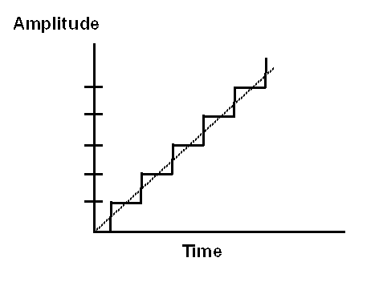
Nombre de bits = N 10 16
Nombre de pas = 2^{N} 1024 65536
Gamme d’amplification = A 100 mV 100 mV
Résolution = A/2^{N} 100 µV 1.5 µV
Résolution en amplitude : au moins 12 bits
Notes:
If a ramp like signal is sampled by an ADC, the digital output looks like a “stair case”. The ADC can resolve amplitude change only in “quantal” fashion. The amplitude corresponding to the size of the step is called the “least bit resolution”. Clearly, this amplitude should be low for high fidelity recordings.
The resolution is defined by the “number of bits” in the ADC. These days, most commercially available systems use a 16+ bit ADC. Hence amplitude resolution is no longer an issue in EMG systems.

Slide 9
Si la résolution est de 500 points pour 100 ms =>
La précision d’une mesure de latence sera de +/- 0,2 ms
Résolution de l’écran numérique
Notes:
If a ramp like signal is sampled by an ADC, the digital output looks like a “stair case”. The ADC can resolve amplitude change only in “quantal” fashion. The amplitude corresponding to the size of the step is called the “least bit resolution”. Clearly, this amplitude should be low for high fidelity recordings.
The resolution is defined by the “number of bits” in the ADC. These days, most commercially available systems use a 16+ bit ADC. Hence amplitude resolution is no longer an issue in EMG systems.

Slide 10
Les SIGNAUX et le BRUIT sont affectés par toutes les composantes de l’électromyographe et toutes les étapes du traitement du signal
Il faut atténuer le BRUIT sans distorsion du SIGNAL
Il faut donc augmenter le rapport SIGNAL/BRUIT
Rapport signal/bruit
Notes:
At each stage in this process, the signal and noise are affected. Hence it is important to understand their important characteristics and specifications. The goal should be to attenuate noise without distorting the signal. This is best accomplished by minimizing the ambient noise. Reduced noise with high amplitude signal will increase the signal to noise ratio. A good recording has high signal amplitude and low noise.

Slide 11
Des fils métalliques connectent les électrodes au système d’amplification
Un câble est un ensemble de fils, 3 en EMG : Active, Référence, Terre
Chaque fil se comporte comme une antenne pour les radiations électromagnétiques
Plus le fil ou câble est long et plus il captera du BRUIT
Les câbles blindés captent moins de BRUIT
Fils et câbles
Notes:
A lead connects the recording electrode to the amplifier input. A collection of leads makes a cable. Needle EMG recording requires three leads: active reference and ground.
A lead is essentially a piece of wire, just like an antenna. Hence it also acts as a recording device for the ambient electromagnetic radiation. The signals recorded by the lead appear as noise in the EMG recordings. Just as a longer antenna picks more signal for better reception; a longer lead will pick up more noise. Hence the lead should be as short as possible. Shielding the leads will reduce the noise recorded by them.

Slide 12
Lampes à incandescence plutôt que fluorescentes
Débrancher les équipements électriques non nécessaires
Eloigner les émetteurs radio et TV
Tenir éloigner les câbles des prises de secteur et des ordinateurs
Trouver la meilleure place dans le local
Utiliser une cage de Faraday
Utiliser un amplificateur différentiel (cf plus loin)
Référence et active dans un même câble (aiguille concentrique >< aiguille monopolaire)
Réduire les interférences
Notes:
The noise recorded by the lead is best minimized by reducing the ambient electromagnetic radiation. This is accomplished by several simple steps.
Fluorescent lights give out much more radiation than incandescent variety. Hence it is a good practice to turn off the tube-lights and provide illumination using incandescent lamps.
Power off the unnecessary electrically powered instruments. They emit electromagnetic radiation. Better yet, unplug their power cord from the wall outlet. Even when the instrument is not powered on, one of its power cable leads is still connected to the main supply. It behaves as a transmitting antenna and adds noise to the EMG recordings.
The cables can truly behave as a “conventional” antenna and pick up radio and television transmissions. Many have experienced this type of interference. When it is low in amplitude, one may not hear it, but it can be seen as high frequency noise along the baseline. There are three strategies. First, identify the broadcast frequency and inform the instrument manufacturer of that setting. It may be possible to make modifications to the amplifier to attenuate that band of frequencies. Secondly, position the instrument such that it’s back is facing the broadcasting station. The third solution is to reduce the high frequency setting of the bandpass filter of the amplifier, e.g. from 10 kHz to 3 kHz. This reduces the “demodulation” of the radio transmission, It also attenuates the signal amplitude and increases its risetime. This is not the most desirable solution.
Keep the leads away from sources of electromagnetic radiation, i.e. other power cords, computer monitors, etc.
The ambient noise in the EMG examination room can vary significantly at different positions of the instrument within the room. This is easily investigated by moving the system to different locations, before choosing the location that gives the least noise. In extreme cases, one may have to prepare the so-called “Faraday cage” to keep off the external radiation. This is a very costly proposal requiring alterations to the wall of the room.

Slide 13
Amplificateur
Sortie
- Fort signal EMG
- Faible BRUIT
Rapport SIGNAL/BRUIT élevé
Entrée
- Faible signal EMG
- BRUIT élevé
Faible rapport SIGNAL/BRUIT
Amplificateur
Notes:
This is perhaps the most critical component of the electromyography. The recording electrode registers low amplitude neurophysiologic potentials in an environment with high ambient noise. At the input of the amplifier, the signal to noise ratio is poor. At the output of the amplifier, we desire high signal amplitude and a reduced noise, i.e. increased signal to noise ratio. This is accomplished by using a so-called “differential amplifier”.

Slide 14
Amplification de la différence entre l’active et la référence
50 µV
Sortie = 0.5 V
Active
V_{A}
V_{R} = 0
Terre
Référence
2000 µV
V_{A} – V_{R} = 0
Active
V_{A}
Sortie = 0 V
2000 µV
V_{R}
Terre
Référence
Amplificateur différentiel
D’après SD Nandedkar
Notes:
Let us consider that a monopolar electrode is recording a fibrillation potential of 50 microV amplitude. The reference electrode registers no electrical activity. The difference between these two potentials is amplified and the signal at the amplifier output has the same shape but of 0.5 volt amplitude
At the same time there is a 2 mV amplitude noise at the amplifier inputs. However, this noise is identical at both inputs. Their difference is zero and hence we do not see the noise at the amplifier output. In this fashion we have managed to selectively amplify the EMG signal while attenuating the noise

Slide 15
50 µV
Gain différentiel = 0.5 V / 50 µV = 10,000
Sortie = 0.5 V
Active
V_{A}
V_{R} = 0
Terre
Référence
2000 µV
Gain commun = 2000 µV / 2000 µV = 1
Active
Sortie = 2000 µV
V_{A}
2000 µV
V_{R}
Terre
Référence
“common mode rejection ratio (CMRR)” > 90-100 db
Amplificateur différentiel
D’après SD Nandedkar
Notes:
The real amplifiers are not so perfect in attenuating the noise. Signals common to the active and reference inputs are also amplified, but with a much lower gain. In this illustration, the signal common to active and reference input is the noise of 2 mV amplitude. This is often called the common mode signal. The amplifier output is the same signal with same amplitude. This gives it a “common mode gain” of one. In contrast, the differential gain of the amplifier is 10,000 in this illustration. A good amplifier should have a high differential gain and a low common mode gain. These two characteristics are incorporated in to a single measure of performance by computing the differential to common mode gains. The result is called the “common mode rejection ratio (CMRR)”. Engineers often express this value in decibels by using the formula
CMRR (db) = 20 log (CMRR).
Modern EMG instruments have a CMRR greater than 90-100 dB.

Slide 16
Signal
Filtres
Signal
BRUIT
Types : analogique (circuit de résistances et de capacités), digital (algorithme de l’ordinateur)
Filtres affectent le signal et le BRUIT
- utiliser les réglages standards
- comprendre les effets d’un réglage non-standard
Filtres
Notes:
The purpose of a filter is to stop the unwanted noise and interference, and let pass the signal itself. Two types of filters are used in the EMG systems. The analog filter is a hardware circuit consisting of resistors, capacitors, etc. A digital filter is a signal processing algorithm on the computer. The advantage of a digital filter is that it can be “updated” by software. For practical purposes, we need not make distinction between these two types. Perhaps the most commonly used filter is the “tone” control on an audio CD or tape player. One reduces the “treble” to reduce the hiss, or reduces the “base” to cut down the drum line. The same principle is also used in the EMG signal processing. One can judiciously use filters to eliminate noise and interference, and to highlight specific characteristics of the EMG potential. It is important to realize that filters do affect the EMG signals, and as far as possible one should not deviate from their standard settings. When using nonstandard settings, it is important to understand the signal distortion by the filters.

Slide 17
Freq = 200 Hz
V_{IN}
Filtre
V_{OUT}
Freq = 50 Hz
V_{IN}
Filtre
V_{OUT} = 0
V_{OUT} / V_{IN}
1
0
Fréquence (Hz)
100 (cutoff)
Filtre passe-haut ou filtre basse fréquence
D’après SD Nandedkar
Notes:
We will treat the filter as a “black box”. A sinusoidal signal is connected to the input of the filter and the ratio of output to input signal amplitude is measured. This is the gain of the filter, and it is less than or equal to one. By plotting the gain against the input signal frequency, the filter characteristics are defined. In this example, the gain is equal to 1 for all frequencies below 100 Hz. For higher input frequency the gain is zero. In other words, the signals of frequency less than 100 Hz pass through the circuit. Higher frequency signals are stopped and are not seen at the output. Because low frequency signals “pass” through the circuit to its output, this type of a filter is called a “low pass” filter. The frequency where the transition between “pass” and “stop” occurs is called the “cutoff frequency”.

Slide 18
Freq = 500 Hz
V_{IN}
Filtre
V_{OUT} = 0
Freq = 100 Hz
V_{IN}
Filtre
V_{OUT}
V_{OUT} / V_{IN}
1
0
Fréquence (Hz)
200
Filtre passe-bas ou filtre haute fréquence
D’après SD Nandedkar
Notes:
The “high pass” filter attenuates low frequency signals, while high frequency signals pass without attenuation. Practically all electronic amplifier systems use a combination of a “low pass” and a “high pass” filters. The result is so called a bandpass filter. This filter is characterized by two frequencies, the low setting (f_{L}), and the high setting (f_{H}). Note that the low frequency setting corresponds to the cutoff frequency of the high pass filter circuit. Similarly the f_{H} corresponds to the low pass filter cutoff setting. This is often confusing in the initial learning stages.

Slide 19
Fréquence = f_{N}
Notch
Filter
( f_{N} )
V_{IN}
V_{OUT}
Notch
Filter
( f_{N} )
V_{IN}
V_{OUT}
Fréquence  f_{N}
V_{OUT} / V_{IN}
1
0
f_{N}
Fréquence (Hz)
Filtre Notch (50 Hz) : a ne pas utiliser lors de l’étude des VC
Notes:
There is a lot of electromagnetic radiation from the power cords of different electrical devices in the laboratory and the neighboring area. Despite the differential amplification, it may not be adequately suppressed. Therefore, EMG systems offer a filter that “stops” or “attenuates” a very narrow band of frequencies. Other frequencies are unaffected. In the filter characteristics, it looks like a notch in the pass band. Hence this is called the “notch filter”. Its attenuation frequency is matched to the power line frequency. This is quite useful in a hostile environment, e.g. in the ICU. The power line interference is recognized quite easily. If the sweep duration is 100 ms, each sweep contains 6 cycles of a sinusoid for 60 Hz interference. A 50 Hz interference will give 5 cycles. Use notch filter to suppress it.

Slide 20
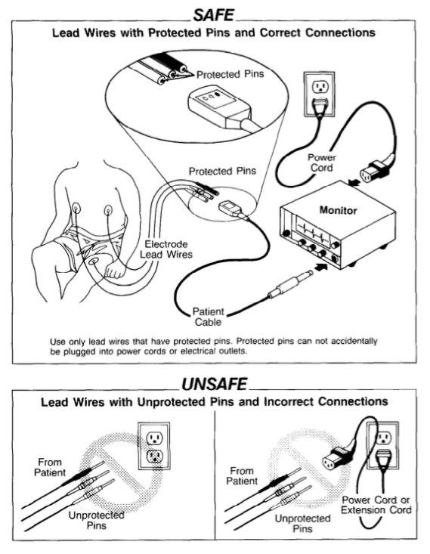
Oh (2003) : si des précautions ne sont pas prises, si le matériel n’est pas entretenu et relié efficacement à la prise de terre, l’électricité peut tuer
Aucun cas n’est rapporté dans la littérature scientifique. Une fuite de courant provenant du matériel ou résultant de la stimulation nerveuse et entrainant une fibrillation ventriculaire fatale reste donc un risque théorique
La Food and Drug Administration (1994) rapporte des cas sporadiques de chocs électriques, de brûlures et d’électrocution lorsque des câbles électriques avec des broches non protégées sont directement branchés dans la prise secteur
Risque d’électrocution

Slide 21
Cathéters intra-veineux ou intra-artériel offre des zones de faible résistance favorisant la pénétration et la propagation des courants dans le corps du patient
Si un cathéter intra-cardiaque est en place, ce dernier court- circuite les tissus mous qui isolent normalement le cœur avec un risque d’amener des courants létaux dans le voisinage immédiat de celui-ci (Kimura, 1989)
Si le patient est connecté à plusieurs équipements reliés au secteur, dont l’un présente une « terre » défectueuse, des courants de fuite peuvent quitter cet équipement défectueux, traverser le patient, pour finalement être éliminés au travers d’une prise de terre en ordre de marche (AANEM, 2014)
Cas particulier des patients en réanimation

Slide 22
Le laboratoire/local d’ENMG
N’utiliser que des prises murales à trois broches dont l’une est reliée à la terre
La prise de terre doit être intacte
Tout équipement électrique non nécessaire doit être débranché, ou mieux éliminer du laboratoire
Recommandations

Slide 23
Le matériel ENMG
Le câble d’alimentation doit être pourvu d’un fil de terre et relié directement à une prise électrique murale à trois broches sans utiliser de rallonge
S’assurer de l’absence de courant de fuite > 50 µA (> 20 µA aux soins intensifs) et le vérifier annuellement et lors de l’ajout d’un nouvel équipement électrique
Ne plus utiliser et soumettre à vérification en cas de : dommage de l’appareil ou de son câble d’alimentation, surchauffe, bruit ou odeur inhabituels, sensation de picotements au contact avec l’appareil, renversement de liquide
Ne pas utiliser d’adaptateur
Délivrer la dose minimale de courant nécessaire à l’obtention des réponses sensitives et motrices
Recommandations

Slide 24
Le patient
Allonger sur une table d’examen en bois
Ne doit toucher aucun objet métallique ou câble d’alimentation
La stimulation, la détection et l’électrode reliée à la terre doivent toutes trois être placées sur la même partie du corps (un membre, la face ou le tronc)
Ne pas éteindre ou allumer l’appareil d’ENMG, ou un autre équipement électrique qui lui est connecté, lorsque le patient est relié à celui-ci
Redoubler de vigilance lorsque l’état du patient ne lui permet pas de renseigner le technicien ou le médecin d’une sensation qui lui semble anormale
Recommandations

Slide 25
l’AANEM (2014) recommande, tout particulièrement chez les patients aux soins intensifs, de ne pas inclure le cœur dans le montage des électrodes
Lors de l’étude de la conduction nerveuse, les électrodes de stimulation et de détection ainsi que l’électrode reliée à la terre (ERT) sont placées sur la même partie du corps (un membre, la face ou le tronc)
Idéalement, l’ERT est placée entre la stimulation et la détection
Lors de l’EMG, l’ERT est placée dans le voisinage immédiat de l’aiguille-électrode
Recommandations

Slide 26
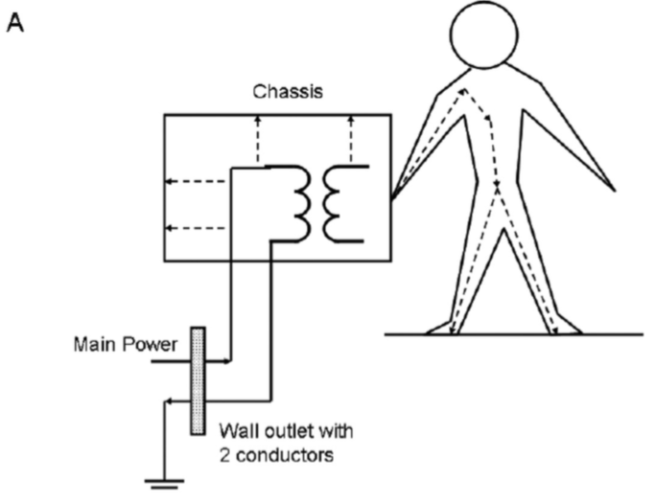
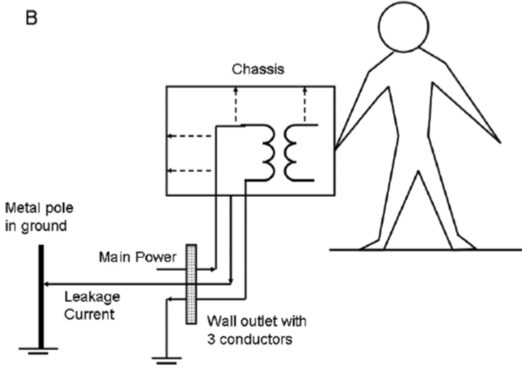
Utiliser un matériel non conforme ou défectueux
Brancher l’appareil d’ENMG à une prise sans broche reliée à la terre
Chez les patients porteurs d’un pacemaker externe, avec un fil conducteur externe se terminant dans ou près du cœur, il est contre-indiqué de réaliser des stimulations électriques percutanées (Al-Shekhlee et al, 2003)
Contre-indications

Slide 27
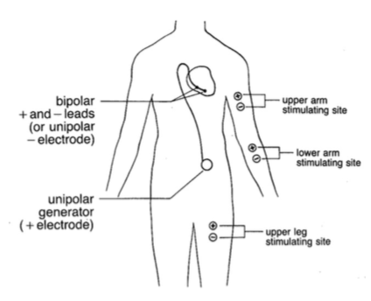
Il existe un risque que l’étude de la conduction nerveuse induise une interférence électromagnétique susceptible d’interférer avec le fonctionnement du matériel implanté
Les pacemakers à sonde monopolaire sont plus sensibles aux interférences électromagnétiques que ceux à sonde bipolaire (Pease et Grove, 2013)
Risque de dysfonctionnement d’un appareillage implanté

Slide 28
A ce jour, il n’y a aucun cas rapporté d’effet secondaire immédiat ou retardé lors de la pratique d’un ENMG chez des patients porteurs - d’un défibrillateur implanté ou - d’une stimulation cérébrale profonde
Données de la littérature

Slide 29
10 patients avec un pacemaker à sonde bipolaire et 5 avec un défibrillateur cardiaque - absence d’influence néfaste de la stimulation nerveuse percutanée (y compris au point d’Erb gauche chez 9 patients) (Schoeck et al, 2007)
20 patients (7 avec un pacemaker à sonde bipolaire et 13 avec un défibrillateur cardiaque) avec étude de la conduction nerveuse des membres supérieurs, en présence d’une voie veineuse dans le membre étudié - aucun dysfonctionnement du matériel implanté et aucun effet secondaire chez les patients (Mellion et al, 2010)
Données de la littérature

Slide 30
Concernant la stimulation nerveuse répétitive (SNR)
Une étude est réalisée chez 14 patients en cours d’implantation ou de révision du matériel (10 défibrillateurs cardiaques et 4 pacemakers) sous anesthésie générale (Cronin et al, 2013)
Une SNR des nerfs médian, axillaire et spinal accessoire est réalisée à 2 Hz (9 stimuli) et 50 Hz (3 secondes)
Des interférences magnétiques sont enregistrées au niveau de 2 défibrillateurs et de 3 pacemakers dont 2, avec une configuration monopolaire, présentent un arrêt momentané de fonctionnement lors de la SNR proximale.
Données de la littérature

Slide 31
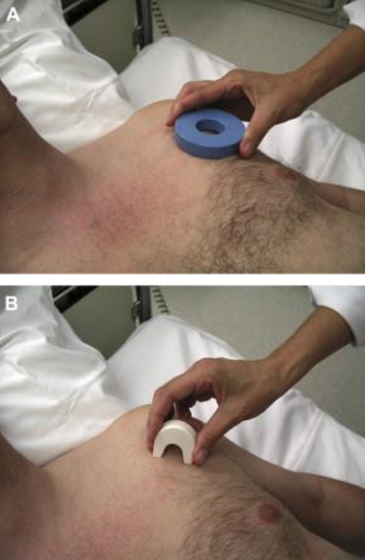
En 1996, l’AAEM préconise de respecter une distance de sécurité de 15 cm entre le site de stimulation nerveuse percutanée et le passage des fils conducteurs des matériels implantés (Nora, 1996)
Il est également préconisé de réduire la fréquence de stimulation à 1 choc toutes les 3 à 5 secondes (Ohira et al, 2013)
Par contre, il n’est pas recommandé d’utiliser un aimant externe, pour inhiber de façon réversible le matériel implanté (Ohira et al, 2013)
Recommandations

Slide 32
Les SNR sont contre-indiquées chez les patients porteurs d’un pacemaker implanté à sonde monopolaire (nerfs axillaire et spinal accessoire) - une étude en EMG fibre unique avec activation volontaire est préconisée
En l’absence de donnée scientifique, les stimuli intramusculaires, les stimulations radiculaires cervicales et les SNR au segment céphalique sont également contre-indiqués
Contre-indications

Slide 33
Chez les patients parkinsoniens ou dystoniques bénéficiant d’une stimulation cérébrale profonde
les stimulations au point d’Erb et les stimulations radiculaires cervicales sont contre-indiquées
En effet, d’une part le dispositif comprend des fils conducteurs passants sous la peau en supra-claviculaire et dans la région occipitale, et d’autre part, ici aussi, aucune donnée scientifique n’est actuellement disponible.
Un raisonnement identique peut être tenu pour d’autres types de matériel implanté tel qu’une stimulation du nerf vague
Contre-indications

Slide 34
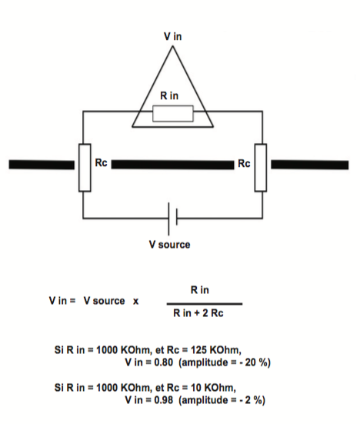
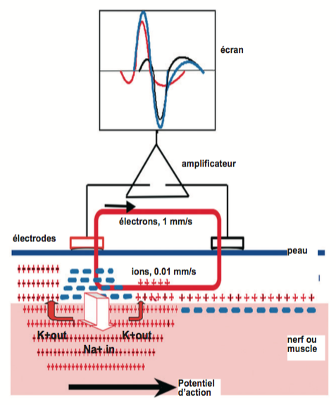
V in : amplitude du signal qui entre dans l’amplificateur
R in : R d’entrée dans l’ampli ; Rc : résistance des électrodes
Électrodes d’enregistrement : impédance
D’après P Guihéneuc

Slide 35
But : impédance idéalement < 10 Kohm impédance acceptable < 20 Kohm homogène sous les 2 électrodes +++ : car la valeur maximale du CMRR (common mode rejection ratio) est limitée par Rin/(Rc+)-(Rc-)
Préparation interface peau-électrode (pas entre les électrodes) - acétone ou mélange acétone-alcool >< sébum - gomme dure, toile émeri, pâte abrasive (pierre ponce mélangée à du sel) => érosion de la couche cornée
Utilisation d’une substance conductrice - film liquide (sérum salé à 0,9 ou 1,4 %)
- gel à forte charge ionique
Préparer la peau

Slide 36
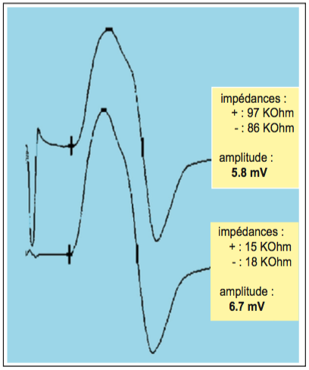
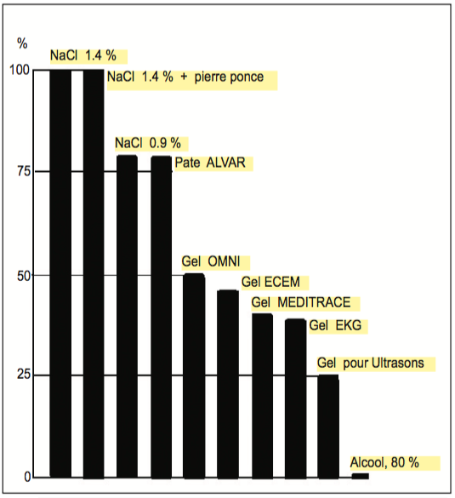
Électrodes d’enregistrement : impédance
D’après P Guihéneuc

Slide 37
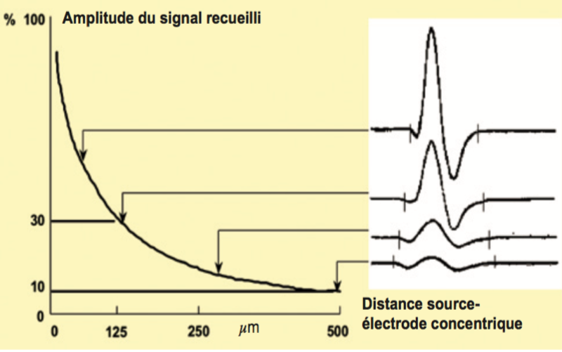
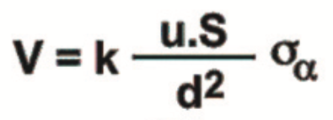
u : débit de charge électrique
S : surface dépolarisée
σ : conductance du milieu traversé
α : angle entre l’électrode et S
Électrodes d’enregistrement : distance source-électrode (d)

Slide 38
Electrodes de surface : - non douloureuse - large volume de recueil - risques de contamination négligeables
Aiguille-électrodes si : - muscle profond (sus-épineux) - nerf profond (versant sensitif du nerf tibial) - oedèmes, infiltrat, tissu adipeux - axonopathie sévère
Électrodes d’enregistrement : type

Slide 39
Stimulation bipolaire ou monopolaire ?
Stimulation à voltage ou courant constant ?
Conduction antidromique ou orthodromique - VCS : anti ou ortho - LDM et VCM : ortho - Ondes F : afférence anti et efférence ortho - Réflexes H afférence ortho et efférence ortho
Dispersion temporelle et Annulation de phases
Champ proche/champ lointain ; onde propagée/onde stationnaire
« Cross Talk »
Stimulation anodale
Quelques notions à comprendre

Slide 40
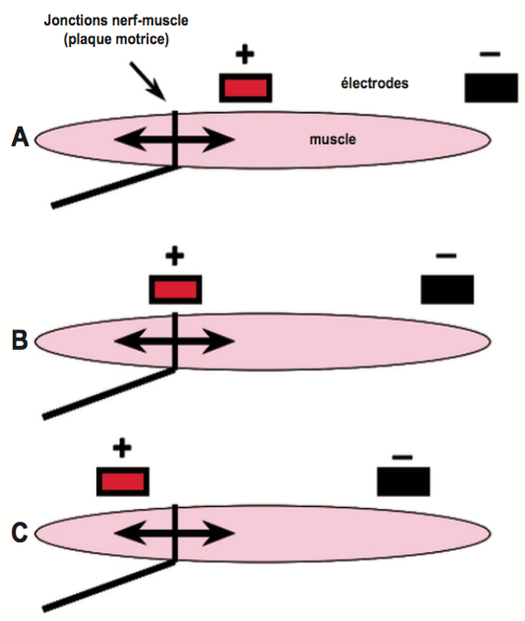
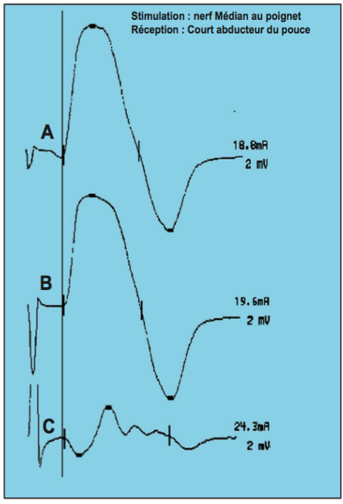
Monopolaire (A) : active 1 cm en aval de la plaque motrice référence très à distance de l’active
Bipolaire (B) : active à hauteur de la plaque motrice référence à 3 cm de l’active
Terre large et très conductrice
Électrodes d’enregistrement : monopolaire vs bipolaire

Slide 41
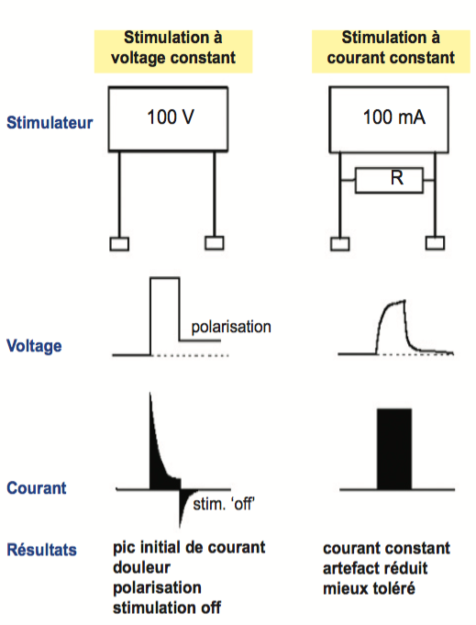
Stimulation à voltage ou courant constant ?
D’après P Guihéneuc

Slide 42
Enregistrement bipolaire (VCS)
Ecart trop faible (1 à 2 cm) : le potentiel arrive sous la référence alors qu’il influence encore l’active => - amplitudes et surfaces réduites - signal fortement biphasique
Ecart trop grand (> à 3 cm) : - amplitude décroît
Ecart idéal (2,5 à 3 cm)
Électrodes d’enregistrement : distance inter-électrode

Slide 43
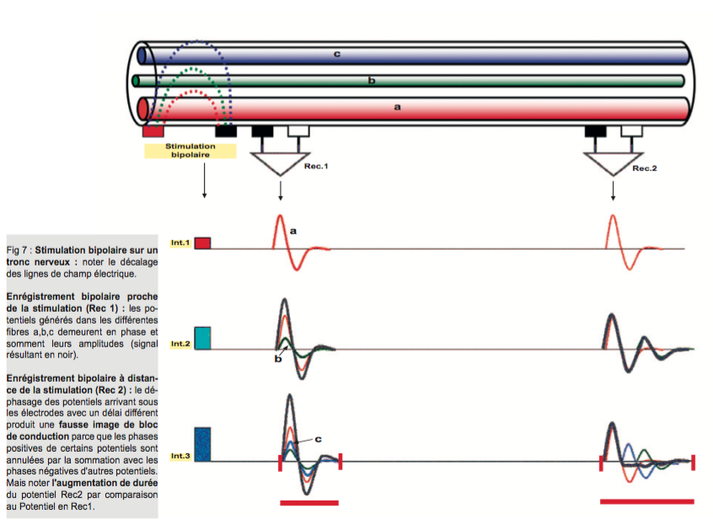
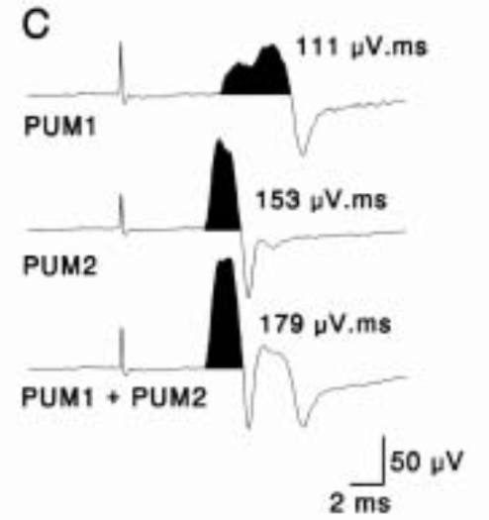
Somme algébrique
Dispersion temporelle et annulation de phases
D’après P Guihéneuc

Slide 44
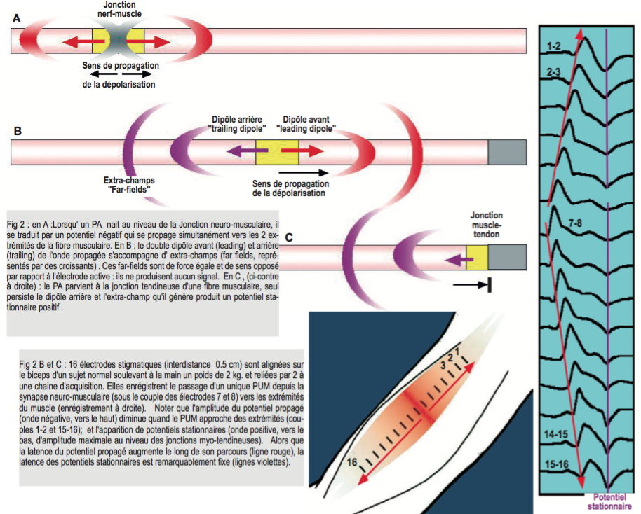
Champ proche/champ lointain ; onde propagée/onde stationnaire

Slide 45
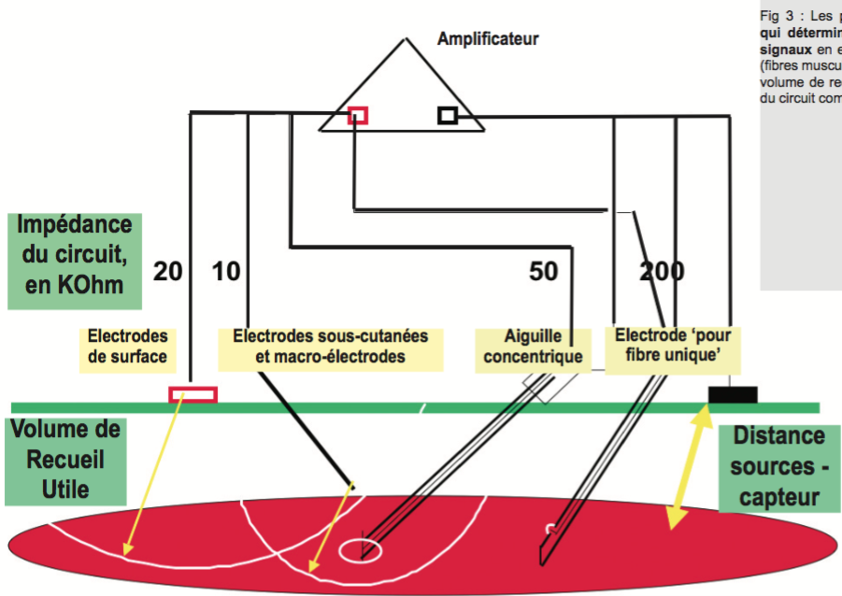
VRU : volume de recueil utile
« Cross Talk »
D’après P Guihéneuc

Slide 46
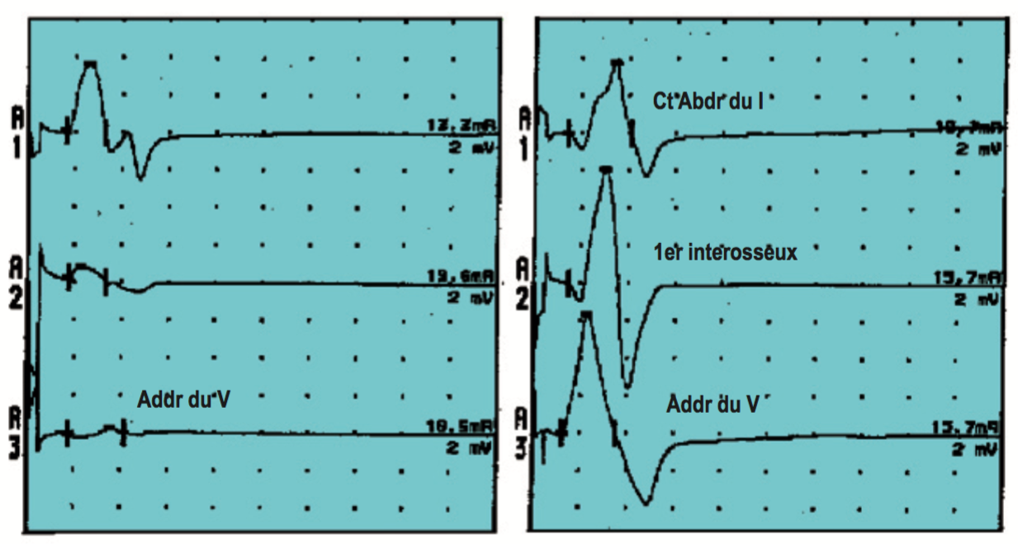
Conduction MOTRICE : réception sur le C. Abd. 1
Stimulation nerf médian
Stimulation nerf ulnaire
« Cross Talk »
D’après P Guihéneuc

Slide 47
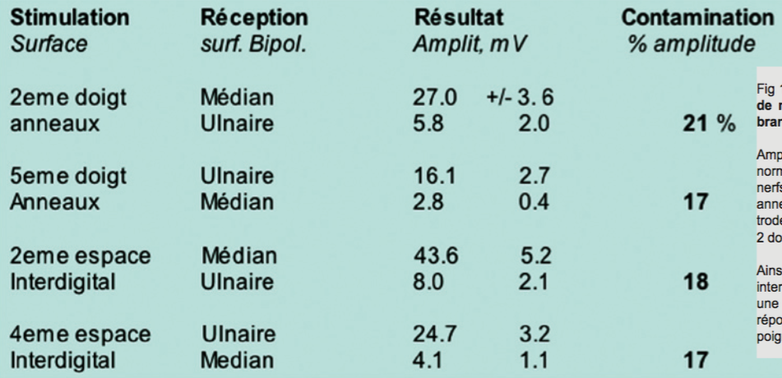
Conduction SENSITIVE
« Cross Talk »
D’après P Guihéneuc

Slide 48
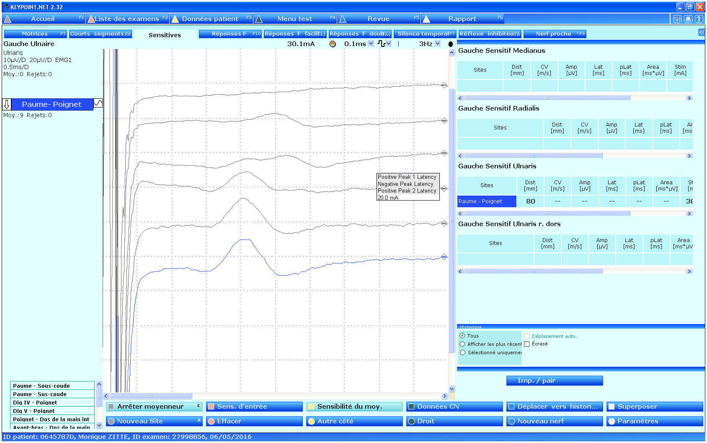
5 mA
10 mA
15 mA
20 mA
25 mA
30 mA
Stimulation anodale

Slide 49
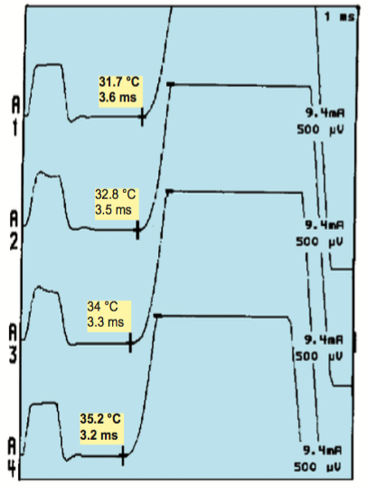
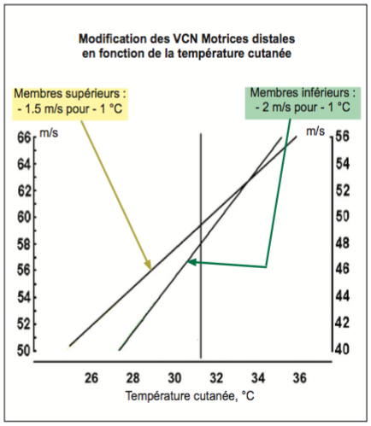
Pièce d’examen : à 25°C
< 28°C aux MI ; < 30°C aux MS
Réchauffer (sèche cheveux) ou corriger les VC mesurées
Effets d’une température cutanée trop basse
D’après P Guihéneuc

Slide 50
Allongement des LD : faux syn canalaire
Diminution des VC : fausse PNP démyélinisante
Amélioration de la transmission neuromusculaire : décréments faussement négatifs
Faux tracés neurogènes
TENIR COMPTE AUSSI DE L’AGE ET DE LA TAILLE
Effets d’une température cutanée trop basse

Slide 51
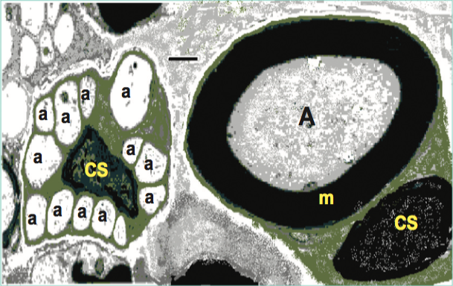
A : grosse fibre
a : petite fibre
m : myéline
CS : cellule de Schwann
Grosses fibres myélinisées : 9-20 𝜇m
Le nerf médian contient > 50% de fibres conduisant < 15 m/s
Fibres étudiées par la neurographie

Slide 52
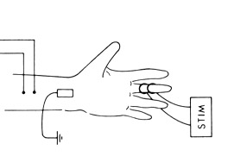
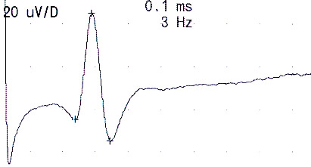
Grosses fibres myélinisées (Ia) dont le corps cellulaire se trouve dans le ganglion rachidien
Stimulation du nerf en un point et détection du potentiel d’action sensitif transmis en un autre point du nerf
LSD VCS : d : LSD Amplitude (> 12 J)
d
LSD
Neurographie sensitive

Slide 53
Préparer la peau
Réduire la distance électrode / nerf (appuyer !)
Eloigner les câbles, garder la peau sèche entre stimulation et recueil
Faire pivoter l’anode vs cathode
Garder bas le filtre passe-bas
Réduire l’artefact de stimulation

Slide 54
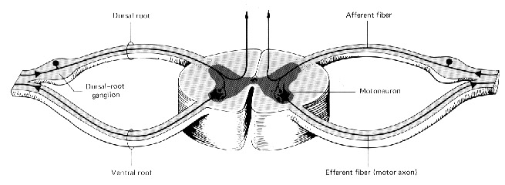
Une lésion même sévère (section complète) en amont du ganglion rachidien n’entraîne aucune dégénérescence axonale sensitive
Neurographie sensitive

Slide 55
M. Sup. n. médian : > 55 m/s, > 20 µv n. radial : > 55 m/s, > 25 µV n. musculo. : > 55 m/s, > 10 µV n. ulnaire : > 55 m/s, > 10 µV n. BCI : > 55 m/s, > 10 µV
M. Inf. n. sural : > 45 m/s, > 10 µV n. péronier sup.: > 45 m/s, > 15 µV n. saphène int. n. fémoro-cut
Neurographie sensitive

Slide 56
 | AMPLITUDE normale | AMPLITUDE réduite
VCS normale | Normal | Perte axonale
 | Atteinte préganglionnaire | BC entre les sites de détection et de stimulation
 | BC proximal au site de stimulation ou distal au site de détection
 | Neuropathie des petites fibres
VCS réduite | Démyélinisation | Perte axonale et/ou démyélinisation et/ou BC
Neurographie sensitive

Slide 57
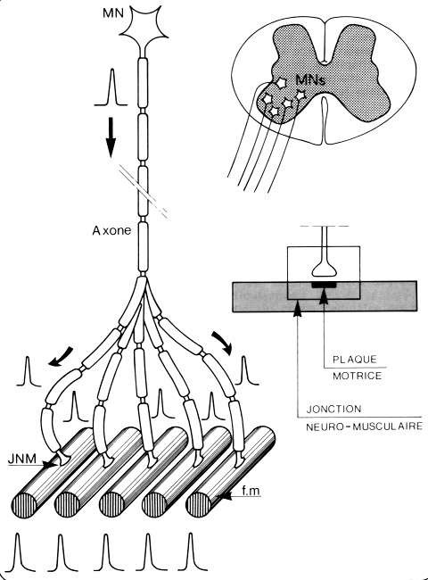
Unité motrice
Stimulation du nerf détection musculaire (surface ou aiguille)
LDM VCM
Amplitude - nombre d’axones (> 9 J) - transmission NM - taille des UMs
Neurographie motrice

Slide 58
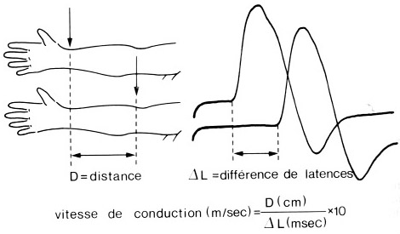
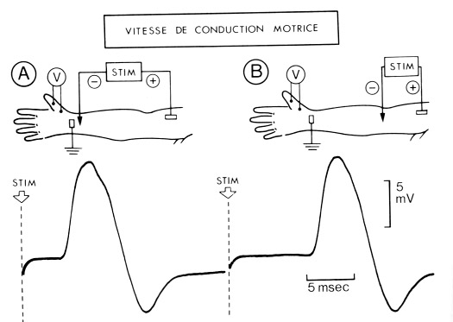
Neurographie motrice

Slide 59
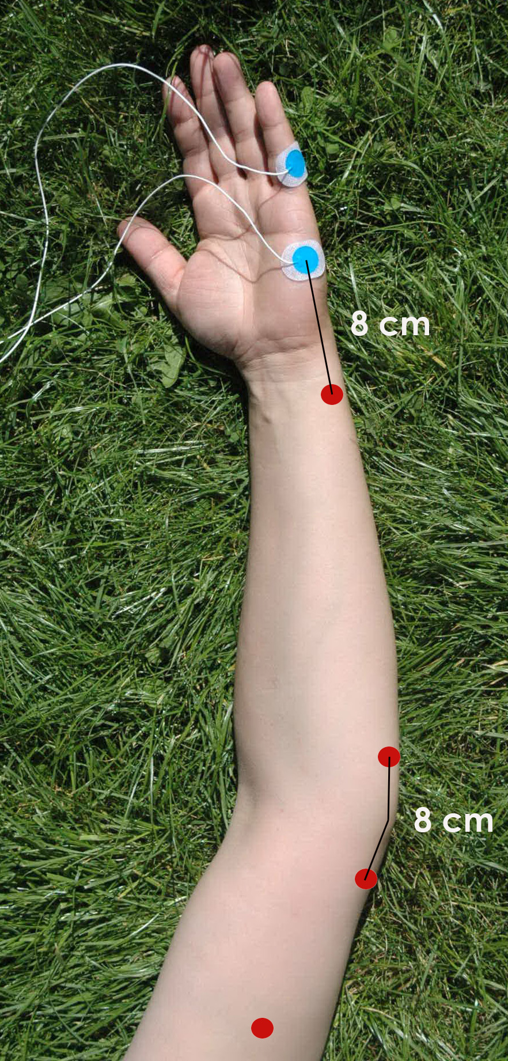
Mesure des distances:
La longueur d’un segment nerveux est mesuré du centre de la cathode (-) à un site de stimulation au centre de la cathode (-) au site de stimulation suivant
Le membre étudié doit être dans une position standardisée fixe durant l’enregistrement des réponses et lors de la mesure de la longueur du segment nerveux
Stimulation des nerfs

Slide 60
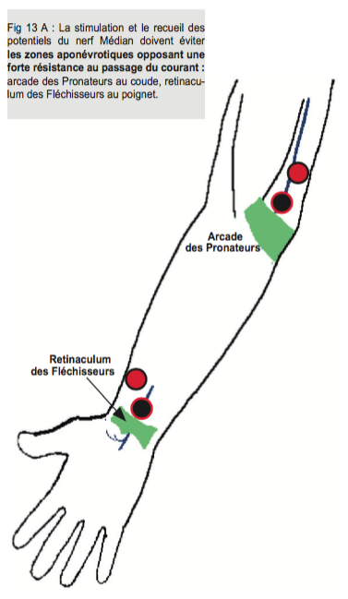
Sites de stimulation et segments nerveux:
Les nerfs doivent être stimulés en des points où ils sont facilement accessibles et suffisamment superficiels pour une stimulation percutanée
Ces points = sites de stimulation. La portion de nerf entre 2 sites de stimulation = segment nerveux
Le plus souvent, les nerfs sont stimulables en plusieurs points de stimulation
Stimulation des nerfs

Slide 61
Electrodes de stimulation:
Des électrodes aiguilles ou de surface peuvent être utilisées pour la stimulation
Lorsque le nerf est superficiel, une stimulation par électrodes de surface est préférable chez l’adulte et chez l’enfant
Chez les nouveau-nés, des électrodes avec une surface de stimulation réduite et une distance interélectrode plus petite peuvent être utilisées. Mais, une stimulation avec de petites électrodes est habituellement plus douloureuses car la densité locale de courant est + élevée qu’avec de larges électrodes
Stimulation des nerfs

Slide 62
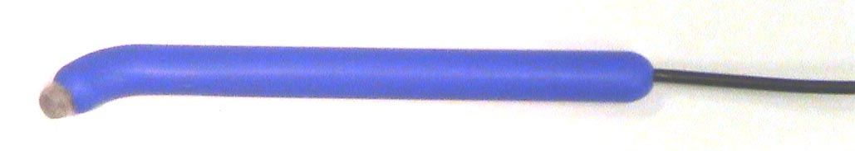
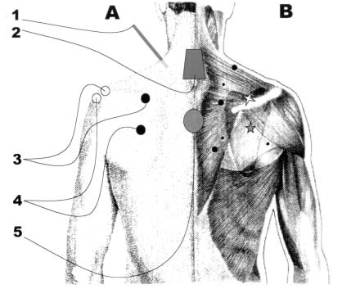
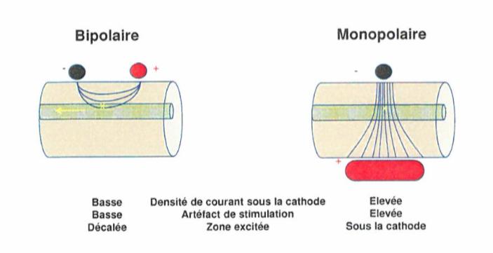
Electrodes de stimulation:
Stimulation monopolaire : plus efficace et moins douloureuse dans les cas où les nerfs sont profonds (ex.: point d’Erb au plexus brachial)
Stimulation des nerfs

Slide 63
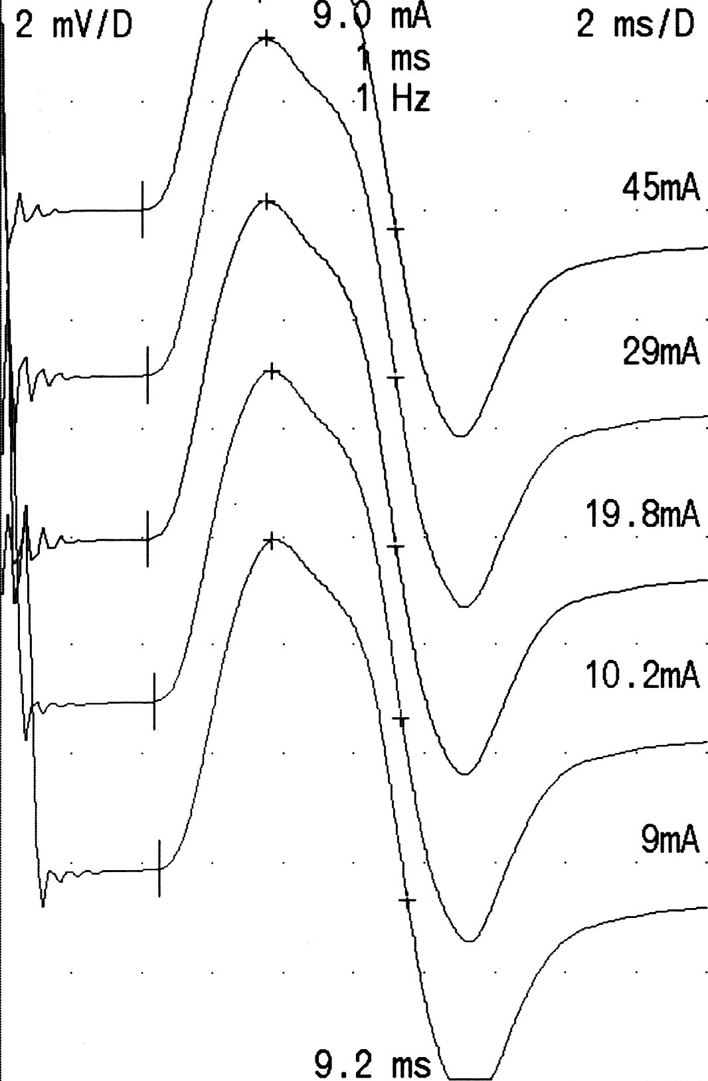
Durée du stimulus:
En général, des ondes rectangulaires d’une durée = 0,1 ou 0,2 ms sont utilisées
Quand la réponse maximale ne peut être obtenue, la durée peut être augmentée à 0,5 ou 1 ms. Ces stimuli plus longs peuvent augmenter les latences
Pour un nerf donné, la même durée de stimulus doit être utilisée aux différents sites de stimulation
St.
dur.
4.0 ms
0.04 ms
4.2 ms
0.1 ms
4.2 ms
0.2 ms
4.3 ms
0.5 ms
4.5 ms
1.0 ms
Stimulation des nerfs

Slide 64
Intensité du stimulus:
L’intensité du stimulus doit permette une activation de tous les axones moteurs alpha dans le nerf, sans causer de douleur inutile et sans dispersion du courant en aval du site de stimulation (raccourcissement de la latence) ou à d’autres nerfs (morphologie de réponse variant d’un site de stimulation à un autre).
Une intensité 30% supérieure à celle permettant d’évoquer une réponse M maximale est habituellement recommandée
Stimulation des nerfs

Slide 65
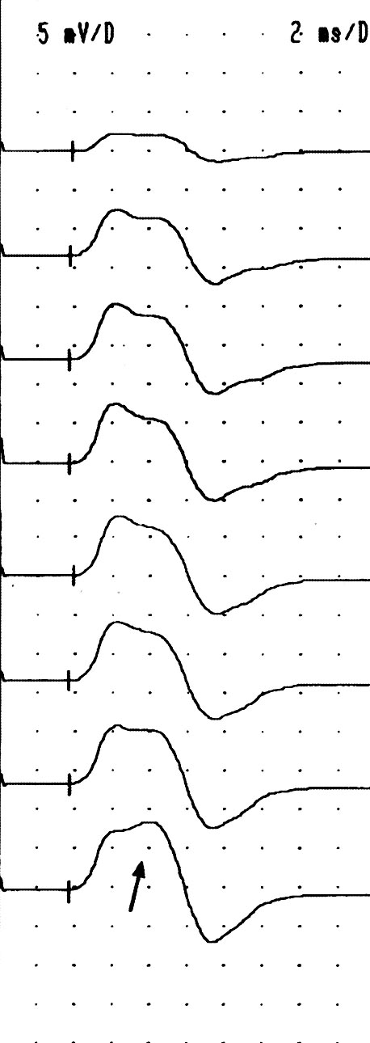
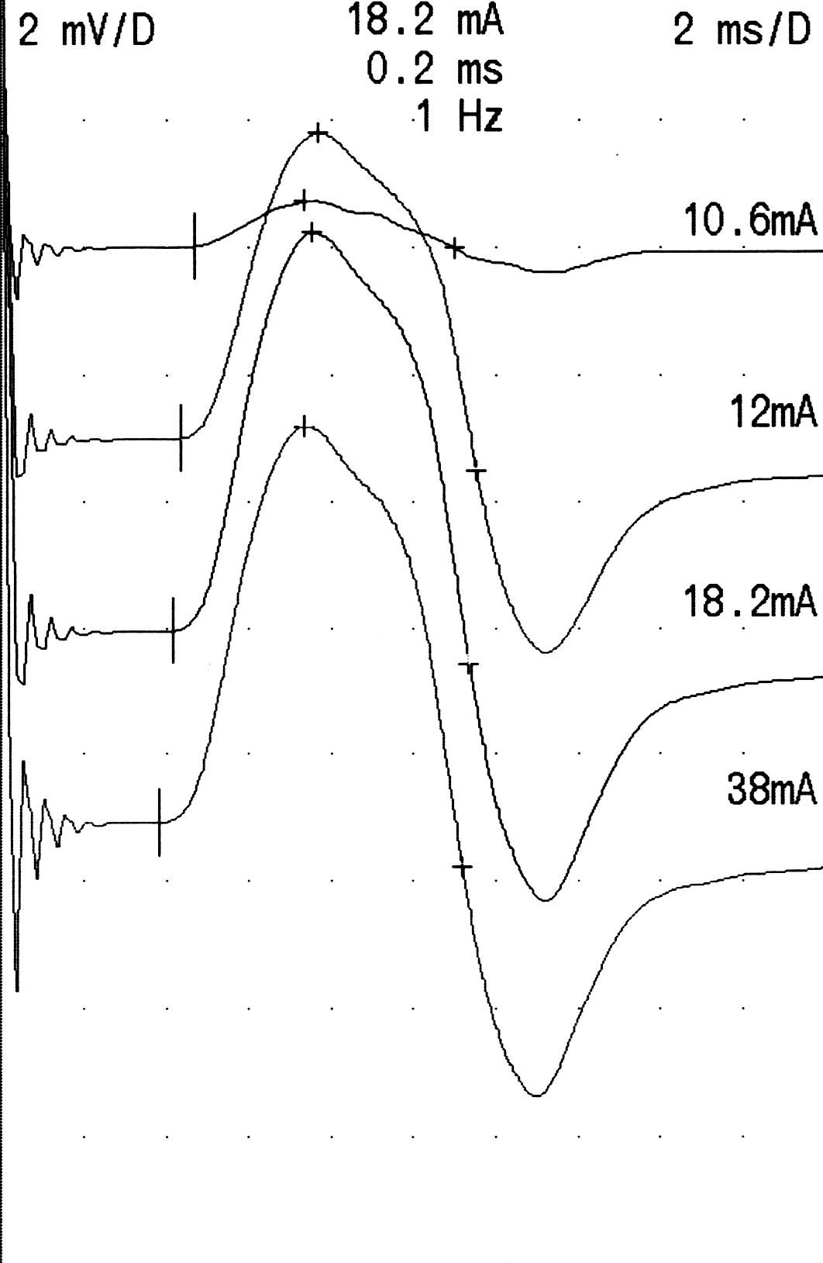
Intensité du stimulus:
DLAT ms | AMPL mV
4.7 | 0.7
4.3 | 4.8
4.2 | 6.2
3.8 | 6.2
4.3 mA
5.0 mA
6.0 mA
11.0 mA
38.0 mA
51.0 mA
61.0 mA
82.0 mA
Nerf médian
Stimulation au poignet
Nerf fibulaire
Stimulation à la cheville
Stimulation des nerfs

Slide 66
Placement des électrodes de stimulation:
En général, la cathode est placée directement sur le nerf et l’anode proximale par rapport à la cathode le long du nerf
Pour réduire l’artéfact de stimulation, il peut être utile d’opérer un déplacement latéral de l’anode par rapport au nerf
Pour l’étude des ondes F, il est inutile de placer la cathode proximalement par rapport à l’anode, car il n’y a pas de bloc anodal pour les axones moteur
Stimulation des nerfs

Slide 67
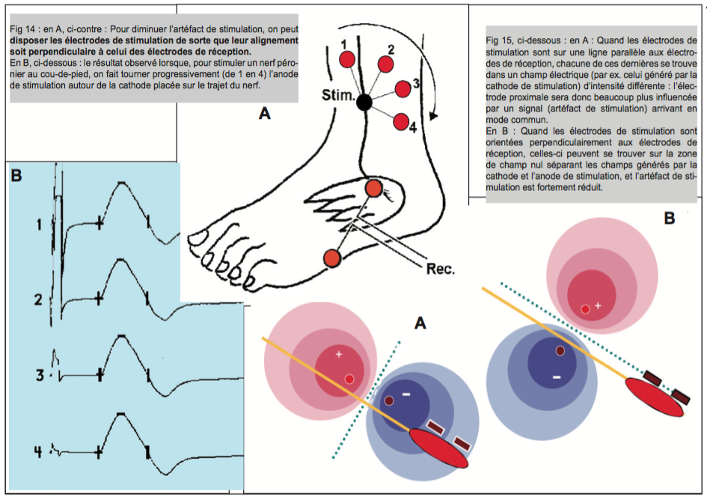
Placement des électrodes de stimulation:
Stimulation des nerfs
D’après P Guihéneuc

Slide 68
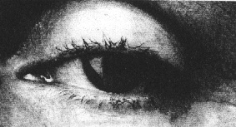
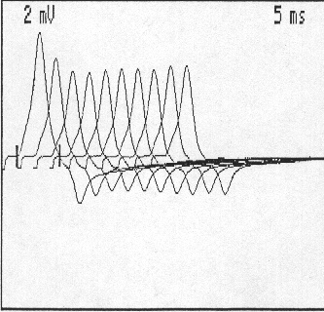
SNR à 3 Hz:
Stimulation nerveuse Détection musculaire
Choc supramaximal : I_{s} = 150 % I
Réponse en U : décrément 1 - 5 léger incrément 6 – 10
Paramètres: A et/ou S de la phase négative initiale
1ère R : nombre de JNM en blocage au repos 5ème R comparée à la 1ère : décrément
e⁻ de surface
Stimulation des nerfs

Slide 69
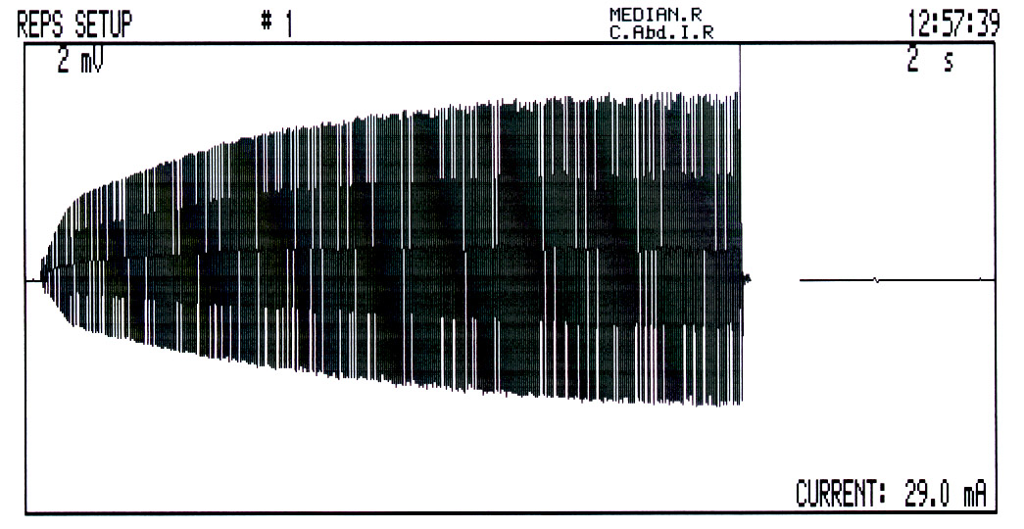
SNR à 20-30 Hz (incrément):
Incrément : facilitation synaptique
M_{max} - M_{i}
Incrément =
M_{i}
Stimulation des nerfs

Slide 70
Origine des réponses M:
La réponse M (potentiel global d’action musculaire PGAM) représente l’activité générée par les fibres musculaires innervées par les axones moteurs qui ont été stimulés
La morphologie et la taille de la réponse M dépend du nombre et de la taille des fibres musculaires activées et de la dispersion temporelle de leurs potentiels d’action
La dispersion temporelle des potentiels d’action peut avoir une influence complexe sur la sommation des potentiels d’action; en principe, l’augmentaion de la dispersion temporelle prolonge la durée et réduit l’amplitude de la réponse M
Enregistrement des réponses motrices

Slide 71
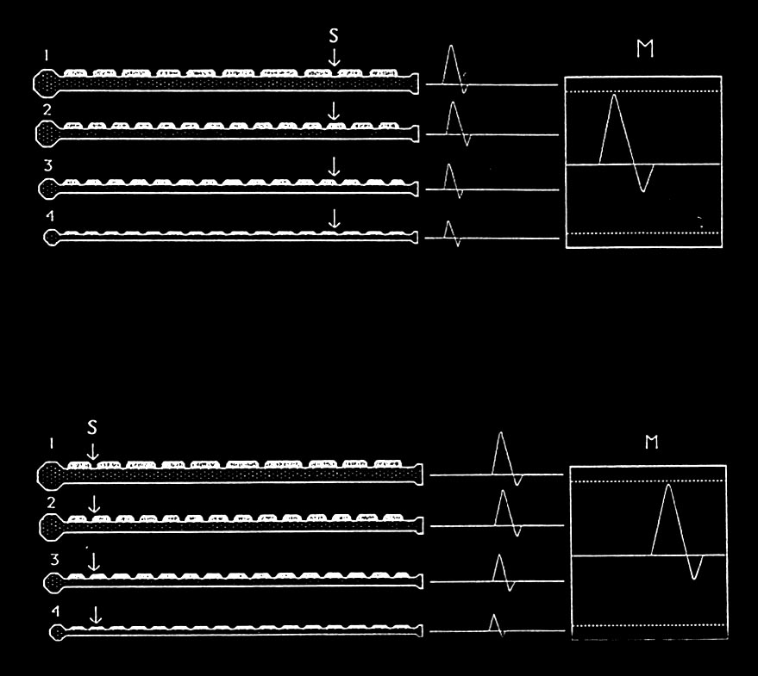
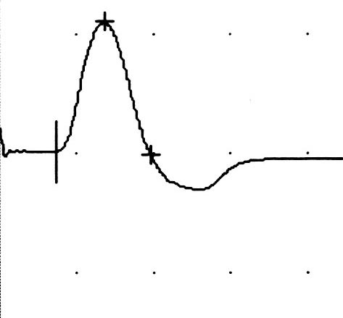
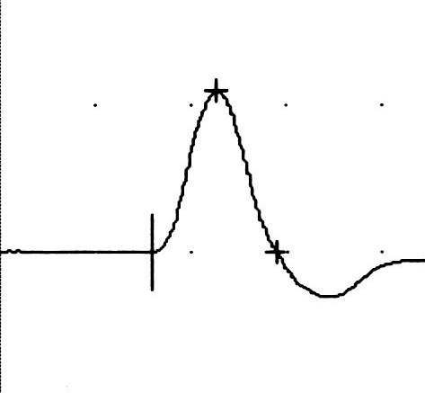
Poignet
Distance poignet-coude (LPM-LDM)
VCM =
Coude
Notes:
Le nerf est représenté par 4 axones de taille différente. La conduction nerveuse est plus rapide au niveau des axones de gros calibre.
Stimulation supramaximale

Slide 72
La taille de la réponse M peut être réduite par : la perte de neurones moteurs alpha, un bloc de conduction entre la stimulation et le muscle, un bloc de transmission neuromuculaire etc…
 | AMPLITUDE normale | AMPLITUDE réduite
VCM normale LDM normale | Normal | Perte axonale
 | FAIBLESSE SANS ATROPHIE affection centrale BC proximal trouble de la transmission NM psy | BC entre les sites de détection et de stimulation
 |  | myopathie trouble de transmission neuromusculaire non-usage
VCM réduite LDM allongée | Démyélinisation | Perte axonale et/ou démyélinisation et/ou BC
Enregistrement des réponses motrices

Slide 73
La plupart des réponses M peuvent être recueillies par des électrodes de surface
Ces électrodes sont moins douloureuses pour le patient et moins sélectives que les aiguilles électrodes
Les aiguilles électrodes enregistre uniquement l’activité des fibres musculaires proches de la pointe de l’aiguille (seule une sous- population des axones est étudiée)
De plus, les contractions musculaires déplacent souvent l’aiguille électrode et la morphologie de la réponse M varie d’une stimulation à l’autre
Enregistrement des réponses motrices

Slide 74
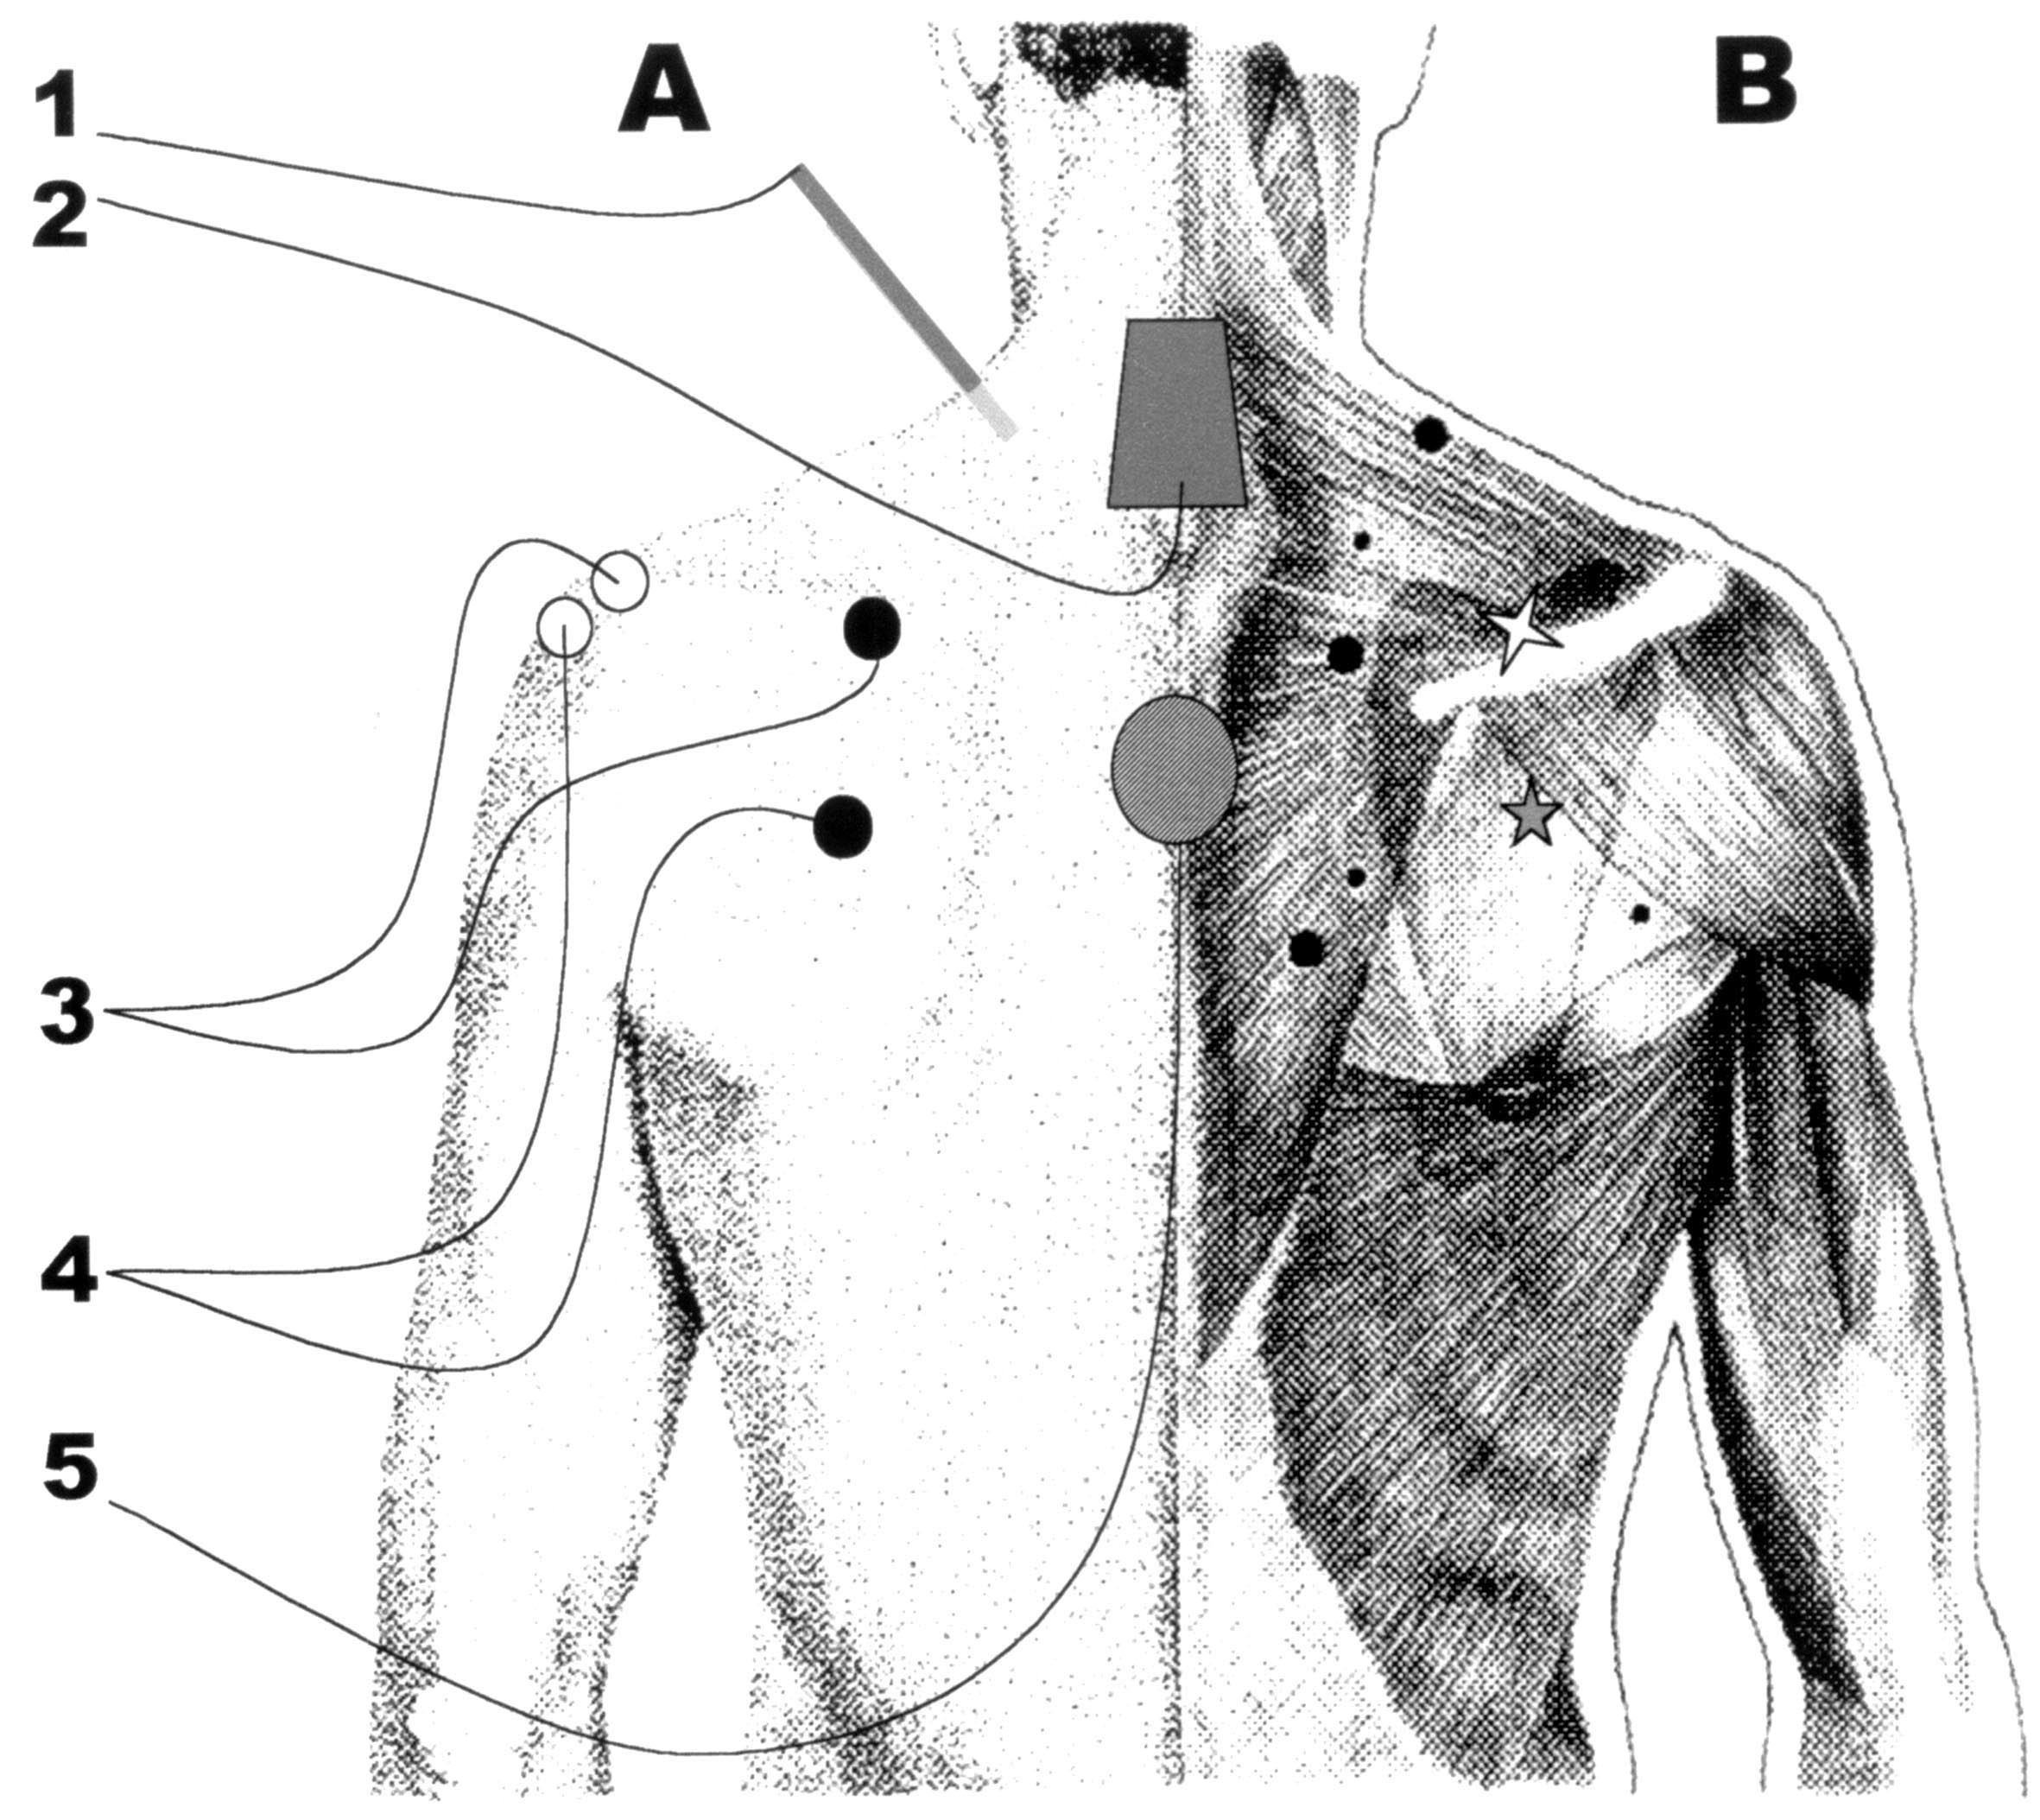
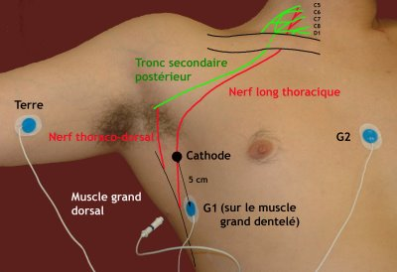
Electrodes d’enregistrement:
Dans certaines situations des aiguilles électrodes intramusculaires sont utilisées ex.: - nerf sus-scapulaire (sus-épineux recouvert entièrement par le trapèze), - nerf thoracique long, - nerf radial (lors de la stimulation axillaire et au point d’Erb) - NIA
Enregistrement des réponses motrices

Slide 75
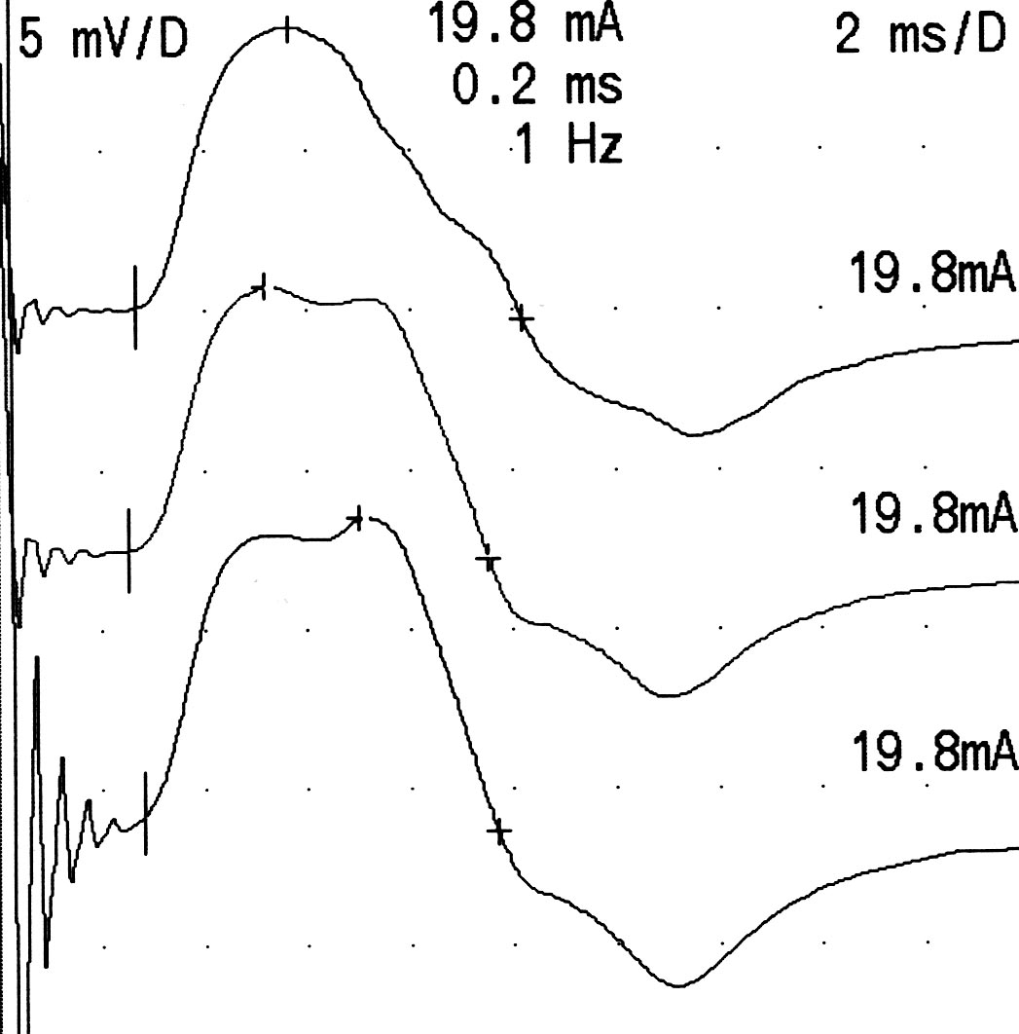
Electrodes d’enregistrement:
Quand une amplification différentielle est utilisée, l’électrode « d’enregistrement» et «la référence» contribuent toutes deux au signal enregistré
G1 sur les muscles thénariens
G2 sur la 1ère phalange du pouce, ipsilat.
G2 sur la première phalange du 5ème doigt, ipsilat.
G2 sur la première phalange du pouce, controlat.
Nerf médian stimulé au poignet
Enregistrement des réponses motrices

Slide 76


Electrodes d’enregistrement:
L’ électrode d’enregistrement (G1) devrait être placée sur la région des plaques motrices du muscle, généralement au milieu du ventre musculaire
Lorsque l’électrode d’enregistrement est idéalement placée, la réponse M débute par une phase négative
Enregistrement bipolaire des réponses motrices

Slide 77


Electrodes d’enregistrement:
L’ electrode d’enregistrement (G1)
Enregistrement des réponses motrices

Slide 78


Réglage des filtres:
Motor nerve
conduction
Le filtre passe-haut (basse fréquence) est fixé à une fréquence qui n’entraîne pas de distorsion de la morphologie de la réponse M : 2 Hz.
Le filtre passe-bas est fixé à 5-10 kHz.
2 Hz
20 Hz
50 Hz
100 Hz
Enregistrement des réponses motrices

Slide 79

Réglage des filtres:
Enregistrement des réponses motrices
D’après P Guihéneuc

Slide 80
Position des membres:
Pour les segments nerveux qui croisent des articulations, la position de celles-ci modifie la longueur mesurée du segment nerveux étudié
Dans les positions articulaires extrêmes, le nerf est étiré, ce qui affecte la longueur mesurée du segment nerveux et la vitesse de conduction calculée
De ce point de vue, le segment le plus important est le nerf ulnaire au niveau du coude : 15-35° de flexion du coude est recommandé
Enregistrement des réponses motrices

Slide 81


Position des membres:
7,5 ms
0°
7,5 ms
7,5 ms
Nerf ulnaire stimulé au poignet, sous- et au-dessus du coude
7,5 ms
100°
Flex. max. du coude
Flexion du coude | Distance | VCM au coude
30° | 100 mm | 53 m/s
0° | 94 mm | 50 m/s
90° | 104 mm | 55 m/s
7,7 ms
Nerf ulnaire stimulé au-dessus du coude
Enregistrement des réponses motrices

Slide 82

Position des membres:
La position du segment étudié influence également la longueur du muscle qui génère la réponse M
Si le muscle est raccourci, la durée de la réponse M diminue et son amplitude augmente
Il est important de maintenir une position neutre relachée des articulation distales du pied et de la maim
Position neutre
m. étiré activement
m. Passivement raccourci
Contraction isométrique
m. étiré passivement
Enregistrement des réponses motrices

Slide 83
La latence distale motrice (LDM):
Temps (ms) écoulé entre la stimulation et le début de la réponse M
La latence est mesurée de l’artéfact de stimulation à la première déflection du signal enregistré
La mesure manuelle de la latence est dépendante de l’amplification du signal (une amplification de 200 µV/div devrait être systématiquement utilisée)
Habituellement, le placement automatique des curseurs est préférable à la méthode manuelle
LDM
Paramètres étudiés

Slide 84



La latence distale motrice (LDM):
Automatique
Manuel : 2mV/D
Manuel : 0,5 mV/D
2,7 ms
2,5 ms
2,3 ms
Paramètres étudiés

Slide 85


Le temps de conduction (TC):
Le TC est la différence entre la latence proximale et la latence distale
Dans le calcul du TC, il est parfois préférable d’utiliser la latence au pic pour les réponses M proximale et distale
TC
auto.
manu.
pic
CV: 63 m/s
CV: 40 m/s
CV: 35 m/s
Paramètres étudiés

Slide 86
La vitesse de conduction motrice (VCM)
La VCM est calculée en divisant la longueur du segment par le TC
Elle correspond à la vitesse de conduction des axones moteurs alpha les plus rapides
DUR
?
La durée (DUR)
La DUR de la réponse M peut être définie : (1) du début de la réponse au premier croisement avec la ligne de base, (2) du début de la réponse à la fin du dernier pic positif (ce dernier point est souvent difficile à déterminer).
Paramètres étudiés

Slide 87
L’amplitude (AMPL)
L’AMPL de la réponse M est mesuré de la ligne de base (même si il y a un pic positif initial) au pic négatif le plus haut
AMPL
SURF
La surface (SURF)
La SURF est l’aire intégrée entre le signal et la ligne de base, le long de la DUR
Paramètres étudiés

Slide 88
La réduction (RED) et la dispersion (DISP)
Même dans un nerf normal, la VCM des différents axones oscille entre 30 et 60 m/s
En raison de cela, il y aura une augmentation de la dispersion temporelle des potentiels d’action nerveux et des potentiels d’unité motrice lorsque la distance de conduction augmente
Les changements de la réponse M en fonction des différents sites de stimulation se calculent ainsi: RED (AMPL)= 100*(AMPL_{dist}-AMPL_{prox})/AMPL_{dist}
RED (SURF) = 100*(SURF_{dist}-SURF_{prox})/SURF_{dist}
DISP (DUR) = 100*(DUR_{prox}-DUR_{dist})/DUR_{dist}
Paramètres étudiés

Slide 89
perte axonale motrice compensée par la réinnervation collatérale : amplitude motrice normale
perte des axones moteur à conduction rapide => VCM et LDM
Avant d’affirmer le caractère démyélinisant d’une neuropathie, il faut s’assurer de l’absence de remaniement neurogène (électrode-aiguille) dans les régions où l’amplitude des réponses motrices reste normale.
Pièges

Slide 90
Face n. facial
M. Sup. n. médian : > 50 m/s, > 4 mV n. cubital : > 50 m/s, > 7 mV n. musculocutané n. radial : n. de Charles Bell n. sus-scapulaire n. spinal n. circonflexe
M. Inf. n. fibulaire: > 40 m/s, > 2 mV n. tibial: > 40 m/s, > 4 mV n. fémoral
Neurographie motrice

Slide 91

Démyélinisation focale (neurapraxie)
P.A. non transmis distalement
Axone et gaine de myéline : intacts sous la lésion
Définition : réduction d’au moins 30% de l’amplitude de la réponse M lors de la stimulation proximale
B.C. très distaux proximaux (persistance des ondes F)
Neurographie motrice

Slide 92



F
Ia
Fibres motrices
F
H
H
Notes:
H : expliquer pas à pas en fonction de l’intensité de la stimulation nerveuse
(durée=1ms, faible intensité uniquement Ia, puis Ia et f motrices, puis f motrices et collision de toutes les H)
F : chaque trace = st supramaximale, 5mV/D à gauche et 500 µV/D à droite
Paramètres pour les F et les H, et exemples pathologiques

Slide 93
Réponses F :
La réponse F est une décharge récurente d’un motoneurone activé de façon antidromique
La réponse F suit la réponse M
La décharge récurente survient dans chaque unité motrice pour 0-5% des stimuli
Plusieurs stimuli (en général 20) sont requis pour obtenir un échantillon de plusieurs axones moteurs
La latence minimale de la réponse F (F-M) est la latence de la réponse F la plus courte sur 20 stimuli consécutifs (enregistrement d’au moins 7 réponses F) moins la LDM
Réponses tardives et intermédiaires

Slide 94





Ondes F : latence F-M minimale
35,3 ms
39,7 ms
41,3 ms
Influence de G2
Réponses tardives et intermédiaires

Slide 95

Réponses F :
Unité motrice
Axone moteur α = afférence et efférence
Stimulation nerveuse détection musculaire (surface ou aiguille)
À chaque stimulation ± 5% des motoneurones génèrent une réponse F
Réponses tardives et intermédiaires

Slide 96

Réponses F :
Latence minimale
Chronodispersion
Amplitude
Persistance
nb d’axones : - perte axonale - B.C.
excitabilité médullaire
taille des unités motrices
Ulnaire : CIDP
Réponses tardives et intermédiaires

Slide 97
Réponses F :
M. Sup. n. médian : C8 D1 < 30 ms n. ulnaire: C8 D1 < 30 ms (n. radial : C7) < 22 ms
M. Inf. n. fibulaire: L5 S1 < 58 ms n. tibial: S1 S2 < 58 ms
Réponses tardives et intermédiaires

Slide 98
Réponses F :
Latence minimale
normes en fonction de l’âge et de la taille
différence G/Dr : < 2 ms aux M.S. < 4 ms aux M.I.
différence médian/ulnaire: < 2 ms
différence fibulaire/tibial: < 4 ms
Chronodispersion
M.S. : < 6 ms
M.I. : < 10 ms
Réponses tardives et intermédiaires

Slide 99
Persistance
Médian : > 60 % (LN : 50%)
Ulnaire: > 80 % (LN : 50%)
Fibulaire: > 30 % (LN : 10%)
Tibial: > 90 % (LN : 80%)
- précocement altéré dans le SGB
- atteintes corticospinales
Amplitude
< 5 % de la M
formellement pathologique si > 10 %
- atteintes corticospinales
- réinnervation collatérale
Réponses tardives et intermédiaires

Slide 100


Réflexe H :
Equivalent (±) du réflexe myotatique - afférence : fibres Ia - efférence : U.M.
Stimulation nerveuse détection musculaire
Latence
S1 < 30 ms L3-L4 < 20 ms C6-C7 < 20 ms
Réponses tardives et intermédiaires

Slide 101
Latence minimale
index H
différence G/Dr
- M.S. : < 1.1 ms
- M.I. : < 1.4 ms
Hmax/Mmax
{30-70} %
- < 30 % : neuropathie périphérique avec atteinte des fibres proprioceptives de gros calibre Ia
- > 70 % atteintes corticospinales
Amplitude
différence G/Dr : < 50 %
Taille en cm
INDEX H = X 2
H-M
> 80 %
2
Réponses tardives et intermédiaires

Slide 102
Stimulation | Durée (ms) | Fréquence (Hz)
Pot. Sensitif | 0,1 | 3
Réponse M | 0,2 - 1 | 1
Réponse F | 0,2 - 1 | (0,2 –) 1
Réflexe H | 1 | 0,1 – O,5
S.N.R. | 0,2 | 3 - 50
Comptage UM | 0,05 | 1
Méthodologie

Slide 103
Modifications structurales :
Axones et tissus de soutien restent intacts
Absence de modification structurale du nerf - ischémie de courte durée (jambes croisées) - neuropathies fonctionnelles (hypoxie, canaux ioniques) => ralentissement Démyélinisation paranodale - ralentissement de la conduction internodale => des V.C. Démyélinisation segmentaire - ralentissement de la conduction internodale => des V.C. - bloc de conduction quand le temps de conduction internodale > 500-600 µs
Neurapraxie

Slide 104

Ac anti canaux ioniques
Neurapraxie vs NODOPATHIE

Slide 105
ENMG:
B.C. - immédiatement détectable - chute d’amplitude ou de surface de la réponse M > 30% sur un segment de nerf de 25 cm ou moins
Ralentissement de la conduction nerveuse
Ralentissement + B.C.
- B.C. sur les fibres les plus rapides - démyélinisation des fibres restant fonctionnelles Ralentissement sans B.C. - démyélinisation, au moins des fibres les plus rapides B.C. sans ralentissement - B.C. épargnant les fibres les plus rapides
Réduction du recrutement spatial, augmentation du recrutement temporel, morphologie normale des P.U.M.s - aspect pseudo-myogène si B.C. très terminaux
Neurapraxie

Slide 106
Site lésionnel:
La présence d’un ralentissement focal et/ou d’un bloc de conduction permet de localiser facilement le site lésionnel (sauf si la lésion est très proximale voire très distale)
Neurapraxie

Slide 107
Récupération:
Lésion purement ischémique (sans modification structurale) : récupération très rapide
Démyélinisation paranodale - élongation de la myéline pour recouvrir les zones axonales dénudées - restauration ad integrum
Démyélinisation segmentaire - prolifération des cellules de Schwann - production d’une nouvelle myéline dont les segments internodaux sont habituellement plus courts qu’à l’origine - persistance d’un ralentissement focal de la conduction
Neurapraxie

Slide 108

Pronostic:
Toujours très bon avec une récupération fonctionnelle complète dans les 3 mois (max. 6 mois)
Neurapraxie

Slide 109
Modifications structurales :
Axonotmèse : interruption des axones dégénérescence Wallérienne épinèvre intact régénérescence axonale possible
Neurotmèse : section nerveuse complète dégénérescence Wallérienne régénérescence axonale souvent impossible
L’ENMG ne peut différencier ces deux types de lésion nerveuse (échographie, exploration chirurgicale)
L’anamnèse est parfois évocatrice
Axonotmèse-neurotmèse

Slide 110
Modifications structurales :
Axone - J1-J2 : - fuite du fluide intra-axonal - gonflement et disparition des neurofilaments au niveau de l’extrémité distale - J3 : - fragmentation de l’axone et de la myéline avec début de digestion de celle-ci - J8 : - axone digéré
Corps neuronal - premières 48 h : corps de Nissl (r.e.) se fragmentent en fines particules - S2-S3 : noyau et nucléole excentrés
Axonotmèse-neurotmèse

Slide 111
ENMG :
Immédiatement et dans les jours qui suivent : anomalies identiques à celles d’une neurapraxie
J9 : - chute de l’amplitude de la réponse M - parfois plus tôt lorsque le segment nerveux est court - ENG pour apprécier le degré de perte axonale (LSN : 30%)
J11 : chute de l’amplitude des réponses sensitives
Axonotmèse-neurotmèse

Slide 112
ENMG :
J10-J14 J21-J30 : - fibrillations et ondes lentes de dénervation - amplitude des fibrillations diminue avec le temps - abondance des fibrillations diminue réinnervation fibrose musculaire - fibrillations également présentes dans les lésion musculaires directes biopsie musculaire polytraumatisme
J21 : - réinnervation collatérale manifeste : potentiels satellites et polyphasiques
Axonotmèse-neurotmèse

Slide 113

Axonotmèse-neurotmèse

Slide 114
Site lésionnel:
Neurographie motrice : peu utile car ralentissement homogène de la conduction nerveuse par perte des axones à conduction rapide
Neurographie sensitive lésion préganglionnaire vs lésion postganglionnaire
EMG : exige une connaissance approfondie de l’anatomie
Axonotmèse-neurotmèse

Slide 115

Site lésionnel:
Axonotmèse-neurotmèse

Slide 116
Récupération:
Réinnervation collatérale : dans les lésions partielles
Réinnervation terminale : dans les lésions complètes - prolifération active des cellules de Schwann (qui participent à la phagocytose des débris) - cellules de Schwann se placent en colonnes longitudinales le long de la lame basale d’origine - excroissances axonales apparaissent dans la 1ère semaine qui suit la lésion - repousse axonale guidée par les cellules de Schwann disposées le long de la lame basale : 1 à 5 mm/J - remyélinisation avec segments internodaux plus courts qu’à l’origine : la conduction nerveuse reste ralentie
Axonotmèse-neurotmèse

Slide 117

Récupération:
Axonotmèse-neurotmèse

Slide 118
Récupération:
Réinnervation terminale : dans les lésions complètes - premier signe EMG de réinnervation terminale : petits potentiels polyphasiques souvent instables - le muscle reste viable pour la réinnervation 18 à 24 mois - sur le plan sensitif - de façon précoce, les fibres saines de la sensibilité tactile étendent leur territoire cutané de perception sensitive - repousse axonale qui peut se poursuivre > 2 ans
Axonotmèse-neurotmèse

Slide 119
Chirurgie réparatrice:
Immédiate : lésion nerveuse complète par lacération
Après 1 mois : lésion nerveuse complète par avulsion T. contondant
Après 3 à 6 mois : - aucune certitude sur la discontinuité nerveuse au départ - pas d’amélioration clinique après 3 à 6 mois - aucun signe de réinnervation dans les muscles les plus proches du site lésionnel
Tardive : - complication sur le versant sensitif : névrome - transfert tendineux
Axonotmèse-neurotmèse

Slide 120
Comparaison des réponses motrices après stimulation distale et proximale par rapport au site lésionnel : pourcentage des fibres avec bloc de conduction
Comparaison des réponses motrices entre côté sain et côté atteint (ENG) : pourcentage de la perte axonale
B.C. sur 50% des fibres et 50% des fibres en dégénérescence Wallérienne : aucun tracé volontaire en EMG bon pronostic
Lésions mixtes

Slide 121

Axonotmèsis 50 %
Neurapraxie 85%
Neuropathie du nerf fibulaire commun gauche à la tête de la fibula : J30

Slide 122



Le type physiopathologique de la lésion nerveuse
Neurapraxie : PRONOSTIC FAVORABLE : 2 à 3 mois
Neurotmèse : PRONOSTIC RESERVE Axonotmèse : PRONOSTIC VARIABLE : en fonction des possibilités de repousse axonale
Avulsion de racine : PRONOSTIC NUL
Pronostic

Slide 123

Degré de démyélinisation : faible impact sur le PRONOSTIC sauf SCC : meilleure réponse au ttt chirurgical si le ralentissement est d’intensité moyenne (vs absent, léger ou sévère)
Degré de perte axonale : déterminant sur le PRONOSTIC : FAVORABLE si faible, RESERVE si > 90%
Sévérité de la nodopathie (Ac anti canaux, ischémie -> pompe à Na/K) : PRONOSTIC FAVORABLE : pas de perte axonale secondaire PRONOSTIC RESERVE : perte axonale secondaire
Pronostic

Slide 124
La distance entre le site lésionnel et la musculature devant être réinnervée
Sachant que : un muscle squelettique reste réinnervable durant 18 à 24 mois
la repousse axonale est de 1 à 5 mm/j (et d’autant plus rapide que le sujet est jeune)
PRONOSTIC FAVORABLE : TPS >> TPI
PRONOSTIC FAVORABLE : nerf facial > nerf sciatique
Concernant le contingent des fibres sensitives : la récupération peut se poursuivre au-delà de 2 ans
Pronostic

Slide 125
Autres caractéristiques intrinsèques du nerf lésé
Architecture nerveuse : Bcp de fascicules séparés par une grande quantité de tissus mous : PRONOSTIC FAVORABLE : nerf tibial > nerf fibulaire
Apport sanguin : Important : PRONOSTIC FAVORABLE : nerf tibial > nerf fibulaire
Pronostic

Slide 126
Aspects fonctionnels
Type de motricité : Globale/Intense >< En finesse/En précision : PRONOSTIC FAVORABLE : nerf fémoral > nerf facial
Localisation du segment fonctionnel : Proximal >< Distal PRONOSTIC FAVORABLE : nerf fibulaire > nerf ulnaire
L’importance fonctionnelle de l’innervation sensitive : Négligeable >< Majeure PRONOSTIC FAVORABLE : nerf fibulaire profond > nerf médian
Gène fonctionnelle liée à la réinnervation aberrante : nerf facial +++
Pronostic

Slide 127

Chirurgie palliative
Plus performante pour certains troncs nerveux que pour d’autres
PRONOSTIC FAVORABLE : nerf radial (transferts tendineux) > atteintes complètes des nerfs ulnaire ou médian
Pronostic

