Slide 1


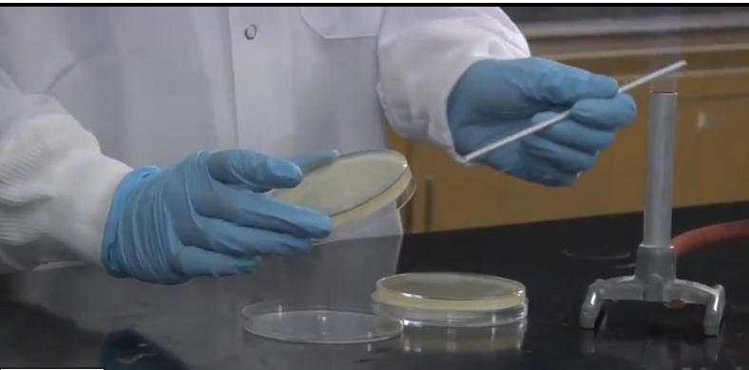
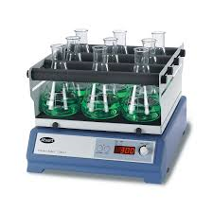
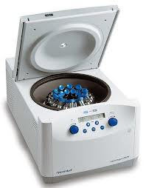
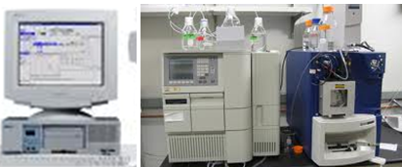
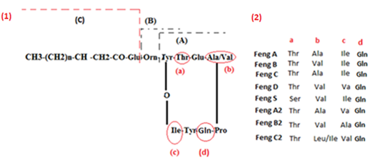
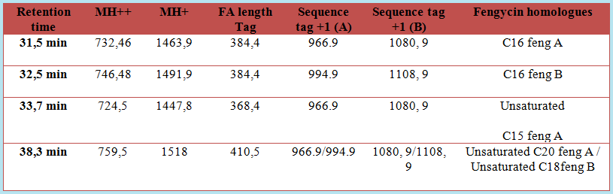
Characterization of fengycin homologues produced by B. amyloliquefaciens (ET) strain isolated from a salt lake ( Eastern Algeria)
Asma Ait Kaki^{1, 2}, Noreddine Kacem Chaouche², Monira Kara Ali², Asma Milet², Nassim Moula³, Marc Ongena¹, Philippe Thonart¹
Walloon Centre of Applied Biology (CWBI)-ULG-Belgium
Laboratory of Mycology, Biotechnologies, and Microbial Activity, University of Mentouri 1, Constantine, Algeria.
Department of Animal Production, FMV, ULg, Belgium.
Correspondance : Email : a.aitkaki@student.ulg.ac.be
Context and objective
Material and methods
Bacillus subtilis strains are a rich source of antimicrobial compounds having a high potential for biofertilizer and biocontrol applications. A great deal of interest has centered on the antibiotics produced by non-ribosomal peptides synthetases (NRPSs), including cyclic lipopeptides (C-LPs). These molecules are classed into three families, i.e., surfactin, iturin and fengycin. Fengycins show strong fungitoxic activity, specifically against filamentous fun. They are involved in plant systemic resistance elicitation (Ongena and Jacques, 2008).
The identification of produced C-LPs has been largely investigated, using matrix assisted laser desorption ionization (MALDI) mass spectrometry and liquid chromatography coupled with electrospray ionization tandem mass spectrometry (LC-ESI-MS) (Vater et al., 2002; Pueyo et al., 2005).
The main objective of this work is to analyze fengycin homologues produced by the B. amyloliquefaciens (ET) strains, isolated from the salt lake of Oued Al-Athmanya in Eastern Algeria
1. Inoculation of the nutrient medium with the B. amyloliquefaciens (ET) strain.
2. Incubation at 30°C and 160 rpm of agitation, for 72 h.
3. Supernatant recuperation by centrifugation.
4. Fengycin extraction by acid precipitation .
5. NanoHPLC Dionex Ultimate 3000 system,
coupled to an Amazon speed ETD mass spectrometer (Bruker Daltonics)
*LC-MS analysis MH+
*LC-MS.MS (CID) Diagnostic ions (A/B)
*LC-MS for opened peptide cycle sequencing
fengycin
Results
Table 1: Fengycin variants produced by B. amyloliquefaciens (SWI) strain, isolated from a salt lake in Eastern Algeria
Scheme A: Primary structures of fengycins: (1) CID fragmentation scheme, (2) list of identified fengycin.
CONCLUSION
The B. amyloliquefaciens (ET) strain produced C15/C16/C19 feng A; C16 feng B; Unsaturated C16 S feng; Unsaturated C16/C18 / C19/C20 feng A and Unsaturated C15 / C16 / C17 / C18 feng B. To conclude, this bacterium synthesized a wide variety of unsaturated fengycin homologues, which is a rare thing in the majority of Bacillus species. In addition, to our knowledge, this is the first time that fatty acid chains with 20 carbons are described.
References
*Ongena M, Jacques P: Bacillus lipopeptides: versatile weapons for plant disease biocontrol. Trends Microbiol 2008; 16: 115–125.
*Vater, J., Kablitz, B., Wilde, C., Franke, P., Mehta, N., Cameotra, S.S.: Matrix-assisted laser desorption ionization-time of flight mass spectrometry of lipopeptide biosurfactants in whole cells and culture filtrates of Bacillus subtilis C-1 isolated from petroleum sludge. Appl. Environ. Microbiol. 68, 6210–6219 (2002)
Pueyo, M.T., Bloch Jr., C., Carmon-Ribeiro, A.M., di Mascio, P.: Lipopeptides produced by a soil Bacillus megaterium Strain. Microb. Ecol. 57, 367–378 (2005)

