Slide 1
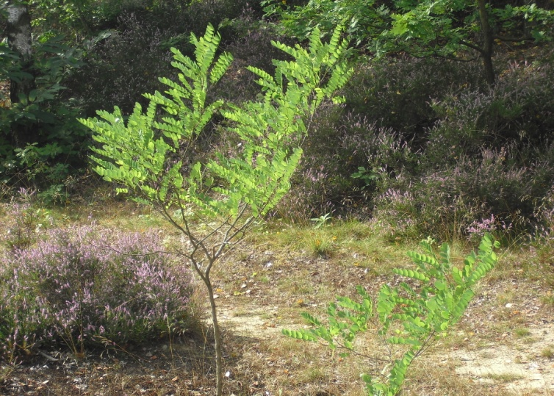

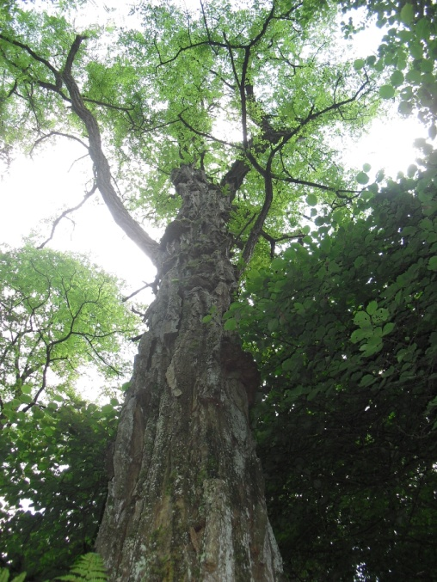
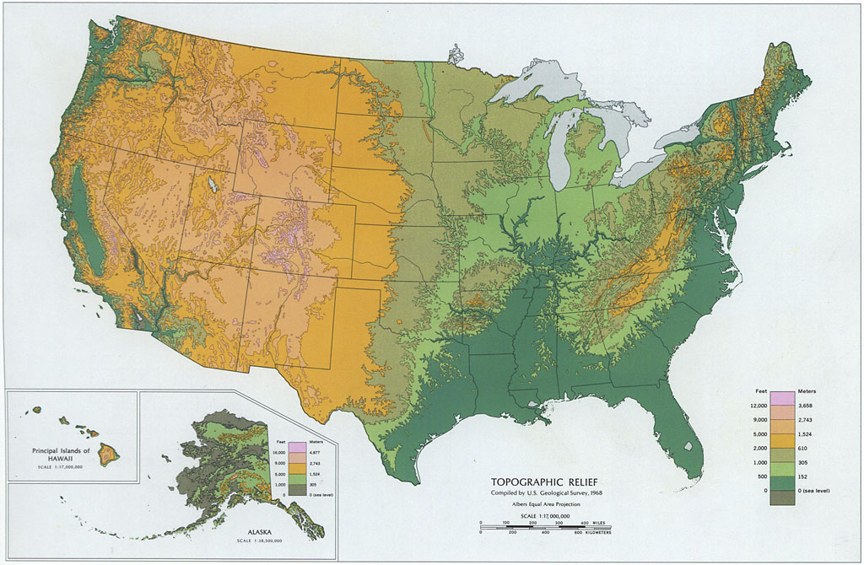
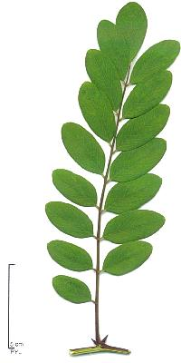
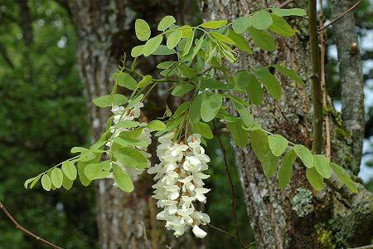
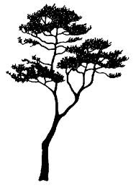
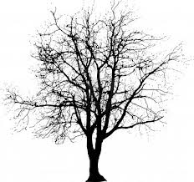


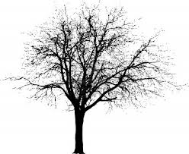
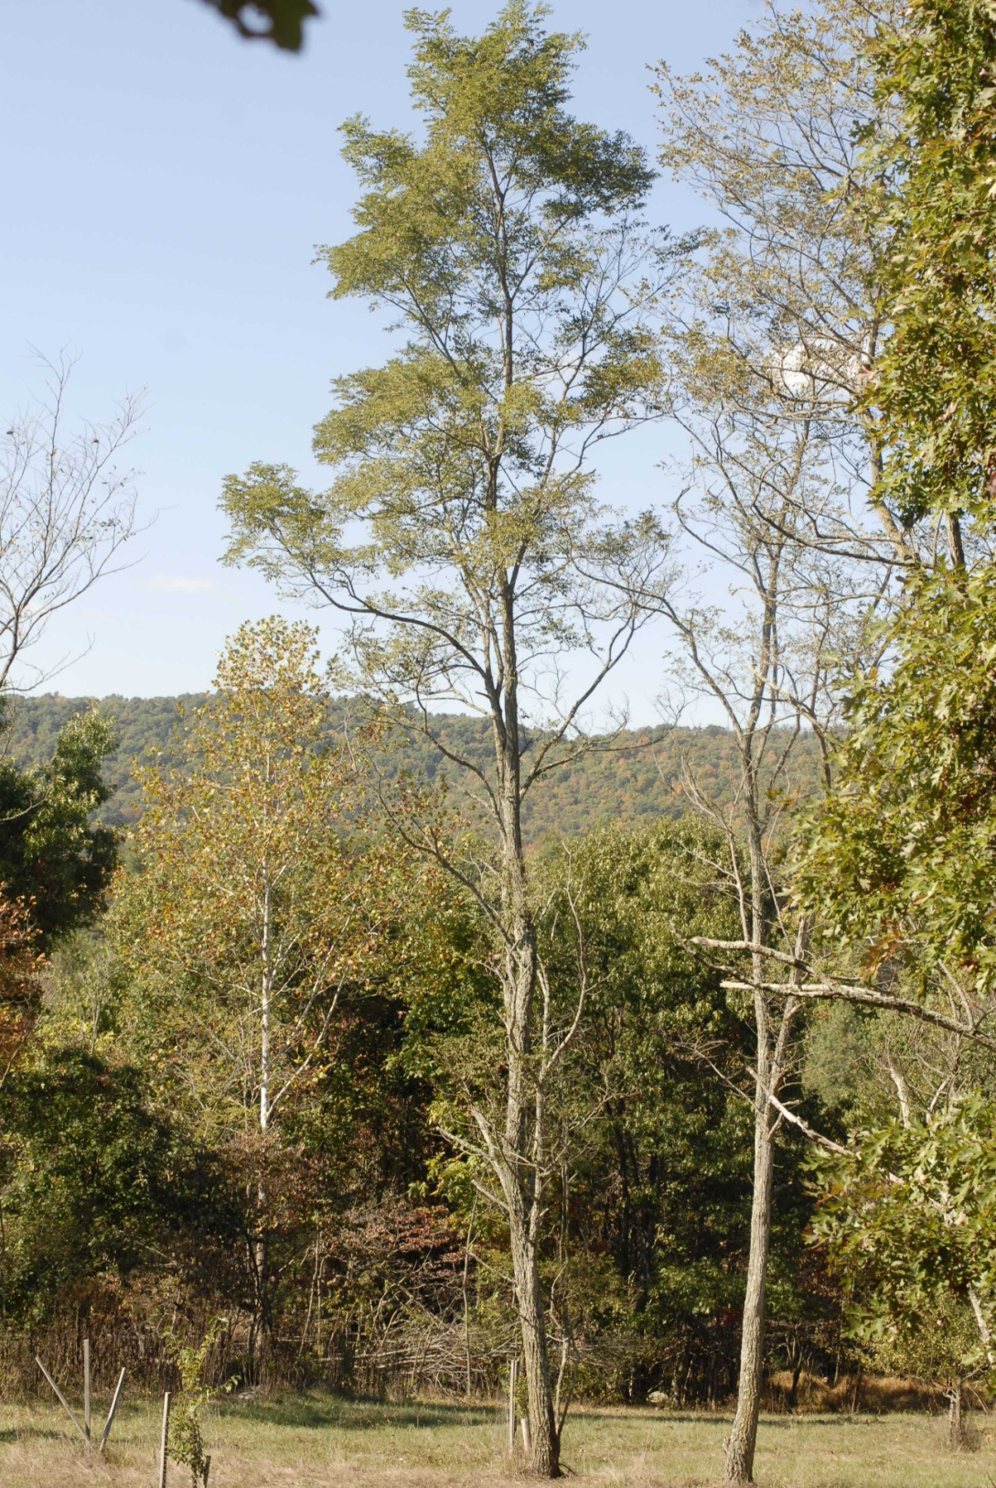
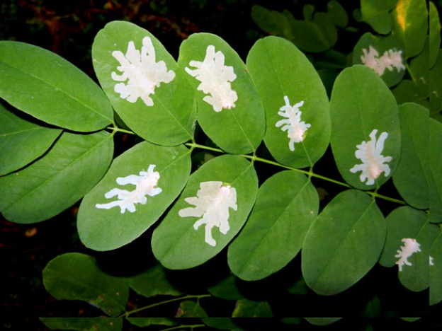
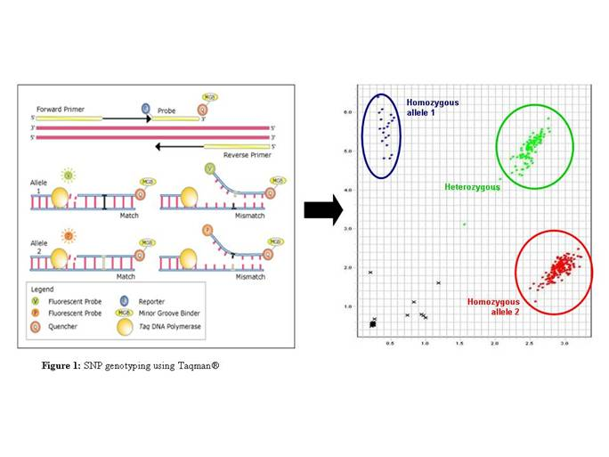

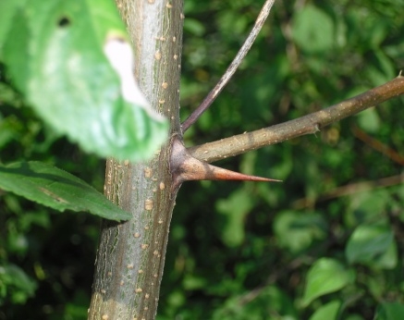

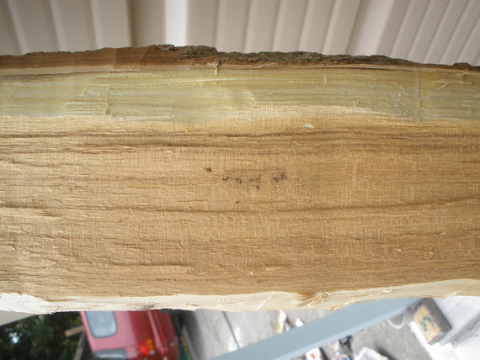

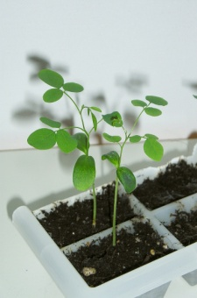
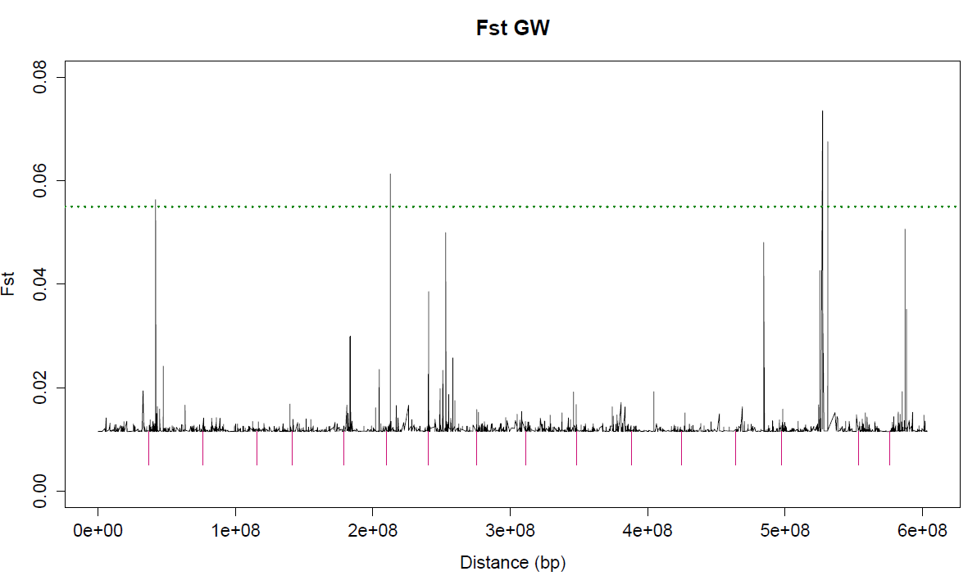
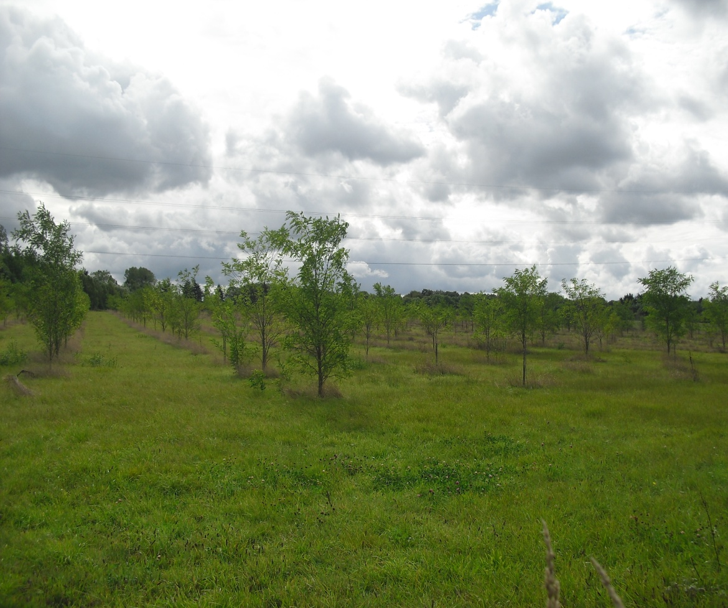



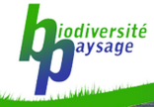


Prerequisites for a Black locust genomic selection program
Cindy VERDU, Coralie MENGAL, Frédéric HENROTAY, Philippe LEJEUNE & Ludivine LASSOIS
cverdu@ulg.ac.be
Context:
Latin name: Robinia pseudoacacia L.
Common name: Black locust
Origin: Appalachian Mountains and
Ozark Plateau, eastern United States
Invasiveness in Belgium:
Unknown
Uses: - horticultural properties
- plantation for stabilizing and revegetating disturbed areas
- production of molecules with high added value
- biomass for energy production
- timber,
- honeybee
- feed…
The use of renewable resources as an alternative to fossil fuels has become a priority. Producing biomass and developing “green chemistry” from forest tree species require the selection of suitable and competitive genotypes ready to meet the challenges of global change. In this context, the Black locust is a very promising species.
Aim of the project:
Performing preliminary studies for the development of a genomic selection program that may be more reliable than recurrent selection, for Black locust in Belgium.
Definitions:
Phenotyping: Scoring an observable physical or biochemical character
Genotyping: Determining the identity of a genetic variation at a specific position on the genome
Loci: fixed position on a chromosome
Advantages of genomic selection
vs recurrent selection:
Principle of genomic selection:
Once loci identified, genomic selection allow to:
- Reduce selection time
- Reduce surfaces of culture
- Reduce selection costs
- Increase rates of genetic progress
- Increase selection pressure
- Increase genetic diversity
- …
Rate of growth
Reference population
Resistance
Spines
SNPs array
Recurrent selection
Wood quality
Genotyping
SNP markers
“Plus trees”
Test plantation
Phenotyping
Natural populations
SNP09884
Selection of efficient genotypes based on early prediction of their value with markers
SNP00132
SNP03159
SNP09897
SNP10099
Clonal plantation
Best genotypes
Detection of loci linked to traits
Seed orchard
Preliminary studies required before starting genomic selection program:
Determine the genetic diversity and establish a core collection
Sampling around 750 genotypes in 10 Belgian and 12 U.S. populations throughout the areas
Genotyping with neutral markers
Establish a reference population
Phenotyping the core collection for target traits (straightness of the trunk, branching, rate of growth, spines, resistance…)
Develop thousands of new SNP markers
Determine the invasiveness of the species in forestry conditions
Using new generation sequencing technologies to cover most parts of the whole genome
Evaluate its phenotypic plasticity
Measuring the dispersal distances of seeds and suckers
Planting same genotypes in different climatic environments
Identifying high-risk environments
Measuring phenotypic variability
Selecting genotypes phenotypically at the extreme levels of target traits
Gestion des Ressources Forestières et des Milieux Naturels
Forest Nature and Landscape Department, passage des déportés, 2, 5030 Gembloux, Belgium

