Slide 1
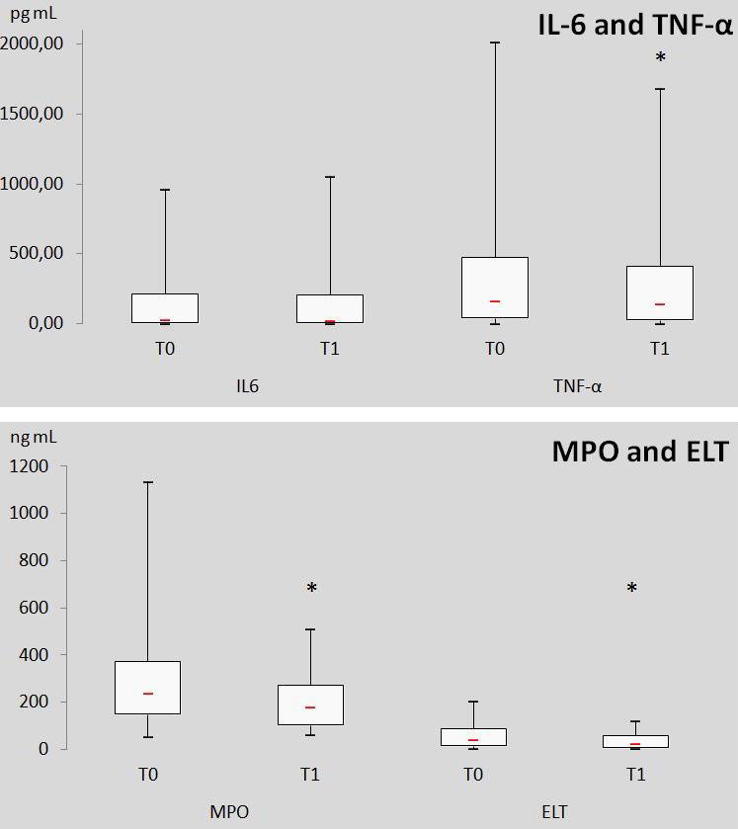
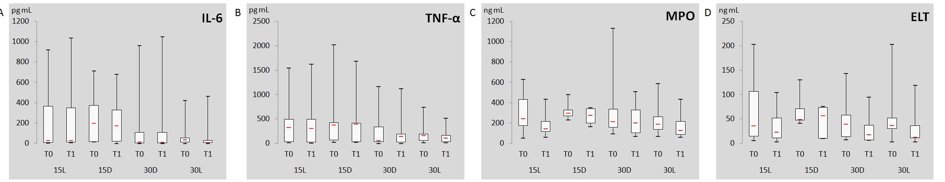
Effect of high pressure-volume and low pressure-volume mechanical ventilation on plasmatic levels of IL-6, TNF-α,
neutrophil elastase (ELT) and myeloperoxidase (MPO)
in horses during general anaesthesia Cenani A. ¹, Cerri S. ¹, Gougnard A. ¹, Detilleux J. ², Franck T. ¹, Serteyn D. ¹, Sandersen C. ¹ ¹Clinical Department of Companion Animals and Horses, ²Department of Animal Production, Faculty of Veterinary Medicine, University of Liege, Liege, Belgium.
INTRODUCTION
Mechanical ventilation (MV) may trigger some pulmonary inflammatory response in absence of pre-existing lung disease¹. Conventional ventilation may also enhance systemic inflammatory response after major surgical procedure².
AIM
To investigate SYSTEMIC changes in equine pro-inflammatory mediators (IL-6, TNF-α, ELT, MPO) after 60 min of conventional mechanical ventilation in anaesthetized horses undergoing surgery.
METHODS
Animals: 34 client-owned ASA I-II horses (9.8±5.4 years, 510±88 kg) undergoing elective soft tissue or orthopaedic surgery.
Anaesthesia: Premedication with acepromazine (0.1 mg.kg⁻¹, IM) followed by xylazine (0.6 mg.kg-1, IV) 10 minutes prior to induction with ketamine (2.2 mg.kg-1, IV) and midazolam (0.06 mg.kg-1, IV). Partial intravenous anaesthesia was used for maintenance of anaesthesia: isoflurane in 70% O2 and 30% air; ketamine and midazolam CRIs (1 and 0.02 mg.kg.h⁻¹, respectively, discontinued 20 min prior to recovery).
Surgical procedure started 25 min after induction and lasted a minimum of 45 min.
Antibiotics and NSAIDs were given on the morning of the surgery.
Mechanical Ventilation : Intermittent positive pressure ventilation was started 10 min after induction, using a volume-target, time-cycled ventilator (Drager AVE ventilator, Drager Medical) used in continuous mandatory ventilation mode . Horses were randomly allocated to 4 groups:
Low pressure-low volume: PIP 15 cmH2O, V_{T}≤ 10ml.kg⁻¹, in DORSAL (15D, n=5) or LATERAL (15L, n=11) recumbency.
High pressure-high volume: PIP 30 cmH2O, V_{T}>10 ml.kg⁻¹, in DORSAL (30D, n=9), or LATERAL (30L, n=9) recumbency.
I:E ratio was set between 1:2 and 1:3. Respiratory rate was 7.6±3.1 breaths per min (Min: 4 - Max: 15) to achieve the PIP and V_{T}.
Measurements:
Peripheral arterial blood gas analysis every 20 min (AVL Compact 3 blood gas analyser). Horses were excluded if P_{a}CO₂ was < 30 or >60 mmHg, and if P_{a}O₂ < 80 mmHg.
Peripheral venous blood samples (EDTA, jugular vein) immediately before the start of MV (T0, n=34) and 60 min after (T1, n=34) were immediately centrifuged. The plasma was stored 30 min at -20°C. IL-6, TNF-α, ELT and MPO measured with equine specific ELISA.
Statistical analysis:
A linear mixed model with a 1st-order autoregressive structure was used on normalized data (significance: α<0.05)
Fixed effects: time, recumbency, PIP and their 2x2 interactions. Main effects: anti-inflammatory drugs and antibiotics. Covariate: weight. Random effects: horse and repeated measures within horses.
RESULTS
Plasma concentrations of TNF-α, ELT and MPO significantly decreased at T1 independently of PIP, recumbency or their 2-by-2 interactions. Plasma concentration of IL-6 was not significantly different at T1 (fig 1-3).
V_{T} significantly varied with PIP and recumbency; RR and PaCO₂ significantly varied with PIP; minute volume significantly varied with recumbency (table I).
No correlation with anti-inflammatory drug and antibiotic therapies was found.
Figure 1: Plasma concentrations of equine IL-6, TNF-α , MPO and ELT at T0 and T1 (n=34). *: Significantly different from T0 (p < 0.05).
CONCLUSIONS
None of the protocols tested in this study were associated with a systemic increase of equine pro-inflammatory mediators (IL-6, TNF-α, ELT, MPO) after 60 minutes of mechanical ventilation.
The use of drugs with anti-inflammatory properties may have contributed to the overall decreased systemic inflammatory mediator concentration, despite MV and surgery.
Pulmonary inflammation, undetectable systemically, cannot be excluded, as suggested recently.³
Figure 2:Plasma concentrations of equine IL-6, TNF-α , MPO and ELT in 15D, 15L, 30D and 30L at T0 and T1
Table I: Intraoperative respiratory and pulmonary variables at T0 and T1 in 15L, 15D, 30D and 30L at T1 (mean±standard deviation, *: significantly different (p<0.05)).
group |  | 15D | 30D | 15L | 30L
number of horses |  | 5 | 9 | 11 | 9
VT (ml/kg) | T0 T1 | 9.2 ± 2.3* 8.5 ± 2* | 16.6 ± 2.8* 16.6 ± 2* | 8 ± 1.8* 8 ± 1.8* | 14.2 ± 2.3* 15.4 ± 2.8*
RR (breaths/min) | T0 T1 | 10.2 ± 3.2* 11.3 ± 2.3* | 5.9 ± 1.3 5.3 ± 0.7 | 9.4 ± 2.6* 10.1 ± 2.5* | 5.2 ± 0.8 5.1 ± 0.5
minute volume (ml/kg/min) | T0 T1 | 94.4 ± 36.4* 93.7 ± 19.3* | 96.1 ± 20.6* 86 ± 8.5* | 73.4 ± 19.9 80.1 ± 22.6 | 72.2 ± 13 77.3 ± 14.9
PaCO₂ (mmHg) | T0 T1 | 53.5 ± 5.8* | 39.1 ± 3.2 | 51.1 ± 7.5* | 39.2 ± 7.2
PaO₂ (mmHg) | T0 T1 | 170.7 ± 65 | 215.2 ± 130.3 | 232.5 ± 70.4 | 241.3 ± 48.5
Figure 3: Percent change in plasma equine IL-6, TNF-α, MPO and ELT concentrations in 15L, 15D, 30D and 30L at T1. Results are expressed as relative values (%) of T0
Abbreviations:
15L: low pressure-volume ventilation in lateral recumbency; 15D: low pressure-volume ventilation in dorsal recumbency; 30D: high pressure-volume ventilation in dorsal recumbency; 30L: high pressure-volume ventilation in lateral recumbency;
IL: Interleukin; TNF: Necrosis Factor, MPO: Myeloperoxidase, ELT: Neutrophil Elastase, MV: Mechanical Ventilation, PIP: Peak Inspiratory Pressure, T0: at the start of mechanical ventilation; T1: after 60 minutes of mechanical ventilation;
V_{T}: Tidal Volume
References:
1: Wolthuis EK, Vlaar AP, Choi G, Roelofs JJ, Jeffermans NP, Schultz MJ (2009) Mechanical ventilation using non-injurious ventilation settings cause lung injury in the absence of pre-existing lung injury in healthy mice. Crit Care 13, R1.
2: Michelet P, D'journo XB, Roch A, Doddoli C, Marin V, Papazian L, Decamps I, Bregeon F, Thomas P, Auffray JP (2006) Protective ventilation influences systemic inflammation after esophagectomy: a randomized controlled study. Anesthesiology 105, 911-919.
3: Hong CM, Xu DZ, Lu Q, Cheng Y, Pisarenko V, Doucet D, Brown M, Zhang C, Deitch EA, Delphin E (2012) Systemic inflammatory response does not correlate with acute lung injuray associated mechanical ventilation startegies in normal lungs. Anesth Anal, 115:118-21.
Contact: Charlotte Sandersen, charlotte.sandersen@ulg.ac.be

