Slide 1
The Mahatma Gandhi National Rural Employment Guarantee Act
Tackling Poverty in India

Slide 2
Content
Background
The Act
Implementation
Impact
Problems and Conclusions

Slide 3
Background
India is a parliamentary democracy since 15 August 1947
It is a federation of 28 States and 7 Union Territories
1.2 billion people live in India. 30% of them are under 14
It has a labour force of 487.6 million
Notes:
*It is the largest democracy in the world.

Slide 4
Development Indicators
About 50% of India’s population is poor i.e. about 600 million people. Official Poverty Line: 30%
44%of children under the age of 5 are underweight (Brazil: 2.2%). Children mortality rate is 48/1000 (Brazil: 9/1000; China: 16/1000;). In recent years there were cases of starvation deaths.
Life expectancy is 64 – Brazil: 72; China: 73; South Africa: 78.
Human Development Index (UNDP): India is 134th out of 179 countries. Brazil 84th, China 101st, South Africa 123rd.
65% of rural houses in India has no toilet.
About 2/3 of the population is dependant on agriculture.
Since the mid-1990s over 270.000 farmers’ suicidies
Economic inequalities are increasing; built on deep social inequalities.
According to a recent survey among gender experts, India is the worst country to be a woman in the G20, even worse than Saudi Arabia (where women cannot vote or drive)
India is the third largest economy on the planet
Notes:
Number of poor people: Various estimates exist. These estimates are those of a government-appointed commission headed by N. C. Saxena. The Oxford’s Poverty and Human Development Initiative and the UNDP reached similar results (Multidimensional Poverty Index). Official estimates (Planning Commission 2012): 30%, assuming a daily expenditure of 0,40 US$ in rural areas and 0,50 US$ in urban areas would not make people poor. With 0,50$ in Delhi you would buy 1 kg of rice and three stops by bus. Other estimates put the number of poor to as much as 80 per cent of the population.
India has the largest number of malnurished children in the whole world.
Toilets: defecation in the open helps the spreading of diseases which in turn further aggravates undernurishment.

Slide 5
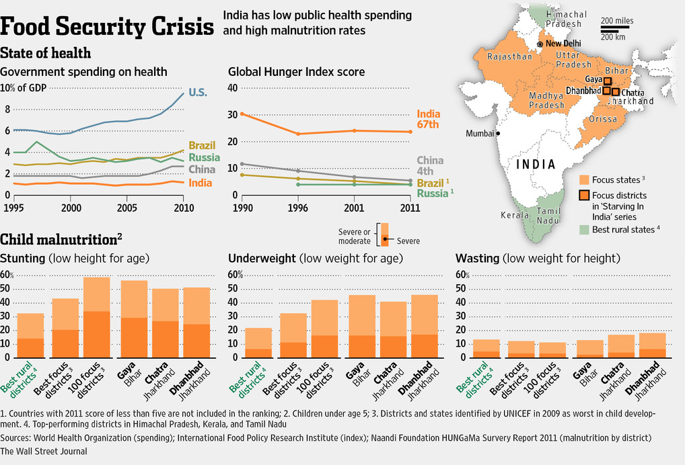
Development Indicators

Slide 6
What has India done to combat poverty?
Nearly nothing for 60 years
Land reform remained on paper (1947-80)
Anti-poverty programmes as “clientelistic” programmes and rampant corruption (1980-2004)
In 2004 things changed. A large policy project sought to tackle poverty and inequalities in an unprecedent way
Between 2004 and 2008 more than 57 Billion $ were spent in anti-poverty programmes.
The most important policy initiative is the National Rural Employment Guarantee Act (NREGA) 2005
Notes:
1.2) According to Rajiv Gandhi about 85% of the funds allocated for anti-poverty programmes were siphoned off
There is a Belgian among the designers of these law, the economist Jean Dreze.

Slide 7
The Act
The NREGA gives any person living in rural areas the RIGHT to be employed in public works to do hard, unskilled manual labour at a decent minimum wage.
It is a self-targeting programme: anyone who is willing to do unskilled manual labour at the minimum wage is presumed to be in need of public support.
Any adult who applies for work is entitled to being employed within 15 days.
It is a demand-driven programme. State support is activated from the bottom, rather than from the top.
Notes:
2.1) These two provisions (self-targeting and demand-driven) by themselves solve many of the problems that affect most anti-poverty programmes in the world. The universality of the NREGA is indeed a key aspect. One just needs to think that most anti-poverty programmes were based on top-down targeting. However, at least three national surveys indicate that, around 2004-05, about half of all poor households in rural India did not have a “Below Poverty Line card” and were thus excluded from anti-poverty programmes. Moreover, India’s official poverty line is so low that it excludes million of poor households. Minimum wages must be kept low, so as to make effective the self-targeting mechanism.

Slide 8
The Act – Basic Features
Limitations:
the work guarantee applies in rural areas only
it is limited to 100 days per household per year
Workers’ Entitlements:
Minimum wage (supposedly paid weekly)
The same for men and women
Unemployment allowance if job is not provided within 15 days
Facilities at the worksite
Employment should be provided within 5km from the village.
Women should constitute at least 1/3 of the beneficiaries
Contractors and usage of machine are officially banned
Notes:
1.b) Supposed to provide an additional income in the lean season, when agricultural jobs are hardly available. The quota of 100 days can be “shared” between adult members of the household: different persons can work on different days, or even on the same day, as long as their combined days of employment do not exceed 100 days in the financial year.
2.e) although it is not clear how the women “quota” should be implemented.
safe drinking water
shade for children and periods of rest,
first-aid box with adequate material for emergency treatment for minor injuries and other health hazards connected with the work
In case there are 5 or more children aged 6 or less, one woman (worker) will be deputed to look after the children

Slide 9
The Act – Basic Features
Not every kind of work is allowed under the programme. There is a list of eligible works (Schedule I of the Act).
Between 2006 and 2011 almost 51 per cent of the works were related to water (water conservation, flood control, irrigation, drought proofing, micro-irrigation…)
Between 2006 and 2011 over 19 per cent of the works were related to rural connectivity (mainly roads).
More and more important is the construction of small infrastructures on the private land of particlarly backward categories (ST, SC, BPL…)
Notes:
1.i.1) NREGA 2.0: Link it with the “Total Sanitation Campaign” and briefly explain what it is. Mention the percentage of people defecating on the open and explain links with malnutrition. Eligible households are those who are eligible for works on their private land.

Slide 10
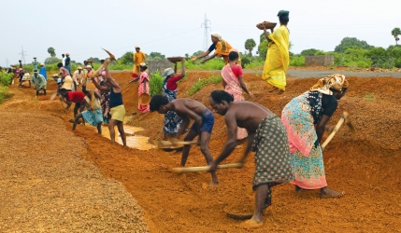
The Act – Basic Features
Building a road

Slide 11
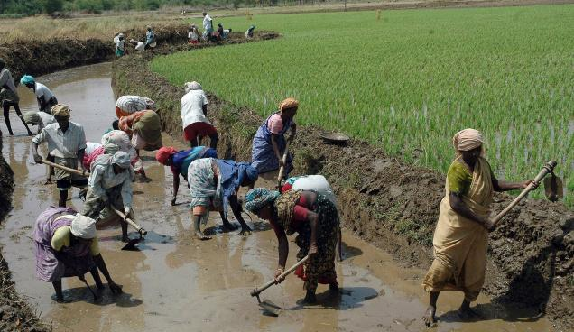
The Act – Basic Features
Digging a Canal

Slide 12
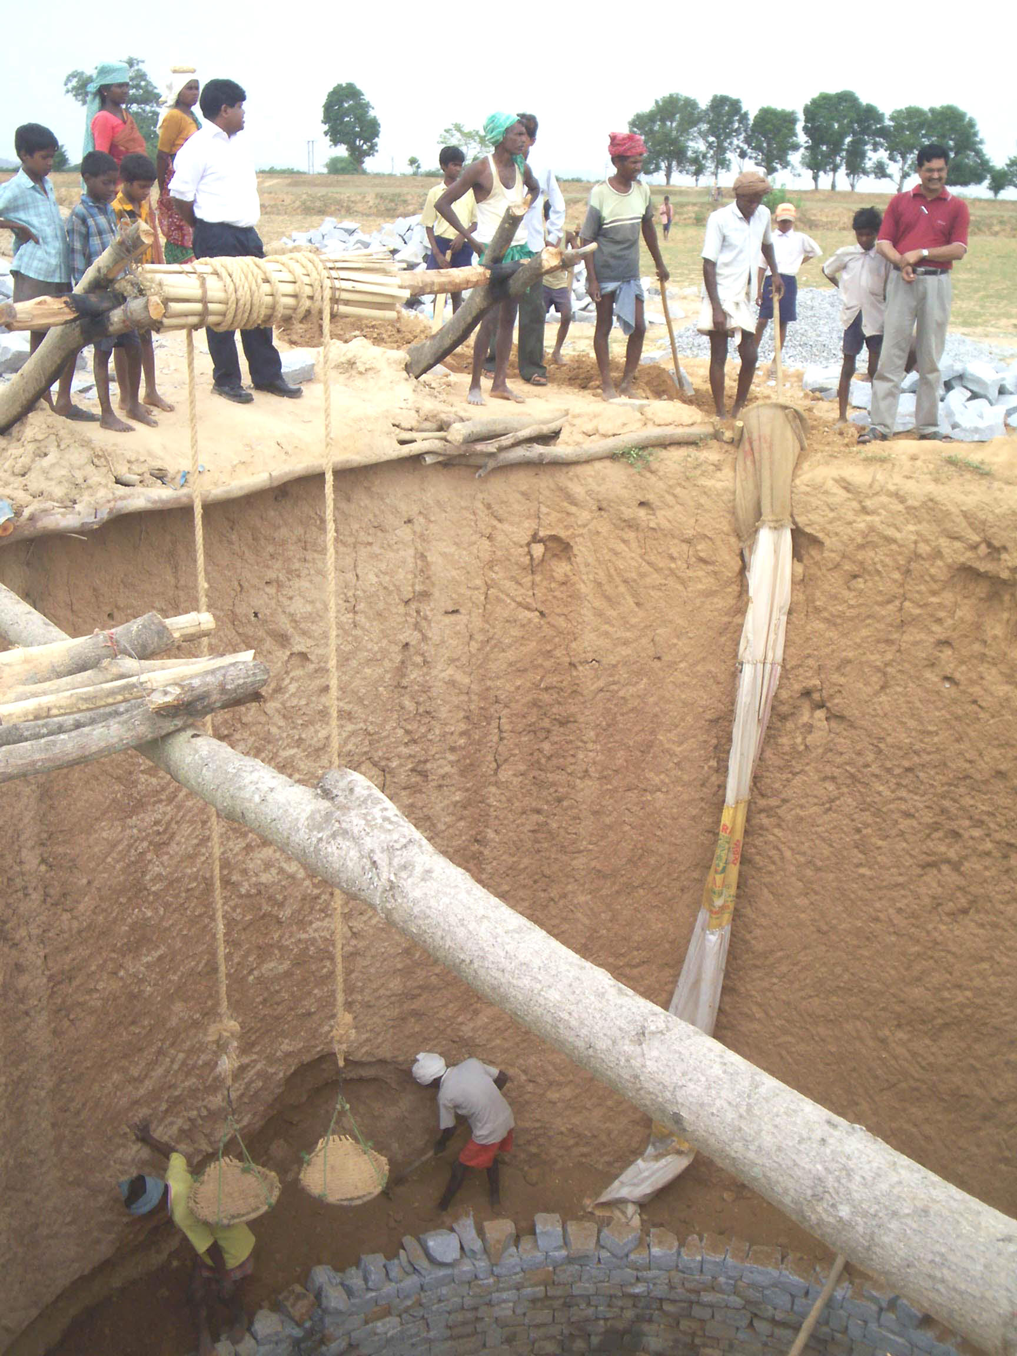
The Act – Basic Features
Building a well

Slide 13
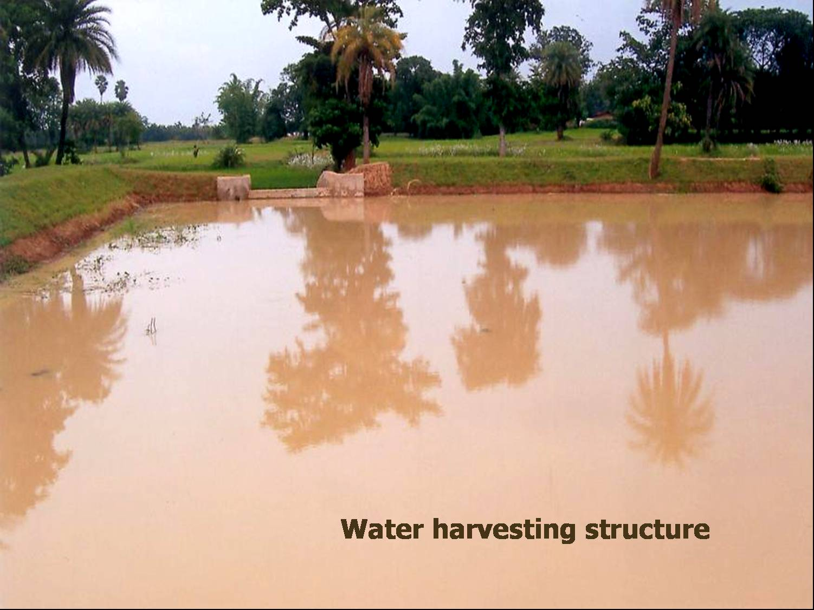
The Act – Basic Features

Slide 14
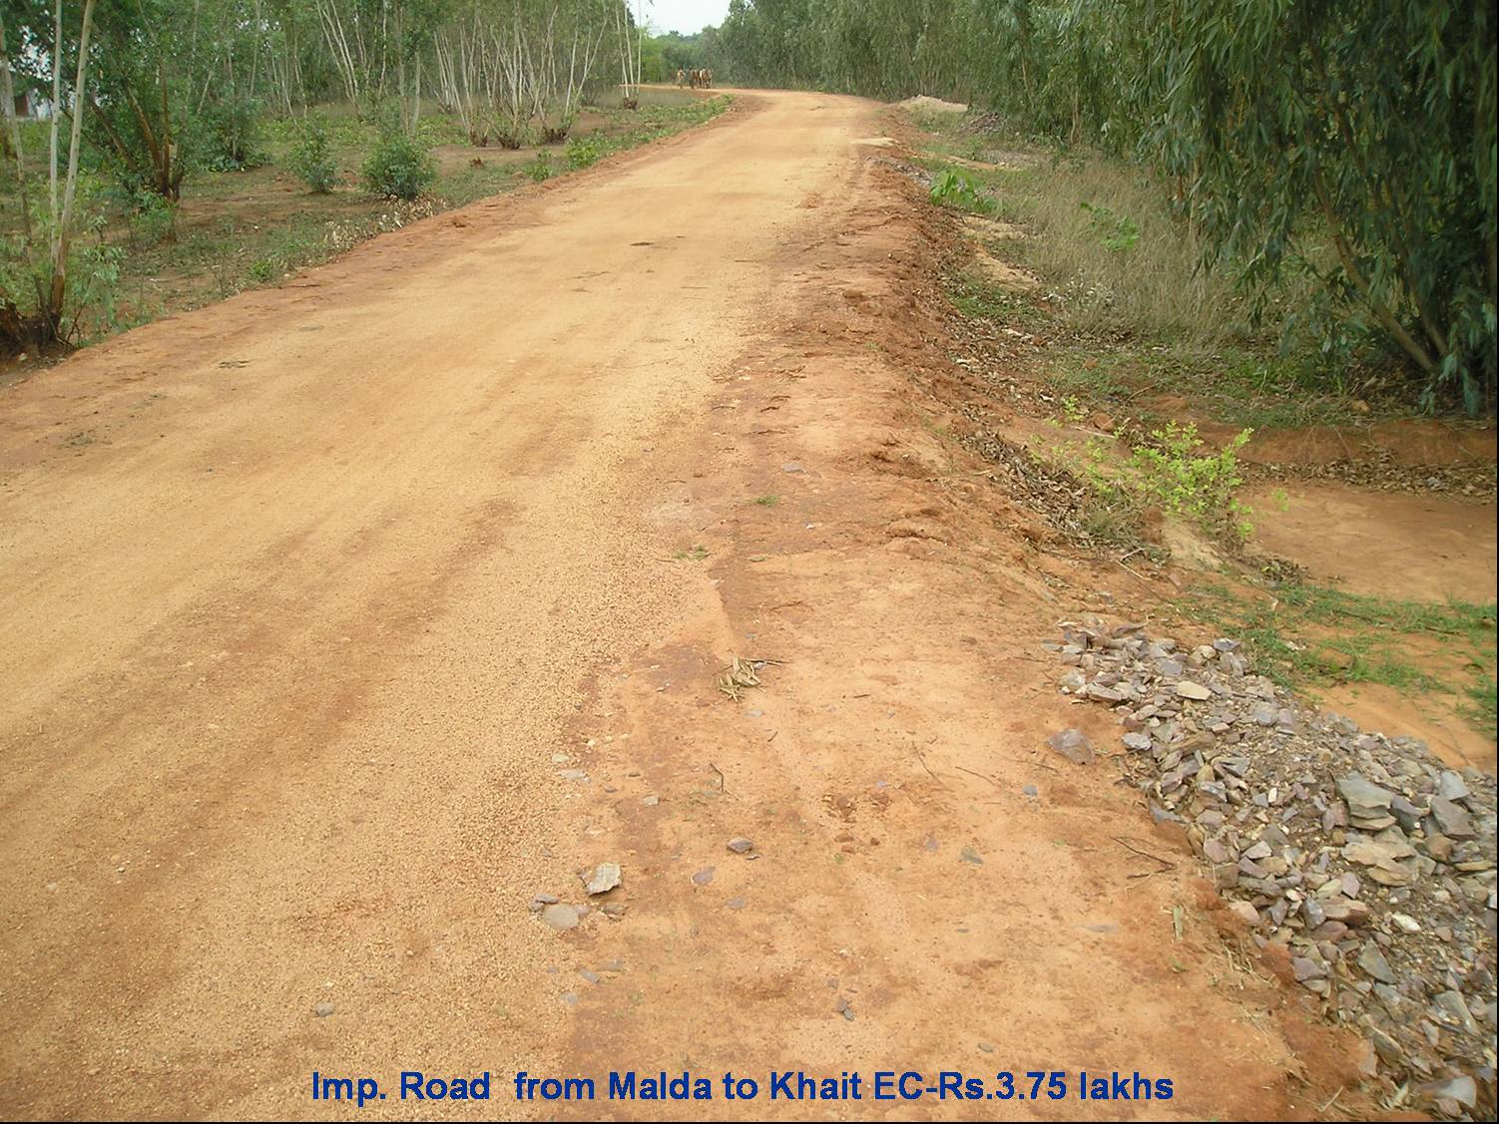
The Act – Basic Features

Slide 15
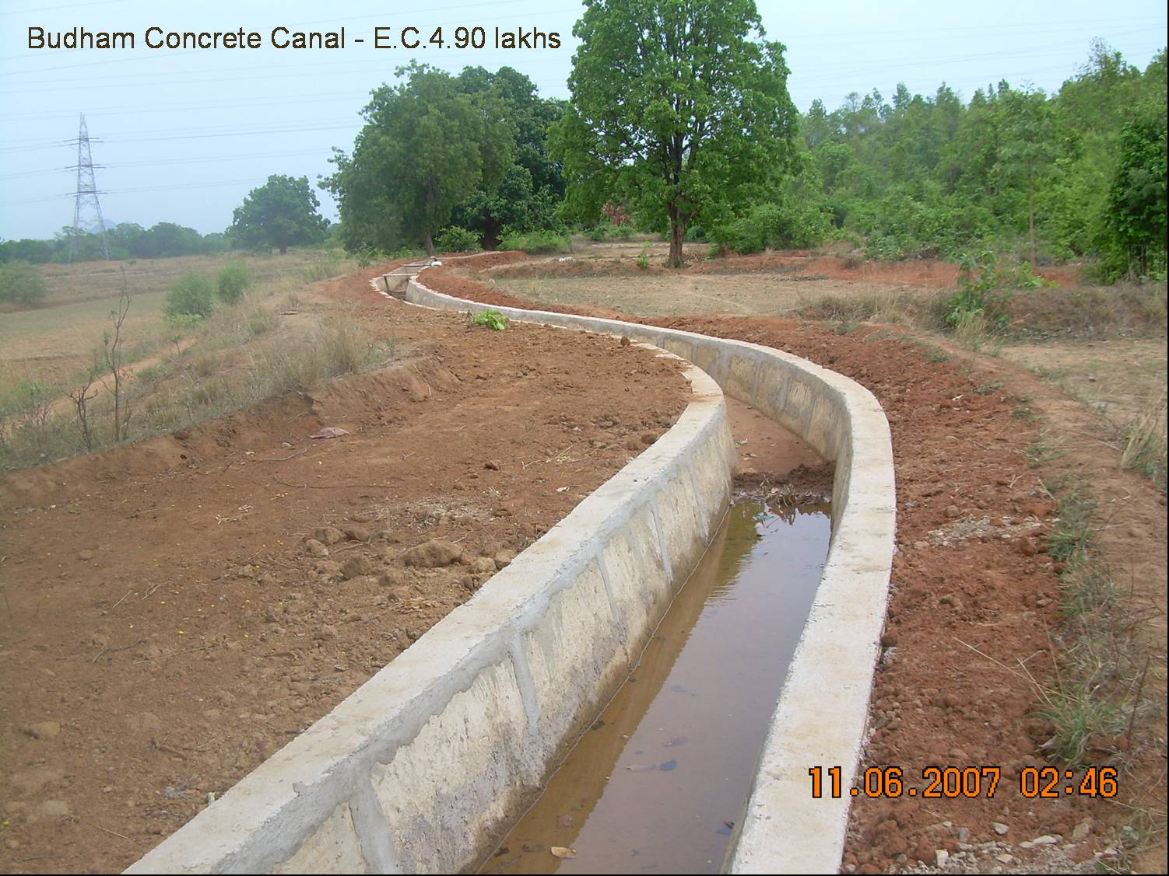
The Act – Basic Features

Slide 16
The Act - Objectives
Objectives:
Ensuring social protecion for the most vulnerable people living in rural India providing employment opportunities
Creating durable assets in rural areas to provide water security, soil conservation and higher land productivity
Strengthening decentralised planning, bottom-up participation, and deepening democracy at the grass roots
Enhancing transparency and accountability in the public sphere
Notes:
Explain Dalits, Scheduled Tribes

Slide 17
The Act – Accountability and Transparency
The Act contains strong transparency and accountability measures.
The act goes hand in hand with the Right to Information Act
The strong emphasis on transparency and accountability helps making the NREGA work better than previous programmes and give CSOs the tools for action
Notes:
*Perhaps the strongest in the world
*Explain what the Right to Information Act is. The Right to Information Act is very strong, and gives legal backing to these transparency provisions. It also calls for stiff penalties against officers who fail to supply information as prescribed, or fail to accept requests for information.
Under the provisions of the Act, any citizen may request information from a "public authority" (a body of Government or "instrumentality of State") which is required to reply expeditiously or within thirty days.

Slide 18
The Act – Accountability and Transparency
All processes must be carried out in public
All NREGA-related documentation is public. “No request should be refused under any circumstances” (OG, ch. 11).
Workers’ entitlements must be printed at the back of the Job card
Key documents related to NREGA should be proactively disclosed to the public, without waiting for anyone to ‘apply’ for them
Financial Audit is mandatory
Whenever feasible documents should be made available on the internet (MIS System)
Social Audit must be conducted regularly
Key role of civil society organisations
85% of the salaries are paid through bank accounts
Notes:
*Explain public: in front of everybody
*The introduction of bank payments greatly reduced abuses and possibilities to steal from the workers’ salaries. A few examples (there are many more19) will illustrate this. Before bank accounts,
village-level officials sometimes recorded fewer days on a worker’s job card than s/he has actually laboured, and they then entered a larger number of days into the MGNREGA’s IT
system which is used to determine how much money should go to each worker. The village officials would then pay the workers for the smaller number of days and pocket the rest of the
money. When bank accounts were introduced, this became impossible because the wages, paid according to data in the IT system, all had to go to their accounts. The new system cut out the middle men. It is also now extremely difficult for local officials to claim funds for non-existent workers, since bank accounts must be created for them, and impersonators must withdraw funds from them. It is now much more complicated to arrange wage payments for non-existent local projects, since wages for work allegedly done on them must again pass into bank accounts – which makes the scam apparent to workers, and which may give workers opportunities to demand a share of the profits or to keep them all. When the IT records show that workers have completed tasks that have actually been performed cheaply by machines, profits can only be obtained by local officials when (once again) they make workers aware of this and seek a share of the illicit payments which flow into their bank accounts. When the IT system shows that workers have received official wage rates, it is now very difficult to pay them less and then pocket the difference -- because the full wage goes into their accounts. Here again, workers will inevitably become aware of the manoeuvre because the system is now more transparent to them, and they may resist demands for money.
*Financial audit are conducted at the district level
*The Andhra Pradesh NREGA website as an example

Slide 19
Implementation
One of the key objectives of the Act is to promote bottom-up participation. For this reason significant power and resources are devolved to local structures of government
India’s federal structure is constituted by the village, block, district, state, and central level administrative units.
Each of these levels has 2 fundamental structures: one elected, one administrative
Notes:
1) It is probably the largest develoment of funds lo local elected bodies ever attempted in the whole world.

Slide 20
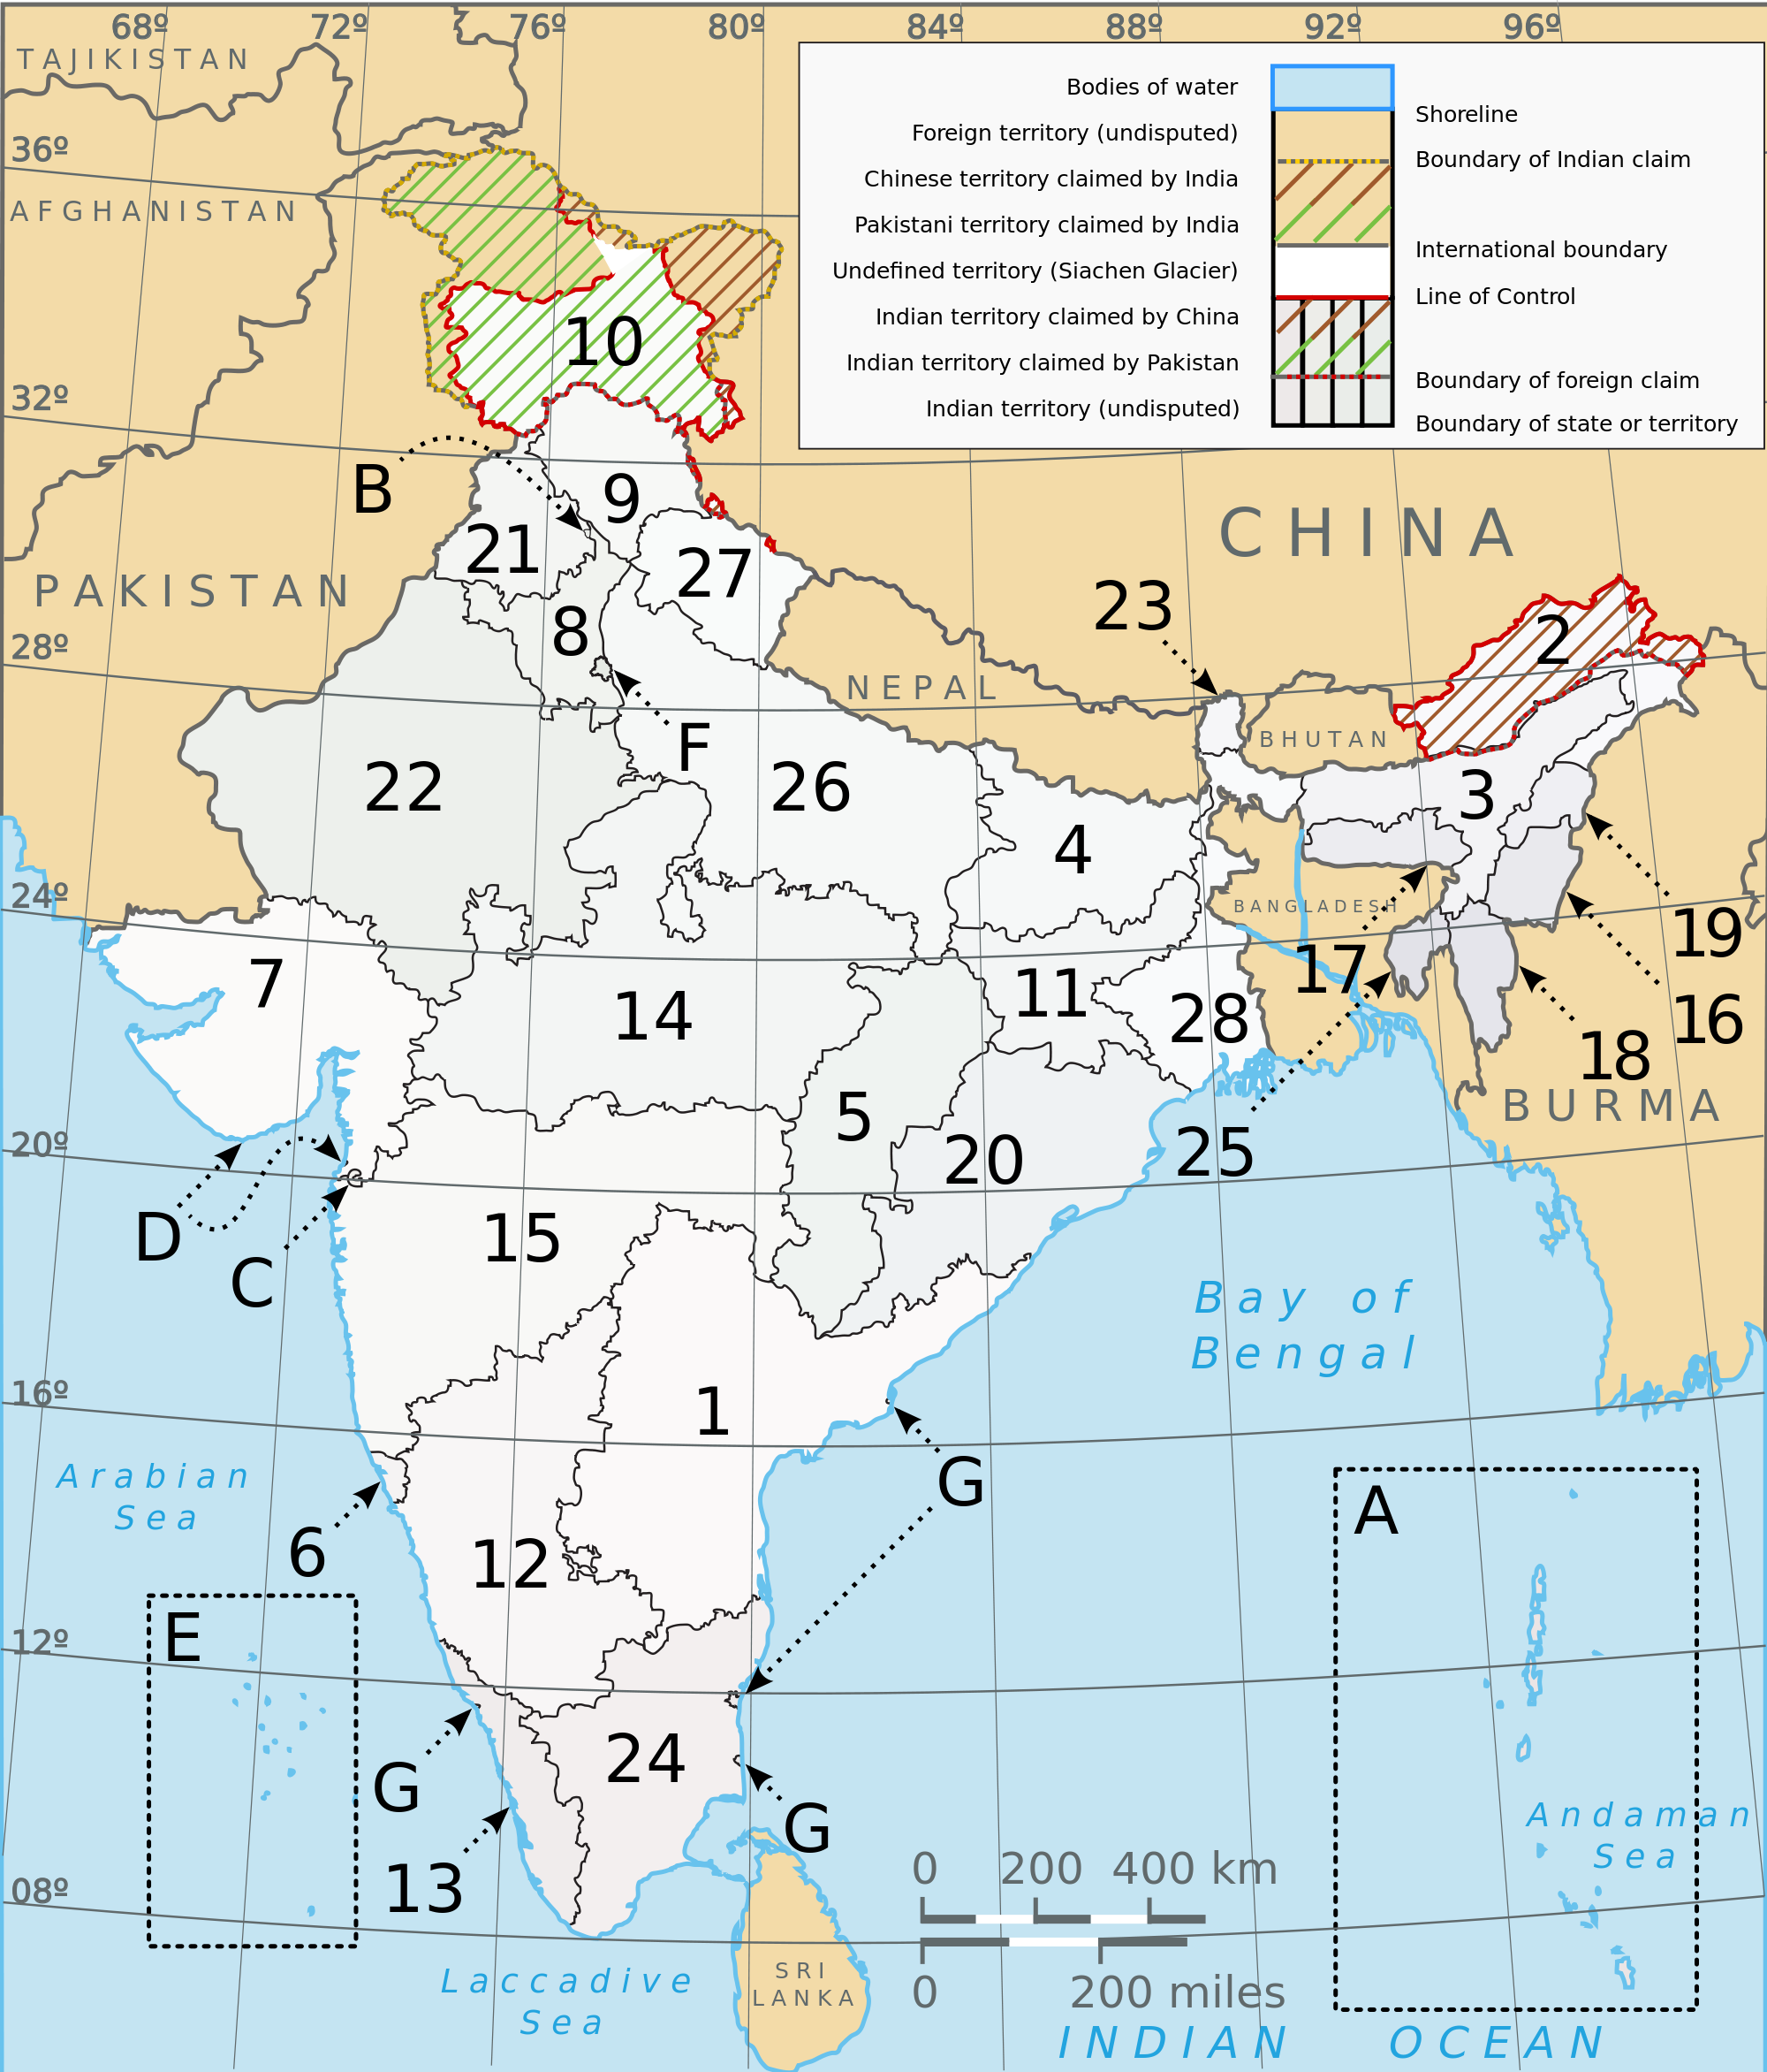
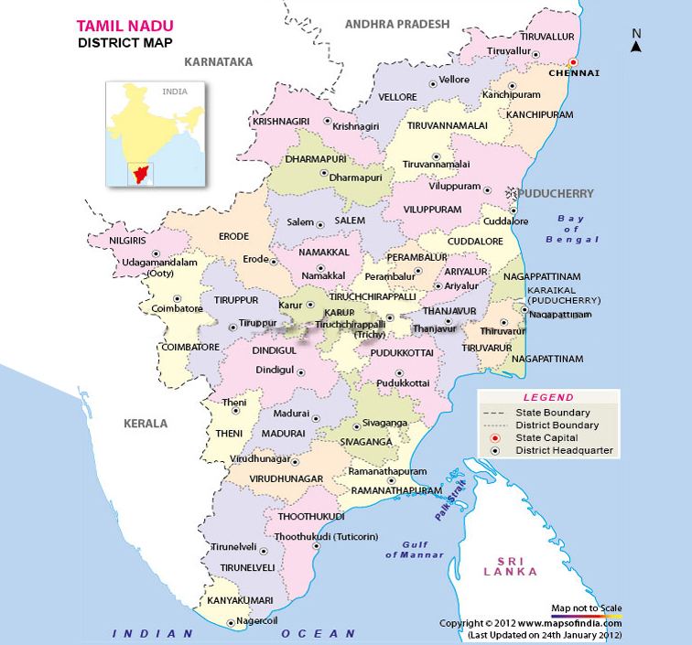
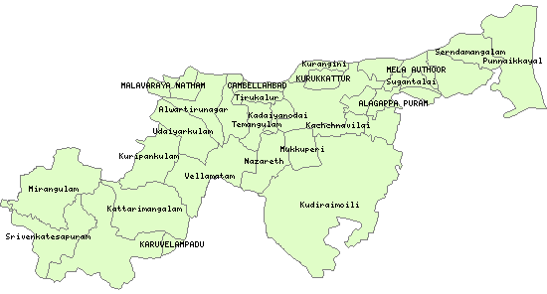
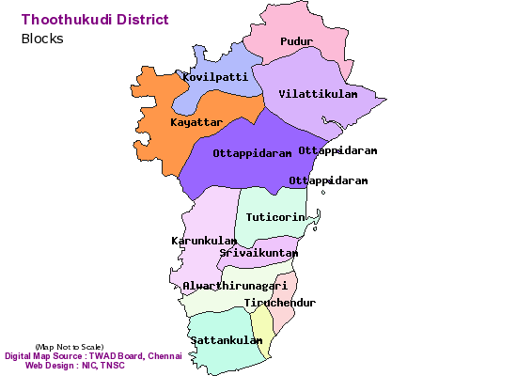
India’s Federal Structure
India
A State (Tamil Nadu)
A District
A Block
A Village

Slide 21
Gram Panchayat – The Village
The Gram Panchayat is an elected council at the village level. It is responsible for the implementation of the the NREGA in the village.
At least 50% of the NREGA funds must be spent by GPs. At the national evel it means that about 3.5 billion $/year are spent by elected local council at the village level.
First Step: workers have to register with the Gram Panchayat and obtain a Job Card
Workers need to apply for work each time.
They receive a receipt
Applicants are supposed to be told where and when to show for work within 15 days
Notes:
In the Job Card are registered the number of days they have worked, wages paid, unemployment allowances received, etc. All these data must match computerised records in the IT system.

Slide 22
Gram Panchayat – The Vellage
The GP prepares a “development plan” for the village which contains all the works to be done under the NREGS. These are prepared following the Gram Sabha’s recommendations.
The GP executes the works after having obtained the authorisation by the Programme Officer (Block Level)
The GP must keep records of every transaction and all official documents must be available for social audits.
The headmen of the GP in practice is able to control all NREGA processes at the village level.
Notes:
(i.e. an assembly comprising ALL adult members of the Panchayat).
Between 17 and 21 records. A lot of work.

Slide 23
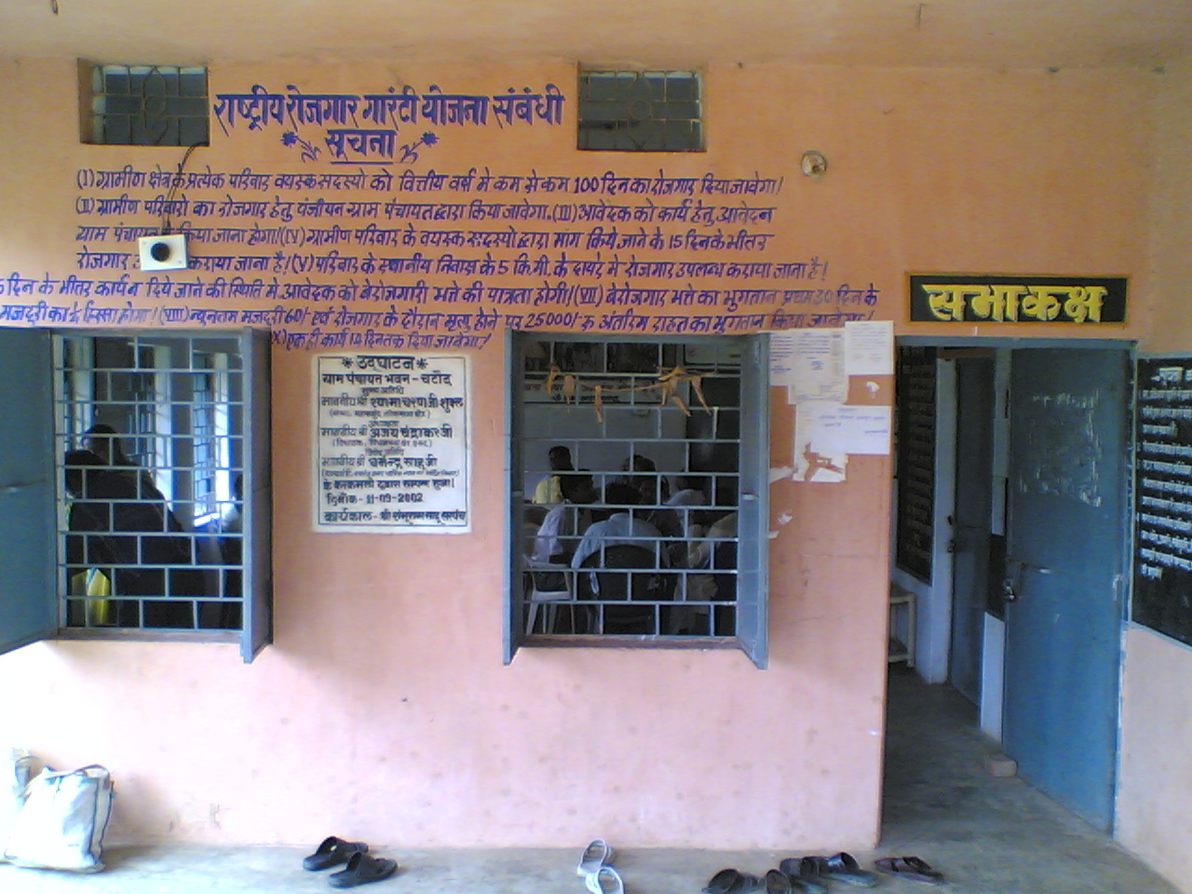
Gram Panchayat

Slide 24
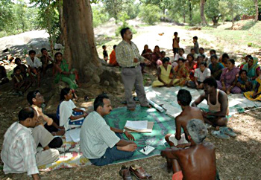
Gram Panchayat

Slide 25
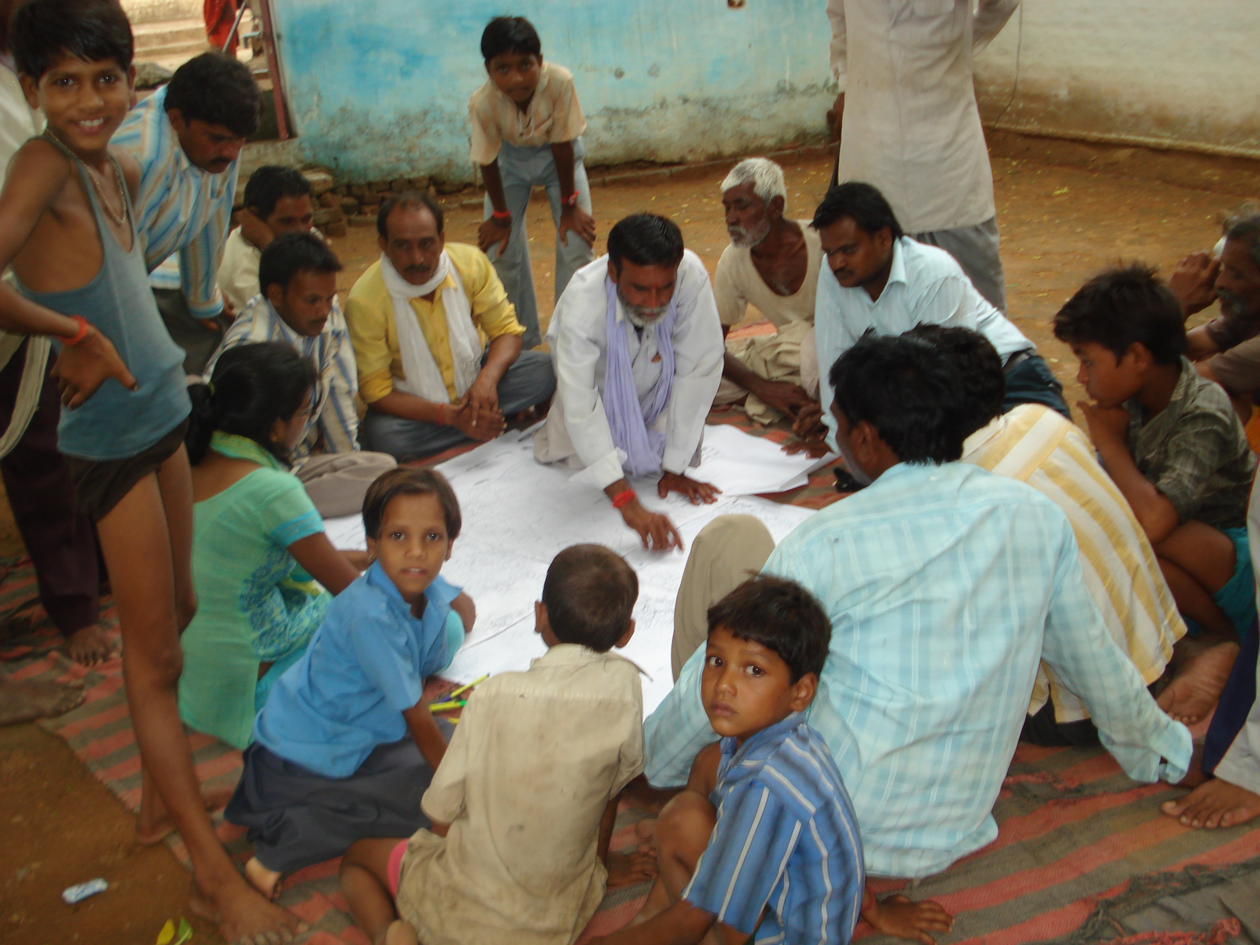
Gram Panchayat

Slide 26
Civil Society Organisations
Awareness Campaigns
This is crucial, being the NREGA demand-driven
Organize mass registration programmes at the Gram Panchayat
Organize labourers in their area
Encourage and help women to apply
Explain workers’ entitlements and help them get what they are due
In Jharkhand, a CSO opened several “NREGA Help Centres”
Watchdogs
Organize a survey of NREGA worksites to check whether the provisions of the Act and operational Guidelines are being followed
Monitor works, and use the transparency and accountability provisions of the NREGA and the Right to Information Act to fight corruption.
Conduct social audits at NREGA worksites.
Often the relationship with local authorities becomes very conflictual. Some CSOs members have been killed in recent years.

Slide 27
The Block
This is the basic unit of implementation
A “Programme Officer” (paid by the Central Government) is in charge of the NREGA at the Block Level.
The NREGA is (should be) the sole responability of the PO.
(S)he “matches” demand for work (from workers) and proposal for works to be taken up (from GPs).
(S)he monitors the implementation of the NREGA
(S)he sanctions work plans proposed by the gram panchayats and certicates the complention of the works
If (s)he is not committed to the programme or (s)he is corrupt then we are in trouble
Notes:
Often Block Programme Officers ask for bribes at panchayat headmen

Slide 28
The District
The supervision of the scheme in the responsibility of the District Coordinator.
The Districts request and receive the funds from the central government
(S)he must conduct inspections
Again if (s)he is corrupt then we are in trouble. But elected politicians are usually able to control them (if they are not corrupt themselves).

Slide 29
The State
The state government must prepare a “National Rural Employment Guarantee Scheme” for the implementation of the NREGA
The State Government has to pay for 25% of the material costs, and for the unemployment allowance (which is in fact never paid).

Slide 30
The Centre
The funds for the programme come mostly from the Central government
The Central Government pays for 100% of the wages of labourers employed under the NREGA, and for 75% of the material costs (which include skilled labour).
Labour-material ratio must be at least 60:40
The total allocation is 400 billion rupees i.e. about 7.1 billion US$ a year
The Central Employment Guarantee Council monitors the programme.

Slide 31
Impact
Broadly speaking the NREGA has had a great impact on poverty
‘Poverty’ is defined broadly here, and not in narrowly economistic terms. It is not just a severe shortage of funds, incomes and assets, but also a severe shortage of liberties, opportunities and the capacity to operate effectively and to exercise influence in the public sphere. […] In other words, ‘poverty’ consists in part of a severe shortage of ‘political capacity’. This implies four things: poor people’s political awareness, confidence, skills and connections (to other poor people and to allies among the non-poor) (J. Manor)

Slide 32
Impact on Income-related Poverty
In 2010-11 about 55 million households (about 250 million people) obtained employment for a total of more than 2,5 billion person-days generated.
About 70% of these happen during the lean agricultural season
Between 2006 and 2011 12 billion person days generated.
28% were Scheduled Castes (former untouchables)
23% were Scheduled Tribes
47% were women
In 2010/11 a household worked for 47 days on average
In 2011/12 25% of all rural households in the country worked under the NREGA.
Notes:
This is the largest anti-poverty programme in the world.
For both SC and ST the particpation rate exceeds their share in the total population

Slide 33
Impact on Income-related Poverty
By contributing to food security, the salary coming from the NREGA help avoiding the “poverty trap”
Workers use their additional income largely on food. A single day wage is enough to provide two meals per day for a family for several weeks (thanks to subsidised food in government shops).
Other expenditures include clothing, education, health care, housing improvements
The additional income let poor people to withstand economic shocks (e.g. weather shocks) and deal with inflation
A good number of non-(officially)-poor participate in the scheme.
Notes:
Poverty trap: low wages → poor nutrition → low productivity and vulnerability to illness, → even lower wages.
A longitudinal study surveying the same 2500 households in 2004 (i.e. before the NREGA) and then in 2006 and 2008 shows the very positive effect on consumption expenditure, intake of energy, and protein and asset accumulation.

Slide 34
Financial Impact
The NREGA has contributed to increase salaries in rural areas, also for works NOT covered by the programme.
Reduced distress migration to urban areas will probably translates in less crowded slums and higher salaries in urban areas too.
Evidence that NREGA salaries are being used to start own ventures, to increase land productivity, to lease and farm small plots of land, or to buy livestock.
85% per cent of the salaries paid through bank accounts. This means enhanced financial inclusion of the poor (including women), less exposure to risk, and access to institutional credit

Slide 35
Impact on Women
The NREGA is a women-friendly programme
Main benefits for women include:
work available at legal minimum wage (same for man and women)
Women working outside the NREGA are harassed in up to 35% of the cases. The ban on private contractors in the NREGA has brought this percentage down to 9%.
The additional income has been reported as “very important” to avoid hunger by 69 per cent of widows interviewed in six states;
Women workers can get work at their village; many women (about 50%) would not work outside their village (either voluntarily or because of discrimination)
Can foster gender equality and women’s material independence from their husbands.
Studies indicates that in many states women have increased decision-making power within the family. This could (slowly) lead to a transformation of gender and intra-household relations
However, there are important areas of concerns: absence of child care facilities (mandatory as per law), presence of contractors (higher risk of exclusion from work/harassment), low attendance of women at gram panchayat and gram sabhas; bank accounts are sometimes in the husband’s name;

Slide 36
Impact on Rural Economy
India’s rural sector suffer from a severe lack of basic infrastructure
Some studies show that the NRGEA has a great potential for building infrastructures in rural areas: out of 143 best performing assets, 117 had a RoI of over 100 per cent in the first year
Surveys show that most people use the infrastructures built under the NREGA for the purpose they were built for.
A study evaluating 580 assets created under the NREGA found that most of them are durable and will last for their designed average life.
“All-weather roads” (a critical infrastructure) are usually poorly built and do not last long, mainly because of non-use of machines like road rollers (forbidden by the law).
In a lot of cases NREGA assets are “fail proof”, meaning that they are useful even though technically not very good.

Slide 37
Political Impact
Decentralisation and empowerment of local institutions
Mixed results
Enhanced “Political Capacity” of the Poor. The working of the programme develops poor people political awareness, skills, confidence as actors in the public sphere, and political connections with poor people and allies among the non-poor.
Breaking bonds of dependency
New relations of status and power
Increased bargaining power of the poor. No more bonded labour.
The collapse of private armies in Andhra Pradesh
The NREGA has increased labour force participation significantly. Many women work for the first time.
Reduction of child labour and increased school attendance.

Slide 38
Problems (yes, last slide)
Studies show how awareness among the potential beneficiaries of the provisions of the Act are still low.
In many states less than 10% of the people are aware of the unemployment allowance
In many states less than 50% of the people are aware that they can demand work at any time.
According to a recent survey, around 19% of the rural households sought but did not get employment and the unemployment allowances are rarely paid. This percentage is higher in poorer states, where the demand for work is higher.
Perhaps the greatest problem is delayed payments (in some cases up to 2-3 months). This is the biggest problem according to the beneficiaries themselves
Still many cases of poor quality of asset created. But there are important exceptions.
Corruption
Social Audit seldom occur
Heavy shortage of staff

Slide 39
Contact
Diego Maiorano
d.maiorano@ulg.ac.be

