Slide 1



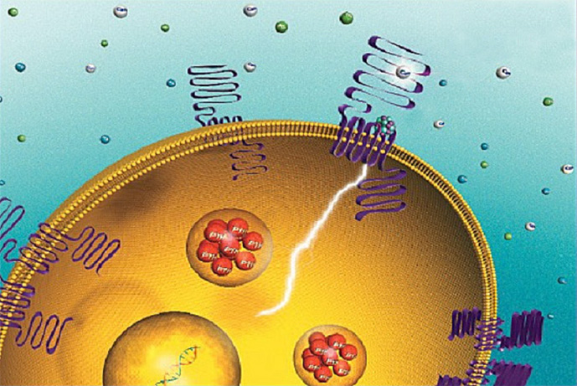
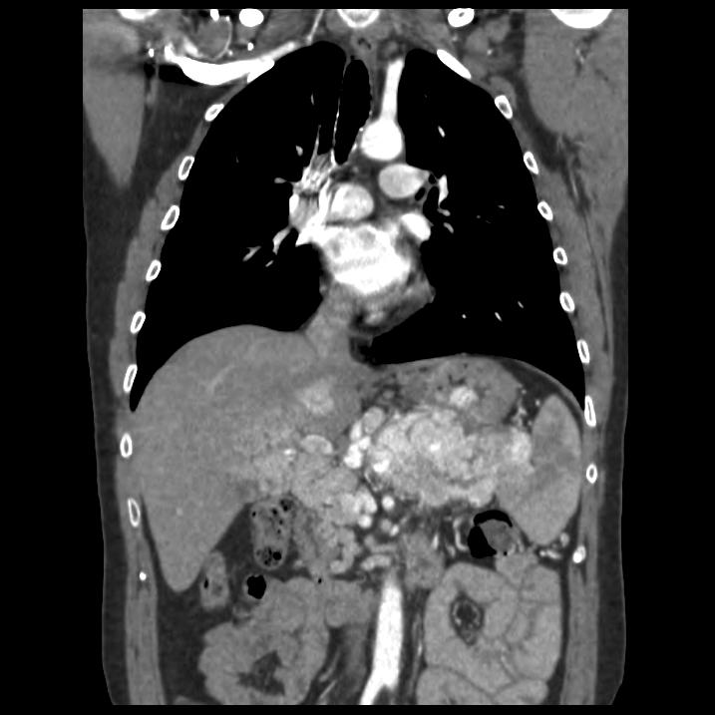
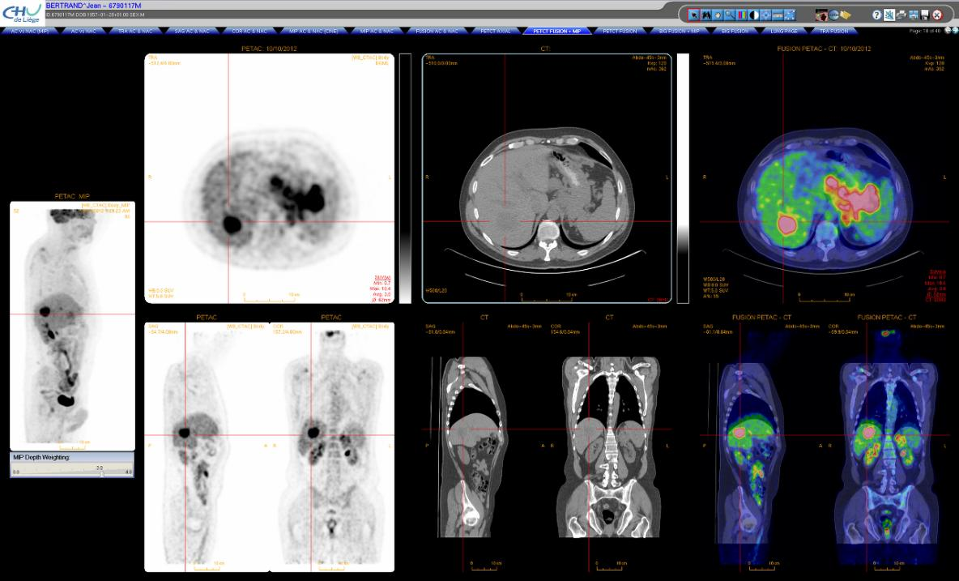
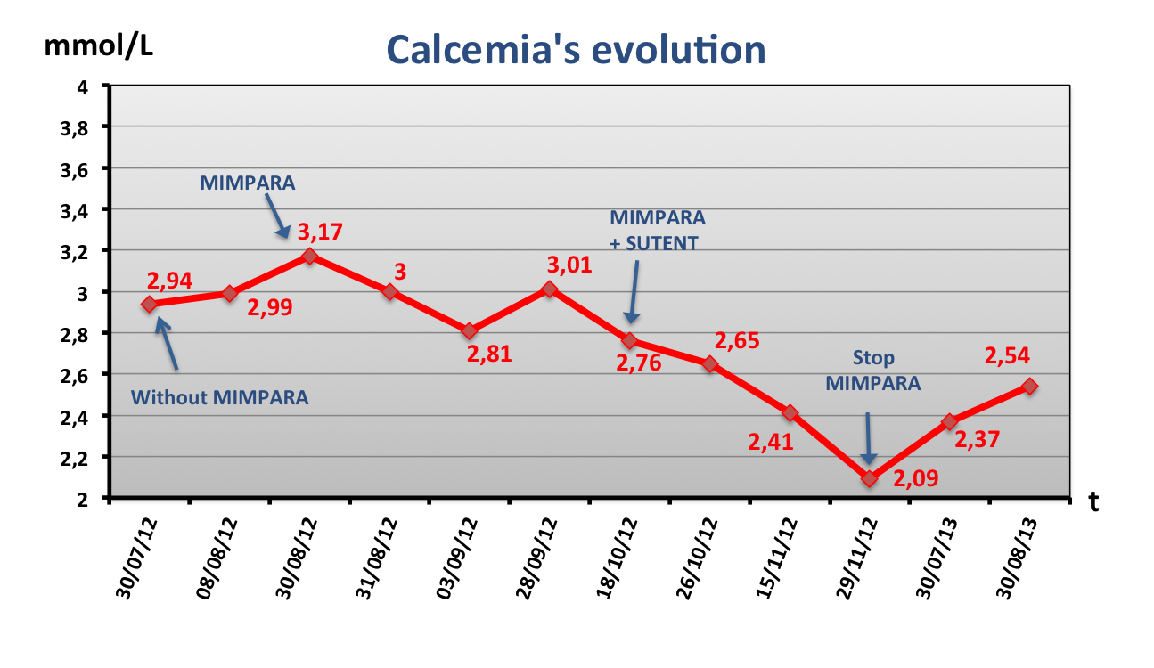
Refractory hypercalcemia and ectopic calcitonin secretion in a malignant pancreatic neuroendocrine tumor: hypocalcemic effects of Cinacalcet
P 42
Dr H Valdes Socin, Dr M Rubio, Dr JP Loly, Dr D Betea, Pr A Beckers, Dr M Polus
Endocrinologie, CHU de Liège.
INTRODUCTION:
Paraneoplastic hypercalcemia is a sign of poor prognosis, as it is particularly resistant to the usual hypocalcemic treatments.
Cinacalcet (Mimpara)® is an hypocalcemic treatment which is agonist to calcium receptor in parathyroid glands.
Mimpara®:
Binds to the CaR
Increases the sensibility of the receptor to extracellular Ca
Reduces PTH secretion
CASE REPORT:
A well-differentiated pancreatic neuroendocrine tumor (ki-67 = 2 %) was diagnosed in a 52 –year-old diabetic man, in 2009.
Ostreoscan: Liver and intraabdominal hyperfixation.
Bone scintigraphy: Negative.
Blood test: Calcium: 3,54 mmol/L (2,15-2,6 mmol/L), phosphorus: 0,71 (0,74-1,51 mmol/L), PTH < 4 ng/ml, 1,25 OH vitamin D: 89 (< 85 pq/ml), calcitonin: 1016 (<12 ng/ml).
Urinary test: hypercalciuria and hypophosphaturia.
Treatment:
Streptozotocin-Adriamicyn, FOLFOX. Sandostatin LAR.
2012: Despite hypocalcemic treatments, calcemia remained high (3,17 mmol/L). Cinacalcet (Mimpara)¹ was prescribed up to 120 mg per day.
3) One month later Sunitinib (Sutent) 37,5 mg per day was added.
Hypocalcemia and high serum PTH Stop Cinacalcet
Calcitonin normalized. Improvment of pancreatic lesions and metastasis.
NMR and PET scan: Splenic and liver carcinomatosis
CONCLUSION
Cinacalcet is a Calcium Sensing Receptor oral agonist. Cinacalcet hypocalcemic effects have not been previously documented in pancreatic paraneoplastic hypercalcemia. In our patient, Cinacalcet has significantly improved cancer prognosis: this drug could be a new alternative in paraneoplastic hypercalcemia
¹ Anneke Becha Koen Smoldersb Darryl Teltingc
Hans de BoeraCinacalcet for hypercalcemia cused by a pulmonary squamous cell carcinoma producing parathyroid hormone-related peptide. Case Rep 2012. Oncol 2012;5:1–8

