Slide 1
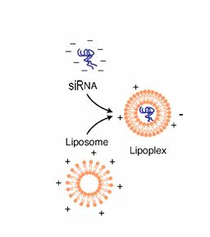
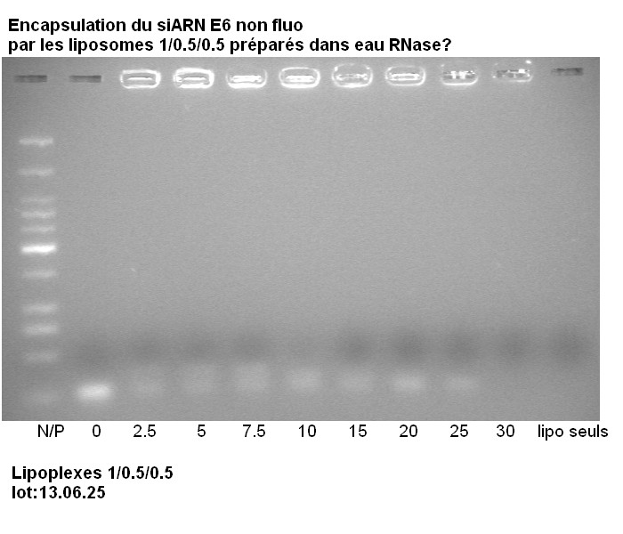
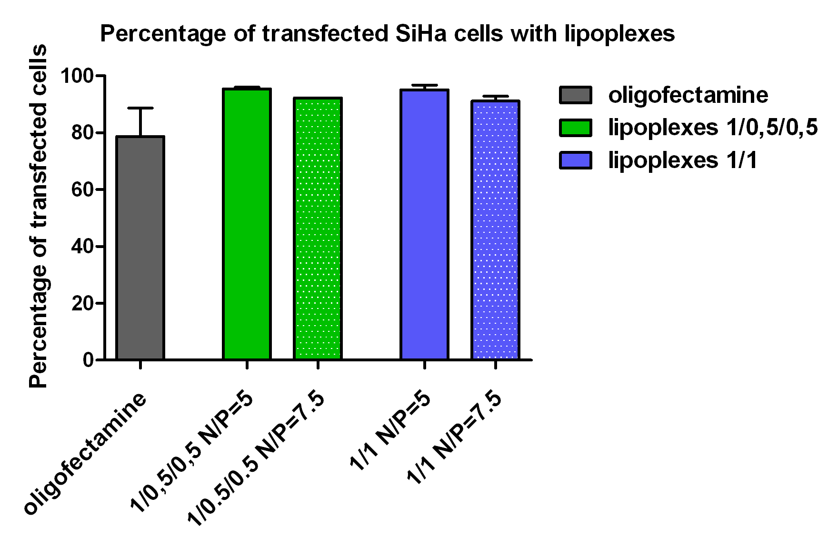
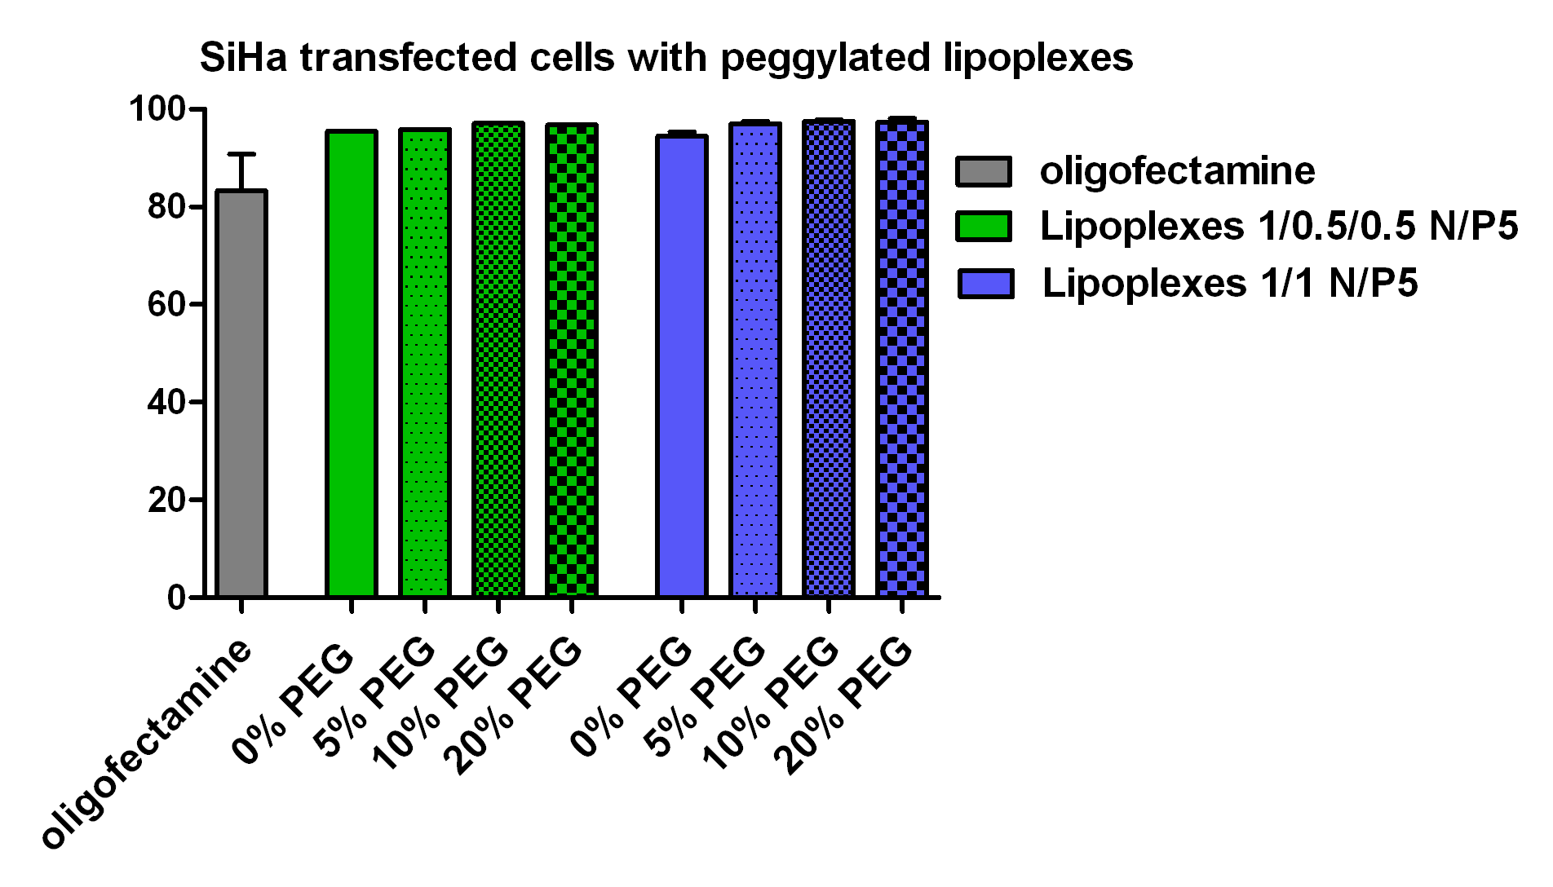
DEVELOPMENT OF PEGGYLATED LIPOPLEXES WITH siRNA ANTI-E6/E7 ONCOPROTEINS FOR THE TREATMENT OF CANCERS INDUCED BY HPV
Tania Furst¹, Anna Lechanteur^{1,2}, Pascale Hubert², Brigitte Evrard¹, Géraldine Piel¹
¹Laboratory of Pharmaceutical Technology and Biopharmacy, CIRM, University of Liège, Belgium
²Laboratory of Experimental Pathology, GIGA-Cancer, University of Liège, Belgium
E-mail: tania.furst@ulg.ac.be
INTRODUCTION
Human Papillomaviruses (HPV), most notably high-risk 16 and 18 genotypes, are responsible for chronic infection of keratinocytes of the uterine cervix mucosa. This infection is associated with the development of cervical cancer by the overexpression of oncogenes E6 and E7. In fact, the two encoded oncoproteins interact with the tumor suppressor genes p53 and pRb and inactive them, which prevents apoptosis of tumor cells.
OBJECTIVE
The purpose of this project is to develop a suitable vector ( liposome ) able to protect and transport a specific siRNA through the vaginal mucus and into the cytoplasm of tumor cells, in order to target and knockdown the mRNA encoding for E6-E7 oncoproteins. The physicochemical characteristics of this vector must be optimal to be effective. Moreover, liposomes are peggylated because it has been demonstrated that coating nanoparticles with a hydrophilic polymer like PEG, could improve the diffusion through the mucus.
RESULTS AND DISCUSSION
3.1. Formulation and characterisation of liposomes
Lipids: - Cationic lipid DOTAP
- Fusogenic lipid DOPE
- Cholesterol
The size of liposomes prepared in RNAse free water are between 150 and 200nm
3.3. Characterisation of lipoplexes : sizes and zeta potential
Analyse of the mean diameter (Z-average) and of the charge density of lipoplexes
3.2. Encapsulation of siRNA
To form lipoplexes, siRNA is added to liposomes at different molar ratios (N/P) between the positive charges of the lipids (N) and the negative charges of siRNA (P) in a nuclease free environment
[siRNA]=constant ; [liposomes]=increased
→ N/P : from 2,5 to 30
3.4. Peggylation of lipoplexes and characterisation
Lipoplexes are peggylated by the addition of DSPE-PEG₂₀₀₀ at 5, 10 and 20%mol of the total lipids by the post-insertion technique
DOTAP/Chol/DOPE 1/0.5/0.5 DOTAP/DOPE 1/1 Total lipid concetration = 5mM
Liposomes 1/0.5/0.5
Liposomes 1/1
-
Fig.1: Hydration of lipidic film method
Free siRNA
+
Fig.2: Agarose gel electrophoresis (4%) is used to evaluate at which N/P ratio the complexation occurs between the cationic liposomes and the negative siRNA. For 1/0.5/0.5 and 1/1 liposomes, siRNA is nearly totally incorporated from the N/P ratio of 5
Fig.3 and 4 represent the sizes and the zeta potential of 1/0.5/0.5 and 1/1 lipoplexes according to the N/P ratio. At low ​​N/P values, nanoparticles are large and heterogeneous. From the N/P value 5, sizes become smaller and less polydisperse. Sizes are between 150 and 250nm and zeta potential is positive (+45mV)
Fig.5 and 6 represent the sizes and the zeta potential of peggylated lipoplexes at the N/P ratio 5: DSPE-PEG₂₀₀₀ does not modify the size of lipoplexes while the zeta potential decreases proportionally to the PEG percentage.
3.5. Transfection experiments with lipoplexes on SiHa cells
SiHa cells are HPV 16+ positive keratinocyte cells
Oligofectamine® is a commercial transfection agent used as a positive control
CONCLUSION AND PERSPECTIVES
Resultant lipoplexes show good physicochemical characteristics from the N/P ratio of 5; a good encapsulation efficiency, an hydrodynamic diameter between 150 and 250nm and a positive zeta potential. Moreover, the zeta potential decreases when DSPE-PEG₂₀₀₀ is added and with a more significant drop for 20% of PEG. The percentage of transfection on SiHa cells (HPV16+ cell line) is high for both unpeggylated and peggylated lipoplexes compared to the Oligofectamine®.
Other studies will be realized to confirm the stability over the time of the lipoplexes and to verify the influence of pH variations, protection from nucleases degradation and contact with mucus.
Fig.7: Compared to Oligofectamine®, the percentage of transfection with unpeggylated lipoplexes is high (amore than 90%)
Fig.8: Peggylation of lipoplexes does not modify the percentage of transfection. This percentage is around 90% for all the formulalions with the 3 different percentages of PEG
Fig.7.
Fig.8.

